Slide 1
CPS 235 Object Oriented Programming Paradigm
Inheritance

Slide 2
Contents
Composition (or containership)
  Objects as Members of Classes
Concept of Inheritance
Levels of access control
CPS235:Inheritance

Slide 3
Inheritance
Inheritance is a relationship between two or more classes where derived class inherits behaviour and attributes of pre-existing (base) classes
Intended to help reuse of existing code with little or no modification
CPS235:Inheritance

Slide 4
Inheritance
Inheritance can be continuous
  Derived class can inherit from a base class
  The derived class can act as a base class and another class can inherit from it
  If you change the base class, all derived classes also change
  Any changes in the derived class do not change the base class
  All features of the base class are available in the derived class
    However, the additional features in the derived class are not available in the base class
CPS235:Inheritance

Slide 5
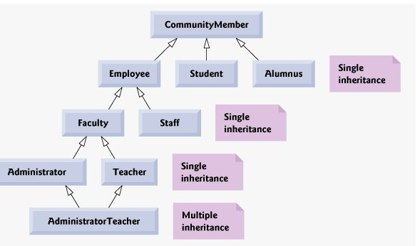
CPS235:Inheritance

Slide 6
Inheritance
Features: a,b
a
b
Class A
Features: a,b,c
Features: a,b,d,e
c
d
e
Class B
Class C
Features: a,b,d,e,f
f
Class D
CPS235:Inheritance

Slide 7

Inheritance and Encapsulation
private member
  Is accessible only via the base class
public member
  Is accessible everywhere (base class, derived class, othe classes)
protected member
  Is accessible by the base class and derived classes

Slide 8
Inheritance Concept
class Rectangle{
private:
int width, length;
public:
void set(int w, int l);
int area();
};
Polygon
Rectangle
Triangle
class Polygon
{
private:
int width, length;
public:
void set(int w, int l);
};
class Triangle{
private:
int width, length;
public:
void set(int w, int l);
int area();
};
CPS235:Inheritance

Slide 9
Inheritance Concept
class Polygon
{
protected:
int width, length;
public:
void set(int w, int l);
};
Polygon
Rectangle
Triangle
class Rectangle{
protected:
int width, length;
public:
void set(int w, int l);
int area();
};
class Rectangle: public Polygon
{
public:
int area();
};
CPS235:Inheritance

Slide 10
Inheritance Concept
class Polygon
{
protected:
int width, length;
public:
void set(int w, int l);
};
Polygon
Rectangle
Triangle
class Triangle{
protected:
int width, length;
public:
void set(int w, int l);
int area();
};
class Triangle : public Polygon
{
public:
int area();
};
CPS235:Inheritance

Slide 11
Inheritance Concept
class Point
{
protected:
int x, y;
public:
void set(int a, int b);
};
Point
x
y
Circle
3D-Point
x
y
r
x
y
z
class Circle : public Point
{
private:
double r;
};
class 3D-Point: public Point
{
private:
int z;
};
CPS235:Inheritance

Slide 12
Declaring Inheritance
Syntax:
class DerivedClassName : access-level BaseClassName
where
  access-level specifies the type of derivation
    private by default, or
    public or
    protected (used very rarely)
Any class can serve as a base class
  Thus a derived class can also be a base class
CPS235:Inheritance

Slide 13
Class Derivation
Point
class Point{
protected:
int x, y;
public:
void set(int a, int b);
};
3D-Point
Sphere
class 3D-Point : public Point{
private: double z;
… …
};
class Sphere : public 3D-Point{
private: double r;
… …
};
Point is the base class of 3D-Point, while 3D-Point is the base class of Sphere
CPS235:Inheritance

Slide 14
What to Inherit?
In principle, every member of a base class is inherited by a derived class
  just with different access permission
CPS235:Inheritance

Slide 15
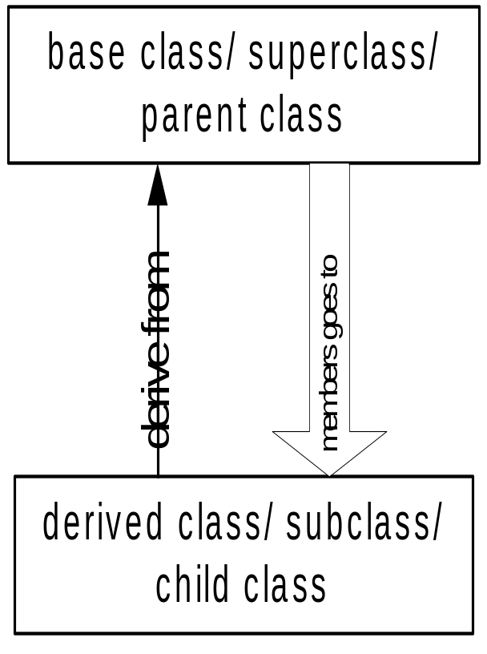
Access Control Over the Members
Two levels of access control over class members
  class definition
  inheritance type
class Point{
protected: int x, y;
public: void set(int a, int b);
};
class Circle : public Point{
… …
};
CPS235:Inheritance

Slide 16
Member Access Control
There are 3 levels of member (data or methods) access control:
  public: members can be used by itself and the whole world; any function can access them
  protected: methods (and friends) of itself and any derived class can use it
  private: members can only be used by its own methods (and its friends)
    We’ll study friend functions later
Without inheritance, private and protected have the same meaning
The only difference is that methods of a derived class can access protected members of a base class, but cannot access private members of a base class
CPS235:Inheritance

Slide 17
Access Rights of Derived Classes
Type of Inheritance
Access Control
for Members
 | private | protected | public
private | private | private | private
protected | private | protected | protected
public | private | protected | public
The type of inheritance defines the minimum access level for the members of derived class that are inherited from the base class
With public inheritance, the derived class follows the same access permission as in the base class
With protected inheritance, only the public members inherited from the base class can be accessed in the derived class as protected members
With private inheritance, none of the members of base class is accessible by the derived class

Slide 18
Access Rights of Derived Classes
Take these classes as examples:
  class B { /*...*/ };
  class D_priv : private B { /*...*/ };
  class D_prot : protected B { /*...*/ };
  class D_publ : public B { /*...*/ };
  class UserClass { B b; /*...*/ };
None of the derived classes can access anything that is private in B
In D_priv, the public and protected parts of B are private
In D_prot, the public and protected parts of B are protected
In D_publ, the public parts of B are public and the protected parts of B are protected (D_publ is-a-kind-of-a B)
class UserClass can access only the public parts of B, which "seals off" UserClass from B
CPS235:Inheritance

Slide 19
protected vs. private
So why not always use protected instead of private?
Because protected means that we have less encapsulation
  All derived classes can access protected data members of the base class
Assume that later you decided to change the implementation of the base class having the protected data members
  For example, we might want to represent address by a new class called Address instead of string
  If the address data member is private, we can easily make this change
  The class documentation does not need to be changed.
  If it is protected, we have to go through all derived classes and change them
  We also need to update the class documentation.
CPS235:Inheritance

Slide 20
Class Derivation Example
class daughter : public mother{
private:
double a;
public:
void foo ( );
};
mother
daughter
son
class mother{
protected:
int x, y;
public:
void set(int a, int b);
private:
int z;
};
void daughter :: foo ( ){
x = y = 20;
set(5, 10);
cout<<“value of a ”<<a<<endl;
z = 100; // error, a private member
};
daughter can access 3 of the 4 inherited members
CPS235:Inheritance

Slide 21
Class Derivation
class son : protected mother{
private:
double b;
public:
void foo ( );
}
mother
daughter
son
class mother{
protected:
int x, y;
public:
void set(int a, int b);
private:
int z;
}
void son :: foo ( ){
x = y = 20; // error, not a public member
set(5, 10);
cout<<“value of b ”<<b<<endl;
z = 100; // error, not a public member
}
son can access only 1 of the 4 inherited member

Slide 22
Class Derivation Example
mother
class daughter : public mother
{
private:
double a;
public:
void foo ( );
};
daughter
son
granddaughter
grandson
class mother{
protected:
int x, y;
public:
void set(int a, int b);
private:
int z;
};
class granddaughter : public daughter
{
public:
void foo ( );
};
CPS235:Inheritance

Slide 23
Class Derivation Example
void granddaughter :: foo ( ){
x = y = 20; //OK
set(5, 10); //OK
cout<<“value of a ”<<a<<endl; //error: private member of daughter
z = 100; // error, a private member of mother
};
CPS235:Inheritance

Slide 24
Class Derivation Example
mother
class son : protected mother
{
private:
double b;
public:
void foo ( );
};
daughter
son
granddaughter
grandson
class mother{
protected:
int x, y;
public:
void set(int a, int b);
private:
int z;
};
class grandson : public son
{
public:
void foo ( );
};
CPS235:Inheritance

Slide 25
Class Derivation Example
void grandson:: foo ( ){
x = y = 20; //ERROR: not accessible
set(5, 10); //ERROR: not accessible
z = 100; // error, a private member of mother
};
CPS235:Inheritance

Slide 26
Encapsulation
class Figure
{
protected:
int x, y;
};
class Circle : public Figure
{
public:
int radius;
};
int main()
{
Circle a;
a.x = 0;
a.y = 0;
a.radius = 10;
}

Slide 27
Encapsulation
class Figure
{
protected:
int x_, y_;
};
class Circle : public Figure
{
private:
int radius_;
public:
Circle(int x, int y, int radius);
};
Circle::Circle(int x, int y, int radius)
{
x_ = x;
y_ = y;
radius_ = radius;
}
int main()
{
Circle a(0,0,10);
}

Slide 28

Encapsulation
class Figure
{
private:
int x_, y_;
};
class Circle : public Figure
{
private:
int radius_;
public:
Circle(int x, int y, int radius);
};
Circle::Circle(int x, int y, int radius)
{
x_ = x;
y_ = y;
radius_ = radius;
}
int main()
{
Circle a(0,0,10);
}

Slide 29
Encapsulation
class Circle : public Figure
{
private:
int radius_;
public:
Circle(int x, int y, int radius);
};
Circle::Circle(int x, int y, int radius)
{
SetX(x);
SetY(y);
radius_ = radius;
}
int main()
{
Circle a(0,0,10);
}
class Figure
{
private:
int x_, y_;
public:
void SetX(int x);
void SetY(int y);
};
void Figure::SetX(int x)
{
x_ = x;
}
void Figure::SetY(int y)
{
y_ = y;
}

Slide 30
What to Inherit?
In principle, every member of a base class is inherited by a derived class
  just with different access permission
However, there are exceptions for
  Constructor and destructor
  Overloaded Assignment operator
  Friends
Since all these functions are class-specific!
CPS235:Inheritance

Slide 31
Compulsory Reading
Robert Lafore
  Chapter 9: Inheritance
CPS235:Inheritance

