Slide 1

Fundamentals of Cryptography
ASHRAF MASOOD
dean@mcs.edu.pk
Lecture Slides – BESE16B- Spring 2013- Lecture Set #1

Slide 2
Welcome!
Course Introduction

Slide 3
Cryptography is everywhere !
Secure communication:
web traffic: HTTPS
wireless traffic: 802.11i WPA2 (and WEP), GSM, Bluetooth
Encrypting files on disk: EFS, TrueCrypt
Content protection (e.g. DVD, Blu-ray): CSS, AACS
User authentication
… and much much more

Slide 4
Cryptology
Cryptography comes from Greek and it means hidden/secret (crypto) and writing (graphy)
The study of mathematical techniques related to aspects of information security such as confidentiality, data integrity, entity authentication, and data origin authentication.
Cryptology is the art and science of making and breaking “secret codes”.

Slide 5
Information Security
Confidentiality
Integrity
Availability

Slide 6
Role of Cryptography
All of Confidentiality
Significant component of Integrity
Indirect role in availability

Slide 7
Cryptographic Applications
Identification
Authorization
License and/or certification
Signature
Witnessing (notarization)
Concurrence
Liability
Receipts
Certification of origination and/or receipt
Endorsement
Access (egress)
Validation
Time of occurrence
Authenticity-software and/or files
Vote
Ownership
Registration
Approval/disapproval
Privacy (secrecy)
Confidentiality

Slide 8
Cryptographic Goals
Confidentiality :
Assurance that information is shared only among authorised people or organisations
Authentication :
Applies to both entities and information itself.
Two parties entering into a communication should identify each other.
Subdivided into two major classes: entity authentication and data origin authentication.
Non-Repudiation :
Prevents an entity from denying previous commitments or actions.

Slide 9
Cryptographic Goals
Integrity :
Assurance that the information is authentic and complete; ensuring that information can be relied upon to be sufficiently accurate for its purpose
Availability :
Assurance that the systems responsible for delivering, storing and processing information are accessible when needed, by those who need them

Slide 10
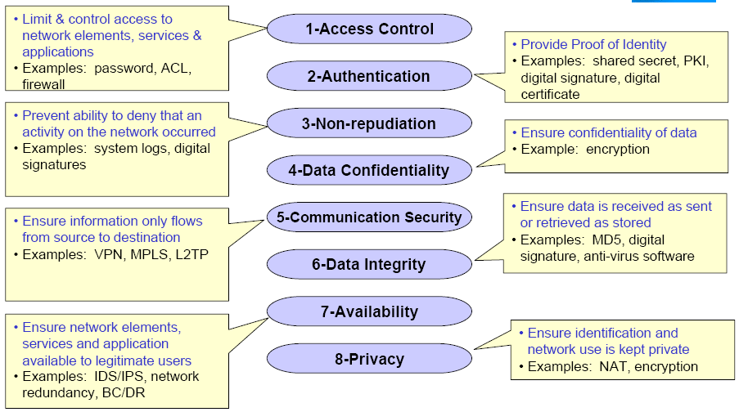
Security Dimensions

Slide 11
What is Cryptology?

Slide 12
What is Cryptology?
Cryptography
The art and science of keeping message secure, is called cryptography
Cryptography comes from Greek and it means hidden/secret (crypto) and writing (graphy)
Cryptanalysis
The art and science of breaking ciphertext: that is seeing through disguise (without the knowledge of key)
Cryptology
The branch of mathematics encompassing both cryptography and cryptanalysis is Cryptology. Its practitioners are Cryptologists

Slide 13
Course Objectives
The objective of this course is to learn the primitives of cryptography through study of classical and conventional cryptography and their application mechanism (along with required mathematical background)
Learn how crypto primitives work
Learn how to use them correctly and reason about security

Slide 14
Course Objectives
Upon completing this course, the participants should be able to:
Understand the extent of security provided by any specific cryptographic primitive and their application mechanisms
Assess the suitability of a particular cryptographic primitive against some specific information security requirement
describe the application scenario of various cryptographic schemes
Be able to understand contemporary standards of cryptographic primitives & application mechanisms
Be able to design a cryptographic system based on well established cryptographic primitives

Slide 15
Course Topics
Introduction to Classical Cryptography:
Transposition ciphers
Simple Mono & Poly-alphabetic substitution ciphers
Cryptanalysis methods
Frequency Analysis
Machine Ciphers
Notion of Security
Symmetric (Private key) Encryption algorithms:
Block ciphers (DES, AES)
Stream ciphers (LFSR-based stream ciphers, RC4)
Modes of operation (ECB, CBC, CFB, OFB).

Slide 16
Course Topics
Public-key cryptography:
Data encryption (RSA)
Digital signatures (RSA)
Key management Schemes
Key generation
Key exchange/agreement (Diffie-Hellman)
Secret sharing
Integrity and authentication:
Hash functions (MD5, SHA-1)
Message-authentication codes

Slide 17
Text books & Reference Material
The course will cover material in the following text books:
Cryptography & Network Security – Principles & Practices 4th Edition – William Stalling
D. Stinson, Cryptography: Theory & Practice, CRC Press, 2004.
A. Menezes, P. van Oorschot, S. Vanstone, Handbook of Applied Cryptography, CRC Press, 1997. (Online at http://www.cacr.math.uwaterloo.ca/hac/)
The following books are recommended for supplementary reading:
B. Schneier, Applied Cryptography, 2nd Edition, Wiley, 1996.
S. Singh, The Code Book, Fourth Estate, 1999.
G. J. Simmons, Contemporary Cryptology: the Science of Information Integrity

Slide 18
Background Knowledge
Basic Calculus
Discrete probability Theory
Basic Number Theory (Modular Arithmetic)
Familiarity with MATLAB or other High level language programming

Slide 19
General Notes
Credits: 3+0
Lectures:
1x Lecture (Tuesday) 11:20 am – 12:10 pm
2x Lecture (Thursday) 11:20 am – 13:10 pm
STI:
1x Lecture (Tuesday) 12:20 pm – 13:10 pm
2x Lecture (Thursday) 10:00 am – 10:50 am
Assignments:
Usually once per week
Peer collaboration is encouraged for discussion and understanding but not copying.
Late submissions will not be accepted
Opportunity to score bonus points

Slide 20
General Notes
3x Quizzes
Usually extracted from the home assignments
2x OHTs & Final Exams
Solutions
Solutions to selected home assignments, quizzes and exams will be provided
LMS
All info related to course proceedings will be posted on LMS or e-mailed to you on your e-mail address.
Please check both of these resources on daily basis.
Non-compliance to any instructions given on LMS or e-mail is an unacceptable excuse.

Slide 21
Grading Policy

Slide 22
What is Cryptology?

Slide 23
What is Cryptology?
Cryptography
The art and science of keeping message secure, is called cryptography
Cryptography comes from Greek and it means hidden/secret (crypto) and writing (graphy)
Cryptanalysis
The art and science of breaking ciphertext: that is seeing through disguise (without the knowledge of key)
Cryptology
The branch of mathematics encompassing both cryptography and cryptanalysis is Cryptology. Its practitioners are Cryptologists

Slide 24
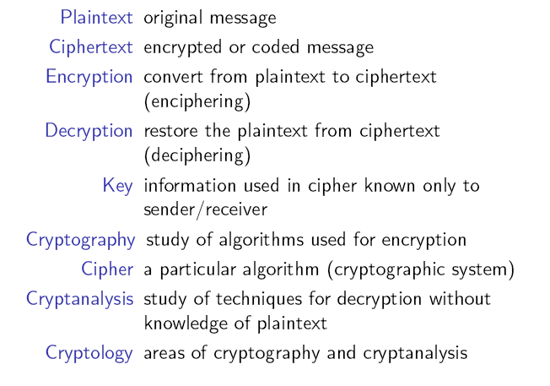
Terminology

Slide 25
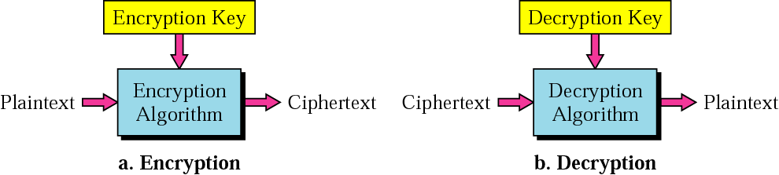
Message & Encryption
C = E_{K}(P)
P = D_{K}(C)
P
C
C
P
The process of disguising a message in such a way to hide its substance, is called Encryption
The mathematical function mapping ciphertext to plaintext using the specified key: P = D_{K}(C) or D(K, Y) = EK⁻¹(C) = P

Slide 26
Cryptographic Algorithm & Keys
Cipher
A cryptographic algorithm is called a cipher. It is a mathematical function used for both encryption and decryption
Key & Key Space
The security of modern cryptosystem is based on a Key: which could a be one of any large values.
The range of possible key values is called the Key Space
Both encryption and decryption depends upon the Key
Given a key, every possible plaintext must result in a unique ciphertext—if not – decryption would not be unambiguously possible

Slide 27
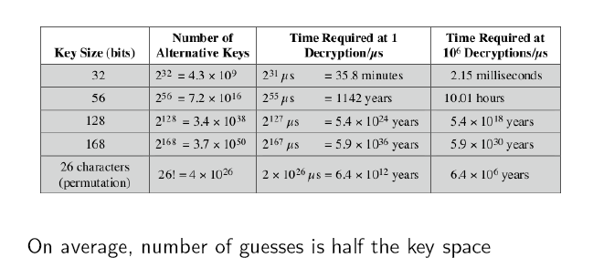
Brute Force Attack

Slide 28
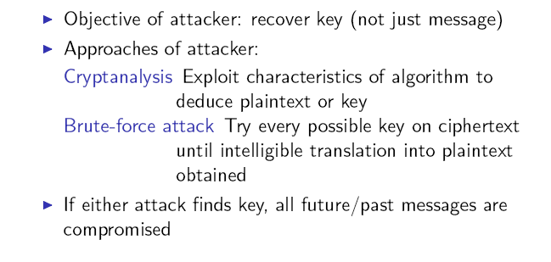
Attacks

Slide 29
Cryptosystem
A cryptosystem is a five-tuple (P, C, K, E, D), where following
conditions are satisfied :
P is a finite set of possible plaintexts
C is a finite set of possible ciphertexts
K, the keyspace, is a finite set of possible keys
For each K ∈ K, there is an encryption algorithm E_{K} ∈ E and a corresponding decryption algorithm D_{K} ∈ D. Each E_{K} : P → C and D_{K} : C → P are functions such that D_{K}(E_{K}(X)) = X for every plaintext X ∈ P.

Slide 30
Cryptosystem

Slide 31
Building blocks: Symmetric Encryption
E, D: cipher k: secret key (e.g. 128 bits)
m, c: plaintext, ciphertext
Encryption algorithm is publicly known
Never use a proprietary cipher
Alice
Bob
m
E
E(k,m)=c
c
D
D(k,c)=m
k
k

Slide 32
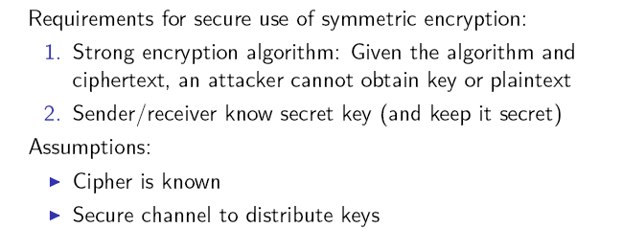
Requirements & Assumptions

Slide 33
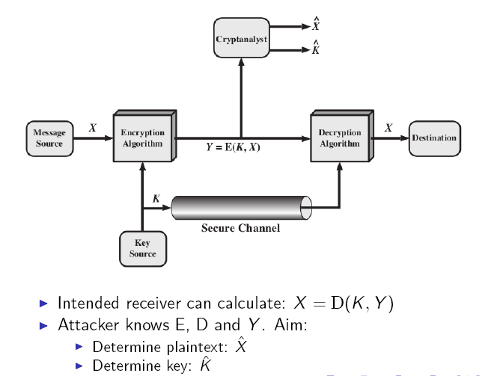
Model of Symmetric Crypto System

Slide 34


Crypto core
Talking to Bob
Talking to Alice
Alice
Secret key establishment:
Secure communication:
Bob
attacker???
k
m₁
k
m₂
confidentiality and integrity

Slide 35
Kerchhoff’s Principle
“Encryption algorithms being used should be assumed to be publicly known and the security of the algorithm should reside only in the key chosen”

Slide 36


But crypto can do much more
Digital signatures
Anonymous communication
Alice signature
Who did I just talk to?
Alice
Bob

Slide 37


But crypto can do much more
Anonymous digital cash
Can I spend a “digital coin” without anyone knowing who I am?
How to prevent double spending?
1$
Who was that?
Alice
Internet
(anon. comm.)

Slide 38

Protocols
Elections
Private auctions

Slide 39
Protocols
Elections
Private auctions
Secure multi-party computation
trusted authority
Goal: compute f(x₁, x₂, x₃, x₄)
“Thm:” anything that can done with trusted auth. can also be done without

Slide 40


Crypto magic
What did she search for?
Privately outsourcing computation
Zero knowledge (proof of knowledge)
search query
E[ query ]
Alice
E[ results ]
results
???
N=p∙q
Alice
I know the factors of N !!
proof π
N
Bob
Notes:
ZKPK: can be used for authentication

Slide 41
Things to Remember (Again & Again)!
Cryptography is:
A tremendous tool
The basis for many security mechanisms
Cryptography is not:
The solution to all security problems
Reliable unless implemented and used properly
Something you should not try to invent yourself
many many examples of broken ad-hoc designs

Slide 42
Cryptography: A Rigorous Science
The three steps in cryptography:
Precisely specify threat model
Propose a construction
Prove that breaking construction under threat mode will solve an underlying hard problem
Notes:
Example: define what it means to forge signatures, give construction, show that forging signatures is as hard as factoring.

Slide 43
Classical Cryptography

Slide 44
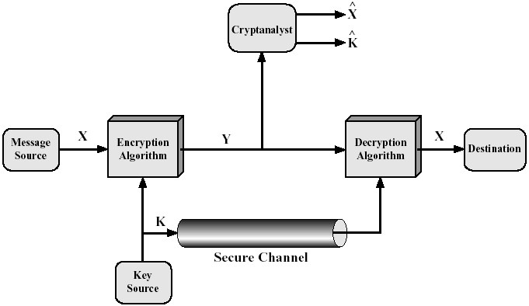
Conventional Cryptosystem Model
Conventional
Secret-Key (⇔ Public-Key)
Single-Key (⇔ Two-Key)
Symmetric (⇔ Asymmetric)
Requirements
Strong encryption algorithm
Share of the secret key in a
secure fashion

Slide 45
Cryptosystem
A cryptosystem is a five-tuple (P, C, K, E, D), where following
conditions are satisfied :
P is a finite set of possible plaintexts
C is a finite set of possible ciphertexts
K, the keyspace, is a finite set of possible keys
For each K ∈ K, there is an encryption algorithm E_{K} ∈ E and a corresponding decryption algorithm D_{K} ∈ D. Each E_{K} : P → C and D_{K} : C → P are functions such that D_{K}(E_{K}(X)) = X for every plaintext X ∈ P.

Slide 46
Kerchhoff’s Principle
“Encryption algorithms being used should be assumed to be publicly known and the security of the algorithm should reside only in the key chosen”

Slide 47
Classical Cryptography
Started with more of a steganography than Cryptography (being an art than a science).
Prior to machines, manual cryptography involved one operation out of substitution, transposition or permutation (simple scientific functions)
Prior to computers, mechanical/electromechanical machines implemented one layer of SP network (mix of art & science)
Post WW-II, computer based machines implemented multi-layered SP network
Public-key cryptography revolutionalized the cryptography

Slide 48
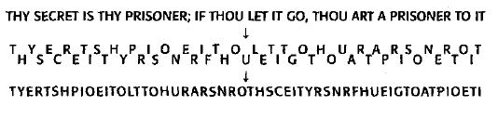
Transposition Cipher
Transposition ciphers jumble the letters of the message in a way that is designed to confuse the attacker, but can be un-jumbled by the intended recipient.

Slide 49
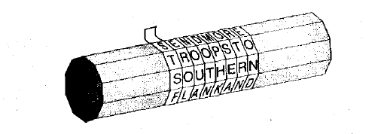
Transposition Cipher
One of the earliest recorded uses of cryptography was the Spartan scytale (circa 500 B.C.). A thin strip of parchment was wrapped helically around a cylindrical rod and the message was written across the rod, with each letter on a successive turn of the parchment. The strip was unwound and delivered to the receiver. The message could then be decrypted with the use of an identical cylindrical rod.

Slide 50
The Permutation Cipher
It was described in book by Giovanni Porta written in 1563.

Slide 51
The Permutation Cipher
In order to use the cipher a permutation has to be defined. Let us use the following permutation as example:
Since m = 6, the original message has to be broken on n groups of six letters each. If last group is shorter, necessary number of dummy letters can be appended to the end.
Each group is rearranged according to the permutation defined previously.
To decrypt a ciphertext message inverse permutation should be applied in a similar way.
x | 1 | 2 | 3 | 4 | 5 | 6
π(x) | 5 | 1 | 6 | 3 | 2 | 4
c | 1 | 2 | 3 | 4 | 5 | 6
π⁻¹(c) | 2 | 5 | 4 | 6 | 1 | 3

Slide 52
Example: The Permutation Cipher
Suppose m=6, and the key is the following permutation π:
x | 1 | 2 | 3 | 4 | 5 | 6
π(x) | 3 | 5 | 1 | 6 | 4 | 2
Now suppose we are given the plaintext:
shesellsseashellsbytheseashore
We first partition it into a group of 6:
shesel lsseas hellsb ythese ashore
Now each group of 6 letters is rearranged according to the permutation table π:
EESLSH SALSES LSHBLE HSYEET HRAEOS
This is ciphertext, which can be decrypted in a similar fashion using inversion permutation π⁻¹
x | 1 | 2 | 3 | 4 | 5 | 6
Π⁻¹(x) | 3 | 6 | 1 | 5 | 2 | 4

Slide 53
Classical Cryptosystems
Mono-alphabetic Ciphers

Slide 54
Touching the math a bit!
The integer modulo m, denoted by Zm is the set of integers {0,1,2,..,m-1} where addition, subtraction and multiplication is performed modulo m.
Examples: Z25 ≡ {0,1,2,…..,24}
In Z25,
13 + 16 =4, since 13+16=29≡4 (mod 25)
Similarly
In Z25,
13.16 =8, since 13.16=208≡8 (mod 25)

Slide 55
Monoalphabetic Ciphers
The ciphers for which, once a key is chosen, each alphabetic character is mapped to a unique alphabetic character
Examples of mono alphabetic ciphers include:
Transposition Cipher
Shift cipher
Substitution Cipher
Affine cipher

Slide 56
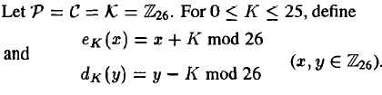
Shift Cipher
We first convert the plaintext string into integers. The rule is:
a<->0, b<->1, c<->2, d<->3, e<->4, f<->5, g<->6, h<->7, i<->8, j<->9, k<->10, l<->11, m<->12,n<->13, o<->14, p<->15,q<->16, r<->17, s<->18, t<->19, u<->20, v<->21, w<->22, x<->23, y<->24, z<->25

Slide 57
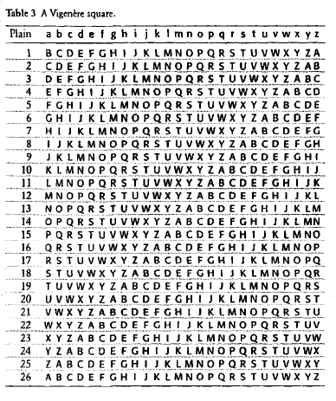
The Shift Cipher Table

Slide 58
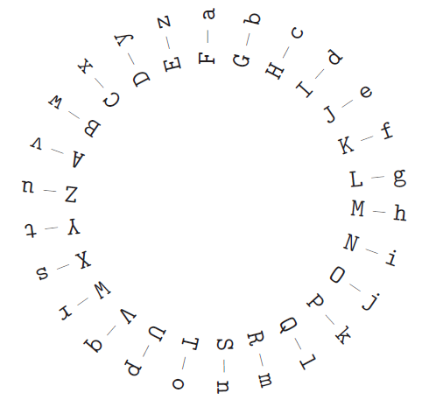
Cipher wheel

Slide 59
Shift Cipher
Example
Let plaintext (p) =
We will meet at mid night
w | e | w | i | l | l | m | e | e | t | a | t | m | i | d | n | i | g | h | t
22 | 4 | 22 | 8 | 11 | 11 | 12 | 4 | 4 | 19 | 0 | 19 | 12 | 8 | 3 | 13 | 8 | 6 | 7 | 19
Let K=11, we add 11 to each value, reducing each sum modulo 26, we get ciphertext
7 | 15 | 7 | 19 | 22 | 22 | 23 | 15 | 15 | 4 | 11 | 4 | 23 | 19 | 14 | 24 | 19 | 17 | 18 | 4
H | P | H | T | W | W | X | P | P | E | L | E | X | T | O | Y | T | R | S | E

Slide 60
Shift Cipher
For a particular Key k=3, the cryptosystem is often called the
Caesar Cipher (Roman Empire, 2000 years ago )
0123456...
Plain: abcdefghijklmnopqrstuvwxyz
Cipher: DEFGHIJKLMNOPQRSTUVWXYZABC
3456789...
Plain: meet me after the toga party
Cipher: PHHW PH DIWHU WKH WRJD SDUWB

Slide 61
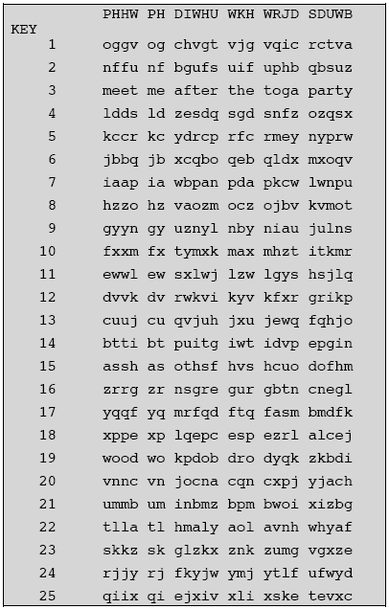
Cryptanalysis of Shift Cipher
Shift cipher (modulo 26) is not secure, since it can be cryptanalyzed by brute force attack
There are only 25 keys to try, until a meaningful plaintext string is obtained
On average, a plaintext will be computed using 26/2=13 decryption rule

Slide 62
The Substitution Cipher
Example:
Plaintext: s u b s t i t u t i o n
Ciphertext: V U N V M Z M U M Z F S

