Slide 1
Z - Language
Reference: The Z Notation,
A Reference Manual

Slide 2
Abstract Model Specification
Explicitly describes behavior in terms of a model using well-defined types (sets, sequences, relations, functions) & defines operations by showing effects on model
Specification includes
type - syntax of object being specified
model - underlying structure
invariant - properties of modeled object
pre/post conditions – semantics of operations

Slide 3

Notation
Is used to test the results
Independent of program code
Mathematical Data model
Represent both static and dynamic aspects of a system

Slide 4
Features( Z-notation)
Decompose specification into small pieces (Schemas)
Schemas are used to describe both static and dynamic aspects of a system
Data Refinement
You can ignore details in order to focus on the aspects of the problem you are interested in

Slide 5
Advantages
The flexibility to model a specification which can directly lead to the code.
Easy to understand
A large class of structural models can be described in Z without higher – order features, and can thus be analyzed efficiently.
Independent Conditions can be added later

Slide 6
Schema
Static Aspect
The invariant relationships are maintained as the system moves from state to state

Slide 7
Schema(cont.)
Dynamic Aspect
The operations that are possible
The relationship between their inputs and outputs.
The change of state that happen.

Slide 8
Notation - Example
Name
Some variables are declared.
Relationship between the values of the variables
Init Birthday Book
Birthday Book
Known = ∅

Slide 9
Example
Birthday book
known: NAME
birthday: NAME DATE
Known : dom birthday
Add Birthday
Birthday Book
name?: NAME
date?: DATE
name? ∉ known
birthday’ = birthday { name? date?}

Slide 10
Example(cont.)
Find Birthday
Birthday book
name?: NAME
Date! : DATE
name?∈ Known
date != birthday(name?)

Slide 11
Race condition
We have not handled the condition when user tries to add a birthday, which is already known to the system, or tries to find the birthday of someone not known.
Handle this by adding an extra result! To each operation.
Result := ok| already_known | not_known
Success
Result! : REPORT
Result! = ok

Slide 12
Operators
Λ (Conjunction of the two predicate parts)
V (Disjunction of two predicate parts)

Slide 13
Logical Conjunction Operator
The conjunction operator Λ of the schema calculus allows us to combine this description with our previous description of AddBirthday
AddBirthday Λ Success
This describes an operation which, for correct input, both acts as described by AddBirthday and produces the result ok.

Slide 14
Logical Disjunction operator
AlreadyKnown
BirthdayBook name? : NAME result!: REPORT
Name? ∈ known Result! = already_known
This declaration specifies that if error occurs, the state of the system should not change.
Robust version of AddBirthday can be
RAddBirthday = (AddBirthday Λ Success) V Alreadyknown

Slide 15
Use of Operators
RAdd Birthday
ΔBirthday Book
name?: NAME
date?: DATE
result!: REPORT
(name? ∉ known Λ
birthday’= birthday ∪ {name? Date?} Λ
result!= ok) V
(name? ∈ known Λ
birthday’ = birthday Λ result != already_known)

Slide 16
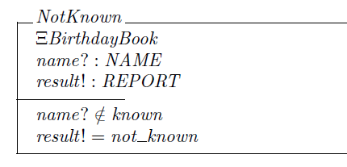

Slide 17
From specification to design
Data Refinement
“ to describe the concrete data structures which the program will use to represent the abstract data in the specification, and to derive description of the operation in terms of the concrete data structures”
Direct Refinement: method to go directly from abstract specification to program in one step

Slide 18
Data Refinement
Data Structures:
Two arrays : names [1…] of NAME
dates [1…] of DATES
names’ = names⊕{i v} ; names[i] := v the right side of this equation is a function which takes the same value as names everywhere except at the argument i, where it takes the value ‘v’.

Slide 19
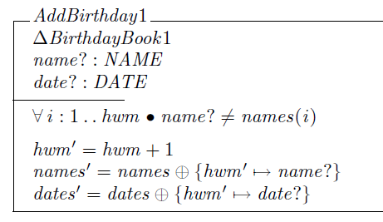
Data Refinement

Slide 20
Example(Data and Direct Refinement)
FindBirthday1
BirthdayBook1 name?:NAME date!:DATE
∃i : 1.. hwm
name?=names(i) Λ date! = dates(i)
Procedure FindBirthday(var name: NAME; var date : DATE); var i: INTEGER; begin i:=1; while names[i] ≠ name do i := i+1; dates := dates[i] end;

Slide 21
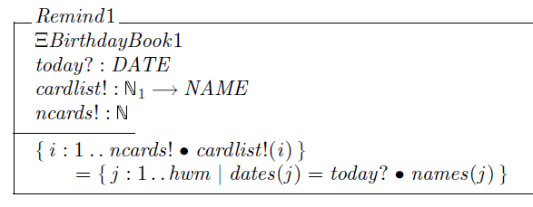

Slide 22
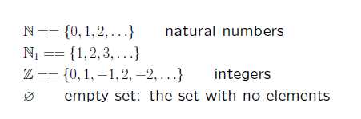
Sets in Z

Slide 23


Sets in Z

Slide 24

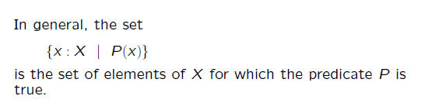
Sets in Z

Slide 25
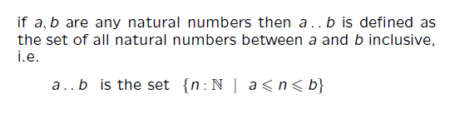
Sets in Z

Slide 26
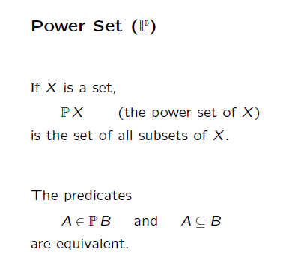
Sets in Z

Slide 27
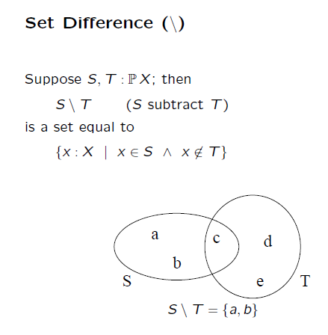
Sets in Z

Slide 28
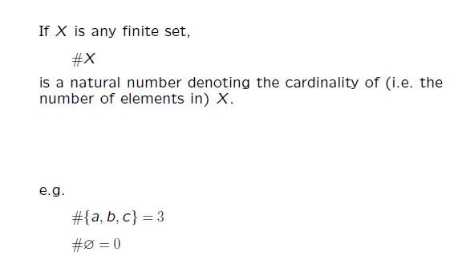
Sets in Z - Cardinality

Slide 29
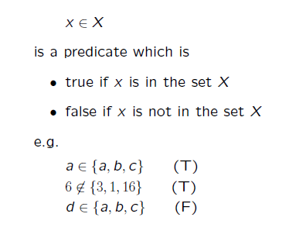
Membership

Slide 30
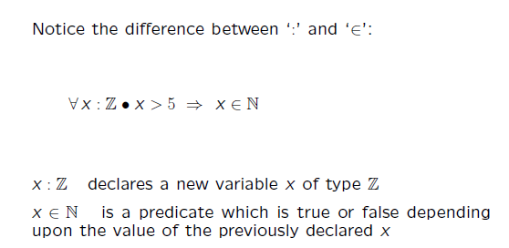
Membership

Slide 31
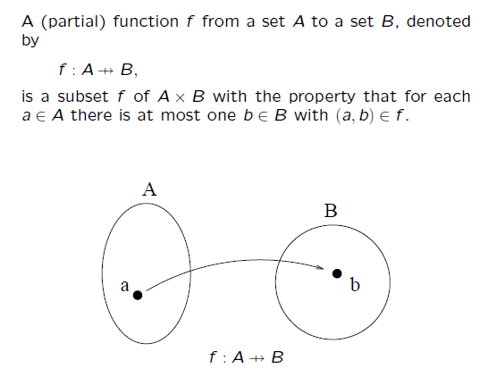
Functions in Z

Slide 32
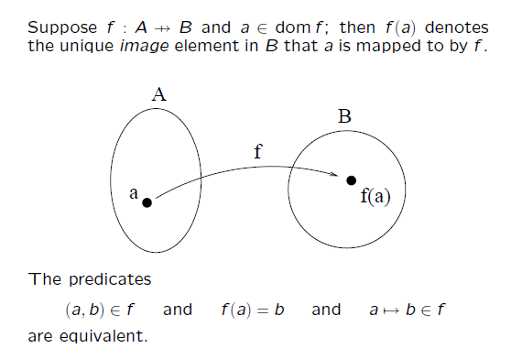
Function Application

Slide 33
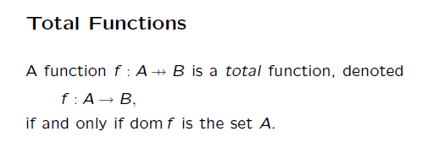
Functions in Z

Slide 34
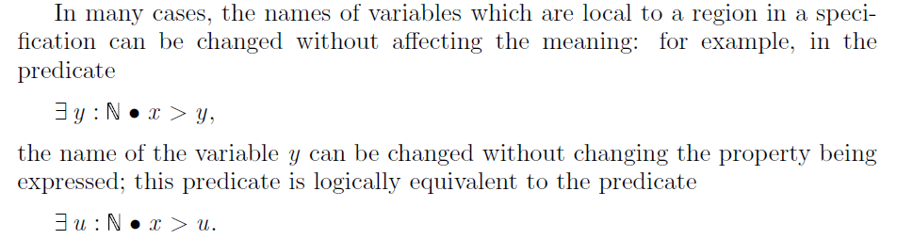
Nested Scope

Slide 35



Nested Scope

Slide 36
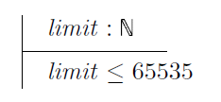
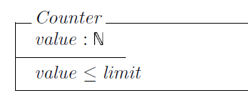
Global Signatures

Slide 37
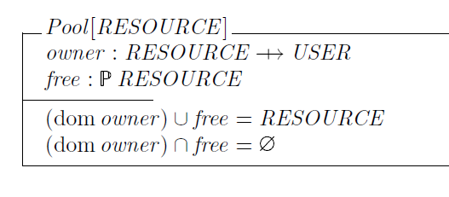
Generic Schema

Slide 38
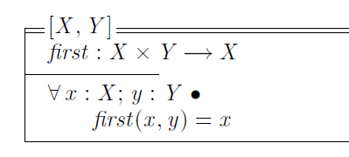



Slide 39
Operator Symbols
Function symbols (e.g. +,*)
Relation symbols (e.g. =,ε,^)
Generic symbols (e.g. )

Slide 40
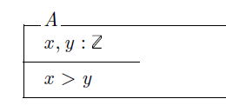
Declarations

Slide 41
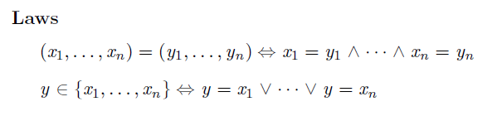

Slide 42
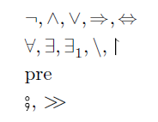
Predicates

Slide 43
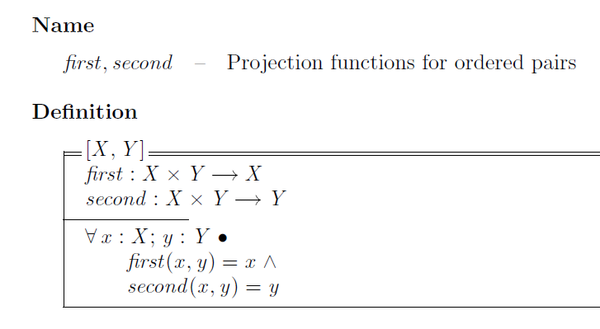

Slide 44
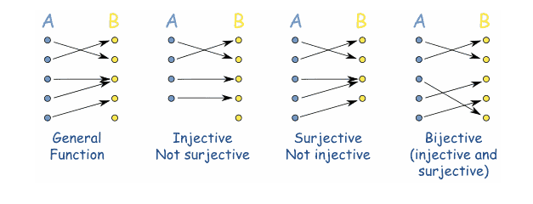
Functions in Z

Slide 45
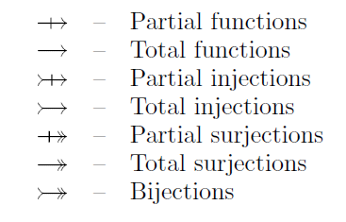
Functions in Z

Slide 46
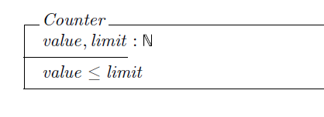
States and Operations

Slide 47
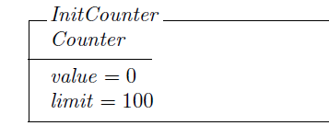

Slide 48
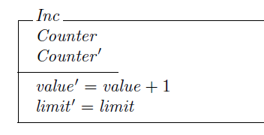
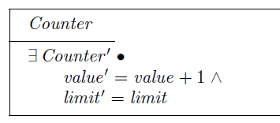

Slide 49
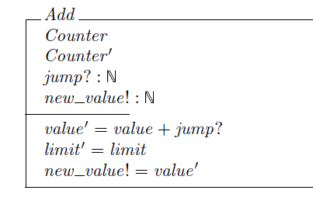

Slide 50
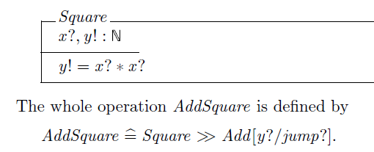
Piping

Slide 51
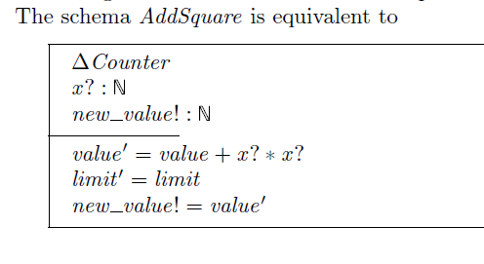

Slide 52


Collection entities
Set
{ }
Sequence (Seq)
Bag

