Slide 1

Applied Cryptography
ASHRAF MASOOD
dean@mcs.edu.pk
Lecture Notes – Spring 2012
Lecture #1

Slide 2
Welcome!
Course Introduction

Slide 3
Instructor
Ashraf Masood, Dean MCS-NUST
Teaching at MCS since 1985 (cryptography since 1986)
Studied (MS & PhD) at Michigan State University
Designed & developed several cryptographic products, applications and algorithms
Associated with IS Dept since its inception in 1996

Slide 4
Course Objectives
The objective of this course is to learn the primitives of cryptography through study of classical and conventional cryptography and their application mechanism along with required mathematical background.
Learn how crypto primitives work
Learn how to use them correctly and reason about security

Slide 5
Course Objectives
Upon completing this course, the participants should be able to:
Understand the extent of security provided by any specific cryptographic primitive and their application mechanisms
Assess the suitability of a particular cryptographic primitive against some specific information security requirement
describe the application scenario of various cryptographic schemes
Be able to understand contemporary standards of cryptographic primitives & application mechanisms
Be able to design a cryptographic system based on well established cryptographic primitives

Slide 6
Course Topics
Introduction to Classical Cryptography:
Transposition ciphers
Simple Mono & Poly-alphabetic substitution ciphers
Cryptanalysis methods
Frequency Analysis
Machine Ciphers
Notion of Security (Shannon’s Theory)
Symmetric (Private key) Encryption algorithms:
Block ciphers (DES, AES)
Stream ciphers (LFSR-based stream ciphers, RC4)
Modes of operation (ECB, CBC, CFB, OFB).

Slide 7
Course Topics
Public-key cryptography:
Data encryption (RSA)
Digital signatures (RSA)
Key management Schemes
Key generation
Key exchange/agreement (Diffie-Hellman)
Secret sharing
Integrity and authentication:
Hash functions (MD5, SHA-1)
Message-authentication codes
Mathematical Foundation
Discrete Probability
Number Theory

Slide 8
Text books & Reference Material
The course will cover material in the following text books:
A. Menezes, P. van Oorschot, S. Vanstone, Handbook of Applied Cryptography, CRC Press, 1997. (Online at http://www.cacr.math.uwaterloo.ca/hac/)
D. Stinson, Cryptography: Theory & Practice, CRC Press, 2004.
The following books are recommended for supplementary reading:
B. Schneier, Applied Cryptography, 2nd Edition, Wiley, 1996.
S. Singh, The Code Book, Fourth Estate, 1999.
G. J. Simmons, Contemporary Cryptology: the Science of Information Integrity

Slide 9
Background Knowledge
Basic Calculus
Discrete probability Theory
Basic Number Theory (Modular Arithmetic)
Familiarity with MATLAB or other High level language programming

Slide 10
General Notes
Credits: 3+0
Lectures:
1x Lecture/week (Thursday) 5:00 pm – 8:00 pm
Assignments:
Usually once per week
Peer collaboration is encouraged for discussion and understanding but not copying.
Late submissions will not be accepted
Opportunity to score bonus points

Slide 11
General Notes
3x Quizes (2x Best will be counted towards grading)
Usually extracted from the home assignments
2x OHTs & Final Exams
Solutions
Solutions to selected home assignments, quizzes and exams will be provided
LMS
All info related to course proceedings will be posted on LMS or e-mailed to you on your e-mail address.
Please check both of these resources on daily basis.
Non-compliance to any instructions given on LMS or e-mail is an unacceptable excuse.

Slide 12
Grading Policy

Slide 13
Paper Writing Projects
Subject should be confirmed by instructor
Find partner (group of three or more!)
Due (at the beginning of class)
Proposal approval by Week: 4
Final paper submission Week: 18
Presentation in the class during Week: 19

Slide 14
Paper Writing Projects
Survey paper
Convey information to readers, original analysis of the papers , pros and cons, future work
Simple summary of papers will get partial credit.
The paper should contain original analysis of the papers you choose to cover, and ideally suggest directions for future research on the topic.
Research paper
Though small, try to solve any problem. Extra credit will be given.
To get the full credit, the project should contain new ideas (new design, new analysis, new implementation, new evaluation), which could be publishable in academic conferences (not necessarily top notch).
Implementation paper
Implement meaningful mechanism
simple implementation (e.g. re-do previously implemented system without new analysis, or no comparison) will get partial credit.

Slide 15
Useful Information (Cnt.)
Paper search
Google Scholar: http://scholar.google.com/
Citeseer: http://citeseer.ist.psu.edu/
Cryptology ePrint Archive: http://eprint.iacr.org/
ACM Digital Library: http://portal.acm.org/
IEEE Explorer: http://ieeexplore.ieee.org/

Slide 16
Useful Information (Cnt.)
Writing a good research paper
Some comments on how not to write a good paper.
How to read a paper? Not from our field, and the rules still apply.
Mark Hill's Oral Presentation Advices.
Robert Drysdale's slides on Giving Technical Talks.

Slide 17
Cryptography
Basic Concepts

Slide 18
Cryptography is everywhere !
Secure communication:
web traffic: HTTPS
wireless traffic: 802.11i WPA2 (and WEP), GSM, Bluetooth
Encrypting files on disk: EFS, TrueCrypt
Content protection (e.g. DVD, Blu-ray): CSS, AACS
User authentication
… and much much more

Slide 19
Cryptology
Cryptography comes from Greek and it means hidden/secret (crypto) and writing (graphy)
The study of mathematical techniques related to aspects of information security such as confidentiality, data integrity, entity authentication, and data origin authentication.
Cryptology is the art and science of making and breaking “secret codes”.

Slide 20
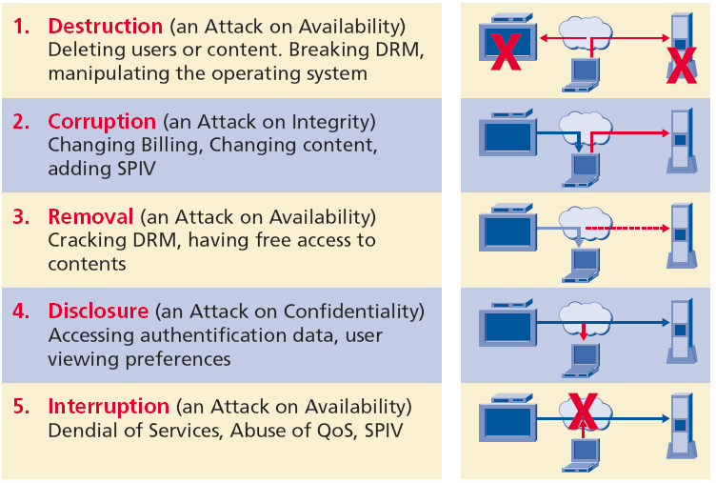
Security Threats

Slide 21
Information Security
Confidentiality
Integrity
Availability

Slide 22
Information Security
Confidentiality
Assurance that information is confidentially shared/exchanged among authorised entities (people or organisations) only
Integrity
Assurance that the information is authentic and complete; ensuring that information can be relied upon to be sufficiently accurate for its purpose
Availability
Assurance that the systems responsible for delivering, storing and processing information are accessible when needed, by those who need them

Slide 23
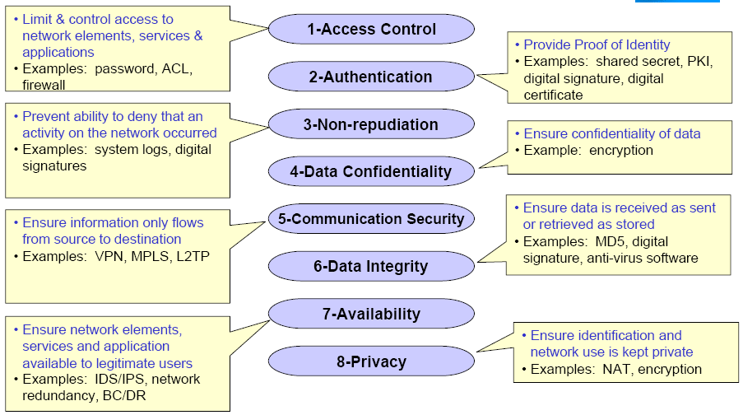
Security Dimensions

Slide 24
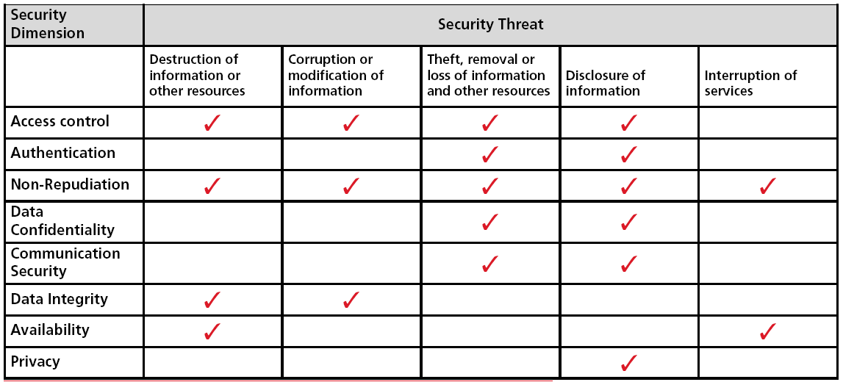
Security Dimensions -> Threats

Slide 25
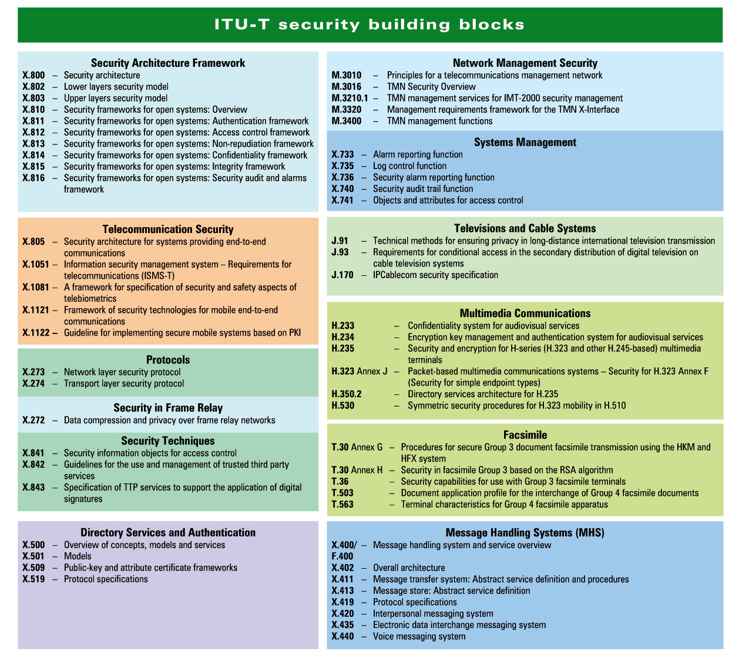

Slide 26
Role of Cryptography
All of Confidentiality
Significant component of Integrity
Indirect role in availability

Slide 27
Cryptographic Applications
Identification
Authorization
License and/or certification
Signature
Witnessing (notarization)
Concurrence
Liability
Receipts
Certification of origination and/or receipt
Endorsement
Access (egress)
Validation
Time of occurrence
Authenticity-software and/or files
Vote
Ownership
Registration
Approval/disapproval
Privacy (secrecy)
Confidentiality

Slide 28
Cryptographic Goals
Confidentiality :
Assurance that information is shared only among authorised people or organisations
Authentication :
Applies to both entities and information itself.
Two parties entering into a communication should identify each other.
Subdivided into two major classes: entity authentication and data origin authentication.
Non-Repudiation :
Prevents an entity from denying previous commitments or actions.

Slide 29
Cryptographic Goals
Integrity :
Assurance that the information is authentic and complete; ensuring that information can be relied upon to be sufficiently accurate for its purpose
Availability :
Assurance that the systems responsible for delivering, storing and processing information are accessible when needed, by those who need them

Slide 30
What is Cryptology?

Slide 31
What is Cryptology?
Cryptography
The art and science of keeping message secure, is called cryptography
Cryptography comes from Greek and it means hidden/secret (crypto) and writing (graphy)
Cryptanalysis
The art and science of breaking ciphertext: that is seeing through disguise (without the knowledge of key)
Cryptology
The branch of mathematics encompassing both cryptography and cryptanalysis is Cryptology. Its practitioners are Cryptologists

Slide 32
Cryptography vs Steganography
Information has to be concealed from an unauthorised person (attacker), so that in the event that it is passively accessed (e.g., copied or intercepted) by an attacker, it should not be useful to them
Cryptography is the study of hiding information by transforming it to a unintelligible form using a secret key
The transformation is commonly called encryption
If the encrypted information gets revealed, the attacker should not be able to decode (decrypt) it back to the original information without knowledge of the secret key
Steganography is the study of hiding critical information within some less important information:
If the less important information is revealed, the attacker should not be able to even identify, let alone extract, the critical information

Slide 33
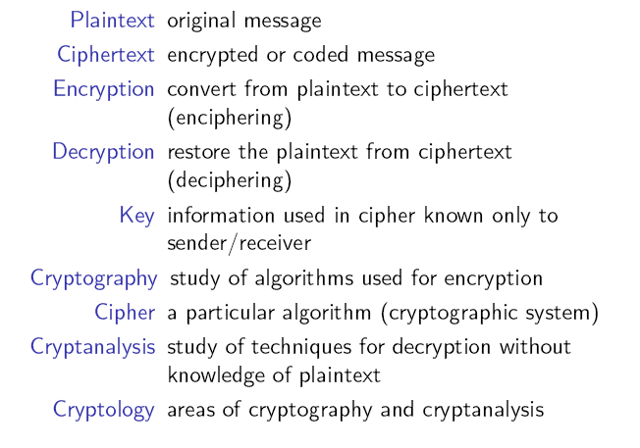
Terminology

Slide 34
Message & Encryption
Encryption
The original message is called Plaintext
The process of disguising a message in such a way to hide its substance, is called Encryption
The Encryption is done using the specified key: C = E_{K}(P) or E(K, P)
The encrypted message is called Ciphertext
Decryption
The mathematical function mapping ciphertext to plaintext using the specified key: P = D_{K}(C) or D(K, Y) = EK⁻¹(C) = P

Slide 35
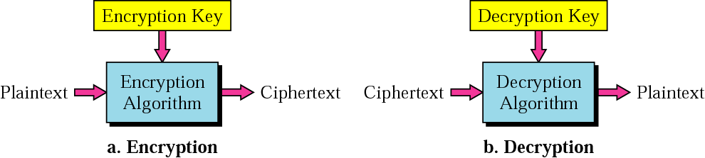
Message & Encryption
C = E_{K}(P)
P = D_{K}(C)
P
C
C
P

Slide 36
Cryptographic Algorithm & Keys
Cipher
A cryptographic algorithm is called a cipher. It is a mathematical function used for both encryption and decryption
Key & Key Space
The security of modern cryptosystem is based on a Key: which could a be one of any large values.
The range of possible key values is called the Key Space
Both encryption and decryption depends upon the Key
Given a key, every possible plaintext must result in a unique ciphertext—if not – decryption would not be unambiguously possible

Slide 37
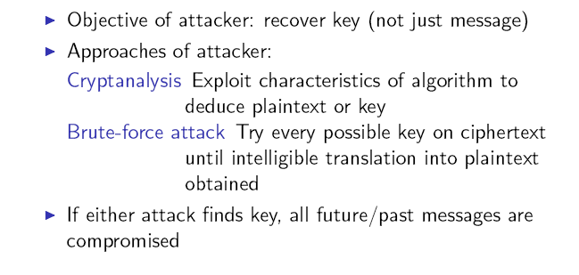
Attacks

Slide 38
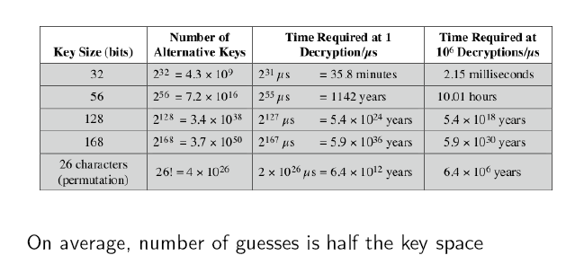
Brute Force Attack

Slide 39
Cryptosystem
A cryptosystem is a five-tuple (P, C, K, E, D), where following
conditions are satisfied :
P is a finite set of possible plaintexts
C is a finite set of possible ciphertexts
K, the keyspace, is a finite set of possible keys
For each K ∈ K, there is an encryption algorithm E_{K} ∈ E and a corresponding decryption algorithm D_{K} ∈ D. Each E_{K} : P → C and D_{K} : C → P are functions such that D_{K}(E_{K}(X)) = X for every plaintext X ∈ P.

Slide 40
Cryptosystem

Slide 41
Cryptosystem
Plain Text
The original readable (meaningful) message
Key
The Secret Code
Cipher Text
The unreadable(meaningless) text that results from encrypting the plaintext
Encryption/Decryption Rule (Cryptographic Algorithms)
Cryptographic Protocol

Slide 42
Building blocks: Symmetric Encryption
E, D: cipher k: secret key (e.g. 128 bits)
m, c: plaintext, ciphertext
Encryption algorithm is publicly known
Never use a proprietary cipher
Alice
Bob
m
E
E(k,m)=c
c
D
D(k,c)=m
k
k

Slide 43
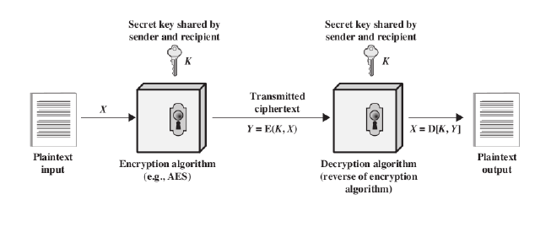
Simplified Model of Symmetric Encryption

Slide 44
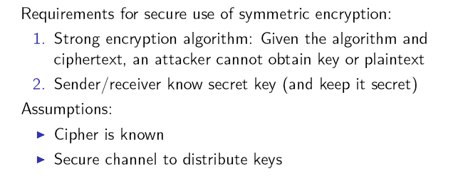
Requirements & Assumptions

Slide 45
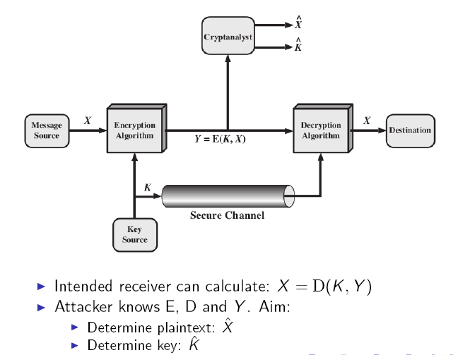
Model of Symmetric Crypto System

Slide 46


Crypto core
Talking to Bob
Talking to Alice
Alice
Secret key establishment:
Secure communication:
Bob
attacker???
k
m₁
k
m₂
confidentiality and integrity

Slide 47
Kerchhoff’s Principle
“Encryption algorithms being used should be assumed to be publicly known and the security of the algorithm should reside only in the key chosen”

Slide 48


But crypto can do much more
Digital signatures
Anonymous communication
Alice signature
Who did I just talk to?
Alice
Bob

Slide 49


But crypto can do much more
Anonymous digital cash
Can I spend a “digital coin” without anyone knowing who I am?
How to prevent double spending?
1$
Who was that?
Alice
Internet
(anon. comm.)

Slide 50

Protocols
Elections
Private auctions

Slide 51
Protocols
Elections
Private auctions
Secure multi-party computation
trusted authority
Goal: compute f(x₁, x₂, x₃, x₄)
“Thm:” anything that can done with trusted auth. can also be done without

Slide 52


Crypto magic
What did she search for?
Privately outsourcing computation
Zero knowledge (proof of knowledge)
search query
E[ query ]
Alice
E[ results ]
results
???
N=p∙q
Alice
I know the factors of N !!
proof π
N
Bob
Notes:
ZKPK: can be used for authentication

Slide 53
Things to Remember (Again & Again)!
Cryptography is:
A tremendous tool
The basis for many security mechanisms
Cryptography is not:
The solution to all security problems
Reliable unless implemented and used properly
Something you should try to invent yourself
many many examples of broken ad-hoc designs

Slide 54
Cryptography: A Rigorous Science
The three steps in cryptography:
Precisely specify threat model
Propose a construction
Prove that breaking construction under threat mode will solve an underlying hard problem
Notes:
Example: define what it means to forge signatures, give construction, show that forging signatures is as hard as factoring.

Slide 55
Classical cryptography
Next Lecture

Slide 56
Copyright Notice
The material in this presentation has been taken from text books, reference books, research literature and various sources on Internet; and compiled/edited for class room teaching at MCS-NUST without any infringement into the copyrights of the author(s). The original authors retain their respective copyrights as per their stated claims.
Commercial use of the material contained herein in full or in part through copying, publication and reproducing in any form is strictly prohibited.

