Slide 1

Applied Cryptography
ASHRAF MASOOD
dean@mcs.edu.pk
Lecture Slides– Fall 2012
Lecture #10

Slide 2
Computational Number Theory

Slide 3
Why Number Theory
We will use a bit of number theory to construct:
Public-key encryption
Key exchange protocols
Digital signatures
This lecture module (x2): crash course on relevant concepts
More info:
A Computational Introduction to Number Theory and Algebra, V. Shoup, 2008 (V2), Chapter 1-4, 11, 12
Available at //shoup.net/ntb/ntb-v2.pdf

Slide 4
Notation
Z = {. . . ,−2,−1, 0, 1, 2, . . .}
N = {0, 1, 2, . . .}
Z+ = {1, 2, 3, . . .}
p: Prime Number
Subscript indicates mod value sich as Z_{N}

Slide 5


Modular arithmetic
Examples: let N = 12
9 + 8 = 5 in
5 × 7 = 11 in
5 − 7 = 10 in
Arithmetic in works as you expect, e.g x⋅(y+z) = x⋅y + x⋅z in

Slide 6
Divisibility
b divides a if a = mb for some m, where a, b and m are integers
b|a
(Example: 2|4)
b is a divisor of a
gcd(a; b): greatest common divisor of a and b
For a,N ∈ Z let gcd(a,N) be the largest d ∈ Z+ such that d|a and d|N.
Example: gcd(30, 70) = 10.

Slide 7
Def: For ints. x,y: gcd(x, y) is the greatest common divisor of x,y
Example: gcd( 12, 18 ) = 6 2x12 + (-1)x18 = 6
Fact: for all ints. x,y there exist ints. a,b such that
a⋅x + b⋅y = gcd(x,y)
a,b can be found efficiently using the extended Euclid alg.
If gcd(x,y)=1 we say that x and y are relatively prime

Slide 8
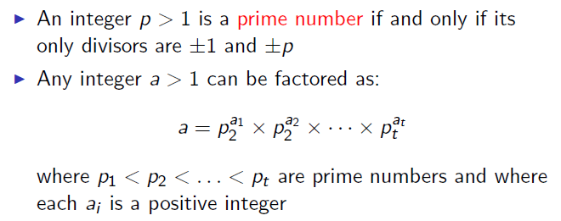
Prime Numbers

Slide 9
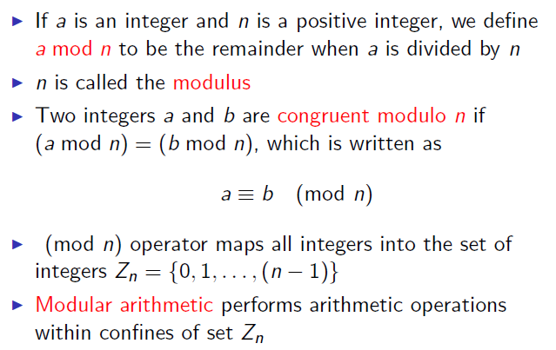
Modular Arithmatic

Slide 10
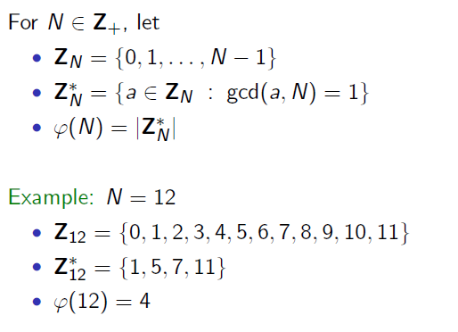
Integer mod N

Slide 11
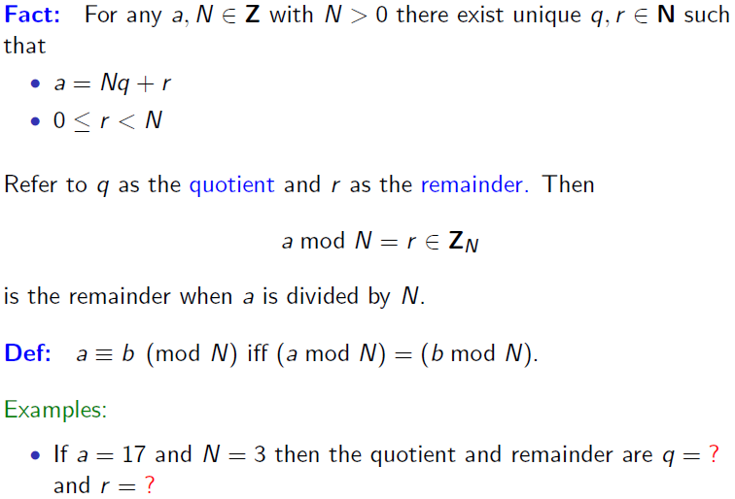
Division & Mod

Slide 12
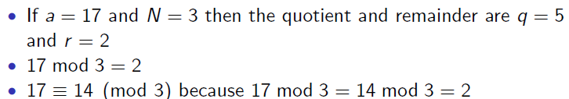
Example

Slide 13
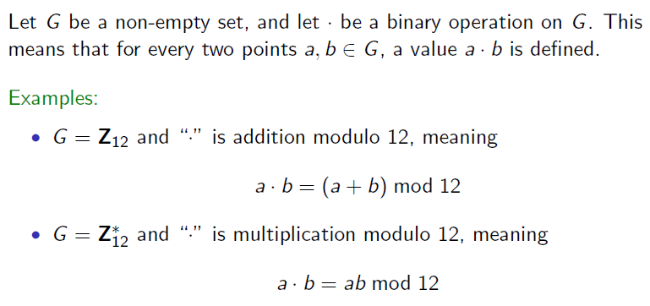
Groups

Slide 14
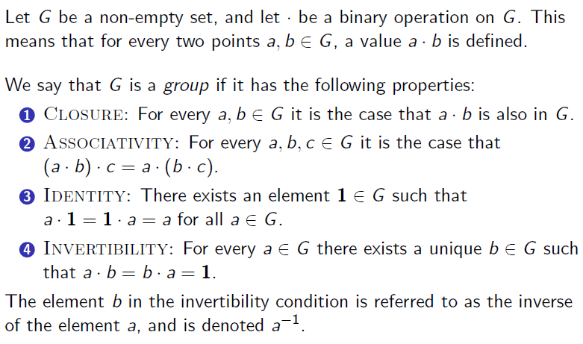
Groups

Slide 15
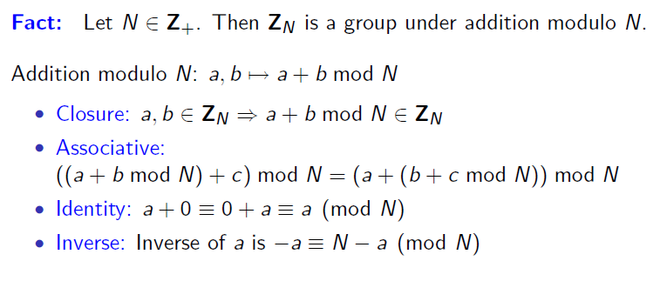
Z_{N} under Mod Addition

Slide 16
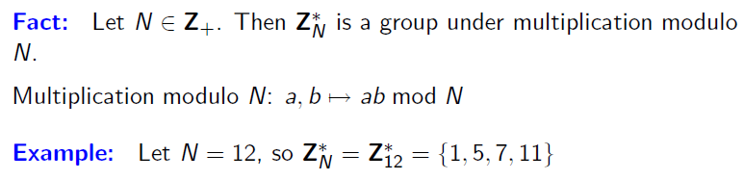
Z_{N}* under Mod Multiplication

Slide 17
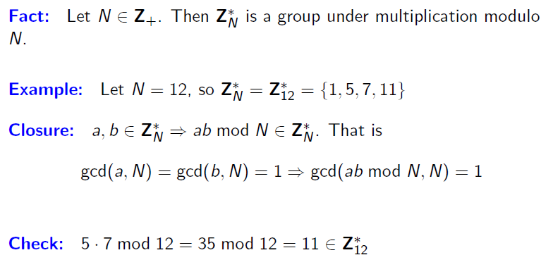
Z_{N}* under Mod Multiplication

Slide 18
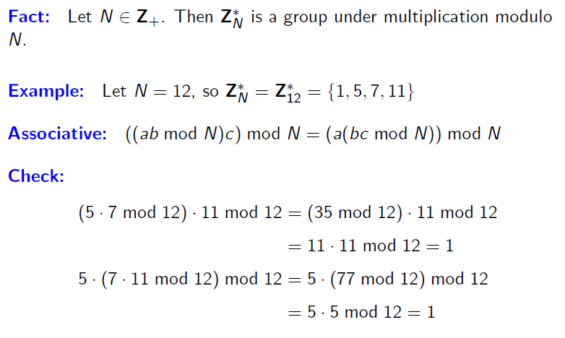
Z_{N}* under Mod Multiplication

Slide 19
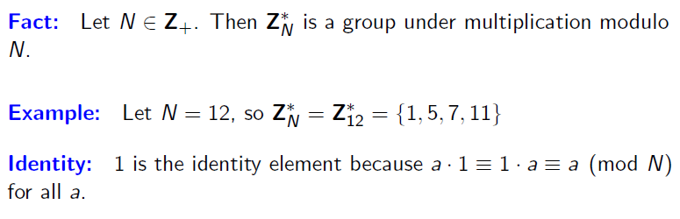
Z_{N}* under Mod Multiplication

Slide 20
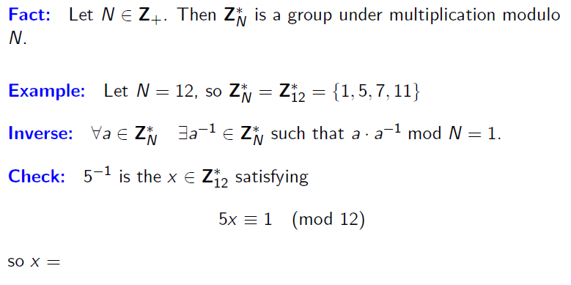
Z_{N}* under Mod Multiplication
Z_{N}

Slide 21
Modular Inversion
Over the rationals, inverse of 2 is ½ . What about in Z_{N} ?
Def: The inverse of x in Z_{N} is an element y in Z_{N} s.t.
x.y=1 in Z_{N} y is denoted x⁻¹ .
Example: let N be an odd integer. The inverse of 2 in is (N+1)/2

Slide 22
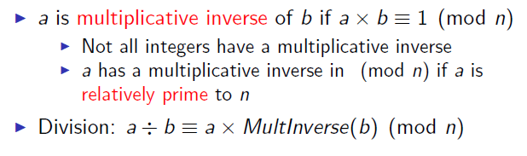
Division in Mod Arithmatic

Slide 23
Review
N denotes an n-bit positive integer. p denotes a prime.
Z_{N} = { 0, 1, …, N-1 }
(Z_{N})* = (set of invertible elements in Z_{N}) =
= { x∈Z_{N} : gcd(x,N) = 1 }

Slide 24

Computational Shortcuts

Slide 25
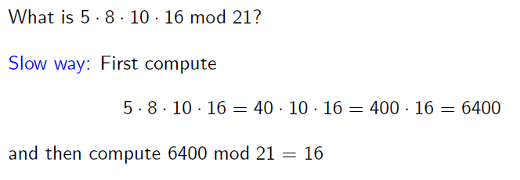
Computational Shortcuts

Slide 26
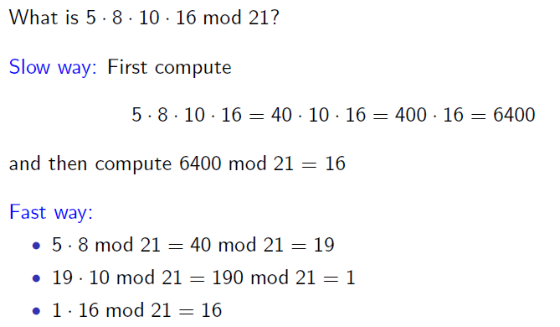
Computational Shortcuts

Slide 27
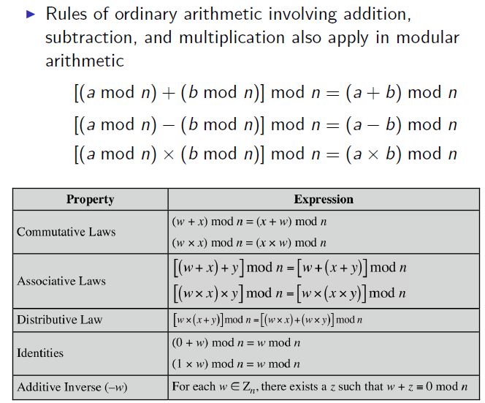
Properties of Mod Arithmatic

Slide 28
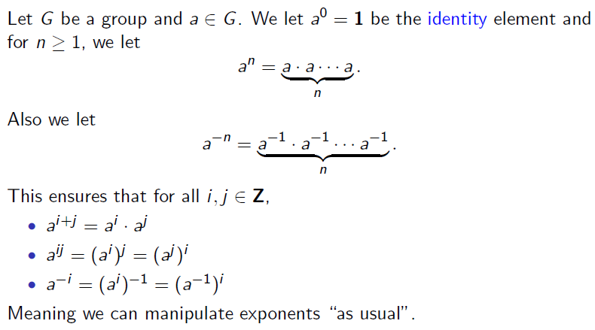
Exponenciation

Slide 29
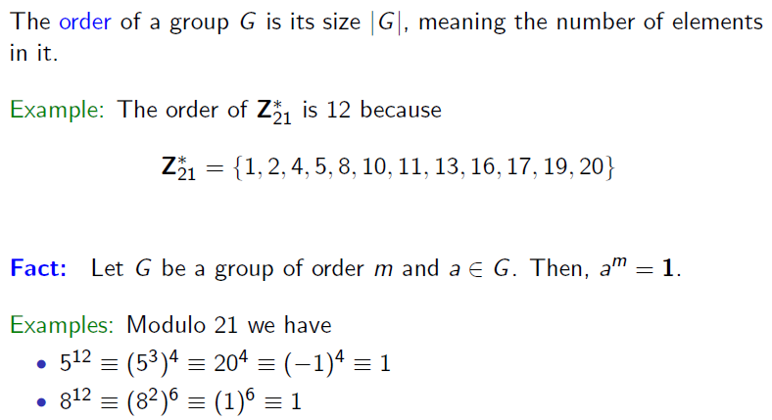
Group Order

Slide 30
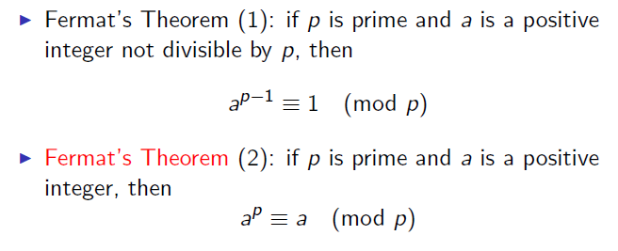
Fermat’s Theorem

Slide 31
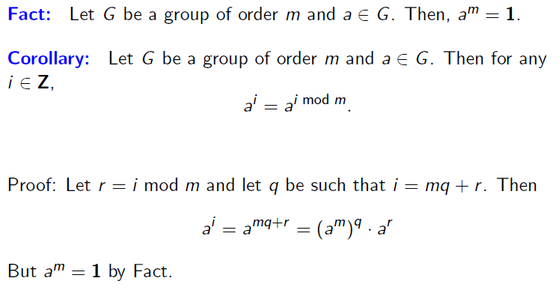
Proof of Corollary

Slide 32
Fermat Theorem
Thm: Let p be a prime
∀ x ∈ (Z_{p})* : x^{p-1} = 1 in Z_{p}
Example: p=5. 3⁴ = 81 = 1 in Z₅
So: x ∈ (Z_{p})* ⇒ x⋅x^{p-2} = 1 ⇒ x⁻¹ = x^{p-2} in Z_{p}
Another way to compute inverses, but less efficient than Euclid

Slide 33
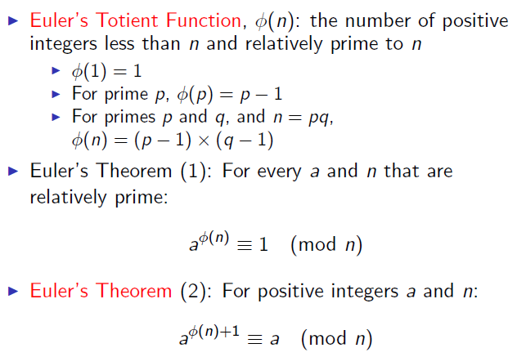
Euler’s Theorem

Slide 34
Euler’s generalization of Fermat (1736)
Def: For an integer N define ϕ (N) = |(Z_{N})*| (Euler’s ϕ func.)
Examples: ϕ (12) = |{1,5,7,11}| = 4 ; ϕ (p) = p-1
For N=p⋅q: ϕ (N) = N-p-q+1 = (p-1)(q-1)
Thm (Euler): ∀ x ∈ (Z_{N})* : x^{ϕ(N)} = 1 in Z_{N}
Example: 5^{ϕ(12)} = 5⁴ = 625 = 1 in Z₁₂
Generalization of Fermat. Basis of the RSA cryptosystem

Slide 35
The structure of (Z_{p})*
Thm (Euler): (Z_{p})* is a cyclic group, that is
∃ g∈(Z_{p})* such that {1, g, g², g³, …, g^{p-2}} = (Z_{p})*
g is called a generator of (Z_{p})*
Example: p=7. {1, 3, 3², 3³, 3⁴, 3⁵} = {1, 3, 2, 6, 4, 5} = (Z₇)*
Not every elem. is a generator: {1, 2, 2², 2³, 2⁴, 2⁵} = {1, 2, 4}

Slide 36
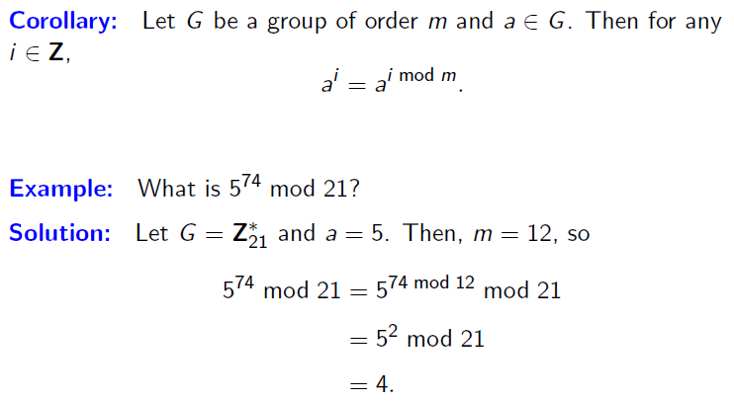
Group Orders

Slide 37
Group Orders

Slide 38
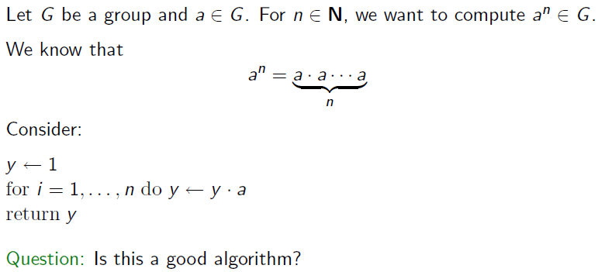
Modular Exponentiation

Slide 39
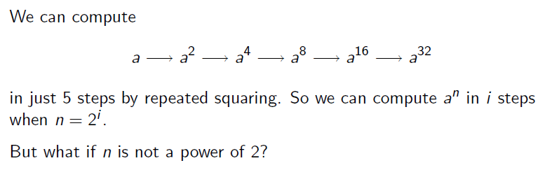
Modular Exponentiation

Slide 40
Fast Modular Exponentiation
Finite cyclic group G (for example G = )
Goal: given g in G and x compute g^{x}
Example: suppose x = 53 = (110101)₂ = 32+16+4+1
Then: g⁵³ = g³²⁺¹⁶⁺⁴⁺¹ = g³²⋅g¹⁶⋅g⁴⋅g¹
g ⟶ g² ⟶ g⁴ ⟶ g⁸ ⟶ g¹⁶ ⟶ g³² g⁵³

Slide 41
The Repeated Squaring Algorithm
Input: g in G and x>0 ; Output: g^{x}
write x = (x_{n} x_{n-1} … x₂ x₁ x₀)₂
y ⟵ g , z ⟵ 1
for i = 0 to n do:
if (x[i] == 1): z ⟵ z⋅y
y ⟵ y²
output z
example: g⁵³
y z
g² g
g⁴ g
g⁸ g⁵
g¹⁶ g⁵
g³² g²¹
g⁶⁴ g⁵³

Slide 42
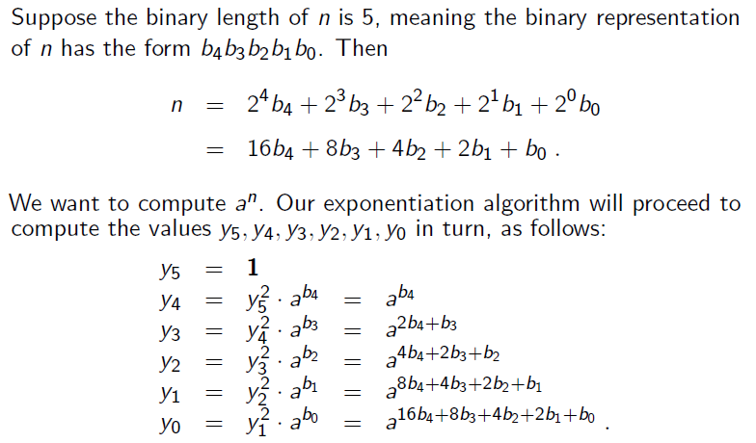
Fast Modular Exponentiation

Slide 43
Order of the Group
For g∈(Z_{p})* the set {1 , g , g², g³, … } is called the group generated by g, denoted <g>
Def: the order of g∈(Z_{p})* is the size of <g>
ord_{p}(g) = |<g>| = (smallest a>0 s.t. gª = 1 in Z_{p})
Examples: ord₇(3) = 6 ; ord ₇(2) = 3 ; ord₇(1) = 1
Thm (Lagrange): ∀g∈(Z_{p})* : ord_{p}(g) divides p-1

Slide 44
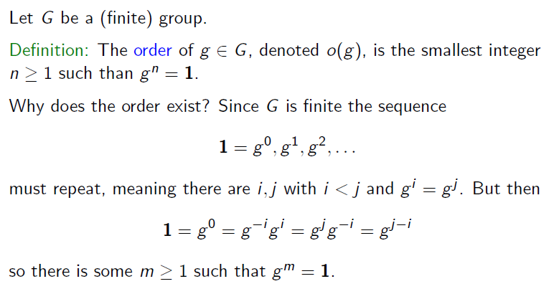
Order of a Group

Slide 45
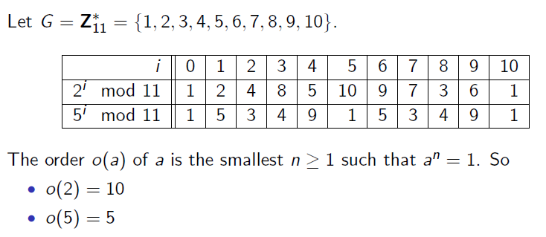
Order Determination

Slide 46
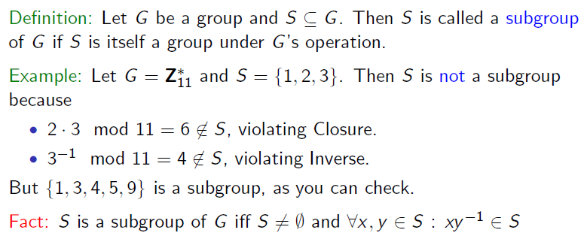
Subgroup

Slide 47
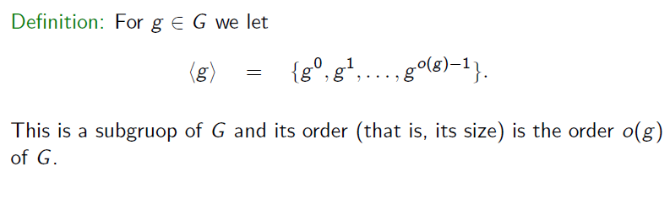
Subgroup

Slide 48
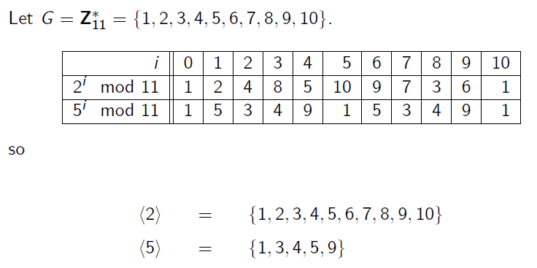
Order of Subgroup

Slide 49
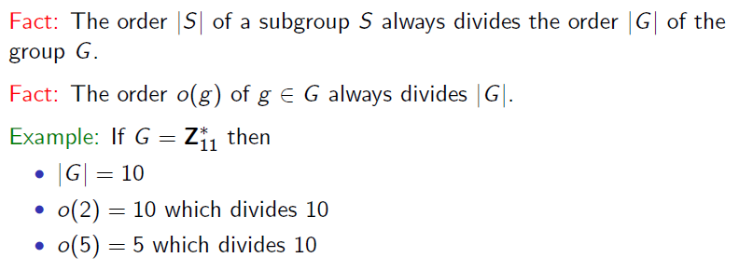
Order of Subgroup

Slide 50
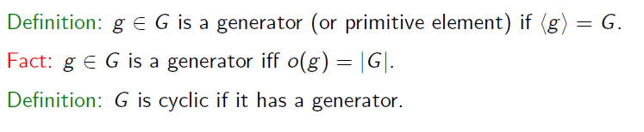
Generator

Slide 51
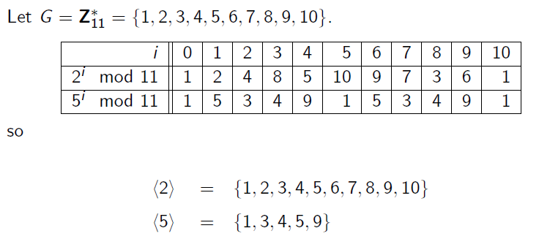
Generator

Slide 52
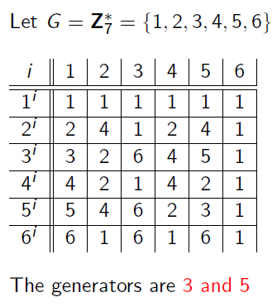
Generators

Slide 53
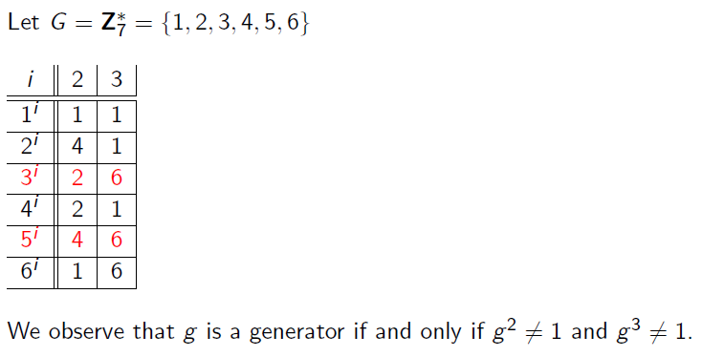
Generators

Slide 54
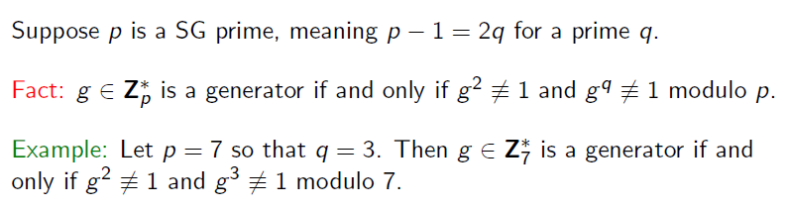
Test for a Generator

Slide 55
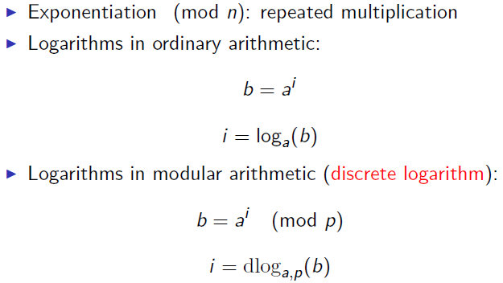
Logarithm

Slide 56
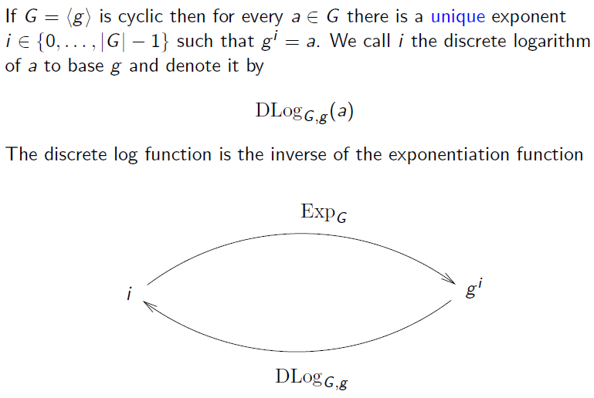
Discrete Logarithm

Slide 57
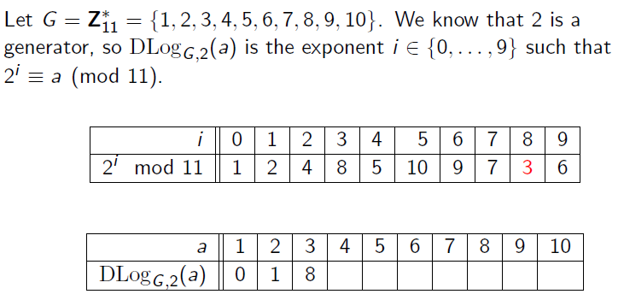
Discrete Logarithm

Slide 58
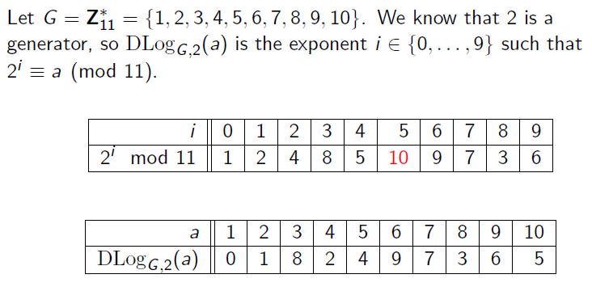
Discrete Logarithm

Slide 59
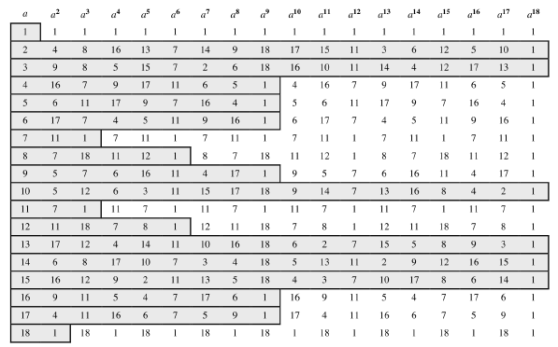
Powers of Integers (mod 19)

Slide 60
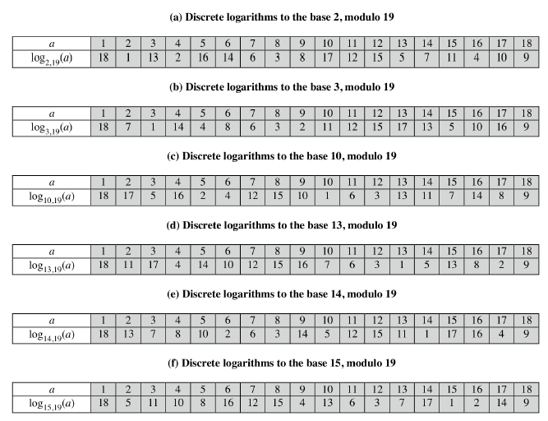
Discrete Log (mod 19)

Slide 61
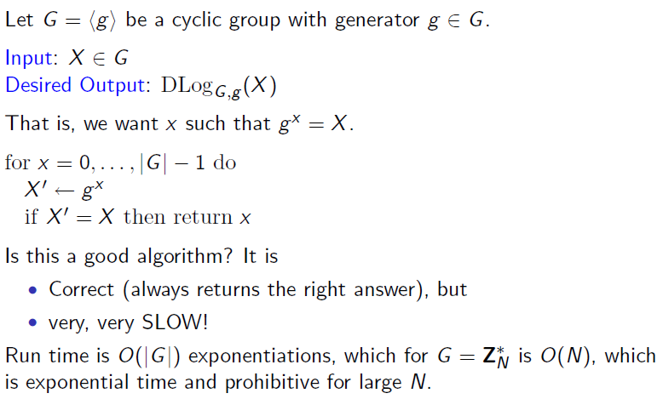
Discrete Logarithm

Slide 62
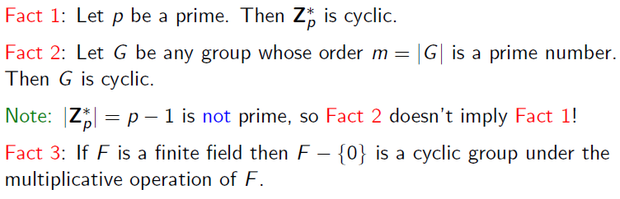
Finding Cyclic Groups

Slide 63
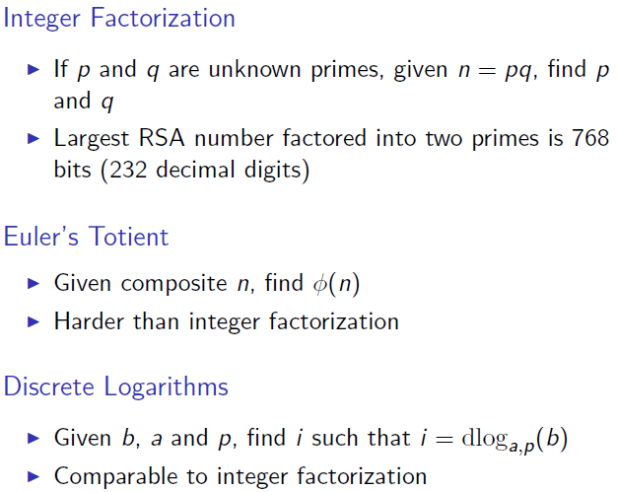
Complexity

Slide 64
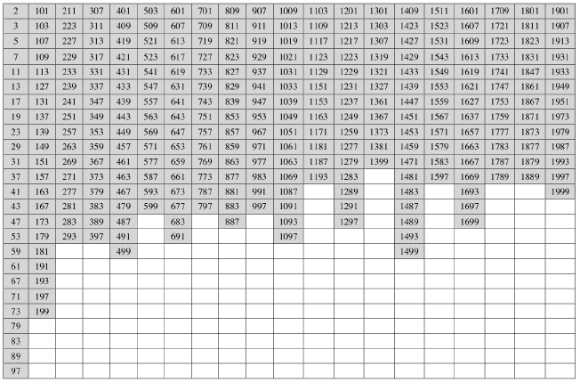
Primes under 2000

Slide 65
Copyright Notice
The material in this presentation has been taken from text books, reference books, research literature and various sources on Internet; and compiled/edited for class room teaching at MCS-NUST without any infringement into the copyrights of the author(s). The original authors retain their respective copyrights as per their stated claims.
Commercial use of the material contained herein in full or in part through copying, publication and reproducing in any form is strictly prohibited.

