Slide 1

Applied Cryptography
ASHRAF MASOOD
dean@mcs.edu.pk
Lecture Slides– Fall 2012
Lecture #11

Slide 2
Computational Number Theory

Slide 3
Why Number Theory
We will use a bit of number theory to construct:
Public-key encryption
Key exchange protocols
Digital signatures
This lecture module (x2): crash course on relevant concepts
More info:
A Computational Introduction to Number Theory and Algebra, V. Shoup, 2008 (V2), Chapter 1-4, 11, 12
Available at //shoup.net/ntb/ntb-v2.pdf

Slide 4
Notation
Z = {. . . ,−2,−1, 0, 1, 2, . . .}
N = {0, 1, 2, . . .}
Z+ = {1, 2, 3, . . .}
p: Prime Number
Subscript indicates mod value sich as Z_{N}

Slide 5


Modular arithmetic
Examples: let N = 12
9 + 8 = 5 in
5 × 7 = 11 in
5 − 7 = 10 in
Arithmetic in works as you expect, e.g x⋅(y+z) = x⋅y + x⋅z in

Slide 6
Divisibility
b divides a if a = mb for some m, where a, b and m are integers
b|a
(Example: 2|4)
b is a divisor of a
gcd(a; b): greatest common divisor of a and b
For a,N ∈ Z let gcd(a,N) be the largest d ∈ Z+ such that d|a and d|N.
Example: gcd(30, 70) = 10.

Slide 7
Def: For ints. x,y: gcd(x, y) is the greatest common divisor of x,y
Example: gcd( 12, 18 ) = 6 2x12 + (-1)x18 = 6
Fact: for all ints. x,y there exist ints. a,b such that
a⋅x + b⋅y = gcd(x,y)
a,b can be found efficiently using the extended Euclid alg.
If gcd(x,y)=1 we say that x and y are relatively prime

Slide 8
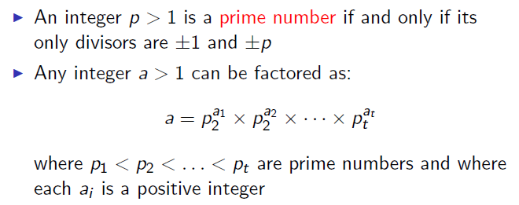
Prime Numbers

Slide 9
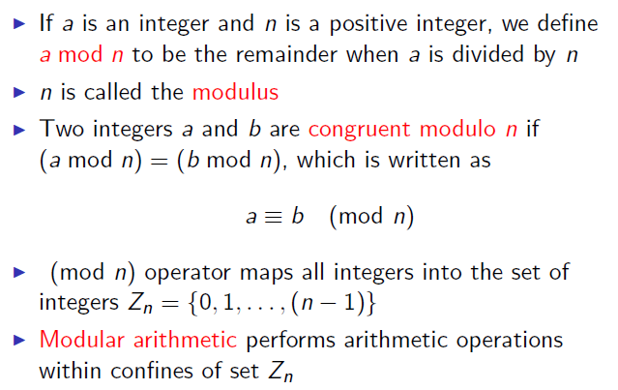
Modular Arithmatic

Slide 10
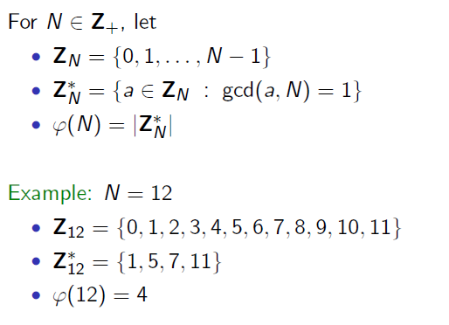
Integer mod N

Slide 11
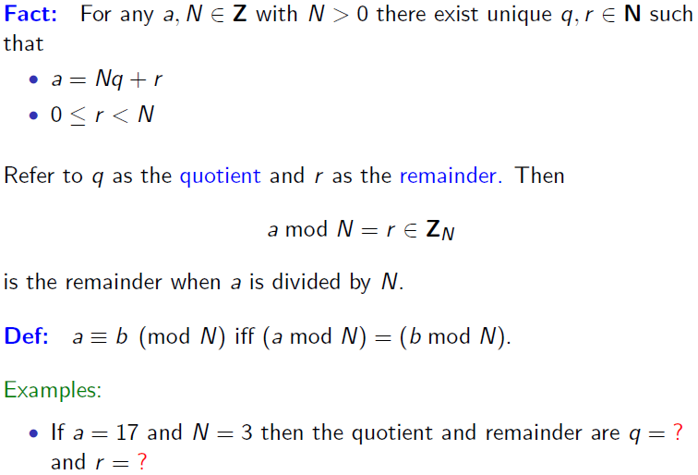
Division & Mod

Slide 12
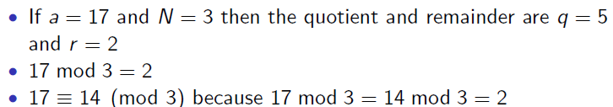
Example

Slide 13
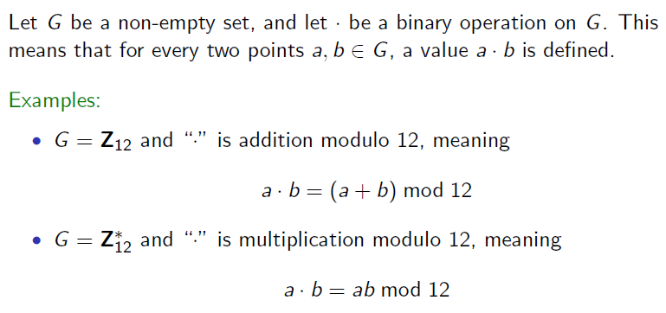
Groups

Slide 14
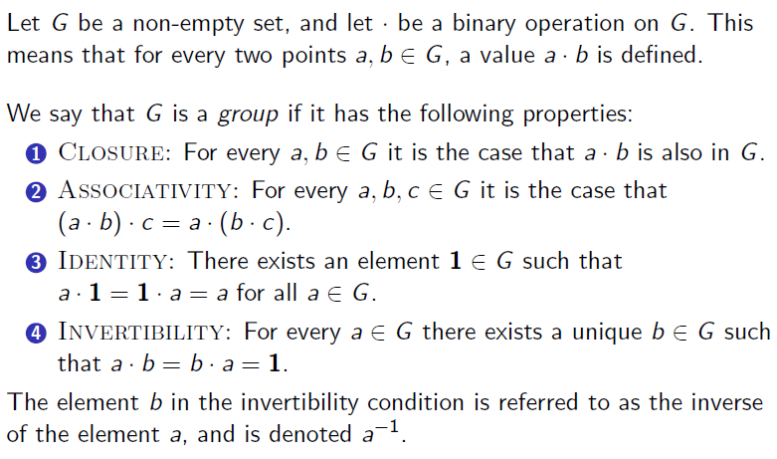
Groups

Slide 15
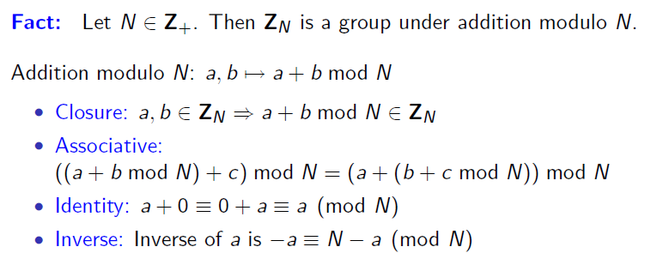
Z_{N} under Mod Addition

Slide 16
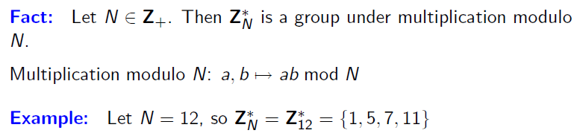
Z_{N}* under Mod Multiplication

Slide 17
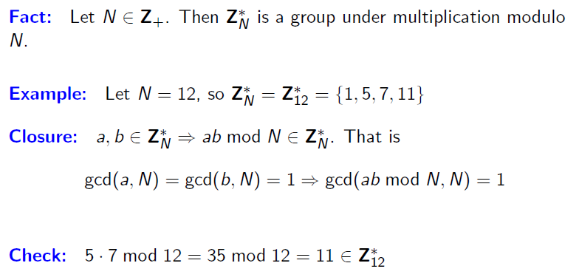
Z_{N}* under Mod Multiplication

Slide 18
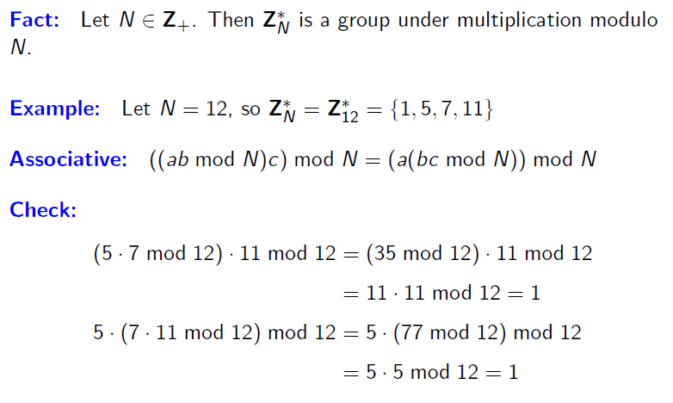
Z_{N}* under Mod Multiplication

Slide 19
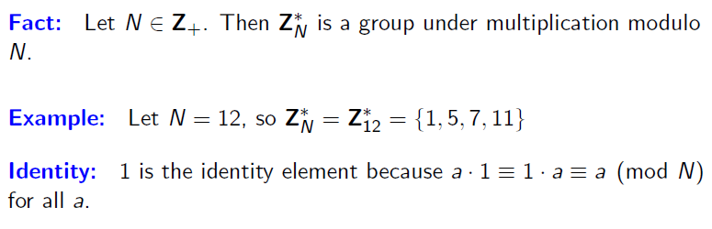
Z_{N}* under Mod Multiplication

Slide 20
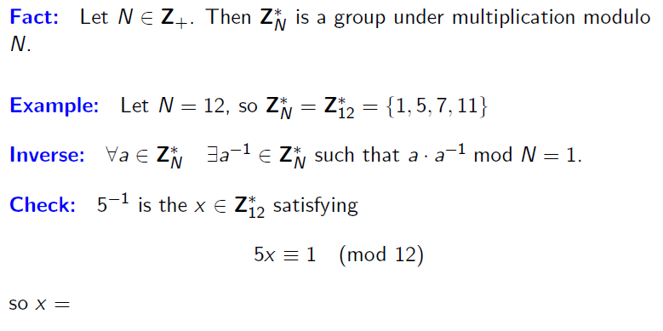
Z_{N}* under Mod Multiplication
Z_{N}

Slide 21
Modular Inversion
Over the rationals, inverse of 2 is ½ . What about in Z_{N} ?
Def: The inverse of x in Z_{N} is an element y in Z_{N} s.t.
x.y=1 in Z_{N} y is denoted x⁻¹ .
Example: let N be an odd integer. The inverse of 2 in is (N+1)/2

Slide 22
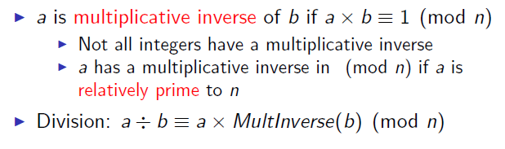
Division in Mod Arithmatic

Slide 23
Review
N denotes an n-bit positive integer. p denotes a prime.
Z_{N} = { 0, 1, …, N-1 }
(Z_{N})* = (set of invertible elements in Z_{N}) =
= { x∈Z_{N} : gcd(x,N) = 1 }

Slide 24

Computational Shortcuts

Slide 25
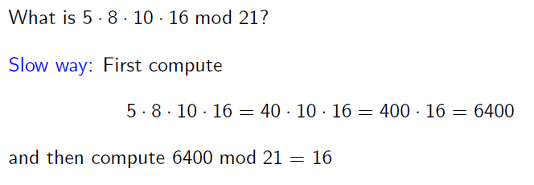
Computational Shortcuts

Slide 26
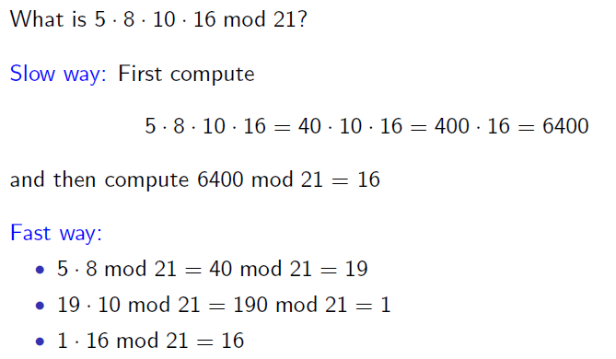
Computational Shortcuts

Slide 27
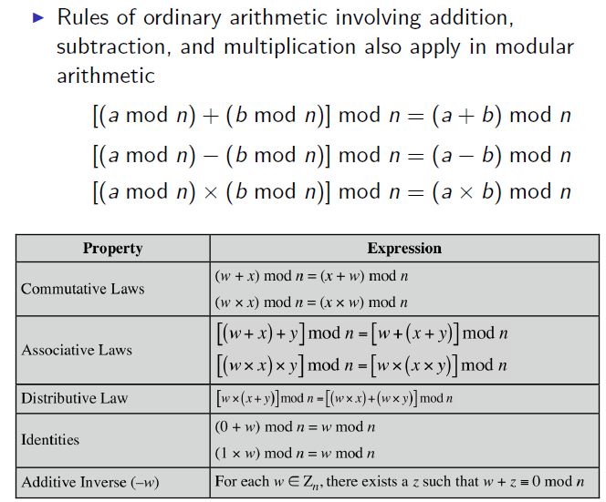
Properties of Mod Arithmatic

Slide 28
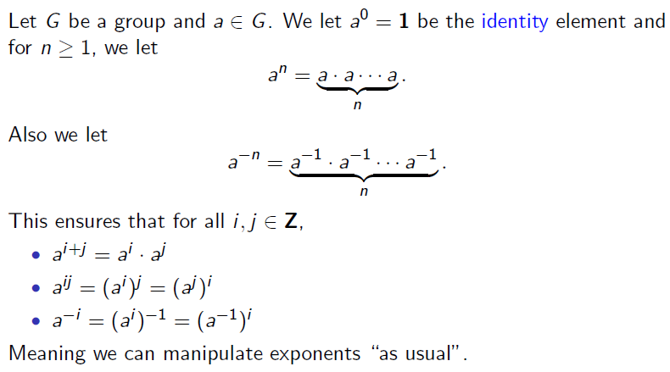
Exponenciation

Slide 29
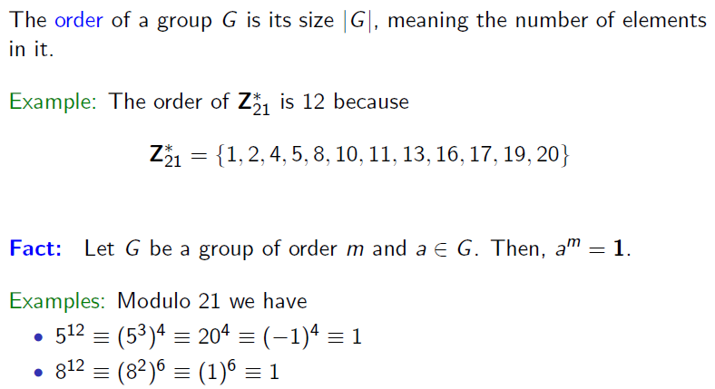
Group Order

Slide 30
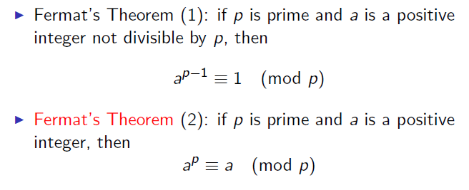
Fermat’s Theorem

Slide 31
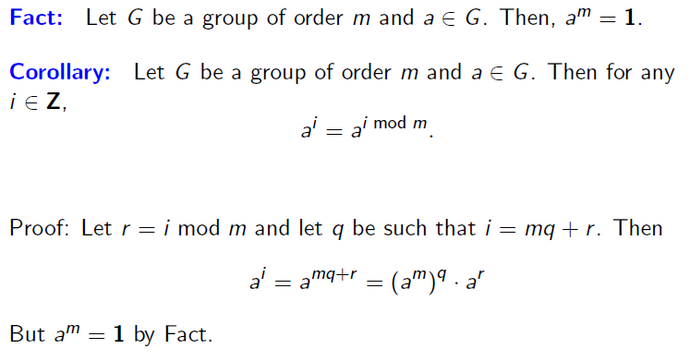
Proof of Corollary

Slide 32
Fermat Theorem
Thm: Let p be a prime
∀ x ∈ (Z_{p})* : x^{p-1} = 1 in Z_{p}
Example: p=5. 3⁴ = 81 = 1 in Z₅
So: x ∈ (Z_{p})* ⇒ x⋅x^{p-2} = 1 ⇒ x⁻¹ = x^{p-2} in Z_{p}
Another way to compute inverses, but less efficient than Euclid

Slide 33
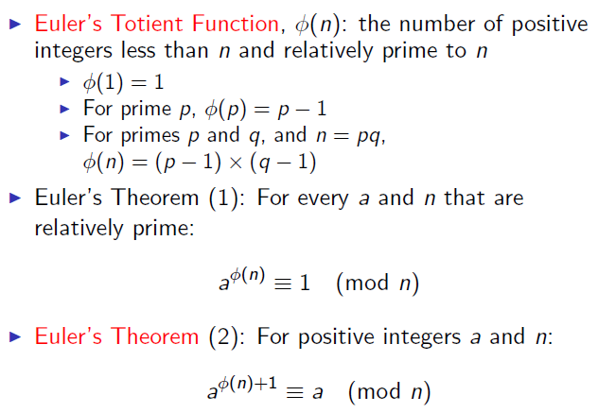
Euler’s Theorem

Slide 34
Euler’s generalization of Fermat (1736)
Def: For an integer N define ϕ (N) = |(Z_{N})*| (Euler’s ϕ func.)
Examples: ϕ (12) = |{1,5,7,11}| = 4 ; ϕ (p) = p-1
For N=p⋅q: ϕ (N) = N-p-q+1 = (p-1)(q-1)
Thm (Euler): ∀ x ∈ (Z_{N})* : x^{ϕ(N)} = 1 in Z_{N}
Example: 5^{ϕ(12)} = 5⁴ = 625 = 1 in Z₁₂
Generalization of Fermat. Basis of the RSA cryptosystem

Slide 35
The structure of (Z_{p})*
Thm (Euler): (Z_{p})* is a cyclic group, that is
∃ g∈(Z_{p})* such that {1, g, g², g³, …, g^{p-2}} = (Z_{p})*
g is called a generator of (Z_{p})*
Example: p=7. {1, 3, 3², 3³, 3⁴, 3⁵} = {1, 3, 2, 6, 4, 5} = (Z₇)*
Not every elem. is a generator: {1, 2, 2², 2³, 2⁴, 2⁵} = {1, 2, 4}

Slide 36
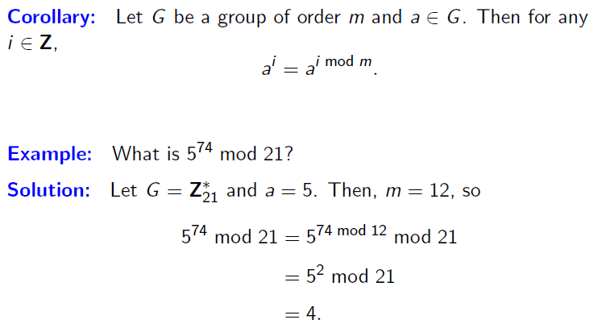
Group Orders

Slide 37
Group Orders

Slide 38
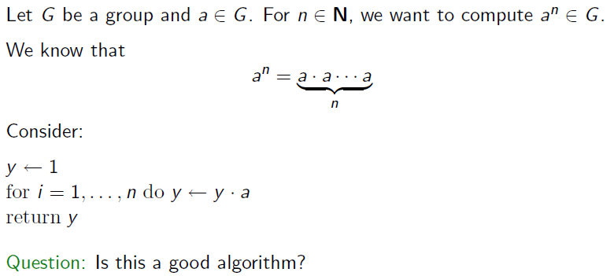
Modular Exponentiation

Slide 39
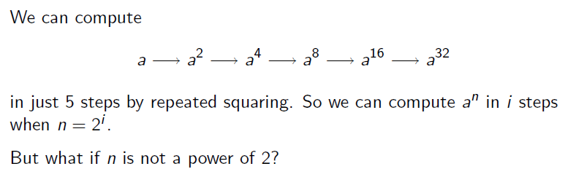
Modular Exponentiation

Slide 40
Fast Modular Exponentiation
Finite cyclic group G (for example G = )
Goal: given g in G and x compute g^{x}
Example: suppose x = 53 = (110101)₂ = 32+16+4+1
Then: g⁵³ = g³²⁺¹⁶⁺⁴⁺¹ = g³²⋅g¹⁶⋅g⁴⋅g¹
g ⟶ g² ⟶ g⁴ ⟶ g⁸ ⟶ g¹⁶ ⟶ g³² g⁵³

Slide 41
The Repeated Squaring Algorithm
Input: g in G and x>0 ; Output: g^{x}
write x = (x_{n} x_{n-1} … x₂ x₁ x₀)₂
y ⟵ g , z ⟵ 1
for i = 0 to n do:
if (x[i] == 1): z ⟵ z⋅y
y ⟵ y²
output z
example: g⁵³
y z
g² g
g⁴ g
g⁸ g⁵
g¹⁶ g⁵
g³² g²¹
g⁶⁴ g⁵³

Slide 42
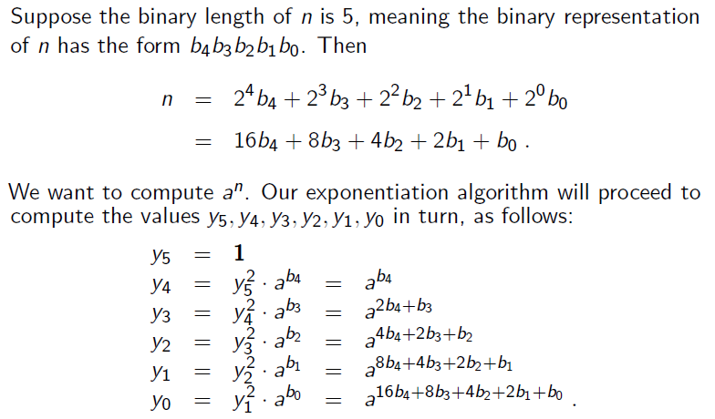
Fast Modular Exponentiation

Slide 43
Order of the Group
For g∈(Z_{p})* the set {1 , g , g², g³, … } is called the group generated by g, denoted <g>
Def: the order of g∈(Z_{p})* is the size of <g>
ord_{p}(g) = |<g>| = (smallest a>0 s.t. gª = 1 in Z_{p})
Examples: ord₇(3) = 6 ; ord ₇(2) = 3 ; ord₇(1) = 1
Thm (Lagrange): ∀g∈(Z_{p})* : ord_{p}(g) divides p-1

Slide 44
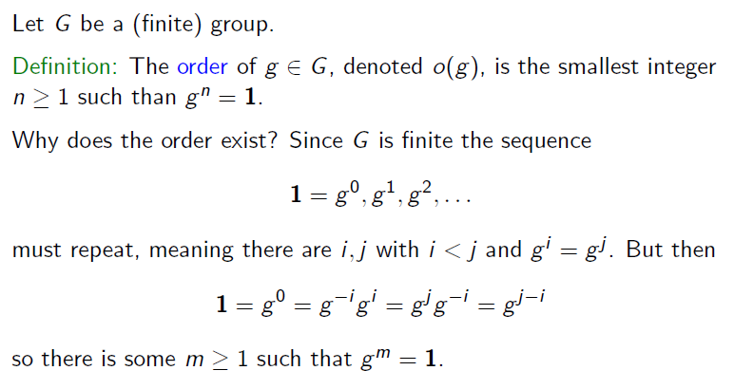
Order of a Group

Slide 45
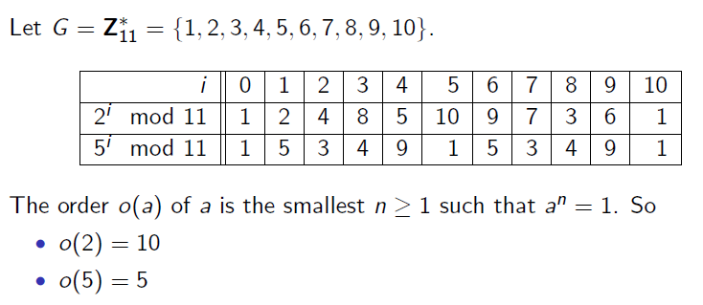
Order Determination

Slide 46
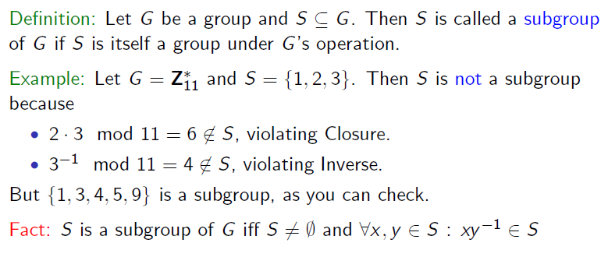
Subgroup

Slide 47
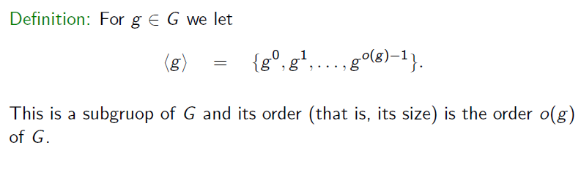
Subgroup

Slide 48
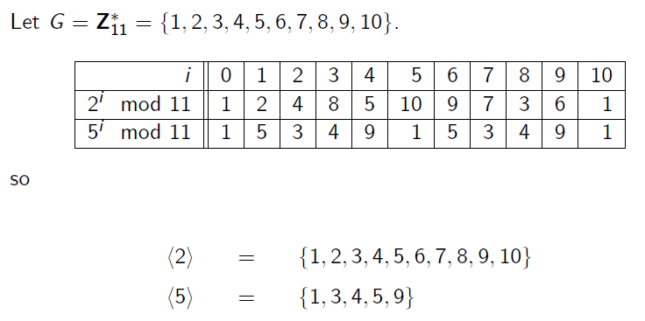
Order of Subgroup

Slide 49
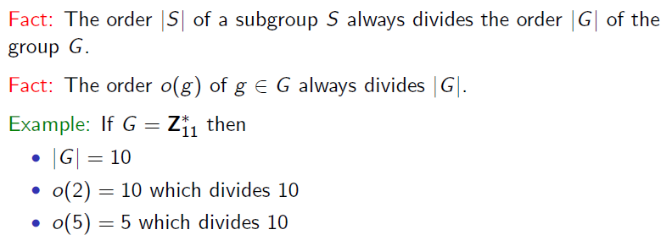
Order of Subgroup

Slide 50
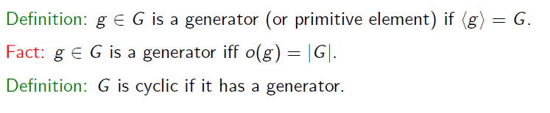
Generator

Slide 51
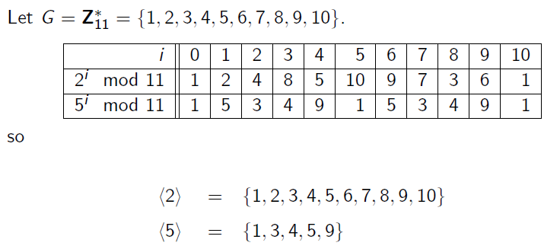
Generator

Slide 52
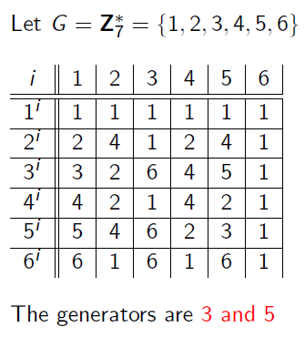
Generators

Slide 53
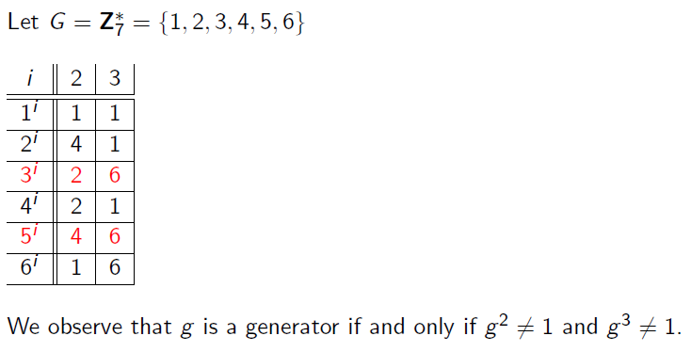
Generators

Slide 54
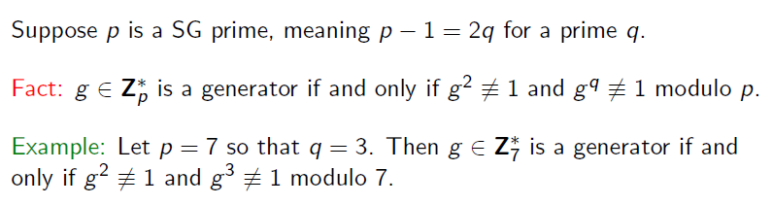
Test for a Generator

Slide 55
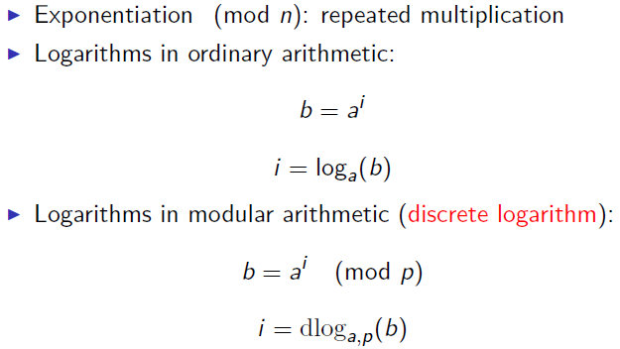
Logarithm

Slide 56
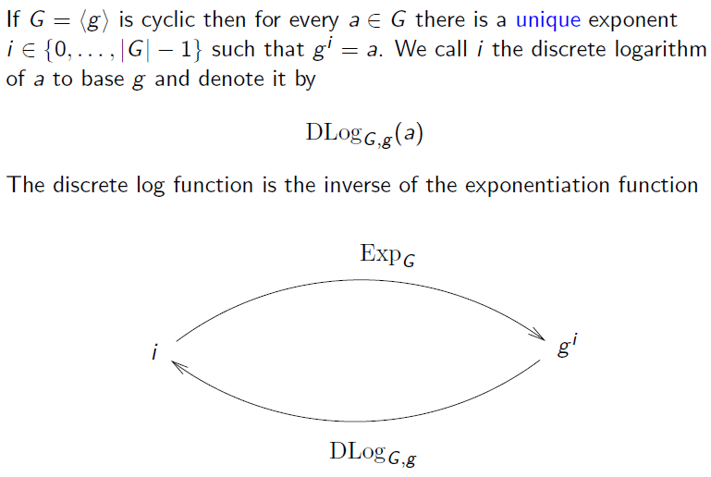
Discrete Logarithm

Slide 57
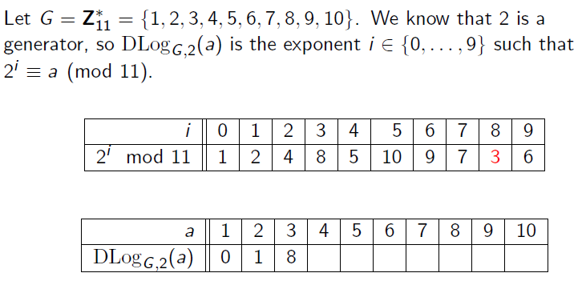
Discrete Logarithm

Slide 58
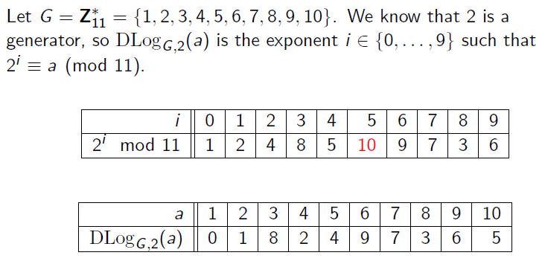
Discrete Logarithm

Slide 59
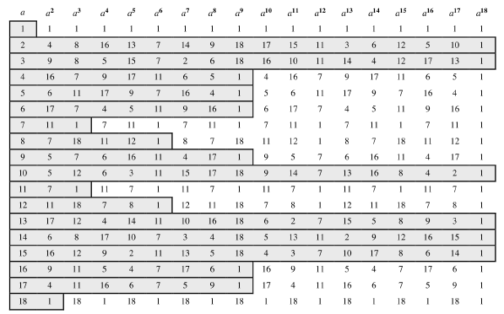
Powers of Integers (mod 19)

Slide 60
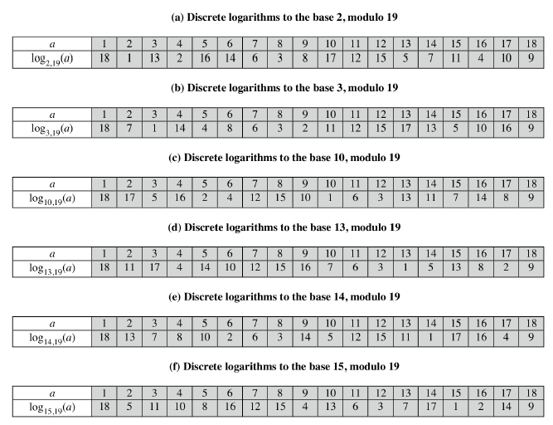
Discrete Log (mod 19)

Slide 61
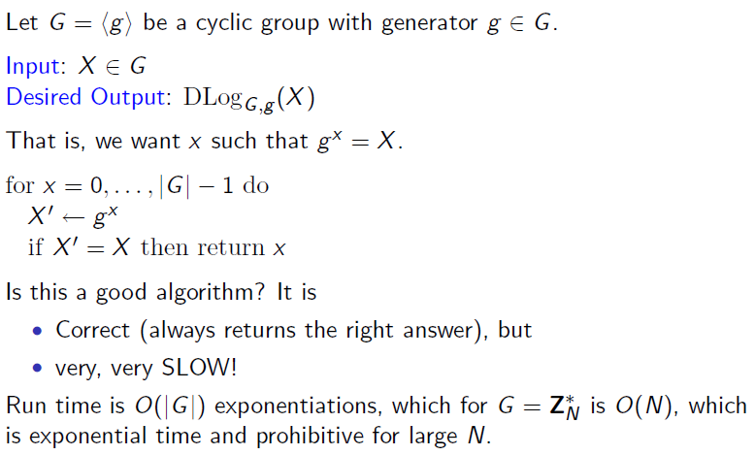
Discrete Logarithm

Slide 62
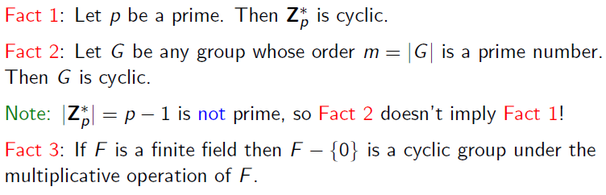
Finding Cyclic Groups

Slide 63
The Euclidean Algorithm
By recursive use of the division algorithm, we may find the gcd of two positive integers a and b without factoring either, and the x and y in
For example, for a = 329 and b = 182, we compute
329 = 1 · 182 + 147,
182 = 1 · 147 + 35,
147 = 4 · 35 + 7,
35 = 5 · 7,
and stop when there is no remainder. The last dividend is the gcd, so in our example, gcd(329,182) = 7.

Slide 64
The Euclidean Algorithm
Now, working through the above equations backwards,
7 = 147 − 4 · 35 = 147 − 4 · (182 − 1 · 147)
= 5 · 147 − 4 · 182 = 5 · (329 − 182) − 4 · 182
= 5 · 329 − 9 · 182.

Slide 65
Check!
The numbers 7 and 23 are relatively prime and therefore there must exist integers a and b such that 7a+23b=1. Find such a pair of integers (a,b) with the smallest possible a>0

Slide 66
Check!
Solve the equation 3x+2=7 in Z19.

Slide 67
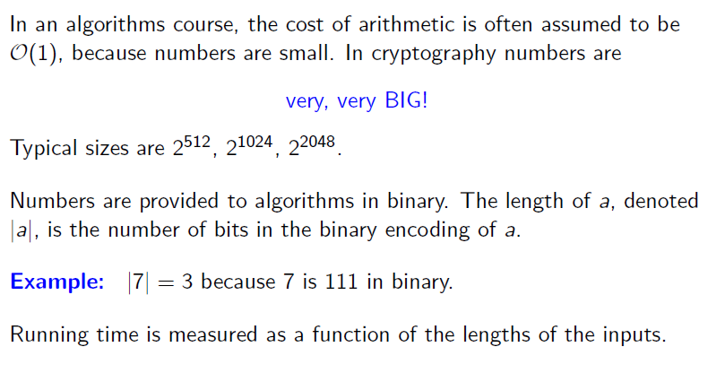
Complexity – Running Time of Algorithms

Slide 68
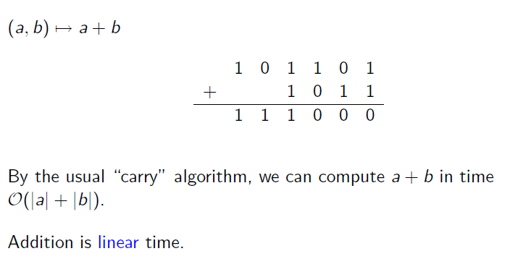
Addition

Slide 69
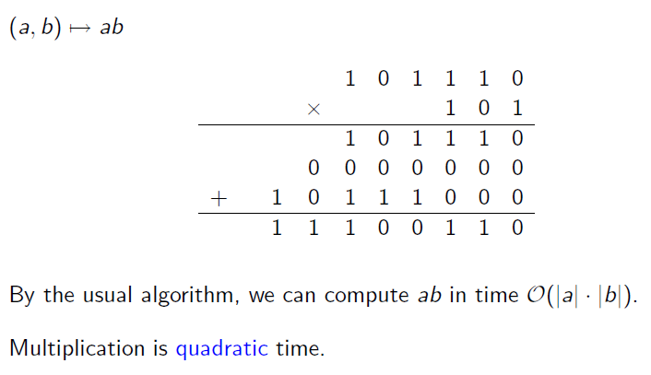
Multiplication

Slide 70
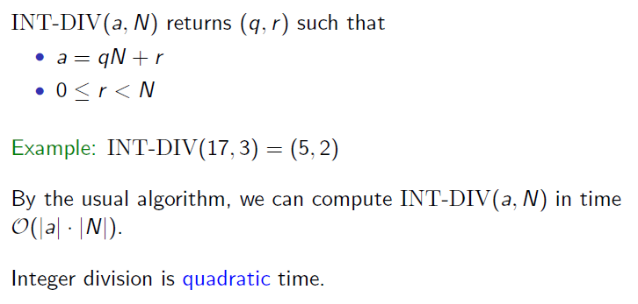
Integer Division

Slide 71
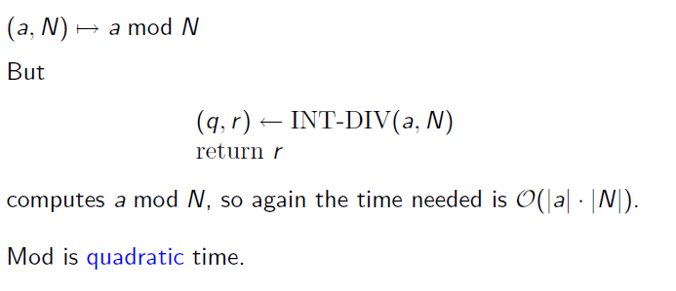
Modulo

Slide 72
Running times
Given n-bit int. N:
Addition and subtraction in Z_{N}: linear time T₊ = O(n)
Modular multiplication in Z_{N}: naively T× = O(n²)
Modular exponentiation in Z_{N} ( g^{x} ):
O( (log x)⋅T×) ≤ O( (log x)⋅n²) ≤ O( n³ )

Slide 73

Running Time

Slide 74

Complexity

Slide 75
Modular e’th roots
We know how to solve modular linear equations:
a⋅x + b = 0 in Z_{N}
Solution: x = −b⋅a⁻¹ in Z_{N}
What about higher degree polynomials?
Example: let p be a prime and c∈Z_{p} .
Can we solve:
x² – c = 0 , y³ – c = 0 , z³⁷ – c = 0 in Z_{p}

Slide 76

Modular e’th roots
Let p be a prime and c∈Z_{p} .
Def: x∈Z_{p} s.t. x^{e} = c in Z_{p} is called an e’th root of c .
Examples:
7^{1/3} = 6 in as 6^3 = 216 = 7 in
3^{1/2} = 5 in
1^{1/3} = 1 in
2^{1/2} does not exist in

Slide 77
The easy case
When does c^{1/e} in Z_{p} exist? Can we compute it efficiently?
The easy case: suppose gcd( e , p-1 ) = 1 Then for all c in (Z_{p})*: c^{1/e} exists in Z_{p} and is easy to find.
Proof: let d = e⁻¹ in Z_{p-1} . Then c^{1/e} = c^{d} in Z_{p}
d⋅e = 1 in Z_{p-1} ⇒ k in Z: d.e = k.(p-1)+1 ⇒
(c^{d} )^{e} = c^{d .e} = c^{k.(p-1)+1} = (c^{p-1})^{k} . c = c in Z_{p}
Notes:
c^(1/e) = c^d in Zp. Show that (c^d)^e = c in Zp.

Slide 78



The case e=2: square roots
x
−x
If p is an odd prime then gcd( 2, p-1) ≠ 1
Fact: in , x ⟶ x² is a 2-to-1 function
Example: in :
Def: x in is a quadratic residue (Q.R.) if it has a square root in
p odd prime ⇒ the # of Q.R. in is (p-1)/2 + 1
x²
1
10
2
9
3
8
4
7
5
6
1
4
9
5
3

Slide 79
Euler’s theorem
Thm: x in (Z_{p})* is a Q.R. ⟺ x^{(p-1)/2} = 1 in Z_{p} (p odd prime)
Example:
Note: x≠0 ⇒ x^{(p-1)/2} = (x^{p-1})^{1/2} = 1^{1/2} ∈ { 1, -1 } in Z_{p}
Def: x^{(p-1)/2} is called the Legendre Symbol of x over p (1798)
in : 1⁵, 2⁵, 3⁵, 4⁵, 5⁵, 6⁵, 7⁵, 8⁵, 9⁵, 10⁵
= 1 -1 1 1 1, -1, -1, -1, 1, -1

Slide 80
Computing square roots mod p
Suppose p = 3 (mod 4)
Lemma: if c∈(Z_{p})* is Q.R. then √c = c^{(p+1)/4} in Z_{p}
Proof: [c^{(p+1)/4}]² = c^{(p+1)/2} = c^{(p-1)/2} .c = c in Z_{p}
When p = 1 (mod 4), can also be done efficiently, but a bit harder
run time ≈ O(log³ p)
Notes:
p = 1 (mod 4) requires randomized algorithm. Mention ERH.

Slide 81
Solving quadratic equations mod p
Solve: a⋅x² + b⋅x + c = 0 in Z_{p}
Solution: x = (-b ± √b² – 4⋅a⋅c ) / 2a in Z_{p}
Find (2a)⁻¹ in Z_{p} using extended Euclid.
Find square root of b² – 4⋅a⋅c in Z_{p} (if one exists) using a square root algorithm

Slide 82
Computing e’th roots mod N ??
Let N be a composite number and e>1
When does c^{1/e} in Z_{N} exist? Can we compute it efficiently?
Answering these questions requires the factorization of N
(as far as we know)

Slide 83
Copyright Notice
The material in this presentation has been taken from text books, reference books, research literature and various sources on Internet; and compiled/edited for class room teaching at MCS-NUST without any infringement into the copyrights of the author(s). The original authors retain their respective copyrights as per their stated claims.
Commercial use of the material contained herein in full or in part through copying, publication and reproducing in any form is strictly prohibited.

