Slide 1

Applied Cryptography
ASHRAF MASOOD
dean@mcs.edu.pk
Lecture Slides– Fall 2012
Lecture #12

Slide 2
Public Key Cryptography & RSA

Slide 3
Public key encryption
Bob: generates (PK, SK) and gives PK to Alice
Alice
Bob
E
D
m
c
c
m
pk
sk
Notes:
Note: asymmetric keys

Slide 4
Applications
Session setup (for now, only eavesdropping security)
Non-interactive applications: (e.g. Email)
Bob sends email to Alice encrypted using pk_{alice}
Note: Bob needs pk_{alice} (public key management)
Alice
pk
Bob
Generate (pk, sk)
choose random x
(e.g. 48 bytes)
E(pk, x)
x

Slide 5
Public key encryption
Def: a public-key encryption system is a triple of algs. (G, E, D)
G(): randomized alg. outputs a key pair (pk, sk)
E(pk, m): randomized alg. that takes m∈M and outputs c ∈C
D(sk,c): det. alg. that takes c∈C and outputs m∈M or ⊥
Consistency: ∀(pk, sk) output by G :
∀m∈M: D(sk, E(pk, m) ) = m

Slide 6
Trapdoor functions (TDF)
Def: a trapdoor func. X⟶Y is a triple of efficient algs. (G, F, F⁻¹)
G(): randomized alg. outputs a key pair (pk, sk)
F(pk,⋅): det. alg. that defines a function X ⟶ Y
F⁻¹(sk,⋅): defines a function Y ⟶ X that inverts F(pk,⋅)
More precisely: ∀(pk, sk) output by G
∀x∈X: F⁻¹(sk, F(pk, x) ) = x

Slide 7
Secure Trapdoor Functions (TDFs)
(G, F, F⁻¹) is secure if F(pk, ⋅) is a “one-way” function:
can be evaluated, but cannot be inverted without sk
Chal.
Adv. A
(pk,sk)←G()
x ⟵ X
R
pk, y ← F(pk, x)
x’
Def: (G, F, F⁻¹) is a secure TDF if for all efficient A:
Adv_{OW} [A,F] = Pr[ x = x’ ] < negligible

Slide 8
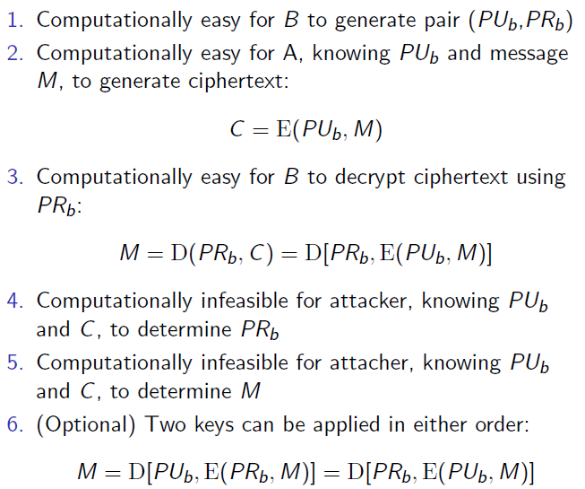
Requirements of PKE System

Slide 9
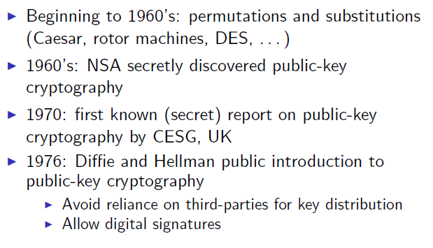
Birth of Public Key Encryption (PKE)

Slide 10
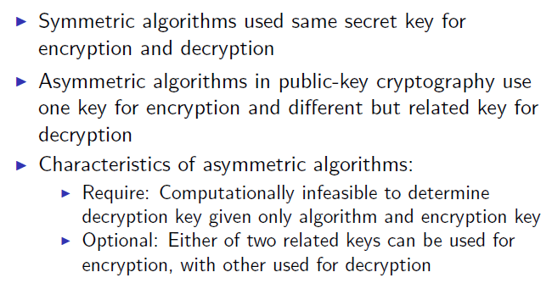
Principles of PKE

Slide 11
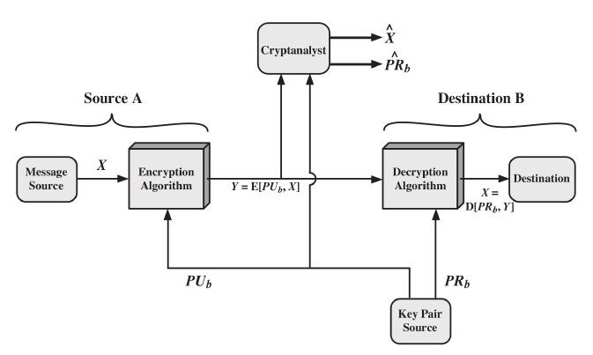
Secrecy with PKE

Slide 12
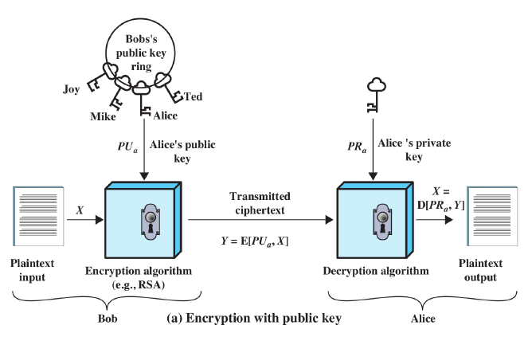
Encryption with Public Key

Slide 13
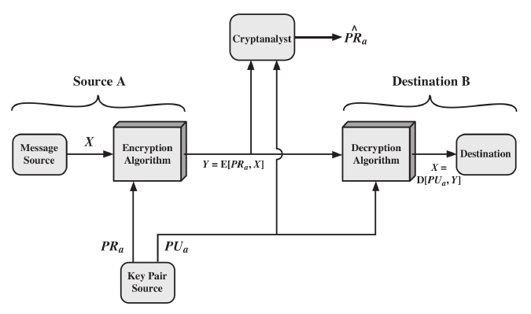
Authentication with PKE

Slide 14
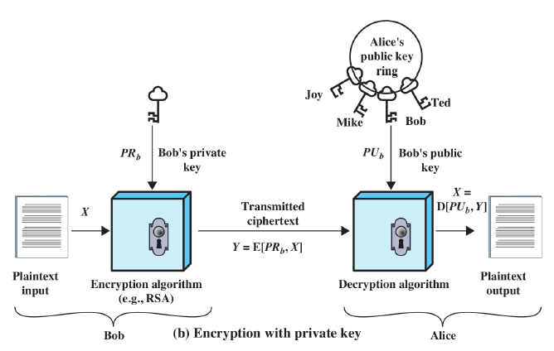
Encryption with Private Key

Slide 15
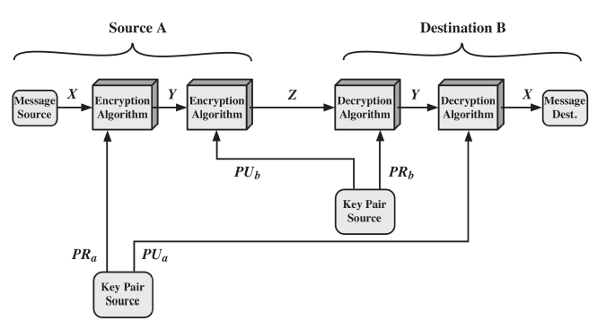
Authenticated Encryption with PKE

Slide 16
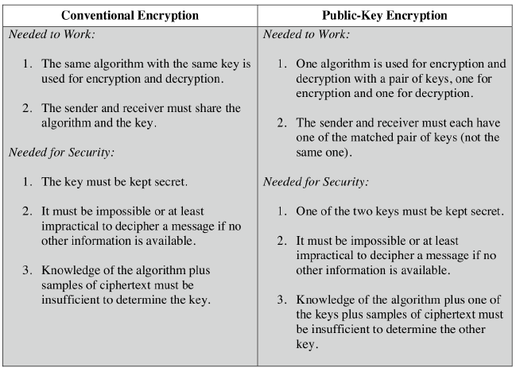
Conventional vs PKE

Slide 17
RSA
Ron Rivest, Adi Shamir and Len Adleman
Created in 1978; RSA Security sells related products
Most widely used public-key algorithm
Block cipher: plaintext and ciphertext are integers

Slide 18
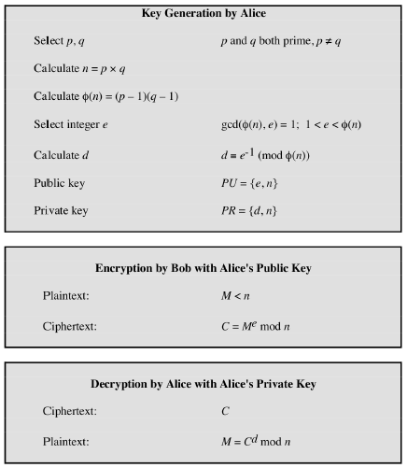
RSA Algorithm

Slide 19
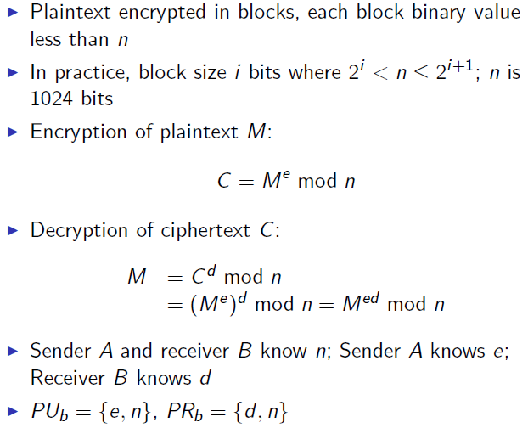
RSA Algorithm

Slide 20
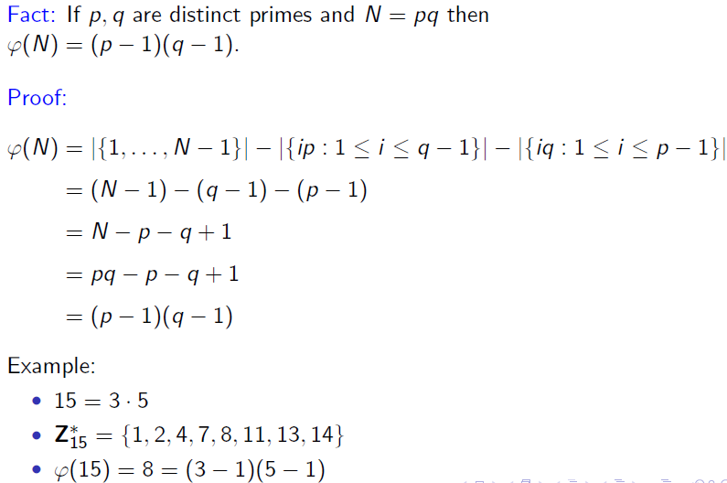
RSA Math

Slide 21
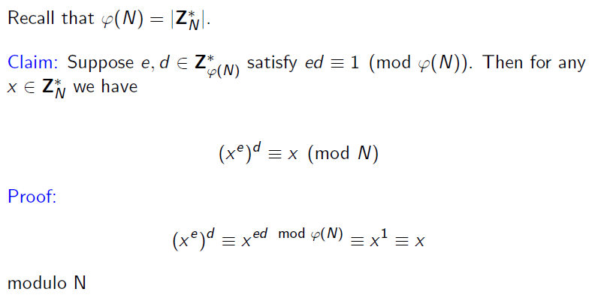
RSA Math

Slide 22
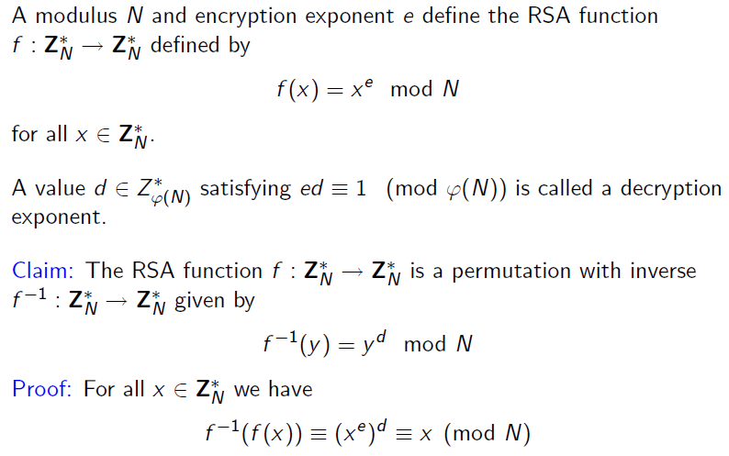
RSA Function

Slide 23
The RSA assumption
RSA assumption: RSA is one-way permutation
For all efficient algs. A:
Pr[ A(N,e,y) = y^{1/e} ] < negligible
where p,q ← n-bit primes, N←pq, y←Z_{N}*
R
R

Slide 24
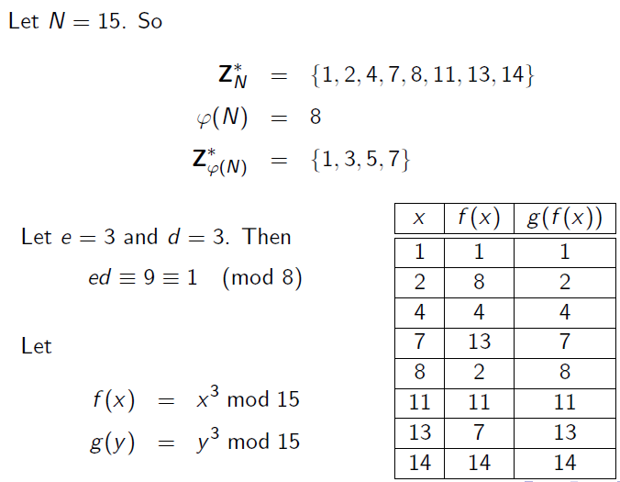
Example

Slide 25
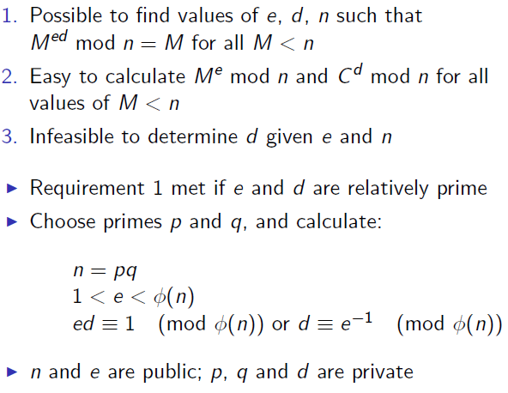
RSA Algorithm

Slide 26
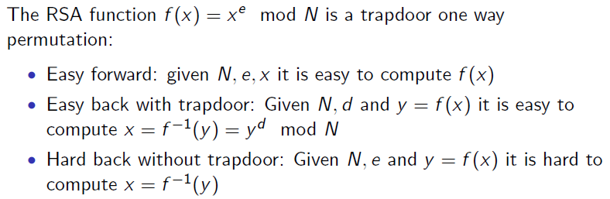
RSA Algorithm

Slide 27
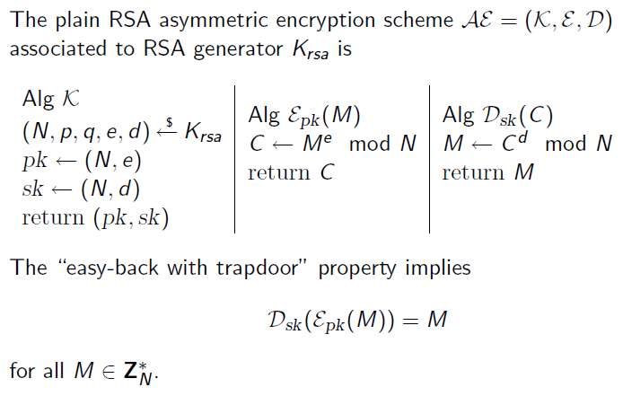
RSA Algorithm

Slide 28
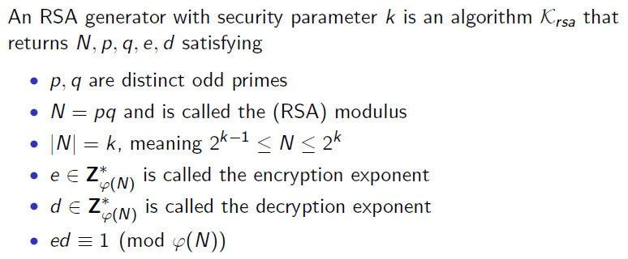
RSA Generators

Slide 29
Example
Let Bob select p = 101 and q = 113.
Then n = 11413 and φ(n) = 100 × 112 = 11200.
Since 11200 = 2⁶5²7, an integer b can be used as an encryption exponent if and only if b is not divisible by 2, 5 or 7
Suppose b = 3533.
Then a = 6597.
Publish n = 11413 and b = 3533 in a directory.
Now, suppose Alice wants to send the plaintext 9726 to Bob. She will compute and send the ciphertext 5761 over the channel. Bob uses a to compute plaintext

Slide 30
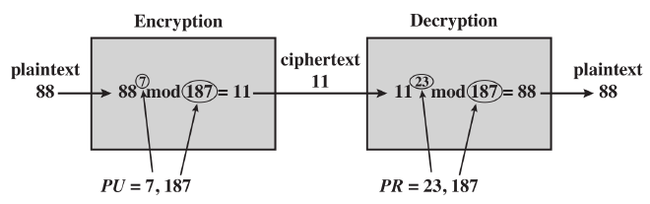
Example

Slide 31
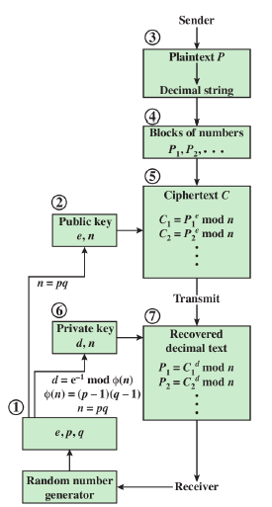
Multiple Block Encryption

Slide 32
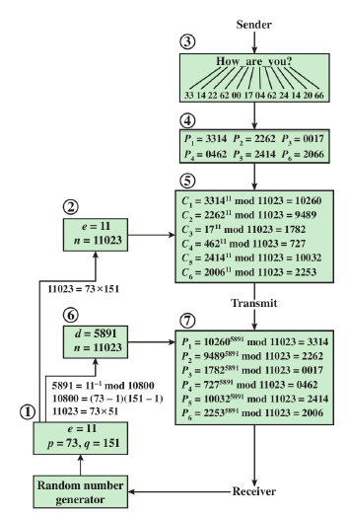
Example – Multiple Blocks

Slide 33
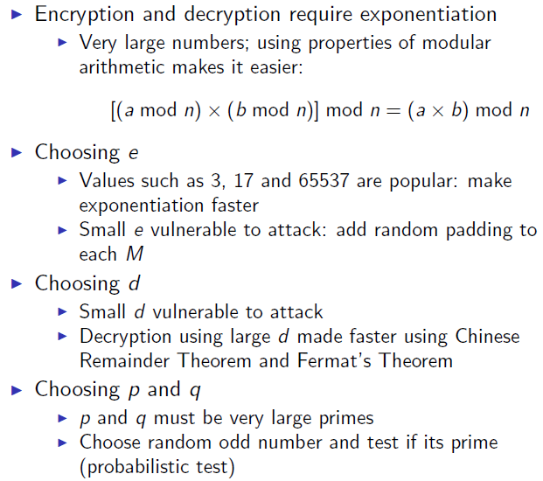
Computational Efficiency of RSA

Slide 34
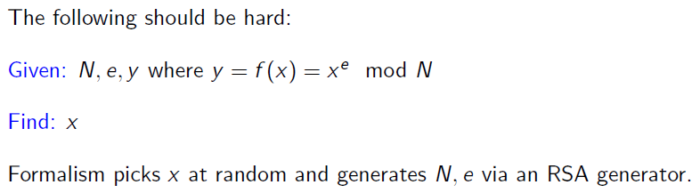
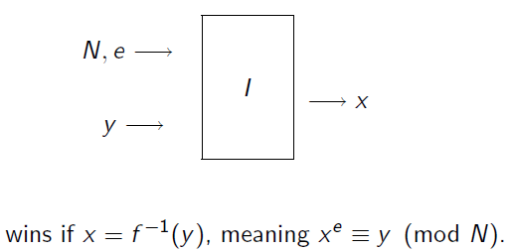
One-Wayness of RSA

Slide 35
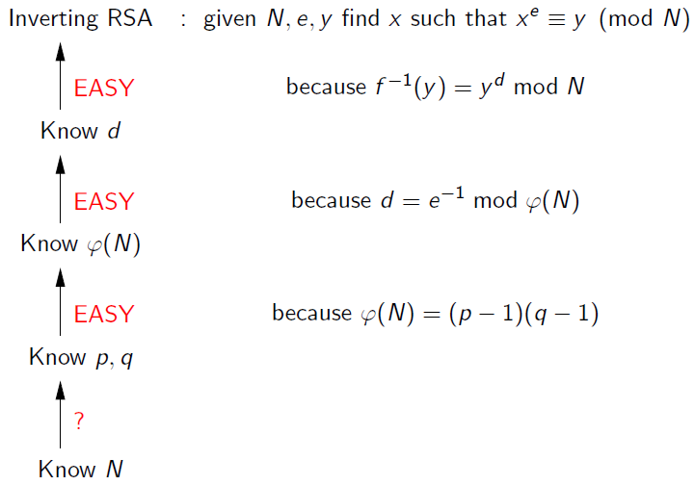
Inverting RSA

Slide 36
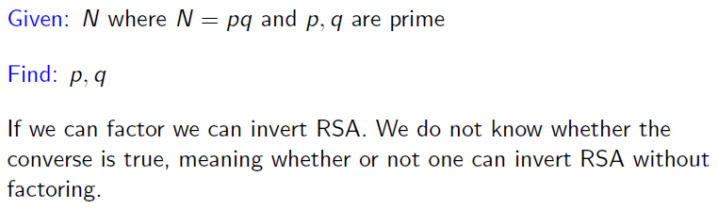
Factoring Problem

Slide 37
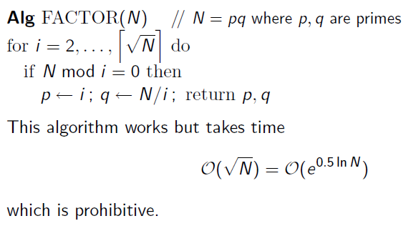
Factoring Problem

Slide 38
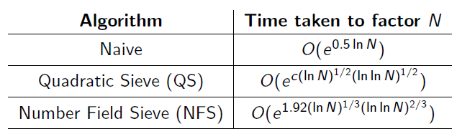
Factoring Problem

Slide 39
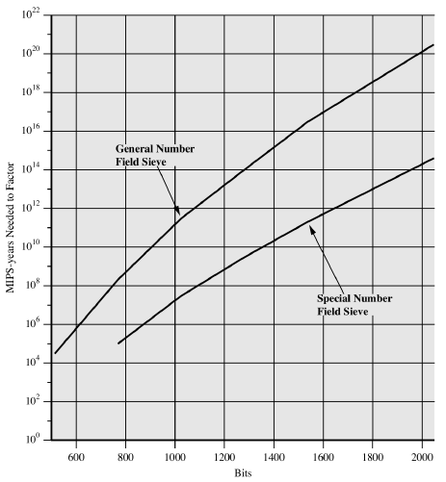
Factorization

Slide 40
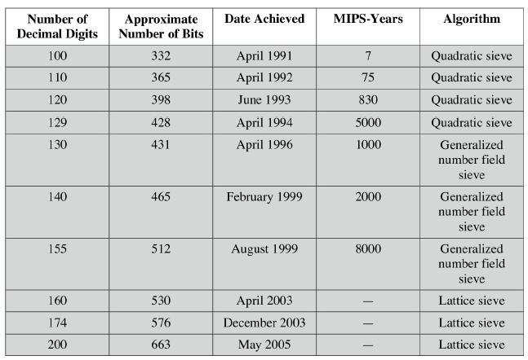
Progress in Factorization

Slide 41
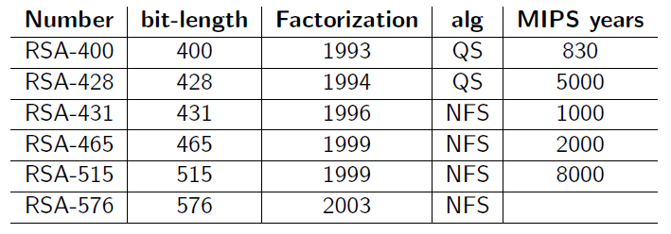
Progress in Factorization

Slide 42
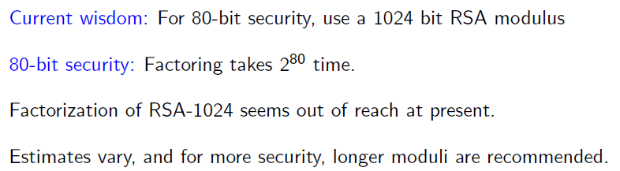
How big is Big enough!

Slide 43
Public-key encryption from TDFs
(G, F, F⁻¹): secure TDF X ⟶ Y
(E_{s}, D_{s}) : symmetric auth. encryption defined over (K,M,C)
H: X ⟶ K a hash function
We construct a pub-key enc. system (G, E, D):
Key generation G: same as G for TDF

Slide 44
Public-key encryption from TDFs
(G, F, F⁻¹): secure TDF X ⟶ Y
(E_{s}, D_{s}) : symmetric auth. encryption defined over (K,M,C)
H: X ⟶ K a hash function
E( pk, m) :
x ⟵ X, y ⟵ F(pk, x)
k ⟵ H(x), c ⟵ E_{s}(k, m)
output (y, c)
D( sk, (y,c) ) :
x ⟵ F⁻¹(sk, y),
k ⟵ H(x), m ⟵ D_{s}(k, c)
output m
R

Slide 45
In pictures:
Security Theorem:
If (G, F, F⁻¹) is a secure TDF, (E_{s}, D_{s}) provides auth. enc. and H: X ⟶ K is a “random oracle” then (G,E,D) is CCA^{ro} secure.
F(pk, x)
E_{s}( H(x), m )
header
body
Notes:
Need to explain what is a random oracle. NEVER encrypt m directly with RSA.

Slide 46
Incorrect use of a Trapdoor Function (TDF)
Never encrypt by applying F directly to plaintext:
Problems:
Deterministic: cannot be semantically secure !!
Many attacks exist (next segment)
E( pk, m) :
output c ⟵ F(pk, m)
D( sk, c ) :
output F⁻¹(sk, c)

Slide 47
Copyright Notice
The material in this presentation has been taken from text books, reference books, research literature and various sources on Internet; and compiled/edited for class room teaching at MCS-NUST without any infringement into the copyrights of the author(s). The original authors retain their respective copyrights as per their stated claims.
Commercial use of the material contained herein in full or in part through copying, publication and reproducing in any form is strictly prohibited.

