Slide 1

Applied Cryptography
ASHRAF MASOOD
dean@mcs.edu.pk
Lecture Slides– Fall 2012
Lecture #12

Slide 2
Public Key Cryptography & RSA

Slide 3
Public key encryption
Bob: generates (PK, SK) and gives PK to Alice
Alice
Bob
E
D
m
c
c
m
pk
sk
Notes:
Note: asymmetric keys

Slide 4
The RSA trapdoor permutation
First published: Scientific American, Aug. 1977.
Very widely used:
SSL/TLS: certificates and key-exchange
Secure e-mail and file systems
… many others

Slide 5

The RSA trapdoor permutation
G(): choose random primes p,q ≈1024 bits. Set N=pq.
choose integers e , d s.t. e⋅d = 1 (mod ϕ(N) )
output pk = (N, e) , sk = (N, d)
F( pk, x ): ; RSA(x) = x^{e} (in Z_{N})
F⁻¹( sk, y) = y^{d} ; y^{d} = RSA(x)^{d} = x^{ed} = x^{kϕ(N)+1} = (x^{ϕ(N)})^{k} ⋅ x = x

Slide 6
Review: arithmetic mod composites
Let N = p⋅q where p,q are prime
Z_{N} = {0,1,2,…,N-1} ; (Z_{N})* = {invertible elements in Z_{N}}
Facts: x ∈ Z_{N} is invertible ⇔ gcd(x,N) = 1
Number of elements in (Z_{N})* is ϕ(N) = (p-1)(q-1) = N-p-q+1
Euler’s thm: ∀ x∈ (Z_{N})* : x^{ϕ(N)} = 1
Notes:
A random element in Z_N is *very* likely to be in Z_N^*

Slide 7
Review: RSA pub-key encryption (ISO std)
(E_{s}, D_{s}): symmetric enc. scheme providing auth. encryption.
H: Z_{N} → K where K is key space of (E_{s},D_{s})
G(): generate RSA params: pk = (N,e), sk = (N,d)
E(pk, m): (1) choose random x in Z_{N}
(2) y ← RSA(x) = x^{e} , k ← H(x)
(3) output (y , E_{s}(k,m) )
D(sk, (y, c) ): output D_{s}( H(RSA⁻¹ (y)) , c)
Notes:
AE-secure: the scheme provides Authenticated Encryption.
Resulting system is chosen ciphertext secure (in the random oracle model).

Slide 8
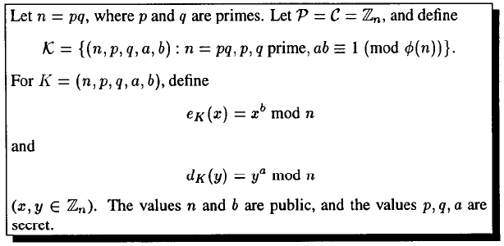
RSA Cryptosystem

Slide 9
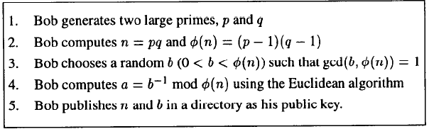
Implementing RSA

Slide 10
Example
Let Bob select p = 101 and q = 113.
Then n = 11413 and φ(n) = 100 × 112 = 11200.
Since 11200 = 2⁶5²7, an integer b can be used as an encryption exponent if and only if b is not divisible by 2, 5 or 7
Suppose b = 3533.
Then a = 6597.
Publish n = 11413 and b = 3533 in a directory.
Now, suppose Alice wants to send the plaintext 9726 to Bob. She will compute and send the ciphertext 5761 by computing 5761=9726³⁵³³ mod 11413
Bob uses a to compute plaintext by
9726=5761⁶⁵⁹⁷ mod 11413

Slide 11
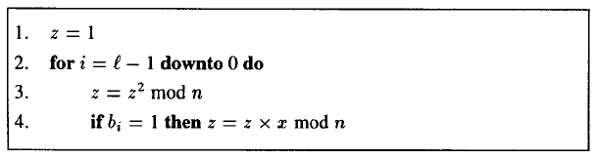
Square & Multiply Algorithm

Slide 12
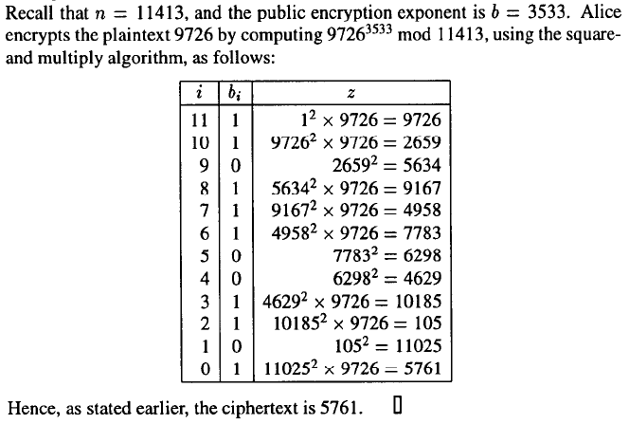
Example: Square & Multiply Algorithm

Slide 13
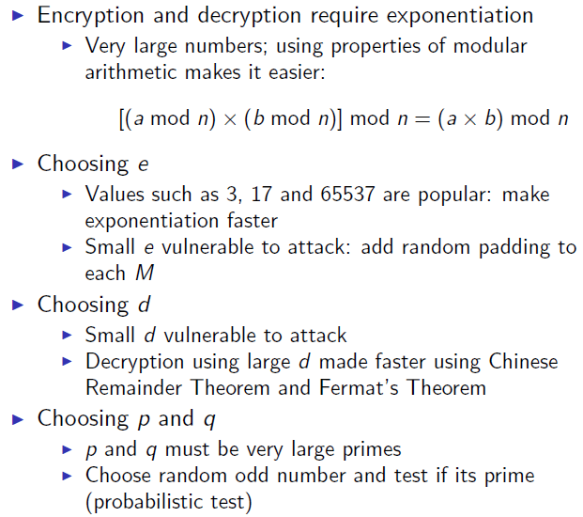
Computational Efficiency of RSA

Slide 14
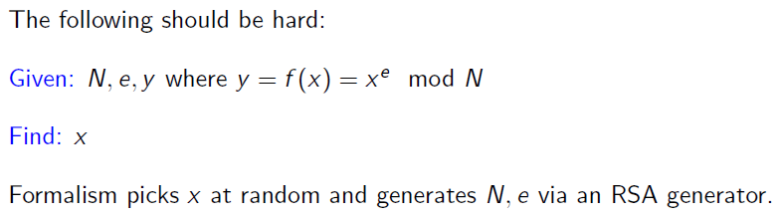
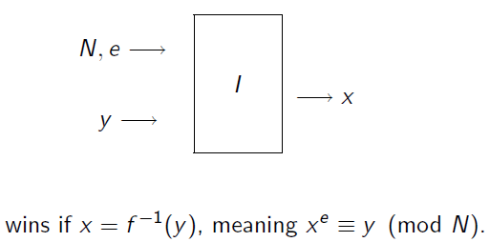
One-Wayness of RSA

Slide 15
The RSA assumption
RSA assumption: RSA is one-way permutation
For all efficient algs. A:
Pr[ A(N,e,y) = y^{1/e} ] < negligible
where p,q ← n-bit primes, N←pq, y←Z_{N}*
R
R

Slide 16
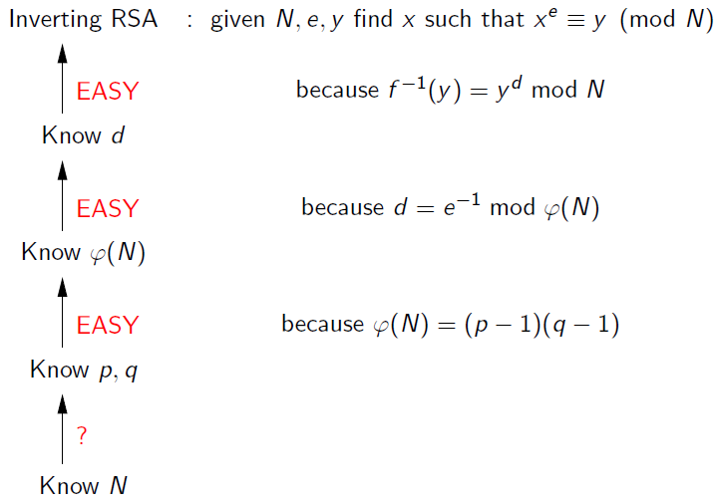
Inverting RSA

Slide 17
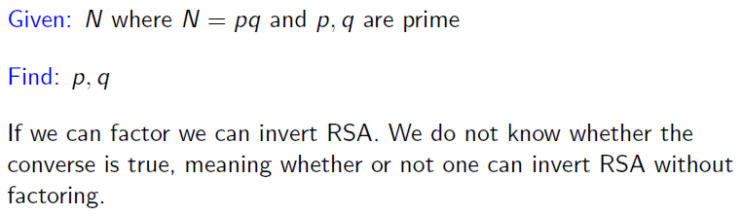
Factoring Problem

Slide 18
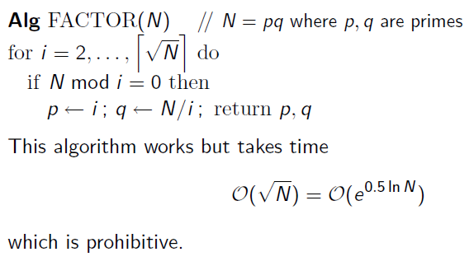
Factoring Problem

Slide 19
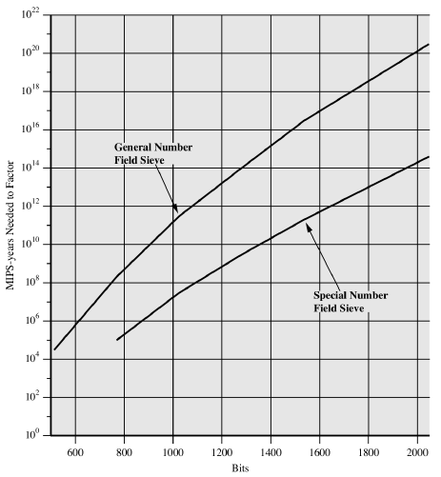
Factorization

Slide 20
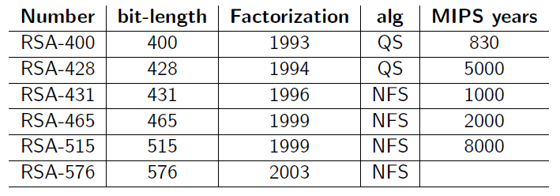
Progress in Factorization

Slide 21
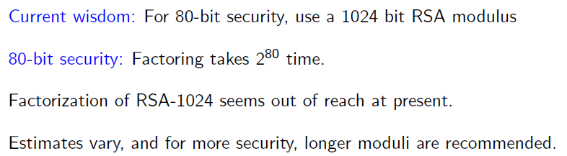
How big is Big enough!

Slide 22
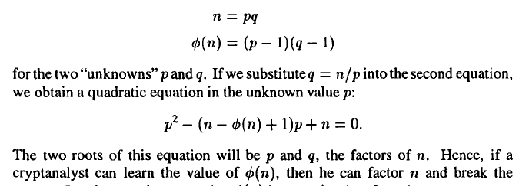
Inverting RSA through ф(n)

Slide 23
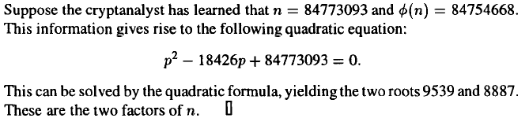
Example: Inverting RSA through ф(n)

Slide 24
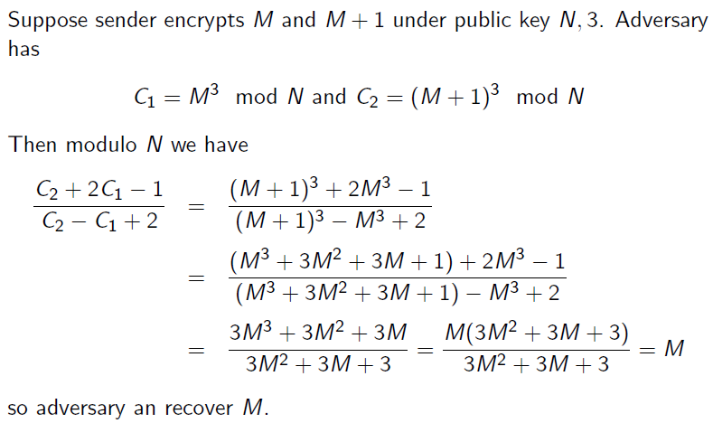
RSA Insecurity

Slide 25
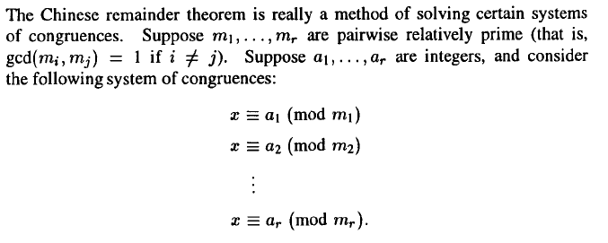
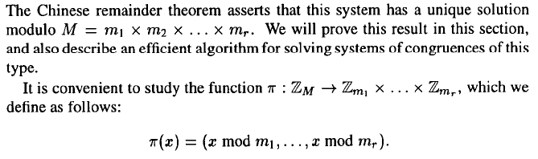
Chinese Remainder Theorem (P)

Slide 26
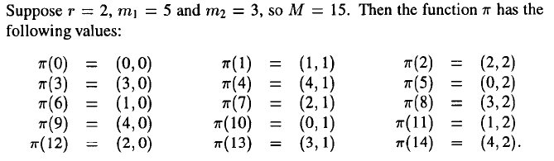
Example: Chinese Remainder Theorem (P)

Slide 27
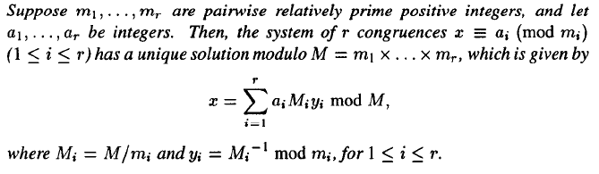
Chinese Remainder Theorem

Slide 28
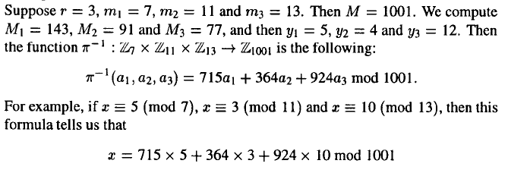
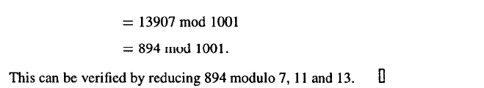
Example: Chinese Remainder Theorem

Slide 29

Exercise!

Slide 30
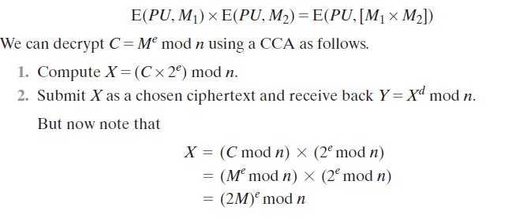
Another Attack

Slide 31
A simple attack on textbook RSA
Web Browser
CLIENT HELLO
Web Server
random session-key k
SERVER HELLO (e,N)
d
c=RSA(k)
Suppose k is 64 bits: k ∈ {0,…,2⁶⁴}. Eve sees: c= k^{e} in Z_{N}
If k = k₁⋅k₂ where k₁, k₂ < 2³⁴ (prob. ≈20%) then c/k₁e = k₂e in Z_{N}
Step 1: build table: c/1e, c/2e, c/3e, …, c/2^{34e} . time: 2³⁴
Step 2: for k₂ = 0,…, 2³⁴ test if k₂e is in table. time: 2³⁴
Output matching (k₁, k₂). Total attack time: ≈2⁴⁰ << 2⁶⁴

Slide 32
Textbook RSA is insecure
Textbook RSA encryption:
public key: (N,e) Encrypt: c ⟵ m^{e} (in Z_{N})
secret key: (N,d) Decrypt: c^{d} ⟶ m
Insecure cryptosystem !!
Is not semantically secure and many attacks exist
⇒ The RSA trapdoor permutation is not an encryption scheme !

Slide 33
Incorrect use of a Trapdoor Function (TDF)
Never encrypt by applying F directly to plaintext:
Problems:
Deterministic: cannot be semantically secure !!
Many attacks exist
E( pk, m) :
output c ⟵ F(pk, m)
D( sk, c ) :
output F⁻¹(sk, c)

Slide 34
Active attacks: symmetric vs. pub-key
Recall: secure symmetric cipher provides authenticated encryption
[ chosen plaintext security & ciphertext integrity ]
Roughly speaking: attacker cannot create new ciphertexts
Implies security against chosen ciphertext attacks
In public-key settings:
Attacker can create new ciphertexts using pk !!
So instead: we directly require chosen ciphertext security

Slide 35
Public-key encryption from TDFs
(G, F, F⁻¹): secure TDF X ⟶ Y
(E_{s}, D_{s}) : symmetric auth. encryption defined over (K,M,C)
H: X ⟶ K a hash function
We construct a pub-key enc. system (G, E, D):
Key generation G: same as G for TDF

Slide 36
Public-key encryption from TDFs
(G, F, F⁻¹): secure TDF X ⟶ Y
(E_{s}, D_{s}) : symmetric auth. encryption defined over (K,M,C)
H: X ⟶ K a hash function
E( pk, m) :
x ⟵ X, y ⟵ F(pk, x)
k ⟵ H(x), c ⟵ E_{s}(k, m)
output (y, c)
D( sk, (y,c) ) :
x ⟵ F⁻¹(sk, y),
k ⟵ H(x), m ⟵ D_{s}(k, c)
output m
R

Slide 37
In pictures:
Security Theorem:
If (G, F, F⁻¹) is a secure TDF,
then (E_{s}, D_{s}) provides auth. enc.
F(pk, x)
E_{s}( H(x), m )
header
body
Notes:
Need to explain what is a random oracle. NEVER encrypt m directly with RSA.

Slide 38
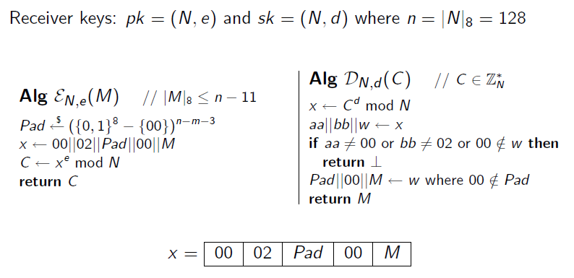
PKCS-1

Slide 39
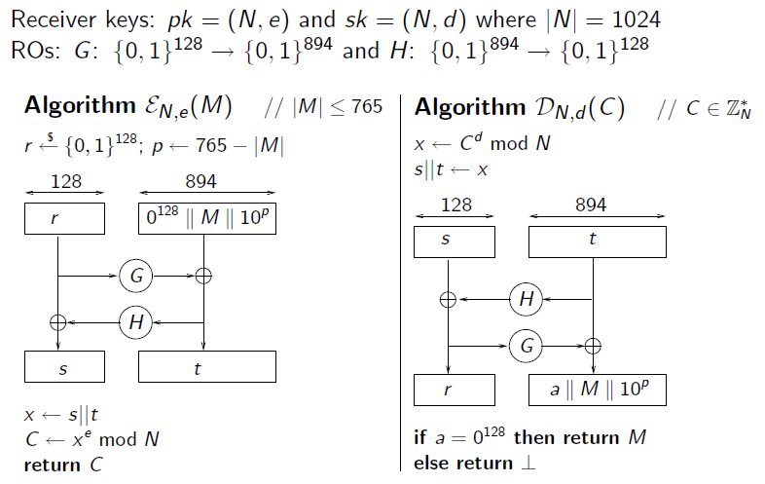
OAEP

Slide 40
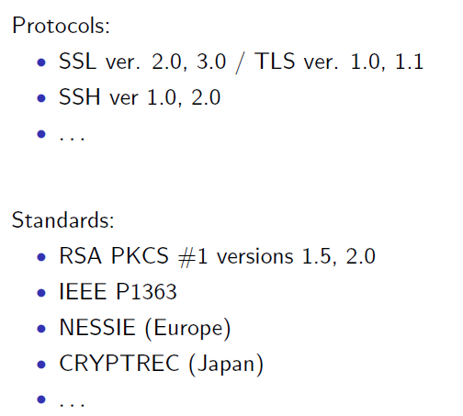
OAEP Applications

Slide 41
Public Key Cryptography & EL-GAMAL

Slide 42
DH Key Exchange Protocol
Goal: Alice and Bob want shared secret, unknown to eavesdropper
For now: security against eavesdropping only (no tampering)
Alice
Bob
eavesdropper ??
Can this be done with an exponential gap?

Slide 43
The Diffie-Hellman protocol (informally)
Fix a large prime p (e.g. 600 digits)
Fix an integer g in {1, …, p}
Alice
Bob
choose random a in {1,…,p-1}
choose random b in {1,…,p-1}
“Alice”, A = gª (mod p)
“Bob”, B = g^{b} (mod p)
Bª (mod p) = (g^{b})ª
(gª)^{b} = A^{b} (mod p)
k_{AB} = g^{ab} (mod p)
Notes:
“Alice”, A = ga (mod p) ; “Bob”, B = gb (mod p)

Slide 44
Security (much more on this later)
Eavesdropper sees: p, g, A=gª (mod p), and B=g^{b} (mod p)
Can she compute g^{ab} (mod p) ??
More generally: define DH_{g}(gª, g^{b}) = g^{ab} (mod p)
How hard is the DH function mod p?

Slide 45
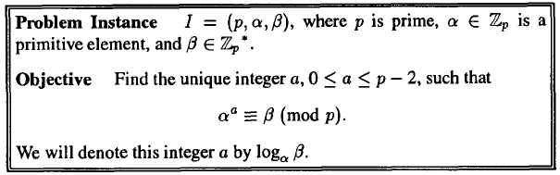
Dlog Problem

Slide 46

How hard is the DH function mod p?
Suppose prime p is n bits long.
Best known algorithm (GNFS): run time exp( )
cipher key size modulus size
80 bits 1024 bits
128 bits 3072 bits
256 bits (AES) 15360 bits

Slide 47
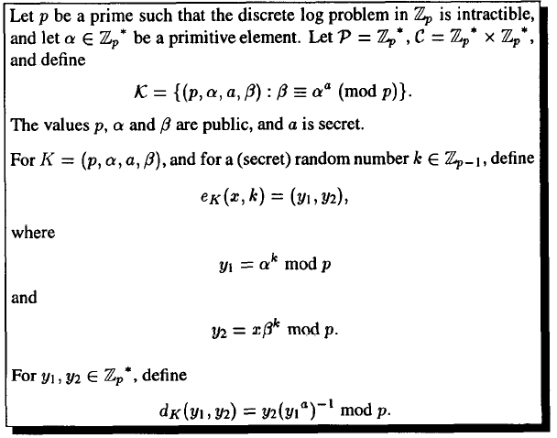
El-Gamal Cryptosystem

Slide 48
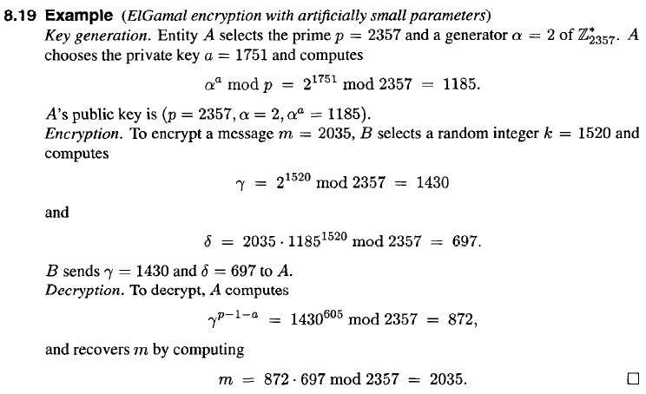
Example: ElGamal Encryption

Slide 49
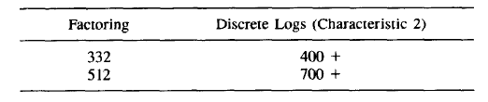
Estimated Comparative Bitlength Security

Slide 50
Assignment #4
Following problems from Stinson
4.1-4.6
4.9
5.4

Slide 51
Copyright Notice
The material in this presentation has been taken from text books, reference books, research literature and various sources on Internet; and compiled/edited for class room teaching at MCS-NUST without any infringement into the copyrights of the author(s). The original authors retain their respective copyrights as per their stated claims.
Commercial use of the material contained herein in full or in part through copying, publication and reproducing in any form is strictly prohibited.

