Slide 1

Applied Cryptography
ASHRAF MASOOD
dean@mcs.edu.pk
Lecture Slides– Fall 2012
Lecture #5

Slide 2
Information Theoretic Security (Shannon 1949)
Definition: A cipher (E,D) over (K,M,C) has perfect secrecy if
∀m₀, m₁ ∈M ( |m₀| = |m₁| ) and ∀c∈C
Pr[ E(k,m₀)=c ] = Pr[ E(k,m₁)=c ] where k ⟵K
R

Slide 3
Information Theoretic Security (Shannon 1949)
Definition: A cipher (E,D) over (K,M,C) has perfect secrecy if
∀m₀, m₁ ∈M ( |m₀| = |m₁| ) and ∀c∈C
Pr[ E(k,m₀)=c ] = Pr[ E(k,m₁)=c ] where k ⟵K
Given CT, adversary can’t tell whether m₀ or m₁ is encrypted (∀m₀, m₁ ∈M)
Most powerful adversary can’t learn anything from CT about PT
No CT only attack !! (Others attacks may be possible)
R

Slide 4
Review
Cipher over (K,M,C): a pair of “efficient” algs (E, D) s.t.
∀ m∈M, k∈K: D(k, E(k, m) ) = m
Weak ciphers: subs. cipher, Vigener, …
A good cipher: OTP M=C=K={0,1}^{n}
E(k, m) = k ⊕ m , D(k, c) = k ⊕ c
Lemma: OTP has perfect secrecy (i.e. no CT only attacks)
Bad news: perfect-secrecy ⇒ key-len ≥ msg-len

Slide 5
Stream Ciphers: Making OTP practical
idea: replace “random” key by “pseudorandom” key
Notes:
State PRG syntax

Slide 6
Stream Ciphers: Making OTP practical
Stream ciphers cannot have perfect secrecy !!
Need a different definition of security
Security will depend on specific PRG
Notes:
No more perfect secrecy

Slide 7
PRG must be unpredictable!
Notes:
Define unpredictability

Slide 8
PRG must be unpredictable!
We say that G: K ⟶ {0,1}^{n} is predictable if:
Def: PRG is unpredictable if it is not predictable
⇒ ∀i: no “eff” adv. can predict bit (i+1) for “non-neg” ε

Slide 9
Negligible and non-negligible
In practice: ε is a scalar and
ε non-neg: ε ≥ 1/2³⁰ (likely to happen over 1GB of data)
ε negligible: ε ≤ 1/2⁸⁰ (won’t happen over life of key)

Slide 10
PRG Construction
Linear Congruential generators
Linear Feedback Shift Registers
Non-Linear feedback Shift Registrers

Slide 11
LCG
Linear congruential generator with parameters a,b,p
Example:
Seed r[0]
r[i] = a.r[i-1]+b mod p
output r[i]
i++
For p=7, a=5, b=1, 1, 6, 3, 2, 4, 0
For p=8, a=5, b=1, 1, 6, 7, 4, 5, 2,3,0 (period 8)
For p=8, a=4, b=2, 2, 2, 2, 2, 2, 2,2,2 (period 1)
For p=8, a=2, b=1, 1, 3, 7, 7, 7 (period 3)

Slide 12
Working Assignment
Build a linear congruential generator (LCG) with following parameters.
a=106
b= 1283
m=6075
A starting point (seed) of your own choice
Generate a sequence of at least 50 consecutive numbers.
Try to crack this generator!
i.e., find generator parameters

Slide 13
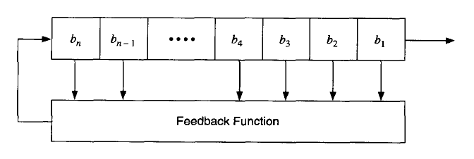
Feedback Shift Register
Linear Feedback Shift Register (LFSR) or Non-linear Feedback Shift Register (NLFSR) is defined by Feedback Function

Slide 14

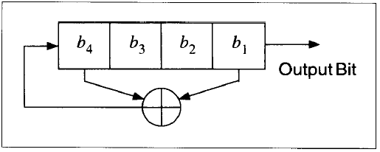


4-Bit LFSR
b(i) = (b(i-1) + b(i-4)) mod 2 (feedback)
The output sequence is:

Slide 15
Computing LFSR Output Sequences
Let be a linear shift register of length m with initial state vector and recurrence relation
Then the entire output sequence can be determined from any 2m consecutive output bits of this sequence, provided that

Slide 16
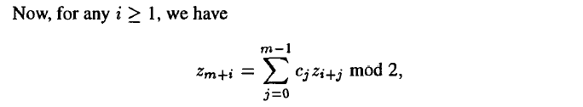
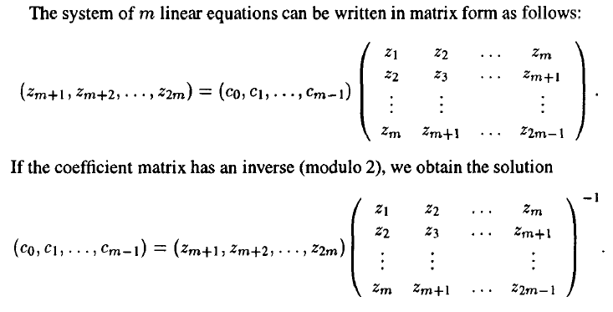
Computing LFSR Output Sequences

Slide 17

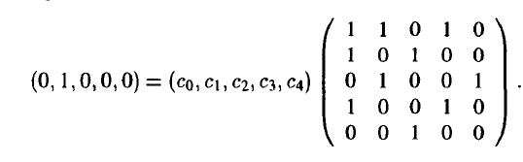
Example: Computing LFSR Output Sequences
The output stream of a 5-bit LFSR is:

Slide 18
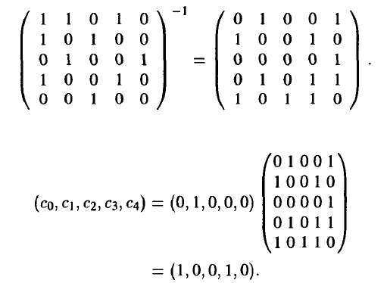

Example: Computing LFSR Output Sequences (2)

Slide 20
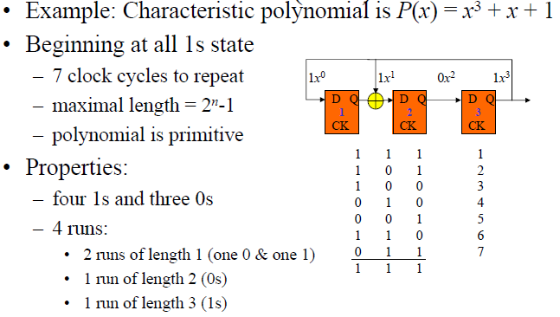
LFSR

Slide 21
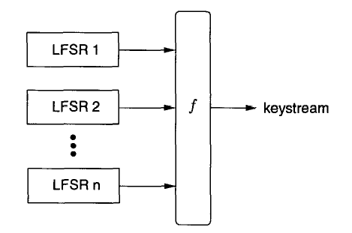
LFSR based Stream Ciphers

Slide 22
LFSR based Stream Ciphers
Three general Methodologies for destroying the linearity properties of LFSRs are following
Nonlinear combining function on the outputs of several LFSRs
Filtering function on the contents of a single LFSR and
one (or more) LFSRs to control the clock of one (or more) other LFSRs

Slide 23

Old example (software): RC4 (1987)
2048 bits
128 bits
1 byte
per round
seed
Used in HTTPS and WEP
Weaknesses:
Bias in initial output: Pr[ 2nd byte = 0 ] = 2/256
Prob. of (0,0) is 1/256² + 1/256³
Related key attacks

Slide 24
Old example (hardware): CSS (badly broken)
Linear feedback shift register (LFSR):
DVD encryption (CSS): 2 LFSRs
GSM encryption (A5/1,2): 3 LFSRs
Bluetooth (E0): 4 LFSRs
all broken

Slide 25
CSS (2¹⁷ time attack)
8
For
all possible initial settings of 17-bit LFSR do:
Run 17-bit LFSR to get 20 bytes of output
Subtract from CSS prefix ⇒ candidate 20 bytes output of 25-bit LFSR
If consistent with 25-bit LFSR, found correct initial settings of both !!
Using key, generate entire CSS output
17-bit LFSR
⊕
encrypted movie
+ (mod 256)
8
prefix
25-bit LFSR
8
CSS prefix

Slide 26
Modern stream ciphers: eStream
PRG: {0,1}^{s} × R ⟶ {0,1}^{n}
Nonce: a non-repeating value for a given key.
E(k, m ; r) = m ⊕ PRG(k ; r)
The pair (k,r) is never used more than once.

Slide 27
eStream: Salsa 20 (SW+HW)
Salsa20: {0,1} ¹²⁸ ^{or 256} × {0,1}⁶⁴ ⟶ {0,1}^{n} (max n = 2⁷³ bits)
Salsa20( k ; r) := H( k , (r, 0)) ll H( k , (r, 1)) ll …
h: invertible function. designed to be fast on x86 (SSE2)
τ₀ k τ₁ r i τ₂ k τ₃
kr
i
⊕
64 byte
output
h
(10 rounds)
32 bytes
64 bytes
64 bytes

Slide 28
Is Salsa20 secure (unpredictable) ?
Unknown: no known provably secure PRGs
In reality: no known attacks better than exhaustive search

Slide 29
Performance: Crypto++ 5.6.0 [ Wei Dai ]
AMD Opteron, 2.2 GHz ( Linux)
PRG Speed (MB/sec)
RC4 126
Salsa20/12 643
Sosemanuk 727
eStream

Slide 30
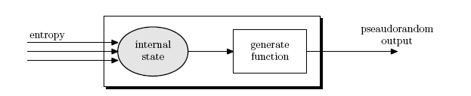
Generating Randomness (e.g. keys, IV)
Pseudo random generators in practice: (e.g. /dev/random)
Continuously add entropy to internal state
Entropy sources:
Hardware RNG: Intel RdRand inst. (Ivy Bridge). 3Gb/sec.
Timing: hardware interrupts (keyboard, mouse)
NIST SP 800-90: NIST approved generators

Slide 31
PRG Security Definition

Slide 32
Let G:K ⟶ {0,1}^{n} be a PRG
Goal: define what it means that
[ k ← K, output G(k)]
is “indistinguishable” from
[ r ← {0,1}^{n} , output r]
{0,1}^{n}
G(k)

Slide 33
Statistical Tests
Statistical test on {0,1}^{n}:
an alg. A s.t. A(x) outputs “0” or “1”
0: Not random
1: Random
Examples:
A(x)=1 iff | #0(x) - #1(x) | ≤ 10. √n
A(x)=1 iff | #00(x) - #n/4 | ≤ 10. √n
A(x)=1 iff max-run-of 0(x) ≤ 10. log2 (n)
…
…
…
Notes:
|#0-#1| < 10 sqrt(n), |#00 – n/4| < 10 sqrt{n}

Slide 34
Advantage
Let G:K ⟶{0,1}^{n} be a PRG and A a stat. test on {0,1}^{n}
Define:
Adv_{PRG} [A,G] = | Pr[ A(G(k))=1] - Pr[ A(r)=1 ] | є [0,1]
Advantage close to 1 => A can distinguish G from random
Advantage close to 0 => A cannnot distinguish G from random
Notes:
Advantage is in [0,1]. (o – good, 1 – bad) Old definition using statistics tests: Simple statistical tests.

Slide 35
Example
Suppose G:K ⟶{0,1}^{n} satisfies msb(G(k)) = 1 for 2/3 of keys in K Define stat. test A(x) as:
if [ msb(x)=1 ] output “1” else output “0”
Then
Adv_{PRG} [A,G] = | Pr[ A(G(k))=1] - Pr[ A(r)=1 ] | =
| 2/3 – 1/2 | = 1/6

Slide 36
Secure PRGs: crypto definition
Def: We say that G:K ⟶{0,1}^{n} is a secure PRG if
For every “Efficient” statistical test A:
Adv_{PRG} [A,G] is “negligible”
Are there provably secure PRGs?
but we have heuristic candidates
.
Notes:
Mention that can’t prove secure PRGs exist since that would imply P \neq NP.

Slide 37
Easy fact: a secure PRG is unpredictable
We show: PRG predictable ⇒ PRG is insecure
Suppose A is an efficient algorithm s.t.
Pr _{k ← K} [A(G(k)|_{1,…,i}) = G(k)|_{i+1}} > ½ +ε
for non-negligible ε (e.g. ε = 1/1000)
Notes:
Give examples of distinguishers.

Slide 38
Easy fact: A secure PRG is unpredictable
Define statistical test B as:
B(x) = if A(X|_{1,…,i}) = X|_{i+1} output 1
else output 0
r ← {0,1}^{n} Pr{B(r)=1} =1/2
k ← K Pr[B(G(k))=1] > ½+ ε
Adv_{PRG} [B,G] = | Pr[ B(r)=1] - Pr[ B(G(k))=1 ] | > ε
Notes:
Give examples of distinguishers.

Slide 39
Thm (Yao’82): an unpredictable PRG is secure
Let G:K ⟶{0,1}^{n} be PRG
“Thm”:
if ∀ i ∈ {0, … , n-1} PRG G is unpredictable at pos. i
then G is a secure PRG.
If next-bit predictors cannot distinguish G from random then no statistical test can !!
Notes:
Give examples of distinguishers.

Slide 40
Let G:K ⟶{0,1}^{n} be a PRG such that
from the last n/2 bits of G(k)
it is easy to compute the first n/2 bits.
Is G predictable for some i ∈ {0, … , n-1} ?
Yes
No

Slide 41
More Generally!
Let P₁ and P₂ be two distributions over {0,1}^{n}
Def: We say that P₁ and P₂ are computationally indistinguishable (denoted P₁ ≈_{p} P₂ )
If for all “efficient” statistical tests A:
|Pr _{x ← P1} [A() = 1] - Pr _{x ← P2} [A(X)|=1] | < “negligible”
Example: a PRG is secure if { k ⟵K : G(k) } ≈_{p} uniform({0,1}^{n})
R

Slide 42
Sample Questions
Let G:{0,1}^{s} →{0,1}^{n} be a secure PRG.
G′((k1,k2)=G(k1)∥G(k2) (here ∥ denotes concatenation)
G′(k)=G(k) ∥ 0
G′(k)=G(k)∥G(k)

Slide 43
Semantic Security

Slide 44
Recall Shannon’s perfect secrecy
Let (E,D) be a cipher over (K,M,C)
(E,D) has perfect secrecy if ∀ m₀, m₁ ∈ M ( |m₀| = |m₁| )
{ E(k,m₀) } = { E(k,m₁) } where k⟵K
(E,D) has perfect secrecy if ∀ m₀, m₁ ∈ M ( |m₀| = |m₁| )
{ E(k,m₀) } ≈_{p} { E(k,m₁) } where k⟵K
… but also need adversary to exhibit m₀, m₁ ∈ M explicitly

Slide 45
Semantic Security (one-time key)
For b=0,1 define experiments EXP(0) and EXP(1) as:
for b=0,1: W_{b} := [ event that EXP(b)=1 ]
Adv_{SS}[A,E] := | Pr[ W₀ ] − Pr[ W₁ ] | ∈ [0,1]
b
Chal.
m₀ , m₁ ∈ M : |m₀| = |m₁|
Adv. A
k←K
c ← E(k, m_{b})
b’ ∈ {0,1}

Slide 46
Semantic Security (one-time key)
Def: E is semantically secure if for all efficient A Adv_{SS}[A,E] is negligible.
⇒ for all explicit m₀ , m₁ ∈ M : { E(k,m₀) } ≈_{p} { E(k,m₁) }

Slide 47
Examples
Suppose efficient A can always deduce LSB of PT from CT.
⇒ E = (E,D) is not semantically secure.
b∈{0,1}
m₀, LSB(m₀)=0
m₁, LSB(m₁)=1
Chal.
Adv. B (us)
k←K
C← E(k, m_{b})
C
Adv. A
(given)
LSB(m_{b})=b
Then Adv_{SS}[B, E] = | Pr[ EXP(0)=1 ] − Pr[ EXP(1)=1 ] |= |0 – 1| = 1
Notes:
The same holds for any predicate P for which you can construct m0,m1 efficiently.

Slide 48
Examples
Suppose efficient A can always deduce LSB of PT from CT.
⇒ E = (E,D) is not semantically secure.
b∈{0,1}
m₀, LSB(m₀)=0
m₁, LSB(m₁)=1
Chal.
Adv. B (us)
k←K
C← E(k, m_{b})
C
Adv. A
(given)
LSB(m_{b})=b
Then Adv_{SS}[B, E] = | Pr[ EXP(0)=1 ] − Pr[ EXP(1)=1 ] |= |0 – 1| = 1
Notes:
The same holds for any predicate P for which you can construct m0,m1 efficiently.

Slide 49
OTP is semantically secure
EXP(0):
Chal.
m₀ , m₁ ∈ M : |m₀| = |m₁|
Adv. A
k←K
c ← k⊕m₀
b’ ∈ {0,1}
identical distributions
Chal.
m₀ , m₁ ∈ M : |m₀| = |m₁|
Adv. A
EXP(1):
k←K
c ← k⊕m₁
b’ ∈ {0,1}
For all A: Adv_{SS}[A,OTP] = | Pr[ A(k⊕m₀)=1 ] − Pr[ A(k⊕m₁)=1 ] |= 0

Slide 50
OTP is semantically secure
EXP(0):
Chal.
m₀ , m₁ ∈ M : |m₀| = |m₁|
Adv. A
k←K
c ← k⊕m₀
b’ ∈ {0,1}
identical distributions
Chal.
m₀ , m₁ ∈ M : |m₀| = |m₁|
Adv. A
EXP(1):
k←K
c ← k⊕m₁
b’ ∈ {0,1}
For all A: Adv_{SS}[A,OTP] = | Pr[ A(k⊕m₀)=1 ] − Pr[ A(k⊕m₁)=1 ] |= 0

Slide 51
Sample Questions
Let (E,D) be a (one-time) semantically secure cipher where the message and ciphertext space is {0,1}^{n}. Which of the following encryption schemes are (one-time) semantically secure
E′((k, x)=reverse E(k,x)
E′(k,x)=E(k,x) ∥ LSB(x) (here ∥ denotes concatenation)
E′(k, x)=E(0^{n}, x)

Slide 52
Stream ciphers are semantically secure
Thm: G:K ⟶{0,1}^{n} is a secure PRG ⇒ stream cipher E derived from G is sem. sec.
∀ sem. sec. adversary A , ∃a PRG adversary B s.t.
Adv_{SS}[A,E] ≤ 2 ∙ Adv_{PRG}[B,G]
Notes:
B has about the same running time as A.

Slide 53
Proof: intuition
m₀ , m₁
m₀ , m₁
chal.
adv. A
chal.
≈_{p}
adv. A
c ← m₀ ⊕ G(k)
c ← m₀ ⊕ r
k←K
r←{0,1}^{n}
b’≟1
b’≟1
≈_{p}
m₀ , m₁
m₀ , m₁
chal.
adv. A
≈_{p}
chal.
adv. A
c ← m₁ ⊕ G(k)
c ← m₁ ⊕ r
k←K
r←{0,1}^{n}
b’≟1
b’≟1

Slide 54
Proof: Let A be a sem. sec. adversary.
For b=0,1: W_{b} := [ event that b’=1 ].
Adv_{SS}[A,E] = | Pr[ W₀ ] − Pr[ W₁ ] |
Chal.
m₀ , m₁ ∈ M : |m₀| = |m₁|
Adv. A
b
k←K
c ← m_{b} ⊕ G(k)
r←{0,1}^{n}
b’ ∈ {0,1}
Notes:
The same holds for any predicate P for which you can construct m0,m1 efficiently.

Slide 55
Proof: Let A be a sem. sec. adversary.
For b=0,1: W_{b} := [ event that b’=1 ]. Adv_{SS}[A,E] = | Pr[ W₀ ] − Pr[ W₁ ] |
For b=0,1: R_{b} := [ event that b’=1 ]
Chal.
m₀ , m₁ ∈ M : |m₀| = |m₁|
Adv. A
b
k←K
c ← m_{b} ⊕ r
r←{0,1}^{n}
b’ ∈ {0,1}
Notes:
The same holds for any predicate P for which you can construct m0,m1 efficiently.

Slide 56
Proof: Let A be a sem. sec. adversary.
Adv_{SS}[A,OTP] = 0
Claim 1: |Pr[R₀] – Pr[R₁]| = Adv_{PRG}[B,G] for b=0,1
Claim 2: ∃B: |Pr[W_{b}] – Pr[R_{b}]| =
Adv_{PRG}[B,G] Adv_{PRG}[B,G]
⇒ Adv_{SS}[A,E] = |Pr[W₀] – Pr[W₁]| ≤ 2 ∙ Adv_{PRG}[B,G]
0
Pr[W₀]
Pr[R_{b}]
Pr[W₁]
1

Slide 57
Proof of claim 2: ∃B: |Pr[W₀] – Pr[R₀]| = Adv_{PRG}[B,G]
Algorithm B:
Adv_{PRG}[B,G] = | Pr_{r←{0,1}}^{n}[B(r) =1] – Pr _{k←K}[B(G(k))=1]|
= |Pr[R₀] – Pr[W₀]|
y ∈ {0,1}^{n}
PRG adv. B (us)
m₀, m₁
Adv. A
(given)
c ← m₀⊕y
b’ ∈ {0,1}

Slide 58
Block Ciphers
Next Lecture
PRF
Machine Ciphers
Block Ciphers construction (esp DES)

Slide 59
Copyright Notice
The material in this presentation has been taken from text books, reference books, research literature and various sources on Internet; and compiled/edited for class room teaching at MCS-NUST without any infringement into the copyrights of the author(s). The original authors retain their respective copyrights as per their stated claims.
Commercial use of the material contained herein in full or in part through copying, publication and reproducing in any form is strictly prohibited.

