Slide 1

Applied Cryptography
ASHRAF MASOOD
dean@mcs.edu.pk
Lecture Slides– Fall 2012
Lecture #5

Slide 2
Block Ciphers
Block Ciphers construction (Fiestal Network)
Data Encryption Standard
Attacks
Security of Block Ciphers

Slide 3
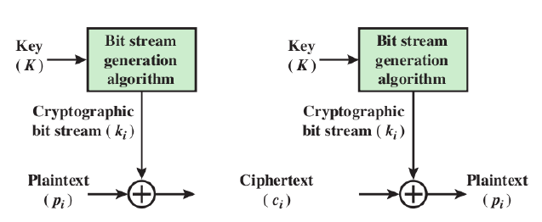
Stream Ciphers
Encrypts a digital data stream one bit or one byte at a Time
One time pad is example; but practical limitations
Typical approach for stream cipher:
Key (K) used as input to bit-stream generator algorithm
Algorithm generates cryptographic bit stream (ki ) used to encrypt plaintext
Users share a key; use it to generate keystream

Slide 4
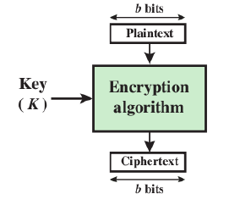
Block Ciphers
Encrypt a block of plaintext as a whole to produce same sized ciphertext
Typical block sizes are 64 or 128 bits
Modes of operation used to apply block ciphers to larger plaintexts

Slide 5
Block ciphers: crypto work horse
n bits
n bits
E, D
PT Block
CT Block
Key
k bits
Canonical examples:
DES: n= 64 bits, k = 56 bits
3DES: n= 64 bits, k = 168 bits
AES: n=128 bits, k = 128, 192, 256 bits

Slide 6
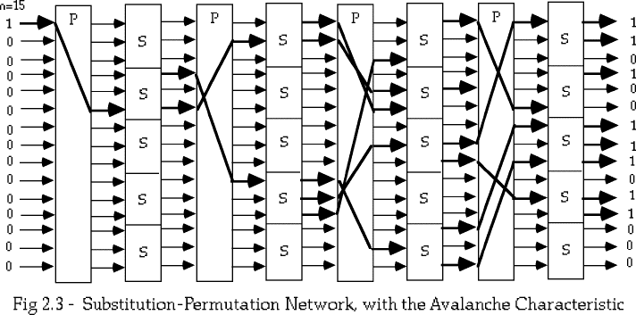
Motivation
In 1949, Claude Shannon also introduced the idea of substitution-permutation (S-P) networks which form the basis of modern block ciphers
S-P networks are based on the two primitive cryptographic operations: substitution (S-box) & permutation (P-box)
provide confusion and diffusion of message

Slide 7
Diffusion
Statistical nature of plaintext is reduced in ciphertext e.g., A plaintext letter affects the value of many ciphertext letters
How: repeatedly apply permutation (transposition) to data, and then apply function

Slide 8
Confusion
Make relationship between ciphertext and key as complex as possible
Even if attacker can find some statistical characteristics of ciphertext, still hard to find key
How: apply complex (non-linear) substitution algorithm

Slide 9
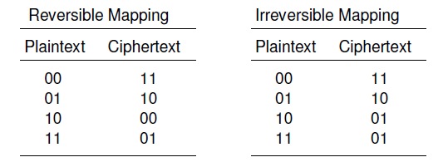
Reversible & Irreversible Mappings
n-bit block cipher takes n bit plaintext and produces n bit ciphertext
2^n possible different plaintext blocks
Encryption must be reversible (decryption possible)
Each plaintext block must produce unique ciphertext block
Total transformations are (2^n)!

Slide 10
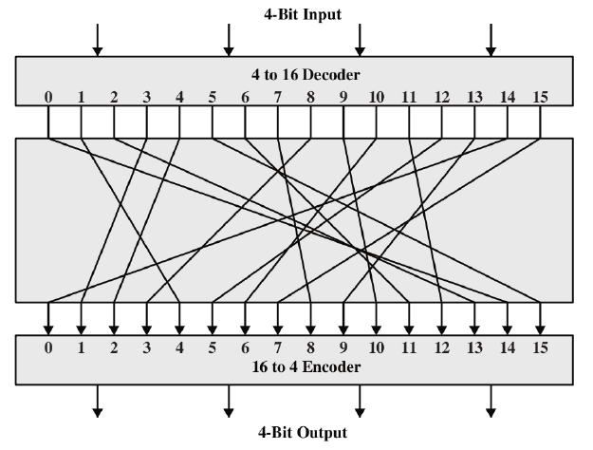
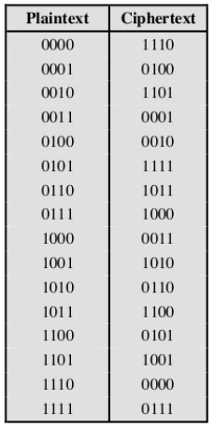
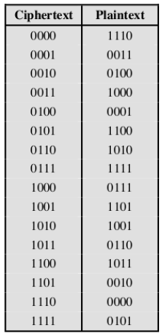
General Block Substitution

Slide 11
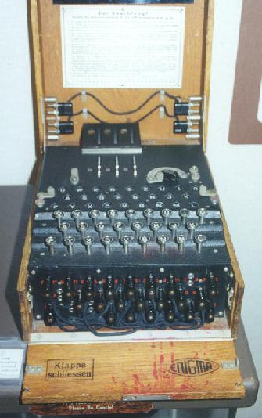
Enigma

Slide 12
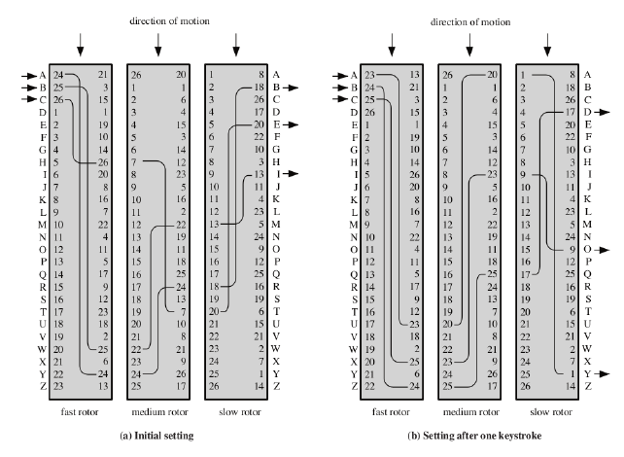
Rotor Machine

Slide 13
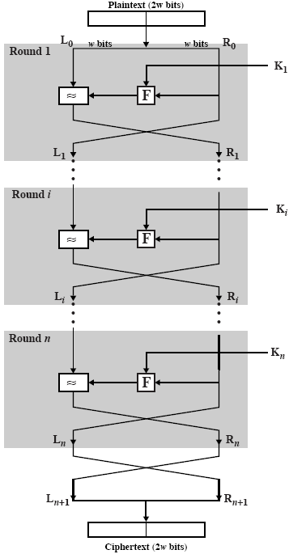
Fiestal Structure
Feistel proposed applying two or more simple ciphers in sequence so final result is cryptographically stronger than component ciphers
n-bit block length; k-bit key length; 2k transformations
Feistel cipher alternates: substitutions, transpositions (permutations)
Applies concepts of diusion and confusion
Applied in many ciphers today
Approach:
Plaintext split into halves
Subkeys (or round keys) generated from key
Round function, F, applied to right half
Apply substitution on left half using XOR
Apply permutation: interchange to halves

Slide 14
Feistel Cipher Design Principles
Block size
increasing size improves security, but slows cipher
Key size
increasing size improves security, makes exhaustive key searching harder, but may slow cipher
Number of rounds
increasing number improves security, but slows cipher
Subkey generation
greater complexity can make analysis harder, but slows cipher
Round function
greater complexity can make analysis harder, but slows cipher
Fast software en/decryption & ease of analysis
are more recent concerns for practical use and testing

Slide 15
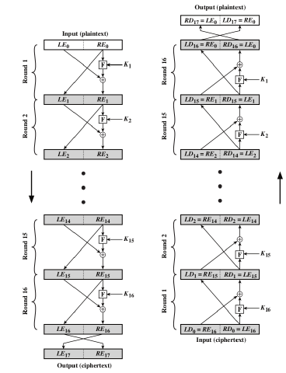
Fiestal Encryption & Decryption

Slide 16
Block Ciphers Built by Iteration
key k
key expansion
k₁
k₂
k₃
k_{n}
m
R(k₁, ⋅)
R(k₂, ⋅)
R(k₃, ⋅)
R(k_{n}, ⋅)
c
R(k,m) is called a round function
for DES (n=16), 3DES (n=48), AES-128 (n=10)

Slide 17
Performance: Crypto++ 5.6.0 [ Wei Dai ]
AMD Opteron, 2.2 GHz ( Linux)
Cipher Block/key size Speed (MB/sec)
RC4 126
Salsa20/12 643
Sosemanuk 727
3DES 64/168 13
AES-128 128/128 109
stream
block

Slide 18
The Data Encryption Standard (DES)
Early 1970s: Horst Feistel designs Lucifer at IBM
key-len = 128 bits ; block-len = 128 bits
1973: NBS asks for block cipher proposals. IBM submits variant of Lucifer.
1976: NBS adopts DES as a federal standard
key-len = 56 bits ; block-len = 64 bits
1997: DES broken by exhaustive search
2000: NIST adopts Rijndael as AES to replace DES
Widely deployed in banking and commerce

Slide 19
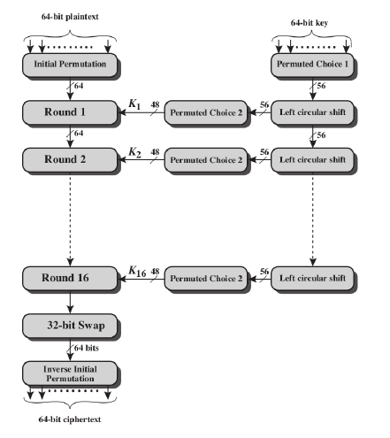
DES – General Structure

Slide 20
Input of DES
Data: need to be broken into 64-bit blocks; add pad at the last message if necessary.
e.g. X =(3 5 0 7 7 F 1 0 A B 1 2 F C 6 5)HEX
Secret key:
Any string of 64 bits long including 8 parity bits.
1 parity bit in each 8-bit byte of the key may be utilized for error detection in key generation, distribution, and storage
K=(k1…k7k8… k15k16 k17…k24…k32… k40… k48… k56… k64)
The bits k8, k16, k24, k32, k40, k48, k56, k64 can be used for parity check

Slide 21
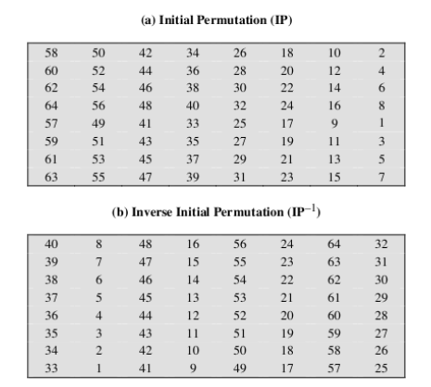
Initial Permutation (IP) & Inverse Initial Permutation (IP⁻¹)

Slide 22
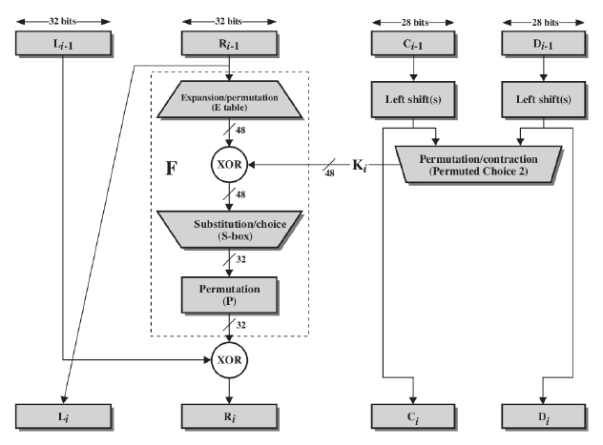
One Round of DES

Slide 23
DES Round Structure
Uses two 32-bit L & R halves
As for any Feistel cipher can describe as:
Li = Ri–1
Ri = Li–1 xor F(Ri–1, Ki)
Takes 32-bit R half and 48-bit sub-key and:
expands R to 48-bits using perm E (Transposition)
adds to subkey (Substitution)
passes through 8 S-boxes to get 32-bit result (S&T)
finally permutes this using 32-bit perm P (transposition)
Notes:
Note that the s-boxes provide the “confusion” of data and key values, whilst the permutation P then spreads this as widely as possible, so each S-box output affects as many S-box inputs in the next round as possible, giving “diffusion”.

Slide 24
DES: core idea – Feistel Network
Given functions f₁, …, f_{d}: {0,1}^{n} ⟶ {0,1}^{n}
Goal: build invertible function F: {0,1}^{2n} ⟶ {0,1}^{2n}
n-bits
R₀
R₁
R₂
R_{d-1}
R_{d}
f₁
f₂
⋯
f_{d}
L₀
L₁
L₂
L_{d-1}
L_{d}
n-bits
⊕
⊕
⊕
input
output
L_{i} = R_{i-1}
R_{i} = f_{i}(R_{i-1}) ⨁ L_{i-1}
In symbols:

Slide 25
n-bits
R₀
R₁
R₂
R_{d-1}
R_{d}
f₁
f₂
⋯
f_{d}
L₀
L₁
L₂
L_{d-1}
L_{d}
n-bits
⊕
⊕
⊕
input
output
Claim: for all f₁, …, f_{d}: {0,1}^{n} ⟶ {0,1}^{n}
Feistel network F: {0,1}^{2n} ⟶ {0,1}^{2n} is invertible
Proof: construct inverse
R_{i-1}
R_{i}
R_{i-1} = L_{i}
L_{i-1} = f_{i}(L_{i}) ⨁ R_{i}
inverse
f_{i}
L_{i-1}
L_{i}
⊕

Slide 26
n-bits
R₀
R₁
R₂
R_{d-1}
R_{d}
f₁
f₂
⋯
f_{d}
L₀
L₁
L₂
L_{d-1}
L_{d}
n-bits
⊕
⊕
⊕
input
output
Claim: for all f₁, …, f_{d}: {0,1}^{n} ⟶ {0,1}^{n}
Feistel network F: {0,1}^{2n} ⟶ {0,1}^{2n} is invertible
Proof: construct inverse
R_{i-1}
R_{i}
R_{i}
⊕
R_{i-1}
inverse
f_{i}
L_{i}
f_{i}
L_{i-1}
L_{i-1}
L_{i}
⊕

Slide 27
Decryption circuit
R_{d}
⊕
⊕
⊕
n-bits
R_{d-1}
R_{d-2}
R₁
R₀
⋯
f_{d}
f_{d-1}
f₁
L_{d}
L_{d-1}
L_{d-2}
L₁
L₀
n-bits
Inversion is basically the same circuit, with f₁, …, f_{d} applied in reverse order
General method for building invertible functions (block ciphers) from arbitrary functions.
Used in many block ciphers … but not AES

Slide 28
Security
“Thm:” (Luby-Rackoff ‘85):
f: K × {0,1}^{n} ⟶ {0,1}^{n} a secure PRF
⇒ 3-round Feistel F: K³ × {0,1}^{2n} ⟶ {0,1}^{2n} a secure PRP
R₀
R₁
R₂
R₃
f
f
f
L₀
L₁
L₂
L₃
⊕
⊕
⊕
input
output

Slide 29
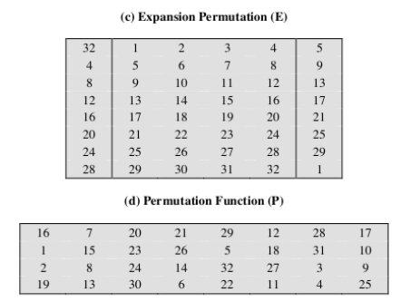
Permutation Tables

Slide 30
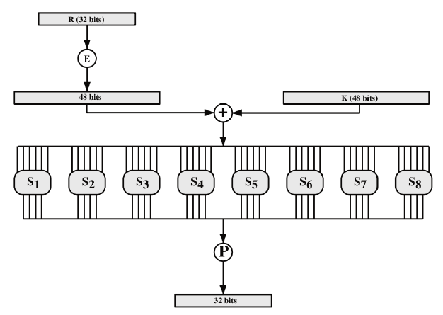
F(K[48],R[32])

Slide 31
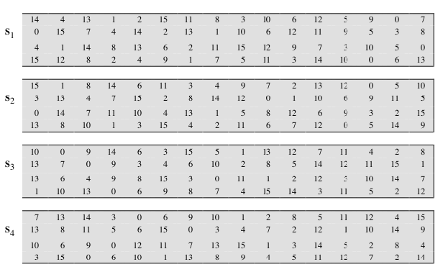
DES S-Boxes

Slide 32
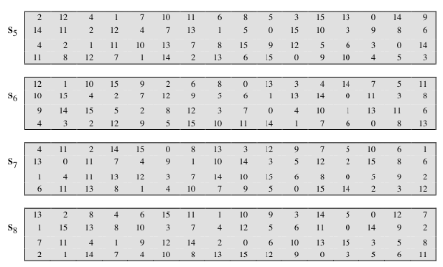
DES S-Boxes

Slide 33
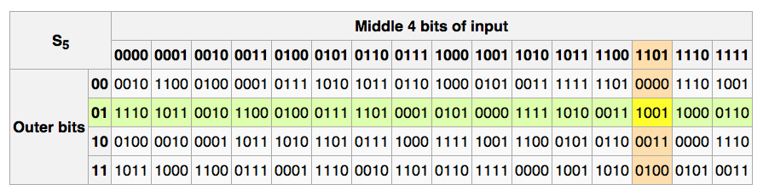
The S-boxes
S_{i}: {0,1}⁶ ⟶ {0,1}⁴

Slide 34
Key Schedule
64-bit Secret key
64 bits of secret key are input to the key generator, 8 parity bits are removed; So, DES key has only 56 bits
Objective: use these 56 bits to generate a different 48 bit sub-key for each round of DES
PC1 is a P box where 8 parity bits are removed with input of 64 bits key
56-bit output of PC1 is split into two 28-bit keys which is input into shift registers C and D
PC2 is also a P box which ignores certain input bits and permutes to a 48-bit sub-key
PC1 (64⇒56)
C (28-bit)
D (28-bit)
PC2 (56⇒48)
48-bit sub-key

Slide 35
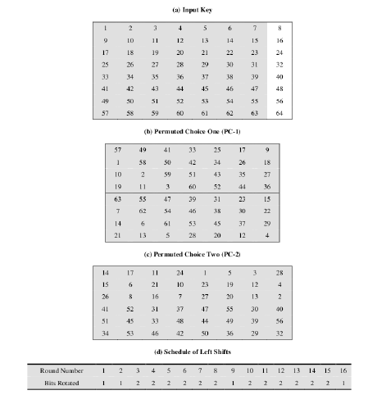
DES Key Schedule

Slide 36
Generating subkeys used in each round
consists of:
initial permutation of the key (PC1) which selects 56-bits in two 28-bit halves
16 stages consisting of:
selecting 24-bits from each half
permuting them by PC2 for use in function f,
rotating each half separately either 1 or 2 places depending on the key rotation schedule K
Notes:
The 56 bit key size comes from security considerations as we know now. It was big enough so that an exhaustive key search was about as hard as the best direct attack (a form of differential cryptanalysis called a T-attack, known by the IBM & NSA researchers), but no bigger. The extra 8 bits were then used as parity (error detecting) bits, which makes sense given the original design use for hardware communications links. However we hit an incompatibility with simple s/w implementations since the top bit in each byte is 0 (since ASCII only uses 7 bits), but the DES key schedule throws away the bottom bit! A good implementation needs to be cleverer!
Details of these permutations and the key rotation schedule are given in text Table 3.4.

Slide 37
Generation of Many Sub-Keys
K
PC1
48-bit sub-keys
C₁
D₁
PC2
K₁
C₂
D₂
PC2
K₂
C₃
D₃
C₁₆
D₁₆
PC2
K₁₆

Slide 38
Sub-Key generations
Now, let’s first learn how to generate 16 sub-keys for each round of DES, given a secret key K of 64 bits long (includes 8 parity bits) by the sender
K= [0101 1000 0001 1111 1011 1100 1001 0100 1101 0011 1010 0100 0101 0010 1110 1010]
For each byte, the 8th bit is 1 if the number of 1s in the first 7 bits is even, 0 otherwise.

Slide 39
Permuted Choice 1 (PC1)
The table below specifies how the key is loaded to memory in PC1.
If 64-bit Secret Key K = [0101 1000 0001 1111 1011 1100 1001 0100 1101 0011 1010 0100 0101 0010 1110 1010], then PC1(K) = [L R] where both L and R are 28 bits long and
L = [1011110011010001101001000101] and
R = [1101001000101110100001111111]
Bit | 57 | 49 | 41 | 33 | 25 | 17 | 9 | 1 | 58 | 50 | 42 | 34 | 26 | 18
Goes to bit | 1 | 2 | 3 | 4 | 5 | 6 | 7 | 8 | 9 | 10 | 11 | 12 | 13 | 14
Bit | 10 | 2 | 59 | 51 | 43 | 35 | 27 | 19 | 11 | 3 | 60 | 52 | 44 | 36
Goes to bit | 15 | 16 | 17 | 18 | 19 | 20 | 21 | 22 | 23 | 24 | 25 | 26 | 27 | 28
Bit | 63 | 55 | 47 | 39 | 31 | 23 | 15 | 7 | 62 | 54 | 46 | 38 | 30 | 22
Goes to bit | 29 | 30 | 31 | 32 | 33 | 34 | 35 | 36 | 37 | 38 | 39 | 40 | 41 | 42
Bit | 14 | 6 | 61 | 53 | 45 | 37 | 29 | 21 | 13 | 5 | 28 | 20 | 12 | 4
Goes to bit | 43 | 44 | 45 | 46 | 47 | 48 | 49 | 50 | 51 | 52 | 53 | 54 | 55 | 56

Slide 40
Shift Registers C and D
The contents of C = {C₁, C₂, … C₁₆} and D = {D₁, D₂, … D₁₆} are circularly shifted to left by 1 or 2 bits (according to a shift table) prior to each iteration
Total of 28 bit shifts will be done after 16 rounds
Shift tables is determined as below.
Assume we are at the first round. According to the table, the number of shift to left =1.
C₁(L) = 0111100110100011010010001011 and D₁(R) = 1010010001011101000011111111
And C₂(C₁(L)) 1111001101000110100100010110 and D₂(D₁(R)) = 0100100010111010000111111111
Round | No. of Shift to left | Round | No. of Shift to left
1 | 1 | 9 | 1
2 | 1 | 10 | 2
3 | 2 | 11 | 2
4 | 2 | 12 | 2
5 | 2 | 13 | 2
6 | 2 | 14 | 2
7 | 2 | 15 | 2
8 | 2 | 16 | 1

Slide 41
Permuted Choice 2 (PC2)
PC2 is determined by the table below
Consider input X= [C₁(L) D₁(R)] and Y=[C₂(L) D₂(R)]
K₁ = PC2(X) = 27 A1 69 E5 8D DA _{HEX} = (00100111 10100001 01101001 11100101 10001101 11011010)
K₂ = PC2(Y) = DA91 DDD7 B748_{HEX} = (110110 101001 000111 011101 110101 111011 011101 001000)
Bit | 14 | 17 | 11 | 24 | 1 | 5 | 3 | 28 | 15 | 6 | 21 | 10
Goes to bit | 1 | 2 | 3 | 4 | 5 | 6 | 7 | 8 | 9 | 10 | 11 | 12
Bit | 23 | 19 | 12 | 4 | 26 | 8 | 16 | 17 | 27 | 20 | 13 | 2
Goes to bit | 13 | 14 | 15 | 16 | 17 | 18 | 19 | 20 | 21 | 22 | 23 | 24
Bit | 41 | 52 | 31 | 37 | 47 | 55 | 30 | 40 | 51 | 45 | 33 | 48
Goes to bit | 25 | 26 | 27 | 28 | 29 | 30 | 31 | 32 | 33 | 34 | 35 | 36
Bit | 44 | 49 | 39 | 56 | 34 | 53 | 46 | 42 | 50 | 36 | 29 | 32
Goes to bit | 37 | 38 | 39 | 40 | 41 | 42 | 43 | 44 | 45 | 46 | 47 | 48

Slide 42
Choosing the S-boxes and P-box
Choosing the S-boxes and P-box at random would result in an insecure block cipher (key recovery after ≈2²⁴ outputs) [BS’89]
Several rules used in choice of S and P boxes:
No output bit should be close to a linear function of the input bits
S-boxes are 4-to-1 maps

Slide 43
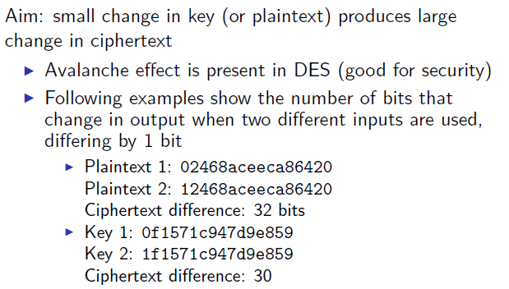
The Avalanche Effect

Slide 44
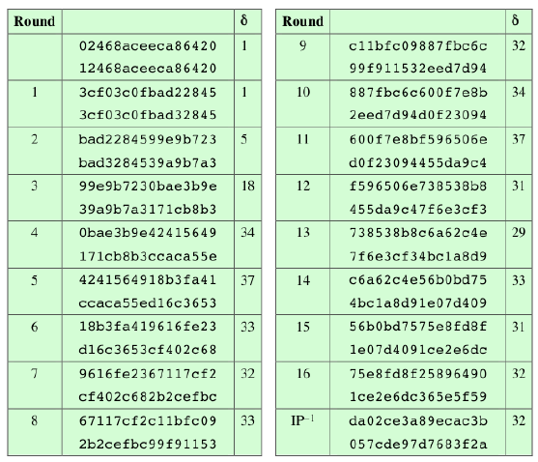
The Avalanche Effect - Plaintext

Slide 45
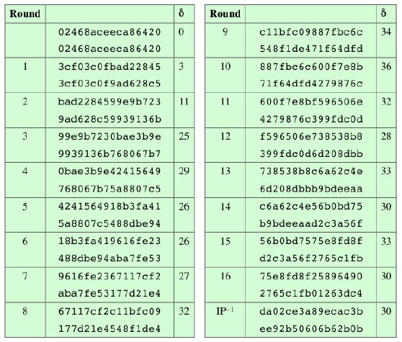
The Avalanche Effect - Key

Slide 46
Ideal Block Cipher
n-bit input maps to 2n possible input states
Output states map to n-bit output
Substitution used to produce 2n output states
Ideal block cipher allows maximum number of possible encryption mappings from plaintext block
Problems with ideal block cipher:
Small block size: equivalent to classical substitution cipher; cryptanalysis based on statistical characteristics feasible
Large block size: key must be very large; performance/implementation problems

Slide 47
64-bit plaintext
Initial permutation
64 bits output of Initial permutation is split:
Left hand 32 bits sent to L
Right hand 32 bits sent to R
K₁
Iteration 1
K₂
Iteration 2
56-bit key
K₁₆
Iteration 16
32-bit Swap
Inverse permutation
64-bit ciphertext

Slide 48
Initial Permutation (IP)
IP is determined as the following table
It occurs before round one
Bits in the plaintext are moved to next location, e.g. bit 58 to bit 1, bit 50 to bit 2 and bit 42 to bit 3, etc
58 | 50 | 42 | 34 | 26 | 18 | 10 | 2
60 | 52 | 44 | 36 | 28 | 20 | 12 | 4
62 | 54 | 46 | 38 | 30 | 22 | 14 | 6
64 | 56 | 48 | 40 | 32 | 24 | 16 | 8
57 | 49 | 41 | 33 | 25 | 17 | 9 | 1
59 | 51 | 43 | 35 | 27 | 19 | 11 | 3
61 | 53 | 45 | 37 | 29 | 21 | 13 | 5
63 | 55 | 47 | 39 | 31 | 23 | 15 | 7

Slide 49
Initial Permutation (IP)
Since M = 3570 E2F1 BA46 82C7HEX = (0011 0101 0111 0000 1110 0010 1111 0001 1011 1010 0100 0110 1000 0010 1100 0111), then IP(M) = [L0 R0] where
L0 = 1010 1110 0001 1011 1010 0001 1000 1001 = AE1BA189HEX
R0 = 1101 1100 0001 1111 0001 0000 1111 0100 = DC1F10F4HEX
Now we have L0 and R0 ready for iteration!

Slide 50
Structure
32 bits
32 bits
L_{i-1}
R_{i-1}
L_{i-1}⊕ f(R_{i-1}, K_{i})
L_{i}
R_{i}
32 bits
32 bits

Slide 51
f(R_{i-1}, K_{i})
R (32 bits)
E
48 bits
K (48 bits)
+
S₁
S₂
S₃
S₄
S₅
S₆
S₇
S₈
P
32 bits

Slide 52
Computation of f(Ri-1, Ki)
Three types of boxes: E, S, P
R (32 bits) is passed to expansion and permutation box E-box
48 bits output of E-box is added modulo 2 to 48 bits sub-key and result sent to S boxes
S boxes (S1, S2…S8) store a set of numbers; input 48 (=6×8) bits used to look up numbers like a code book and 32 bits output is sent to permutation box P
Permutation box P permutes 32 bit input producing a 32-bit output

Slide 53
E-box used in DES
The E-box expands 32 bits to 48 bits; it changes the order of the bits as well as repeating certain bits.
Bit | 32 | 1 | 2 | 3 | 4 | 5 | 4 | 5 | 6 | 7 | 8 | 9
Goes to bit | 1 | 2 | 3 | 4 | 5 | 6 | 7 | 8 | 9 | 10 | 11 | 12
Bit | 8 | 9 | 10 | 11 | 12 | 13 | 12 | 13 | 14 | 15 | 16 | 17
Goes to bit | 13 | 14 | 15 | 16 | 17 | 18 | 19 | 20 | 21 | 22 | 23 | 24
Bit | 16 | 17 | 18 | 19 | 20 | 21 | 20 | 21 | 22 | 23 | 24 | 25
Goes to bit | 25 | 26 | 27 | 28 | 29 | 30 | 31 | 32 | 33 | 34 | 35 | 36
Bit | 24 | 25 | 26 | 27 | 28 | 29 | 28 | 29 | 30 | 31 | 32 | 1
Goes to bit | 37 | 38 | 39 | 40 | 41 | 42 | 43 | 44 | 45 | 46 | 47 | 48

Slide 54
Substitution Boxes S
Have eight S-boxes which map 6 to 4 bits
Each S-box is actually 4 bit boxes
outer bits 1 & 6 (row bits) select one rows
inner bits 2-5 (col bits) are substituted
result is 8 lots of 4 bits, or 32 bits
Row selection depends on both data & key
feature known as autoclaving (autokeying)
Example: S(1809123d11173839) = 5fd25e03
Notes:
The substitution consists of a set of eight S-boxes, each of which accepts 6 bits as input and produces 4 bits as output. These transformations are defined in Table 3.3, which is interpreted as follows: The first and last bits of the input to box Si form a 2-bit binary number to select one of four substitutions defined by the four rows in the table for Si. The middle four bits select one of the sixteen columns. The decimal value in the cell selected by the row and column is then converted to its 4-bit representation to produce the output. For example, in S1, for input 011001, the row is 01 (row 1) and the column is 1100 (column 12). The value in row 1, column 12 is 9, so the output is 1001.

Slide 55
Input of S-boxes
R0 = DC1F10F4HEX and
K = K0 = 27A169E58DDAHEX ; (here K is not the secret key but a symbol for all sub-keys)
⇒ E(R0) = 0110 1111 1000 0000 1111 1110 1000 1010 0001 0111 1010 1001 = 6F80FE8A 17A9HEX
⇒ E(R0) ⊕ K0 = 0100 1000 0010 0001 1001 0111 0110 1111 1001 1010 0111 0011 = 4821976F9A73HEX
⇒ Input Z = 4821976F9A73HEX into S-boxes
R (32 bits)
E
48 bits
K (48 bits)
+
Z

Slide 56
S-box
After the sub-key is XORed with the expanded right blocked, 48-bit result moves to the substitution operation, S-boxes
The S-boxes in DES swap bits around in the 48-bit block in a reversible manner
Each S-box are differently defined.
Each input “b1b2b3b4b5b6”, S box will output a hexadecimal number at
Row = (b1b6)
Column = (b2b3b4b5 )
Z
S₁
S₂
S₃
S₄
S₅
S₆
S₇
S₈
P
32 bits

Slide 57
S-box used in DES – S₁ and S₂
Since Z= 4821976F9A73_{HEX} = 010010 000010 000110 010111 011011 111001 101001 110011
⇒ S₁(010010) is the value 10 (at row 0 and column 1001₂= 9₁₀ )
⇒ S₂(000010) = 1₁₀ = 0001₂ (at row 0 and column 0001₂= 1₁₀ )
S₁
Row 0 | 14 | 4 | 13 | 1 | 2 | 15 | 11 | 8 | 3 | 10 | 6 | 12 | 5 | 9 | 0 | 7
Row 1 | 0 | 15 | 7 | 4 | 14 | 2 | 13 | 1 | 10 | 6 | 12 | 11 | 9 | 5 | 3 | 8
Row 2 | 4 | 1 | 14 | 8 | 13 | 6 | 2 | 11 | 15 | 12 | 9 | 7 | 3 | 10 | 5 | 0
Row 3 | 15 | 12 | 8 | 2 | 4 | 9 | 1 | 7 | 5 | 11 | 3 | 14 | 10 | 0 | 6 | 13
S₂
Row 0 | 15 | 1 | 8 | 14 | 6 | 11 | 3 | 4 | 9 | 7 | 2 | 13 | 12 | 0 | 5 | 10
Row 1 | 3 | 13 | 4 | 7 | 15 | 2 | 8 | 14 | 12 | 0 | 1 | 10 | 6 | 9 | 11 | 5
Row 2 | 0 | 14 | 7 | 11 | 10 | 4 | 13 | 1 | 5 | 8 | 12 | 6 | 9 | 3 | 2 | 15
Row 3 | 13 | 8 | 10 | 1 | 3 | 15 | 4 | 2 | 11 | 6 | 7 | 12 | 0 | 5 | 14 | 9

Slide 58
S-box used in DES – S₃ and S₄
Since Z= 4821976F9A73_{HEX} = 010010 000010 000110 010111 011011 111001 101001 110011
⇒ S₃(000110) = 14₁₀ = 1110₂
⇒ S₄(010111) = 12₁₀ = 1100₂
S₃
Row 0 | 10 | 0 | 9 | 14 | 6 | 3 | 15 | 5 | 1 | 13 | 12 | 7 | 11 | 4 | 2 | 8
Row 1 | 13 | 7 | 0 | 9 | 3 | 4 | 6 | 10 | 2 | 8 | 5 | 14 | 12 | 11 | 15 | 1
Row 2 | 13 | 6 | 4 | 9 | 8 | 15 | 3 | 0 | 11 | 1 | 2 | 12 | 5 | 10 | 14 | 7
Row 3 | 1 | 10 | 13 | 0 | 6 | 9 | 8 | 7 | 4 | 15 | 14 | 3 | 11 | 5 | 2 | 12
S₄
Row 0 | 7 | 13 | 14 | 3 | 0 | 6 | 9 | 10 | 1 | 2 | 8 | 5 | 11 | 12 | 4 | 15
Row 1 | 13 | 8 | 11 | 5 | 6 | 15 | 0 | 3 | 4 | 7 | 2 | 12 | 1 | 10 | 14 | 9
Row 2 | 10 | 6 | 9 | 0 | 12 | 11 | 7 | 13 | 15 | 1 | 3 | 14 | 5 | 2 | 8 | 4
Row 3 | 3 | 15 | 0 | 6 | 10 | 1 | 13 | 8 | 9 | 4 | 5 | 11 | 12 | 7 | 2 | 14

Slide 59
S-box used in DES – S₅ and S₆
Since Z= 4821 976F 9A73_{HEX} = 010010 000010 000110 010111 011011 111001 101001 110011
⇒ S₅(011011) = 9₁₀ = 1001₂
⇒ S₆(111001) = 6₁₀ = 0110₂
S₅
Row 0 | 2 | 12 | 4 | 1 | 7 | 10 | 11 | 6 | 8 | 5 | 3 | 15 | 13 | 0 | 14 | 9
Row 1 | 14 | 11 | 2 | 12 | 4 | 7 | 13 | 1 | 5 | 0 | 15 | 10 | 3 | 9 | 8 | 6
Row 2 | 4 | 2 | 1 | 11 | 10 | 13 | 7 | 8 | 15 | 9 | 12 | 5 | 6 | 3 | 0 | 14
Row 3 | 11 | 8 | 12 | 7 | 1 | 14 | 2 | 13 | 6 | 15 | 0 | 9 | 10 | 4 | 5 | 3
S₆
Row 0 | 12 | 1 | 10 | 15 | 9 | 2 | 6 | 8 | 0 | 13 | 3 | 4 | 14 | 7 | 5 | 11
Row 1 | 10 | 15 | 4 | 2 | 7 | 12 | 9 | 5 | 6 | 1 | 13 | 14 | 0 | 11 | 3 | 8
Row 2 | 9 | 14 | 15 | 5 | 2 | 8 | 12 | 3 | 7 | 0 | 4 | 10 | 1 | 13 | 11 | 6
Row 3 | 4 | 3 | 2 | 12 | 9 | 5 | 15 | 10 | 11 | 14 | 1 | 7 | 6 | 0 | 8 | 13

Slide 60
S-box used in DES – S₇ and S₈
Since Z= 4821976F9A73_{HEX} = 010010 000010 000110 010111 011011 111001 101001 110011
⇒ S₇(101001) = 1₁₀ = 0001₂
⇒ S₈(010011) = 9₁₀ = 1100₂
S₇
Row 0 | 4 | 11 | 2 | 14 | 15 | 0 | 8 | 13 | 3 | 12 | 9 | 7 | 5 | 10 | 6 | 1
Row 1 | 13 | 0 | 11 | 7 | 4 | 9 | 1 | 10 | 14 | 3 | 5 | 12 | 2 | 15 | 8 | 6
Row 2 | 1 | 4 | 11 | 13 | 12 | 3 | 7 | 14 | 10 | 15 | 6 | 8 | 0 | 5 | 9 | 2
Row 3 | 6 | 11 | 13 | 8 | 1 | 4 | 0 | 7 | 9 | 5 | 0 | 15 | 14 | 2 | 3 | 12
S₈
Row 0 | 13 | 2 | 8 | 4 | 6 | 15 | 11 | 1 | 10 | 9 | 3 | 14 | 5 | 0 | 12 | 7
Row 1 | 1 | 15 | 13 | 8 | 10 | 3 | 7 | 4 | 12 | 5 | 6 | 11 | 0 | 14 | 9 | 2
Row 2 | 7 | 11 | 4 | 1 | 9 | 12 | 14 | 2 | 0 | 6 | 10 | 13 | 15 | 3 | 5 | 8
Row 3 | 2 | 1 | 14 | 7 | 4 | 10 | 8 | 13 | 15 | 12 | 9 | 0 | 3 | 5 | 6 | 11

Slide 61
Combine all 8 S-boxes
Now we have all outputs from 8 S-boxes
S(Z) = 1010 0001 1110 1100 1001 0110 0001 1100 = A1EC961C_{HEX}
Input the result into P-box!
Z
S₁
S₂
S₃
S₄
S₅
S₆
S₇
S₈
A1EC961C_{HEX}
P
32 bits

Slide 62
P-box used in DES
The P-box permutation is determined as below which is a straight permutation; no bits are used twice, and no bits are ignored.
⇒ P(A1EC961C_{HEX}) = 0010 1011 1010 0001 0101 0011 0110 1100 = 2BA1536C_{HEX}
Bit | 16 | 7 | 20 | 21 | 29 | 12 | 28 | 17 | 1 | 15 | 23 | 26 | 5 | 18 | 31 | 10
Goes to bit | 1 | 2 | 3 | 4 | 5 | 6 | 7 | 8 | 9 | 10 | 11 | 12 | 13 | 14 | 15 | 16
Bit | 2 | 8 | 24 | 14 | 32 | 27 | 3 | 9 | 19 | 13 | 30 | 6 | 22 | 11 | 4 | 25
Goes to bit | 17 | 18 | 19 | 20 | 21 | 22 | 23 | 24 | 25 | 26 | 27 | 28 | 29 | 30 | 31 | 32

Slide 63
A 2-Round Example

Slide 64
First Round
L0 = AE1BA189HEX and R0 = DC1F10F4HEX
Sub-key K1 = 27A169E58DDAHEX
f(R0,K1) = 2BA1536CHEX
⇒L0⊕ f(R0,K1)=1000 0101 1011 1010 1111 0010 1110 0101=85BAF2E5HEX
⇒ L1 = DC1F10F4HEX and R1 = 85BAF2E5HEX
L₀
R₀
L₀⊕ f(R₀, K₁)
L₁
R₁

Slide 65
Second Round
L1 = DC1F10F4HEX and R1 = 85BAF2E5HEX
Sub-key K2 = DA91DDD7B748HEX
E(R1) =110000001011110111110101011110100 101011100001011 = C0BDF57A570BHEX
E(R1)⊕ K2=000110100010110000101000101011011110 000001000011
S1(000110)=0001; S2(100010)=1110;S3(110000)=1011; S4(101000)=1100; S5(101011)=1110; S6(011110)=1011; S7(000001)=1101; S8(000011)=1111
P(8 outputs of S-boxes) = 0101 1111 0011 1110 0011 1001 1111 0111 = 5F3E39F7HEX = f(R1,K2)
⇒L1⊕ f(R1,K1) = 1000 0011 0010 0001 0010 1001 0000 0011 = 8321 2903HEX
⇒ L2= R1 = 85BAF2E5HEX ; R2= 83212903HEX
L₁
R₁
L₁⊕ f(R₁, K₂)
L₂
R₂

Slide 66
DES – Ciphertext
32 bits
32 bits
L_{i-1}
R_{i-1}
Express DES encryption algebraically (in binary number)
R_{j}=L_{j-1}⊕ f(R_{j-1},K_{j})
L_{j}=R_{j-1}
After 16 rounds of iterations, the contents of L and R are swapped and input to Inverse permutation
Finally, a 64-bit ciphertext is done!
L_{i-1}⊕ f(R_{i-1}, K_{i})
For i=16
L_{i}
R_{i}
32 bits
32 bits
32-bit Swap
Inverse permutation
64-bit ciphertext

Slide 67
Inverse Initial Permutation (IP⁻¹)
IP⁻¹ is determined as the following table;
Since DES consists of 16 rounds, too many for our lecture!
Consider DES algorithm of two rounds.
Ciphertext = IP⁻¹(R₁L₁) = 1101 0111 0110 1001 1000 0010 0010 0100 0010 1000 0011 1110 0000 1010 1110 1010 = D7698224283E0AEA_{HEX}
40 | 8 | 48 | 16 | 56 | 24 | 64 | 32
39 | 7 | 47 | 15 | 55 | 23 | 63 | 31
38 | 6 | 46 | 14 | 54 | 22 | 62 | 30
37 | 5 | 45 | 13 | 53 | 21 | 61 | 29
36 | 4 | 44 | 12 | 52 | 20 | 60 | 28
35 | 3 | 43 | 11 | 51 | 19 | 59 | 27
34 | 2 | 42 | 10 | 50 | 18 | 58 | 26
33 | 1 | 41 | 9 | 49 | 17 | 57 | 25

Slide 68
DES Encryption & Decryption
64-bit plaintext
64-bit ciphertext
Initial permutation
Initial permutation
K₁
Iteration 1
Iteration 1
K₁₆
K₂
Iteration 2
Iteration 2
K₁₅
56-bit key
56-bit key
K₁₆
Iteration 16
Iteration 16
K₁
32-bit Swap
32-bit Swap
Encryption
Inverse permutation
Inverse permutation
Decryption
64-bit ciphertext
64-bit plaintext

Slide 69
Algebraic Expressions
Decryption (C)
Input ciphertext to Initial permutation box to get A16 and B16
Repeat 15 times with
Bj-1=Aj ⊕ f(Bj,Kj)
Aj-1=Bj
to get A0 and B0
Swap them to get B0A0
Put B0A0 to Inverse permutation box to get back the plaintext
Encryption (M)
Input plaintext to Initial permutation box to get L0 and R0
Repeat 15 times with
Rj=Lj-1⊕ f(Rj-1,Kj)
Lj=Rj-1
to get L16 and R16
Swap them to get R16L16
Put R16L16 to Inverse permutation box to get ciphertext

Slide 70
A Simple Example
Consider there are only 2 rounds in DES
Given ciphertext = C = D7698224283E0AEAHEX
Let’s decipher it to get back our plaintext M.
Normally, in deciphering operation, sub-key must be used in reversed order; i.e. K16, K15,…
In our case, we will use K2 and then K1 only
Also, those shift registers C = {C1, C2} and D = {D1,D2} will be altered to right shift
⇒IP(C) = 8321290385BAF2E5HEX
⇒Let A2= 83212903HEX and B2= 85BAF2E5HEX

Slide 71
Decryption
A2= 83212903HEX and B2= 85BAF2E5HEX
First Round
E(B2)=110000 001011 110111 110101 011110 100101 011100 001011
E(B2)⊕K2=000110 100010 110000 101000 101011 011110 000001 000011
S1(000110)=0001; S2(100010)=1110; S3(110000)=1011; S4(101000)=1100; S5(101011)=1110; S6(011110)=1011; S7(000001)=1101; S8(000011)=1111;
Let S=0001 1110 1011 1100 1110 1011 1101 1111
P(S)=0101 1111 0011 1110 0011 1001 1111 0111
P(S)⊕A2= 1101 1100 0001 1111 0001 0000 1111 0100 = DC1F10F4HEX

Slide 72
Decryption
B1= DC1F10F4HEX and A1= B2 = 85BAF2E5HEX
Second Round
E(B1)=011011 111000 000011 111110 100010 100001 011110 101001
E(B1)⊕K1=010010 000010 000110 010111 011011 111001 101001 110011
S1(010010)=1010; S2(000010)=0001; S3(000110)=1110; S4(010111)=1100; S5(011011)=1001; S6(111001)=0110; S7(101001)=0001; S8(110011)=1100;
Let S = 1010 0001 1110 1100 1001 0110 0001 1100
P(S) = 0010 1011 1010 0001 0101 0011 0110 1100
P(S)⊕A1= 1010 1110 0001 1011 1010 0001 1000 1001 = AE1BA189HEX
B0 = AE1B A189HEX and A0 = B1= DC1F 10F4HEX
IP-1(B0A0) = 0011 0101 0111 0000 1110 0010 1111 0001 1011 1010 0100 0110 1000 0010 1100 0111 = 3570 E2F1 BA46 82C7HEX
= M

Slide 73
Strength of DES
56-bit key (256 = 7.2 x 1016 values) is susceptible to exhaustive key search due to rapid advances in computing speed
Have demonstrated breaks
1997 on a large network of computers in a few months
1998 on dedicated H/W in a few days (www.eff.org/descracker)
EFF (Electronic Frontier Foundation) DES Cracker
1536 chips and search 88 billion keys/second
$250,000 cost, won the RSA DES Challenge II Contest in less than 3 days (56 hours)
1999 above combined in 22 hours !! (DES Cracker + 100,000 computers)
DES also theoretically broken using Differential or Linear Cryptanalysis
DES Controversy
Although the standard is public, the design criteria used are classified

Slide 74
Key property
Avalanche
small change in plaintext or in key produces significant change in ciphertext
test for avalanche
encrypt two plaintext blocks that differ only in one bit
about half the (ciphertext) bits will differ
Strict Avalanche Effect
any output bit j of an S-box should change with probability 1/2 when any single input bit i is inverted for all i, j.
Bit Independence Criteria
output bits j and k should change independently when any single input bit i is inverted, for all i, j, and k.

Slide 75
DES Design Criteria
as reported by Coppersmith in [COPP94]
7 criteria for S-boxes provide for
non-linearity
resistance to differential cryptanalysis
good confusion
3 criteria for permutation P provide for
increased diffusion
Notes:
Although much progress has been made in designing block ciphers that are cryptographically strong, the basic principles have not changed all that much since the work of Feistel and the DES design team in the early 1970s. Some of the criteria used in the design of DES were reported in [COPP94], and focused on the design of the S-boxes and on the P function that distributes the output of the S boxes, as summarized above. See text for further details.

Slide 76
DES S-boxes Design Criteria
No output bit of any S-box should be too close a linear function of the input bits. Specifically, if we select any output bit and any subset of the six input bits, the fraction of inputs for which this output bit equals the XOR of these input bits should not be close to 0 or 1, but rather should be near 1/2.
Each row of an S-box (determined by a fixed value of the leftmost and rightmost input bits) should include all 16 possible output bit combinations.
If two inputs to an S-box differ in exactly one bit, the outputs must differ in at least two bits.
If two inputs to an S-box differ in the two middle bits exactly, the outputs must differ in at least two bits.
If two inputs to an S-box differ in their first two bits and are identical in their last two bits, the two outputs must not be the same.
For any nonzero 6-bit difference between inputs, no more than 8 of the 32 pairs of inputs exhibiting that difference may result in the same output difference.
Notes:
Coppersmith pointed out that the first criterion in the preceding list was needed because the S-boxes are the only nonlinear part of DES. If the S-boxes were linear (i.e., each output bit is a linear combination of the input bits), the entire algorithm would be linear and easily broken. We have seen this phenomenon with the Hill cipher, which is linear. The remaining criteria were primarily aimed at thwarting differential cryptanalysis and at providing good confusion properties

Slide 77
Block Cipher Design
basic principles still like Feistel’s in 1970’s
number of rounds
more is better, exhaustive search best attack
function f:
provides “confusion”, is nonlinear, avalanche
have issues of how S-boxes are selected
key schedule
complex subkey creation, key avalanche
Notes:
The cryptographic strength of a Feistel cipher derives from three aspects of the design: the number of rounds, the function F, and the key schedule algorithm. Briefly discuss these.
The greater the number of rounds, the more difficult it is to perform cryptanalysis, even for a relatively weak F. In general, the criterion should be that the number of rounds is chosen so that known cryptanalytic efforts require greater effort than a simple brute-force key search attack. This criterion is attractive because it makes it easy to judge the strength of an algorithm and to compare different algorithms.
The function F provides the element of confusion in a Feistel cipher, want it to be difficult to “unscramble” the substitution performed by F. One obvious criterion is that F be nonlinear. The more nonlinear F, the more difficult any type of cryptanalysis will be. We would like it to have good avalanche properties, or even the strict avalanche criterion (SAC). Another criterion is the bit independence criterion (BIC). One of the most intense areas of research in the field of symmetric block ciphers is that of S-box design. Would like any change to the input vector to an S-box to result in random-looking changes to the output. The relationship should be nonlinear and difficult to approximate with linear functions.
A final area of block cipher design, and one that has received less attention than S-box design, is the key schedule algorithm. With any Feistel block cipher, the key schedule is used to generate a subkey for each round. Would like to select subkeys to maximize the difficulty of deducing individual subkeys and the difficulty of working back to the main key. The key schedule should guarantee key/ciphertext Strict Avalanche Criterion and Bit Independence Criterion.

Slide 78
DES challenge
msg = “The unknown messages is: XXXX … “
CT = c₁ c₂ c₃ c₄
Goal: find k ∈ {0,1}⁵⁶ s.t. DES(k, m_{i}) = c_{i} for i=1,2,3
1997: Internet search -- 3 months
1998: EFF machine (deep crack) -- 3 days (250K $)
1999: combined search -- 22 hours
2006: COPACOBANA (120 FPGAs) -- 7 days (10K $)
⇒ 56-bit ciphers should not be used !! (128-bit key ⇒ 2⁷² days)

Slide 79
Strengthening DES against exhaustve search
Method 1: Triple-DES
Let E : K × M ⟶ M be a block cipher
Define 3E: K³ × M ⟶ M as
For 3DES: key-size = 3×56 = 168 bits. 3×slower than DES.
(simple attack in time ≈2¹¹⁸ )
3E( (k₁,k₂,k₃), m) = E(k1,D(k2,E(k3,m)))

Slide 80
Why not double DES?
Define 2E( (k₁,k₂), m) = E(k₁ , E(k₂ , m) )
Attack: M = (m₁,…, m₁₀) , C = (c₁,…,c₁₀).
step 1: build table.
sort on 2nd column
key-len = 112 bits for DES
E(k₂,⋅)
E(k₁,⋅)
m
c
k⁰ = 00…00
k¹ = 00…01
k² = 00…10
⋮
k^{N} = 11…11
E(k⁰ , M)
E(k¹ , M)
E(k² , M)
⋮
E(k^{N} , M)
2⁵⁶
entries

Slide 81
Meet in the middle attack
Attack: M = (m₁,…, m₁₀) , C = (c₁,…,c₁₀)
step 1: build table.
Step 2: for all k∈{0,1}⁵⁶ do:
test if D(k, C) is in 2nd column.
if so then E(k^{i},M) = D(k,C) ⇒ (k^{i},k) = (k₂,k₁)
k⁰ = 00…00
k¹ = 00…01
k² = 00…10
⋮
k^{N} = 11…11
E(k⁰ , M)
E(k¹ , M)
E(k² , M)
⋮
E(k^{N} , M)
E(k₂,⋅)
E(k₁,⋅)
m
c

Slide 82
Security of Block Ciphers

Slide 83
Abstractly: PRPs and PRFs
Pseudo Random Function (PRF) defined over (K,X,Y):
F: K × X → Y
such that exists “efficient” algorithm to evaluate F(k,x)
Pseudo Random Permutation (PRP) defined over (K,X):
E: K × X → X
such that: 1. Exists “efficient” deterministic algorithm to evaluate E(k,x)
2. The function E( k, ⋅ ) is one-to-one
3. Exists “efficient” inversion algorithm D(k,y)

Slide 84
Running example
Example PRPs: 3DES, AES, …
AES: K × X → X where K = X = {0,1}¹²⁸
3DES: K × X → X where X = {0,1}⁶⁴ , K = {0,1}¹⁶⁸
Functionally, any PRP is also a PRF.
A PRP is a PRF where X=Y and is efficiently invertible.

Slide 85
Secure PRFs
Let F: K × X → Y be a PRF
Funs[X,Y]: the set of all functions from X to Y
S_{F} = { F(k,⋅) s.t. k ∈ K } ⊆ Funs[X,Y]
Intuition: a PRF is secure if a random function in Funs[X,Y] is indistinguishable from a random function in S_{F}
Funs[X,Y]
S_{F}
Size |Y|^{|X|}
Size |K|

Slide 86
Secure PRFs
Let F: K × X → Y be a PRF
Funs[X,Y]: the set of all functions from X to Y
S_{F} = { F(k,⋅) s.t. k ∈ K } ⊆ Funs[X,Y]
Intuition: a PRF is secure if a random function in Funs[X,Y] is indistinguishable from a random function in S_{F}
f ← Funs[X,Y]
x ∈ X
???
k ← K
f(x) or F(k,x) ?

Slide 87
Secure PRPs (secure block cipher)
Let E: K × X → Y be a PRP
Perms[X]: the set of all one-to-one functions
from X to Y
S_{F} = { E(k,⋅) s.t. k ∈ K } ⊆ Perms[X,Y]
Intuition: a PRP is secure if a random function in Perms[X] is indistinguishable from a random function in S_{F}
π ← Perms[X]
x ∈ X
???
k ← K
π(x) or E(k,x) ?

Slide 88
Check!
Let F: K × X → {0,1}¹²⁸ be a secure PRF.
Is the following G a secure PRF?
G(k, x) =
0 ¹²⁸ if x=0
F(k,x) otherwise
No, it is easy to distinguish G from a random function
Yes, an attack on G would also break F
It depends on F

Slide 89
More attacks on block ciphers

Slide 90
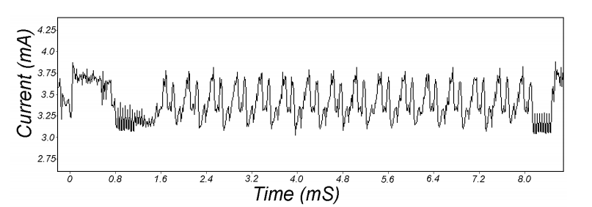
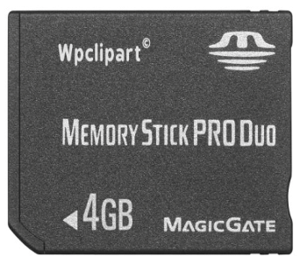
Attacks on the implementation
1. Side channel attacks:
Measure time to do enc/dec, measure power for enc/dec
2. Fault attacks:
Computing errors in the last round expose the secret key k
⇒ do not even implement crypto primitives yourself …
smartcard
[Kocher, Jaffe, Jun, 1998]
Notes:
Many timing attacks: cache timing, multi-core attacks, smartcard attacks

Slide 91
Linear and differential attacks [BS’89,M’93]
Given many inp/out pairs, can recover key in time less than 2⁵⁶ .
Linear cryptanalysis (overview) : let c = DES(k, m)
Suppose for random k,m :
Pr[m[i₁]⨁⋯⨁m[i_{r}] ⨁ c[j_{j}]⨁⋯⨁c[j_{v}]=k[l₁]⨁⋯⨁k[l_{u}] ] = ½ + ε
For some ε. For DES, this exists with ε = 1/2²¹ ≈ 0.0000000477
Notes:
If S-boxes were random, then ε = 1/2¹⁰

Slide 92
Linear attacks
Pr[m[i₁]⨁⋯⨁m[i_{r}] ⨁ c[j_{j}]⨁⋯⨁c[j_{v}] = k[l₁]⨁⋯⨁k[l_{u}] ] = ½ + ε
Thm: given 1/ε² random (m, c=DES(k, m)) pairs then
k[l₁,…,l_{u}] = MAJ [ m[i₁,…,i_{r}] ⨁ c[j_{j},…,j_{v}] ]
with prob. ≥ 97.7%
⇒ with 1/ε² inp/out pairs can find k[l₁,…,l_{u}] in time ≈1/ε² .

Slide 93
Linear attacks
For DES, ε = 1/2²¹ ⇒
with 2⁴² inp/out pairs can find k[l₁,…,l_{u}] in time 2⁴²
Roughly speaking: can find 14 key “bits” this way in time 2⁴²
Brute force remaining 56−14=42 bits in time 2⁴²
Total attack time ≈2⁴³ ( << 2⁵⁶ ) with 2⁴² random inp/out pairs

Slide 94
Lesson
A tiny bit of linearly in S₅ lead to a 2⁴² time attack.
⇒ don’t design ciphers yourself !!

Slide 95
Quantum attacks
Generic search problem:
Let f: X ⟶ {0,1} be a function.
Goal: find x∈X s.t. f(x)=1.
Classical computer: best generic algorithm time = O(|X|)
Quantum computer [Grover ’96] : time = O( |X|^{1/2} )
Can quantum computers be built: unknown

Slide 96
Quantum exhaustive search
if E(k,m) = c
0 otherwise
Given m, c=E(k,m) define
Grover ⇒ quantum computer can find k in time O(|K|^{1/2})
DES: time ≈2²⁸ , AES-128: time ≈2⁶⁴
quantum computer ⇒ 256-bits key ciphers (e.g. AES-256)
f(k) =

Slide 97
Block ciphers from PRGs

Slide 98
Can we build a PRF from a PRG?
Let G: K ⟶ K² be a secure PRG
Define 1-bit PRF F: K × {0,1} ⟶ K as
F(k, x∈{0,1} ) = G(k)[x]
Thm: If G is a secure PRG then F is a secure PRF
Can we build a PRF with a larger domain?
k
G
G(k)[0]
G(k)[1]

Slide 99
Extending a PRG
Let G: K ⟶ K² .
define G₁: K ⟶ K⁴ as G₁(k) = G(G(k)[0]) ll G(G(k)[1])
k
G
We get a 2-bit PRF:
F(k, x∈{0,1}² ) = G₁(k)[x]
G(k)[0]
G(k)[1]
G
G
00
01
10
11
G₁(k)

Slide 100
G₁ is a secure PRG
k
G
G(k)[0]
G(k)[1]
r₀
r₁
G
G
G
G
≈_{p}
00
01
10
11
≈_{p}
G₁(k)
r₁
G
≈_{p}
random in K⁴
r₀₁
r₀₀

Slide 101
Extending more
Let G: K ⟶ K² .
define G₂: K ⟶ K⁸ as G₂(k) =
k
G
G(k)[0]
G(k)[1]
We get a 3-bit PRF
G
G
G
G
G
G
000
001
010
011
100
101
110
111
G₂(k)
Notes:
Show to evaluate for x=101

Slide 102
Extending even more: the GGM PRF
Let G: K ⟶ K² . define PRF F: K × {0,1}^{n} ⟶ K as
For input x = x₀ x₁ … x_{n-1} ∈ {0,1}^{n} do:
k
k₁
k₂
k₃
k_{n}
G(k)[x₀]
G(k₁)[x₁]
G(k₂)[x₂]
⋯
G(k_{n-1})[x_{n-1}]
Security: G a secure PRG ⇒ F is a secure PRF on {0,1}^{n} .
Not used in practice due to slow performance.

Slide 103
Secure block cipher from a PRG?
Can we build a secure PRP from a secure PRG?
No, it cannot be done
Yes, just plug the GGM PRF into the Luby-Rackoff theorem
It depends on the underlying PRG

Slide 104
Copyright Notice
The material in this presentation has been taken from text books, reference books, research literature and various sources on Internet; and compiled/edited for class room teaching at MCS-NUST without any infringement into the copyrights of the author(s). The original authors retain their respective copyrights as per their stated claims.
Commercial use of the material contained herein in full or in part through copying, publication and reproducing in any form is strictly prohibited.

