Slide 1

Applied Cryptography
ASHRAF MASOOD
dean@mcs.edu.pk
Lecture Slides– Fall 2012
Lecture #7

Slide 2
Block Ciphers
Advanced Encryption Standard + Other Ciphers
Security of Block Ciphers
Modes of Operation

Slide 3
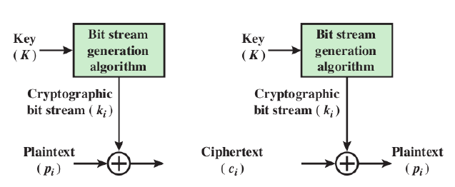
Stream Ciphers
Encrypts a digital data stream one bit or one byte at a Time
One time pad is example; but practical limitations
Typical approach for stream cipher:
Key (K) used as input to bit-stream generator algorithm
Algorithm generates cryptographic bit stream (ki ) used to encrypt plaintext
Users share a key; use it to generate keystream

Slide 4
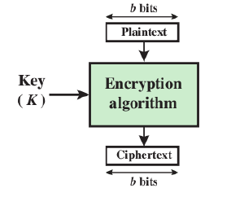
Block Ciphers
Encrypt a block of plaintext as a whole to produce same sized ciphertext
Typical block sizes are 64 or 128 bits
Modes of operation used to apply block ciphers to larger plaintexts

Slide 5
Block ciphers: crypto work horse
n bits
n bits
E, D
PT Block
CT Block
Key
k bits
Canonical examples:
DES: n= 64 bits, k = 56 bits
3DES: n= 64 bits, k = 168 bits
AES: n=128 bits, k = 128, 192, 256 bits

Slide 6
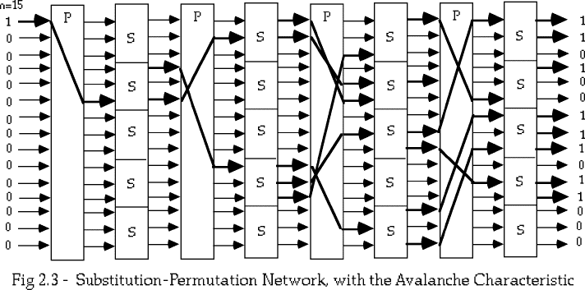
Motivation
In 1949, Claude Shannon also introduced the idea of substitution-permutation (S-P) networks which form the basis of modern block ciphers
S-P networks are based on the two primitive cryptographic operations: substitution (S-box) & permutation (P-box)
provide confusion and diffusion of message

Slide 7
Strength of DES
56-bit key (256 = 7.2 x 1016 values) is susceptible to exhaustive key search due to rapid advances in computing speed
Have demonstrated breaks
1997 on a large network of computers in a few months
1998 on dedicated H/W in a few days (www.eff.org/descracker)
EFF (Electronic Frontier Foundation) DES Cracker
1536 chips and search 88 billion keys/second
$250,000 cost, won the RSA DES Challenge II Contest in less than 3 days (56 hours)
1999 above combined in 22 hours !! (DES Cracker + 100,000 computers)
DES also theoretically broken using Differential or Linear Cryptanalysis

Slide 8
Key property
Avalanche
small change in plaintext or in key produces significant change in ciphertext
test for avalanche
encrypt two plaintext blocks that differ only in one bit
about half the (ciphertext) bits will differ
Strict Avalanche Effect
any output bit j of an S-box should change with probability 1/2 when any single input bit i is inverted for all i, j.
Bit Independence Criteria
output bits j and k should change independently when any single input bit i is inverted, for all i, j, and k.

Slide 9
DES Design Criteria
as reported by Coppersmith in [COPP94]
7 criteria for S-boxes provide for
non-linearity
resistance to differential cryptanalysis
good confusion
3 criteria for permutation P provide for
increased diffusion
Notes:
Although much progress has been made in designing block ciphers that are cryptographically strong, the basic principles have not changed all that much since the work of Feistel and the DES design team in the early 1970s. Some of the criteria used in the design of DES were reported in [COPP94], and focused on the design of the S-boxes and on the P function that distributes the output of the S boxes, as summarized above. See text for further details.

Slide 10
DES S-boxes Design Criteria
No output bit of any S-box should be too close a linear function of the input bits. Specifically, if we select any output bit and any subset of the six input bits, the fraction of inputs for which this output bit equals the XOR of these input bits should not be close to 0 or 1, but rather should be near 1/2.
Each row of an S-box (determined by a fixed value of the leftmost and rightmost input bits) should include all 16 possible output bit combinations.
If two inputs to an S-box differ in exactly one bit, the outputs must differ in at least two bits.
If two inputs to an S-box differ in the two middle bits exactly, the outputs must differ in at least two bits.
If two inputs to an S-box differ in their first two bits and are identical in their last two bits, the two outputs must not be the same.
For any nonzero 6-bit difference between inputs, no more than 8 of the 32 pairs of inputs exhibiting that difference may result in the same output difference.
Notes:
Coppersmith pointed out that the first criterion in the preceding list was needed because the S-boxes are the only nonlinear part of DES. If the S-boxes were linear (i.e., each output bit is a linear combination of the input bits), the entire algorithm would be linear and easily broken. We have seen this phenomenon with the Hill cipher, which is linear. The remaining criteria were primarily aimed at thwarting differential cryptanalysis and at providing good confusion properties

Slide 11
Block Cipher Design
basic principles still like Feistel’s in 1970’s
number of rounds
more is better, exhaustive search best attack
function f:
provides “confusion”, is nonlinear, avalanche
have issues of how S-boxes are selected
key schedule
complex subkey creation, key avalanche
Notes:
The cryptographic strength of a Feistel cipher derives from three aspects of the design: the number of rounds, the function F, and the key schedule algorithm. Briefly discuss these.
The greater the number of rounds, the more difficult it is to perform cryptanalysis, even for a relatively weak F. In general, the criterion should be that the number of rounds is chosen so that known cryptanalytic efforts require greater effort than a simple brute-force key search attack. This criterion is attractive because it makes it easy to judge the strength of an algorithm and to compare different algorithms.
The function F provides the element of confusion in a Feistel cipher, want it to be difficult to “unscramble” the substitution performed by F. One obvious criterion is that F be nonlinear. The more nonlinear F, the more difficult any type of cryptanalysis will be. We would like it to have good avalanche properties, or even the strict avalanche criterion (SAC). Another criterion is the bit independence criterion (BIC). One of the most intense areas of research in the field of symmetric block ciphers is that of S-box design. Would like any change to the input vector to an S-box to result in random-looking changes to the output. The relationship should be nonlinear and difficult to approximate with linear functions.
A final area of block cipher design, and one that has received less attention than S-box design, is the key schedule algorithm. With any Feistel block cipher, the key schedule is used to generate a subkey for each round. Would like to select subkeys to maximize the difficulty of deducing individual subkeys and the difficulty of working back to the main key. The key schedule should guarantee key/ciphertext Strict Avalanche Criterion and Bit Independence Criterion.

Slide 12
Strengthening DES against exhaustve search
Method 1: Triple-DES
Let E : K × M ⟶ M be a block cipher
Define 3E: K³ × M ⟶ M as
For 3DES: key-size = 3×56 = 168 bits. 3×slower than DES.
(simple attack in time ≈2¹¹⁸ )
3E( (k₁,k₂,k₃), m) = E(k1,D(k2,E(k3,m)))

Slide 13
Why not double DES?
Define 2E( (k₁,k₂), m) = E(k₁ , E(k₂ , m) )
Attack: M = (m₁,…, m₁₀) , C = (c₁,…,c₁₀).
step 1: build table.
sort on 2nd column
key-len = 112 bits for DES
E(k₂,⋅)
E(k₁,⋅)
m
c
k⁰ = 00…00
k¹ = 00…01
k² = 00…10
⋮
k^{N} = 11…11
E(k⁰ , M)
E(k¹ , M)
E(k² , M)
⋮
E(k^{N} , M)
2⁵⁶
entries

Slide 14
Meet in the middle attack
Attack: M = (m₁,…, m₁₀) , C = (c₁,…,c₁₀)
step 1: build table.
Step 2: for all k∈{0,1}⁵⁶ do:
test if D(k, C) is in 2nd column.
if so then E(k^{i},M) = D(k,C) ⇒ (k^{i},k) = (k₂,k₁)
k⁰ = 00…00
k¹ = 00…01
k² = 00…10
⋮
k^{N} = 11…11
E(k⁰ , M)
E(k¹ , M)
E(k² , M)
⋮
E(k^{N} , M)
E(k₂,⋅)
E(k₁,⋅)
m
c

Slide 15
Other Block Ciphers

Slide 16
IDEA
IDEA stands for International Data Encryption Algorithm. The algorithm was designed by researchers from Swiss Federal Institute of Technology in 1990.
The algorithm uses a modified Feistel structure with eight rounds and the message block size of 64-bits. Cryptographic keys are 128-bit long.
All transformations used in the algorithm are based on the following three operations in GF(2¹⁶)
Bit by Bit XOR operation denoted by
Addition modulo 2¹⁶ denoted by
Multiplication modulo (2¹⁶ +1) denoted by
+

Slide 17
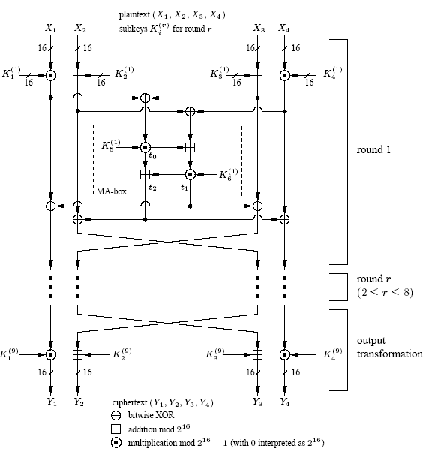
IDEA

Slide 18
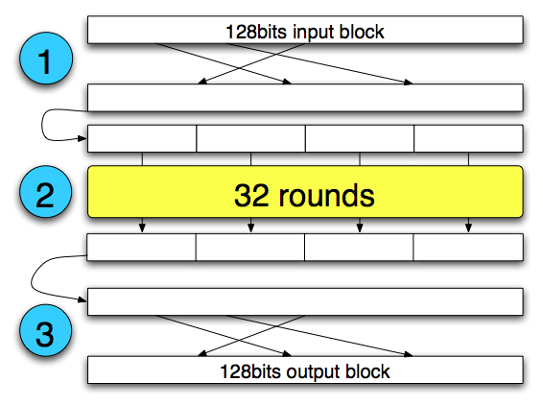
SERPENT
Process
Initial permutation
32 Rounds,
Key mixing
Pass through S-boxes
Linear Transformation (except in last round)
Final permutation
Statically defined
Simplifying the optimized implementation

Slide 19
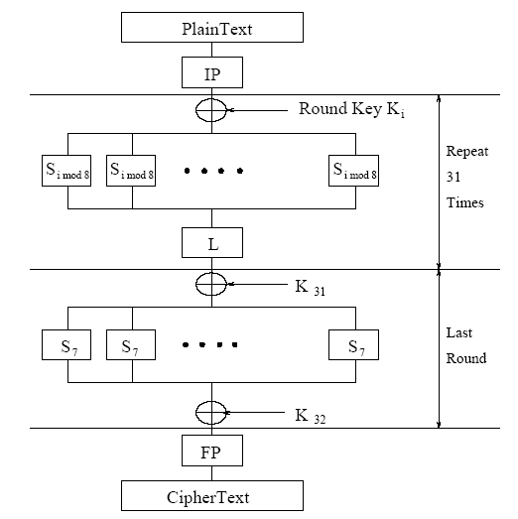
SERPENT

Slide 20
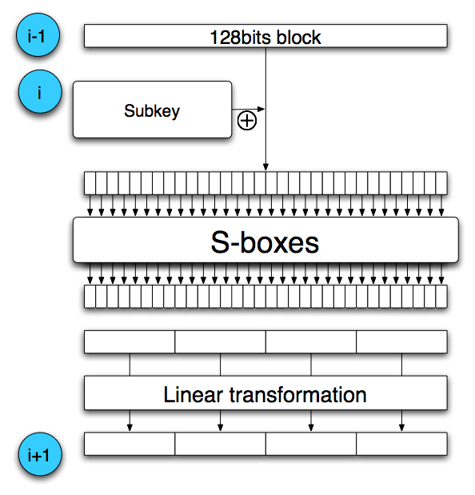
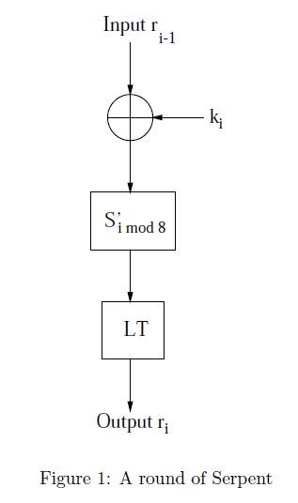
SERPENT

Slide 21
AES

Slide 22
Background & History
DES was US Standard for over 20 years with numerous applications worldwide.
In the spirit of DES’s success, NIST’s goal in the AES development effort was to specify an algorithm that will
have a usable lifetime of at least thirty years
be available royalty-free worldwide
be used extensively throughout the U.S. Government and private sectors
At a minimum, the algorithm would have to implement symmetric key cryptography as a block cipher and support a block size of 128 bits and key sizes of 128, 192, and 256 bits.

Slide 23
NIST called for proposals for new standard in 1997
Aims: security, ecient software/hardware implementations, low memory requirements, parallel processing
Candidate algorithms from around the world
Rijndael chosen, standard called AES created in 2001
AES:
Block size: 128 bits (others possible)
Key size: 128, 192, 256 bits
Rounds: 10, 12, 14 (depending on key)
Operations: XOR with round key, substitutions using
S-Boxes, mixing using Galois Field arithmetic

Slide 24
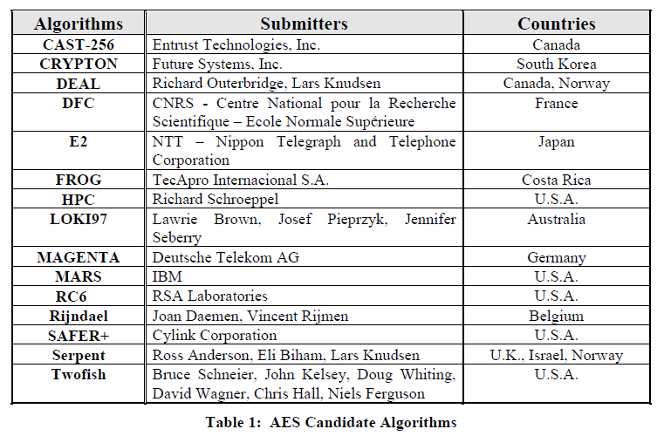
AES R-1

Slide 25
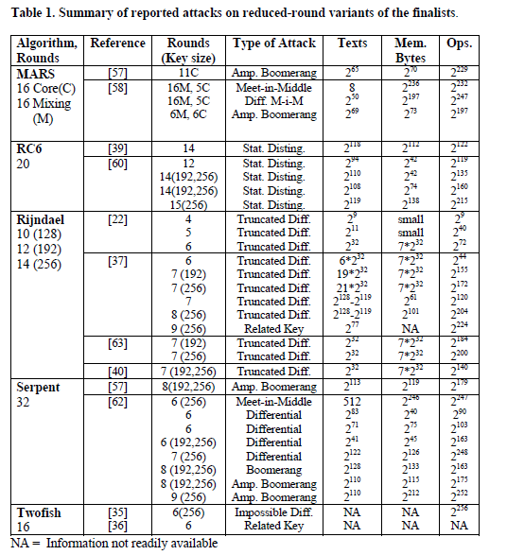
AES R-2

Slide 26
AES Salients
This cipher is not a Feistel structure.
The key that is provided as input is expanded into an array of 44 words (32-bits each). 4 distinct words (128 bits) serve as a round key for each round
Only the Add Round Key stage uses the key. Any other stage is reversible without knowledge of the key.
The Add Round Key is a form of Vernam cipher and by itself would not be formidable. The other 3 stages together provide confusion, diffusion, and nonlinearity
Each stage is easily reversible
Decryption uses the same keys but in the reverse order. Decryption is not identical to encryption
AES uses arithmetic in the finite field GF(2^8), with the irreducible polynomial

Slide 27
AES
Variable number of rounds (10, 12, 14):
10 if K is 128 bits
12 if K is 192 bits
14 if K is 256 bits
128-bit round key used for each round:
128 bits = 16 bytes = 4 words
needs Nr+1 round keys for Nr rounds
needs 44 words for 128-bit key (10 rounds)
State: 4 by 4 array of bytes
128 bits = 16 bytes

Slide 28
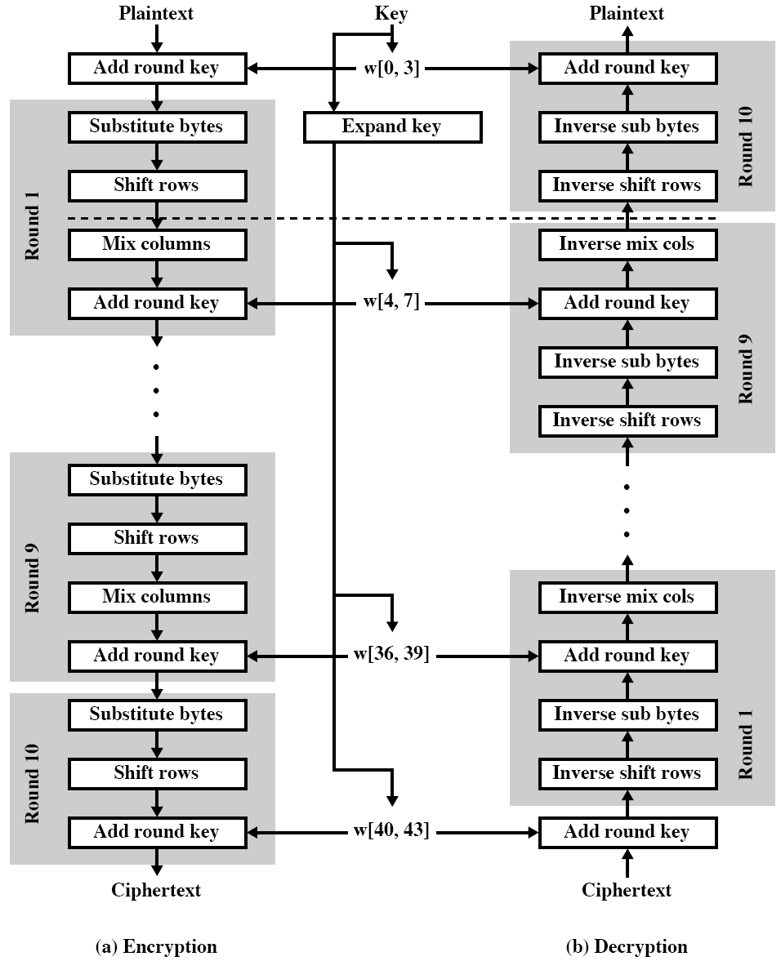
AES Overview

Slide 29
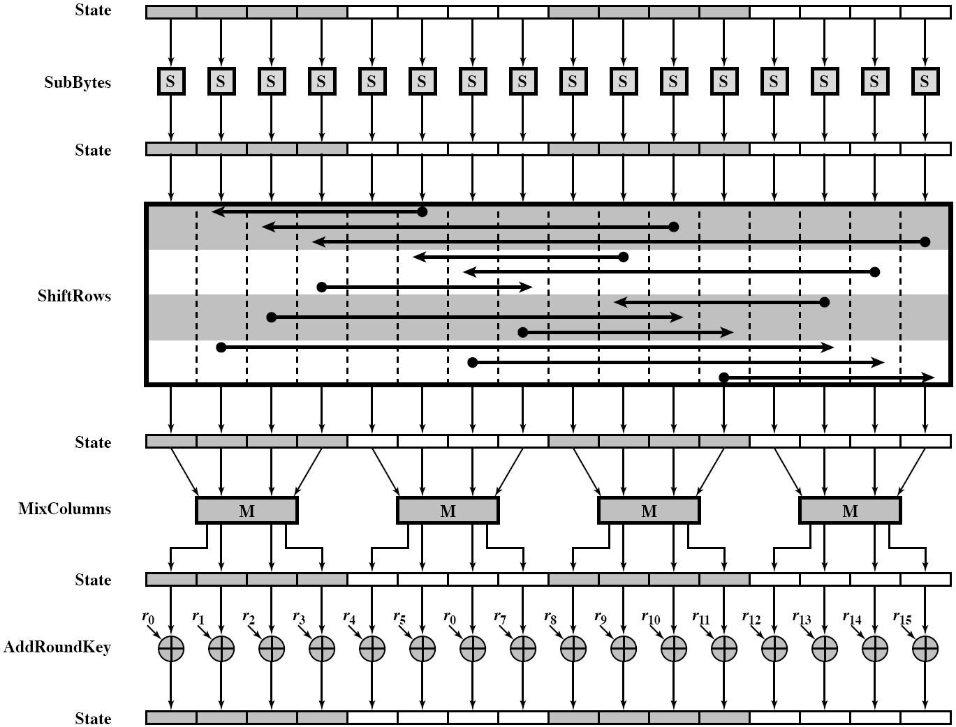
One Round of AES

Slide 30
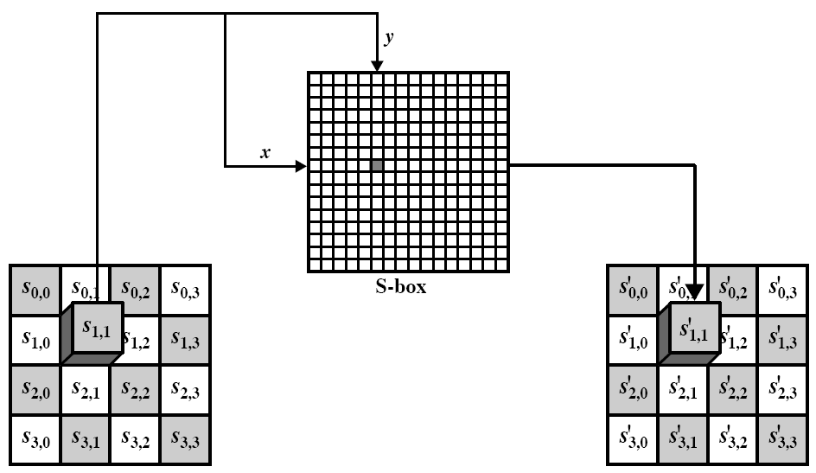
Byte Substitution

Slide 31
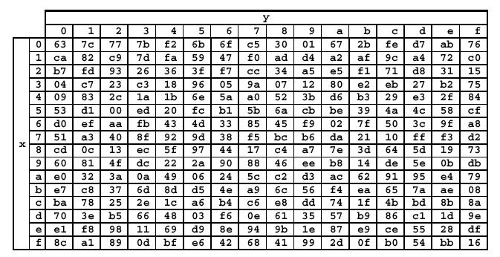
S-Box

Slide 32
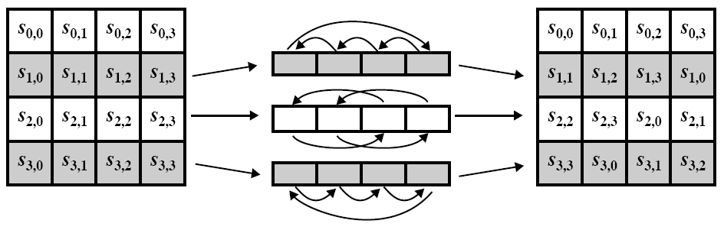
Shift Rows

Slide 33
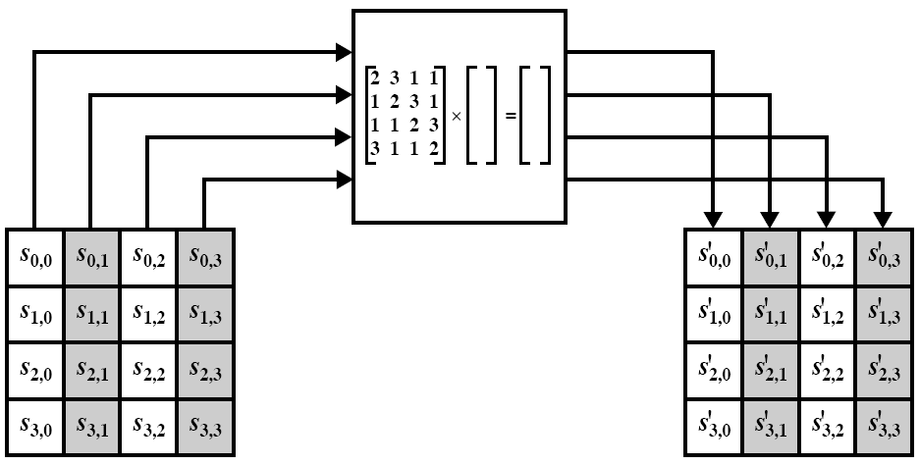

Mix Column
Each column of the state matrix is multiplied modulo (x⁴ + 1) by the fixed polynomial a(x), given by a(x)={03}x³ + {01}x² + {01}x + {02}, In matrix form:
Each byte of the column is multiplied by the constant byte using irreducible polynomial m(x) = x⁸ + x⁴ + x³ + x + 1 in GF(2⁸)

Slide 34
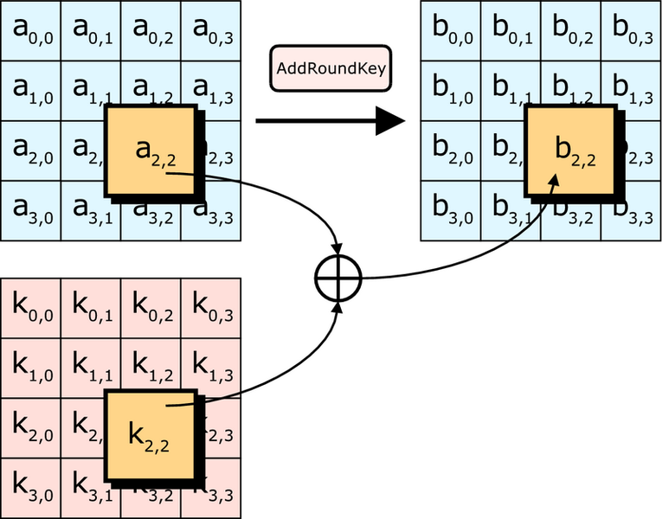
Add Round Key
Added (XOR) each key byte to each byte of the state matrix

Slide 35
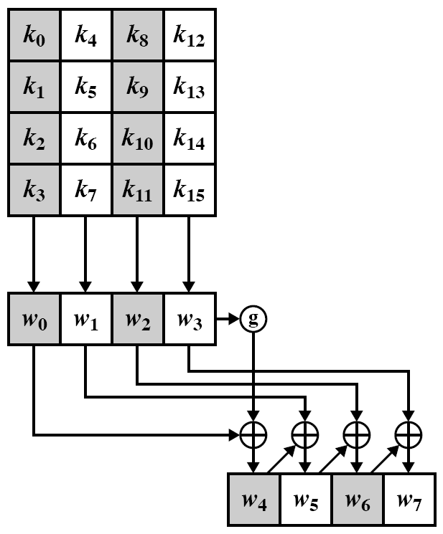
Key Exapansion

Slide 36
Security of Block Ciphers

Slide 37
Abstractly: PRPs and PRFs
Pseudo Random Function (PRF) defined over (K,X,Y):
F: K × X → Y
such that exists “efficient” algorithm to evaluate F(k,x)
Pseudo Random Permutation (PRP) defined over (K,X):
E: K × X → X
such that: 1. Exists “efficient” deterministic algorithm to evaluate E(k,x)
2. The function E( k, ⋅ ) is one-to-one
3. Exists “efficient” inversion algorithm D(k,y)

Slide 38
Running example
Example PRPs: 3DES, AES, …
AES: K × X → X where K = X = {0,1}¹²⁸
3DES: K × X → X where X = {0,1}⁶⁴ , K = {0,1}¹⁶⁸
Functionally, any PRP is also a PRF.
A PRP is a PRF where X=Y and is efficiently invertible.

Slide 39
Secure PRFs
Let F: K × X → Y be a PRF
Funs[X,Y]: the set of all functions from X to Y
S_{F} = { F(k,⋅) s.t. k ∈ K } ⊆ Funs[X,Y]
Intuition: a PRF is secure if a random function in Funs[X,Y] is indistinguishable from a random function in S_{F}
Funs[X,Y]
S_{F}
Size |Y|^{|X|}
Size |K|

Slide 40
Secure PRFs
Let F: K × X → Y be a PRF
Funs[X,Y]: the set of all functions from X to Y
S_{F} = { F(k,⋅) s.t. k ∈ K } ⊆ Funs[X,Y]
Intuition: a PRF is secure if a random function in Funs[X,Y] is indistinguishable from a random function in S_{F}
f ← Funs[X,Y]
x ∈ X
???
k ← K
f(x) or F(k,x) ?

Slide 41
Secure PRPs (secure block cipher)
Let E: K × X → Y be a PRP
Perms[X]: the set of all one-to-one functions
from X to Y
S_{F} = { E(k,⋅) s.t. k ∈ K } ⊆ Perms[X,Y]
Intuition: a PRP is secure if a random function in Perms[X] is indistinguishable from a random function in S_{F}
π ← Perms[X]
x ∈ X
???
k ← K
π(x) or E(k,x) ?

Slide 42
Check!
Let F: K × X → {0,1}¹²⁸ be a secure PRF.
Is the following G a secure PRF?
G(k, x) =
0 ¹²⁸ if x=0
F(k,x) otherwise
No, it is easy to distinguish G from a random function
Yes, an attack on G would also break F
It depends on F

Slide 43
Modes of Operation
One Times Key (ECB)

Slide 44
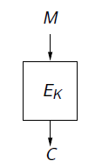
Block Cipher Modes of Operation
Block cipher provides parties sharing K with
which enables them to encrypt a 1-block message.
How do we encrypt a long message using a primitive that only applies to
n-bit blocks?

Slide 45
ECB Mode
Electronic Code Book (ECB):
Problem:
if m₁=m₂ then c₁=c₂
PT:
m₁
m₂
CT:
c₁
c₂

Slide 46
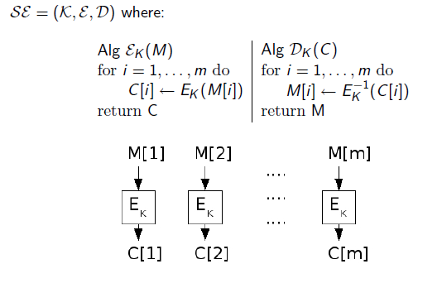
Electronic Code Book (ECB) Mode

Slide 47
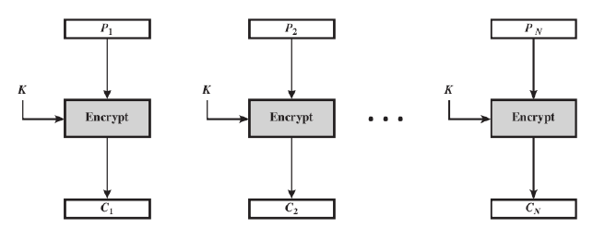
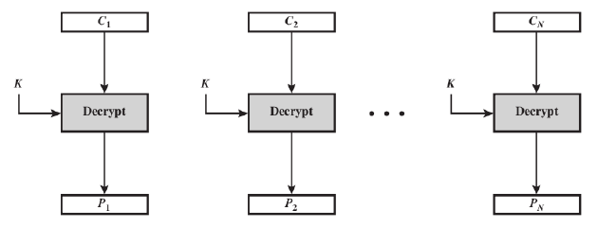
ECB Mode

Slide 48
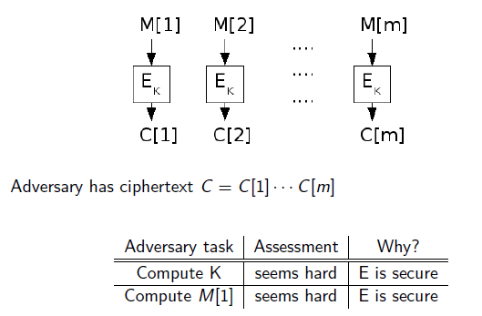
Security of ECB Mode

Slide 49
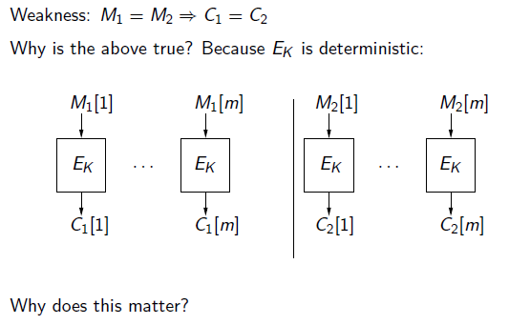
Security of ECB Mode

Slide 50
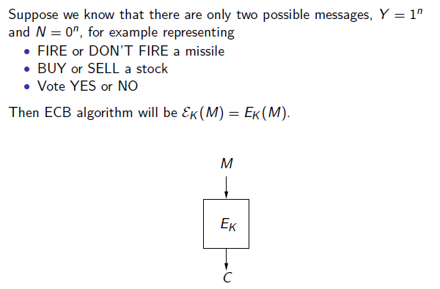
Security of ECB Mode

Slide 51
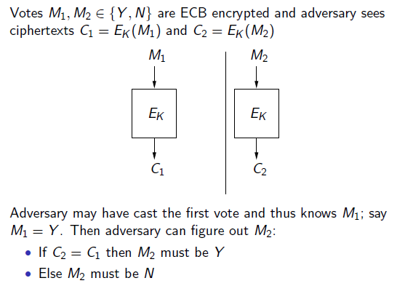
Security of ECB Mode

Slide 52
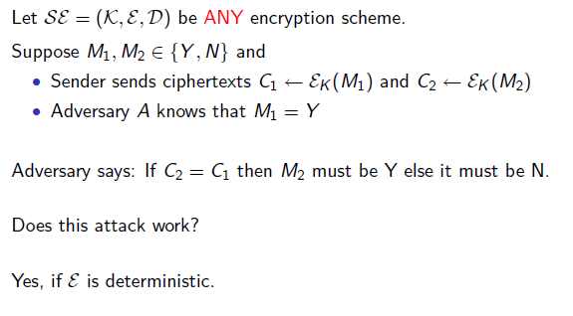
Is it avoidable?

Slide 53
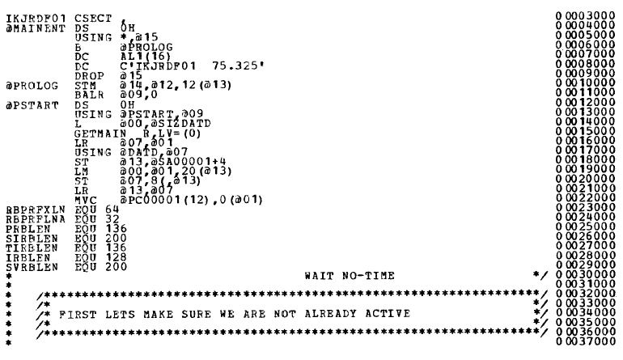
Plaintext

Slide 54
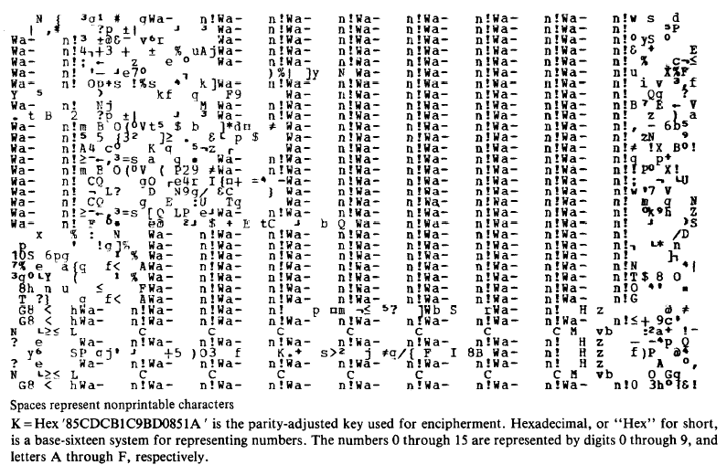
Ciphertext

Slide 55
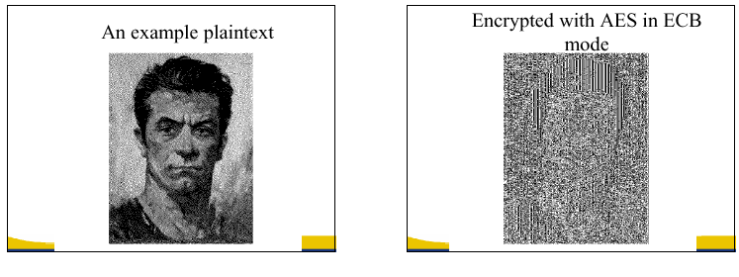
In pictures
(courtesy B. Preneel)

Slide 56
Semantic Security (one-time key)
EXP(0):
Chal.
m₀ , m₁ ∈ M : |m₀| = |m₁|
Adv. A
k←K
c ← E(k,m₀)
b’ ∈ {0,1}
one time key ⇒ adversary sees only one ciphertext
Chal.
m₀ , m₁ ∈ M : |m₀| = |m₁|
Adv. A
EXP(1):
k←K
c ← E(k,m₁)
b’ ∈ {0,1}
Adv_{SS}[A,OTP] = | Pr[ EXP(0)=1 ] − Pr[ EXP(1)=1 ] | should be “neg.”

Slide 57
ECB is not Semantically Secure
ECB is not semantically secure for messages that contain more than one block.
b∈{0,1}
Two blocks
m₀ = “Hello World”
m₁ = “Hello Hello”
Chal.
Adv. A
k←K
(c₁,c₂) ← E(k, m_{b})
If c₁=c₂ output 0, else output 1
Then Adv_{SS} [A, ECB] = 1

Slide 58
Security of Many Times Keys
Many Times Keys

Slide 59
Semantic Security for many-time key
Key used more than once ⇒ adv. sees many CTs with same key
Adversary’s power: chosen-plaintext attack (CPA)
Can obtain the encryption of arbitrary messages of his choice
(conservative modeling of real life)
Adversary’s goal: Break sematic security

Slide 60
Semantic Security for many-time key
E = (E,D) a cipher defined over (K,M,C). For b=0,1 define EXP(b) as:
b
Chal.
Adv.
k←K
m_{1,0} , m_{1,1} ∈ M : |m_{1,0}| = |m_{1,1}|
c₁ ← E(k, m_{1,b})

Slide 61
Semantic Security for many-time key
E = (E,D) a cipher defined over (K,M,C). For b=0,1 define EXP(b) as:
b
Chal.
Adv.
k←K
m_{2,0} , m_{2,1} ∈ M : |m_{2,0}| = |m_{2,1}|
c₂ ← E(k, m_{2,b})

Slide 62
Semantic Security for many-time key (CPA security)
E = (E,D) a cipher defined over (K,M,C). For b=0,1 define EXP(b) as:
Def: E is sem. sec. under CPA if for all “efficient” A: Adv_{CPA} [A,E] = |Pr[EXP(0)=1] – Pr[EXP(1)=1] | is negligible
b
for i=1,…,q:
Chal.
Adv.
k←K
m_{i,0} , m_{i,1} ∈ M : |m_{i,0}| = |m_{i,1}|
c_{i} ← E(k, m_{i,b})
b’ ∈ {0,1}
if adv. wants c = E(k, m) it queries with m_{j,0}= m_{j,1}=m

Slide 63
Ciphers insecure under CPA
Suppose E(k,m) always outputs same ciphertext for msg m. Then:
So what? an attacker can learn that two encrypted files are the same, two encrypted packets are the same, etc.
Leads to significant attacks when message space M is small
m₀ , m₀ ∈ M
Chal.
Adv.
c₀ ←E(k, m₀)
k←K
m₀ , m₁ ∈ M
output 0
if c = c₀
c ← E(k, m_{b})
Notes:
Stream ciphers like RC4, DETCTR are not CPA secure

Slide 64
Ciphers insecure under CPA
Suppose E(k,m) always outputs same ciphertext for msg m. Then:
If secret key is to be used multiple times ⇒
given the same plaintext message twice, encryption must produce different outputs.
m₀ , m₀ ∈ M
Chal.
Adv.
c₀ ←E(k, m₀)
k←K
m₀ , m₁ ∈ M
output 0
if c = c₀
c ← E(k, m_{b})
Notes:
Stream ciphers like RC4, DETCTR are not CPA secure

Slide 65
Solution 1: randomized encryption
E(k,m) is a randomized algorithm:
⇒ encrypting same msg twice gives different ciphertexts (w.h.p)
⇒ ciphertext must be longer than plaintext
Roughly speaking: CT-size = PT-size + “# random bits”
enc
dec
m₀
m₀
m₁
m₁
Notes:
Draw picture where two messages map to two disjoint ciphertext clouds. Each cloud maps to original message.
Encrypting same message twice results in different ciphertexts.

Slide 66
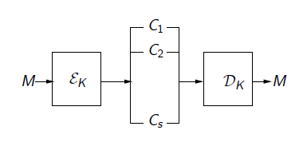
Randomized Cipher
There are many possible ciphertexts corresponding to each message.
If so, how can we decrypt?

Slide 67
Solution 2: nonce-based Encryption
nonce
Alice
Bob
m, n
E
E(k,m,n)=c
c, n
D
D(k,c,n)=m
k
k
nonce n: a value that changes from msg to msg.
(k,n) pair never used more than once
method 1: nonce is a counter (e.g. packet counter)
used when encryptor keeps state from msg to msg
if decryptor has same state, need not send nonce with CT
method 2: encryptor chooses a random nonce, n ← N
Notes:
File encryption: random nonce, no state from file to file
SSL encrytpion (in order delivery): counter is fine, no need to send nonce to peer.
IP sec (out of order delivery): counter is fine, but need to include nonce in every packet.

Slide 68
CPA security for nonce-based encryption
System should be secure when nonces are chosen adversarially.
Def: nonce-based E is sem. sec. under CPA if for all “efficient” A: Adv_{nCPA} [A,E] = |Pr[EXP(0)=1] – Pr[EXP(1)=1] | is “negligible.”
b
for i=1,…,q:
Chal.
Adv.
n_{i} and m_{i,0} , m_{i,1} : |m_{i,0}| = |m_{i,1}|
k←K
c ← E(k, m_{i,b} , n_{i})
b’ ∈ {0,1}
All nonces {n₁, …, n_{q}} must be distinct.

Slide 69
Modes of Operation
Many Times Keys (CBC, CFB, OFB, CTR)

Slide 70
Construction 1: CBC with random IV
Let (E,D) be a PRP. E_{CBC}(k,m): choose random IV∈X and do:
IV
m[0]
m[1]
m[2]
m[3]
⊕
⊕
⊕
⊕
E(k,⋅)
E(k,⋅)
E(k,⋅)
E(k,⋅)
IV
c[0]
c[1]
c[2]
c[3]
ciphertext
Notes:
Unlike ECB, same block in different positions gets mapped to different ciphertexts.

Slide 71
Decryption circuit
In symbols: c[0] = E(k, IV⨁m[0] ) ⇒ m[0] = D(k, c[0]) ⨁ IV
IV
c[0]
c[1]
c[2]
c[3]
D(k,⋅)
D(k,⋅)
D(k,⋅)
D(k,⋅)
⊕
⊕
⊕
⊕
m[0]
m[1]
m[2]
m[3]

Slide 72
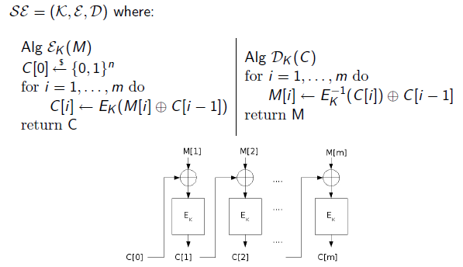
CBC Encryption with Random IV

Slide 73
CBC: CPA Analysis
CBC Theorem: For any L>0, If E is a secure PRP over (K,X) then E_{CBC} is a sem. sec. under CPA over (K, X^{L}, X^{L+1}).
In particular, for a q-query adversary A attacking E_{CBC} there exists a PRP adversary B s.t.:
Adv_{CPA} [A, E_{CBC}] ≤ 2⋅Adv_{PRP}[B, E] + 2 q² L² / |X|
Note: CBC is only secure as long as q²L² << |X|

Slide 74
An example
Adv_{CPA} [A, E_{CBC}] ≤ 2⋅PRP Adv[B, E] + 2 q² L² / |X|
q = # messages encrypted with k , L = length of max message
Suppose we want Adv_{CPA} [A, E_{CBC}] ≤ 1/2³² ⇐ q² L² /|X| < 1/ 2³²
AES: |X| = 2¹²⁸ ⇒ q L < 2⁴⁸
So, after 2⁴⁸ AES blocks, must change key
3DES: |X| = 2⁶⁴ ⇒ q L < 2¹⁶

Slide 75
Warning: an attack on CBC with non-rand. IV
CBC where attacker can predict the IV is not CPA-secure !!
Suppose given c ⟵ E_{CBC}(k,m) can predict IV for next message
0 ∈ X
Chal.
c₁ ← [ IV₁, E(k, 0⨁IV₁) ]
Adv.
k←K
predict IV
m₀=IV⨁IV₁ , m₁ ≠ m₀
c ← [ IV, E(k, IV₁) ] or
output 0
if c[1] = c₁[1]
c ← [ IV, E(k, m₁⨁IV) ]
Bug in SSL/TLS 1.0: IV for record #i is last CT block of record #(i-1)

Slide 76
Construction 1’: nonce-based CBC
Cipher block chaining with unique nonce: key = (k,k₁)
unique nonce means: (key, n) pair is used for only one message
nonce
m[0]
m[1]
m[2]
m[3]
IV
⊕
⊕
⊕
⊕
E(k₁,⋅)
E(k,⋅)
E(k,⋅)
E(k,⋅)
E(k,⋅)
nonce
c[0]
c[1]
c[2]
c[3]
ciphertext
included only if unknown to decryptor
Notes:
Unique means non-random, but unique. Note that setting IV = E(k,nonce) is insecure.

Slide 77
An example Crypto API (OpenSSL)
void AES_cbc_encrypt(
const unsigned char *in,
unsigned char *out,
size_t length,
const AES_KEY *key,
unsigned char *ivec, ⟵ user supplies IV
AES_ENCRYPT or AES_DECRYPT);
When nonce is non random need to encrypt it before use

Slide 78
A CBC technicality: padding
IV
m[0]
m[1]
m[2]
m[3] ll pad
IV′
⊕
⊕
⊕
⊕
E(k₁,⋅)
E(k,⋅)
E(k,⋅)
E(k,⋅)
E(k,⋅)
IV
c[0]
c[1]
c[2]
c[3]
removed
during
decryption
TLS: for n>0, n byte pad is
if no pad needed, add a dummy block
n
n
n
⋯
n
Notes:
Solution: ciphertext stealing, but not discussed here.

Slide 79
Choice of Mode of Operation
Security
Error Propagation
Error Recovery
Computational Efficiency (Parallelism/ Precomputation)
Message Length Preservation
Random Access
Re-ordering of Ciphertext Blocks

Slide 80
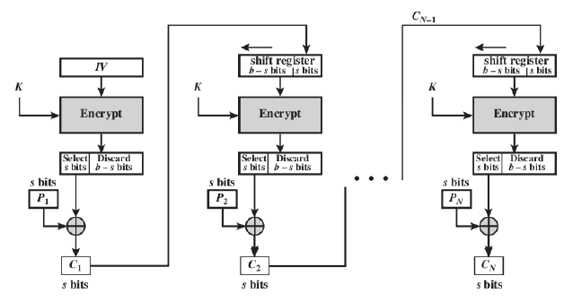
CFB Mode (Encryption)

Slide 81
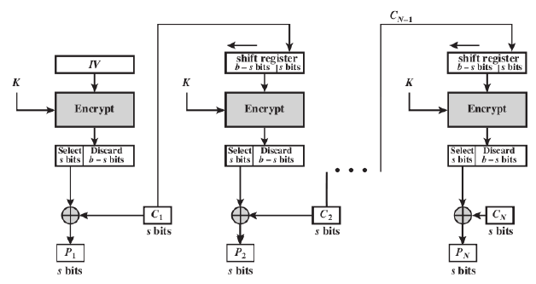
CFB Mode (Decryption)

Slide 82
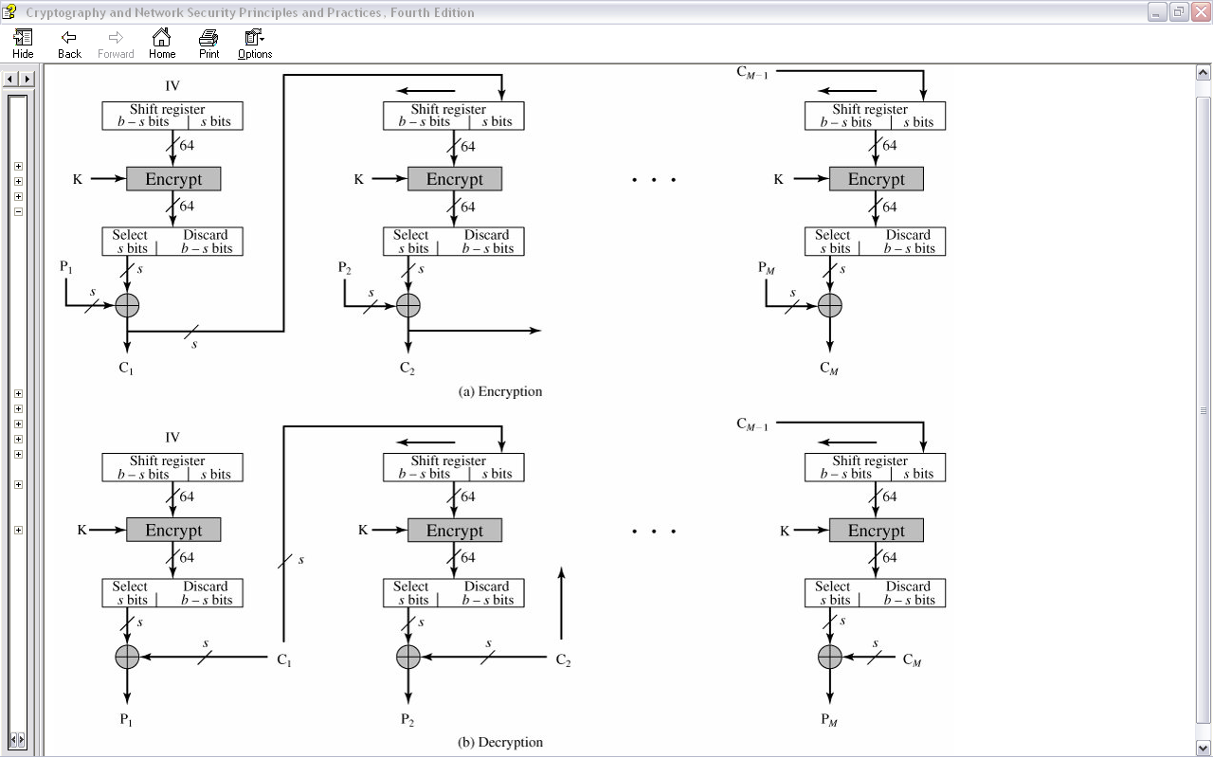
CFB Mode

Slide 83
CFB Mode
Converts block cipher into stream cipher
No need to pad message to integral number of blocks
Operate in real-time: each character encrypted and
transmitted immediately
Input processed s bits at a time
Preceding ciphertext used as input to cipher to produce pseudorandom output
XOR output with plaintext to produce ciphertext
Typical applications: General-purpose stream-oriented transmission; authentication

Slide 84
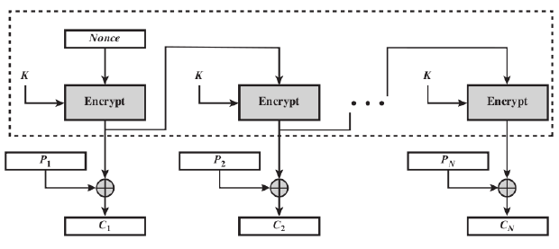
OFB Mode (Encryption)

Slide 85
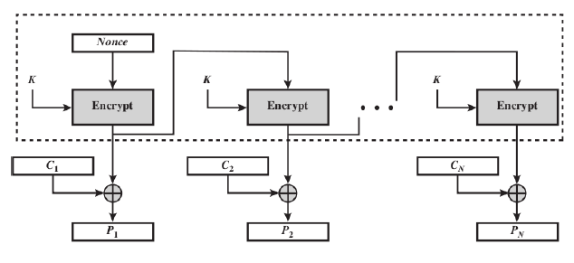
OFB Mode (Decryption)

Slide 86
OFB Mode
Converts block cipher into stream cipher
Similar to CFB, except input to encryption algorithm is preceding encryption output
Typical applications: stream-oriented transmission over noisy channel (e.g. satellite communications)
Advantage compared to OFB: bit errors do not
propagate
Disadvantage: more vulnerable to message stream modification attack

Slide 87
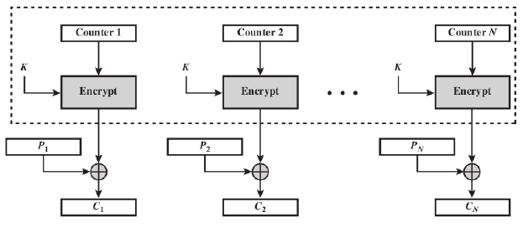
CTR Mode (Encryption)

Slide 88
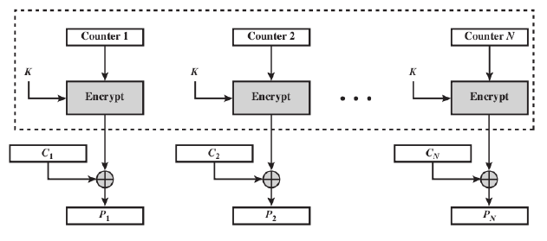
CTR Mode (Decryption)

Slide 89
CTR Mode
Deterministic counter mode from a PRF F :
E_{DETCTR} (k, m) =
⇒ Stream cipher built from a PRF (e.g. AES, 3DES)
m[0]
m[1]
…
m[L]
⊕
F(k,0)
F(k,1)
…
F(k,L)
c[0]
c[1]
…
c[L]

Slide 90
Det. counter-mode security
Theorem: For any L>0, If F is a secure PRF over (K,X,X) then E_{DETCTR} is sem. sec. cipher over (K,X^{L},X^{L}).
In particular, for any eff. adversary A attacking E_{DETCTR} there exists a n eff. PRF adversary B s.t.:
Adv_{SS}[A, E_{DETCTR}] = 2 ⋅ Adv_{PRF}[B, F]
Adv_{PRF}[B, F] is negligible (since F is a secure PRF) Hence, Adv_{SS}[A, E_{DETCTR}] must be negligible.

Slide 91
Proof
m₀ , m₁
m₀ , m₁
chal.
adv. A
chal.
≈_{p}
adv. A
c ←
m0
m0
k←K
⊕
f←Funs
c ←
⊕
F(k,0) … F(k,L)
f(0) … f(L)
b’≟1
b’≟1
≈_{p}
≈_{p}
m₀ , m₁
m₀ , m₁
chal.
adv. A
≈_{p}
chal.
adv. A
c ←
m1
r←{0,1}^{n}
c ←
m1
k←K
⊕
⊕
F(k,0) … F(k,L)
f(0) … f(L)
b’≟1
b’≟1

Slide 92
Construction 2: rand ctr-mode
Let F: K × {0,1}^{n} ⟶ {0,1}^{n} be a secure PRF.
E(k,m): choose a random IV ∈ {0,1}^{n} and do:
msg
IV
m[0]
m[1]
…
m[L]
⊕
F(k,IV)
F(k,IV+1)
…
F(k,IV+L)
IV
c[0]
c[1]
…
c[L]
ciphertext
note: parallelizable (unlike CBC)

Slide 93
Construction 2’: nonce ctr-mode
msg
IV
m[0]
m[1]
…
m[L]
⊕
F(k,IV)
F(k,IV+1)
…
F(k,IV+L)
IV
c[0]
c[1]
…
c[L]
ciphertext
To ensure F(k,x) is never used more than once, choose IV as:
128 bits
IV:
nonce
counter
starts at 0 for every msg
64 bits
64 bits
Notes:
Max message length is 2^64 blocks.

Slide 94
rand ctr-mode (rand. IV): CPA analysis
Counter-mode Theorem: For any L>0, If F is a secure PRF over (K,X,X) then E_{CTR} is a sem. sec. under CPA over (K,X^{L},X^{L+1}).
In particular, for a q-query adversary A attacking E_{CTR} there exists a PRF adversary B s.t.:
Adv_{CPA}[A, E_{CTR}] ≤ 2⋅Adv_{PRF}[B, F] + 2 q² L / |X|
Note: ctr-mode only secure as long as q²L << |X| . Better than CBC !

Slide 95
An example
Adv_{CPA} [A, E_{CTR}] ≤ 2⋅Adv_{PRF}[B, E] + 2 q² L / |X|
q = # messages encrypted with k , L = length of max message
Suppose we want Adv_{CPA} [A, E_{CTR}] ≤ 1/2³² ⇐ q² L/|X| < 1/ 2³²
AES: |X| = 2¹²⁸ ⇒ q L^{1/2} < 2⁴⁸
So, after 2³² CTs each of length 2³² , must change key
(total of 2⁶⁴ AES blocks)

Slide 96
Comparison: CTR vs. CBC
 | CBC | ctr mode
uses | PRP | PRF
parallel processing | No | Yes
Security of rand. enc. | q^2 L^2 << |X| | q^2 L << |X|
dummy padding block | Yes | No
1 byte msgs (nonce-based) | 16x expansion | no expansion
(for CBC, dummy padding block can be solved using ciphertext stealing)

Slide 97
Further reading
A concrete security treatment of symmetric encryption: Analysis of the DES modes of operation, M. Bellare, A. Desai, E. Jokipii and P. Rogaway, FOCS 1997
Nonce-Based Symmetric Encryption, P. Rogaway, FSE 2004

Slide 98
More attacks on block ciphers

Slide 99
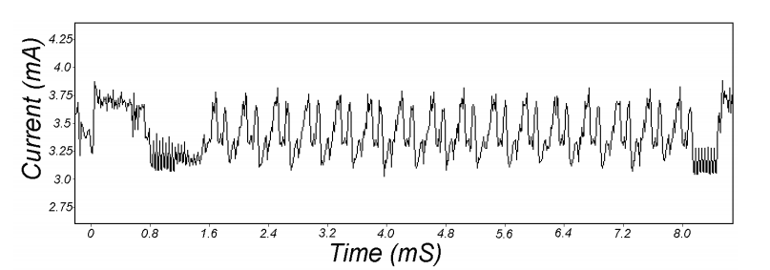
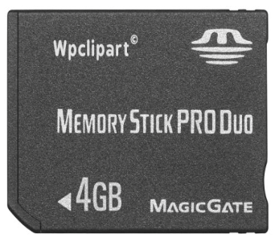
Attacks on the implementation
1. Side channel attacks:
Measure time to do enc/dec, measure power for enc/dec
2. Fault attacks:
Computing errors in the last round expose the secret key k
⇒ do not even implement crypto primitives yourself …
smartcard
[Kocher, Jaffe, Jun, 1998]
Notes:
Many timing attacks: cache timing, multi-core attacks, smartcard attacks

Slide 100
Linear and differential attacks [BS’89,M’93]
Given many inp/out pairs, can recover key in time less than 2⁵⁶ .
Linear cryptanalysis (overview) : let c = DES(k, m)
Suppose for random k,m :
Pr[m[i₁]⨁⋯⨁m[i_{r}] ⨁ c[j_{j}]⨁⋯⨁c[j_{v}]=k[l₁]⨁⋯⨁k[l_{u}] ] = ½ + ε
For some ε. For DES, this exists with ε = 1/2²¹ ≈ 0.0000000477
Notes:
If S-boxes were random, then ε = 1/2¹⁰

Slide 101
Linear attacks
Pr[m[i₁]⨁⋯⨁m[i_{r}] ⨁ c[j_{j}]⨁⋯⨁c[j_{v}] = k[l₁]⨁⋯⨁k[l_{u}] ] = ½ + ε
Thm: given 1/ε² random (m, c=DES(k, m)) pairs then
k[l₁,…,l_{u}] = MAJ [ m[i₁,…,i_{r}] ⨁ c[j_{j},…,j_{v}] ]
with prob. ≥ 97.7%
⇒ with 1/ε² inp/out pairs can find k[l₁,…,l_{u}] in time ≈1/ε² .

Slide 102
Linear attacks
For DES, ε = 1/2²¹ ⇒
with 2⁴² inp/out pairs can find k[l₁,…,l_{u}] in time 2⁴²
Roughly speaking: can find 14 key “bits” this way in time 2⁴²
Brute force remaining 56−14=42 bits in time 2⁴²
Total attack time ≈2⁴³ ( << 2⁵⁶ ) with 2⁴² random inp/out pairs

Slide 103
Lesson
A tiny bit of linearly in S₅ lead to a 2⁴² time attack.
⇒ don’t design ciphers yourself !!

Slide 104
Quantum attacks
Generic search problem:
Let f: X ⟶ {0,1} be a function.
Goal: find x∈X s.t. f(x)=1.
Classical computer: best generic algorithm time = O(|X|)
Quantum computer [Grover ’96] : time = O( |X|^{1/2} )
Can quantum computers be built: unknown

Slide 105
Quantum exhaustive search
if E(k,m) = c
0 otherwise
Given m, c=E(k,m) define
Grover ⇒ quantum computer can find k in time O(|K|^{1/2})
DES: time ≈2²⁸ , AES-128: time ≈2⁶⁴
quantum computer ⇒ 256-bits key ciphers (e.g. AES-256)
f(k) =

Slide 106
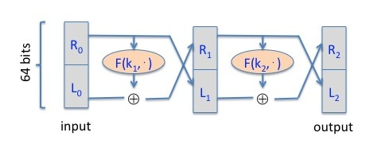
Quiz
On input 0₆₄ the output is "290b6e3a 39155d6f". On input 1₃₂0₃₂ the output is "d6f491c5 b645c008".
On input 0₆₄ the output is "7c2822eb fdc48bfb". On input 1₃₂0₃₂ the output is "325032a9 c5e2364b".
On input 0₆₄ the output is "4af53267 1351e2e1". On input 1₃₂0₃₂ the output is "87a40cfa 8dd39154".
On input 0₆₄ the output is "2d1cfa42 c0b1d266". On input 1₃₂0₃₂ the output is "eea6e3dd b2146dd0".

Slide 107
Copyright Notice
The material in this presentation has been taken from text books, reference books, research literature and various sources on Internet; and compiled/edited for class room teaching at MCS-NUST without any infringement into the copyrights of the author(s). The original authors retain their respective copyrights as per their stated claims.
Commercial use of the material contained herein in full or in part through copying, publication and reproducing in any form is strictly prohibited.

