Slide 1
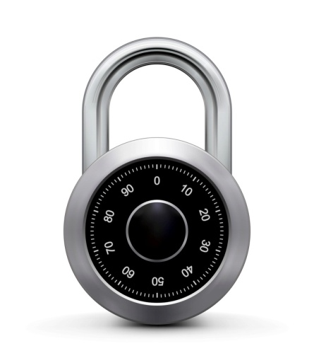
Applied Cryptography
ASHRAF MASOOD
dean@mcs.edu.pk
Lecture Slides– Fall 2012
Lecture #8

Slide 2
Message Integrity
MAC

Slide 3
Message Integrity
Goal: integrity, no confidentiality.
Examples:
Protecting public binaries on disk.
Protecting banner ads on web pages.

Slide 4
Attacks on Communications across Network
1. Disclosure: encryption
2. Traffic analysis: encryption
3. Masquerade: message authentication
4. Content modification: message authentication
5. Sequence modification: message authentication
6. Timing modification: message authentication
7. Source répudiation: digital signatures
8. Destination répudiation: digital signatures

Slide 5
Message Authentication Functions
Message authentication (and digital signature) mechanisms have two parts:
Function that produces authenticator
Protocol that enables receiver to verify authenticity
Three types of authentication functions:
Message encryption
Message authentication code (MAC)
Hash function

Slide 6
Message integrity: MACs
k
k
message m
tag
Alice
Bob
Generate tag:
tag ← S(k, m)
Verify tag:
V(k, m, tag) = `yes’
?
Def: MAC I = (S,V) defined over (K,M,T) is a pair of algs:
S(k,m) outputs t in T
V(k,m,t) outputs `yes’ or `no’

Slide 7
Integrity requires a secret key
message m
tag
Alice
Bob
Generate tag:
tag ← CRC(m)
Verify tag:
V(m, tag) = `yes’
?
Attacker can easily modify message m and re-compute CRC.
CRC designed to detect random, not malicious errors.

Slide 8
MAC
Append small, fixed-size block of data to message: cryptographic checksum or MAC
T = MAC(K;M)
M = input message
MAC = MAC function
K = shared secret key of k bits
T = message authentication code (or tag) of n bits
MAC function also called keyed hash function
MAC function similar to encryption, but does not need to be reversible
Easier to design stronger MAC functions than encryption functions

Slide 9
Secure MACs
Attacker’s power: chosen message attack
for m₁,m₂,…,m_{q} attacker is given t_{i} ← S(k,m_{i})
Attacker’s goal: existential forgery
produce some new valid message/tag pair (m,t).
(m,t) ∉ { (m₁,t₁) , … , (m_{q},t_{q}) }
⇒ attacker cannot produce a valid tag for a new message
given (m,t)
⇒ given (m,t) attacker cannot even produce (m,t’) for t’ ≠ t
⇒ attacker cannot even produce (m’,t) for m’ ≠ m (??)

Slide 10
Secure MACs
For a MAC I=(S,V) and adv. A define a MAC game as:
Def: I=(S,V) is a secure MAC if for all “efficient” A Adv_{MAC}[A,I] = Pr[Chal. outputs 1] is “negligible.”
m₁ ∈ M
m₂
, …, m_{q}
Chal.
Adv.
t₁ ← S(k,m₁)
t₂
, …, t_{q}
k←K
(m,t)
b
b=1 if V(k,m,t) = `yes’ and (m,t) ∉ { (m₁,t₁) , … , (m_{q},t_{q}) }
b=0 otherwise

Slide 11
Example: protecting system files
Suppose at install time the system computes:
filename
filename
filename
F₁
F₂
F_{n}
⋯
k derived from user’s password
t₁ = S(k,F₁)
t₂ = S(k,F₂)
t_{n} = S(k,F_{n})
Later a virus infects system and modifies system files
User reboots into clean OS and supplies his password
Then: secure MAC ⇒ all modified files will be detected
Notes:
Virus cannot create (F’, t’) that will verify properly. Note however that virus may try to swap files around.

Slide 12
Secure PRF ⇒ Secure MAC
For a PRF F: K × X ⟶ Y define a MAC I_{F} = (S,V) as:
S(k,m) := F(k,m)
V(k,m,t): output `yes’ if t = F(k,m) and `no’ otherwise.
message m
tag
Alice
Bob
tag ← F(k,m)
accept msg if
tag = F(k,m)

Slide 13
Abstractly: PRPs and PRFs
Pseudo Random Function (PRF) defined over (K,X,Y):
F: K × X → Y
such that exists “efficient” algorithm to evaluate F(k,x)
Pseudo Random Permutation (PRP) defined over (K,X):
E: K × X → X
such that: 1. Exists “efficient” deterministic algorithm to evaluate E(k,x)
2. The function E( k, ⋅ ) is one-to-one
3. Exists “efficient” inversion algorithm D(k,y)

Slide 14
Running example
Example PRPs: 3DES, AES, …
AES: K × X → X where K = X = {0,1}¹²⁸
3DES: K × X → X where X = {0,1}⁶⁴ , K = {0,1}¹⁶⁸
Functionally, any PRP is also a PRF.
A PRP is a PRF where X=Y and is efficiently invertible.

Slide 15
Security
Thm: If F: K×X⟶Y is a secure PRF and 1/|Y| is negligible (i.e. |Y| is large) then I_{F} is a secure MAC.
In particular, for every eff. MAC adversary A attacking I_{F} there exists an eff. PRF adversary B attacking F s.t.:
Adv_{MAC}[A, I_{F}] ≤ Adv_{PRF}[B, F] + 1/|Y|
⇒ I_{F} is secure as long as |Y| is large, say |Y| = 2⁸⁰ .

Slide 16
Examples
AES: a MAC for 16-byte messages.
Main question: how to convert Small-MAC into a Big-MAC ?
Two main constructions used in practice:
CBC-MAC (banking – ANSI X9.9, X9.19, FIPS 186-3)
HMAC (Internet protocols: SSL, IPsec, SSH, …)
Both convert a small-PRF into a big-PRF.

Slide 17
Truncating MACs based on PRFs
Easy lemma: suppose F: K × X ⟶ {0,1}^{n} is a secure PRF.
Then so is F_{t}(k,m) = F(k,m)[1…t] for all 1 ≤ t ≤ n
⇒ if (S,V) is a MAC is based on a secure PRF outputting n-bit tags
the truncated MAC outputting w bits is secure
… as long as 1/2^{w} is still negligible (say w≥64)

Slide 18
MACs and PRFs
Recall: secure PRF F ⇒ secure MAC, as long as |Y| is large
S(k, m) = F(k, m)
Our goal:
given a PRF for short messages (AES)
construct a PRF for long messages
From here on let X = {0,1}^{n} (e.g. n=128)

Slide 19
Construction 1: encrypted CBC-MAC
raw CBC
m[0]
m[1]
m[3]
m[4]
⊕
⊕
⊕
F(k,⋅)
F(k,⋅)
F(k,⋅)
F(k,⋅)
Let F: K × X ⟶ X be a PRP
Define new PRF F_{ECBC} : K² × X^{≤L} ⟶ X
F(k₁,⋅)
tag
Notes:
Define the notation X^{<L}

Slide 20
Why the last encryption step in ECBC-MAC?
Suppose we define a MAC I_{RAW} = (S,V) where
S(k,m) = rawCBC(k,m)
Then I_{RAW} is easily broken using a 1-chosen msg attack.
Adversary works as follows:
Choose an arbitrary one-block message m∈X
Request tag for m. Get t = F(k,m)
Output t as MAC forgery for the 2-block message (m, t⊕m)
Indeed: rawCBC(k, (m, t⊕m) ) = F(k, F(k,m)⊕(t⊕m) ) = F(k, t⊕(t⊕m) ) = t
Notes:
Note that forgery is an extension of query. rawCBC is a secure PRF if no message is a prefix of another (e.g. if all messages are same length).

Slide 21
Construction 2: NMAC (nested MAC)
cascade
m[0]
m[1]
m[3]
m[4]
k
t
F
F
F
F
>
>
>
>
t ll fpad
F
>
Let F: K × X ⟶ K be a PRF
Define new PRF F_{NMAC} : K² × X^{≤L} ⟶ K
k₁
tag
Notes:
Explain that both MACs use a final encryption step. The internal PRFs are only secure for prefix free messages --- simply say fixed length messages.
Cascade is a generalization of GGM. Is the basis of HMAC.

Slide 22
ECBC-MAC and NMAC analysis
Theorem: For any L>0, For every eff. q-query PRF adv. A attacking F_{ECBC} or F_{NMAC} there exists an eff. adversary B s.t.:
Adv_{PRF}[A, F_{ECBC}] ≤ Adv_{PRP}[B, F] + 2 q² / |X|
Adv_{PRF}[A, F_{NMAC}] ≤ q⋅L⋅Adv_{PRF}[B, F] + q² / 2|K|
CBC-MAC is secure as long as q << |X|^{1/2}
NMAC is secure as long as q << |K|^{1/2} (2⁶⁴ for AES-128)

Slide 23
An example
Adv_{PRF}[A, F_{ECBC}] ≤ Adv_{PRP}[B, F] + 2 q² / |X|
q = # messages MAC-ed with k
Suppose we want Adv_{PRF}[A, F_{ECBC}] ≤ 1/2³² ⇐ q² /|X| < 1/ 2³²
AES: |X| = 2¹²⁸ ⇒ q < 2⁴⁸
So, after 2⁴⁸ messages must, must change key
3DES: |X| = 2⁶⁴ ⇒ q < 2¹⁶

Slide 24
Comparison
ECBC-MAC is commonly used as an AES-based MAC
CCM encryption mode (used in 802.11i)
NIST standard called CMAC
NMAC not usually used with AES or 3DES
Main reason: need to change AES key on every block (requires re-computing AES key expansion)
But NMAC is the basis for a popular MAC called HMAC (next)

Slide 25
Construction 3: PMAC – parallel MAC
P(k, i): an easy to compute function
m[0]
m[1]
m[2]
m[3]
key = (k, k₁)
⊕
⊕
⊕
⊕
P(k,0)
P(k,1)
P(k,2)
P(k,3)
Padding similar to CMAC
F(k₁,⋅)
F(k₁,⋅)
F(k₁,⋅)
⊕
Let F: K × X ⟶ X be a PRF
Define new PRF F_{PMAC} : K² × X^{≤L} ⟶ X
F(k₁,⋅)
tag

Slide 26
PMAC is incremental
Suppose F is a PRP.
When m[1] ⟶ m’[1] can we quickly update tag?
m[0]
m[1]
m[3]
m[4]
P(k,0)
⊕
P(k,1)
⊕
P(k,2)
⊕
P(k,3)
⊕
F(k₁,⋅)
F(k₁,⋅)
F(k₁,⋅)
⊕
F(k₁,⋅)
tag
no, it can’t be done
do F⁻¹(k₁,tag) ⨁ F(k₁, m’[1] ⨁ P(k,1))
do F⁻¹(k₁,tag) ⨁ F(k₁, m[1] ⨁ P(k,1)) ⨁ F(k₁, m’[1] ⨁ P(k,1))
do tag ⨁ F(k₁, m[1] ⨁ P(k,1)) ⨁ F(k₁, m’[1] ⨁ P(k,1))
Then apply F(k₁, ⋅)

Slide 27
Construction 4: HMAC (Hash-MAC)
Most widely used MAC on the Internet.
… but, we first we need to discuss hash function.

Slide 28
Further reading
J. Black, P. Rogaway: CBC MACs for Arbitrary-Length Messages: The Three-Key Constructions. J. Cryptology 18(2): 111-131 (2005)
K. Pietrzak: A Tight Bound for EMAC. ICALP (2) 2006: 168-179
J. Black, P. Rogaway: A Block-Cipher Mode of Operation for Parallelizable Message Authentication. EUROCRYPT 2002: 384-397
M. Bellare: New Proofs for NMAC and HMAC: Security Without Collision-Resistance. CRYPTO 2006: 602-619
Y. Dodis, K. Pietrzak, P. Puniya: A New Mode of Operation for Block Ciphers and Length-Preserving MACs. EUROCRYPT 2008: 198-219

Slide 29
Collision Resistant Hash Functions

Slide 30
Collision Resistance
Let H: M →T be a hash function ( |M| >> |T| )
A collision for H is a pair m₀ , m₁ ∈ M such that:
H(m₀) = H(m₁) and m₀ ≠ m₁
Goal: collision resistant (C.R.) hash functions
Step 1: given C.R. function for short messages,
construct C.R. function for long messages

Slide 31
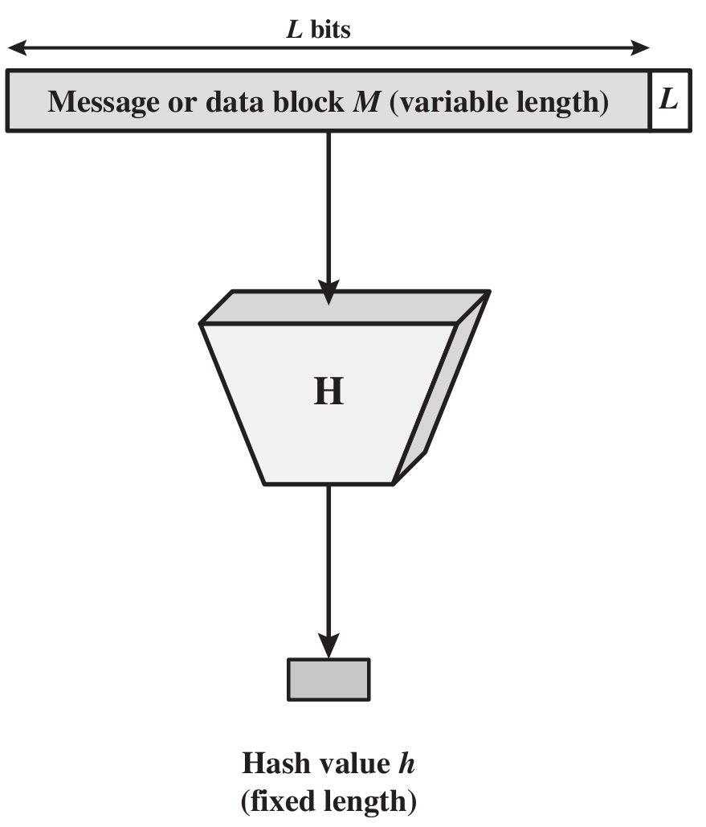
Cryptographic Hash Function

Slide 32
The Merkle-Damgard iterated construction
m[0]
m[1]
m[2]
m[3] ll PB
h
h
h
h
H(m)
IV
(fixed)
H₀
H₁
H₂
H₃
H₄
Given h: T × X ⟶ T (compression function)
we obtain H: X^{≤L} ⟶ T . H_{i} - chaining variables
PB: padding block
1000…0 ll msg len
If no space for PB add another block
64 bits

Slide 33
MD collision resistance
Thm: if h is collision resistant then so is H.
Proof: collision on H ⇒ collision on h
Suppose H(M) = H(M’). We build collision for h.
IV = H₀ , H₁ , … , H_{t} , H_{t+1} = H(M)
IV = H₀’ , H₁’ , … , H’_{r}, H’_{r+1} = H(M’)
h( H_{t}, M_{t} ll PB) = H_{t+1} = H’_{r+1} = h(H’_{r}, M’_{r} ll PB’)

Slide 34
Compression Function from a Block Cipher
E: K× {0,1}^{n} ⟶ {0,1}^{n} a block cipher.
h(H, m) = E(m, H)
m_{i}
>
E
H_{i}

Slide 35
Compression Function from a Block Cipher
E: K× {0,1}^{n} ⟶ {0,1}^{n} a block cipher.
The Davies-Meyer compression function:
h(H, m) = E(m, H)⨁H
Thm: Suppose E is an ideal cipher (collection of |K| random perms.).
Finding a collision h(H,m)=h(H’,m’) takes O(2^{n/2}) evaluations of (E,D).
m_{i}
>
E
⨁
H_{i}
Best possible !!

Slide 36
Case study: SHA-256
Merkle-Damgard function
Davies-Meyer compression function
512-bit key
>
SHA-2
256-bit block
256-bit block

Slide 37
The Merkle-Damgard iterated construction
m[0]
m[1]
m[2]
m[3] ll PB
h
h
h
h
H(m)
IV
(fixed)
Thm: h collision resistant ⇒ H collision resistant
Can we use H(.) to directly build a MAC?

Slide 38
Standardized method: HMAC (Hash-MAC)
Most widely used MAC on the Internet.
H: hash function.
example: SHA-256 ; output is 256 bits
Building a MAC out of a hash function:
HMAC: S( k, m ) = H( k⊕opad ll H( k⊕ipad ll m ) )

Slide 39
HMAC
k⨁ipad
m[0]
m[1]
m[2] ll PB
>
h
h
h
IV
(fixed)
h
>
>
>
ipad= 00110110
opad= 01011100
k⨁opad
>
h
tag
h
>
IV
(fixed)
Similar to the NMAC PRF.
main difference: the two keys k₁, k₂ are dependent
Notes:
Draw arrows to show k1 and k2.

Slide 40
HMAC Properties
Built from a black-box implementation of SHA-256.
HMAC is assumed to be a secure PRF
Can be proven under certain PRF assumptions about h(.,.)
Security bounds similar to NMAC
Need q²/|T| to be negligible ( q << |T|^{½} )
In TLS: must support HMAC-SHA1-96

Slide 41
One Way Hash Functions – MD5
The MD4 Hash Function was proposed in 1990 by Ron Rivest
Message Digest algorithm 5, developed by Ron Rivest in 1991 (strengthened version of MD4)
Standardised by IETF in RFC 1321
Generates 128-bit hash
Was commonly used by applications, passwords, ie. integrity; no longer recommended
Collision and other attacks possible; tools publicly available to attack MD5

Slide 42
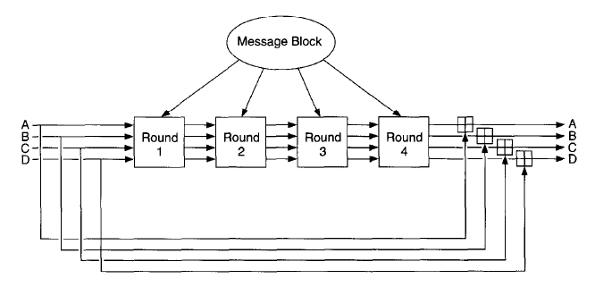
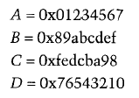
MD-5

Slide 43
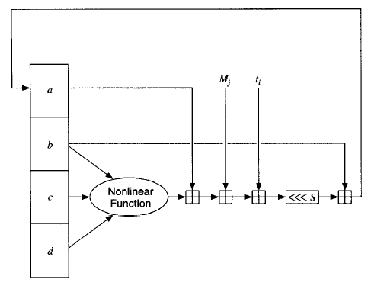
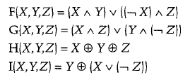
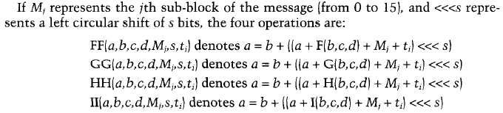
MD-5 Round Function

Slide 44
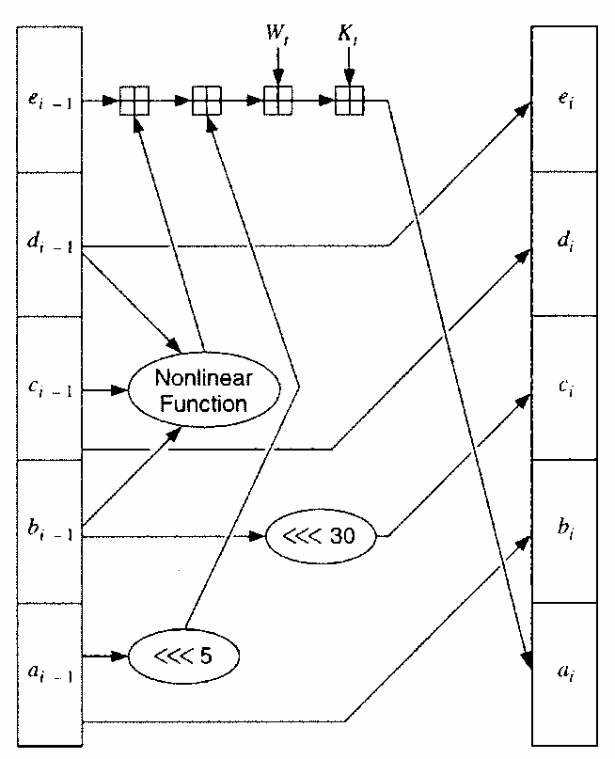
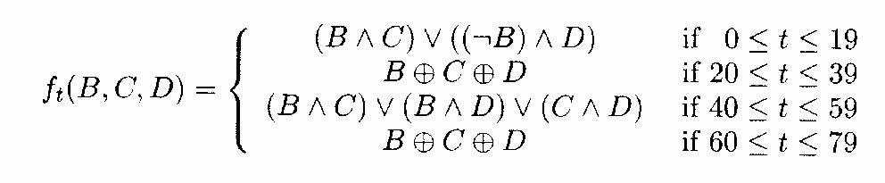
SHA-1
Input: X₀ (160 bits), m₁ (512 bits): Output: X₁
Expand m₁ from 512→2560 bits.
m₁=(W₁..W₁₅)
Initialization
4 rounds of 20 iterations each):
Each round uses
a different K and different nonlinear mixing function f
m₁
w₀
w₁
…
w₁₅
w₁₆
…
w₁₉
…
w₇₉
… (20 iters)
Round 2
Round 3
Round 4
K_{0..19}=5A827999
K_{20..39}=6ED9EBA1
K_{60..79}=CA62C1D6
Round 1
K_{40..59}=8F1BBCDC

Slide 45
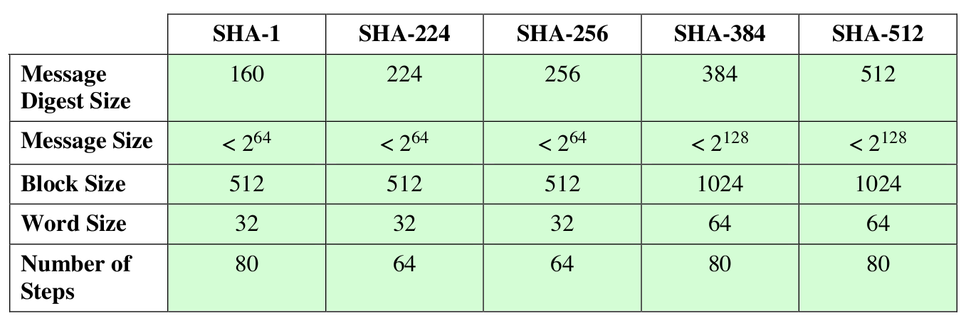
One Way Hash Functions – SHA-x
Secure Hash Algorithm, developed by NIST
Standardised by NIST in FIPS 180 in 1993
Improvements over time: SHA-0, SHA-1,SHA-2,SHA-3
SHA-1 (and SHA-0) are considered insecure; no longer
recommended
SHA-3 in development, competition run by NIST

Slide 46
Copyright Notice
The material in this presentation has been taken from text books, reference books, research literature and various sources on Internet; and compiled/edited for class room teaching at MCS-NUST without any infringement into the copyrights of the author(s). The original authors retain their respective copyrights as per their stated claims.
Commercial use of the material contained herein in full or in part through copying, publication and reproducing in any form is strictly prohibited.

