Slide 1

Applied Cryptography
ASHRAF MASOOD
dean@mcs.edu.pk
Lecture Slides– Fall 2012
Lecture #9

Slide 2
Collision Resistant Hash Functions

Slide 3
Collision Resistance
Let H: M →T be a hash function ( |M| >> |T| )
A collision for H is a pair m₀ , m₁ ∈ M such that:
H(m₀) = H(m₁) and m₀ ≠ m₁
Goal: collision resistant (C.R.) hash functions
Step 1: given C.R. function for short messages,
construct C.R. function for long messages

Slide 4
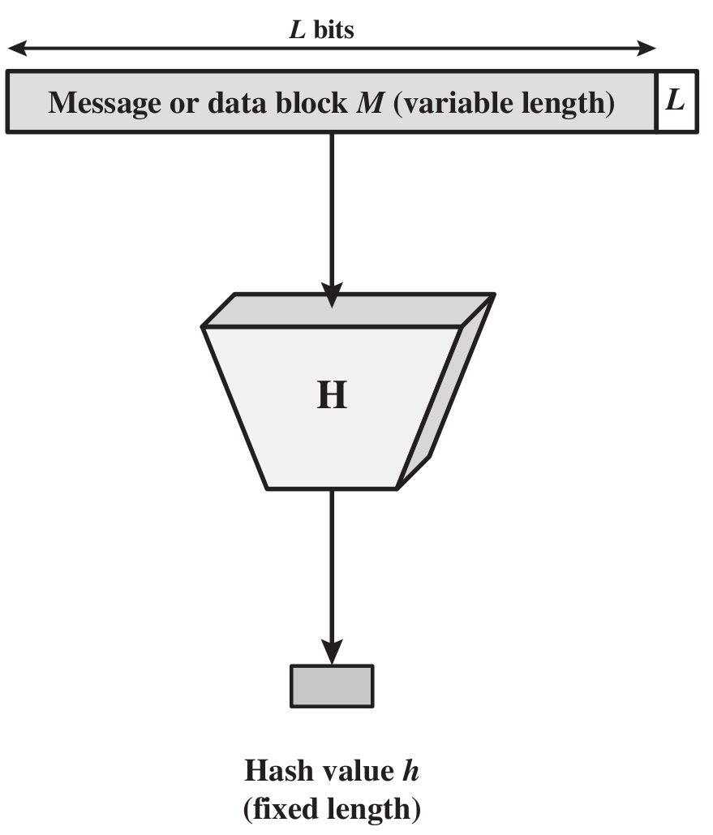
Cryptographic Hash Function

Slide 5
The Merkle-Damgard iterated construction
m[0]
m[1]
m[2]
m[3] ll PB
h
h
h
h
H(m)
IV
(fixed)
H₀
H₁
H₂
H₃
H₄
Given h: T × X ⟶ T (compression function)
we obtain H: X^{≤L} ⟶ T . H_{i} - chaining variables
PB: padding block
1000…0 ll msg len
If no space for PB add another block
64 bits

Slide 6
MD collision resistance
Thm: if h is collision resistant then so is H.
Proof: collision on H ⇒ collision on h
Suppose H(M) = H(M’). We build collision for h.
IV = H₀ , H₁ , … , H_{t} , H_{t+1} = H(M)
IV = H₀’ , H₁’ , … , H’_{r}, H’_{r+1} = H(M’)
h( H_{t}, M_{t} ll PB) = H_{t+1} = H’_{r+1} = h(H’_{r}, M’_{r} ll PB’)

Slide 7
Compression Function from a Block Cipher
E: K× {0,1}^{n} ⟶ {0,1}^{n} a block cipher.
h(H, m) = E(m, H)
m_{i}
>
E
H_{i}

Slide 8
Compression Function from a Block Cipher
E: K× {0,1}^{n} ⟶ {0,1}^{n} a block cipher.
The Davies-Meyer compression function:
h(H, m) = E(m, H)⨁H
Thm: Suppose E is an ideal cipher (collection of |K| random perms.).
Finding a collision h(H,m)=h(H’,m’) takes O(2^{n/2}) evaluations of (E,D).
m_{i}
>
E
⨁
H_{i}
Best possible !!

Slide 9
Case study: SHA-256
Merkle-Damgard function
Davies-Meyer compression function
512-bit key
>
SHA-2
256-bit block
256-bit block

Slide 10
The Merkle-Damgard iterated construction
m[0]
m[1]
m[2]
m[3] ll PB
h
h
h
h
H(m)
IV
(fixed)
Thm: h collision resistant ⇒ H collision resistant
Can we use H(.) to directly build a MAC?

Slide 11
Standardized method: HMAC (Hash-MAC)
Most widely used MAC on the Internet.
H: hash function.
example: SHA-256 ; output is 256 bits
Building a MAC out of a hash function:
HMAC: S( k, m ) = H( k⊕opad ll H( k⊕ipad ll m ) )

Slide 12
HMAC
k⨁ipad
m[0]
m[1]
m[2] ll PB
>
h
h
h
IV
(fixed)
h
>
>
>
ipad= 00110110
opad= 01011100
k⨁opad
>
h
tag
h
>
IV
(fixed)
Similar to the NMAC PRF.
main difference: the two keys k₁, k₂ are dependent
Notes:
Draw arrows to show k1 and k2.

Slide 13
HMAC Properties
Built from a black-box implementation of SHA-256.
HMAC is assumed to be a secure PRF
Can be proven under certain PRF assumptions about h(.,.)
Security bounds similar to NMAC
Need q²/|T| to be negligible ( q << |T|^{½} )
In TLS: must support HMAC-SHA1-96

Slide 14
One Way Hash Functions – MD5
The MD4 Hash Function was proposed in 1990 by Ron Rivest
Message Digest algorithm 5, developed by Ron Rivest in 1991 (strengthened version of MD4)
Standardised by IETF in RFC 1321
Generates 128-bit hash
Was commonly used by applications, passwords, ie. integrity; no longer recommended
Collision and other attacks possible; tools publicly available to attack MD5

Slide 15
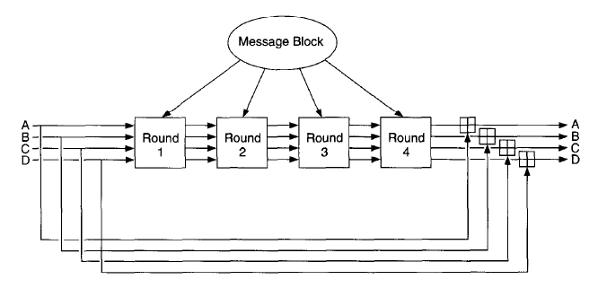
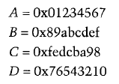
MD-5

Slide 16
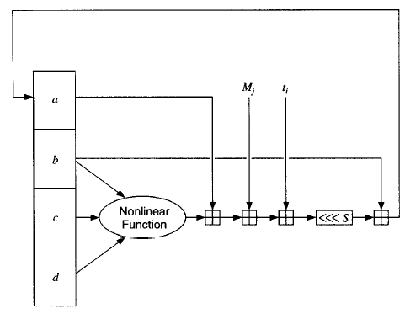
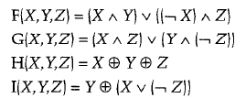
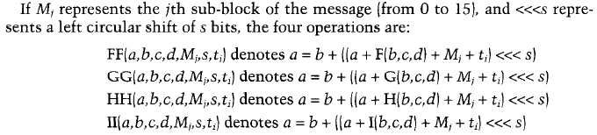
MD-5 Round Function

Slide 17
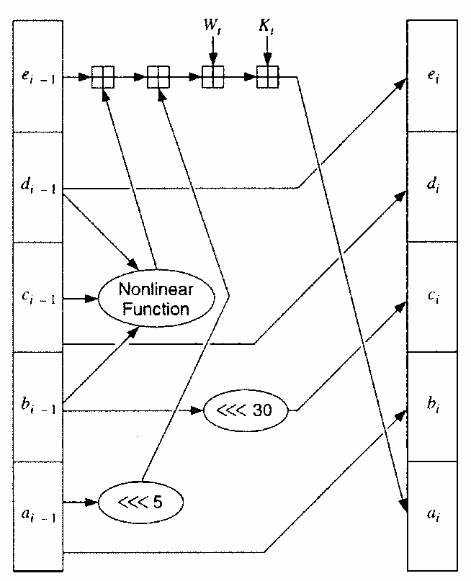
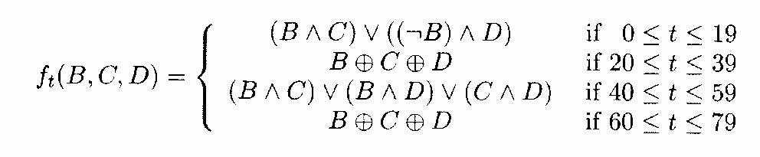
SHA-1
Input: X₀ (160 bits), m₁ (512 bits): Output: X₁
Expand m₁ from 512→2560 bits.
m₁=(W₁..W₁₅)
Initialization
4 rounds of 20 iterations each):
Each round uses
a different K and different nonlinear mixing function f
m₁
w₀
w₁
…
w₁₅
w₁₆
…
w₁₉
…
w₇₉
… (20 iters)
Round 2
Round 3
Round 4
K_{0..19}=5A827999
K_{20..39}=6ED9EBA1
K_{60..79}=CA62C1D6
Round 1
K_{40..59}=8F1BBCDC

Slide 18
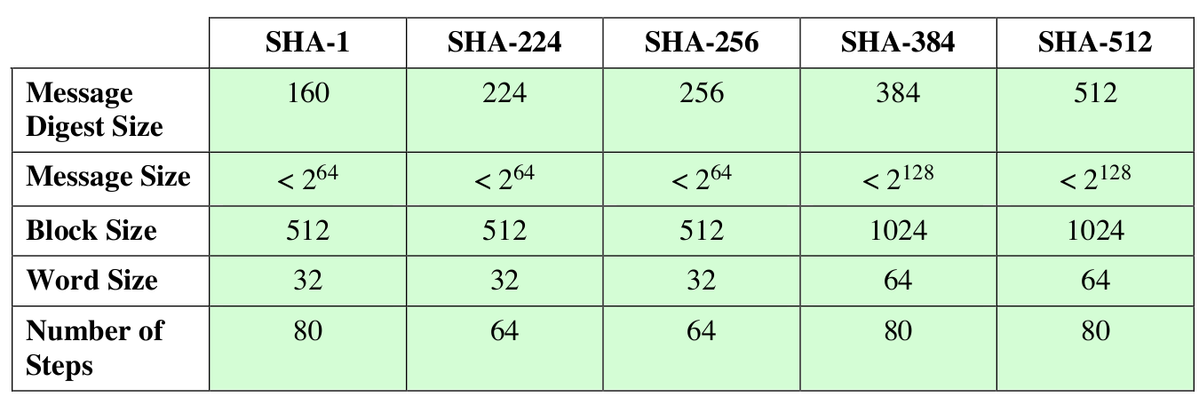
One Way Hash Functions – SHA-x
Secure Hash Algorithm, developed by NIST
Standardised by NIST in FIPS 180 in 1993
Improvements over time: SHA-0, SHA-1,SHA-2,SHA-3
SHA-1 (and SHA-0) are considered insecure; no longer
recommended
SHA-3 in development, competition run by NIST

Slide 19
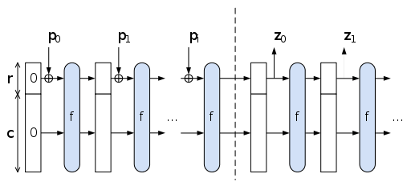
SHA-3
SHA-3, originally known as Keccak (pronounced [kɛtʃak], like “ketchak”),^{[1]} is a cryptographic hash function designed by Guido Bertoni, Joan Daemen, Michaël Peeters, and Gilles Van Assche, building upon RadioGatún. On October 2, 2012, Keccak was selected as the winner of the NIST hash function competition.

Slide 20
Active Attacks on CPA Secure Ciphers

Slide 21
Recap:
Confidentiality: semantic security against a CPA attack
Encryption secure against eavesdropping only
Integrity:
Existential unforgeability under a chosen message attack
CBC-MAC, HMAC, PMAC
Now: encryption secure against tampering
Ensuring both confidentiality and integrity

Slide 22



Sample tampering attacks
TCP/IP: (highly abstracted)
WWW port = 80
data
packet
dest = 80 data
source machine
TCP/IP
stack
Bob
port = 25
destination machine

Slide 23
Sample tampering attacks
IPsec: (highly abstracted)
WWW port = 80
TCP/IP
stack
data
packet
dest = 80 data
stuff
k
dest = 25 stuff
k
packets encrypted using key k
Bob
port = 25

Slide 24


Reading someone else’s data
Note: attacker obtains decryption of any ciphertext beginning with “dest=25”
WWW port = 80
IV,
dest = 80 data
Bob:
data
k
IV’,
dest = 25 data
k
Bob
port = 25
Easy to do for CBC with rand. IV
(only IV is changed)
Notes:
Without integrity, one cannot ensure confidentiality.

Slide 25
IV ,
dest = 80 data
IV’ ,
dest = 25 data
Encryption is done with CBC with a random IV.
m[0] = D(k, c[0]) ⨁ IV = “dest=80…”
IV’ = IV ⨁ (…80…) ⨁ (…25…)
It can’t be done

Slide 26
The lesson
CPA security cannot guarantee secrecy under active attacks.
Only use one of two modes:
If message needs integrity but no confidentiality:
use a MAC
If message needs both integrity and confidentiality:
use authenticated encryption modes

Slide 27
Goals
An authenticated encryption system (E,D) is a cipher where
As usual: E: K × M × N ⟶ C
but D: K × C × N ⟶ M ∪{⊥}
Security: the system must provide
sem. security under a CPA attack, and
ciphertext integrity: attacker cannot create new ciphertexts that decrypt properly
ciphertext
is rejected

Slide 28
Ciphertext integrity
Let (E,D) be a cipher with message space M.
Def: (E,D) has ciphertext integrity if for all “efficient” A: Adv_{CI}[A,E] = Pr[Chal. outputs 1] is “negligible.”
m₁ ∈ M
m₂
, …, m_{q}
Chal.
Adv.
c₁ ← E(k,m₁)
c₂
, …, c_{q}
k←K
c
b
b=1 if D(k,c) ≠⊥ and c ∉ { c₁ , … , c_{q} }
b=0 otherwise
Notes:
For nonce-based encryption adversary also specified nonces in queries.

Slide 29
Authenticated encryption
Def: cipher (E,D) provides authenticated encryption (AE) if it is
(1) semantically secure under CPA, and
(2) has ciphertext integrity

Slide 30
Implication 1: authenticity
Attacker cannot fool Bob into thinking a message was sent from Alice
m₁ , …, m_{q}
Alice
c
Bob
c_{i} = E(k, m_{i})
k
k
Cannot create valid c ∉ { c₁, …, c_{q} }
⇒ if D(k,c) ≠⊥ Bob knows message is from someone
who knows k (but message could be a replay)

Slide 31
Implication 2
Authenticated encryption ⇒
Security against chosen ciphertext attacks
(Next …)

Slide 32
Chosen Ciphertext Attacks

Slide 33
Example : Chosen Ciphertext Attacks (CCA)
Adversary has ciphertext c that it wants to decrypt
Often, adv. can fool server into decrypting certain ciphertexts (not c)
Often, adversary can learn partial information about plaintext
dest = 25 data
data
TCP/IP packet
ACK
if valid checksum

Slide 34
Chosen ciphertext security
Adversary’s power: both CPA and CCA
Can obtain the encryption of arbitrary messages of his choice
Can decrypt any ciphertext of his choice, other than challenge
(conservative modeling of real life)
Adversary’s goal: Break sematic security

Slide 35
Chosen ciphertext security: Definition
E = (E,D) cipher defined over (K,M,C). For b=0,1 define EXP(b):
Chal.
Adv.
for i=1,…,q:
(1) CPA query:
(2) CCA query:
b
k←K
m_{i,0} , m_{i,1} ∈ M : |m_{i,0}| = |m_{i,1}|
c_{i} ← E(k, m_{i,b})
c_{i} ∈ C : c_{i} ∉ {c₁, …, c_{i-1}}
m_{i} ← D(k, c_{i})
b’ ∈ {0,1}

Slide 36
Chosen ciphertext security: Definition
E is CCA secure if for all “efficient” A: Adv_{CCA} [A,E] = |Pr[EXP(0)=1] – Pr[EXP(1)=1] | is “negligible.”
Example: CBC with rand. IV is not CCA-secure
m₀ , m₁ : |m₀| = |m₁|=1
Chal.
Adv.
b
c ← E(k, m_{b}) = (IV, c[0])
k←K
c’ = (IV⨁1, c[0])
b
D(k, c’) = m_{b}⨁1

Slide 37
Authenticated enc. ⇒ CCA security
Thm: Let (E,D) be a cipher that provides AE. Then (E,D) is CCA secure !
In particular, for any q-query eff. A there exist eff. B₁, B₂ s.t.
Adv_{CCA}[A,E] ≤ 2q⋅Adv_{CI}[B₁,E] + Adv_{CPA}[B₂,E]

Slide 38
So what?
Authenticated encryption:
ensures confidentiality against an active adversary that can decrypt some ciphertexts
Limitations:
does not prevent replay attacks
does not account for side channels (timing)

Slide 39
Constructions from Ciphers and MACs

Slide 40
… but first, some history
Authenticated Encryption (AE): introduced in 2000 [KY’00, BN’00]
Crypto APIs before then: (e.g. MS-CAPI)
Provide API for CPA-secure encryption (e.g. CBC with rand. IV)
Provide API for MAC (e.g. HMAC)
Every project had to combine the two itself without a well defined goal
Not all combinations provide AE …

Slide 41
Combining MAC and ENC (CCA)
Encryption key k_{E}. MAC key = k_{I}
Option 1: (SSL)
Option 2: (IPsec)
Option 3: (SSH)
S(k_{I}, m)
E(k_{E} , mlltag)
msg m
msg m
tag
E(k_{E}, m)
S(k_{I}, c)
msg m
tag
E(k_{E} , m)
S(k_{I}, m)
msg m
tag

Slide 42
A.E. Theorems
Let (E,D) be CPA secure cipher and (S,V) secure MAC. Then:
Encrypt-then-MAC: always provides A.E.
MAC-then-encrypt: may be insecure against CCA attacks
However: when (E,D) is rand-CTR mode or rand-CBC M-then-E provides A.E.

Slide 43
Standards (at a high level)
GCM: CTR mode encryption then CW-MAC
(accelerated via Intel’s PCLMULQDQ instruction)
CCM: CBC-MAC then CTR mode encryption (802.11i)
EAX: CTR mode encryption then CMAC
All support AEAD: (auth. enc. with associated data). All are nonce-based.
encrypted
associated data
encrypted data
authenticated
Notes:
Processing associated data: input to MAC signing is (key, AssocData || ciphertext )

Slide 44
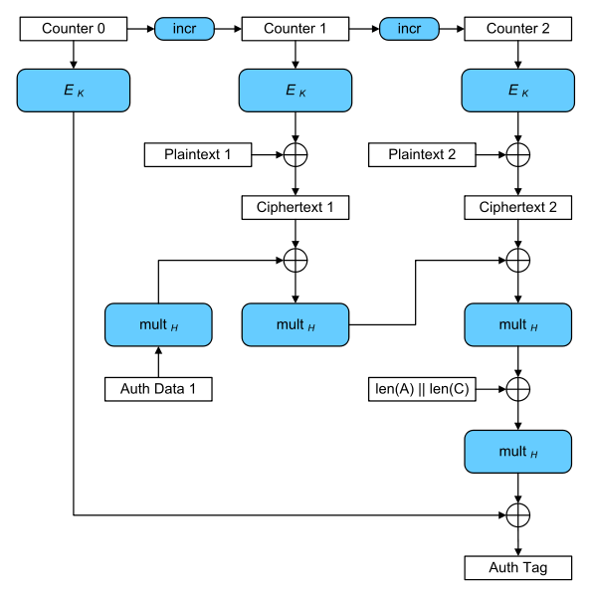
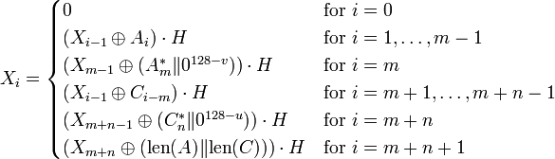
GCM Mode

Slide 45
An example API (OpenSSL)
int AES_GCM_Init(AES_GCM_CTX *ain,
unsigned char *nonce, unsigned long noncelen,
unsigned char *key, unsigned int klen )
int AES_GCM_EncryptUpdate(AES_GCM_CTX *a,
unsigned char *aad, unsigned long aadlen,
unsigned char *data, unsigned long datalen,
unsigned char *out, unsigned long *outlen)

Slide 46
MAC Security -- an explanation
Recall: MAC security implies (m , t) (m , t’ )
Why? Suppose not: (m , t) ⟶ (m , t’)
Then Encrypt-then-MAC would not have Ciphertext Integrity !!
⇏
m₀, m₁
Chal.
Adv.
b
c ← E(k, m_{b}) = (c₀, t)
(c₀, t)
k←K
c’ = (c₀ , t’ ) ≠ c
(c₀, t’)
b
D(k, c’) = m_{b}

Slide 47
OCB: A direct construction from a PRP
More efficient authenticated encryption: one E() op. per block.
m[0]
m[1]
m[2]
m[3]
checksum
P(N,k,0)
⊕
P(N,k,1)
⊕
P(N,k,2)
⊕
P(N,k,3)
⊕
P(N,k,0)
⊕
E(k,⋅)
E(k,⋅)
E(k,⋅)
E(k,⋅)
E(k,⋅)
P(N,k,0)
⊕
P(N,k,1)
⊕
P(N,k,2)
⊕
P(N,k,3)
⊕
auth
⊕
c[0]
c[1]
c[2]
c[3]
c[4]

Slide 48
Performance: Crypto++ 5.6.0 [ Wei Dai ]
AMD Opteron, 2.2 GHz ( Linux)
code Speed
Cipher size (MB/sec)
AES/GCM large **108 AES/CTR 139
AES/CCM smaller 61 AES/CBC 109
AES/EAX smaller 61
AES/CMAC 109
AES/OCB 129* HMAC/SHA1 147
* extrapolated from Ted Kravitz’s results ** non-Intel machines

Slide 49
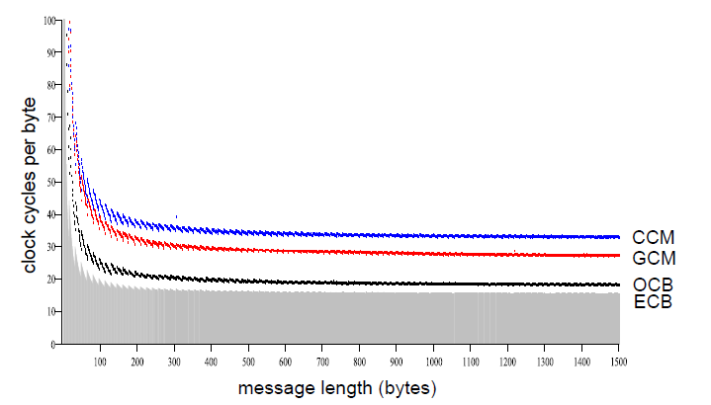
Performance Comparison

Slide 50
CBC Paddings Attacks

Slide 51
Summary
Authenticated encryption: CPA security + ciphertext integrity
Confidentiality in presence of active adversary
Prevents chosen-ciphertext attacks
Limitation: cannot help bad implementations … (this segment)
Authenticated encryption modes:
Standards: GCM, CCM, EAX
General construction: encrypt-then-MAC

Slide 52
The TLS record protocol (CBC encryption)
Decryption: dec(k_{b⇾s} , record, ctr_{b⇾s} ) :
step 1: CBC decrypt record using k_{enc}
step 2: check pad format: abort if invalid
step 3: check tag on [ ++ctr_{b⇾s} ll header ll data]
abort if invalid
data
type ll ver ll len
Two types of error:
padding error
MAC error
tag
pad

Slide 53
Padding oracle
Suppose attacker can differentiate the two errors (pad error, MAC error):
⇒ Padding oracle: attacker submits ciphertext and learns if last bytes of plaintext are a valid pad
data
type ll ver ll len
Nice example of a chosen ciphertext attack
tag
pad

Slide 54
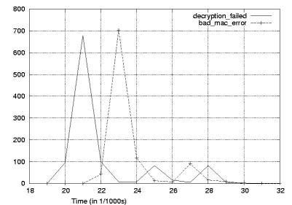
Padding oracle via timing OpenSSL
Credit: Brice Canvel
(fixed in OpenSSL 0.9.7a)
In older TLS 1.0: padding oracle due to different alert messages.

Slide 55
Using a padding oracle (CBC encryption)
Attacker has ciphertext c = (c[0], c[1], c[2]) and it wants m[1]
IV
c[0]
c[1]
c[2]
D(k,⋅)
D(k,⋅)
D(k,⋅)
⊕
⊕
⊕
m[0]
m[1]
m[2] ll pad

Slide 56
Using a padding oracle (CBC encryption)
step 1: let g be a guess for the last byte of m[1]
IV
c[0]
c[1]
⨁ g ⨁ 0x01
D(k,⋅)
D(k,⋅)
= last-byte ⨁ g ⨁ 0x01
⊕
⊕
if last-byte = g: valid pad
otherwise: invalid pad
m[0]
m[1]

Slide 57
Using a padding oracle (CBC encryption)
Attack: submit ( IV, c’[0], c[1] ) to padding oracle
⇒ attacker learns if last-byte = g
Repeat with g = 0,1, …, 255 to learn last byte of m[1]
Then use a (02, 02) pad to learn the next byte and so on …

Slide 58
IMAP over TLS
Problem: TLS renegotiates key when an invalid record is received
Enter IMAP over TLS: (protocol for reading email)
Every five minutes client sends login message to server:
LOGIN "username” "password”
Exact same attack works, despite new keys
⇒ recovers password in a few hours.
Notes:
IMAP gives attacker new ciphertexts to play with, so changing keys doesn’t help.

Slide 59
Lesson
1. Encrypt-then-MAC would completely avoid this problem:
MAC is checked first and ciphertext discarded if invalid
2. MAC-then-CBC provides A.E., but padding oracle destroys it

Slide 60
Check!
Will this attack work if TLS used counter mode instead of CBC?
(i.e. use MAC-then-CTR )
Yes, padding oracles affect all encryption schemes
It depends on what block cipher is used
No, counter mode need not use padding

Slide 61
Further reading
The Order of Encryption and Authentication for Protecting Communications, H. Krawczyk, Crypto 2001.
Authenticated-Encryption with Associated-Data, P. Rogaway, Proc. of CCS 2002.
Password Interception in a SSL/TLS Channel, B. Canvel, A. Hiltgen, S. Vaudenay, M. Vuagnoux, Crypto 2003.
Plaintext Recovery Attacks Against SSH, M. Albrecht, K. Paterson and G. Watson, IEEE S&P 2009
Problem areas for the IP security protocols, S. Bellovin, Usenix Security 1996.

Slide 62
Copyright Notice
The material in this presentation has been taken from text books, reference books, research literature and various sources on Internet; and compiled/edited for class room teaching at MCS-NUST without any infringement into the copyrights of the author(s). The original authors retain their respective copyrights as per their stated claims.
Commercial use of the material contained herein in full or in part through copying, publication and reproducing in any form is strictly prohibited.

