Slide 1

What is Software Quality?
Dr. Zaki Murtaza
MCS
Chapter 2 for SQE

Slide 2
Software Quality
Lets summarize what we know up till now and channel the knowledge to define “software quality”
>> (amended from class) processes and techniques to ensure quality in the softwares.

Slide 3
Quality Understanding – Perspectives and Expectations
Major Viewpoints:
  Transcendental view: hard to define, easy to identify
  User view: according to user's needs
  Manufacturing view: conform to the processes
  Product view: maintain internal quality indicators and hope for improved external behavior
  Value-based view: focuses on attracting customers

Slide 4
Stakeholders
Consumers
  Consumers and users may also be differentiated. Basically the people who have to use the product. Other softwares may also be the 'users'. Have external view of product
Producers
  Developers, managers, maintenance people. Have internal view of the software product.

Slide 5
Expectations of stakeholders
Consumers
  Reliability, long term use, fault-tolerance, performance, accuracy, more for less, ease of use, other quality attributes related to product.
Producers
  Clear req., meeting the req., viable business product, durability, enhancing skills career growth,

Slide 6
Frameworks & Standards
Section 2.2. Self-study.

Slide 7
Correctness and Defects
To understand correctness, first understand whats incorrect
  Definitions of
    Error
    Fault
    Failure
    Defect

Slide 8
Error
Incorrect result because of
  Missing or
  Wrong
human actions
Error sources
  Misunderstanding
  Misconceptions etc

Slide 9
Fault and Failure
Fault
  Incorrect step, process or data definition in computer programs
    Common computer programming bugs (Y2K)
    Discovered by events
Failure
  Inability of a system or component to perform its required functions with required performance.
    Behavior deviation of a system (required precision, required timing not achieved)

Slide 10
Defects
Failures, faults and errors are collectively referred to as defects
  Commonly known as bugs in software
Instead of “bug” we use “defect” and likewise, for debugging we call “defect detection and removal”
Debugging redefined through some properly defined terms

Slide 11
Types of Defects
Latent Defect
  Existing defect not yet discovered because
    All required conditions did not meet
Masked Defect
  Existing defect not yet discovered because
    Another existing defect is masking it

Slide 12
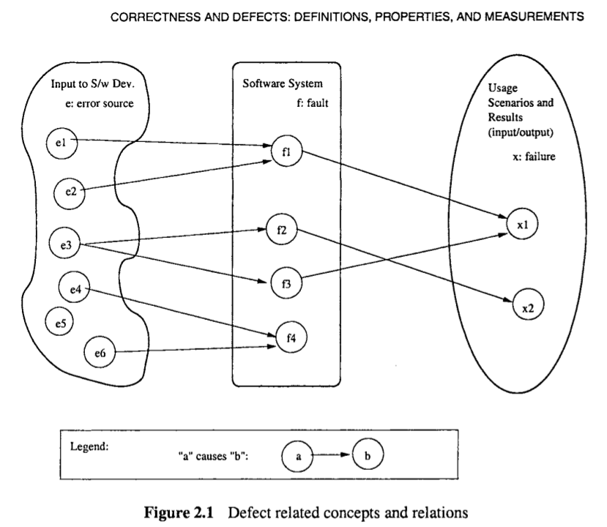

Slide 13
Concepts and Relations
In the middle, are the faults scattered among the software code, design, specs, requirements etc
On the left are the errors in the concepts, information and experiences of humans interacting with system

Slide 14
Concept and Relations
On the right is the space of
  expected results
  expected wrong results (Failures)
  because of
  Incorrect or missing human actions
  Resulting in faults generated in the software

Slide 15
Relation
  Errors → Faults → Failures
Errors may cause faults, which cause failures
A single error may cause multiple faults
  Wrong global dec. used multiple times, example from the temperature gauge, or an error in one algorithm, used by many modules.
A single fault caused by multiple errors
      An interface fault caused by multiple errors. Ever removed an error from a list of errors, only to find that the output remains the same?

Slide 16

Correctness-centered Properties
We are looking at “quality” through the perspective of:
    Consumers (external view)
    Producers (internal view)
  and some attributes like:
    Correctness, Reliability etc
What is primary concern of a consumer/user?
    Software operates without failure
    If there is a failure, damage is limited and recovery is fast

Slide 17


Consumer Perspective on Failure
Failure properties and direct failure measurement
  Properties
    What , why, how about failure
  Measurement
    Failure count, distribution, frequency, density
Failure likelihood and reliability measurement
  How often or how likely
    Measured as reliability of the system
    Reliability = P(failure-free ops)/ predefined time_period

Slide 18
Continued...
Failure Severity measurement and safety assurance
  What is the impact of the failure?
  Where the impact is substantial, we call them accidents
    Need to limit and recover from accidents quickly
    These accidents can be fatal

Slide 19
Producer's view on Correctness
Instead of failure, we look at the properties and measurements of faults
Faults can be analyzed and examined
  Individually
    According to types, relations, causes and context etc
  Collectively
    According to their distribution, density over development phases.

Slide 20
Dealing with defects
Defect Prevention
Defect detection/ removal
Defect Containment
Before all these, plan QA activities
Afterwards, analyze and monitor results to control and direct QA activities

Slide 21
Quiz # 1
Define the following terms and give one example each:
  defect, error, fault, failure, accident.
  What is the relationship among them?

