Slide 1
Multi-Level Hashing

Slide 2
Group Members
Muhammad Sunaam - 393223
Umar Tariq - 368170
M. Uzair Khan - 368187

Slide 3
Security Attribute and motivation
Security Attribute: Integrity
Motivation: "Ensuring data integrity is paramount in safeguarding against unauthorized modifications or tampering, thus preserving the trustworthiness and reliability of information systems."

Slide 4
Design
Utilization of multi-level hashing using binary trees.
Creation of a hierarchical structure where each node contains a word, its count and hash.
Hashing process initiated from leaf nodes up to the root, ensuring data integrity at every level.
Root node's hash represents the entire data structure's integrity

Slide 5
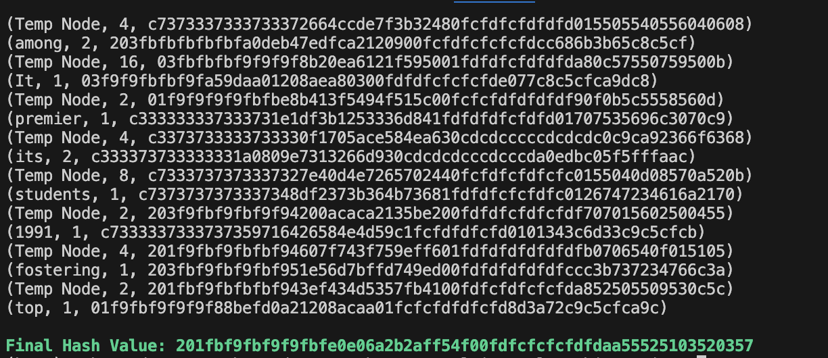
Implementation
Development of algorithms for constructing tree from input text.
Implementation of custom hashing algorithm for generating node hashes.

Slide 6
Hash function:
Input Data: Receive input data to be hashed.
Data Compression:
Convert input data to bytes using UTF-8 encoding.
Divide the input data into 16-byte (128-bit) chunks.
Convert each chunk into hexadecimal representation.
Pad the last chunk with 'f's if it is less than 128 bits.
Perform XOR operation on the hexadecimal chunks:
If there is only one chunk, XOR it with the length of original data bytes.
If there are multiple chunks, XOR each chunk iteratively to produce a final 128 bits result.

Slide 7
Continued…
Initialization:
Split the compressed data into two equal parts, each consisting of 16 bytes (128 bits).
Convert each part into binary representation.
Feistel Structure:
Begin multiple rounds of the Feistel structure with XOR operations
Round Function:
Combine the right part with a key.
Apply a custom round function to produce a hash output.

Slide 8
Continued…
The round function involves:
Concatenating the right part with the key.
Applying a custom compression function to the concatenated data to produce a hash output
XOR Operation:
XOR the hash output with the left part to update the right part.
The original right part updates to become the left part.
Repeat the round function and XOR operation for a specified number of rounds (e.g., 10 rounds).

Slide 9
Continued…
Combine Parts:
Concatenate the left and right parts to produce the output hash.
Hexadecimal Conversion:
Convert the binary hash to hexadecimal representation.
Output Hash: Final output hash value.

Slide 10
Properties of Hash Function
Property | Steps and Approaches Used
Variable Input Size | Custom compression function to handle input of any size. - Padding with null characters if the input size is odd.
Fixed Output Size | Conversion of the final binary hash to a fixed-length hexadecimal representation (256 bits).
Efficiency | Utilization of bitwise operations for computational efficiency. - Optimization of the custom round function and compression function.

Slide 11
Property | Steps and Approaches Used
Preimage Resistance | - Utilization of the Feistel structure with multiple rounds of mixing and XOR operations, making it computationally infeasible to reverse-engineer the input from the output hash.
Second Preimage Resistance | - Use of the compression function with XOR operations to ensure that different inputs produce distinct output hashes, preventing the generation of a second preimage.
Collision Resistance | - XOR operations and the Feistel structure reduce the likelihood of generating collisions by producing unique output hashes for different inputs.

Slide 12

Attack
Attack type: Weak collision resistance
10,000 random strings of the same length as the original string generated and hashed, revealing no collisions.
Weak collision resistance vulnerability identified in the hashing mechanism, after changing some characters in the original string.

Slide 13
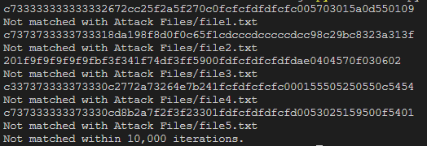
attack
Approach 1:
Generate Random substrings to match the outputs of the hash functions
Approach 2:
Use similar text to evaluate Second Pre-Image Collision Resistance.

Slide 14
Conclusion and Recommendation:
The weak collision resistance attack highlights a vulnerability in the current security protocol.
Transition to stronger custom cryptographic hash functions.
Implement salting techniques to enhance security by adding unique random data to each input.
Collaboration with the cybersecurity community can provide valuable insights for strengthening integrity protection mechanisms.

Slide 15
Contribution and work division:
Member | Contribution
M. Sunaam | Tree structures
M. Uzair Khan | Custom Hash Function
Umar Tariq | Attack

Slide 16
Github:
https://github.com/umar-tariq-1/Multi-Level-Hashing

Slide 17
THANK YOU!

