Slide 1

AcademyX
Product Screen Walkthrough
19 Screens • 6 Sections

Slide 2
01
BRAND
Section 1 of 6

Slide 3
BRAND
1/19
Brand Identity
AcademyX logo mark

Slide 4
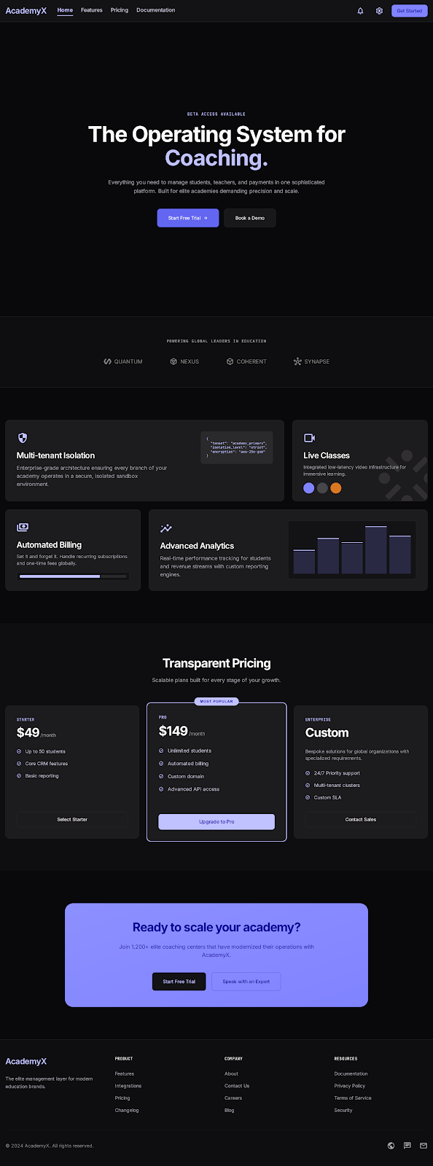
BRAND
2/19
Marketing Site
Public landing page

Slide 5
02
AUTH
Section 2 of 6

Slide 6
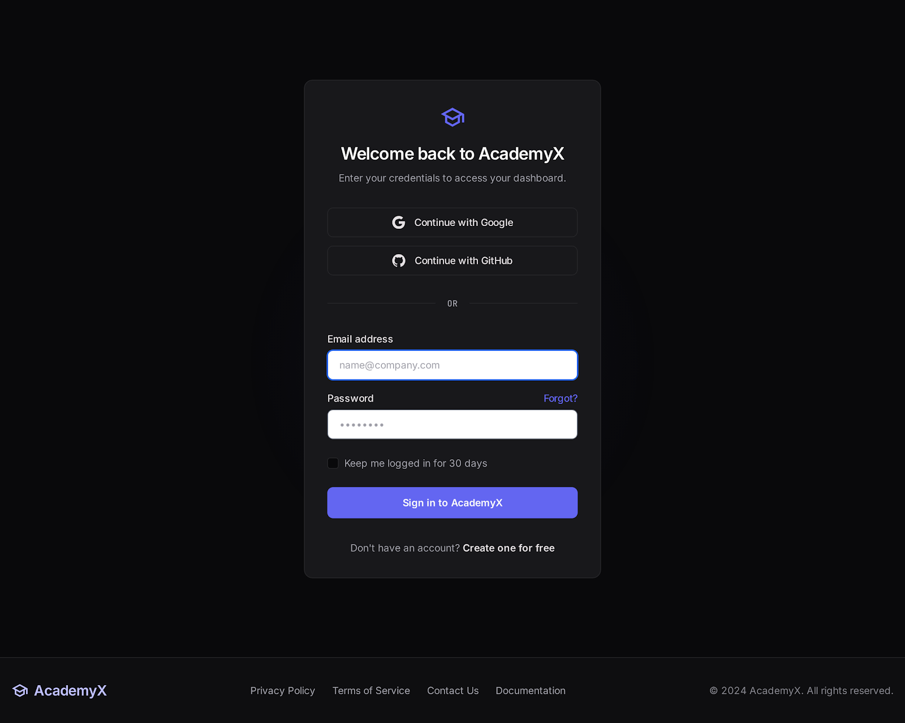
AUTH
3/19
Authentication
Sign in to AcademyX

Slide 7
03
STUDENT
Section 3 of 6

Slide 8
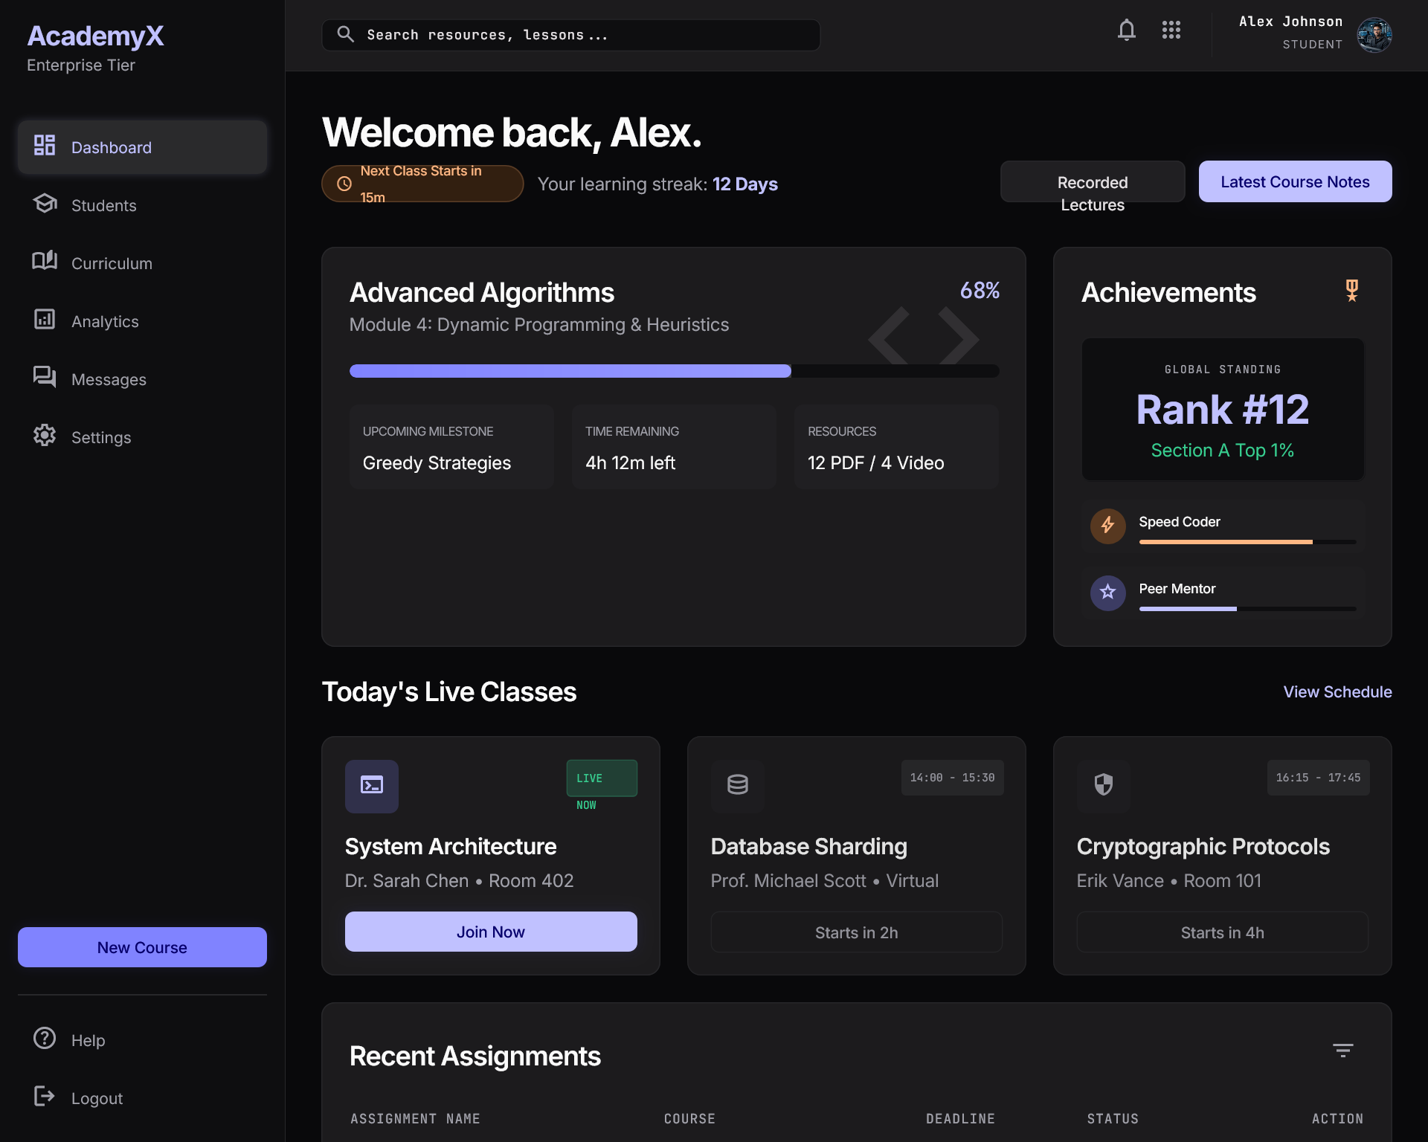
STUDENT
4/19
Student Dashboard
Desktop – Welcome back, Alex

Slide 9
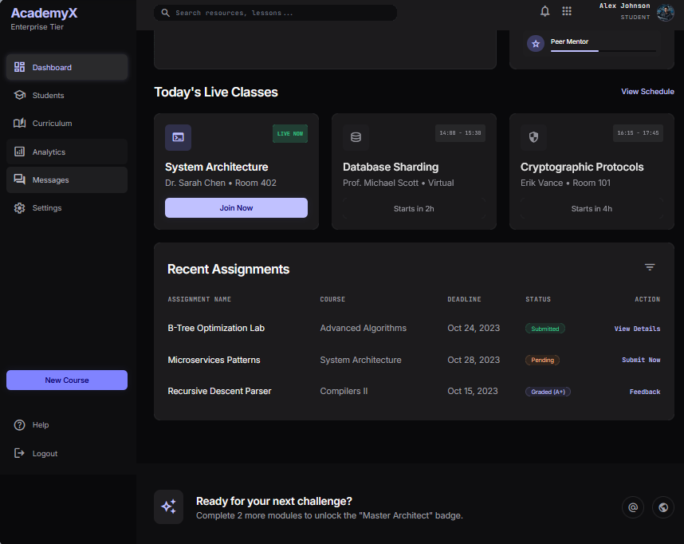
STUDENT
4/19
Student Dashboard
Desktop – Welcome back, Alex

Slide 10
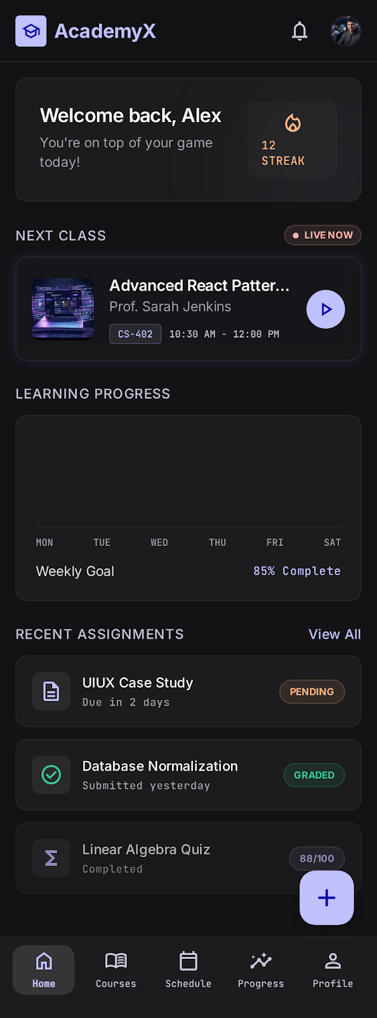
STUDENT
5/19
Student Dashboard
Mobile – Welcome back, Alex

Slide 11
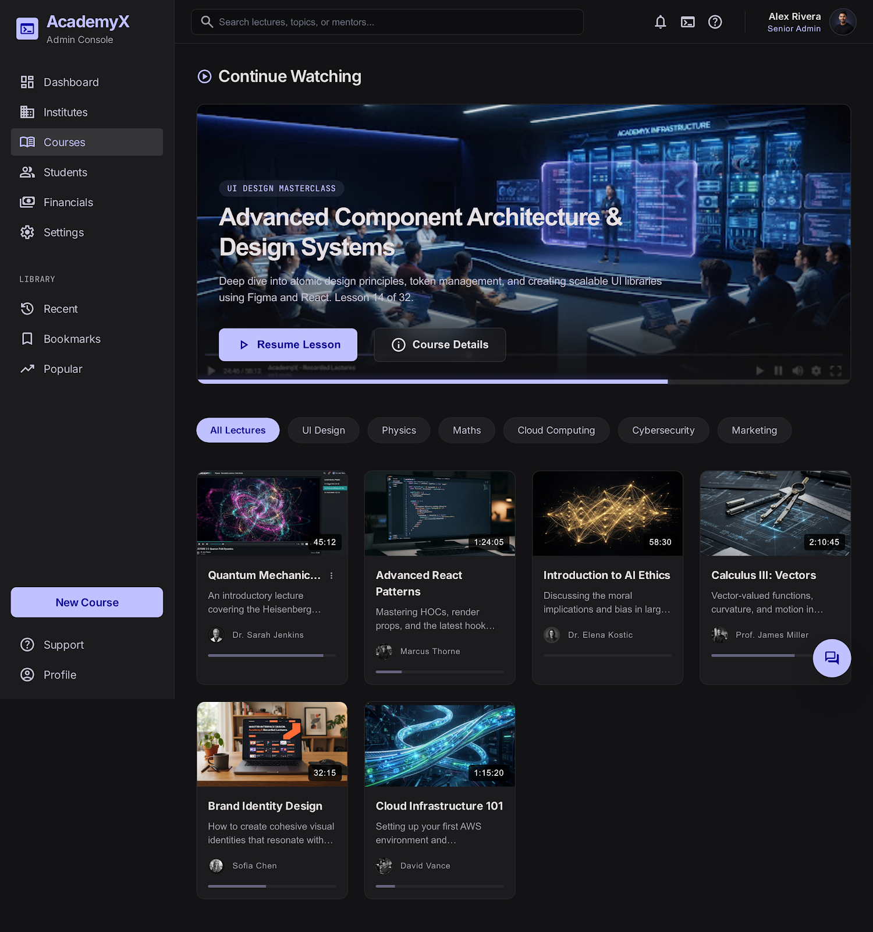
STUDENT
6/19
Courses Library
Continue watching & lecture catalog

Slide 12
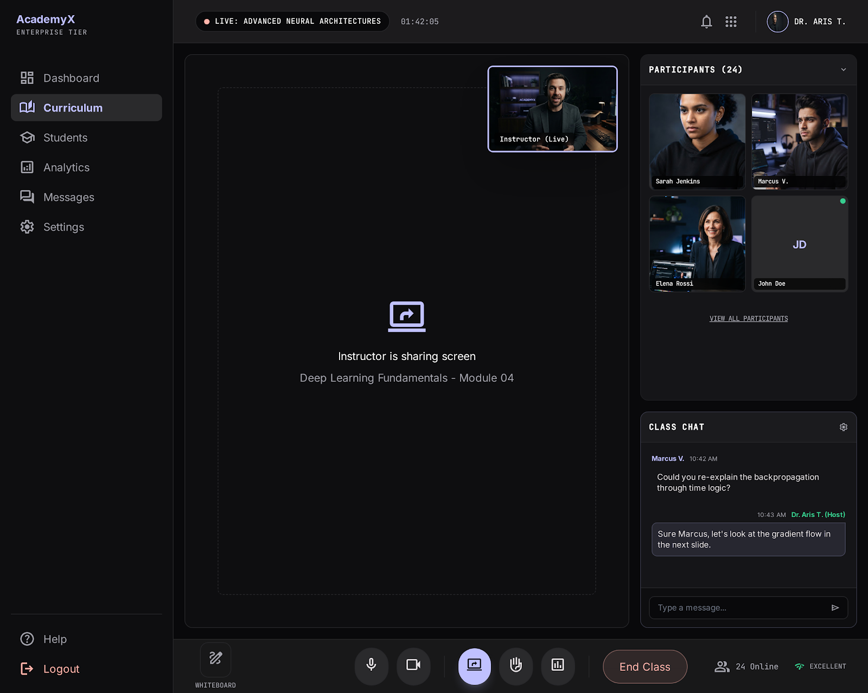
STUDENT
7/19
Live Class
Real-time session with chat & participants

Slide 13
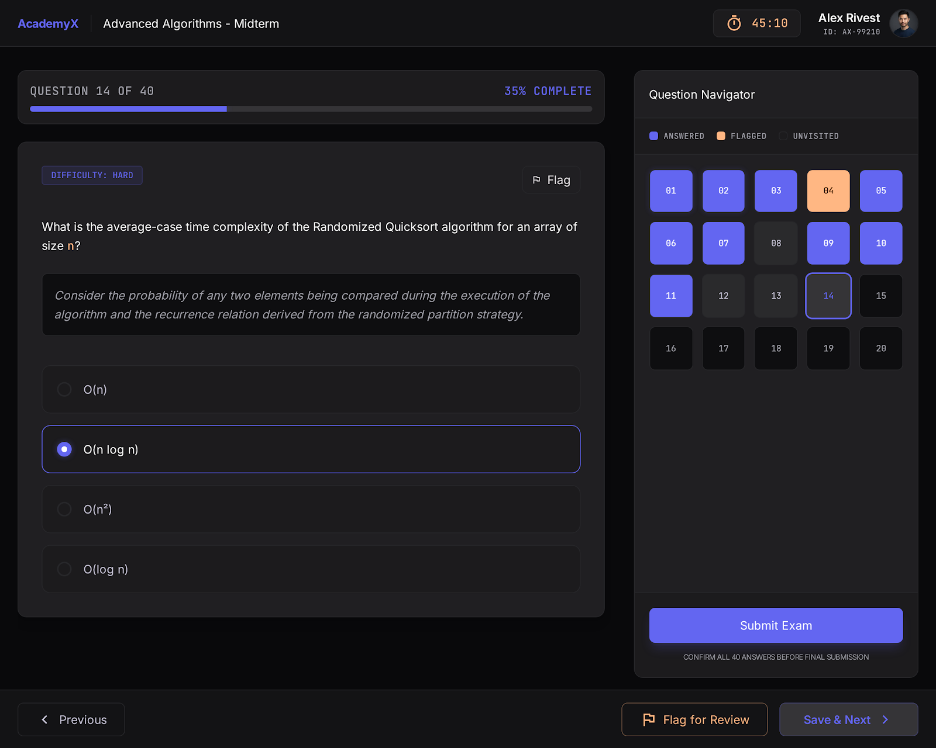
STUDENT
8/19
Quiz / Exam
Timed assessment with question navigator

Slide 14
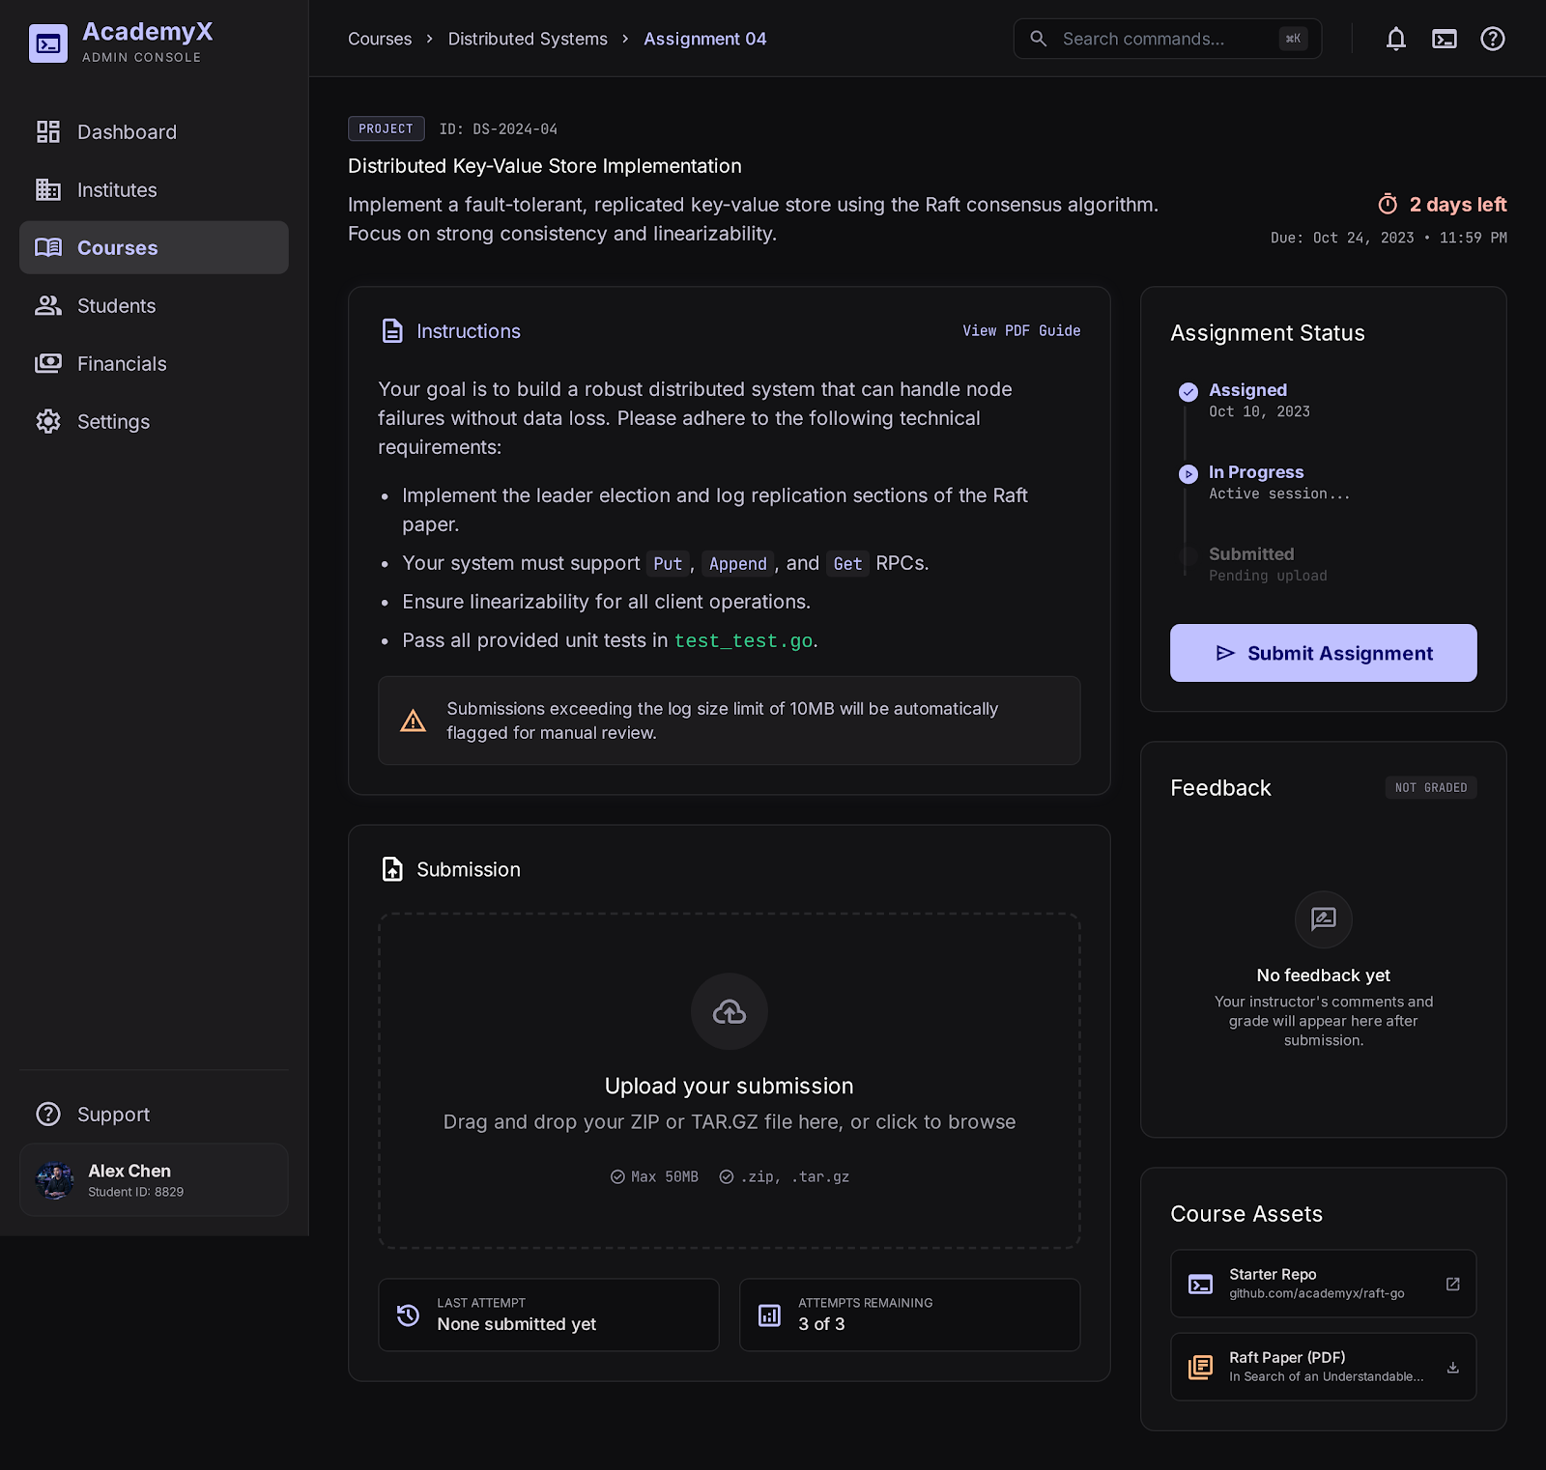
STUDENT
9/19
Assignment Submission
Project upload & status tracking

Slide 15
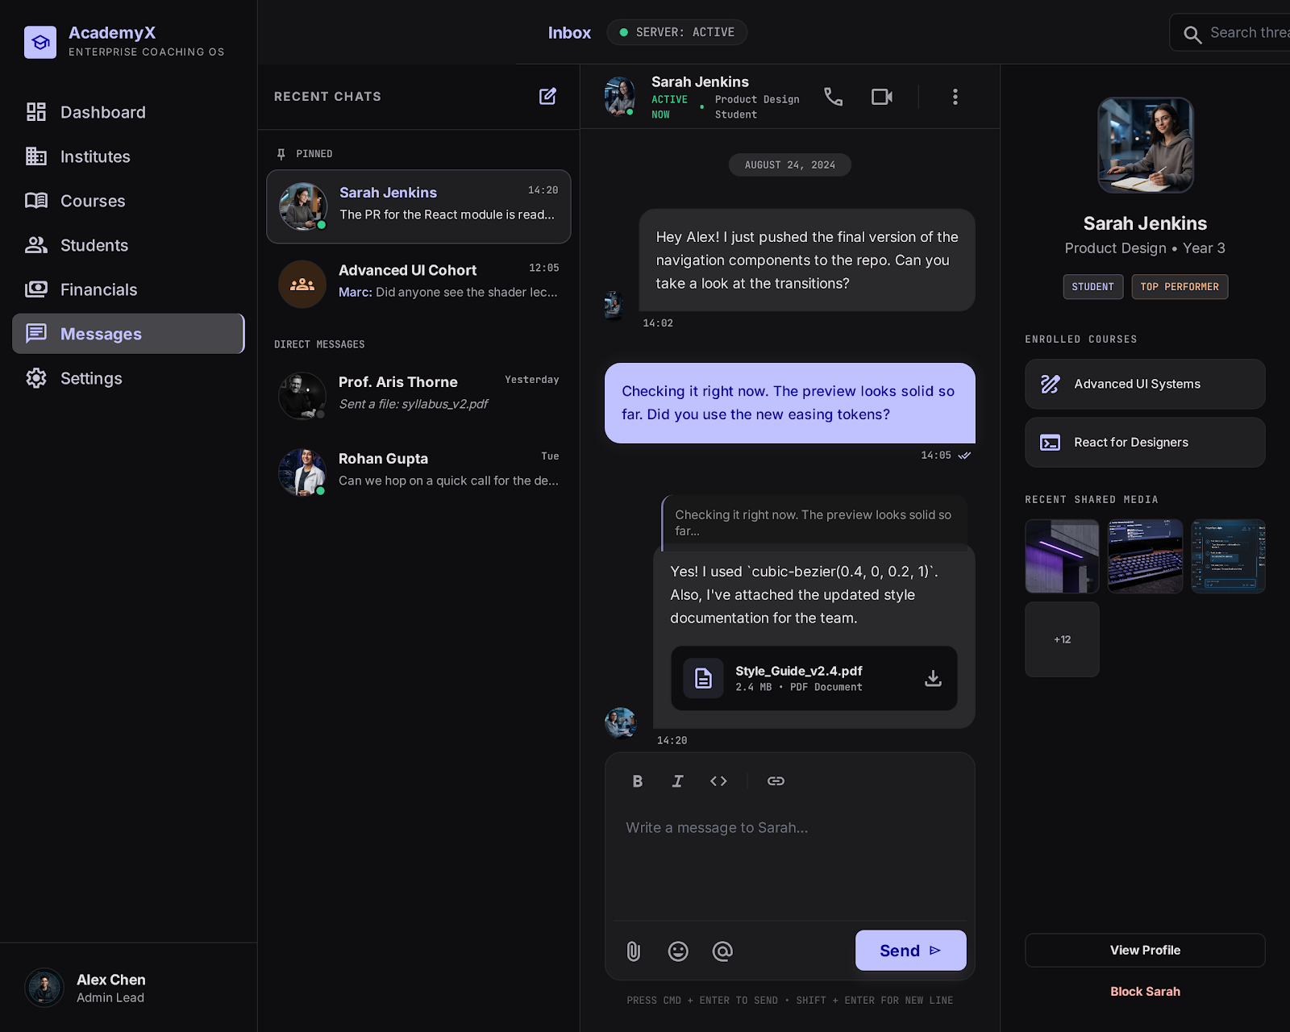
STUDENT
10/19
Messages & Community
Direct messaging inbox

Slide 16
04
TEACHER
Section 4 of 6

Slide 17
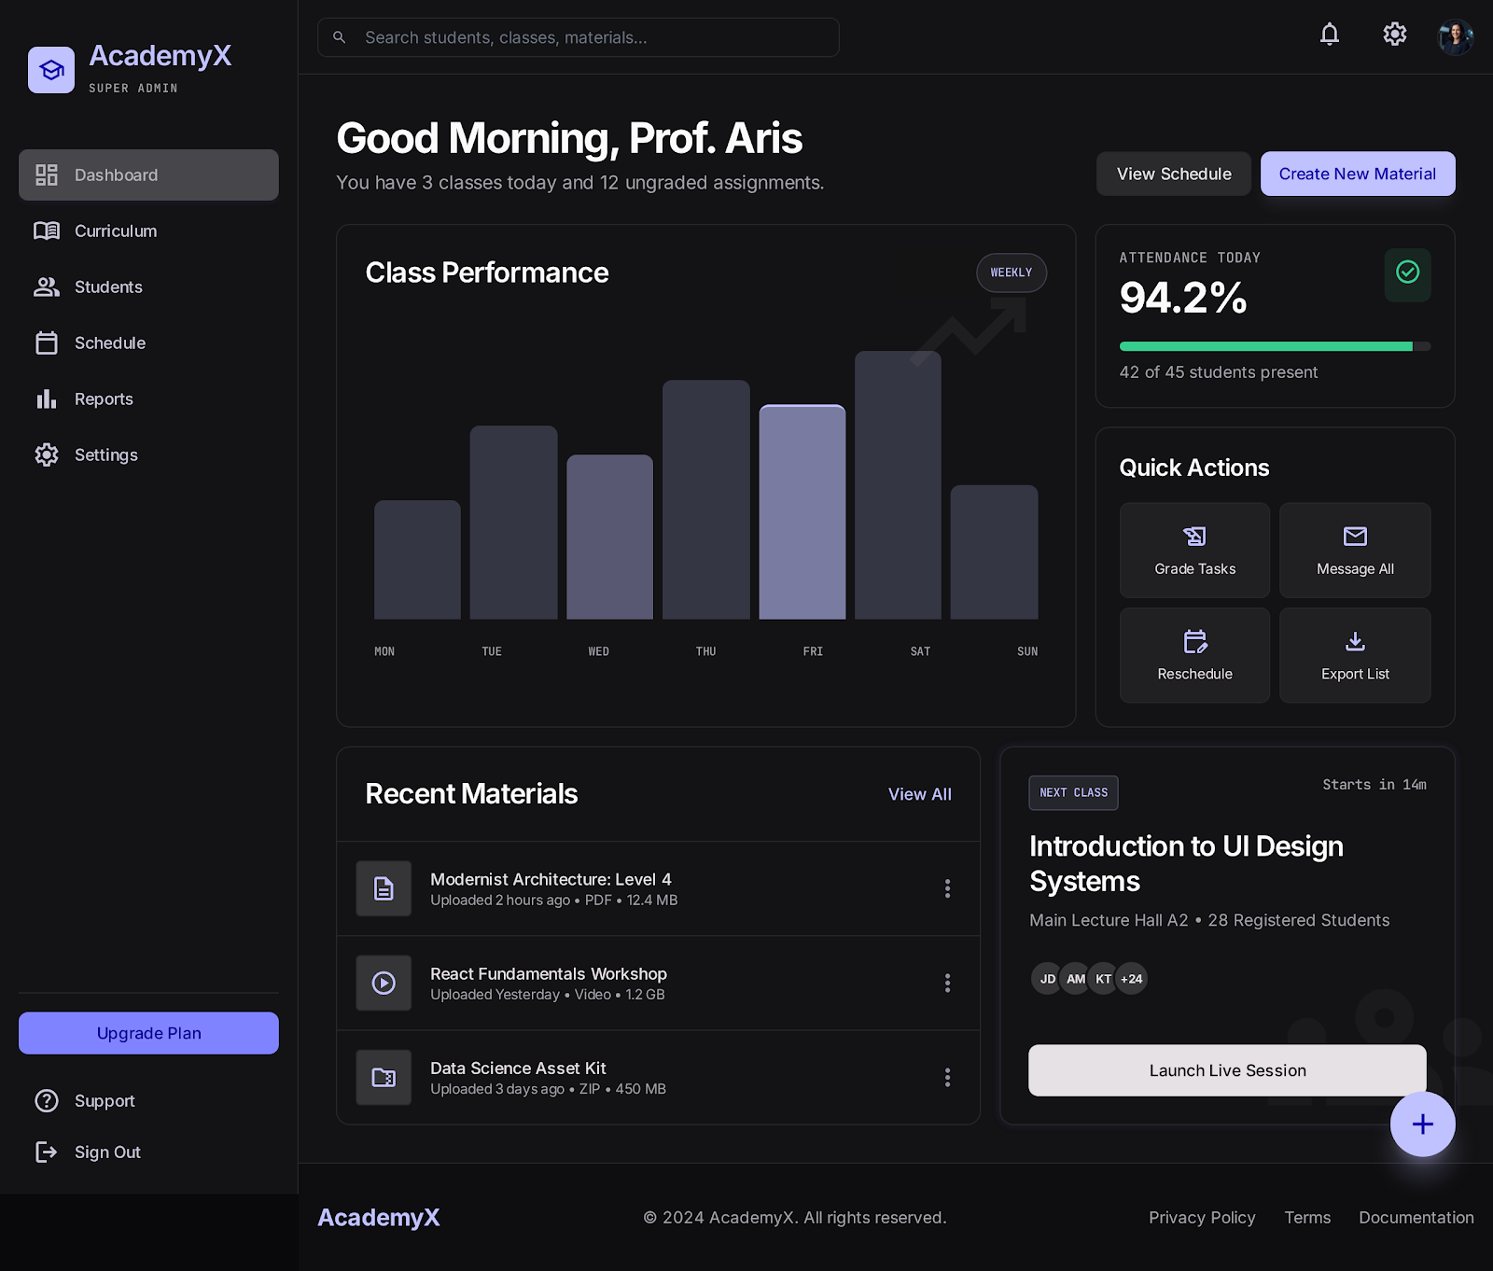
TEACHER
11/19
Teacher Dashboard
Desktop – Good morning, Prof. Aris

Slide 18
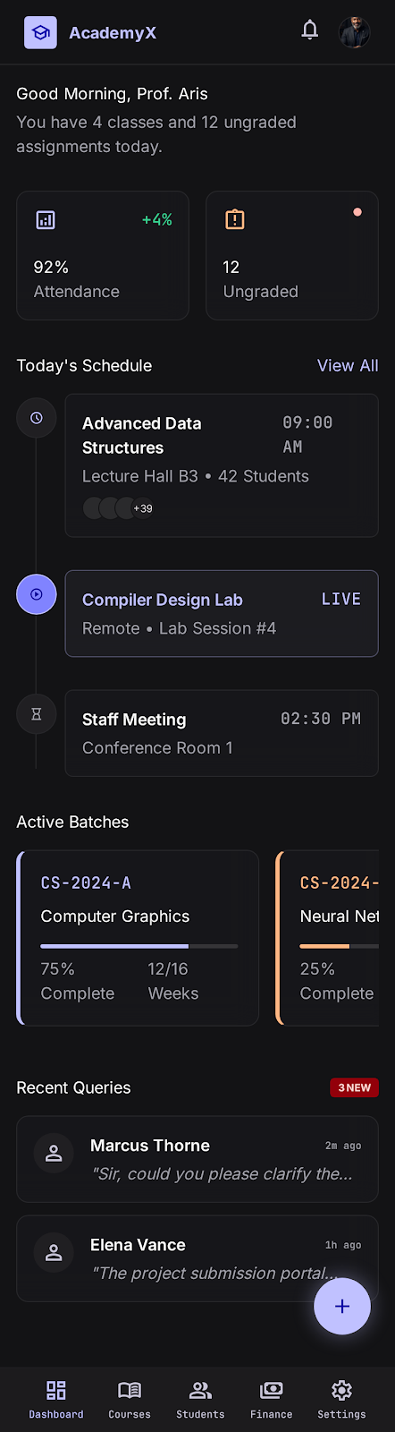
TEACHER
12/19
Teacher Dashboard
Mobile – Good morning, Prof. Aris

Slide 19
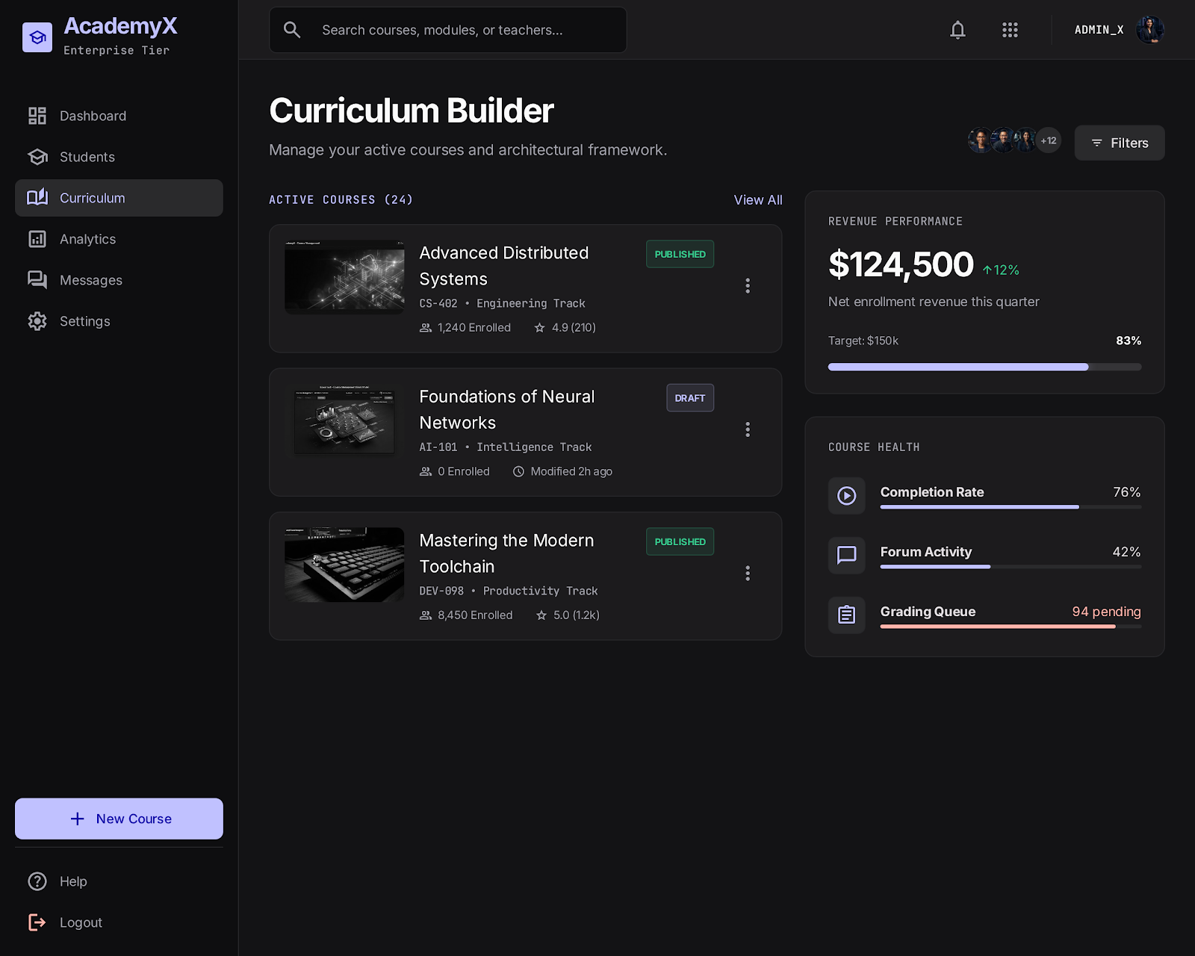
TEACHER
13/19
Curriculum Builder
Manage active courses & course health

Slide 20
05
INSTITUTE ADMIN
Section 5 of 6

Slide 21
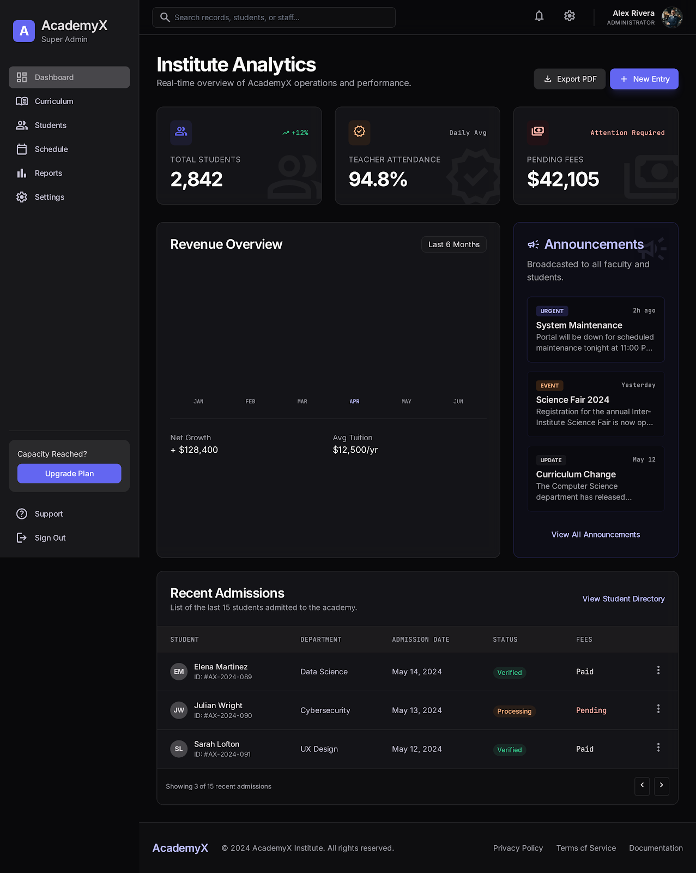
INSTITUTE ADMIN
14/19
Institute Analytics
Real-time institute performance overview

Slide 22
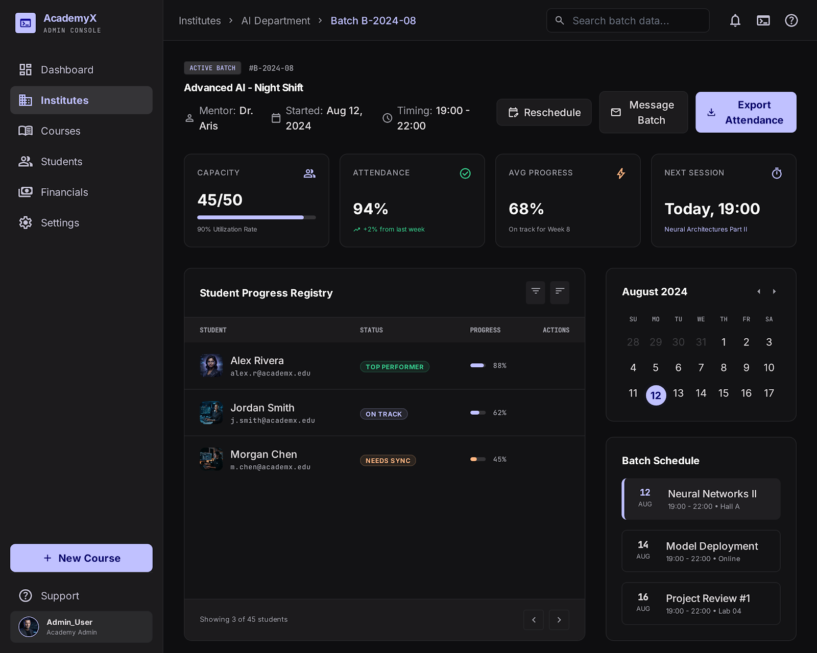
INSTITUTE ADMIN
15/19
Batch Detail
Student progress registry & schedule

Slide 23
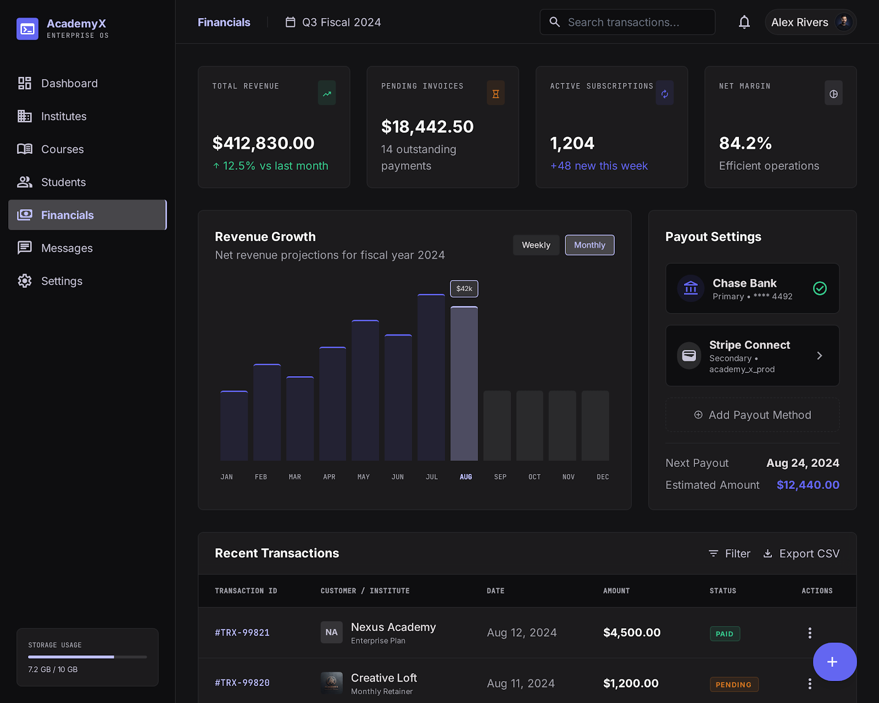
INSTITUTE ADMIN
16/19
Financials
Desktop – revenue, invoices & payouts

Slide 24
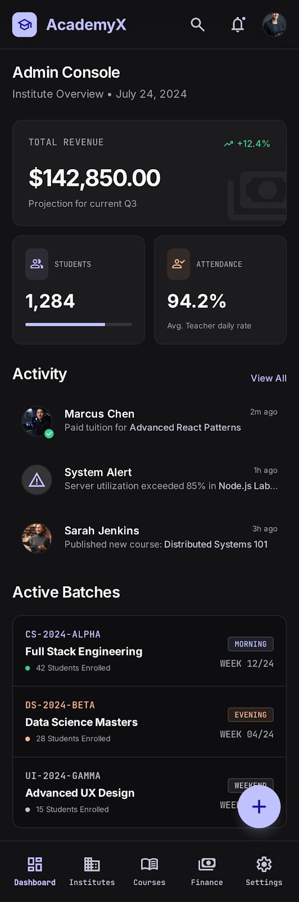
INSTITUTE ADMIN
17/19
Institute Overview
Mobile admin console

Slide 25
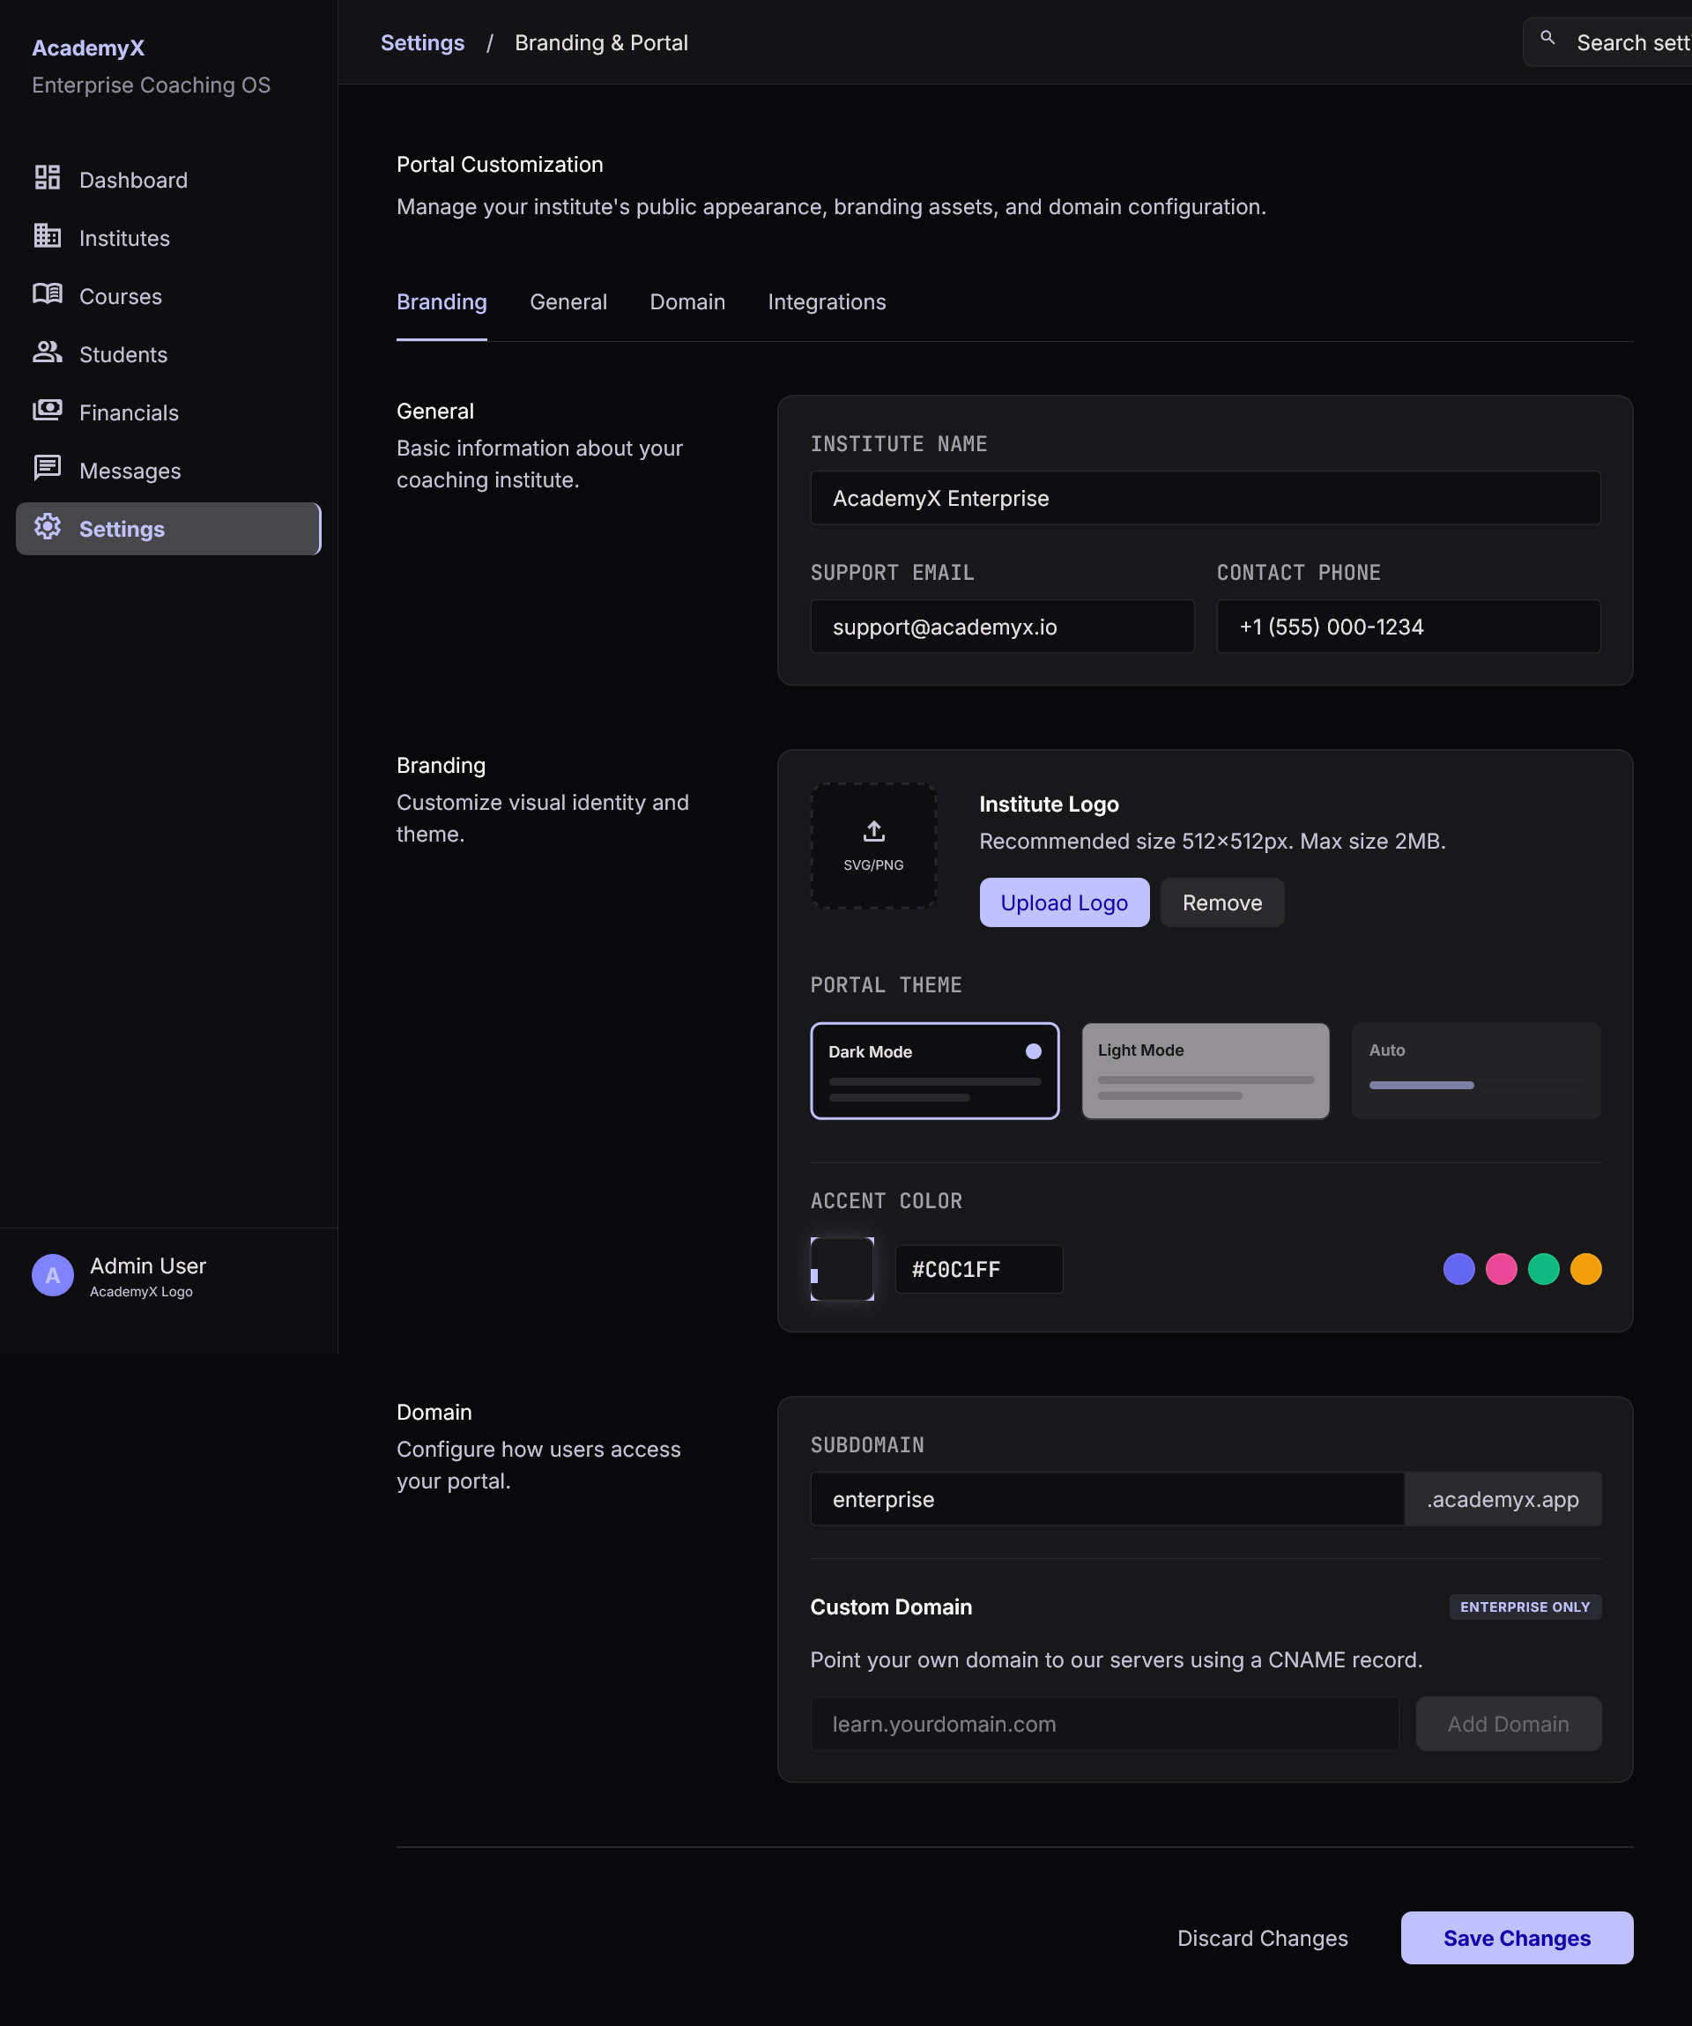
INSTITUTE ADMIN
18/19
Settings
Branding & portal customization

Slide 26
06
PLATFORM OWNER
Section 6 of 6

Slide 27
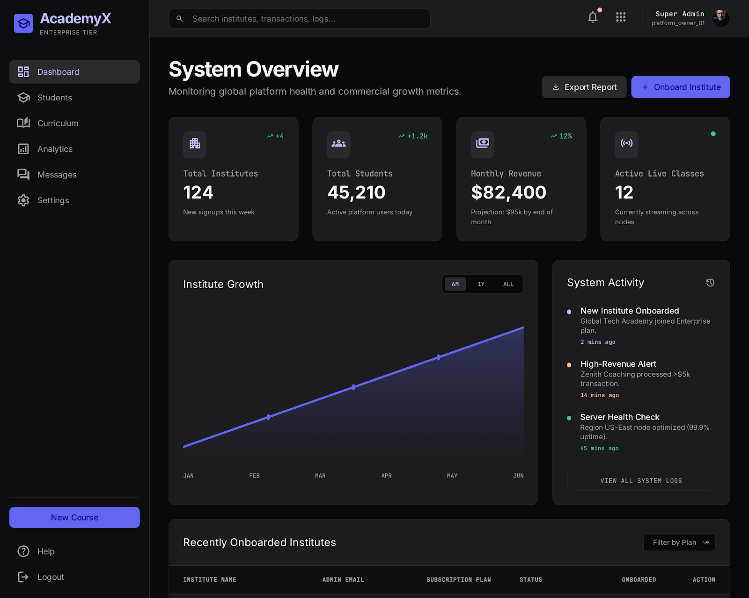
PLATFORM OWNER
19/19
Platform Owner Dashboard
System-wide overview across all institutes

