Slide 1

School of Computing
Vel Tech Rangarajan Dr. Sagunthala R&D Institute of Science and Technology
Department of Computer Science and Engineering
10211CS224 / FULL STACK APPLICATION DEVELOPMENT (JAVA)
PROJECT REVIEW : MILESTONE PROJECT – 2
Date: 20-04-2026
Design and develop a React JS based web application for Ticket Booking of an Internal Department Event.
SDG: SDG No –4 ( Quality Education)
Presented By:
K.UMAR – VTU26656– Reg.No.23UECS0293
Courses Handling Faculty: Dr. S . HEMAMALINI – M.E., Ph.D.,

Slide 2
INTRODUCTION
1
Ticket Booking System is a web-based application developed using React that allows users to view event details and book tickets online.
It simplifies the process of event registration by providing:
Real-time ticket availability
Easy booking interface
Instant confirmation
This system is designed for internal department events such as:
Technical fests
Seminars
Workshops
2
3
4
5
6
7
8
9

Slide 3
PROBLEM STATEMENT
1
Traditional ticket booking methods face several issues:
Manual registration is time-consuming
No real-time tracking of ticket availability
Chances of overbooking
Lack of proper validation
Poor user experience
There is a need for a digital, efficient, and user-friendly system to handle event ticket booking.
2
3
4
5
6
7
8
9

Slide 4
OBJECTIVES
1
To develop a user-friendly ticket booking interface
To display event details clearly
To implement real-time ticket availability
To ensure proper input validation
To prevent booking errors
To provide instant booking confirmation
2
3
4
5
6
7
8
9

Slide 5
PROPOSED SYSTEM
1
2
The proposed system is a React-based web application
Displays complete event details
Allows users to book tickets online
Validates user input
Prevents overbooking
Updates ticket count dynamically
It ensures a smooth and error-free booking experience
3
4
5
6
7
8
9

Slide 6
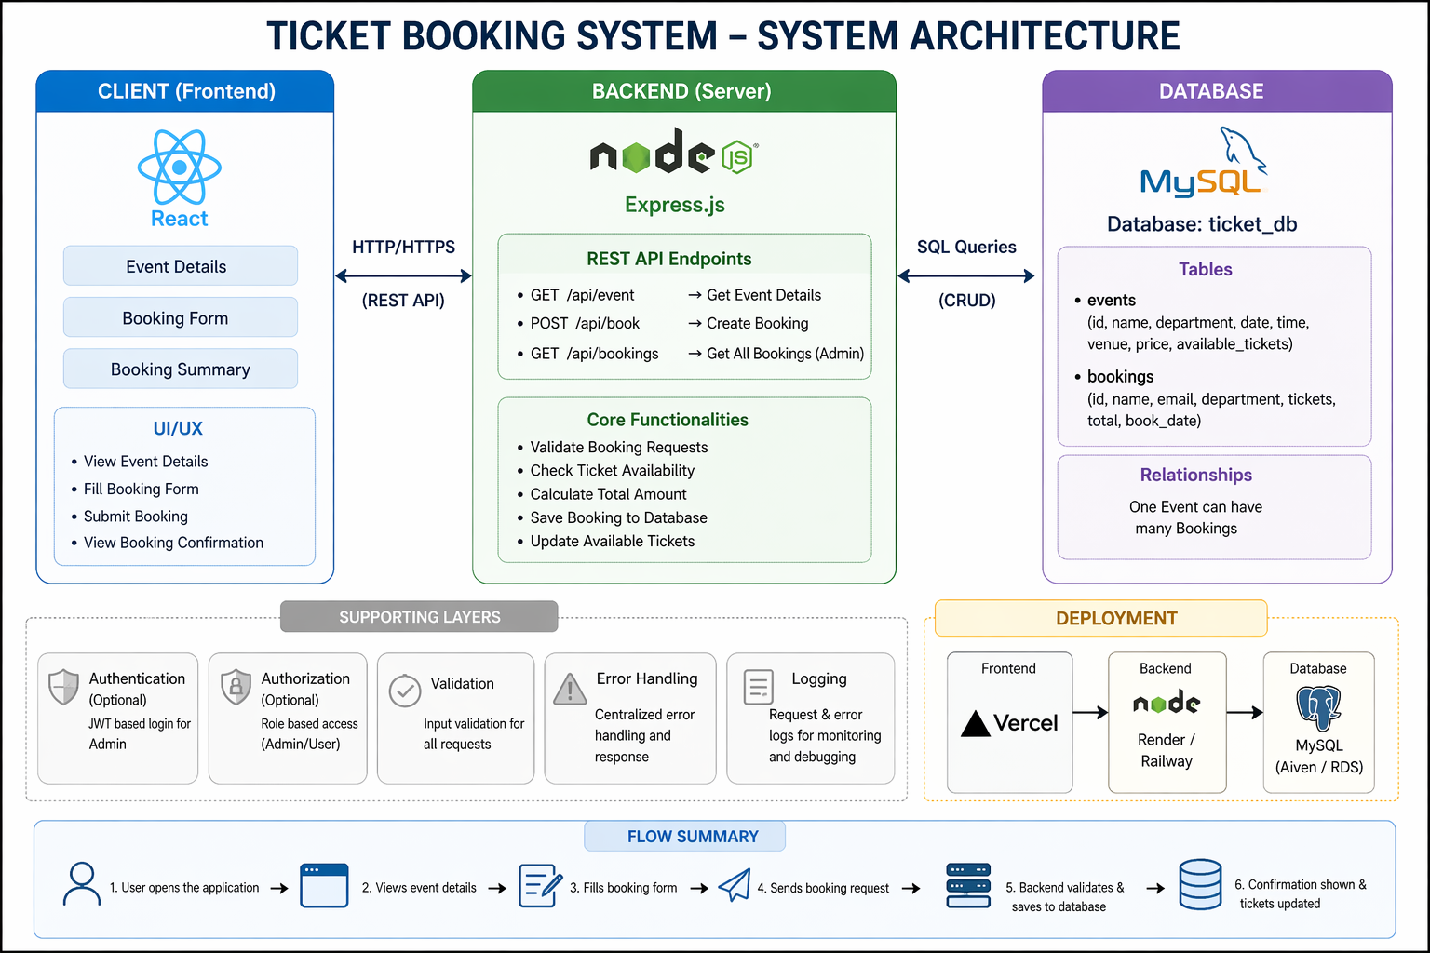
PROPOSED SYSTEM ARCHITECTURE
1
2
3
4
5
6
7
8
9

Slide 7
WORKFLOW
start
1
User Registers / Logs In
2
3
View Events List
4
Select Event
5
Enter Booking Details
6
Confirm Booking
7
Store in Database(MySQL)
8
Show Confirmation
9
End
Notes:
Start

Slide 8
TECHNOLOGIES USED
1
React – Frontend framework
JavaScript (ES6) – Logic handling
HTML5 – Structure
CSS3 – Styling and UI design
Vite – Fast development environment
MySQL - Database
2
3
4
5
6
7
8
9

Slide 9
MODULE DESCRIPTION
🔹 Event Details Module
Displays all the information about the event such as event name, department, date and time, venue, ticket price, and available tickets.
🔹 Ticket Booking Module
Allows users to enter their details like name, email, department, and number of tickets to book tickets for the event.
1
2
3
4
5
6
7
8
9

Slide 10
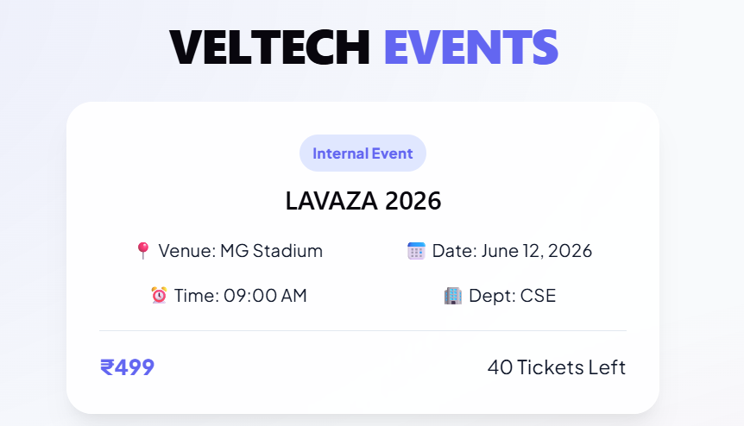
IMPLEMENTATION SCREENSHOTS
1
2
3
4
5
6
7
8
Explanation: .Displays all the information about the event such as event name, department, date and time, venue, ticket price, and available tickets.
9

Slide 11
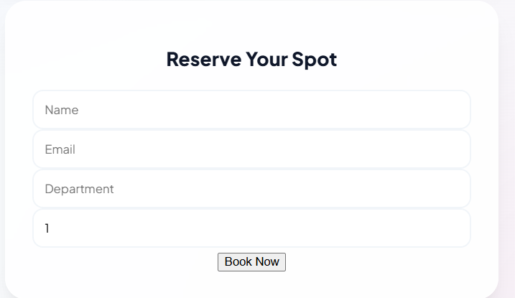
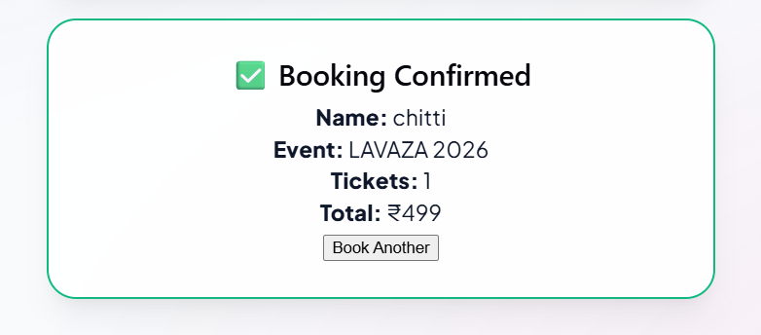
IMPLEMENTATION SCREENSHOTS
1
2
3
4
5
6
7
8(A)
9
.
Ticket Booking Module
Allows users to enter their details like name, email, department, and number of tickets to book tickets for the event

Slide 12
ADVANTAGES & LIMITATIONS
1
Advantages
2
Easy online booking – saves timeand effort
Real-time ticket availability updates
User-friendly interface (simple and clean UI)
Reduces manual work and errors
Data stored securely in database
3
4
5
6
Limitations
Depends on internet connection
Basic security (no login/auth system yet)
Limited to single event (not scalable fully)
No payment integration
Backend must run continuously (no cloud deployment yet)
7
8
9

Slide 13
Thank you

