Slide 1
Chapter 4
Software
4.1 Types of software and interrupts

Slide 2
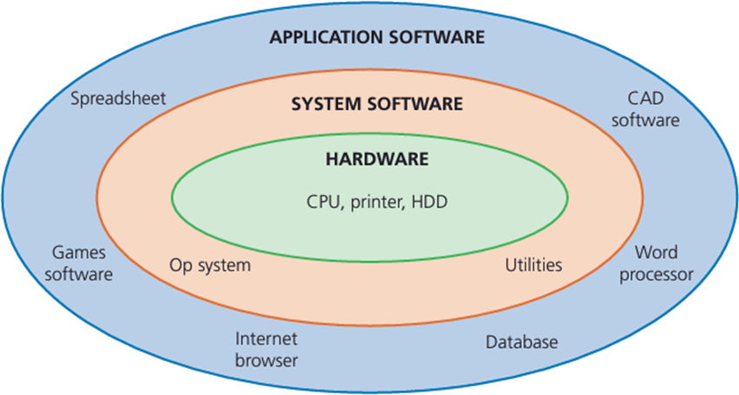
Software Concepts
User
Application Software
System software
Hardware

Slide 3
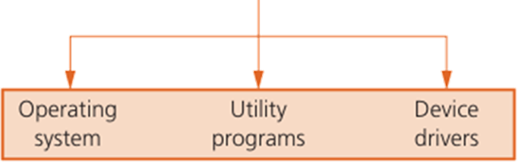
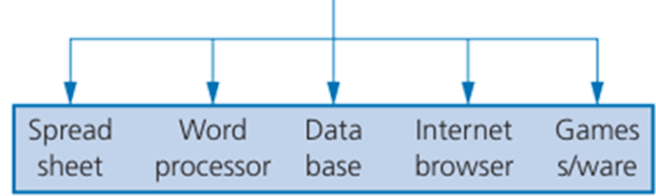
4.1 Software Types
Software
System software
Application software
Controls and manages operations of the computer hardware
Provides a platform on which all software can run properly
Provides a human-computer interface (HCI)
Control the allocation of resources (software and hardware)
Used to perform various tasks on the computer
Allow the user to perform a specific task on the computer
Meets the requirements of the user
user can execute the software as and when the require.

Slide 4
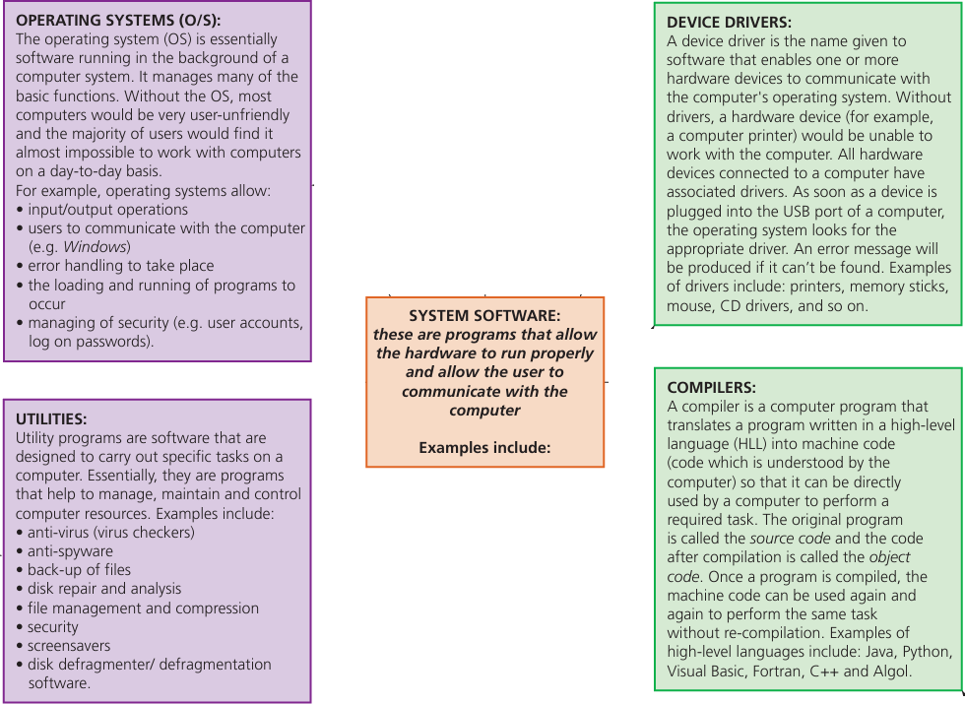
System software - Example

Slide 5
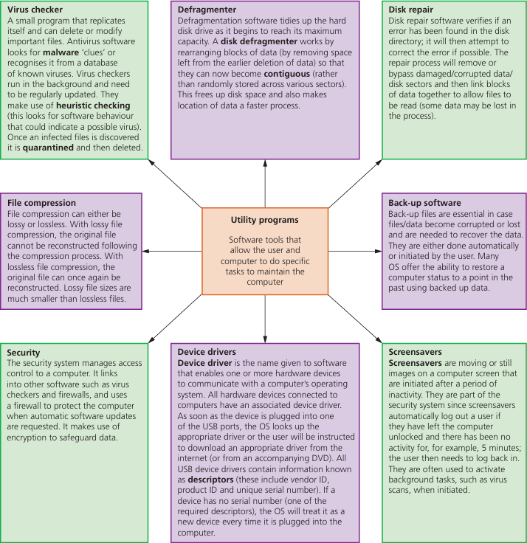
System software - Example

Slide 6
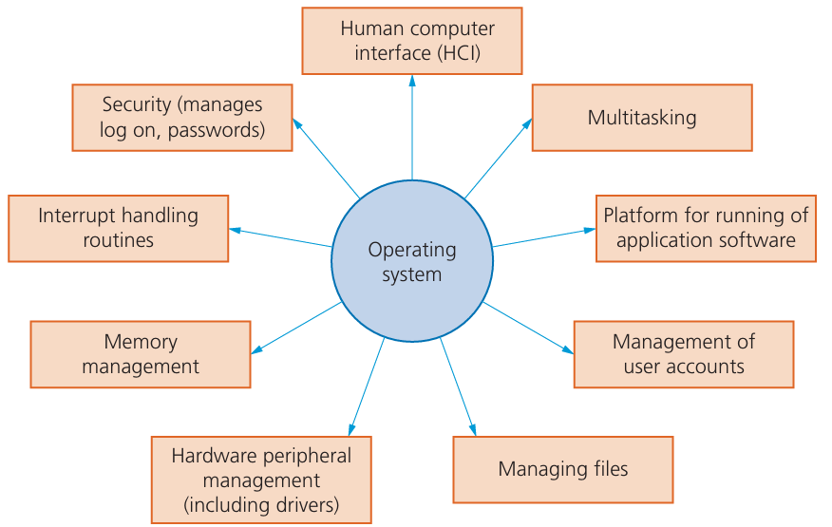
Operating system - Functions

Slide 7
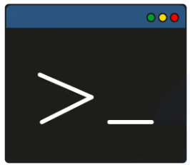
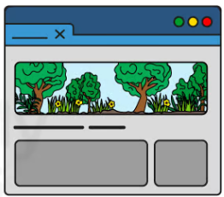
Operating system - Functions
Human Computer Interface (HCI)
The human computer interface (HCI) is in the form of a
Command Line Interface (CLI) or a Graphical User Interface (GUI).
A GUI allows the user to interact with a computer using pictures or symbols (icons) rather than having to type in a number of commands.

Slide 8
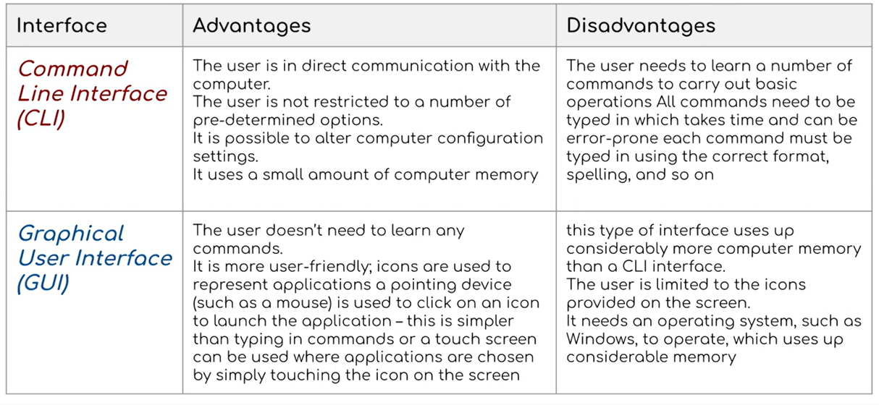
Operating system - Functions
Differences between GUI and CLI interfaces

Slide 9
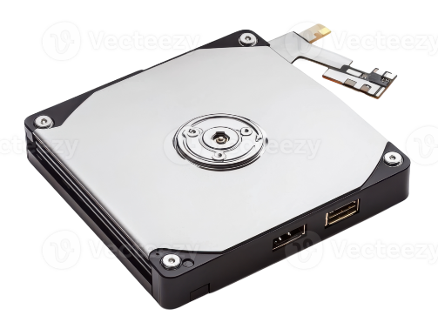
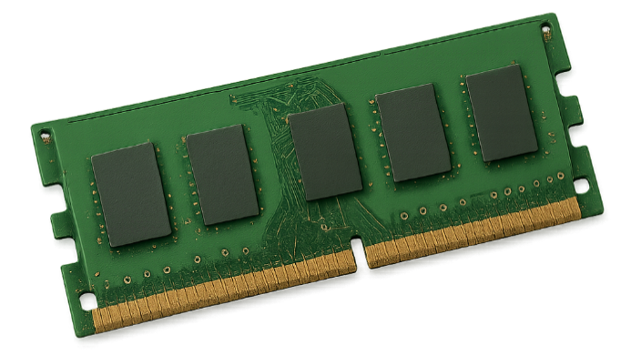
Operating system - Functions
Memory management
manages the primary storage (RAM) and allows data to be moved between RAM and HDD/SSD during the execution of programs
keeps track of all the memory locations
carries out memory protection to ensure that competing applications cannot use the same memory locations at the same time.

Slide 10

Operating system - Functions
Security management
The operating system manages security by ensuring data integrity, confidentiality, and availability.
Security management tasks include:
carrying out updates as and when they become available
ensuring that anti-virus software is always up to date
maintaining access rights for all users
offering the ability for the recovery of data when it has been lost or corrupted

Slide 11
Operating system - Functions
File management
File management tasks include:
file naming conventions which can be used i.e. filename.docx(where the extension can be .bat, .htm, .dbf, .txt, .xls, etc.)
performing specific tasks, such as: create, open, close, delete, rename, copy, and move files
maintain the directory structures
ensuring access control mechanisms are maintained

Slide 12
Operating system - Functions
Hardware and peripheral management
This involves the management of all input and output peripheral devices.
tasks include:
communicates with all input and output devices using device drivers
ensures each hardware resource has a priority so that they can be used and released as required
manages input/output devices by controlling queues and buffers

Slide 13
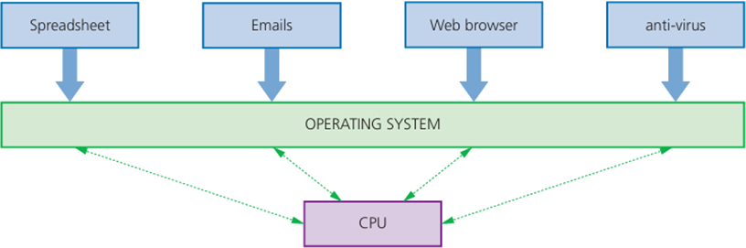
Operating system - Functions
Multitasking
Multitasking means computers can carry out more than one task at a time
Each of these tasks will share the CPU and Memory under the control of the operating system software.
To make sure that multitasking operates correctly, the operating system need to continually monitor each of the processes
resources are allocated to a task for a specific time limit
the task can be interrupted while it is running
the task is given a priority so it can have resources according to its priority.

Slide 14
Operating system - Functions
Management of user accounts
Computers allow more than one user to log onto the system. It is therefore important that users’ data is stored in separate parts of the memory for security reasons.
Each person logging onto the computer will be given a user account protected by a user name and password. The operating system is given the task of managing these different user accounts.
This allow allows each user to:
customise their screen layout and other settings
use separate folders and files and to manage these themselves.
Usually an administrator oversees the management of these user accounts

Slide 15
Operating system - Functions
Interrupt handling
An interrupt is a signal from a device attached to a computer or from a program within the computer that requires the operating system to stop and figure out what to do next.
The Interrupts can be caused by:
An input/output process (e.g. a disk drive or printer requiring more data)
A hardware fault (for example, a paper jam in the printer)
User interaction, for example, the user presses <CTRL> <ALT> <BREAK>
software errors that cause a problem

Slide 16
Operating system - Functions
Interrupt handling
Interrupts allow computers to carry out many tasks or to have several programs open at the same time.
An example would be downloading a file from the internet at the same time as listening to some music in iTunes. Interrupts allow these two functions to co-exist and the user has the impression that both functions are being carried out simultaneously.
In reality, data is being passed in and out of memory very rapidly, allowing both functions to be serviced. This can all be achieved by using an area in memory known as a buffer.

Slide 17
Buffer
Buffer
A buffer is a memory area that stores data temporarily.
For example, buffers are used when downloading a movie from the internet to compensate for the difference between download speeds and the data requirements of the receiving device.
The data transmission rate of the movie file from the web server to the buffer must be greater than the rate at which data is transmitted from buffer to media player.
Without buffers, the movie would frequently ‘freeze’.

Slide 18
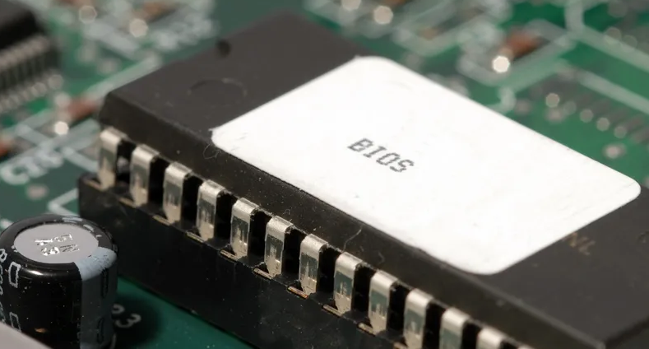
4.1.3 Running of Applications
When a computer starts up, a part of the operating system is loaded into RAM – this is known as booting up the computer
The start-up of the computer’s motherboard is handled by the basic input/output system (BIOS)

Slide 19
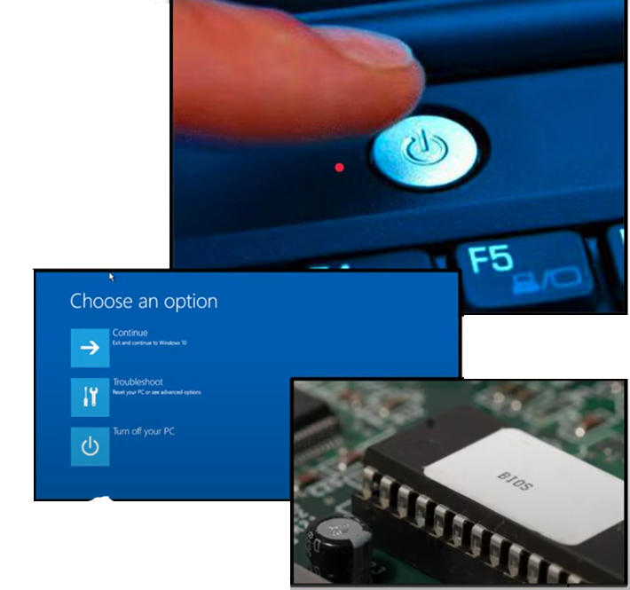
4.1.3 Running of Applications
When a computer starts up, a part of the operating system is loaded into RAM – this is known as booting up the computer
The start-up of the computer’s motherboard is handled by the basic input/output system (BIOS)

Slide 20
Firmware
Firmware is software that's embedded in a piece of hardware. You can think of it simply as "software for hardware."
However, software is different from firmware, so the two are not interchangeable terms.
Devices that you might think of as strictly hardware, such as an optical drive, network card, TV remote, router, media player, camera, or scanner, all have software that's programmed into a special memory contained in the hardware itself.

