Slide 1
Chapter 4
Software
-4.2.1,4.2.2 Types of programming languages
-4.2.3 , 4.2.4 Translators (Compiler, Interpreter, Assembler)
-4.2.5 IDE (Integrated development environment)

Slide 2
Types of programming languages
Programming Languages
High level Language
Low level Language
Assembly Language
Machine Language

Slide 3
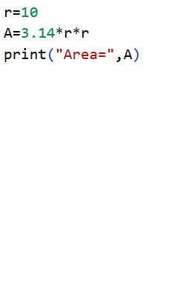
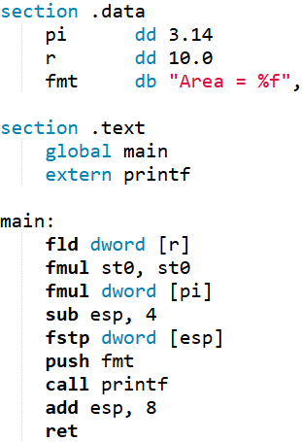
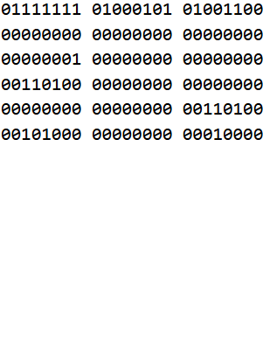
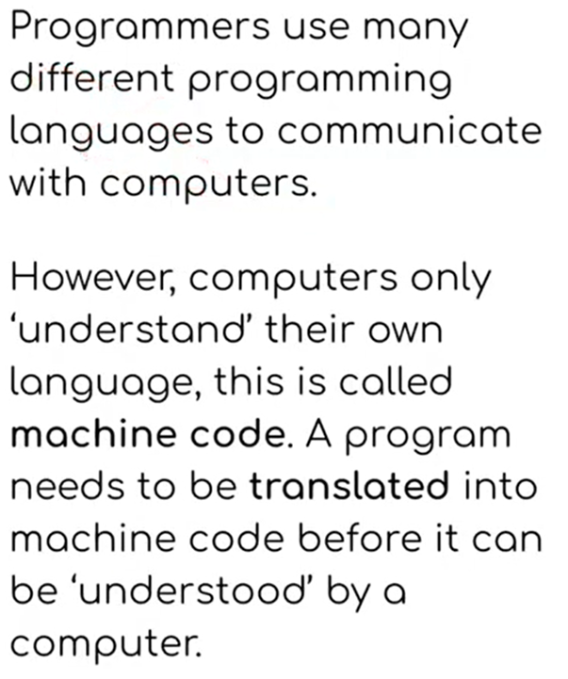
Types of programming languages
High level Language
Assembly Language
Machine Language

Slide 4
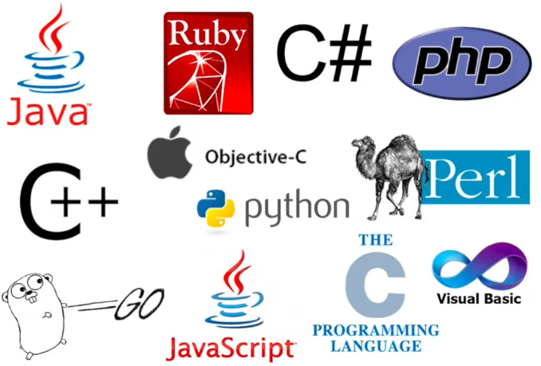
High level Languages
High-level languages enable a programmer to focus on the problem to be solved and require no knowledge of the hardware and instruction set of the computer that will use the program.
Many high-level programming languages are portable and can be used on different types of computers.

Slide 5
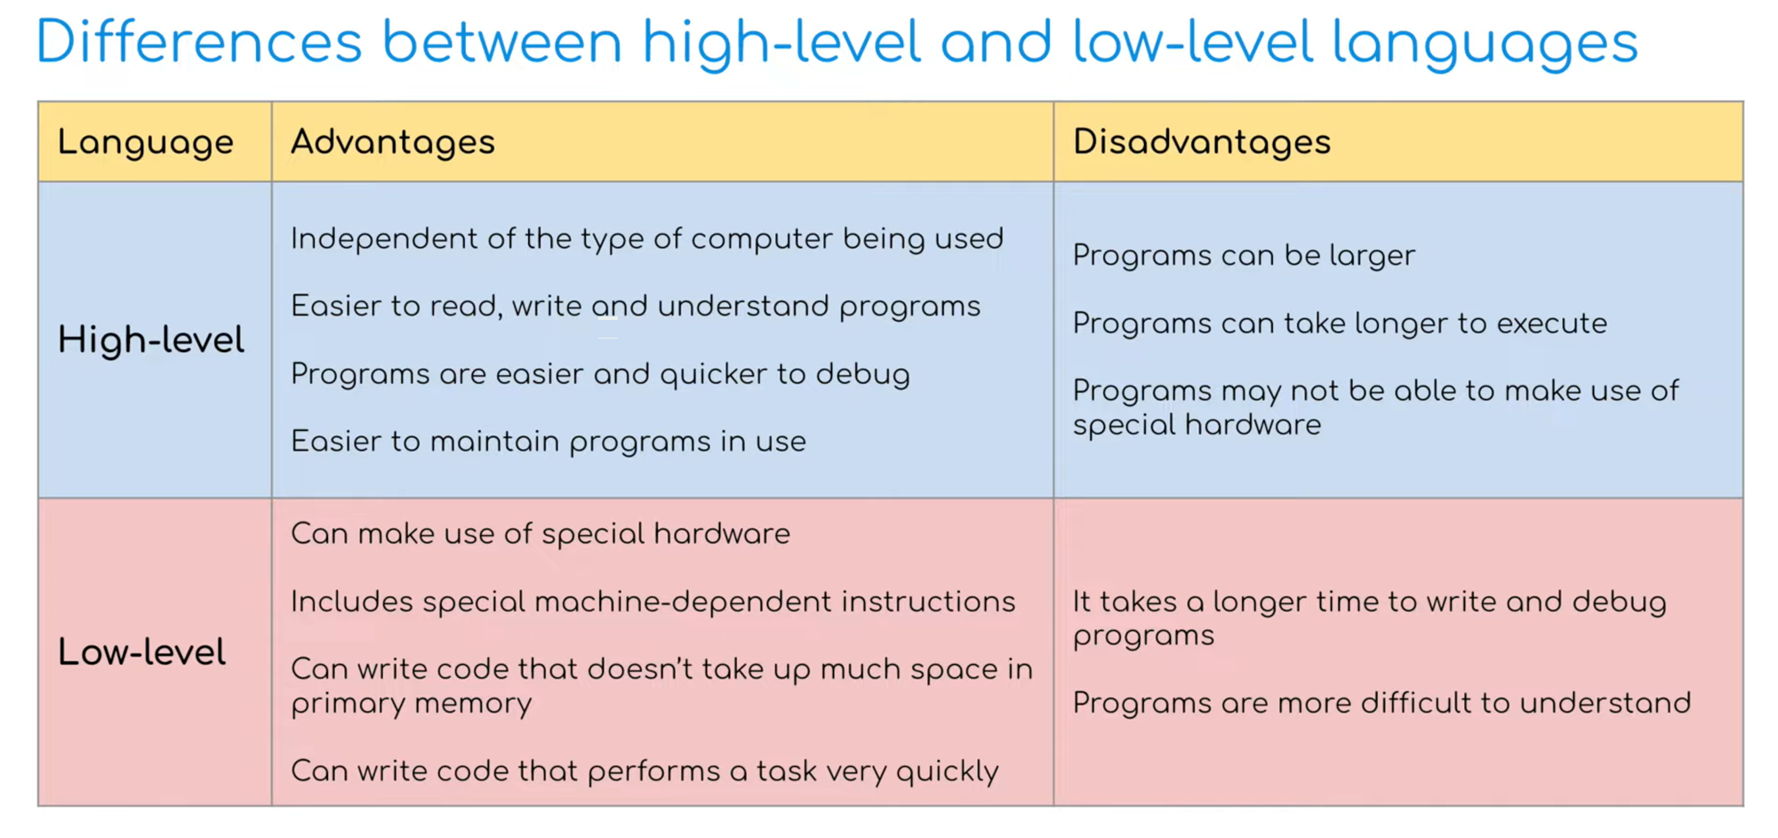
High level Languages Vs Low level Languages

Slide 6
Translators
Translators are needed to translate programs written in high level languages into the machine code that a computer can understand and execute.
There are three types of translators
Compiler
Assembler
Interpreter
converts the High-Level Language into Machine Code all in one go so that it can be directly used by a computer to perform a required task.
This process is called compilation.
If errors are detected, then an error report is produced instead of a compiled program
The purpose of an assembler is to translate assembly language into machine code
Use mnemonic codes
(Eg: MOV, ADD, SUB, JMP)
converts the High-Level Language into Machine Code one instruction at a time.The resulting code is then executed immediately. The process is called interpretation.
If there is an error in the statement then execution ceases and an error message is output, sometimes with a suggested correction

Slide 7
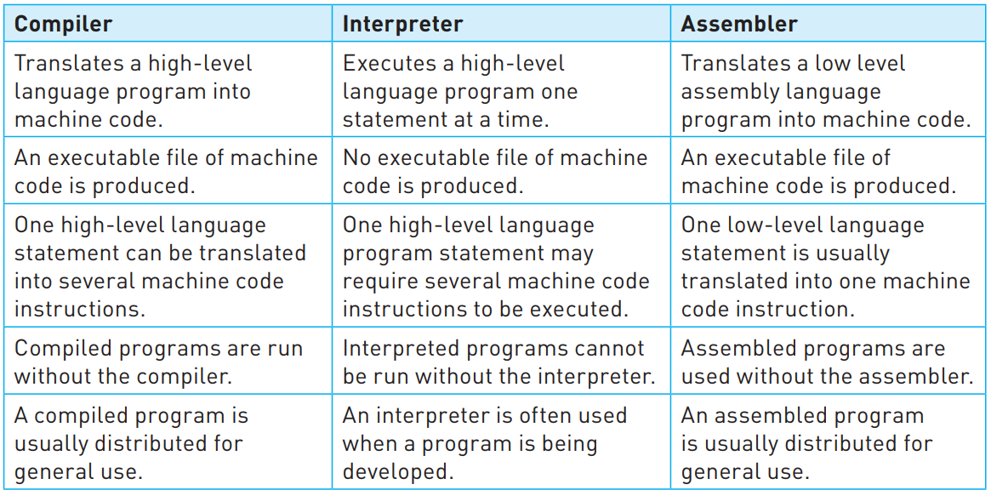
Translation programs - Summary

Slide 8
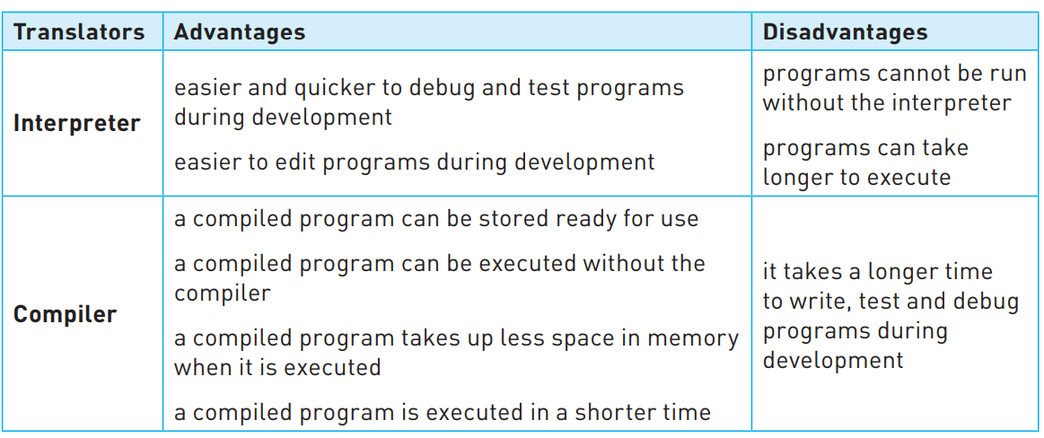
Comparing translators
Advantages and disadvantages of compilers and interpreters

Slide 9
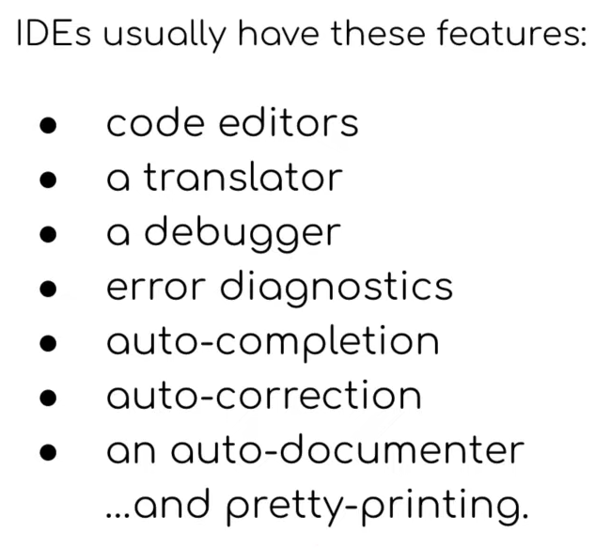




IDE (Integrated Development Environment)
An Integrated development environments (IDE) is used by programmers to aid the writing and development of code.
They are designed to bring together all programming tasks in one application;
There are many different IDEs available;
Examples
Spyder
Python IDLE
VS Code
BlueJ

