Slide 1
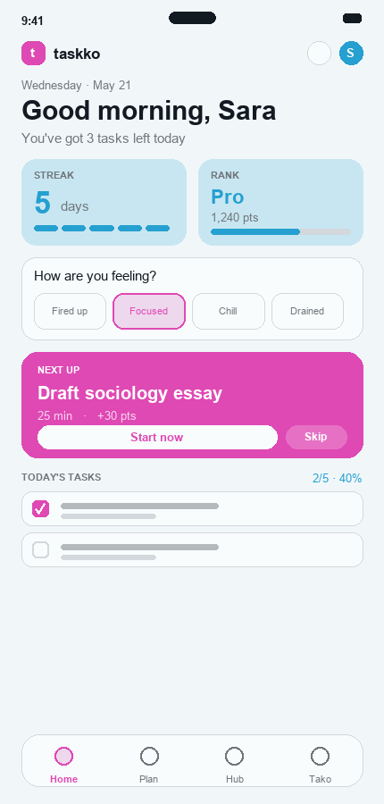
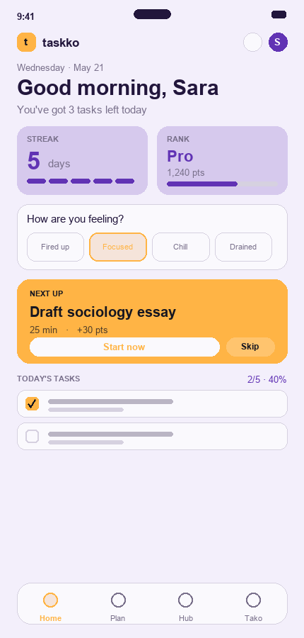
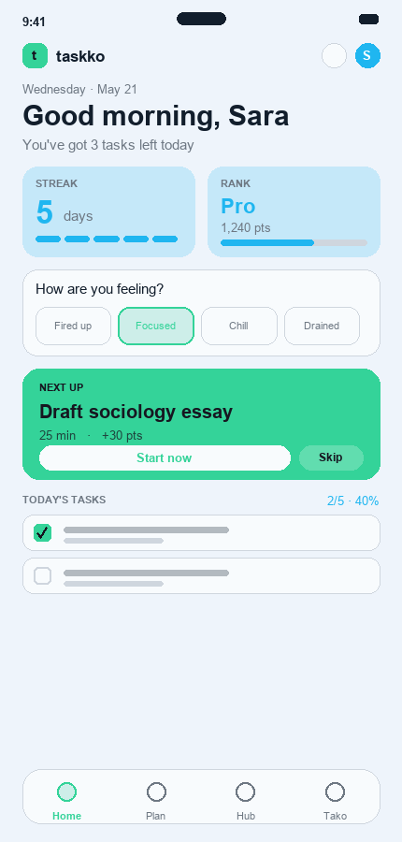
t
taskko
MOBILE APPLICATION DEVELOPMENT · LAB 13
Colour Theory
& the Taskko
Prototype
Competitor palettes · 60-30-10 · harmonies · temperature
Umar Ahad Uddin Ahmed Usmani (SAP 60199)
Muhammad Sharjeel (SAP 59385)
Riphah International University · 20 June 2026

Slide 2
t
taskko
WHAT THIS LAB COVERS
Four colour-theory tasks, applied to Taskko
1 · Competitor palettes
2 · 60-30-10 schemes
Extract the colour palettes of two competitor apps (Habitica & Forest) with Adobe Color.
Re-skin the Taskko Home screen in each palette using the 60-30-10 ratio.
3 · Five harmonies
4 · Temperature
Apply monochromatic, complementary, split-complementary, analogous & triadic harmonies.
Render warm, cool, neutral & achromatic versions and match them to app types.
Taskko — Lab 13: Colour Theory
2

Slide 3
t
taskko
TOOL
Adobe Color + the 60-30-10 rule
We used color.adobe.com in two modes:
Extract Theme from Image
The 60-30-10 rule
Upload a competitor screenshot; Adobe Color samples 5 representative swatches and gives the hex codes.
60% Dominant / background
Colour-wheel harmony rules
Set Taskko's base hue (197°) and switch between the 5 harmony rules to generate each palette mathematically.
30% Secondary
10% Accent
Taskko — Lab 13: Colour Theory
3

Slide 4
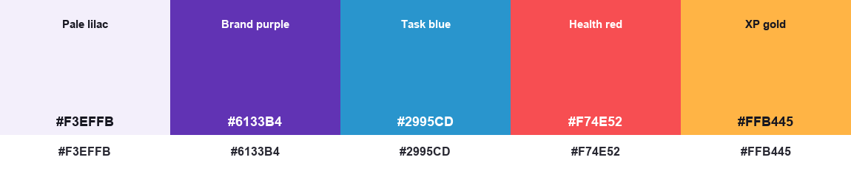
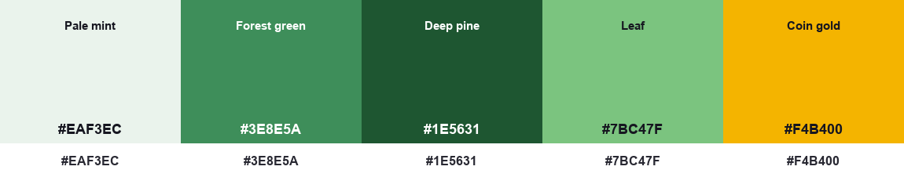
t
taskko
STEP 1 · COMPETITOR PALETTES
Two competitors, extracted with Adobe Color
Habitica
— gamified habit & to-do RPG — purple-dominant with bright RPG stat colours
Forest
— focus / anti-distraction timer — green-dominant with a gold coin reward accent
Taskko — Lab 13: Colour Theory
4

Slide 5
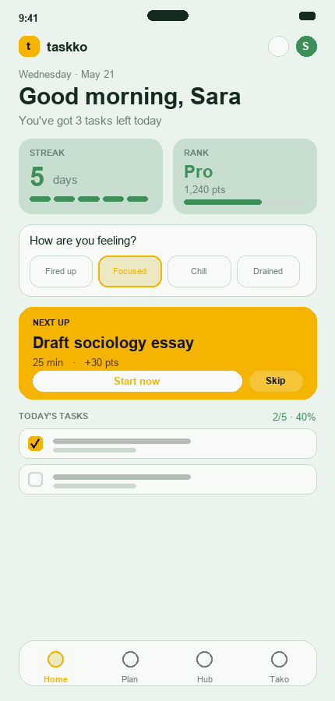
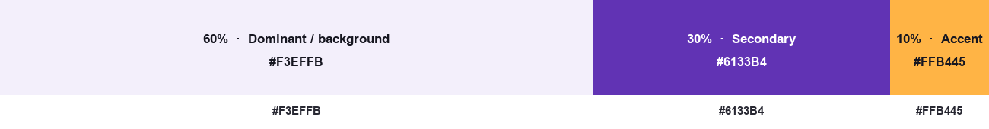
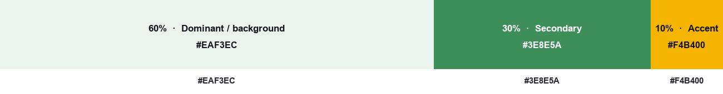
t
taskko
STEP 2 · 60-30-10
Each palette mapped onto the Taskko Home screen
Habitica skin
Forest skin
60% lilac · 30% purple · 10% gold accent
60% mint · 30% green · 10% gold accent
Taskko — Lab 13: Colour Theory
5

Slide 6
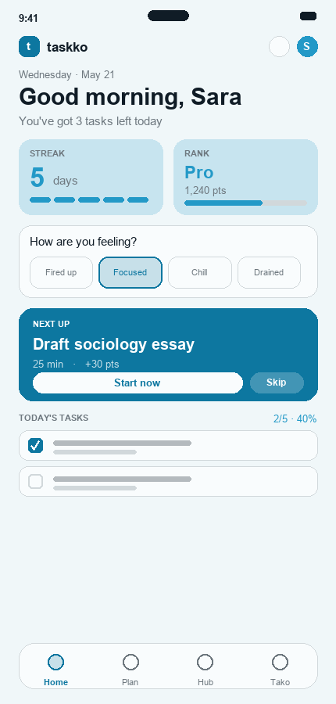
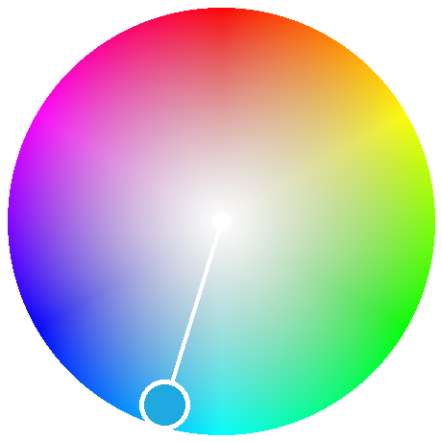
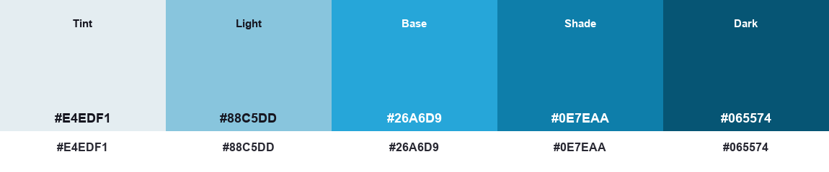
t
taskko
STEP 3 · HARMONY 1 OF 5
Monochromatic — 197° only — tints & shades
Applied to the prototype
One hue in many tints and shades. Calm, cohesive, very low visual noise.
Note:
Trade-off: low contrast, so the darkest shade carries the CTA.
Adobe Color harmony palette
Taskko — Lab 13: Colour Theory
6

Slide 7
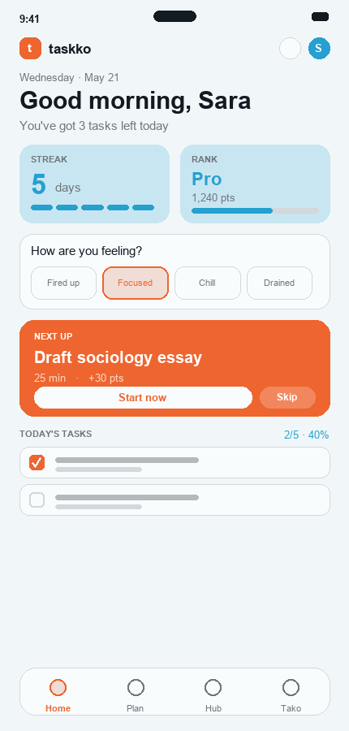
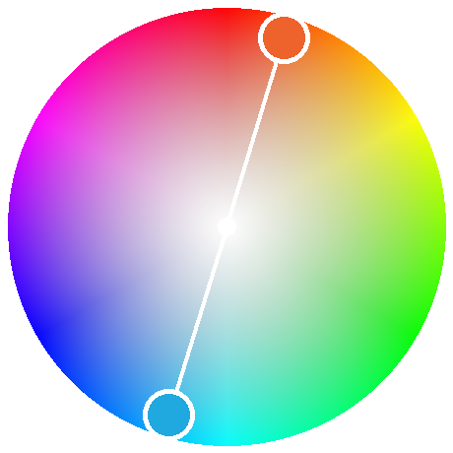
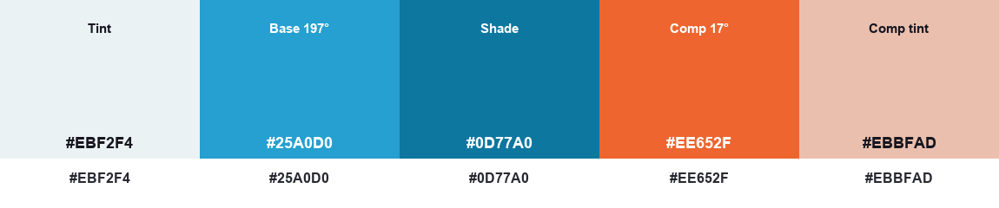
t
taskko
STEP 3 · HARMONY 2 OF 5
Complementary — 197° + 17° (opposite)
Applied to the prototype
Base blue + its opposite, warm orange. Maximum contrast — the hero pops hard.
Note:
Great for one strong CTA; use sparingly to avoid vibration.
Adobe Color harmony palette
Taskko — Lab 13: Colour Theory
7

Slide 8
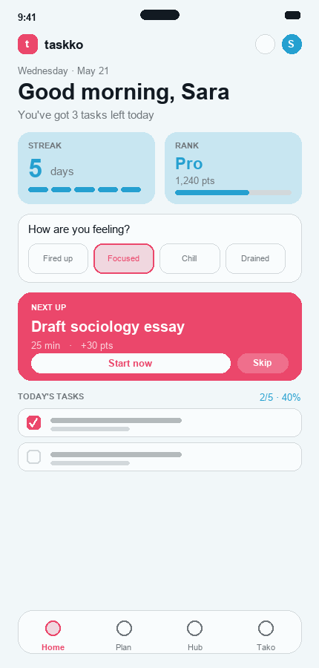
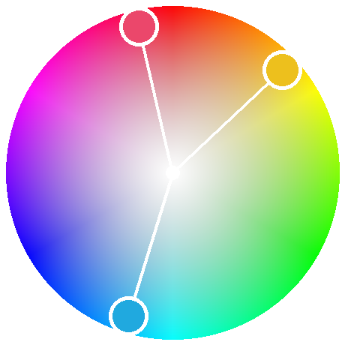
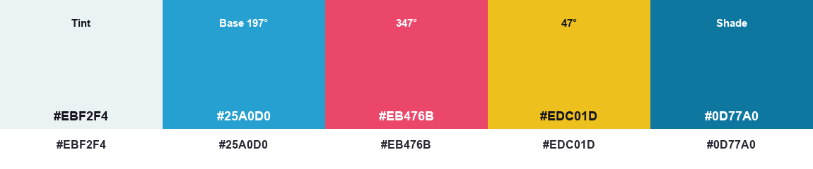
t
taskko
STEP 3 · HARMONY 3 OF 5
Split-Complementary — 197° + 347° + 47°
Applied to the prototype
Base + the two hues beside its complement (rose & amber).
Note:
Complementary contrast, but softer and with two accent options.
Adobe Color harmony palette
Taskko — Lab 13: Colour Theory
8

Slide 9
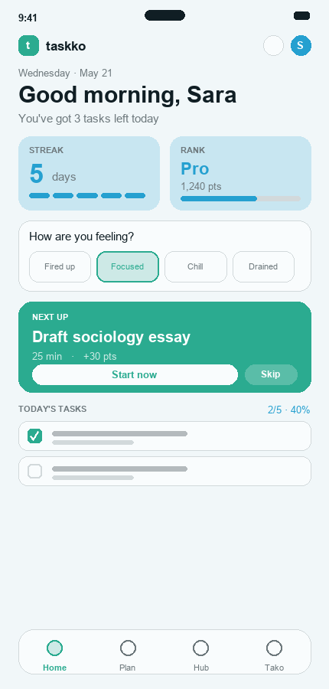
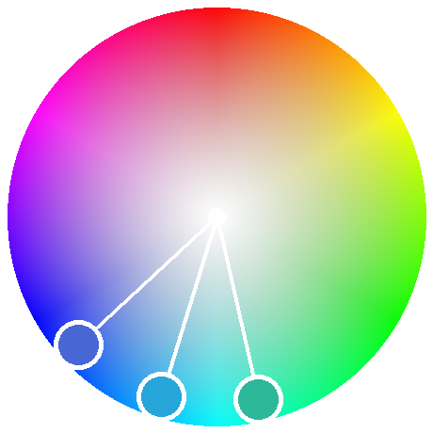
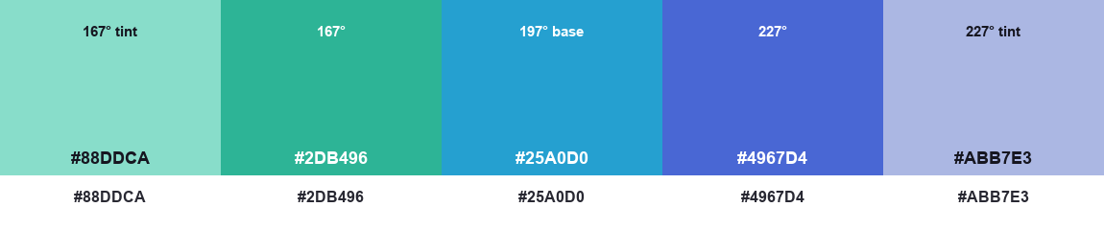
t
taskko
STEP 3 · HARMONY 4 OF 5
Analogous — 167° + 197° + 227°
Applied to the prototype
Three neighbours: teal, blue, indigo. Very harmonious and serene.
Note:
Ideal for a focus app; accents stay subtle and restful.
Adobe Color harmony palette
Taskko — Lab 13: Colour Theory
9

Slide 10
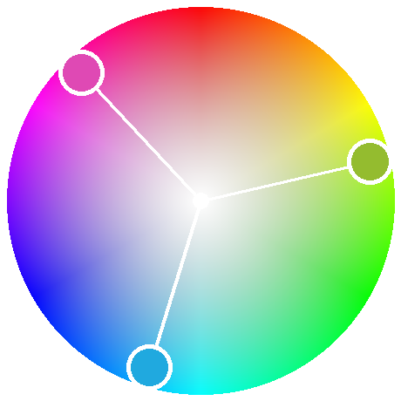
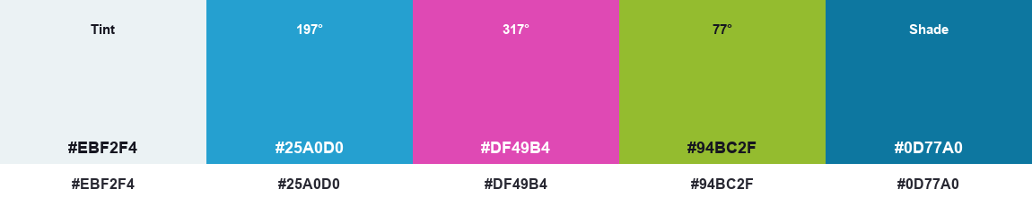
t
taskko
STEP 3 · HARMONY 5 OF 5
Triadic — 197° + 317° + 77°
Applied to the prototype
Three evenly-spaced hues: blue, magenta, lime. Vibrant and playful.
Note:
Fits the gamified side; keep blue dominant to avoid chaos.
Adobe Color harmony palette
Taskko — Lab 13: Colour Theory
10

Slide 11
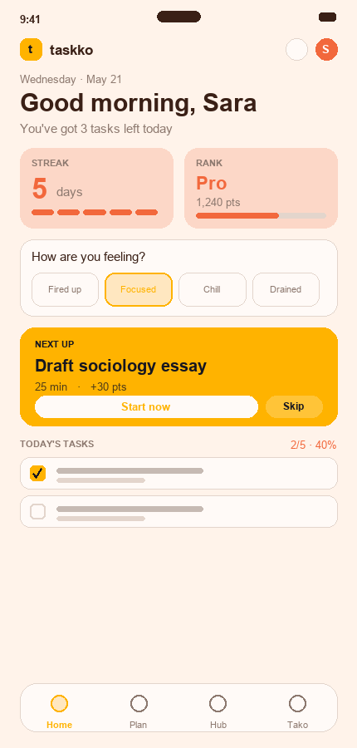
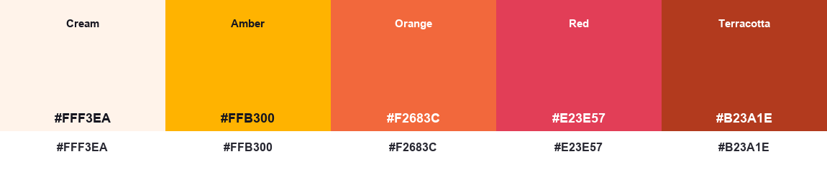
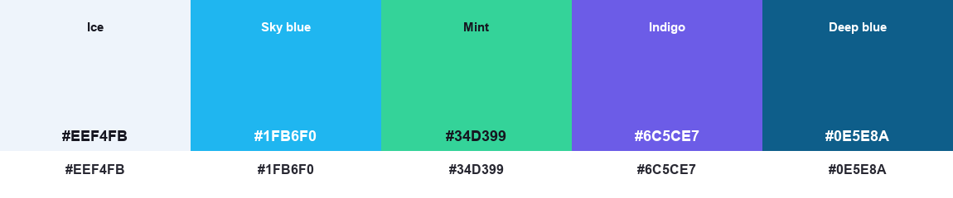
t
taskko
STEP 4 · TEMPERATURE (WARM & COOL)
Matching colour temperature to the app type
Warm colours
Cool colours
Energetic, urgent, motivating. Best for food, fitness, sales & high-energy social apps.
Calm, trustworthy, focus-promoting — Taskko's real base. Best for productivity, finance & learning.
Taskko — Lab 13: Colour Theory
11

Slide 12
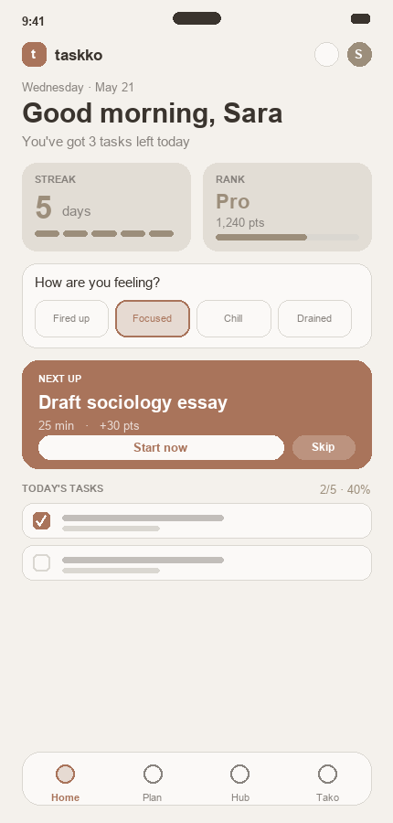
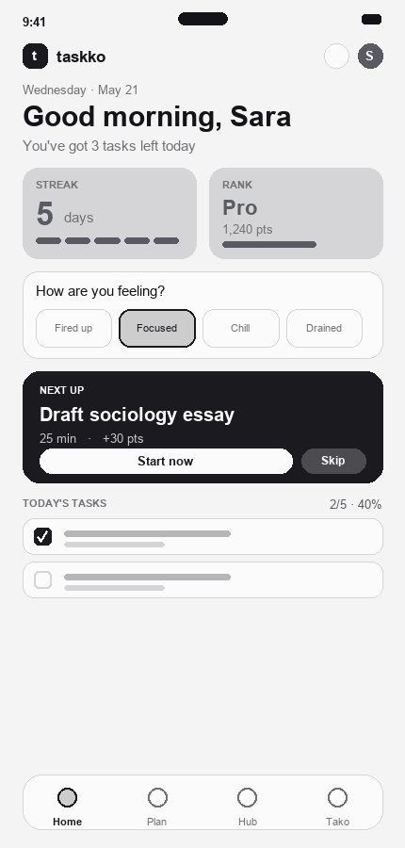
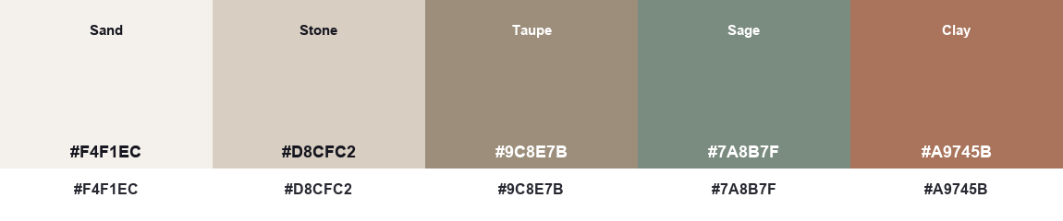
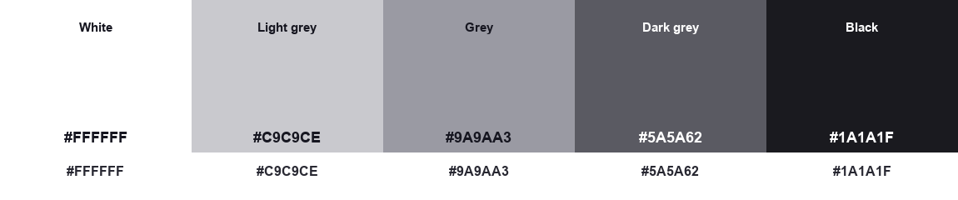
t
taskko
STEP 4 · TEMPERATURE (NEUTRAL & ACHROMATIC)
Matching colour temperature to the app type
Neutral colours
Achromatic colours
Minimal, mature, low-fatigue. A quiet canvas. Best for reading, journaling & lifestyle apps.
Black, white & greys — pure contrast & hierarchy. The accessibility baseline.
Taskko — Lab 13: Colour Theory
12

Slide 13
t
taskko
CONCLUSION
The recommended scheme for Taskko
Taskko is both a focus app (wants calm) and a motivation app (wants energy). The exercise points to one recipe that balances both:
1
Cool base (60–30%)
2
Warm accent (10%)
Sky-blue for a calm, trustworthy, focus-friendly core.
Peach/gold on the hero, streaks & rewards — a split-complementary pairing.
3
Neutral background
4
Achromatic baseline
A near-white, lightly-tinted canvas keeps long sessions low-fatigue.
Design reads in greyscale first — guaranteeing contrast & accessibility.
Matches Taskko's real tokens —
#1FB6F0 sky-blue · #FF8A65 peach · neutral background.
Taskko — Lab 13: Colour Theory
13

Slide 14
t
taskko
LAB 13 · COMPLETE
Colour theory,
applied end-to-end
Two competitor palettes · 60-30-10 skins · five harmonies · four temperatures —
all applied to the Taskko prototype.
https://www.figma.com/design/Xa83tCHsfbzIuGEJft8zAz/Taskko-%E2%80%94-App-Design
Taskko — Lab 13: Colour Theory
14

