Slide 1
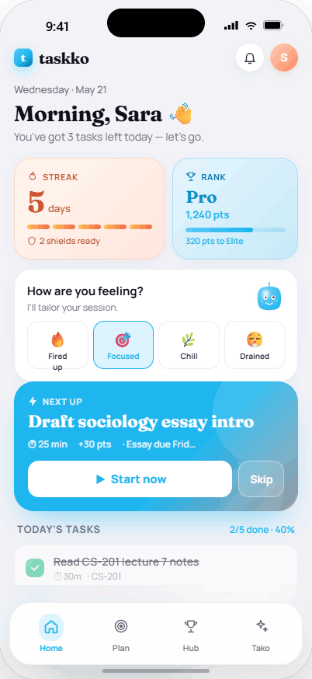
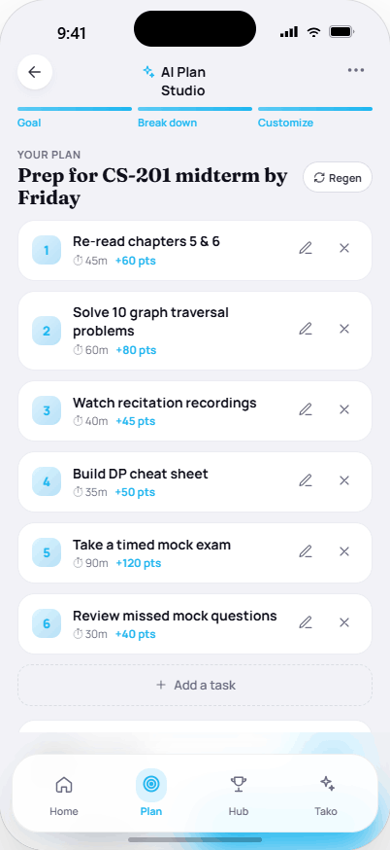
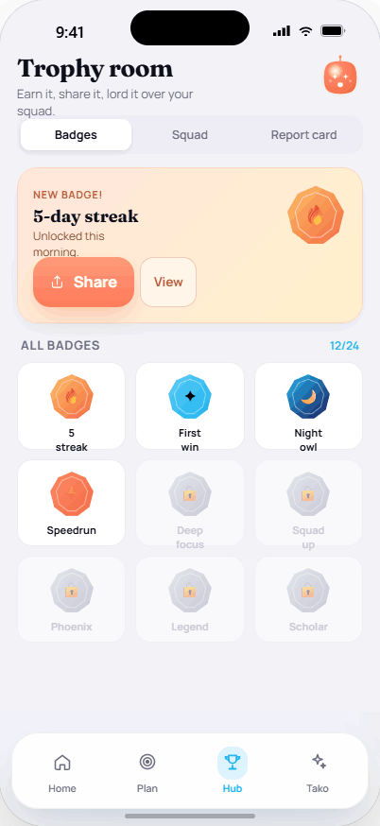
t
taskko
MOBILE APPLICATION DEVELOPMENT · HCI DELIVERABLE
Medium-Fidelity
Prototype
Taskko — Your AI Productivity Companion
Umar Ahad Uddin Ahmed Usmani (SAP 60199)
Muhammad Sharjeel (SAP 59385)
Riphah International University, Lahore · 20 June 2026

Slide 2
t
taskko
WHAT IS TASKKO?
One app for the student productivity loop
1
2
3
AI goal breakdown
Gamification
Social + AI companion
Hand Tako an overwhelming goal; Gemini turns it into bite-sized, editable tasks you can actually start.
Points, ranks, daily streaks, shields and milestone badges turn progress into a motivating loop.
A squad leaderboard, shareable report cards, and Tako — an AI buddy for nudges and support.
Taskko targets the student productivity crisis — overwhelming goals, no accountability, no motivation loop, and burnout — with one fast, motivating, low-fatigue loop.
Taskko — Medium-Fidelity Prototype
2

Slide 3
t
taskko
THE MAIN TASKS
Four user tasks — we prototyped the full signature flow
T1
Get set up
T2
Plan a goal with AI
Understand the value & create an account.
Type a goal; get an editable, bite-sized plan.
Splash · Onboarding · Sign up
AI Plan Studio
T3
Do focused work
T4
Stay motivated
Pick a mood, run a focus session, complete tasks.
Badges, squad, report card, share + Tako chat.
Home · Focus
Hub · Tako
Signature task prototyped end-to-end: “From an overwhelming goal to a started, completed and rewarded study session.”
Taskko — Medium-Fidelity Prototype
3

Slide 4
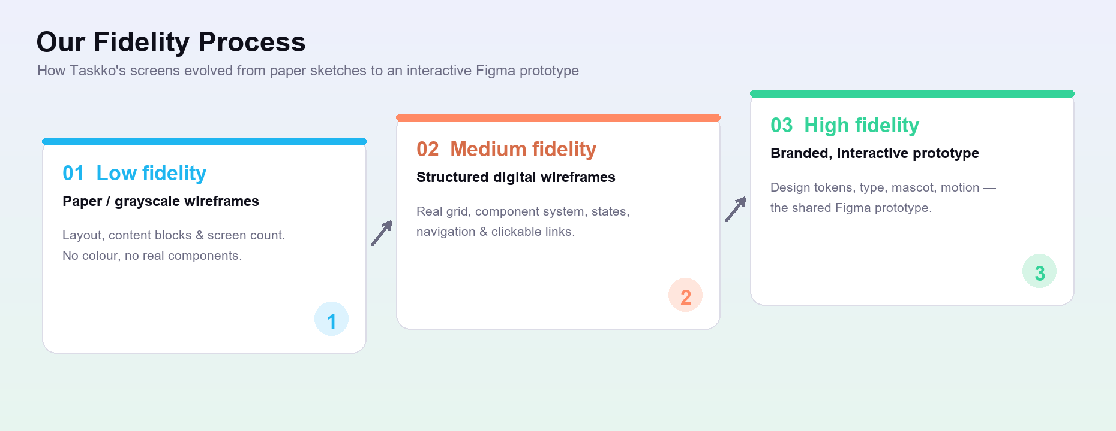
t
taskko
DESIGN PROCESS
From paper sketches to an interactive prototype
Taskko — Medium-Fidelity Prototype
4

Slide 5
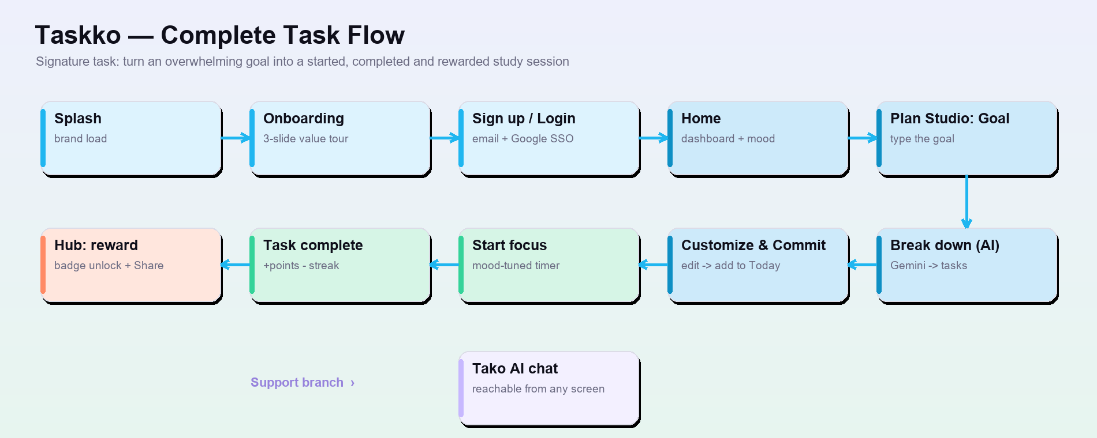
t
taskko
COMPLETE TASK FLOW
The signature task, wired end-to-end in the prototype
Taskko — Medium-Fidelity Prototype
5

Slide 6
t
taskko
CHANGES FROM LOW-FI · 1
Global structural decisions, applied to every screen
Consistent grid & spacing
Reusable component system
402-px frame, 8/12/16 scale, 20–28-px bento radii.
Shared buttons, inputs, cards, task rows, chips, tab bar.
Persistent bottom navigation
System-state screens
Home · Plan · Hub · Tako always visible.
Loading, empty, error/retry and success feedback added.
Realistic content
Interactive links
Real copy replaces lorem to test true layout & overflow.
Click links between frames — sketches become navigable.
Taskko — Medium-Fidelity Prototype
6

Slide 7
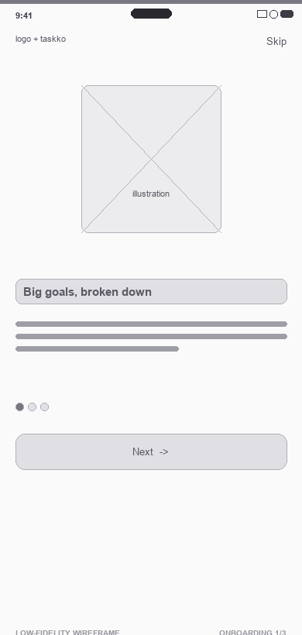
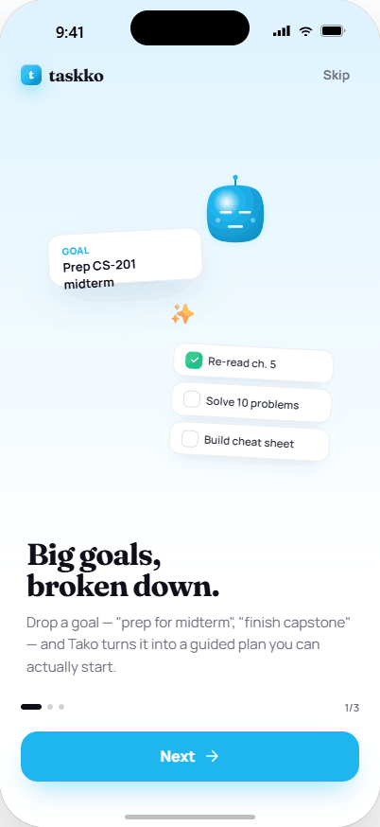
t
taskko
BEFORE / AFTER · 1 OF 5
Onboarding
WHAT CHANGED
One welcome panel → a 3-slide value tour (Plan / Streaks / Squad)
Animated 1/3 dot indicator and a persistent Skip control
Next → Get started; both routes lead into Sign up
Why it matters: Progressive disclosure · user control & freedom
LOW-FIDELITY WIREFRAME
PROTOTYPE SCREEN
Taskko — Medium-Fidelity Prototype
7

Slide 8
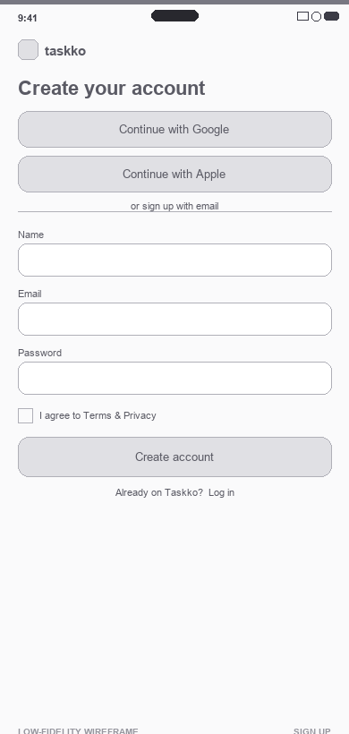
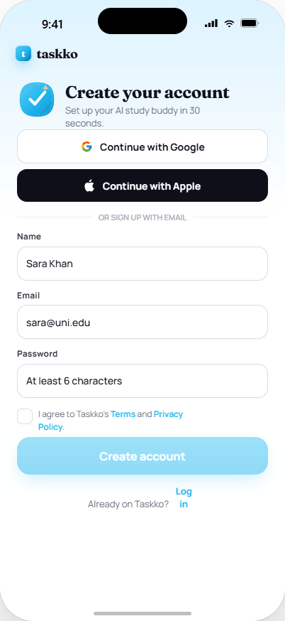
t
taskko
BEFORE / AFTER · 2 OF 5
Sign up
WHAT CHANGED
Google / Apple SSO moved above the fold to cut friction
Required Terms checkbox keeps the CTA disabled until valid
Inline validation, password show/hide, Login cross-link
Why it matters: Error prevention · constraints · affordance
LOW-FIDELITY WIREFRAME
PROTOTYPE SCREEN
Taskko — Medium-Fidelity Prototype
8

Slide 9
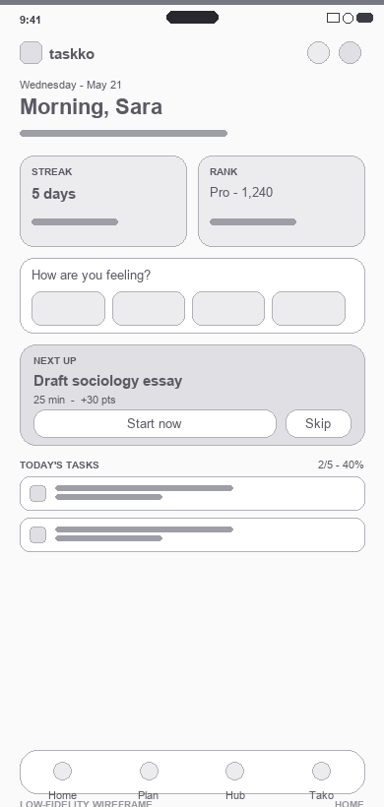
t
taskko
BEFORE / AFTER · 3 OF 5
Home dashboard
WHAT CHANGED
Flat task list → a grouped bento dashboard
Streak & Rank cards with live numbers + progress bars
Mood check-in and a “Next up” hero CTA (Start now)
Why it matters: Bridges the Gulf of Evaluation & Execution · Gestalt
LOW-FIDELITY WIREFRAME
PROTOTYPE SCREEN
Taskko — Medium-Fidelity Prototype
9

Slide 10
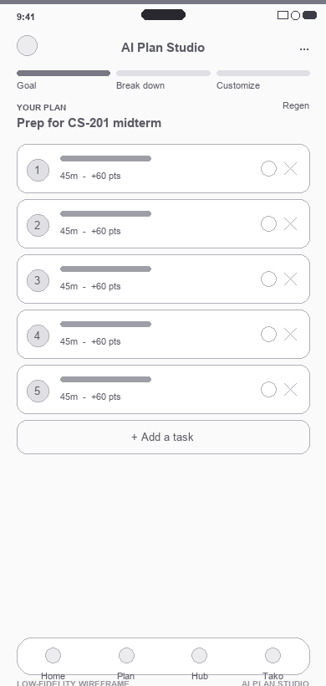
t
taskko
BEFORE / AFTER · 4 OF 5
AI Plan Studio
WHAT CHANGED
Added a 3-step header: Goal → Break down → Customize
Editable AI rows: edit / add / delete / regenerate
Per-task time + points · Commit-to-Today · AI loading state
Why it matters: Visibility of status · user control over the AI
LOW-FIDELITY WIREFRAME
PROTOTYPE SCREEN
Taskko — Medium-Fidelity Prototype
10

Slide 11
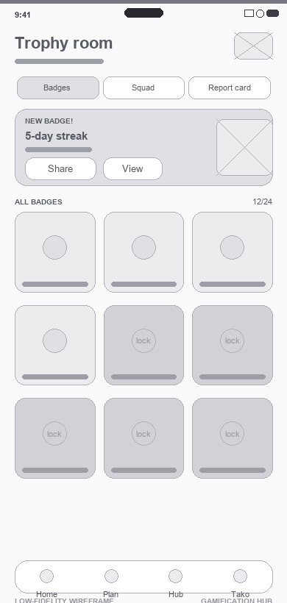
t
taskko
BEFORE / AFTER · 5 OF 5
Gamification Hub
WHAT CHANGED
One badges grid → 3 tabs (Badges / Squad / Report card)
Clear locked vs unlocked badges + a “New badge!” highlight
One-tap Share to the system sheet for accountability
Why it matters: Feedback & reward · recognition over recall
LOW-FIDELITY WIREFRAME
PROTOTYPE SCREEN
Taskko — Medium-Fidelity Prototype
11

Slide 12
t
taskko
RATIONALE · HCI PRINCIPLES
Every change maps to a usability principle
✓
Visibility of system status
✓
Bridge the Gulf of Execution
Streak/rank cards, 3-step Plan progress, AI loading state.
“Next up” hero CTA makes starting the next task effortless.
✓
Bridge the Gulf of Evaluation
✓
Constraints & error prevention
Numbers + progress bars make status readable at a glance.
Disabled CTA, Terms gate, inline validation on sign-up.
✓
Gestalt grouping
✓
User control & freedom
Bento cards group related stats & tasks, reducing overwhelm.
Editable AI plan, persistent Skip, regenerate.
Taskko — Medium-Fidelity Prototype
12

Slide 13
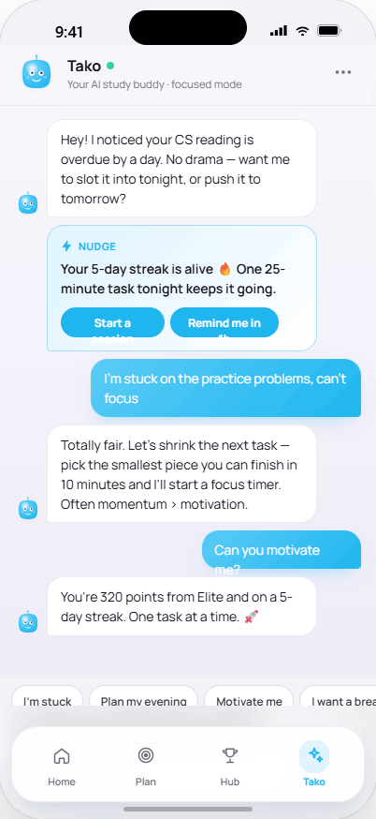
t
taskko
PROTOTYPE WALKTHROUGH
The complete flow, screen by screen
1 · Onboard
2 · Sign up
3 · Home
4 · AI Plan
5 · Reward
↗ Tako
Taskko — Medium-Fidelity Prototype
13

Slide 14
t
taskko
TOOLS BESIDES FIGMA
What we used, why, and the trade-offs
Tool | Why we used it | Pros | Cons
Claude (Claude Design) | Generated the UI concept, low-fi wireframes, this report & deck. | Fast iteration; design+code+docs together; token-consistent. | Needs human review; not pixel-precise; can hallucinate.
HTML / CSS + Chrome | Rendered pixel-accurate screen frames for handoff. | Real fonts/CSS; exact control; free; reusable in the build. | Needs coding; no drag-drop or comments; slower mock-ups.
Python (Pillow/pptx/docx) | Scripted wireframes, diagrams, the report & this deck. | Repeatable; precise; free; regenerate from source fast. | Code-first, not WYSIWYG; manual layout tuning.
Google Fonts | Manrope / Fraunces / JetBrains Mono type system. | Free, open-licensed, high quality, many weights. | Embed for offline; load weight; attribution needed.
Microsoft Office | Final .docx / .pptx submission formats. | Universally accepted; easy edit; reliable PDF export. | Proprietary; less design control; formatting can drift.
Git & GitHub | Version control & backup for assets and docs. | History & rollback; backup; easy collaboration; free. | Learning curve; binary assets don’t diff; conflicts.
Taskko — Medium-Fidelity Prototype
14

Slide 15
t
taskko
SHARE THE PROTOTYPE
The interactive Figma
prototype
All 8 phone screens + the admin portal, with the main task flow wired as
clickable links — open the file and press Present (▶) to play it end-to-end.
https://www.figma.com/design/Xa83tCHsfbzIuGEJft8zAz/Taskko-%E2%80%94-App-Design
Tip:
set the link to “Anyone with the link · can view” so evaluators open it without an account.
Taskko — Medium-Fidelity Prototype
15

