Slide 1

Education for All Fundraising
SQL – Capstone
By
UMAR BUSAYO Alao

Slide 2
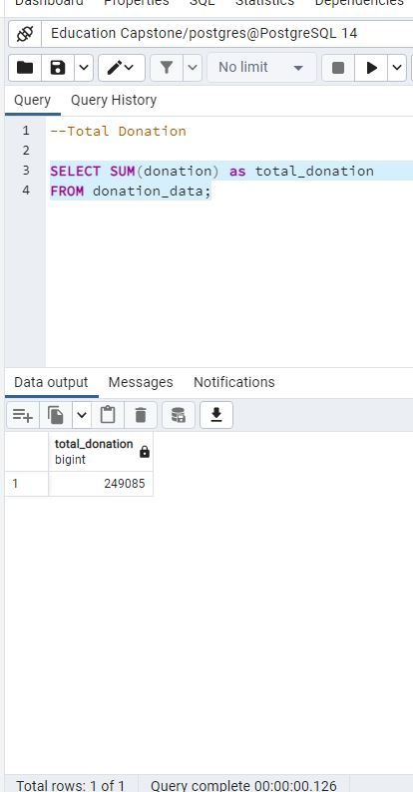
Question 1

Slide 3
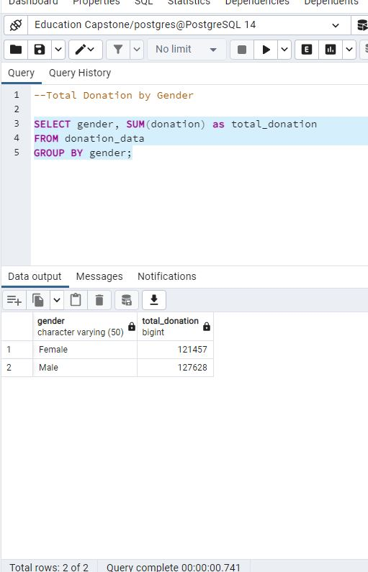
Question 2

Slide 4
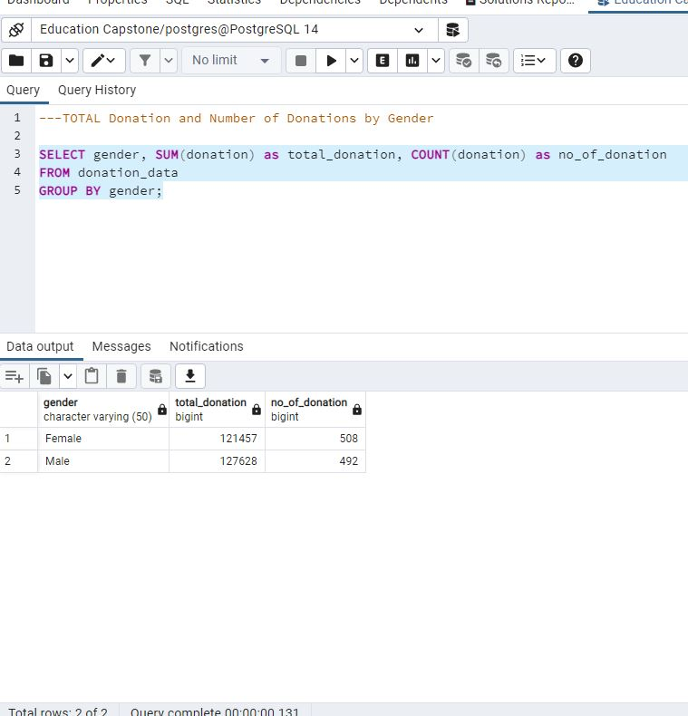
Question 3

Slide 5
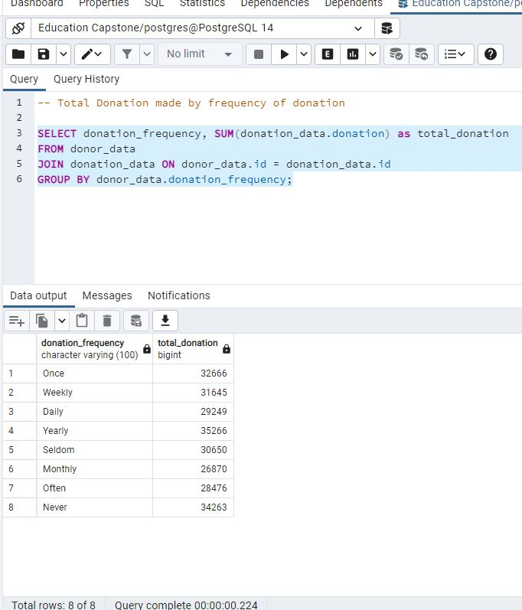
Question 4

Slide 6
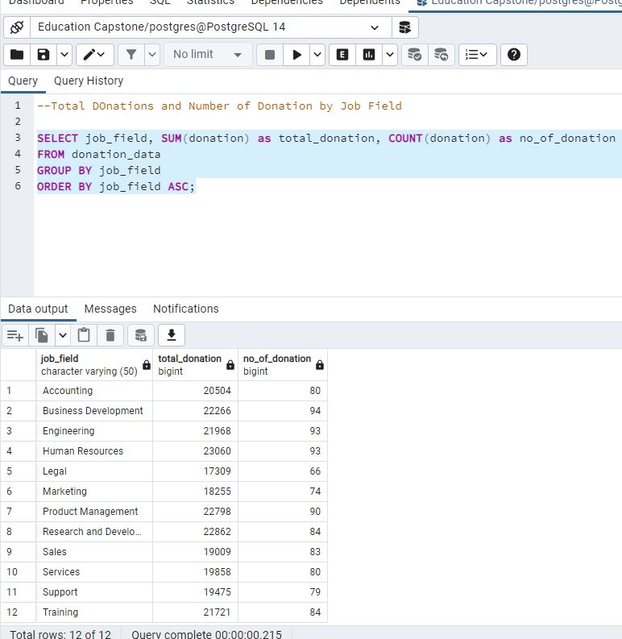
Question 5

Slide 7
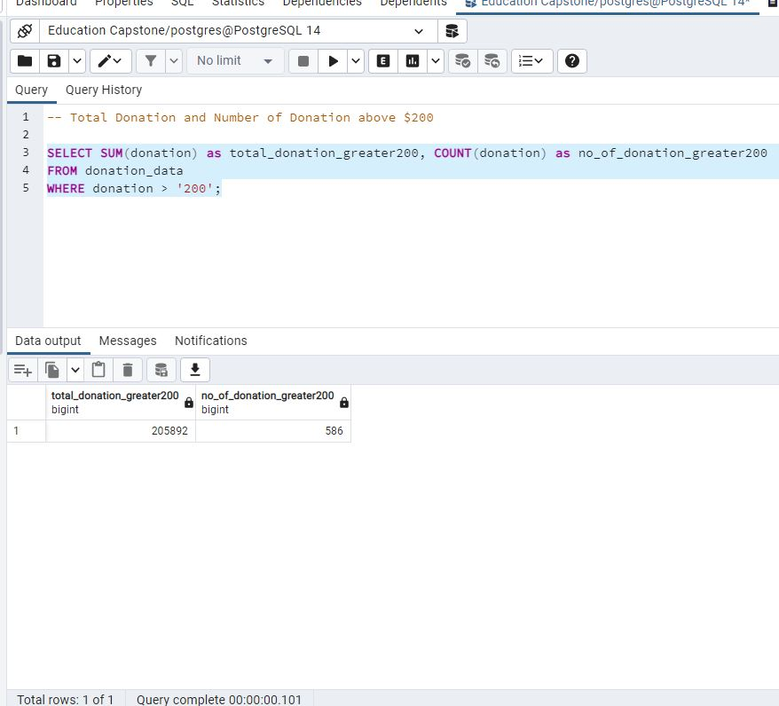
Question 6

Slide 8
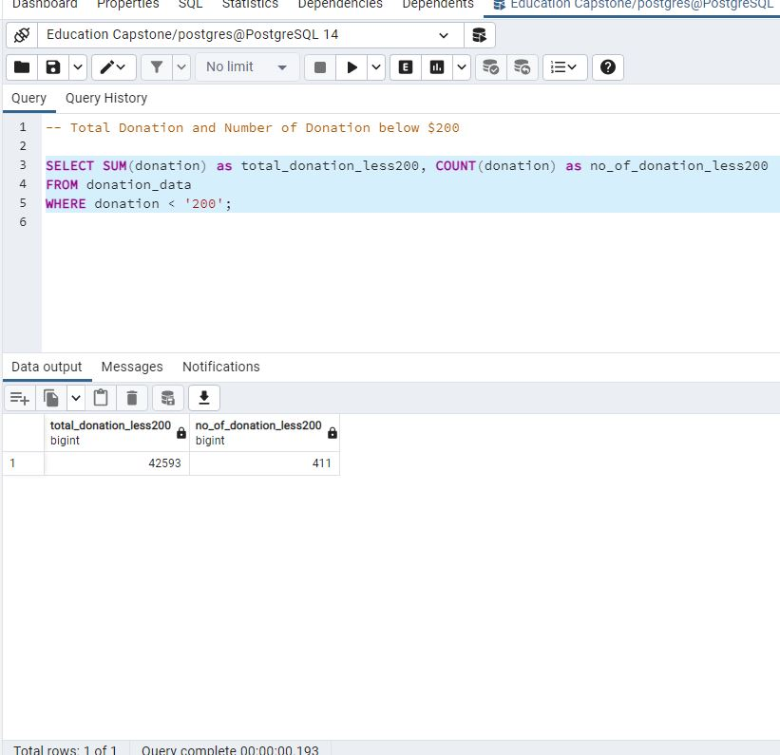
Question 7

Slide 9
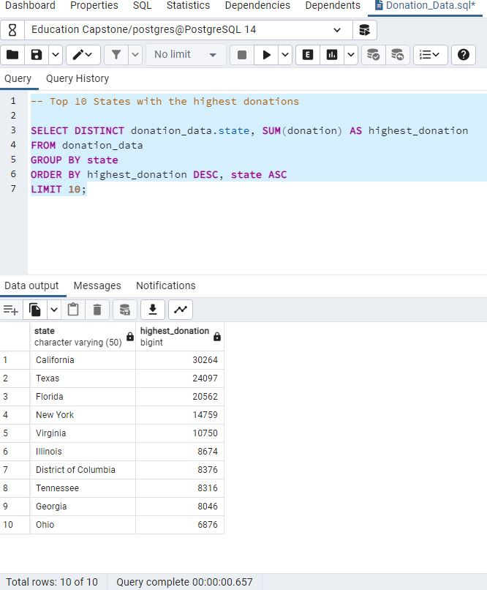
Question 8

Slide 10
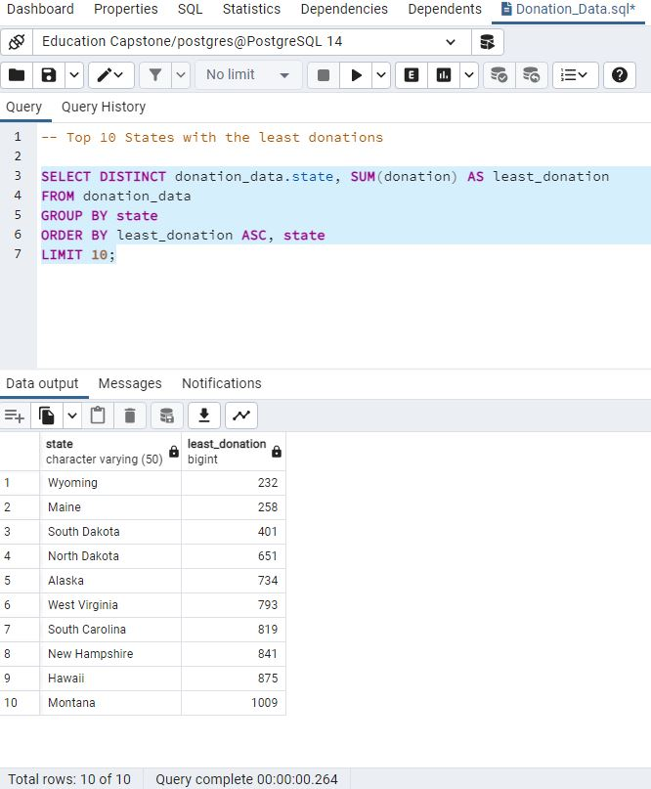
Question 9

Slide 11
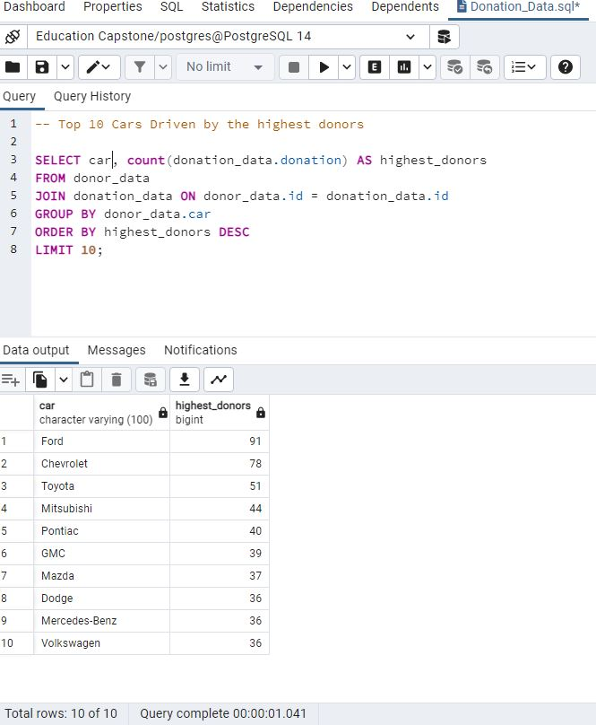
Question 10

Slide 12
Insights:
There should be more awareness and sensitization in low donation states and across other job fields, which are not on the database in order to increase the number of donors.
Looking at the frequency of donation, we can deduce that those in the “Never”, “Seldom”, “Often” and “Once” Frequency can be persuaded to donate a lot more often by introducing them to a more fixed periodic option.
Value of donation can be increased if more people who donate more than $200 can key in and also encourage those who donate less to increase their donation amount.

