Slide 1

Application Software
a.pradeep@newuzbekistanuniversity.uz

Slide 2
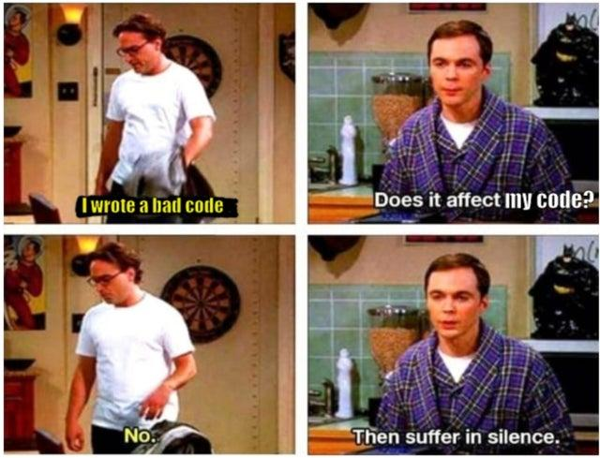
Lesson Overview
Understanding Types of Application Software
Examples and Use Cases of Application Software
Exploring the Software Lifecycle in Software Engineering
Comparing Development Processes: Waterfall and Incremental
Analysis, Design, Implementation, and Testing Phases
Emphasising Quality and Approaches at Each Stage
a.pradeep@newuzbekistanuniversity.uz

Slide 3
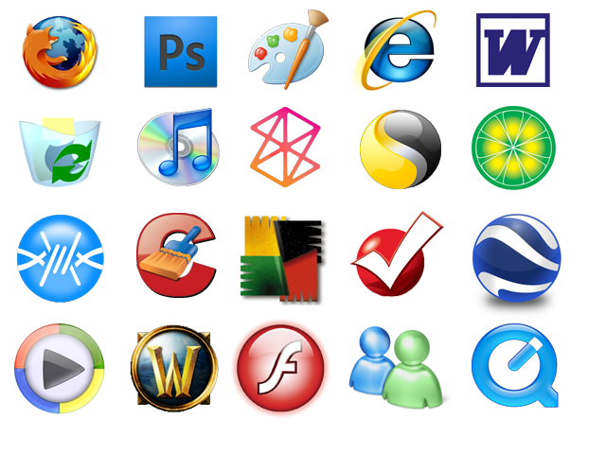
Application Software
Something that was not defined in the von Neumann model is software engineering, which is the design and writing of structured programs.
Today it is not acceptable just to write a program that does a task: the program must follow strict rules and principles.
a.pradeep@newuzbekistanuniversity.uz

Slide 4
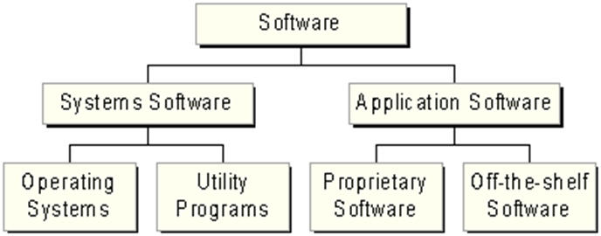
Application Software
Application software consists of programs designed to make users more productive and/or assist with personal tasks
To make business activities more efficient
To assist with graphics and multimedia projects
To support home, personal, and educational tasks
To facilitate communications
a.pradeep@newuzbekistanuniversity.uz

Slide 5
Types of Application Softwares
Name some applications that are used for (2 min)
Business
Graphics and Multimedia
Home/Personal/ Educational
Communication
a.pradeep@newuzbekistanuniversity.uz

