Slide 1
WIUT HACKATHON 26 · COMPUTER VISION TRACK
91 computer-vision startup ideas
Ranked for an investor jury. Two pages per idea: the idea in plain words, then how it works and what it costs.
Team UsedByAI · Tashkent · 10 October 2026
168 generated → 143 checked by web-searching skeptics → 91 kept

Slide 2
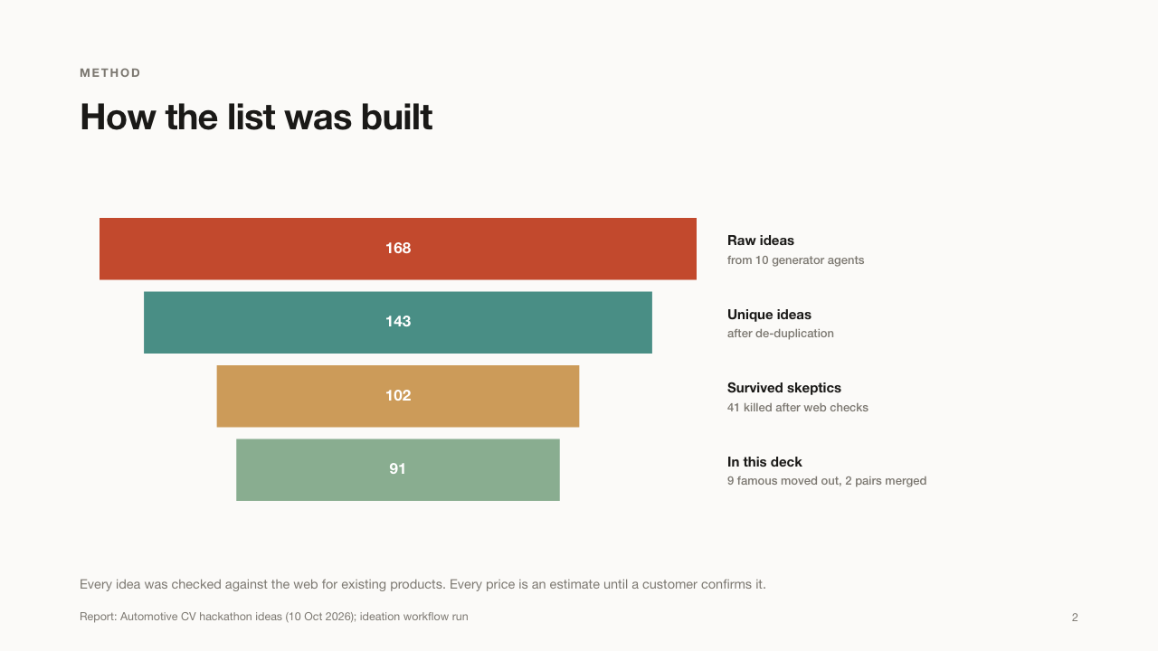

Slide 3
ORDER
Three tiers, ranked for investors
TIER | WHAT IT MEANS | IDEAS
A · Fundable stories | Clear payer, repeat revenue, strong moat | 26
B · Solid B2B niches | Real payers, smaller markets, good modules | 29
C · Hard investor case | City-only payer, small ticket or a feature | 36
Ranking re-weights the verifiers' scores for investors (business and moat count double). Related modules sit right after their lead idea.
Investor re-ranking of verifier sub-scores, 10 Oct 2026
3

Slide 4
ANATOMY
How to read each idea
PAGE | WHAT IT TELLS YOU
1 · The idea, left | What it does and why it matters
1 · The idea, right | Use cases and who buys it
2 · How it works | Four steps; the red box is the decision
2 · The cards | The key number, the build, price, demo
2 · Bottom note | Why it is hard to copy, report score
Both · Eyebrow | Tier and rank out of 91
Deck structure
4

Slide 5
TIER A · 26 IDEAS
Fundable stories
Clear payer, repeat revenue, a moat that compounds and a market beyond Uzbekistan. Pitch one of these.
5

Slide 6
TIER A · 01 / 91 · BANKS & LESSORS
PledgePulse
A monthly check that a car bought on credit still exists and is in safe hands.
WHAT IT DOES
USE CASES
– A bank checks thousands of car loans a month without field visits
– A leasing firm spots a car that was secretly sold
– A lender catches someone filming a screen instead of the real car
WHO BUYS IT
Banks, leasing companies and microfinance lenders that give car loans.
Once a month, the borrower gets a Telegram link and films the car for 30 seconds while following random instructions, like "touch the left mirror" or "show the odometer". The app checks it is the right car, filmed live right now, not an old video or a screen.
WHY IT MATTERS
The car is the bank's only safety net, yet nobody looks at it again after the loan is signed. This replaces costly field visits with a 30-second video.
Report: Automotive CV hackathon ideas (10 Oct 2026), refs [2][18][19][20]
6

Slide 7
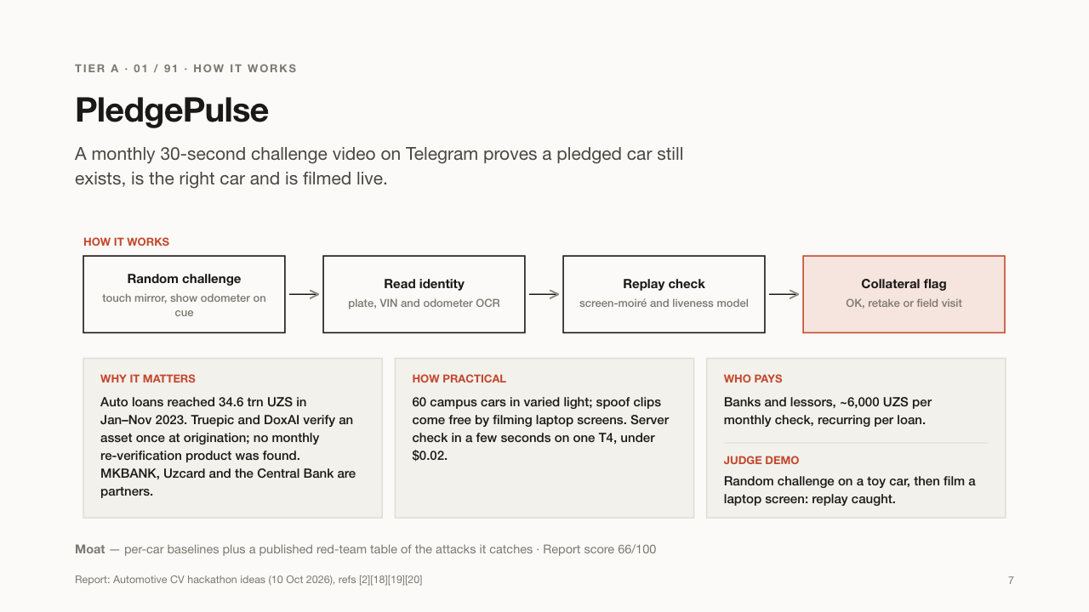

Slide 8
TIER A · 02 / 91 · EV DEALERS & LENDERS
Quvvat
Tells the buyer of a used electric car how healthy its battery really is.
WHAT IT DOES
USE CASES
– A buyer checks a used BYD before paying
– A bank sets a fair loan amount for a used EV
– A dealer proves its trade-in EVs are healthy
WHO BUYS IT
Used-car dealers, car inspectors and banks that finance electric cars.
The buyer takes four photos: the dashboard and the charger screen, before and after a 15-minute charge. From the energy that went in and how much the range moved, Quvvat estimates the battery's real capacity and gives a simple grade with a fair-price hint.
WHY IT MATTERS
The battery is the most expensive part of an EV and it wears out. Most used EVs here are Chinese imports that normal diagnostic apps cannot read.
Report: Automotive CV hackathon ideas (10 Oct 2026), refs [2][13][14][15]
8

Slide 9
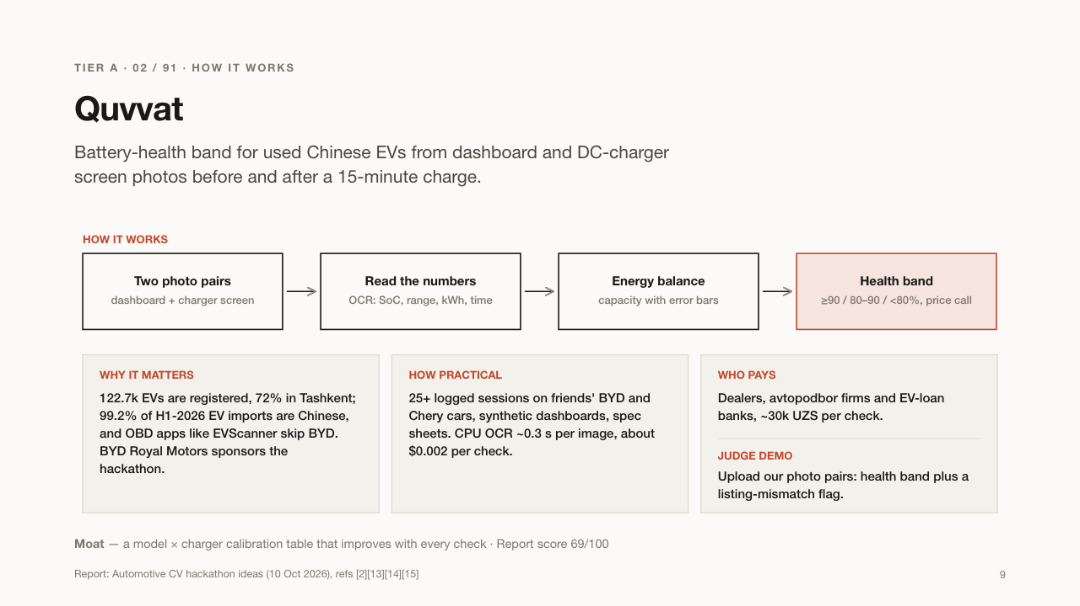

Slide 10
TIER A · 03 / 91 · USED-EV DEALERS & BANKS
Yorliq
Reads the Chinese label on an imported EV and tells you which battery it really has.
WHAT IT DOES
USE CASES
– A buyer checks that the "big battery" in an ad is real
– A dealer documents grey-import EVs before selling
– Quvvat uses it to know the battery's original size
WHO BUYS IT
Used-EV dealers, importers, car inspectors and banks; it also powers Quvvat.
Many Chinese EV models are sold with two or three battery sizes that look identical from outside. You photograph the small metal label (nameplate) inside the car; Yorliq reads the Chinese text and tells you the exact version and battery size.
WHY IT MATTERS
Sellers sometimes advertise the big battery while selling the small one, and a VIN check does not show the battery size. A wrong battery means overpaying by thousands of dollars.
Report: Automotive CV hackathon ideas (10 Oct 2026), refs [47][48][50]
10

Slide 11
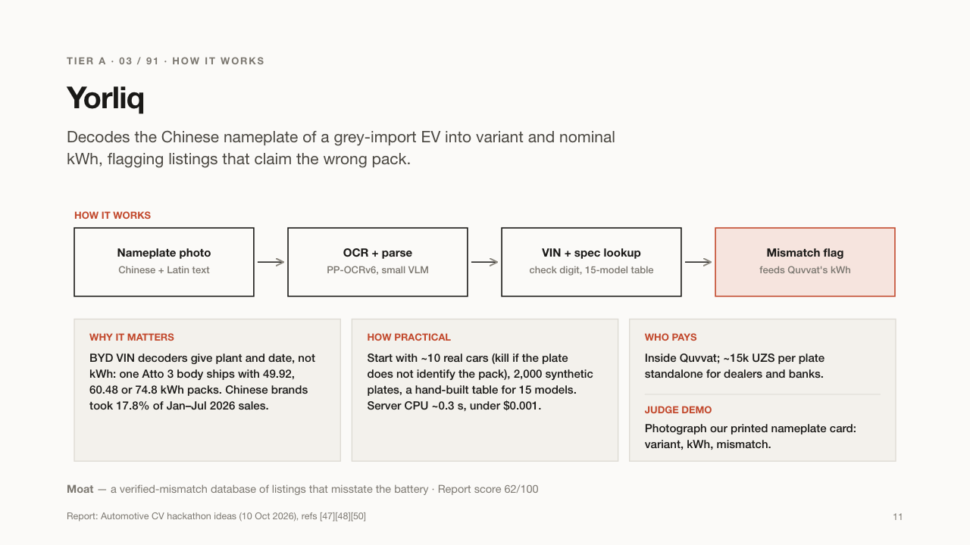

Slide 12
TIER A · 04 / 91 · CAR MARKETPLACES
FlipperFinder
Exposes dealers who pretend to be private sellers on car marketplaces.
WHAT IT DOES
USE CASES
– A marketplace makes hidden dealers pay dealer fees
– A buyer sees that a "private" car comes from a reseller
– Moderators review fake private ads faster
WHO BUYS IT
Car marketplaces such as OLX and Avtoelon.
FlipperFinder ignores the car in each listing photo and looks at the background: the same wall, gate or garage. When dozens of "private" ads were all shot in the same yard, it groups them and shows that one dealer is behind them.
WHY IT MATTERS
Buyers trust private sellers more and pay accordingly, and marketplaces charge dealers higher fees. Hidden dealers cheat both, and today people spot them only by eye.
Report: Automotive CV hackathon ideas (10 Oct 2026), refs [29][30][31]
12

Slide 13
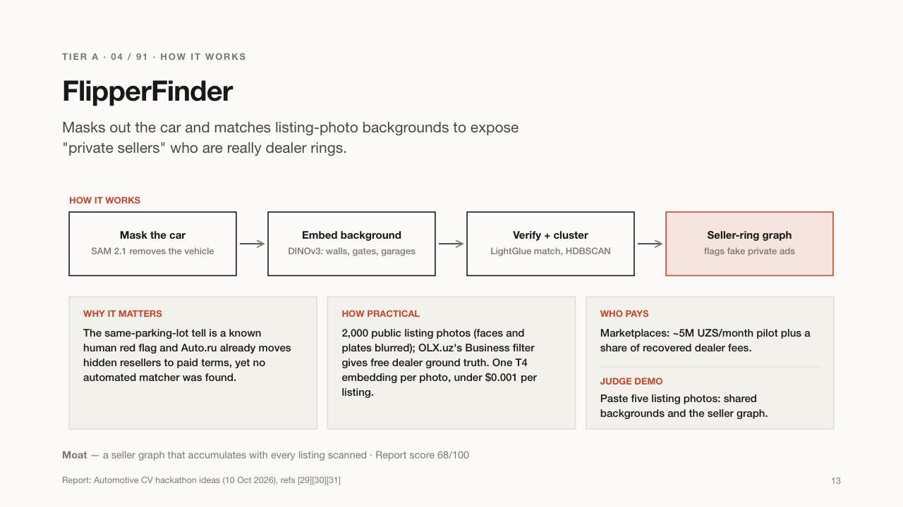

Slide 14
TIER A · 05 / 91 · BANKS, DEALERS, BUYERS
CarTrail
A car history report built from old and current online listings.
WHAT IT DOES
USE CASES
– A buyer sees the mileage was lower in last year's ad
– A bank checks a car's history before a loan
– A dealer checks a trade-in's past
WHO BUYS IT
Banks (per check), car buyers and dealers.
The same car is often sold several times, on OLX, Avtoelon and Telegram. CarTrail recognises the car across listings by its dents, rims, stickers and plate pieces, then shows its past prices, mileage and sellers on one timeline.
WHY IT MATTERS
Uzbekistan has no Carfax-style history service. If the mileage went down between two listings, or the car keeps getting resold, the buyer and the bank should know.
Report: Automotive CV hackathon ideas (10 Oct 2026), refs [44][45][46]
14

Slide 15


Slide 16
TIER A · 06 / 91 · MARKETPLACES & BUYERS
TwinCheck
A quick photo test that tells a buyer whether a car needs a full inspection.
WHAT IT DOES
USE CASES
– A buyer screens ten listings and inspects only two
– A marketplace adds a "check this car" badge
– Inspectors get pre-qualified customers
WHO BUYS IT
Car marketplaces, used-car buyers and inspection firms.
Cars are symmetrical, so the left headlamp, mirror and wheel should age like the right ones. TwinCheck compares each pair in the listing photos. If one side looks newer, that part was probably replaced after a crash.
WHY IT MATTERS
A full inspection costs around 300,000 UZS, too much to do for every car you look at. This cheap first filter tells you which cars deserve it.
Report: Automotive CV hackathon ideas (10 Oct 2026), refs [34][49][192]
16

Slide 17
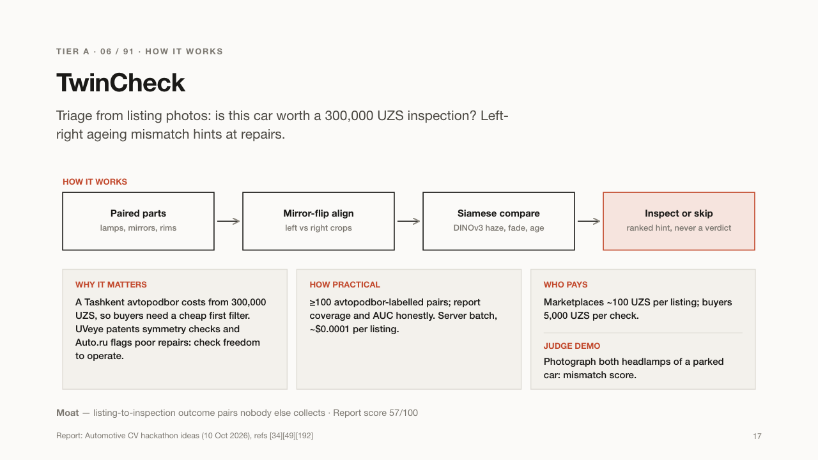

Slide 18
TIER A · 07 / 91 · AUTO-LOAN BANKS
WearTruth
Spots a car whose odometer has been rolled back, from photos of its interior.
WHAT IT DOES
USE CASES
– A bank checks mileage before approving a car loan
– A trade-in desk avoids overpaying for a worn car
– A buyer finds out a car used to be a taxi
WHO BUYS IT
Auto-loan banks and dealers' trade-in desks.
A steering wheel, pedals and driver's seat wear down with every kilometre. WearTruth photographs them, estimates how far the car has really been driven, and compares that with the odometer. It also spots marks left by old taxi stickers.
WHY IT MATTERS
Rolled-back odometers and ex-taxis sold as "family cars" make buyers and banks overpay. Interior wear is hard to fake.
Report: Automotive CV hackathon ideas (10 Oct 2026), refs [26][51]
18

Slide 19
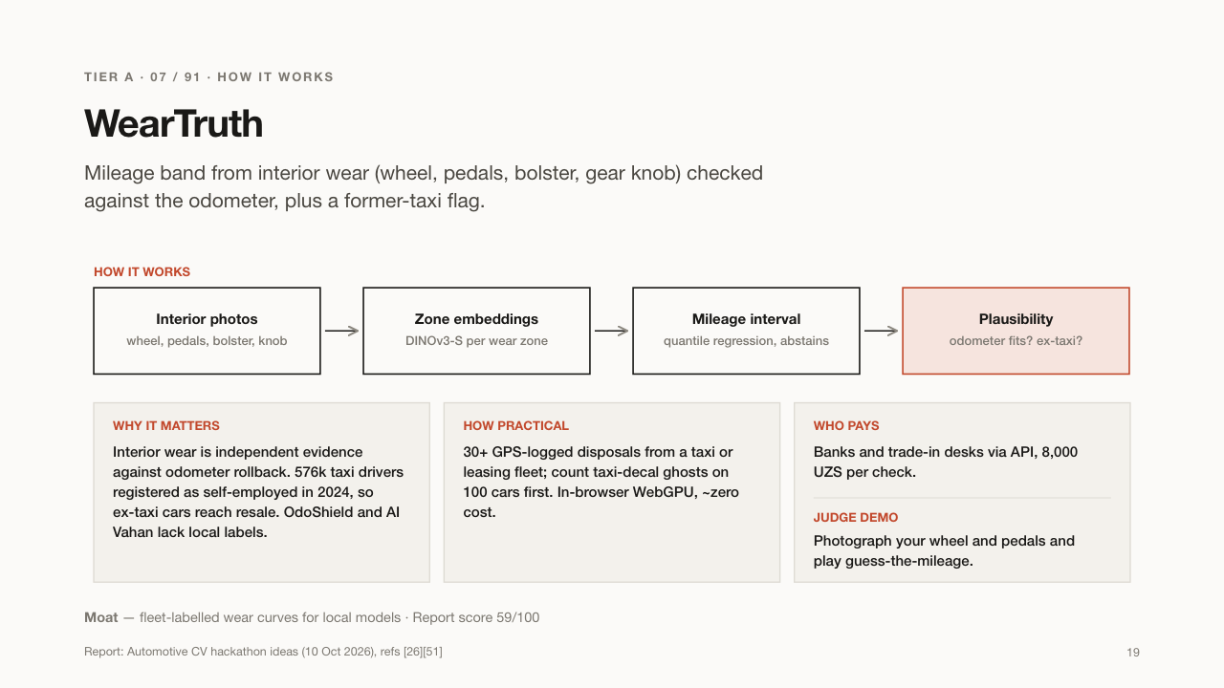

Slide 20
TIER A · 08 / 91 · MARKETPLACES & BANKS
Trim Truth
Checks that a used-car ad's equipment level matches what the car really has.
WHAT IT DOES
USE CASES
– A marketplace shows an "ad matches the car" badge
– A buyer checks a "top version" claim from photos
– A bank avoids lending on an inflated price
WHO BUYS IT
Car marketplaces, and banks once a loan officer confirms the problem.
The same model, like a Cobalt, comes in cheap and expensive versions. Trim Truth looks at photos and checks the visible clues, such as wheels, sunroof, roof rails and rear camera, then marks whether the advertised version matches the car.
WHY IT MATTERS
Sellers often claim a higher version to raise the price. Buyers and banks then pay too much for a basic car.
Report: Automotive CV hackathon ideas (10 Oct 2026), refs [49][50]
20

Slide 21
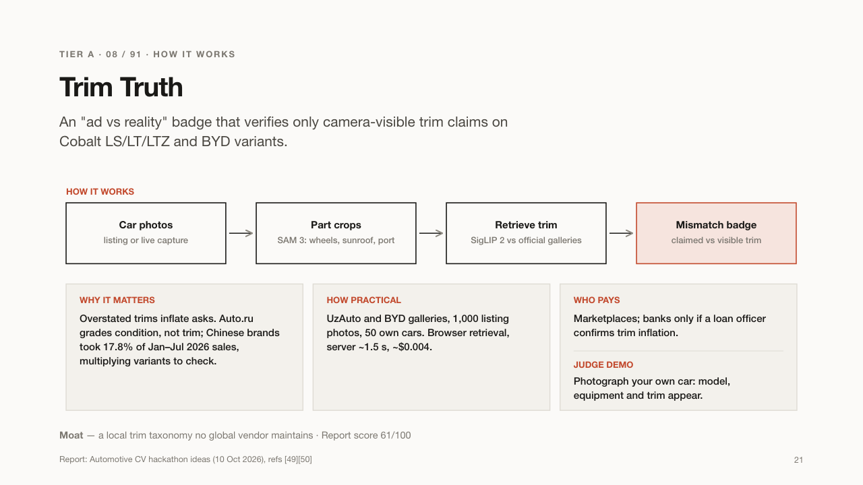

Slide 22
TIER A · 09 / 91 · FREIGHT FORWARDERS
TruckProof
Proves a truck and driver are real before they get a cargo load.
WHAT IT DOES
USE CASES
– A forwarder verifies a new carrier in two minutes
– A Telegram freight group shows a "verified" badge
– A cargo insurer requires a check before trips
WHO BUYS IT
Freight forwarders, logistics marketplaces and cargo insurers.
Before booking a load, the freight forwarder sends the driver a link. The driver films the truck, its plate, the documents and a fresh random code. TruckProof checks that the plate, the papers, the truck type and the driver's face all match.
WHY IT MATTERS
Many loads in Central Asia are booked through Telegram groups where anyone can claim to be a carrier. A fake carrier can disappear with the cargo.
Report: Automotive CV hackathon ideas (10 Oct 2026), refs [27][28]
22

Slide 23
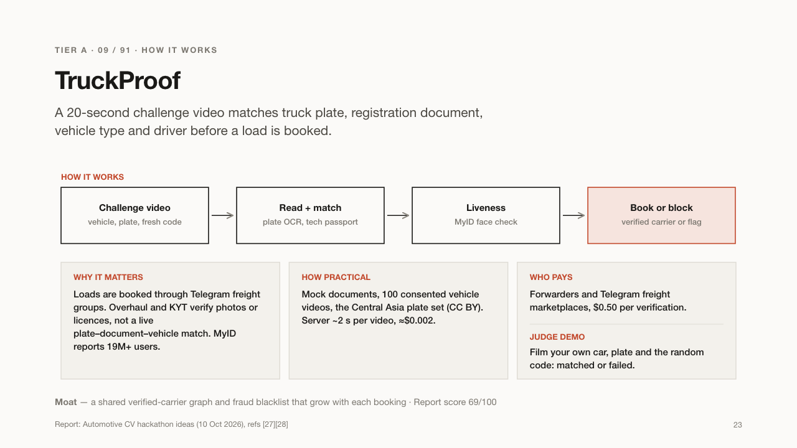

Slide 24
TIER A · 10 / 91 · MOTOR INSURERS
Alibi
Proves an insurance claim photo was really taken at the scene, today.
WHAT IT DOES
USE CASES
– An insurer fast-tracks honest claims and holds suspicious ones
– A claims team catches an old photo sent as new
– Remote claims become safe without an inspector visit
WHO BUYS IT
Car insurers (OSAGO and KASKO claims departments).
When a driver sends damage photos to an insurer's Telegram bot, Alibi checks the physics. Do the shadows match the sun's position at that place and time? Does the weather match? Was the photo taken of a real car, not a screen?
WHY IT MATTERS
Fraudsters reuse old photos or edit damage in. Even trained staff miss half of edited damage photos.
Report: Automotive CV hackathon ideas (10 Oct 2026), refs [61][62]
24

Slide 25
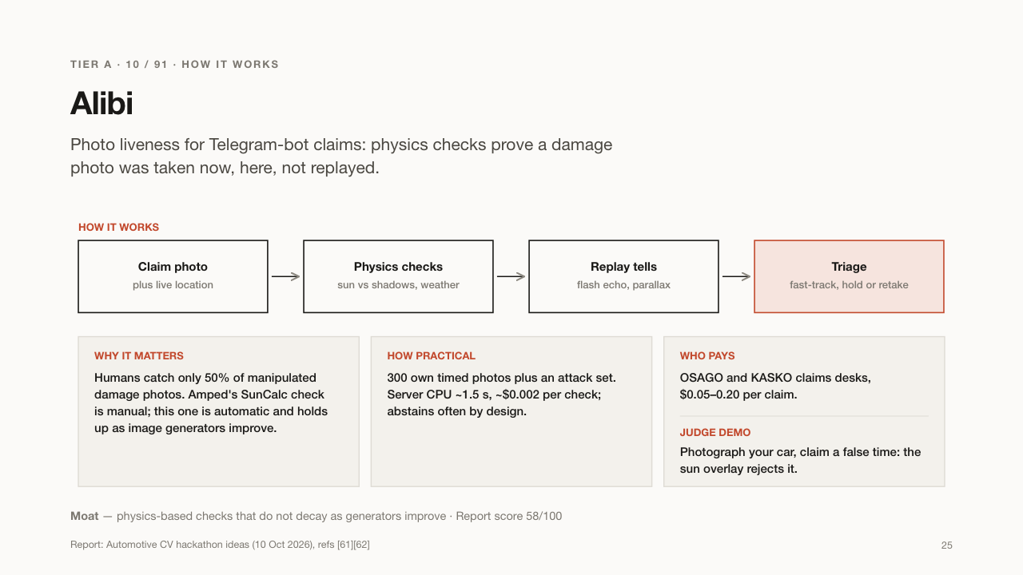

Slide 26
TIER A · 11 / 91 · INSURERS & FLEETS
ScratchPrint
Tells whether a scratch is new or was already there before.
WHAT IT DOES
USE CASES
– A taxi fleet settles "who scratched it" at shift change
– An insurer spots damage that existed before the policy
– A rental company checks returns fairly
WHO BUYS IT
Insurers, taxi fleets, rental and car-sharing companies.
Every scratch and dent has a unique shape, like a fingerprint. ScratchPrint compares new photos with earlier ones and says whether a damage mark is the same old one or a new one.
WHY IT MATTERS
People claim old damage as new, or the same damage twice. Rental and taxi companies argue with drivers about who caused which scratch.
Report: Automotive CV hackathon ideas (10 Oct 2026), refs [63][64]
26

Slide 27


Slide 28
TIER A · 12 / 91 · OSAGO CLAIMS TEAMS
BumperMatch
Checks whether the damage on two cars could really come from the same crash.
WHAT IT DOES
USE CASES
– An insurer flags a claim where the dents don't line up
– An independent expert gets measurements for a report
– A hit-and-run victim learns what kind of car hit them
WHO BUYS IT
Car insurers' claims and fraud teams, and independent damage experts.
Using the licence plate as a ruler, BumperMatch measures how high the damage sits on each car. A dent at knee height cannot come from a bumper that sits much higher, so impossible combinations are flagged.
WHY IT MATTERS
Some accidents are staged or described falsely to get insurance money. A simple height check catches many of them.
Report: Automotive CV hackathon ideas (10 Oct 2026), refs [58][59][60]
28

Slide 29
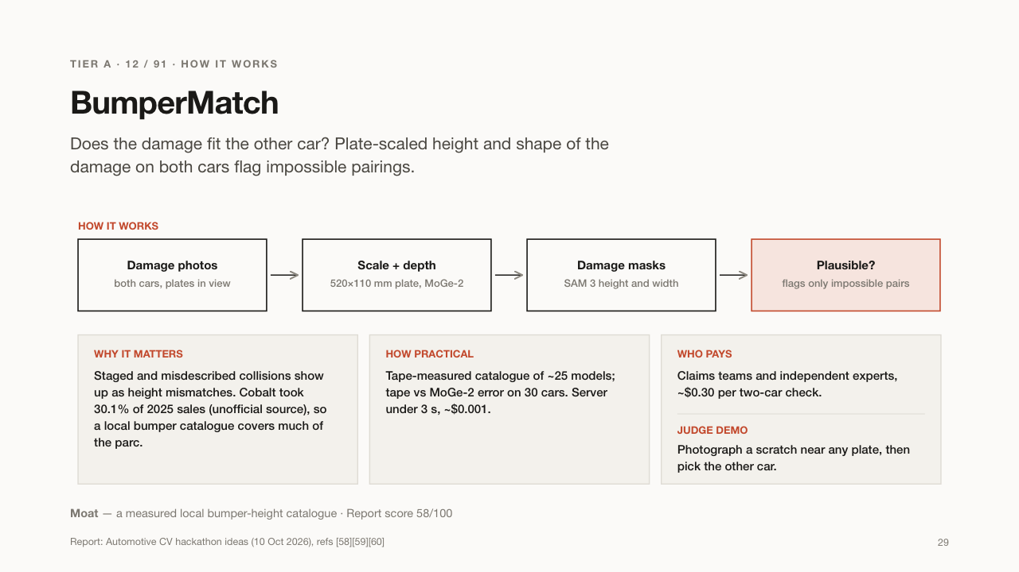

Slide 30
TIER A · 13 / 91 · INSURERS & FLEETS
WitnessHunt
Finds dashcam video of an accident from other vehicles that were nearby.
WHAT IT DOES
USE CASES
– An insurer gets video of a disputed crash
– A fleet earns money from footage it already has
– A driver proves the other car ran the red light
WHO BUYS IT
Insurers pay per clip; fleets join as video suppliers.
Taxi and delivery fleets record dashcam video all day. When an insurer needs evidence for a crash, WitnessHunt searches the fleets' footage for that place and time, finds the clip, and blurs faces and plates before sharing it.
WHY IT MATTERS
Many accident disputes come down to one driver's word against the other's. Video settles them fast, and insurers must decide within 15 days.
Report: Automotive CV hackathon ideas (10 Oct 2026), refs [181][182]
30

Slide 31
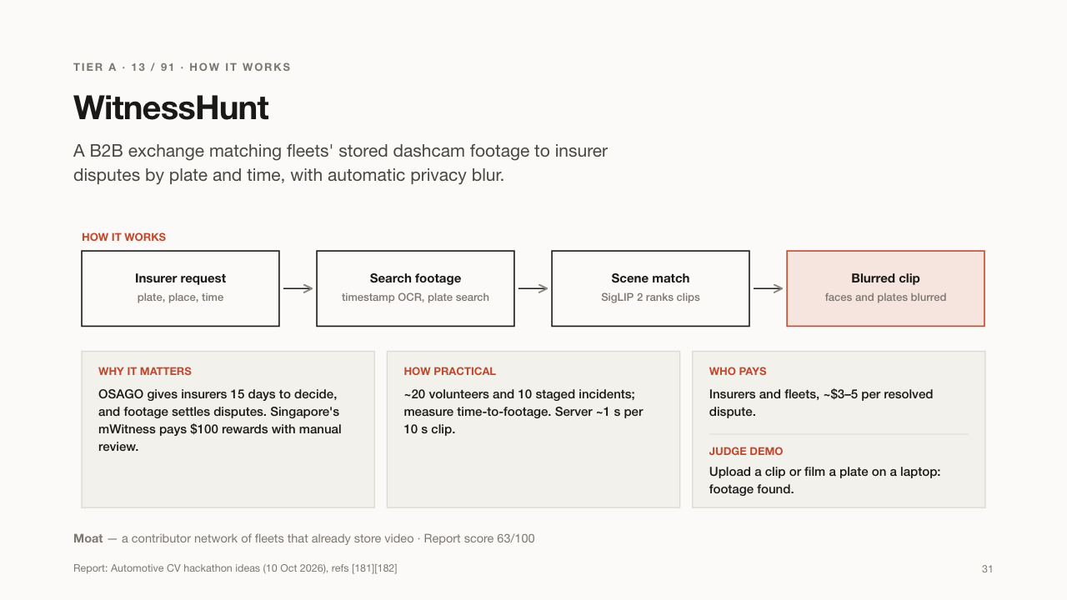

Slide 32
TIER A · 14 / 91 · INSURERS & FLEETS
EuroScene
Lets two drivers report a small accident with their phones, without police.
WHAT IT DOES
USE CASES
– Two drivers file a notice in five minutes
– A taxi company handles its drivers' small accidents
– An insurer receives clean, filmed evidence
WHO BUYS IT
Insurers, the Insurance Guarantee Fund and ride-hailing fleets.
After a minor crash, both drivers film a short walk-around of the scene. EuroScene reads both plates, marks the damage on each car, fills in the accident notice form, and both drivers sign it with a QR handshake.
WHY IT MATTERS
Waiting for police after a fender-bender wastes hours and blocks traffic. A recorded, signed notice is also better evidence for insurers. It does not decide who is at fault.
Report: Automotive CV hackathon ideas (10 Oct 2026), refs [68][69]
32

Slide 33
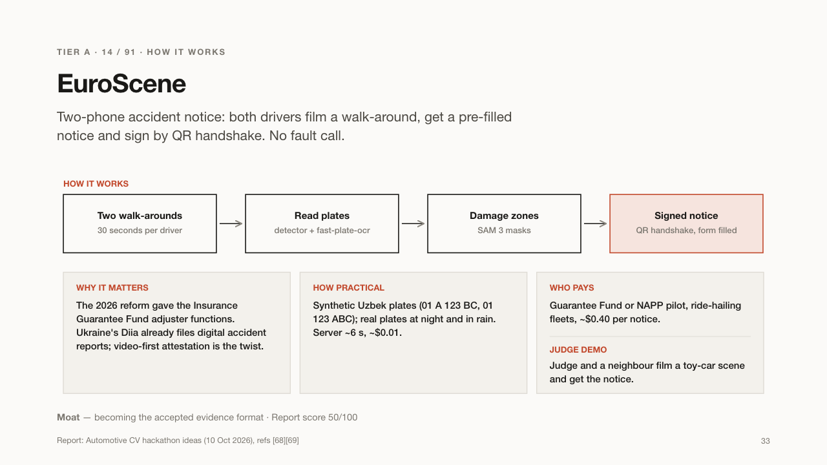

Slide 34
TIER A · 15 / 91 · CAR WASHES → INSURERS
WashScan
Turns car washes into places where a car's condition gets photographed and recorded.
WHAT IT DOES
USE CASES
– A car wash proves a scratch was there before washing
– An insurer gets fresh condition photos without an inspector
– A lender sees a car's recent state
WHO BUYS IT
Car washes first, then insurers who buy the condition records.
When a car arrives at a wash, the attendant walks around it with a phone. The app makes sure every panel is filmed clearly and saves a dated record of the car's condition, linked to its plate.
WHY IT MATTERS
Car washes are often blamed for scratches that were already there; the record protects them. Insurers also want up-to-date condition photos and can buy these records.
Report: Automotive CV hackathon ideas (10 Oct 2026), refs [32][33]
34

Slide 35
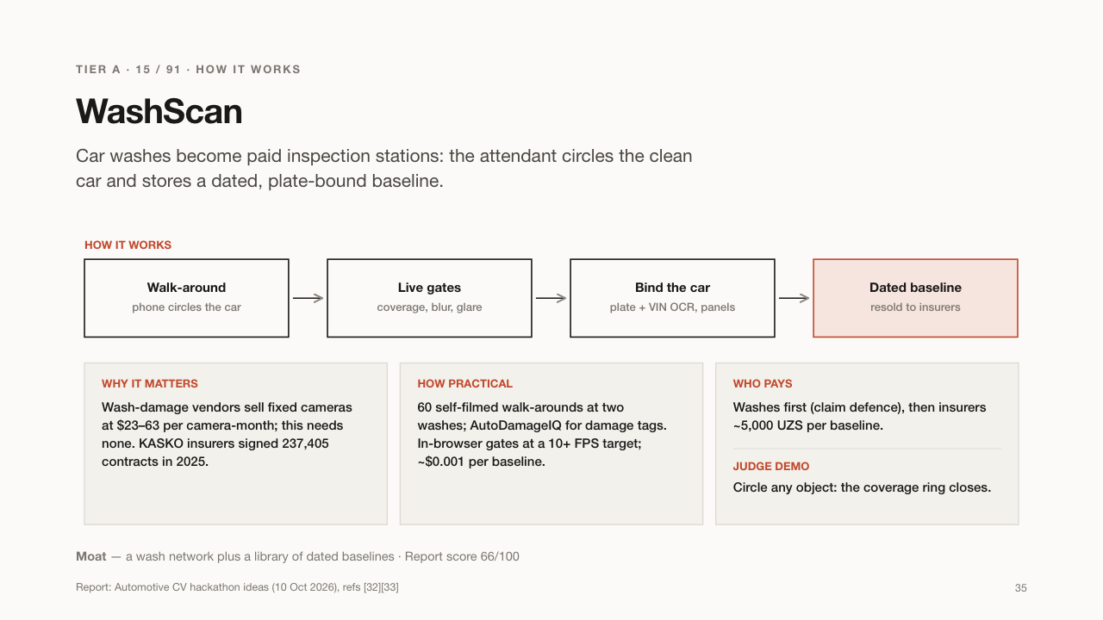

Slide 36
TIER A · 16 / 91 · BUYERS & DEALERS
Columbo
A chat assistant that inspects a used car remotely by asking for the right photos.
WHAT IT DOES
USE CASES
– A buyer in Samarkand checks a car listed in Tashkent
– A dealer screens many cars without visiting them
– Inspectors get only the cars worth a trip
WHO BUYS IT
Used-car buyers in the regions and dealers buying cars from afar.
A buyer in another city sends Columbo a listing. Columbo asks the seller for one photo at a time, always the one that tells it the most, and runs checks for repairs and repaint. It ends with: buy, walk away, or inspect in person.
WHY IT MATTERS
A professional inspection costs 300,000 UZS plus travel. Most bad cars can be ruled out remotely before anyone travels.
Report: Automotive CV hackathon ideas (10 Oct 2026), refs [34][41]
36

Slide 37
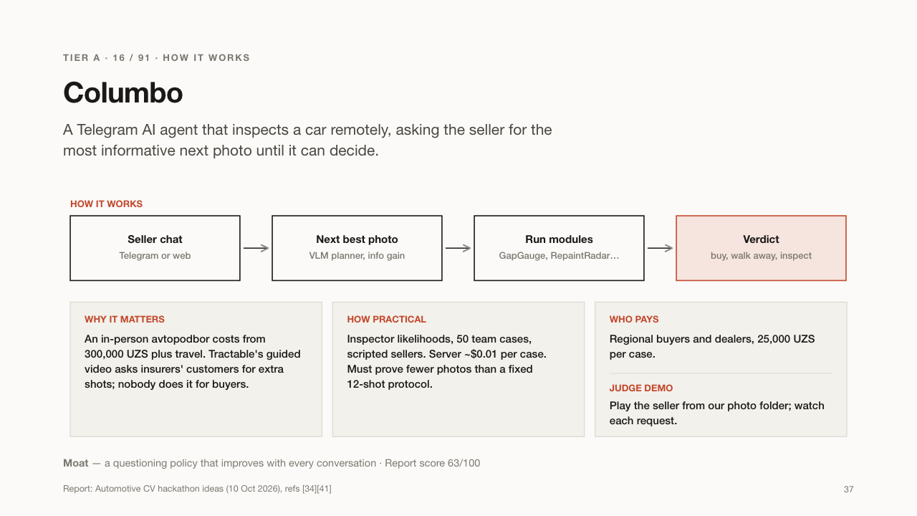

Slide 38
TIER A · 17 / 91 · BANKS & INSURERS
BozorLens
A fair-price guide for used cars, built from the prices at car markets.
WHAT IT DOES
USE CASES
– A bank values a car before a loan
– An insurer sets the insured value
– A buyer sees if an asking price is fair
WHO BUYS IT
Banks and insurers via subscription; buyers use it for free.
At car markets, sellers put price sheets behind the windshield. Walking with a phone, BozorLens reads each sheet, identifies the car, and compares the price with online ads, building a fair-price index over time.
WHY IT MATTERS
Uzbekistan has no trusted price guide, so banks and insurers value cars blind. First check the price sheets really exist at the market.
Report: Automotive CV hackathon ideas (10 Oct 2026), refs [180]
38

Slide 39
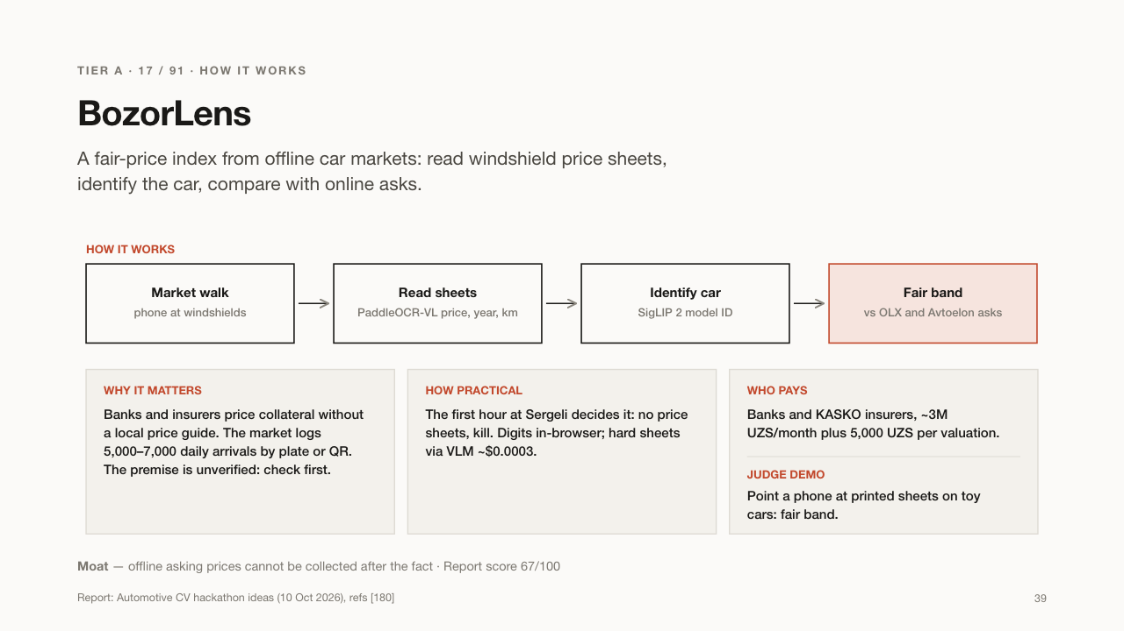

Slide 40
TIER A · 18 / 91 · FLEETS OF 50–500 CARS
Shtraf Shield
Handles traffic-camera fines for company cars: check, pay early or pass on.
WHAT IT DOES
USE CASES
– A car-rental firm transfers fines to customers automatically
– A delivery fleet stops paying for misread plates
– A fleet never misses the 50% discount
WHO BUYS IT
Rental, car-sharing, taxi and delivery fleets with 50 to 500 cars.
Fleets with many cars receive many camera fines. Shtraf Shield reads each fine's photo, checks the plate, make and colour match the fleet's car, flags mistakes and cloned plates, then pays early at the discount or transfers the fine to the driver.
WHY IT MATTERS
Paying within 15 days halves the fine, and since April 2026 fines can go to the actual driver. Fleets lose money missing deadlines or paying for wrong fines.
Report: Automotive CV hackathon ideas (10 Oct 2026), refs [98][99][100][101]
40

Slide 41
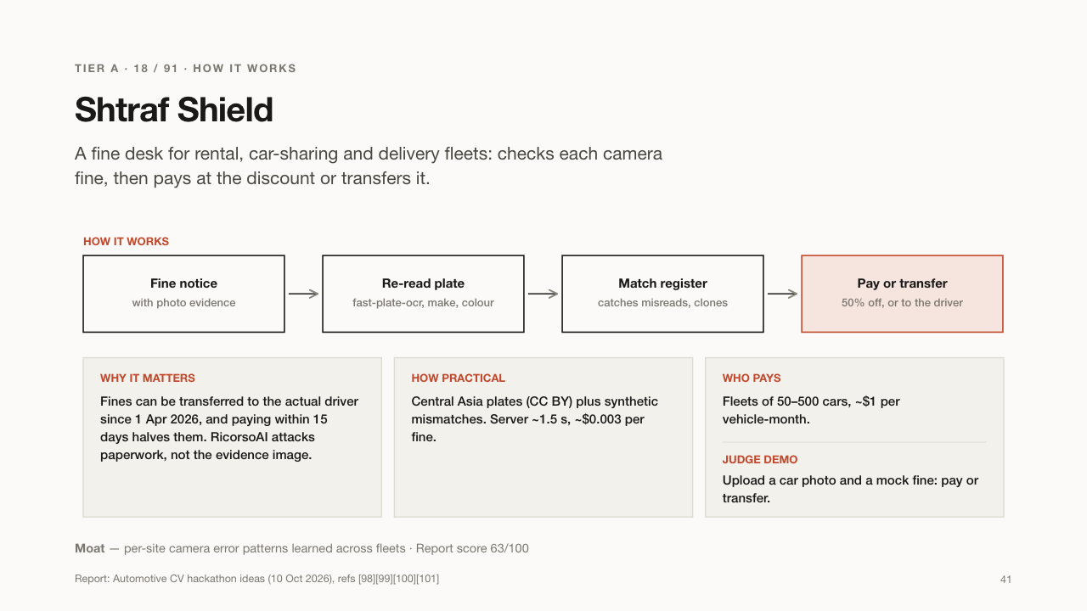

Slide 42
TIER A · 19 / 91 · CORPORATE FLEETS
FuelTruth
Catches fuel theft in company vehicles with one short video at the pump.
WHAT IT DOES
USE CASES
– A fleet manager sees which fills look suspicious
– A company fills in fuel data for its digital waybill
– A municipal fleet audits fuel spending
WHO BUYS IT
Corporate, municipal and logistics fleets.
At each refuel, the driver films the pump display, the plate and the odometer in one 10-second clip. FuelTruth reads the numbers, checks them against the receipt and the trip, and flags fills that don't add up.
WHY IT MATTERS
Drivers can inflate receipts or fill other cars on the company's money. Fuel sensors cost money and need installing; a phone video does not.
Report: Automotive CV hackathon ideas (10 Oct 2026), refs [108][109][110]
42

Slide 43
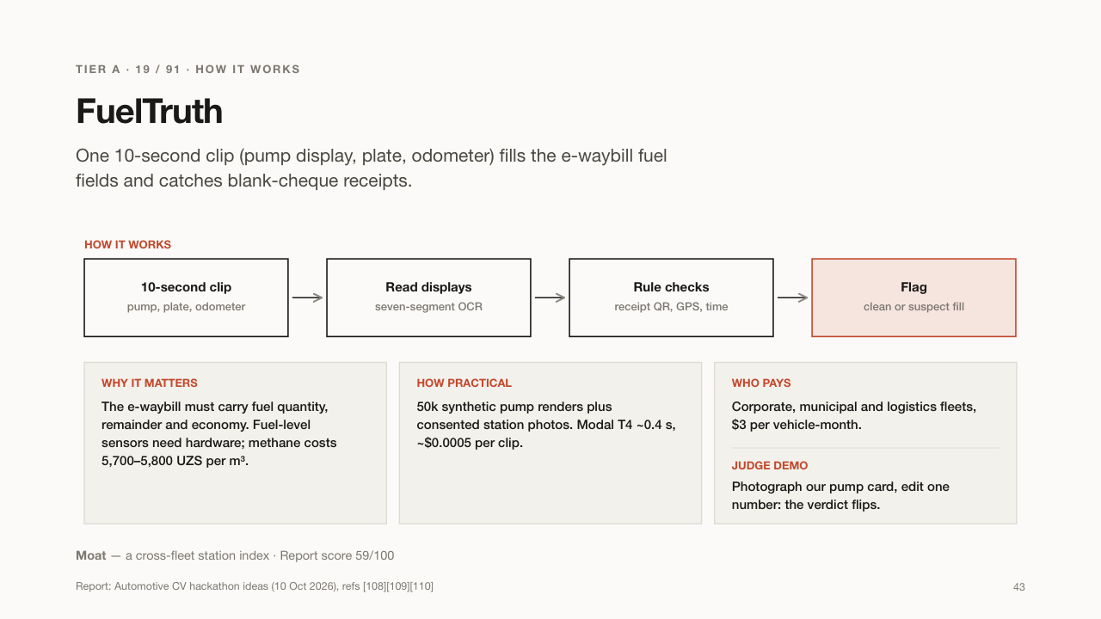

Slide 44
TIER A · 20 / 91 · TAXI & DELIVERY FLEETS
Wrench-Proof
Proves a repair on a company car was really done.
WHAT IT DOES
USE CASES
– A taxi company checks a garage's invoice
– A delivery fleet keeps a verified service history per car
– A buyer sees proven maintenance on a used fleet car
WHO BUYS IT
Taxi parks and delivery fleets.
The mechanic records one continuous 20-second video: the plate, the odometer, the new part's box and the old part removed. Wrench-Proof checks everything is in one take and that the box matches the part, then issues a sealed receipt.
WHY IT MATTERS
Fleet owners pay for oil changes, brake pads and batteries they never see. Today they simply have to trust the mechanic.
Report: Automotive CV hackathon ideas (10 Oct 2026), refs [78][79]
44

Slide 45
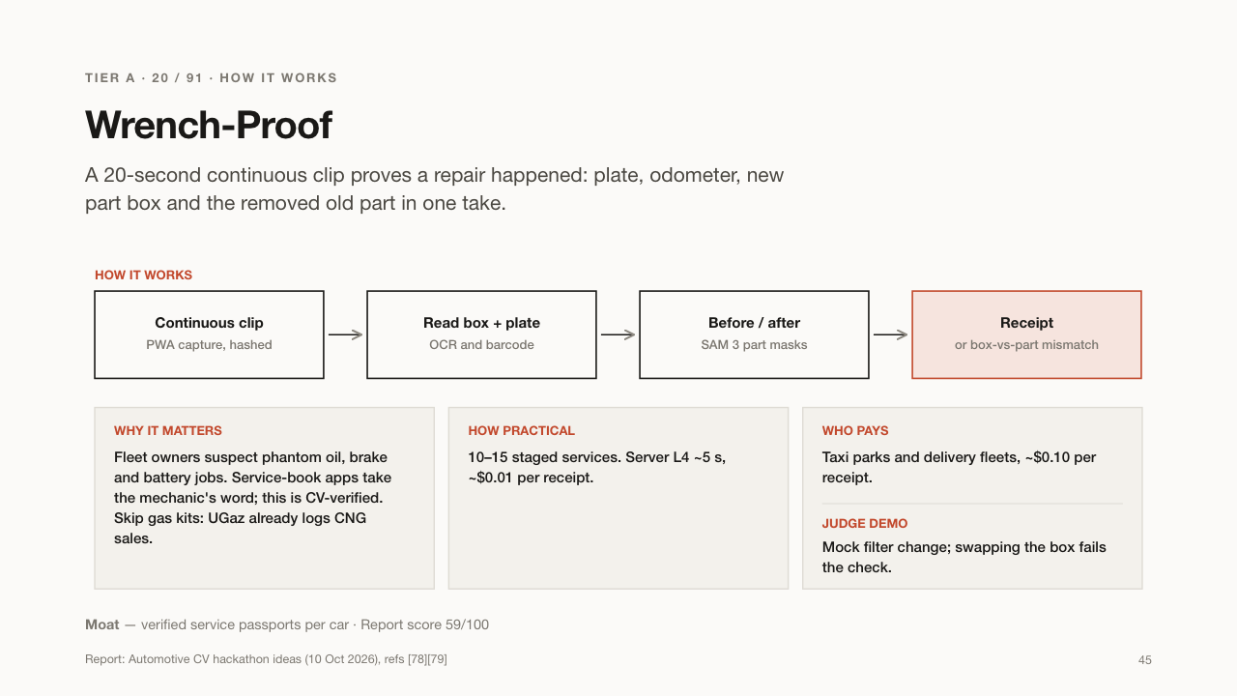

Slide 46
TIER A · 21 / 91 · DELIVERY PLATFORMS
ShiftGate
A 15-second safety check couriers pass before their shift starts.
WHAT IT DOES
USE CASES
– A delivery app unlocks shifts only for safe bikes
– A courier company cuts its fines
– A platform shows regulators its safety record
WHO BUYS IT
Delivery platforms and courier companies.
Before taking orders, the courier films their scooter or bike for 15 seconds. ShiftGate checks the reflectors, lights, number plate and documents. If something is missing, the shift stays locked and the courier gets a fix list.
WHY IT MATTERS
Couriers' fines in 2026 add up to about 4.7 billion UZS, mostly for missing lights and reflectors. Unsafe bikes are also hard to see at night.
Report: Automotive CV hackathon ideas (10 Oct 2026), refs [16][122]
46

Slide 47


Slide 48
TIER A · 22 / 91 · DELIVERY PLATFORMS
Be-Seen
Tests whether a moped's reflectors really shine, using two phone photos.
WHAT IT DOES
USE CASES
– A depot checks all mopeds before night shifts
– A courier checks their own vest and bike
– A fleet proves its bikes meet the rules
WHO BUYS IT
Delivery platforms and fleets with mopeds and bikes.
The courier takes one photo with flash and one without. Be-Seen compares them: good reflective tape shines brightly under flash, while worn or fake tape does not. It grades each reflector and lists what to replace.
WHY IT MATTERS
Most two-wheeler violations in 2026 were about reflectors and lights. A rider who cannot be seen at night can be hit.
Report: Automotive CV hackathon ideas (10 Oct 2026), refs [16][17]
48

Slide 49
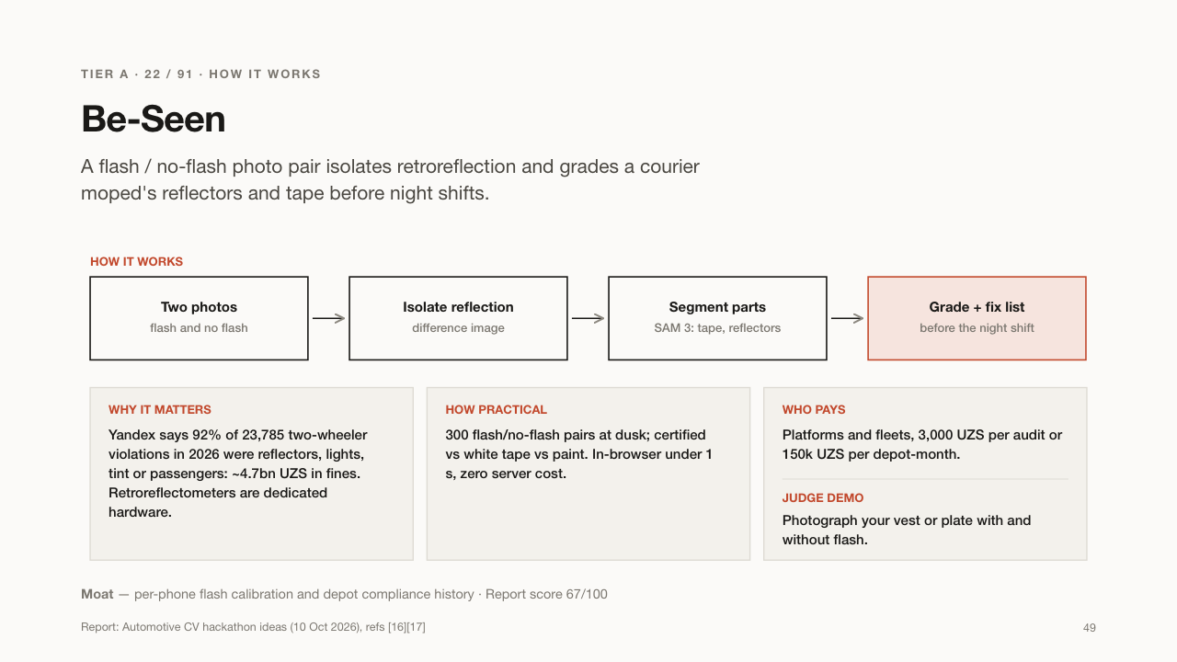

Slide 50
TIER A · 23 / 91 · CAMERA INTEGRATORS
CamAudit
Tests whether a traffic camera's AI still reads plates at night, in rain and in dust.
WHAT IT DOES
USE CASES
– A camera vendor tests itself before the official trial
– A city checks a vendor's claims before paying
– An integrator finds weak cameras before they fail
WHO BUYS IT
Companies that install traffic cameras, and later city traffic centres.
Companies that install road cameras give CamAudit their footage. It creates realistic night, rain, dust and dirty-plate versions of the clips, runs the company's AI on them and reports where it fails, against the government's rules.
WHY IT MATTERS
Under Resolution 148, cameras must read at least 95% of plates day and night or be switched off. Vendors claim 97-99%, but nobody checks independently.
Report: Automotive CV hackathon ideas (10 Oct 2026), refs [8][9]
50

Slide 51
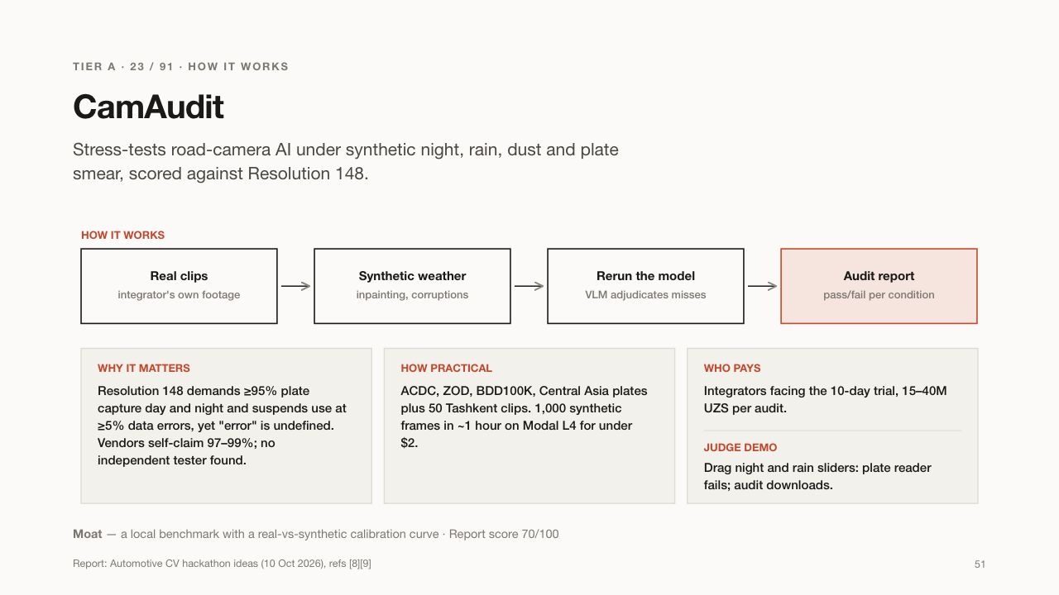

Slide 52
TIER A · 24 / 91 · TAXI & COURIER FLEETS
Navbat
A live map of methane (CNG) stations: which are open and how long the queue is.
WHAT IT DOES
USE CASES
– A taxi driver goes to the station with the shortest wait
– A fleet plans refuelling for 100 cars
– Station owners see their busy hours
WHO BUYS IT
Taxi and courier fleets; drivers use it.
Drivers share short videos of station queues. Navbat counts the cars, estimates the waiting time and whether the station is open, and tells taxi drivers where to fill up now.
WHY IT MATTERS
In winter many CNG stations close or have long queues: on 25 Dec 2025, only 11 of 33 stations for Tashkent public transport were open. Every hour in a queue is lost income for a taxi driver.
Report: Automotive CV hackathon ideas (10 Oct 2026), refs [24][25][26]
52

Slide 53
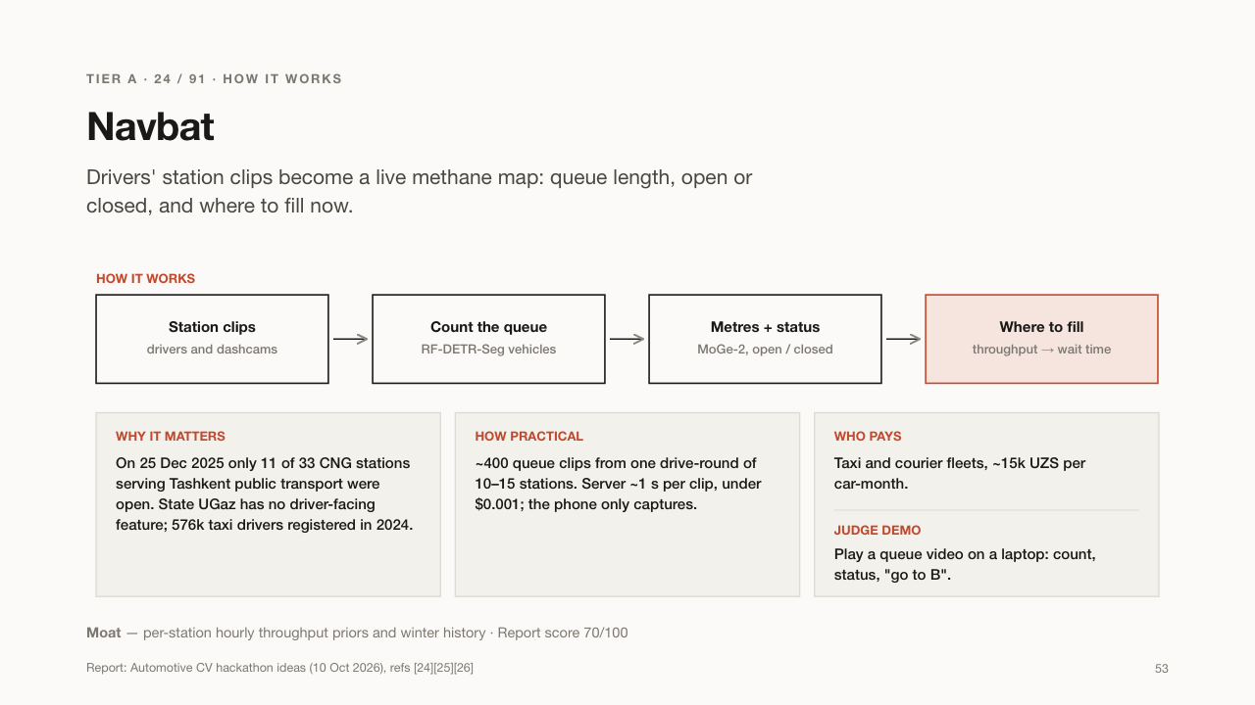

Slide 54
TIER A · 25 / 91 · DRIVING SCHOOLS
AutodromRef
A phone camera that scores driving-school students like the real exam.
WHAT IT DOES
USE CASES
– A student sees exactly where they lost points
– A school runs mock exams without an examiner
– Instructors show replays to explain mistakes
WHO BUYS IT
Driving schools.
One phone mounted above the school's practice yard watches the car. AutodromRef tracks the car, the cones and the lines and scores each exercise, such as hill start, parking and the box, the way the exam sensors do. It saves replay clips.
WHY IT MATTERS
The driving exam is scored by sensors and a retake costs 1.2M UZS. Schools are rated on how their students pass, but have no cheap way to practise the exact scoring.
Report: Automotive CV hackathon ideas (10 Oct 2026), refs [4][5][6][7]
54

Slide 55
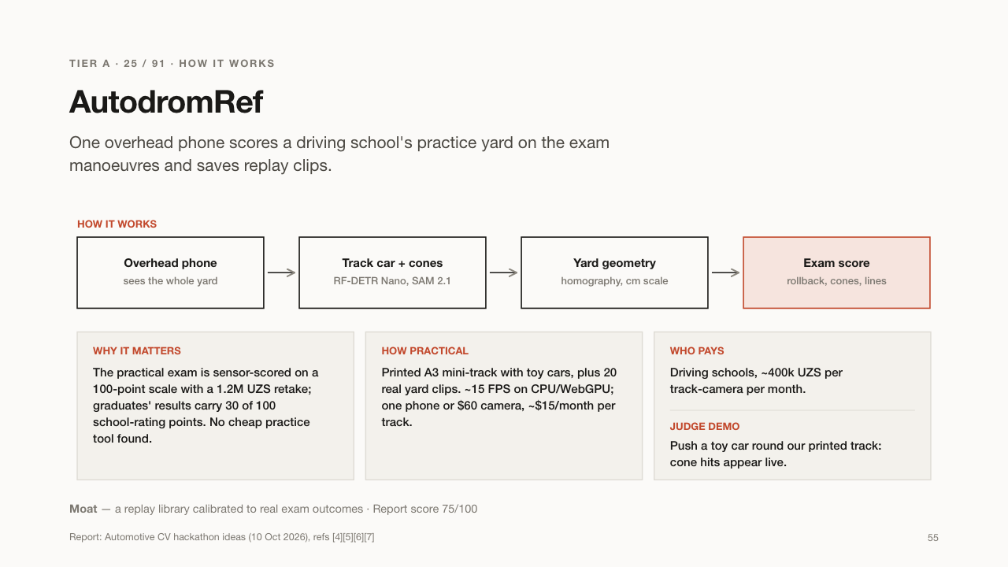

Slide 56
TIER A · 26 / 91 · DRIVING SCHOOLS
MirrorMark
Checks whether a learner driver looks in the mirrors before turning.
WHAT IT DOES
USE CASES
– An instructor gets a report of missed checks after each lesson
– A student practises with feedback
– A school tracks progress across lessons
WHO BUYS IT
Driving schools, as an add-on to AutodromRef.
A phone in the car watches the learner's head during a lesson. When the car turns or changes lanes, MirrorMark checks whether the learner looked in the mirror and over the shoulder, and gives feedback after the drive.
WHY IT MATTERS
Missing mirror checks is a classic exam fail and a cause of crashes. Instructors cannot watch the road and the student's eyes at the same time.
Report: Automotive CV hackathon ideas (10 Oct 2026), refs [4][133][134]
56

Slide 57
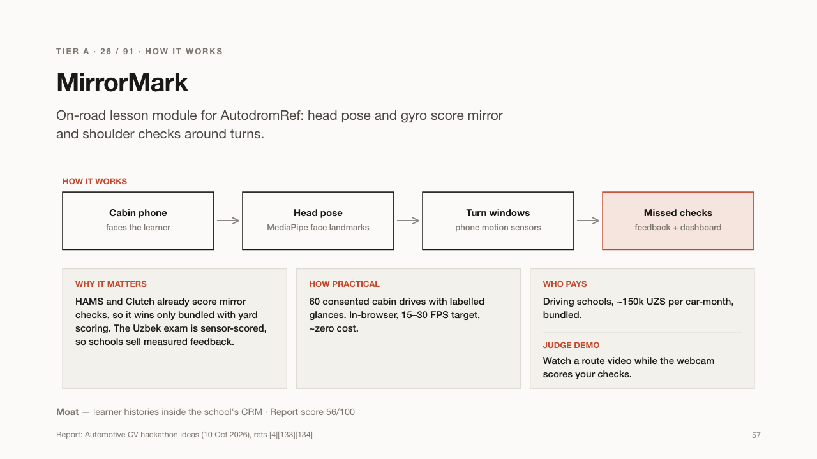

Slide 58
TIER B · 29 IDEAS
Solid B2B niches
Real payers and buildable in a sprint, but smaller markets. Strong modules inside a Tier A platform.
58

Slide 59
TIER B · 27 / 91 · USED-CAR DEALERS
Sotiladi Scout
Finds cars for sale that are never posted online, from "for sale" notes in windows.
WHAT IT DOES
USE CASES
– A dealer finds ten unlisted cars in one market walk
– A trade-in buyer fills stock faster
– A marketplace invites offline sellers online
WHO BUYS IT
Used-car dealers and car flippers.
Many sellers just put a "Sotiladi" (for sale) note with a phone number behind the windshield. A dealer walks a market or street with a phone; the app reads each note, identifies the car and ranks a call list by expected profit.
WHY IT MATTERS
These cars never appear on websites, so dealers who find them first get better deals. Today someone walks around writing numbers by hand.
Report: Automotive CV hackathon ideas (10 Oct 2026), refs [36][37][38]
59

Slide 60
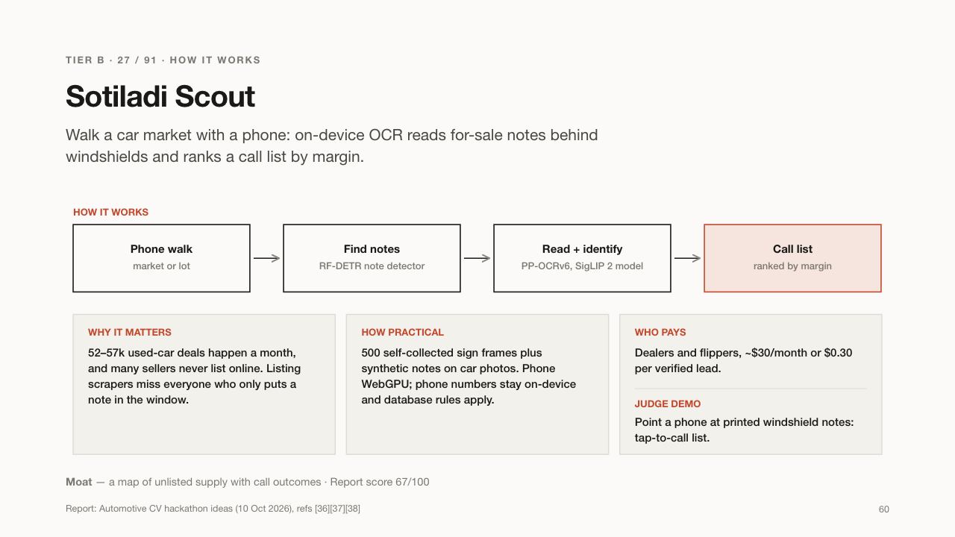

Slide 61
TIER B · 28 / 91 · GAS-CONVERSION WORKSHOPS
Ko'pik
Proves a gas-equipment leak test was really done, from a video of soapy joints.
WHAT IT DOES
USE CASES
– A conversion workshop proves every car passed a leak test
– An inspection centre reviews tests remotely
– An insurer checks a car's gas safety record
WHO BUYS IT
Gas-conversion workshops and inspection centres.
After fitting methane or propane equipment, the technician brushes soapy water on every joint and films it. Ko'pik checks every joint was covered, spots bubbles that grow (a leak) and saves a dated record tied to the gas cylinder.
WHY IT MATTERS
Gas leaks in cars can cause fires and explosions. The rules track cylinders but say nothing about proving the leak test, and a third of used-car listings run on gas.
Report: Automotive CV hackathon ideas (10 Oct 2026), refs [10][11][12]
61

Slide 62
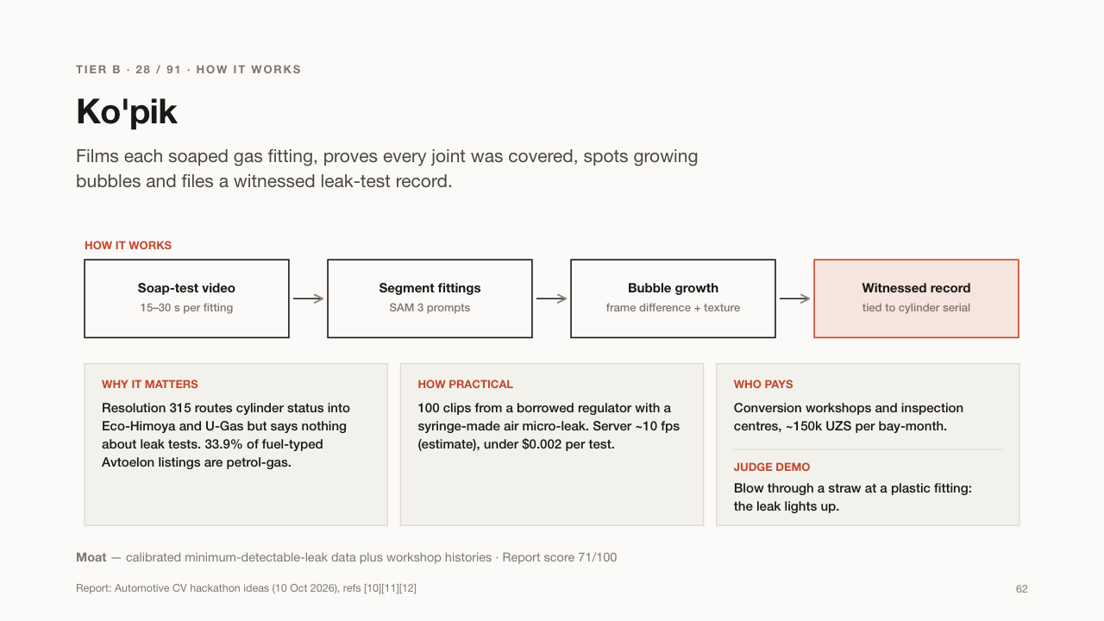

Slide 63
TIER B · 29 / 91 · INSPECTORS & STATIONS
BallonID
Reads a gas cylinder's stamped label and says if it is too old or untested.
WHAT IT DOES
USE CASES
– A filling station checks the cylinder before refuelling
– An inspector reads stamps in seconds
– A car buyer checks a gas-converted car
WHO BUYS IT
Inspection centres, car inspectors and gas stations.
Every gas cylinder has numbers stamped into the metal: serial, dates, pressure and gas type. They are hard to read under rust and paint. BallonID takes two photos lit from the side, reads the stamp and applies the official rules: refill, retest or refuse.
WHY IT MATTERS
An out-of-date or wrong cylinder can explode; in Fergana a propane cylinder filled with methane did. Today checks look up the car's plate, not the cylinder itself.
Report: Automotive CV hackathon ideas (10 Oct 2026), refs [10][79][174]
63

Slide 64
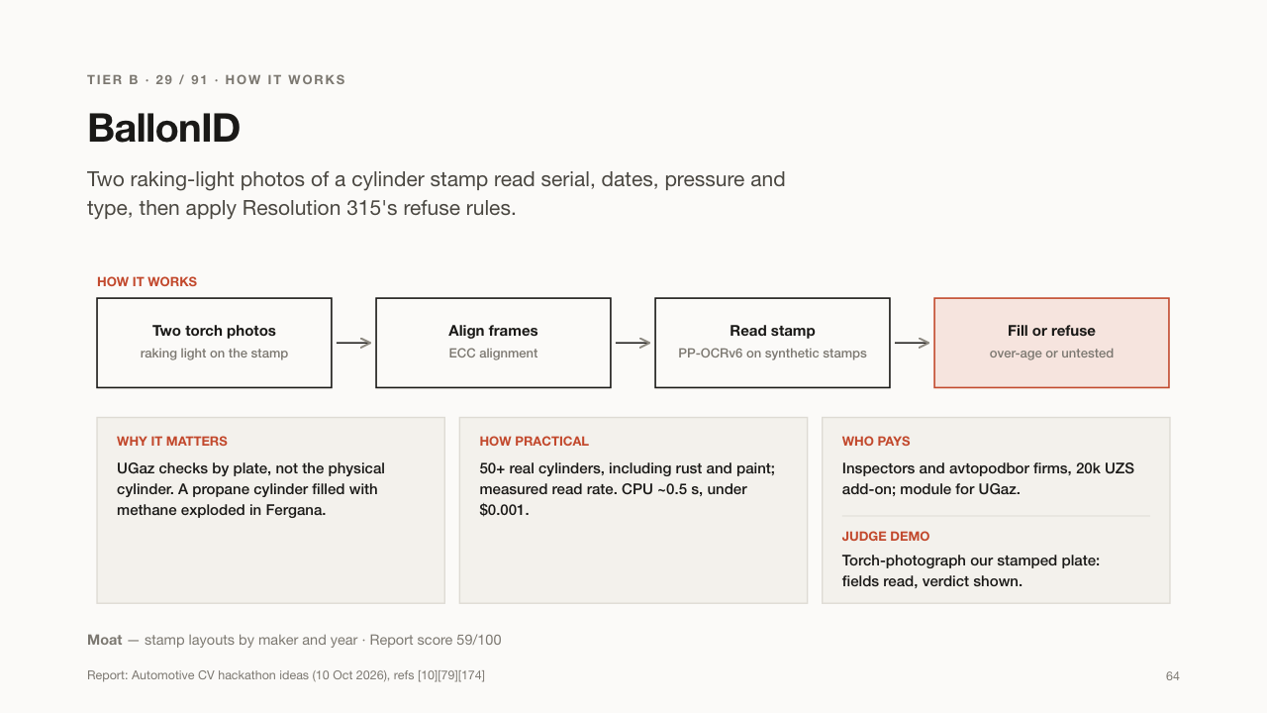

Slide 65
TIER B · 30 / 91 · INSPECTORS & TRADE-IN
GapGauge
Measures the gaps between a car's body panels with a bank card as the ruler.
WHAT IT DOES
USE CASES
– A buyer checks for hidden crash repairs
– An inspector backs up a verdict with numbers
– A trade-in desk prices repaired cars correctly
WHO BUYS IT
Car inspection firms and dealers' trade-in desks.
You hold any bank card next to the gap between, say, the door and the fender, and take photos. Because every bank card is exactly the same size, GapGauge measures the gap in millimetres and compares the left side of the car with the right.
WHY IT MATTERS
After a crash and repair, panels rarely line up perfectly, so uneven gaps reveal hidden accidents. Inspectors check this by eye today.
Report: Automotive CV hackathon ideas (10 Oct 2026), refs [21][22][23]
65

Slide 66
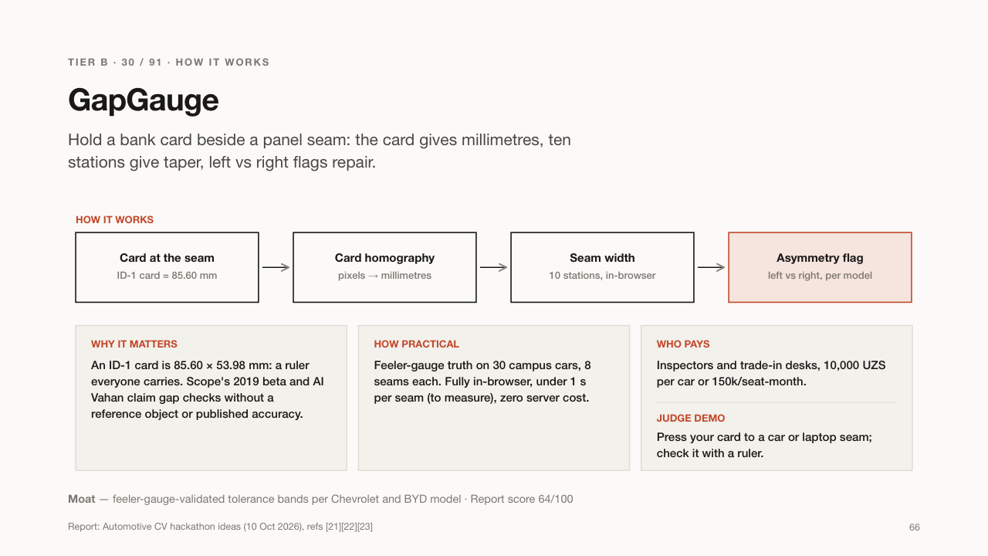

Slide 67
TIER B · 31 / 91 · TRADE-IN DESKS & LENDERS
BoltSeal
Tells whether a car panel was ever removed, from close-up photos of its bolts.
WHAT IT DOES
USE CASES
– A bank checks a car before lending on it
– A trade-in desk spots a replaced fender
– A buyer checks a car before a full inspection
WHO BUYS IT
Dealers' trade-in desks, auto lenders and inspectors.
At the factory, the bolts holding doors, hood and fenders are painted over. If a panel was removed for repair, a wrench leaves marks and cracks the paint. BoltSeal checks close-up photos of each bolt and flags the ones that were turned.
WHY IT MATTERS
It is a well-known trick of professional inspectors, but it needs expertise. Automating it gives any buyer or bank a quick hidden-repair check.
Report: Automotive CV hackathon ideas (10 Oct 2026), refs [34][39][40]
67

Slide 68
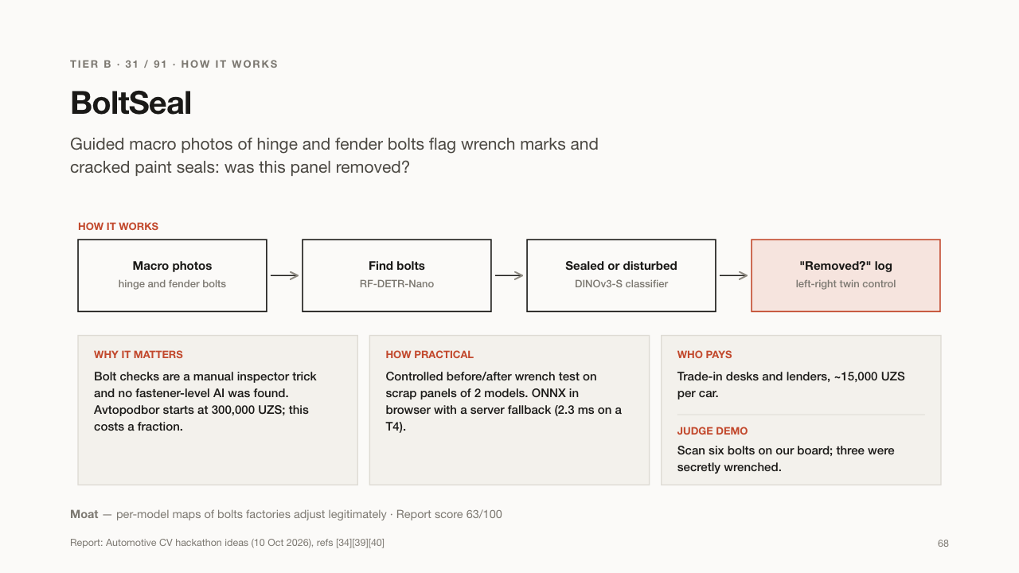

Slide 69
TIER B · 32 / 91 · BANKS & MARKETPLACES
Proof-of-Inspection
Checks the inspector's work, not the car, so banks can trust inspection reports.
WHAT IT DOES
USE CASES
– A bank accepts only verified inspections for car loans
– A marketplace labels trustworthy inspection reports
– An inspection firm proves its quality
WHO BUYS IT
Banks, leasing firms and car marketplaces.
When a car inspector films an inspection, this app checks that all required steps were done: VIN read, odometer shown, paint gauge used. It also catches reused videos and VINs that don't match the documents.
WHY IT MATTERS
Banks and marketplaces rely on inspection PDFs that nobody verifies. A lazy or dishonest inspector can approve a bad car.
Report: Automotive CV hackathon ideas (10 Oct 2026), refs [42]
69

Slide 70
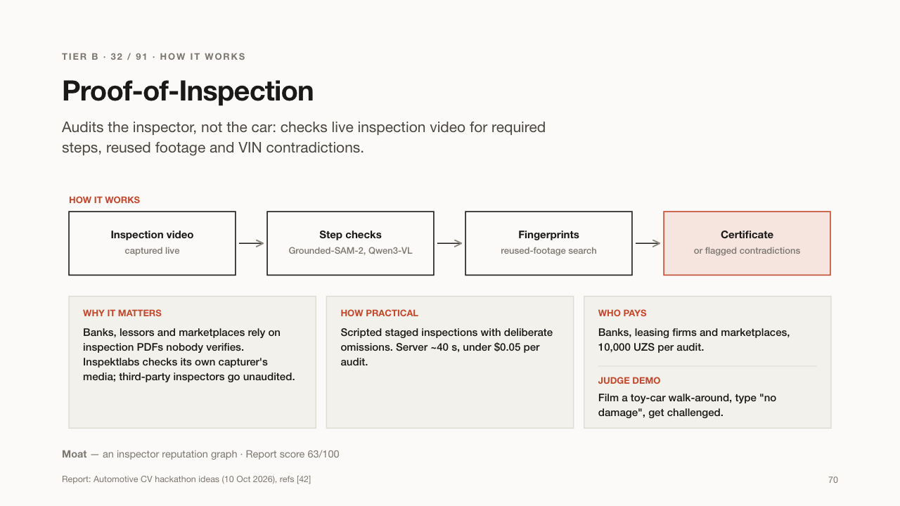

Slide 71
TIER B · 33 / 91 · MOPED FLEETS & LESSORS
Lowside
Shows whether a used moped or motorcycle has been crashed, from photos.
WHAT IT DOES
USE CASES
– A courier fleet checks mopeds at hand-over and return
– A lessor documents damage fairly
– A buyer avoids a crashed bike
WHO BUYS IT
Moped leasing firms and courier fleets.
When a bike falls, it scrapes the same places: levers, foot pegs, mirrors, engine covers. Lowside finds these points in photos, tells crash scrapes from normal wear, and draws a simple damage map.
WHY IT MATTERS
Courier fleets buy and rent out many used mopeds, and hidden crash damage makes them unsafe and costly. There were 563 moped and scooter crashes in nine months of 2026.
Report: Automotive CV hackathon ideas (10 Oct 2026), refs [16][43]
71

Slide 72
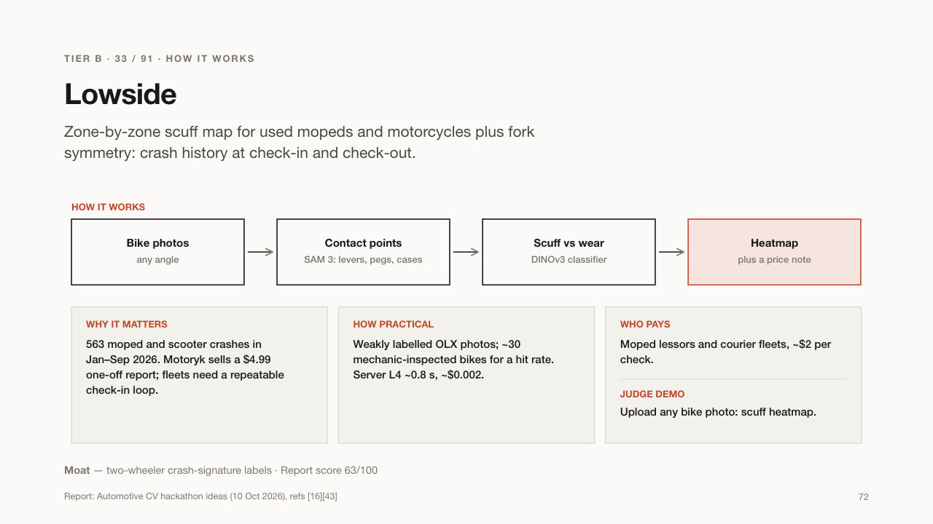

Slide 73
TIER B · 34 / 91 · SELLERS + INSURER
LemonBack
A money-back guarantee for used cars, priced from a 10-minute photo check.
WHAT IT DOES
USE CASES
– An honest seller sells faster with a guarantee
– A buyer gets their money back if the car hid a repair
– An insurer gains a new product line
WHO BUYS IT
Private sellers pay; an insurer carries the risk.
The seller records a guided 10-minute video of the car. Checks for hidden repairs, mileage and damage price the risk. If the buyer later finds a problem the video should have shown, an insurer buys the car back within 30 days.
WHY IT MATTERS
Buyers fear hidden problems, which pushes prices down for honest sellers. A guarantee builds trust, and insurers need new products.
Report: Automotive CV hackathon ideas (10 Oct 2026), refs [33][66][67]
73

Slide 74
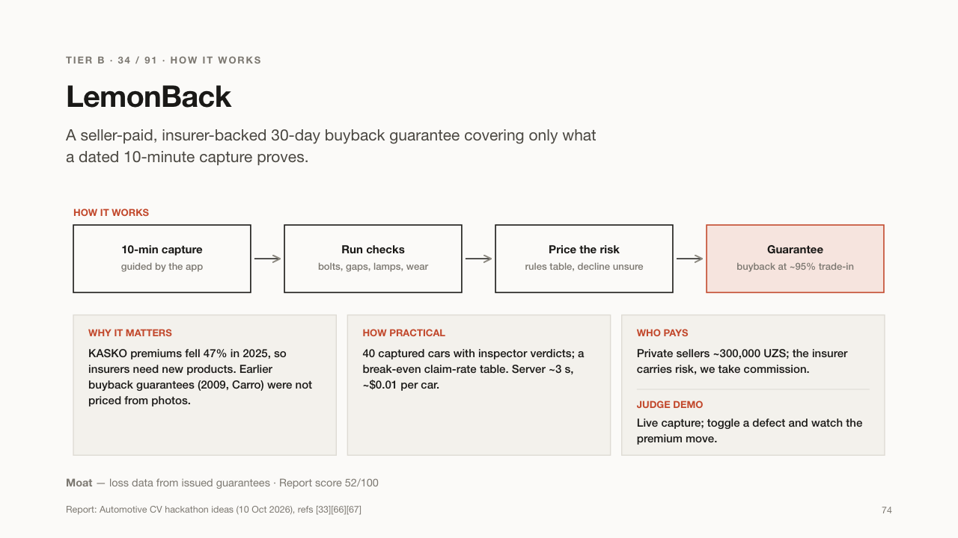

Slide 75
TIER B · 35 / 91 · INSPECTORS & BUYERS
Drip-ID
Tells which fluid a car is leaking, using a printed card and two photos.
WHAT IT DOES
USE CASES
– A buyer checks a used car for leaks
– An inspector adds a leak test to the report
– A driver knows whether to visit a garage
WHO BUYS IT
Car inspectors and used-car buyers.
Put the card under the car's engine and take two photos ten minutes apart. Water from the air-conditioner evaporates; oil, gearbox fluid and coolant stay and have typical colours. Drip-ID names the fluid and how serious it is.
WHY IT MATTERS
A leak can mean a cheap fix or a big repair. Most buyers cannot tell, and standard inspections often skip it.
Report: Automotive CV hackathon ideas (10 Oct 2026), refs [34][35]
75

Slide 76
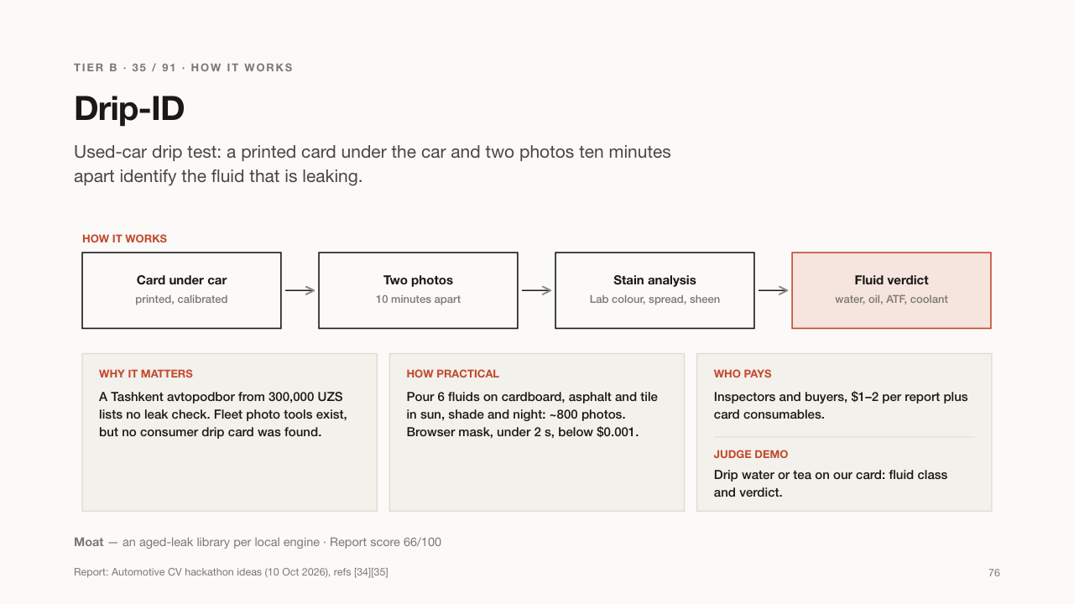

Slide 77
TIER B · 36 / 91 · DISMANTLERS
Razborka Lens
Recognises used car parts from a photo and writes the sale listing.
WHAT IT DOES
USE CASES
– A breaker lists 100 parts a day instead of 10
– A buyer sees which models a part fits
– A parts shop prices stock fairly
WHO BUYS IT
Car breakers and used-parts sellers.
Car breakers (razborka) sell thousands of used parts, many without part numbers. Razborka Lens recognises a bumper, lamp or mirror from its shape, finds which cars it fits, and drafts an Uzbek and Russian ad with a fair price.
WHY IT MATTERS
Listing parts by hand is slow, so most stock never gets listed. Buyers struggle to know if a part fits their car.
Report: Automotive CV hackathon ideas (10 Oct 2026), refs [46][72]
77

Slide 78
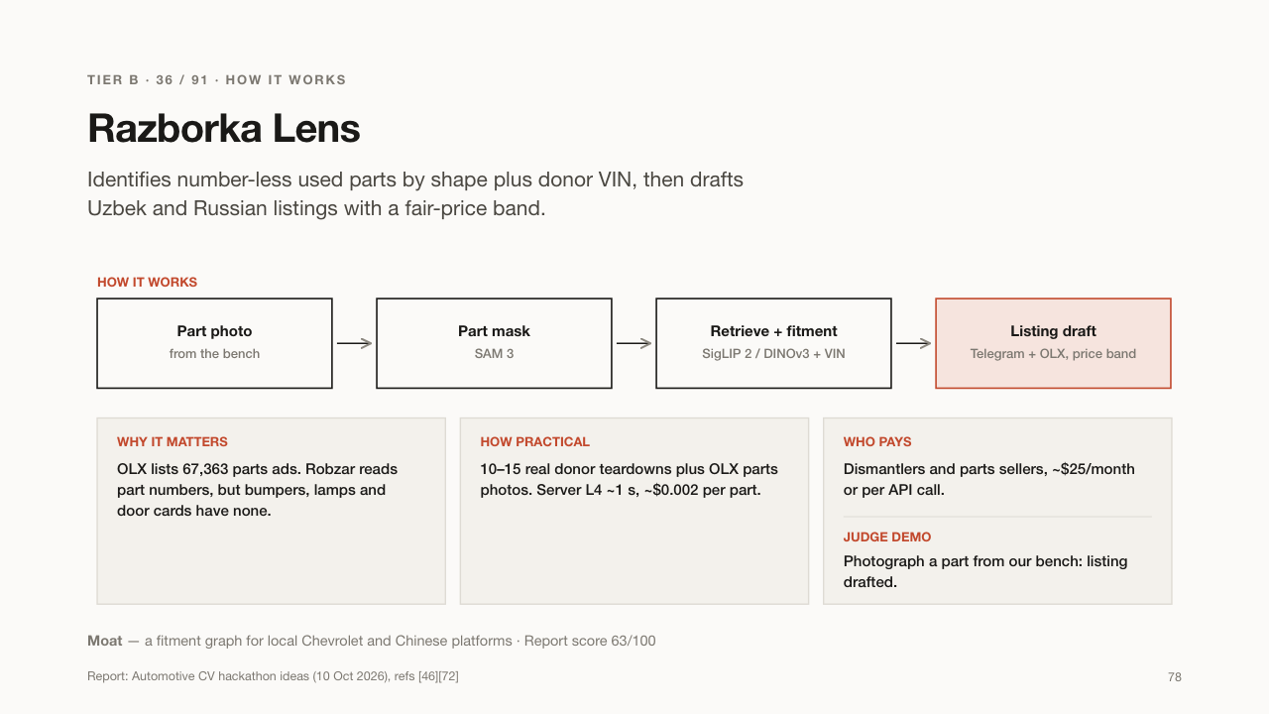

Slide 79
TIER B · 37 / 91 · TYRE SHOPS
Brake Peek
Checks brake-pad thickness during a tyre change, with one photo.
WHAT IT DOES
USE CASES
– A tyre shop offers a brake check with every tyre change
– A driver sees proof their pads are worn
– A fleet tracks brake wear across cars
WHO BUYS IT
Tyre shops and service centres.
When the wheel is off for a tyre change, the brake pads are visible. The mechanic takes one photo with a small marker card. Brake Peek measures the pad thickness and sends the customer a Telegram card: fine, soon, or replace now.
WHY IT MATTERS
Worn brakes are dangerous, and customers rarely believe a mechanic's word. A measured photo builds trust and sells a needed repair.
Report: Automotive CV hackathon ideas (10 Oct 2026), refs [73][74]
79

Slide 80
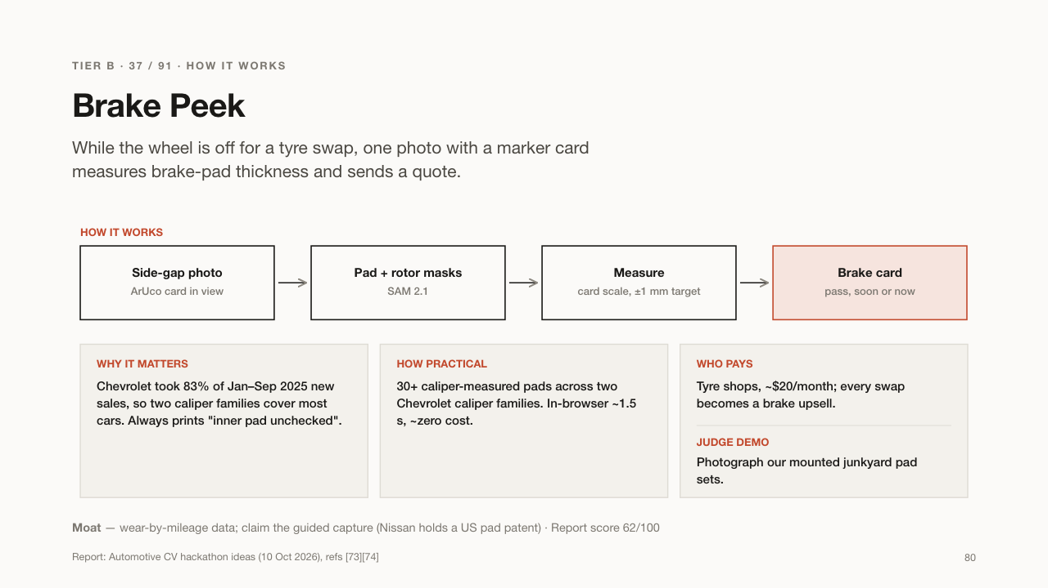

Slide 81
TIER B · 38 / 91 · GARAGES
TremorLab
Measures a car engine's shaking from a phone video to check its engine mounts.
WHAT IT DOES
USE CASES
– A garage shows a customer why the mounts need replacing
– A taxi park checks engines regularly
– A buyer checks a used car's engine
WHO BUYS IT
Garages and taxi-park workshops.
Two small printed tags are stuck on the engine and the body. A phone films while someone revs the engine. TremorLab measures how far the engine rocks in millimetres and compares it with a healthy engine of the same model.
WHY IT MATTERS
Worn engine mounts cause vibration and damage, but mechanics judge them by feel. A measured number makes the diagnosis clear.
Report: Automotive CV hackathon ideas (10 Oct 2026), refs [11][75]
81

Slide 82
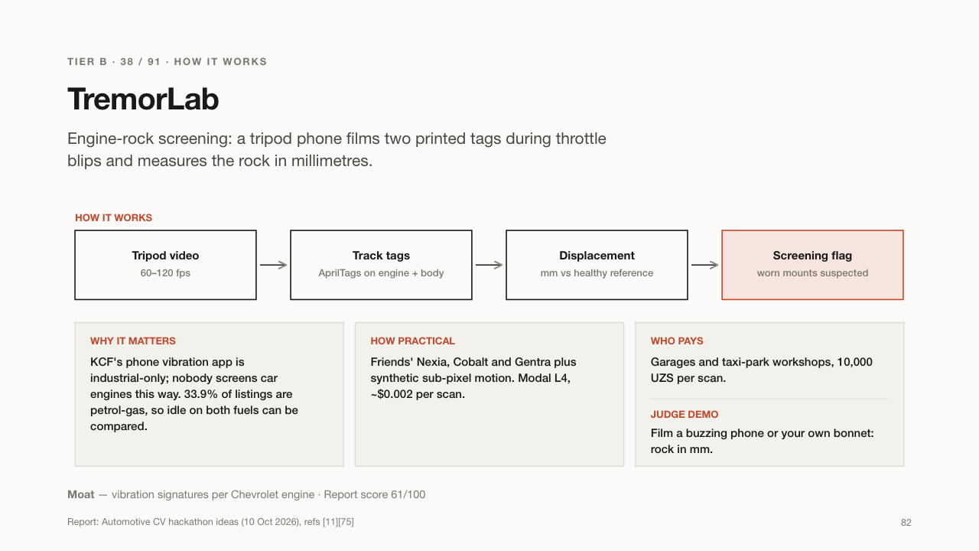

Slide 83
TIER B · 39 / 91 · EV SERVICE ACADEMIES
Orange Guard
Scores mechanics' safety drill before they work on high-voltage electric cars.
WHAT IT DOES
USE CASES
– A dealer trains new EV technicians
– A training college grades practical exams
– A service centre keeps safety records
WHO BUYS IT
EV service academies, dealers and vocational colleges.
Before touching an electric car's high-voltage system, a mechanic must follow strict steps: gloves, warning cones, lock and tag, in the right order. Orange Guard watches the drill on camera and scores each step against the manufacturer's checklist.
WHY IT MATTERS
Mistakes with EV high voltage can kill. Many service bays are new to EVs, and training needs a record. A person still checks the voltage.
Report: Automotive CV hackathon ideas (10 Oct 2026), refs [13][76][77]
83

Slide 84


Slide 85
TIER B · 40 / 91 · BRAND OWNERS
FakeStop
Spots fake car parts from photos of their box and label.
WHAT IT DOES
USE CASES
– A mechanic checks parts before fitting them
– A brand owner maps where fakes are sold
– A buyer checks a box at the bazaar
WHO BUYS IT
Car-parts brand owners and official importers.
Genuine filters, brake pads and spark plugs have fine print and hologram details that fakes copy badly. FakeStop compares close-up photos of the box with genuine samples and says: genuine, suspect, or unknown product.
WHY IT MATTERS
Fake parts are common at bazaars and can fail dangerously, like brakes. A third of Russian repair shops met fakes in 2025.
Report: Automotive CV hackathon ideas (10 Oct 2026), refs [80][81]
85

Slide 86


Slide 87
TIER B · 41 / 91 · IMPORTERS & OEMS
Claim Pack
Catches fake or reused photos in dealers' warranty repair claims.
WHAT IT DOES
USE CASES
– An importer audits all dealers' warranty claims
– A carmaker spots a dealer with suspicious claims
– Honest dealers get paid faster
WHO BUYS IT
Car importers and carmakers' warranty departments.
When dealers ask the importer to pay for warranty repairs, they send photos of the VIN, odometer and parts. Claim Pack searches all dealers' photos and flags pictures used twice, odometers that go backwards, or parts that don't match.
WHY IT MATTERS
Each claim is reviewed alone, so a photo reused across dealers goes unseen. The importer pays for repairs that never happened.
Report: Automotive CV hackathon ideas (10 Oct 2026), refs [84][85]
87

Slide 88
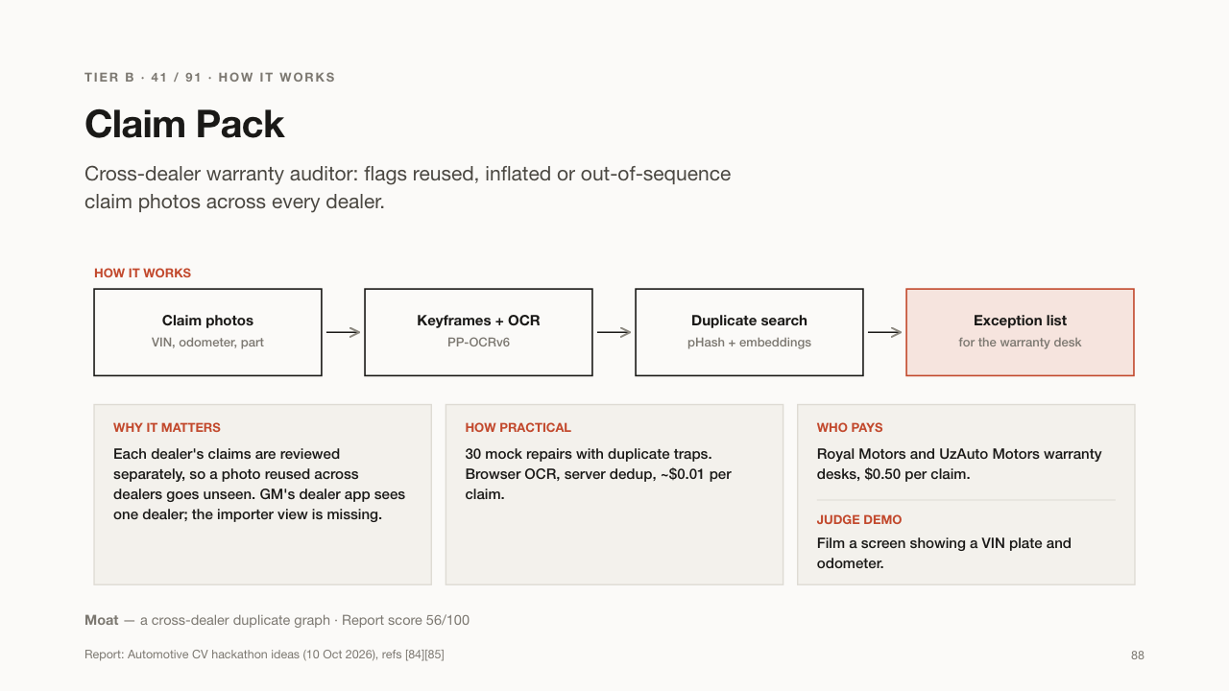

Slide 89
TIER B · 42 / 91 · TAXI & DELIVERY FLEETS
Spot-Oil
Tells whether engine oil needs changing, from one drop on a paper card.
WHAT IT DOES
USE CASES
– A taxi fleet changes oil only when needed
– A mechanic spots coolant in the oil early
– A fleet tracks engine health over time
WHO BUYS IT
Taxi parks and delivery fleets.
The mechanic puts a drop of engine oil on a printed card. The oil spreads into rings; their colour and shape show how dirty or contaminated it is. Spot-Oil reads a photo of the card and says: change now, or suspected contamination.
WHY IT MATTERS
Fleets change oil by the calendar, often too early or too late. Gas-powered taxis wear oil differently from petrol cars.
Report: Automotive CV hackathon ideas (10 Oct 2026), refs [11][92]
89

Slide 90
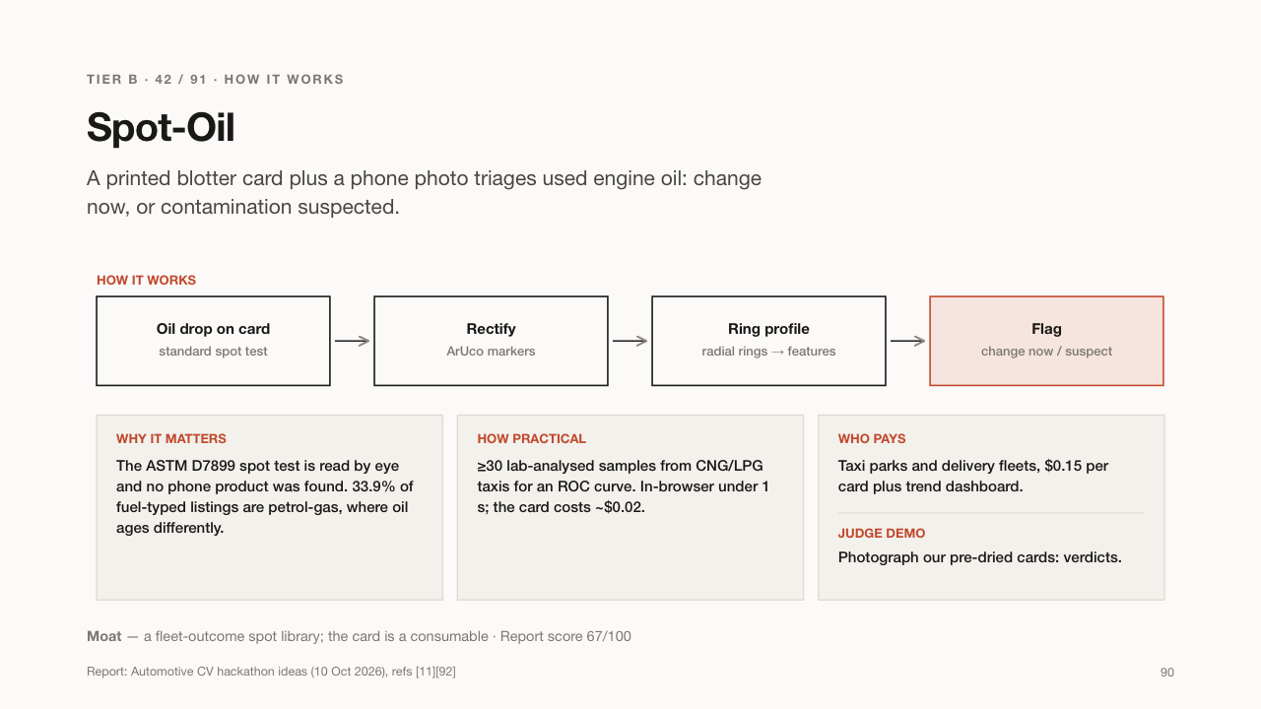

Slide 91
TIER B · 43 / 91 · TANKER OPERATORS
Plomba Twin
Proves a fuel tanker's seal was not swapped during the trip.
WHAT IT DOES
USE CASES
– A fuel company checks seals at each delivery
– A cargo insurer requires seal photos
– A forwarder proves a trip was clean
WHO BUYS IT
Fuel-tanker operators, forwarders and cargo insurers.
Fuel tankers are sealed at the depot. Plomba Twin photographs the seal at the start and at every stop and checks it is the same physical seal, not a lookalike with the same number.
WHY IT MATTERS
Fuel can be stolen by opening a tank and fitting a new seal with the same serial. A serial-number check alone does not catch it.
Report: Automotive CV hackathon ideas (10 Oct 2026), refs [93][94]
91

Slide 92
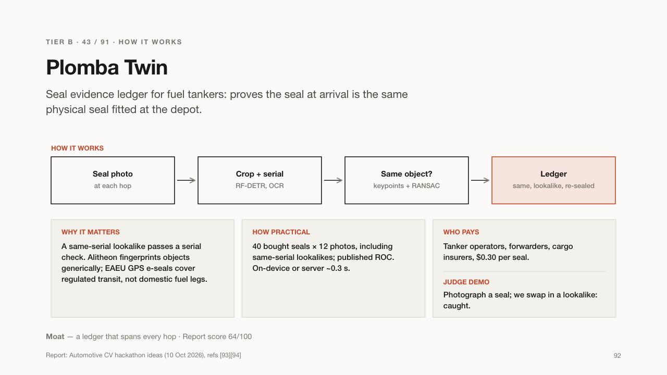

Slide 93
TIER B · 44 / 91 · DEVELOPERS & TRADERS
CubeProof
Measures the volume of sand or gravel in a truck from one photo.
WHAT IT DOES
USE CASES
– A builder checks every delivered load
– A trader proves full loads to customers
– A city checks contractors' deliveries
WHO BUYS IT
Construction companies, material traders and municipal contractors.
Before the truck leaves the quarry, one photo is taken from above. CubeProof measures the load's volume and weight and flags short loads, so the buyer knows they got what they paid for.
WHY IT MATTERS
Buyers of building materials often receive less than they paid for; one quarry pilot found 2-3% under-delivery. Laser scanners are expensive; a phone photo is not.
Report: Automotive CV hackathon ideas (10 Oct 2026), refs [95][96][97]
93

Slide 94
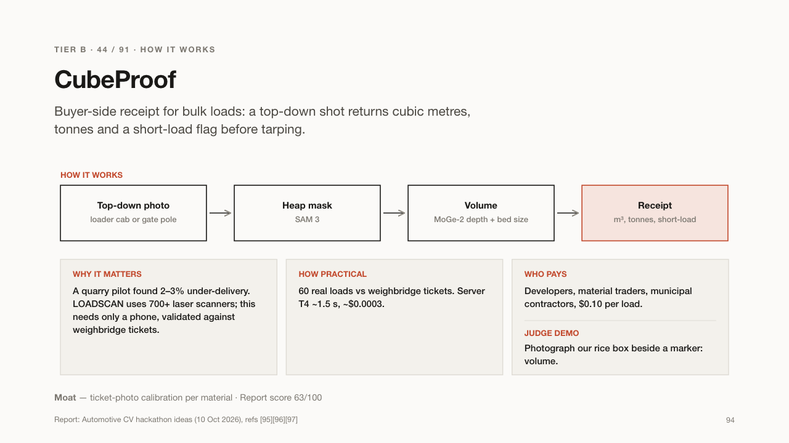

Slide 95
TIER B · 45 / 91 · CORRIDOR FORWARDERS
QueueLedger
Tells truck drivers how long the border queue will take, from one photo.
WHAT IT DOES
USE CASES
– A forwarder picks the faster border crossing
– A driver plans rest around the wait
– A logistics firm warns its customer of delays
WHO BUYS IT
Freight forwarders on Central Asian corridors.
Someone near the border photographs the truck queue. QueueLedger counts the trucks, measures the line's length and, with the crossing's usual speed, estimates how many hours the wait will be. Results go to a Telegram bot.
WHY IT MATTERS
At some crossings 400+ trucks get stuck and waits pass 24 hours. Without an official e-queue, forwarders plan blind.
Report: Automotive CV hackathon ideas (10 Oct 2026), refs [102][103][104]
95

Slide 96
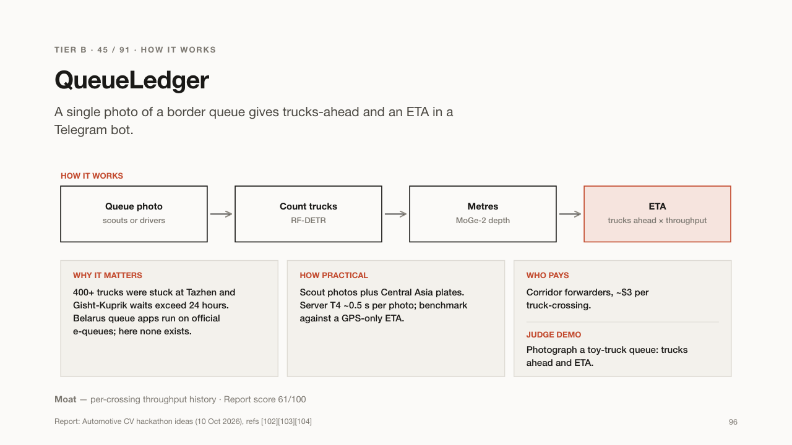

Slide 97
TIER B · 46 / 91 · CARGO PLATFORMS
Cargo-Fit
Picks the right delivery vehicle and price from a photo of what you want to move.
WHAT IT DOES
USE CASES
– A moving app quotes instantly from photos
– A cargo-taxi dispatcher sends the right van
– A customer compares prices before booking
WHO BUYS IT
Cargo-taxi and moving platforms.
A customer photographs the items, such as a sofa, fridge or boxes. Cargo-Fit measures them, works out what fits, and suggests a Damas, Labo or bigger truck with the right number of loaders and a price.
WHY IT MATTERS
Dispatchers guess the vehicle size, so trucks arrive too small or too big. Wrong vehicles waste time and money.
Report: Automotive CV hackathon ideas (10 Oct 2026), refs [73][111]
97

Slide 98
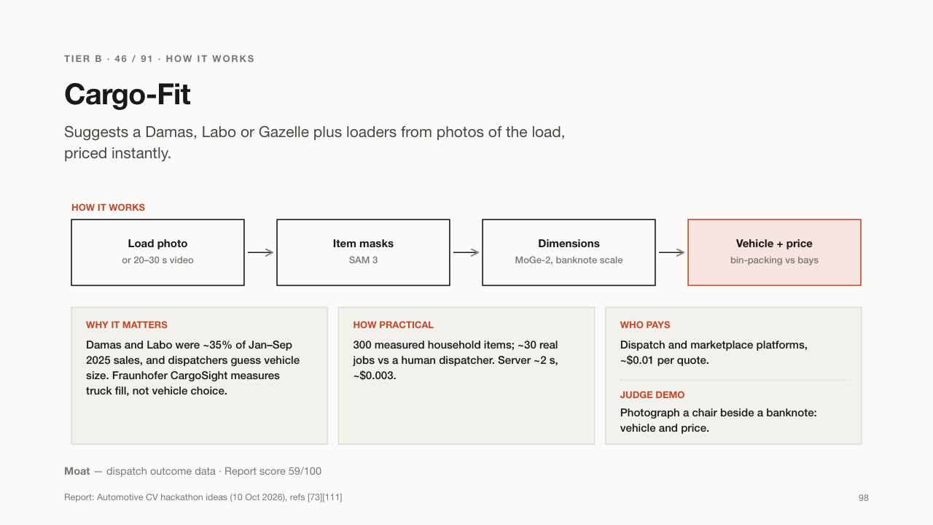

Slide 99
TIER B · 47 / 91 · GRAIN & COTTON BUYERS
ScaleGuard
Catches cheating at truck weighbridges using the camera already there.
WHAT IT DOES
USE CASES
– A grain buyer stops paying for fake weight
– A cement plant audits its scale
– A cotton gin proves fair weighing to farmers
WHO BUYS IT
Grain and cotton buyers and cement plants.
At a weighbridge, trucks are weighed full and empty. ScaleGuard watches the existing camera and flags tricks: a wheel off the scale, a person on the platform, or a different truck at the second weighing.
WHY IT MATTERS
Cheating at the scale costs grain, cotton and cement buyers real money on every load. It needs no new hardware.
Report: Automotive CV hackathon ideas (10 Oct 2026), refs [113][114]
99

Slide 100
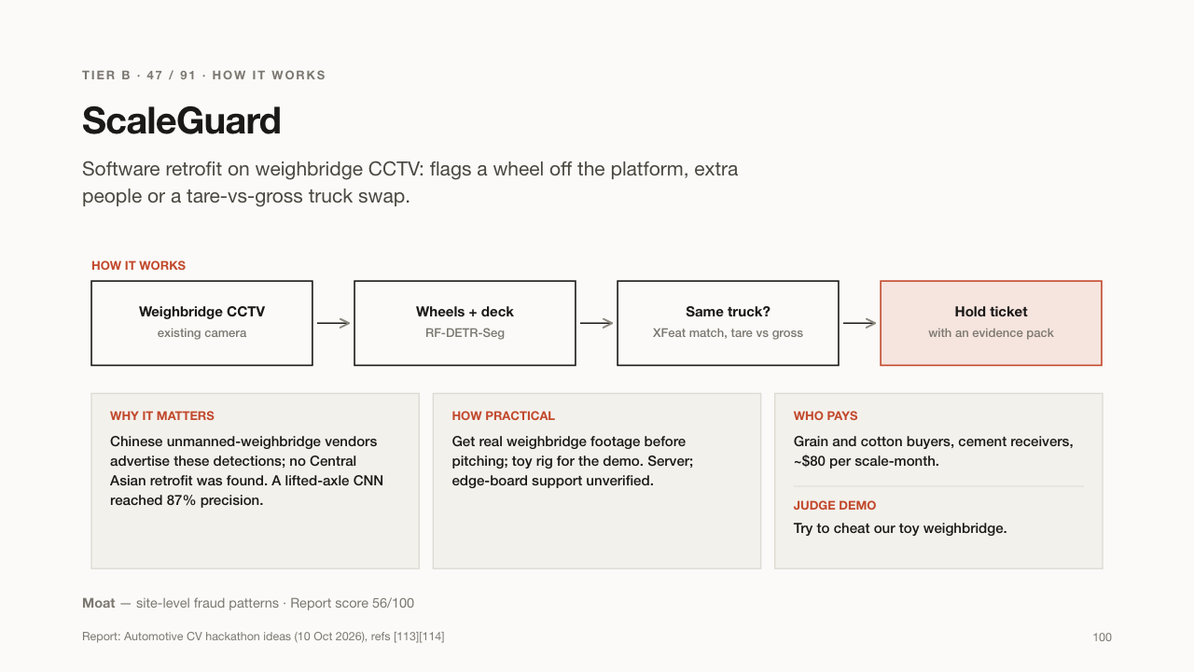

Slide 101
TIER B · 48 / 91 · EV FLEETS
Hakam
Checks electric-car charging bills against what the car actually received.
WHAT IT DOES
USE CASES
– An EV taxi fleet catches card misuse
– A fleet ranks chargers that overbill
– A charger operator proves its meters are accurate
WHO BUYS IT
EV fleets and charging operators.
The driver photographs the charger's screen and the car's "energy added" screen. Hakam compares the two numbers to catch charging someone else's car on the company card, or a charger that overbills.
WHY IT MATTERS
Fleets pay for charging on cards that are easy to misuse. One UK review found 31.5% of chargers out of tolerance.
Report: Automotive CV hackathon ideas (10 Oct 2026), refs [115][116][117]
101

Slide 102
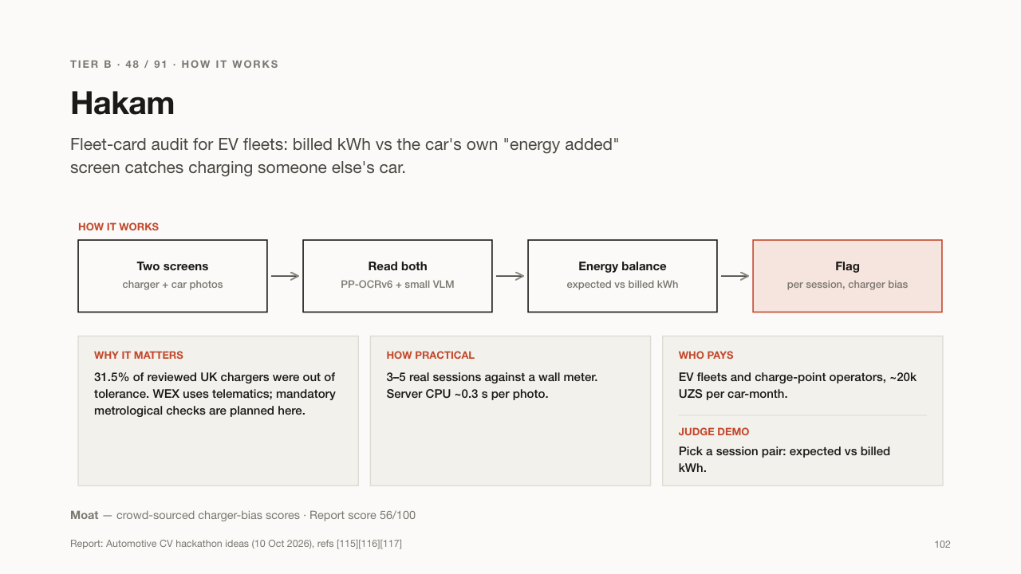

Slide 103
TIER B · 49 / 91 · BANK SPONSORS + CITY
Yield-to-Win
Rewards drivers who stop for pedestrians, instead of only fining those who don't.
WHAT IT DOES
USE CASES
– A bank runs a road-safety loyalty campaign
– A city rewards safe drivers at school crossings
– A driver earns cashback for stopping
WHO BUYS IT
Bank sponsors (such as Uzcard or MKBANK) with a city pilot.
Drivers sign up with their plate number. A camera at a crossing sees a driver stop for waiting pedestrians and enters them into a prize draw funded by a bank's loyalty budget.
WHY IT MATTERS
Pedestrians are involved in about 46% of crashes. Rewards can change habits where fines alone do not, and a sponsor gets positive publicity.
Report: Automotive CV hackathon ideas (10 Oct 2026), refs [123][124]
103

Slide 104


Slide 105
TIER B · 50 / 91 · ROADSIDE ASSISTANCE
Dispatch Card
Turns a crash video into a quick summary card for emergency and assistance services.
WHAT IT DOES
USE CASES
– A roadside-assistance desk sends the right help
– An insurer gets a first report within seconds
– Responders know about gas risk early
WHO BUYS IT
Roadside-assistance companies and insurers' claim desks.
A bystander or dashcam sends a short crash video. Dispatch Card writes a short card in Uzbek or Russian: how many vehicles and people, any fire or smoke, and whether a gas cylinder may be involved.
WHY IT MATTERS
Responders often arrive without knowing what they will find. Gas-powered cars add a fire and explosion risk they should know about.
Report: Automotive CV hackathon ideas (10 Oct 2026), refs [126]
105

Slide 106
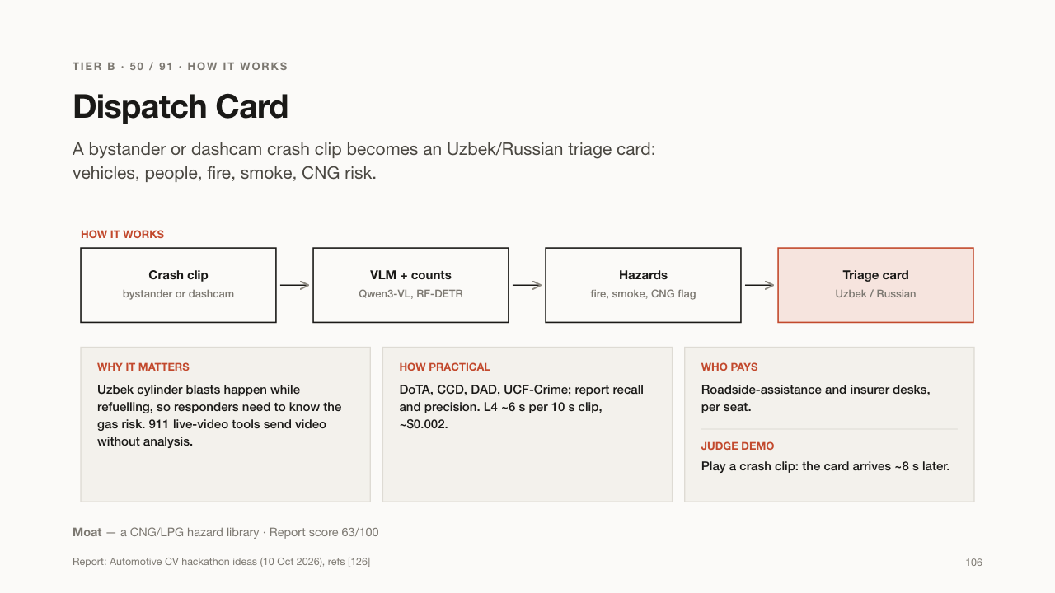

Slide 107
TIER B · 51 / 91 · SEAT RETAILERS & FLEETS
SeatProof
Checks from photos that a child car seat is installed correctly.
WHAT IT DOES
USE CASES
– A shop checks the installation when a parent buys a seat
– A parent checks before a long drive
– A taxi company shows its child seats are installed well
WHO BUYS IT
Child-seat retailers, and parents per check.
A parent photographs the installed child seat. SeatProof checks common mistakes: wrong seat for the child's age, wrong direction, twisted straps, chest clip too low. It marks errors on the photo and always reminds you to check tightness by hand.
WHY IT MATTERS
Badly installed seats protect children much less. A new draft rule proposes fines, and most parents never get a check.
Report: Automotive CV hackathon ideas (10 Oct 2026), refs [127][128]
107

Slide 108
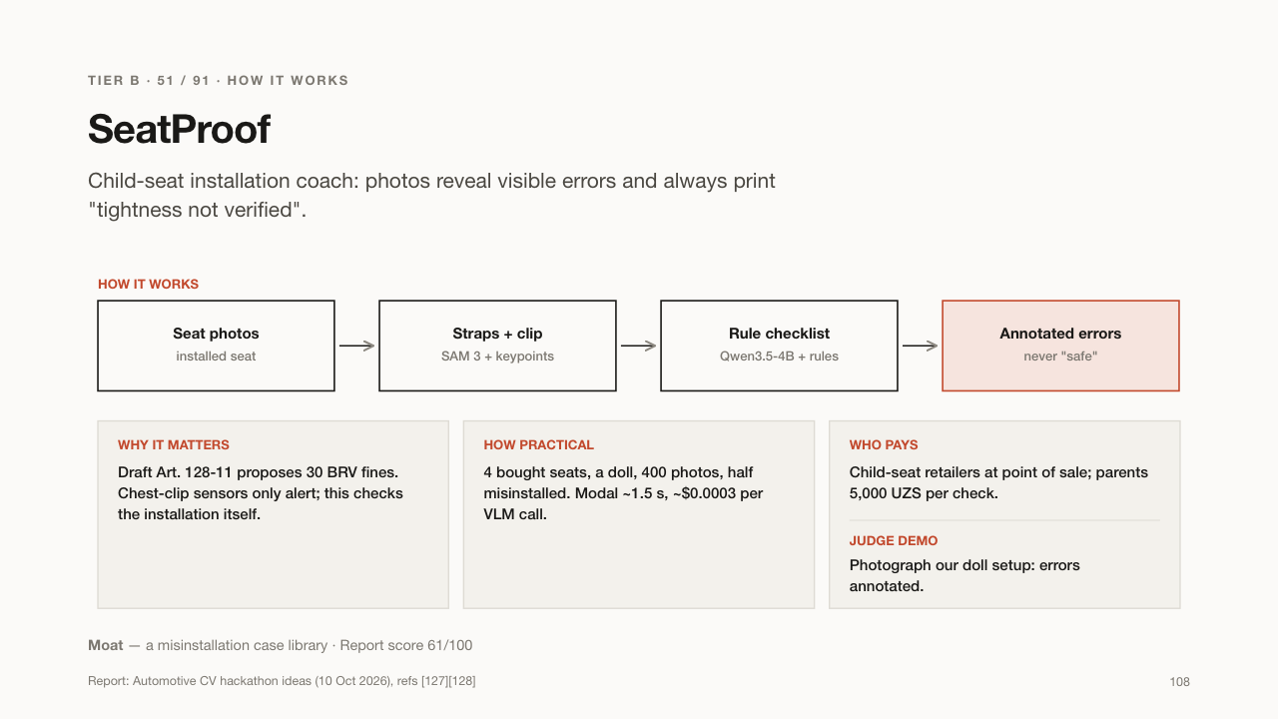

Slide 109
TIER B · 52 / 91 · DEVELOPERS
GateWash
Proves construction trucks leave the site with clean wheels and covered loads.
WHAT IT DOES
USE CASES
– A developer shows inspectors a clean record
– An inspector checks a site remotely
– A contractor finds lazy drivers
WHO BUYS IT
Construction developers and contractors.
A camera at the site exit watches every truck pass the wheel wash. GateWash logs how long it washed, whether the load was covered and the plate, in a tamper-proof record inspectors can check.
WHY IT MATTERS
Mud and dust from building sites add to Tashkent's smog, and a draft rule covers about 1,700 sites. Developers need proof to avoid fines.
Report: Automotive CV hackathon ideas (10 Oct 2026), refs [144][145][146][147]
109

Slide 110
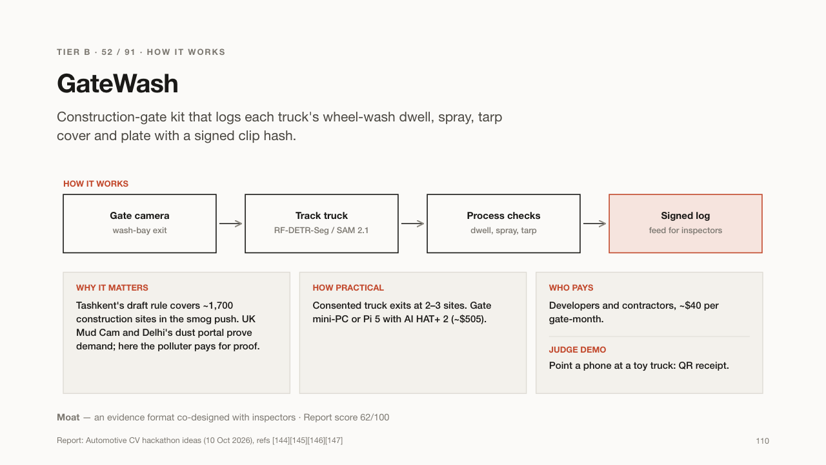

Slide 111
TIER B · 53 / 91 · CHINESE-EV DEALERS
Plug-Ready
Checks if a new EV owner's home can safely charge the car, from a phone video.
WHAT IT DOES
USE CASES
– A dealer sells a home charger with every EV
– A bank adds a charger to the car loan
– An owner learns they need an electrician first
WHO BUYS IT
EV dealers and charger installers, plus banks.
When someone buys an electric car, they film their parking spot, electricity meter, fuse box and socket. Plug-Ready reads the ratings, measures the cable distance with a bank card, flags dangers and quotes the right home charger.
WHY IT MATTERS
New EV owners often charge from unsafe sockets or extension cords, which manuals forbid. A survey visit costs time; a video doesn't.
Report: Automotive CV hackathon ideas (10 Oct 2026), refs [172][173]
111

Slide 112
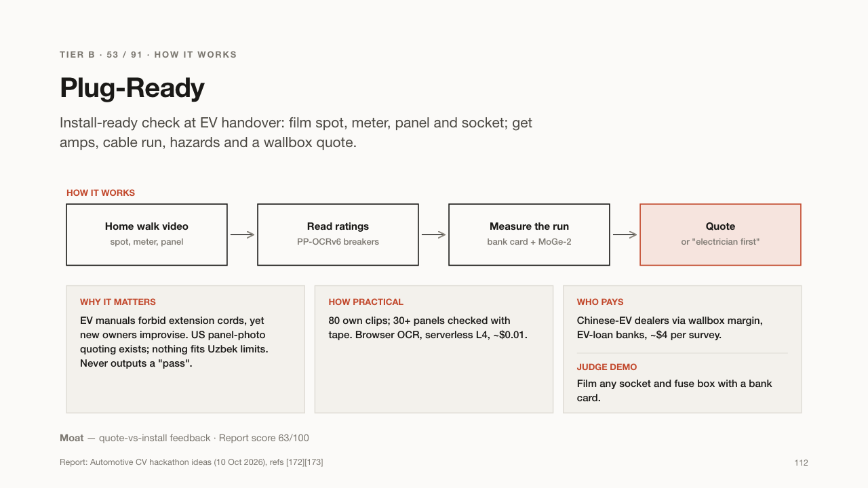

Slide 113
TIER B · 54 / 91 · EV TAXI FLEETS
ChargeMD
Explains a charger's error message in plain language, from a photo.
WHAT IT DOES
USE CASES
– A taxi driver fixes a simple charging error on the spot
– An operator gets precise fault reports
– Drivers see which chargers really work
WHO BUYS IT
EV taxi fleets and charging operators.
Public chargers often show error codes in Chinese or English that drivers cannot understand. The driver photographs the screen; ChargeMD explains the problem, says what to do, and reports it to the operator.
WHY IT MATTERS
An EV taxi stuck at a broken charger loses income. Operators also learn which chargers fail, helping build a reliable uptime map.
Report: Automotive CV hackathon ideas (10 Oct 2026), refs [13][175][176]
113

Slide 114
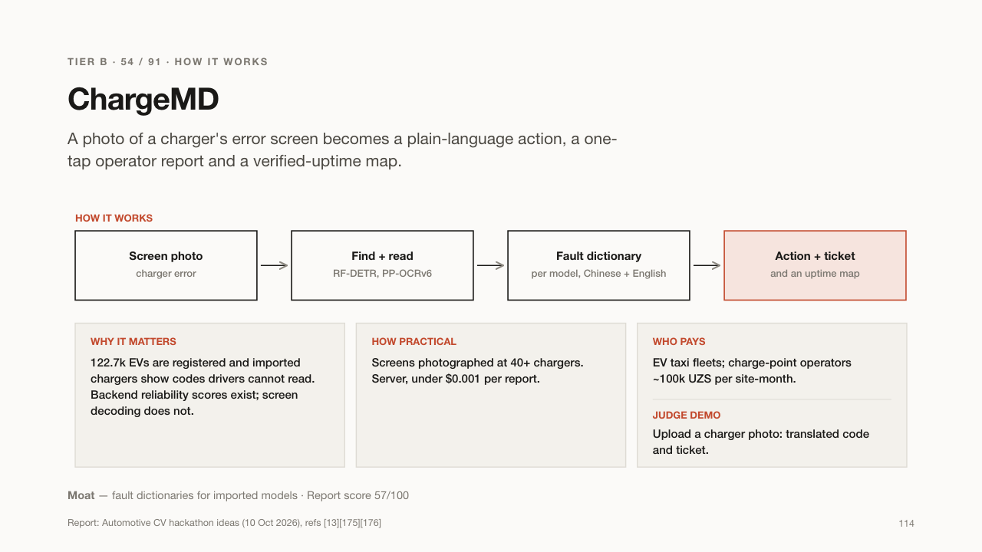

Slide 115
TIER B · 55 / 91 · LENDERS & IMPORT YARDS
YardAudit
Counts and checks a dealer's cars against the bank's list, from a walk-around video.
WHAT IT DOES
USE CASES
– A bank audits a dealer's stock in 10 minutes
– An import yard tracks cars without plates
– A lender spots missing cars early
WHO BUYS IT
Banks and leasing firms that lend to dealers, and import yards.
Banks lend money to dealers against the cars in their yard. The bank's agent walks the yard filming; YardAudit reads every plate and VIN and compares them with the pledged list to find missing cars.
WHY IT MATTERS
If a dealer sells pledged cars without telling the bank, the loan loses its security. Counting by hand is slow and error-prone.
Report: Automotive CV hackathon ideas (10 Oct 2026), refs [180][193]
115

Slide 116
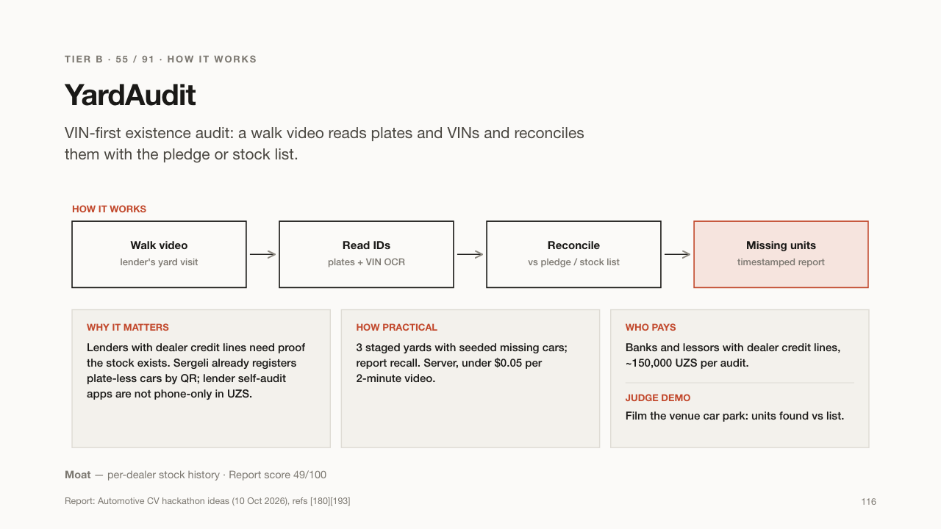

Slide 117
TIER C · 36 IDEAS
Great demo, hard investor case
City hall is the only payer, the ticket is too small, or it is a feature of a bigger product.
117

Slide 118
TIER C · 56 / 91 · CITY HALL: ECOLOGY
PlumeWatch
Spots trucks blowing black smoke or driving with uncovered loads, from road cameras.
WHAT IT DOES
USE CASES
– An ecology inspector targets the dirtiest trucks
– The smog commission tracks repairs
– A city measures progress against smog
WHO BUYS IT
The city's ecology committee and smog commission.
Existing roadside cameras watch passing trucks. PlumeWatch grades how dark each truck's exhaust smoke is, checks whether loads are covered, reads the plate, and keeps a list of repeat offenders for inspectors to send for repair.
WHY IT MATTERS
Vehicles cause about 16% of Tashkent's air pollution, and the city has a smog commission. Fixing the worst trucks gives the biggest gain.
Report: Automotive CV hackathon ideas (10 Oct 2026), refs [140][141][142][143]
118

Slide 119


Slide 120
TIER C · 57 / 91 · CITY HALL: ROAD SAFETY
SightTriangle
Checks whether drivers can really see pedestrians at a crossing, from a phone video.
WHAT IT DOES
USE CASES
– An auditor checks new AI-camera crossings
– A city decides which kiosk to move
– A school asks for a safer crossing
WHO BUYS IT
Road-safety audit consultants, often on development-bank projects.
An auditor stands at the stop line and slowly pans a phone across the junction. SightTriangle finds what blocks the view, like kiosks or parked cars, and says whether a driver can see far enough to stop in time at that speed.
WHY IT MATTERS
A crossing is only safe if drivers can see who is about to cross. Blocked views cause crashes that cameras and fines don't prevent.
Report: Automotive CV hackathon ideas (10 Oct 2026), refs [123][148]
120

Slide 121


Slide 122
TIER C · 58 / 91 · CITY HALL: ROADS
SwerveMap
Finds potholes and road hazards by watching how drivers swerve around them.
WHAT IT DOES
USE CASES
– The road agency gets a ranked repair list
– A city finds dangerous spots early
– An insurer sees accident-prone points
WHO BUYS IT
The road agency and city hall.
Fixed traffic cameras already film every road. SwerveMap tracks the cars, and when many drivers swerve at the same spot, it marks a hazard, like a pothole, open manhole or gravel, and ranks spots for repair.
WHY IT MATTERS
Tashkent's Safe City system has 42,750 cameras but no one watches for road damage. Drivers' behaviour reveals hazards without anyone labelling potholes.
Report: Automotive CV hackathon ideas (10 Oct 2026), refs [149][150]
122

Slide 123


Slide 124
TIER C · 59 / 91 · CITY HALL
ForcedOnRoad
Maps sidewalks too narrow or blocked, forcing pedestrians into traffic.
WHAT IT DOES
USE CASES
– A city decides where to place bollards
– The parking operator moves bays off sidewalks
– Activists document unsafe streets
WHO BUYS IT
City hall and the city's parking operator.
Someone walks a street filming the sidewalk. ForcedOnRoad measures the free width and finds where parked cars or kiosks leave less than 1.2 m, so pedestrians must step onto the road. It ranks blocks by danger.
WHY IT MATTERS
Pedestrians are involved in about 46% of crashes. Knowing exactly where to put bollards or move parking saves lives cheaply.
Report: Automotive CV hackathon ideas (10 Oct 2026), refs [124][151][152]
124

Slide 125


Slide 126
TIER C · 60 / 91 · CITY UTILITIES
Rain-Ready
Finds blocked storm drains before a big rain, so streets don't flood.
WHAT IT DOES
USE CASES
– A district cleans the worst drains before a storm
– Fleets get warnings about flooded underpasses
– A city tracks drain upkeep
WHO BUYS IT
District administrations and storm-water utilities.
Cameras on buses and city vehicles photograph storm drains as they drive. Rain-Ready grades how clogged each drain is and, before a forecast storm, gives the district a cleaning list starting with the lowest, most flood-prone streets.
WHY IT MATTERS
Clogged drains flood streets and underpasses, stranding cars. Cleaning the right drains before the rain is far cheaper than dealing with floods.
Report: Automotive CV hackathon ideas (10 Oct 2026), refs [153][154]
126

Slide 127


Slide 128
TIER C · 61 / 91 · CITY HALL & DONORS
SchoolGate
Measures how dangerous a school's drop-off zone is, in a 10-minute phone video.
WHAT IT DOES
USE CASES
– A school shows the city its danger hotspots
– A city measures a new crossing's effect
– Parents push for changes with real data
WHO BUYS IT
City hall, school-safety programmes and donors.
A phone propped near the school gate records pickup time. SchoolGate counts double-parked cars, blocked crossings, U-turns and drivers who don't stop for children, then sends a one-page report with three fixes.
WHY IT MATTERS
Children are hard for drivers to see, and school zones get chaotic. Numbers before and after a change show what really works.
Report: Automotive CV hackathon ideas (10 Oct 2026), refs [155][156]
128

Slide 129


Slide 130
TIER C · 62 / 91 · CITY CAPITAL WORKS
OverpassIgnored
Shows whether people actually use pedestrian bridges, or still cross the road below.
WHAT IT DOES
USE CASES
– A city decides where to add fences or crossings
– Auditors check a bridge's value
– Planners choose better designs
WHO BUYS IT
City capital-works departments and auditors.
A camera films a pedestrian bridge or underpass. OverpassIgnored follows the people and counts who uses the stairs and who crosses at street level, and where they climb fences, showing whether the investment works.
WHY IT MATTERS
Cities spend a lot on pedestrian bridges that many people avoid. Studies found usage anywhere from 11.6% to 93.7%.
Report: Automotive CV hackathon ideas (10 Oct 2026), refs [157][158][159]
130

Slide 131


Slide 132
TIER C · 63 / 91 · CITY INSPECTORS
Ruxsat
Audits EV charging sites against the regulator's checklist, from a phone video.
WHAT IT DOES
USE CASES
– An operator self-checks all sites before an audit
– An inspector audits faster
– A new site launches without paperwork surprises
WHO BUYS IT
City inspection teams and charging operators.
An inspector films the charging site. Ruxsat reads the charger nameplates, finds the meter and the official verification marks, and checks everything against the rules, giving a pass, a fix-list or a hold.
WHY IT MATTERS
In March 2026, 101 Tashkent chargers were cut off over paperwork, and regular audits are planned. Operators want to pass before inspectors come.
Report: Automotive CV hackathon ideas (10 Oct 2026), refs [115][160][161]
132

Slide 133


Slide 134
TIER C · 64 / 91 · CITY UTILITIES
SunkenLid
Finds open, broken or sunken manhole covers and alerts the right utility.
WHAT IT DOES
USE CASES
– A water utility gets a list of its broken covers
– A citizen reports a dangerous hole in one photo
– A district audits its streets
WHO BUYS IT
City hall and the utilities that own the covers.
Dashcams or citizens' phones photograph the street. SunkenLid finds manhole covers, decides if each is flush, sunken, broken or open, and sends a ticket to the utility that owns it.
WHY IT MATTERS
Open or broken covers injure pedestrians and damage cars, especially at night. Several utilities own covers, so problems sit unreported.
Report: Automotive CV hackathon ideas (10 Oct 2026), refs [153][162]
134

Slide 135


Slide 136
TIER C · 65 / 91 · ROAD & EMERGENCY AGENCIES
DustVis
Turns existing road webcams into fog and dust-storm warning sensors.
WHAT IT DOES
USE CASES
– A highway authority warns drivers on electronic signs
– Emergency services prepare for bad visibility
– Fleets delay trips through dust storms
WHO BUYS IT
The road agency and the emergency ministry.
DustVis looks at fixed objects in each webcam image, like poles and buildings at known distances. The haze over them shows how far drivers can see, so it posts fog and dust-storm alerts when visibility drops.
WHY IT MATTERS
Low visibility causes chain crashes on highways. In January 2026, fog cut visibility to 50-100 m and diverted 26 flights.
Report: Automotive CV hackathon ideas (10 Oct 2026), refs [163][164][165]
136

Slide 137


Slide 138
TIER C · 66 / 91 · TRAFFIC CENTRE
GhostWorks
Checks whether road works actually happen during the hours a lane is closed.
WHAT IT DOES
USE CASES
– The traffic centre checks contractors' real working hours
– A city fines idle closures
– Contractors get a fair record of their work
WHO BUYS IT
The city traffic centre and city hall.
A camera films a road-work zone through the day. GhostWorks measures how much of the road is closed and whether workers and machines are actually working, then compares that with the permitted hours.
WHY IT MATTERS
Closed lanes with nobody working cause needless traffic jams. Tashkent is repairing 36 km of road in 2026.
Report: Automotive CV hackathon ideas (10 Oct 2026), refs [166][167]
138

Slide 139


Slide 140
TIER C · 67 / 91 · AUDITORS
PatchLedger
Proves a road repair was really done, using street photos from before and after.
WHAT IT DOES
USE CASES
– An auditor checks repairs before paying a contractor
– An anti-corruption body tracks road spending
– A city verifies its repair map
WHO BUYS IT
Audit and anti-corruption bodies.
Street-level photos from past years are compared with a new drive. PatchLedger finds where a patch exists now that did not before, and records it with time and place so it can't be faked.
WHY IT MATTERS
Road repairs are sometimes paid for but never done. Auditors found signs of collusion in 200 road-testing tenders in Karakalpakstan.
Report: Automotive CV hackathon ideas (10 Oct 2026), refs [153][168][169]
140

Slide 141


Slide 142
TIER C · 68 / 91 · CITY HALL
StopCount
Independently checks whether "green-wave" traffic lights really cut stops.
WHAT IT DOES
USE CASES
– City leaders verify a contractor's claims
– A lender checks a funded project's results
– Engineers tune signals with real data
WHO BUYS IT
City hall, and lenders' verification agents.
Cameras or dashcam runs along a corridor record traffic. StopCount measures how many cars arrive on green, how often they stop and how long trips take, before and after a signal change.
WHY IT MATTERS
Cities announce big gains from smarter traffic lights without showing a method. One avenue claimed 29% less travel time with no evidence.
Report: Automotive CV hackathon ideas (10 Oct 2026), refs [170][171]
142

Slide 143


Slide 144
TIER C · 69 / 91 · SIGNAL-TIMING PROGRAMMES
FineFirewall
Checks whether a traffic light's yellow is long enough, before drivers are fined.
WHAT IT DOES
USE CASES
– A city fixes signals that trap drivers
– A fleet challenges unfair fines
– A signal programme proves its timing is fair
WHO BUYS IT
Signal-timing programmes and fleets.
A video of the junction is enough. FineFirewall measures the yellow light's duration, how fast cars approach, and how many drivers are caught in the zone where they can neither stop nor pass safely.
WHY IT MATTERS
A yellow just one second longer cut violations by 36% in one study. Fines from a short yellow are unfair and don't improve safety.
Report: Automotive CV hackathon ideas (10 Oct 2026), refs [187][188][189]
144

Slide 145


Slide 146
TIER C · 70 / 91 · EMERGENCY SERVICES
BumpRegistry
Maps speed bumps and flags ones that are illegal or dangerous.
WHAT IT DOES
USE CASES
– Ambulances get routes with fewer bumps
– A district removes illegal bumps
– Taxi fleets avoid damaging streets
WHO BUYS IT
Emergency services or a district; taxi fleets for routing.
As vehicles drive, dashcams and phones record every speed bump: where it is, its spacing, signs, markings and lighting, plus a rough height from the phone's motion sensor. BumpRegistry builds a map and a list of bumps to fix or remove.
WHY IT MATTERS
Homemade bumps damage cars and slow ambulances; one 426 m street in Bukhara has 10 bumps. No one keeps a full register.
Report: Automotive CV hackathon ideas (10 Oct 2026), refs [183][184]
146

Slide 147


Slide 148
TIER C · 71 / 91 · HOUSING ASSOCIATIONS
Lane Clear
Checks whether a fire truck can get through a courtyard full of parked cars.
WHAT IT DOES
USE CASES
– A housing association decides where to ban parking
– The fire service audits courtyards
– Residents show the problem with real numbers
WHO BUYS IT
Housing associations, mahalla committees and the fire service.
Someone walks through the courtyard filming with a phone. Lane Clear builds a 3D map, finds the narrow spots under 3.5 m, and shows which parked cars or bays block a fire truck.
WHY IT MATTERS
In apartment courtyards, parked cars often block the way for fire trucks and ambulances. In a fire, minutes lost can cost lives.
Report: Automotive CV hackathon ideas (10 Oct 2026), refs [137][138][139]
148

Slide 149


Slide 150
TIER C · 72 / 91 · DETAILING STUDIOS
Bead-Check
Measures how well a car's protective coating still repels water.
WHAT IT DOES
USE CASES
– A detailer gives customers a coating certificate
– A studio reminds customers when to re-coat
– A dealer backs a paint-protection warranty
WHO BUYS IT
Detailing studios and dealers' paint programmes.
A water drop is placed on the paint and filmed from the side. Bead-Check measures the drop's angle: a high angle means the coating still works. Repeat checks show when the car needs re-coating.
WHY IT MATTERS
Detailers sell expensive ceramic coatings but can't prove how they last. A lab device costs $4,990; this uses a phone.
Report: Automotive CV hackathon ideas (10 Oct 2026), refs [70][71]
150

Slide 151


Slide 152
TIER C · 73 / 91 · PDR & INSPECTORS
Dent-Lines
Finds small dents and repainted areas using light stripes from a laptop screen.
WHAT IT DOES
USE CASES
– A buyer finds hidden filler in a door
– A dent technician quotes accurately
– An inspector documents panel condition
WHO BUYS IT
Car inspectors and paintless-dent-repair technicians.
A laptop shows black-and-white stripes that reflect in the car's glossy paint. Where the panel is dented or filled, the stripes bend. Dent-Lines measures the bending and maps the problem area.
WHY IT MATTERS
Small dents and filler hide past damage, and dent-repair technicians quote by eye. A phone and laptop replace expensive scanning tunnels.
Report: Automotive CV hackathon ideas (10 Oct 2026), refs [86][87]
152

Slide 153


Slide 154
TIER C · 74 / 91 · TAXI PARKS
WearMap
Tracks tyre wear on taxi cars every month to catch alignment problems.
WHAT IT DOES
USE CASES
– A taxi park schedules alignment only when needed
– A fleet cuts tyre spending
– An alignment shop gets regular customers
WHO BUYS IT
Taxi parks and alignment shops.
Each month the depot photographs all four tyres of each car with a coin for scale. WearMap measures how each tyre wears and flags uneven wear that means the wheels need alignment.
WHY IT MATTERS
Bad alignment eats tyres fast. Tyre apps already exist, so the fleet-level history is what is new; this is a low-priority idea.
Report: Automotive CV hackathon ideas (10 Oct 2026), refs [88][89]
154

Slide 155


Slide 156
TIER C · 75 / 91 · RESTORATION SHOPS
BeamAim
Checks if headlights are cloudy or aimed wrong, from a photo of their beam on a wall.
WHAT IT DOES
USE CASES
– A restoration shop shows customers the problem
– A tyre shop adds a quick light check
– A driver checks lights before a trip
WHO BUYS IT
Headlight restoration and tyre shops.
Park facing a wall and switch on the lights. BeamAim checks if the beam's cut-off line is too high or too low, and grades how cloudy the lenses are, suggesting adjustment or restoration.
WHY IT MATTERS
Headlights aimed too high blind oncoming drivers; one study found 75% of vehicles mis-aimed. Cloudy lenses make night driving darker.
Report: Automotive CV hackathon ideas (10 Oct 2026), refs [90][91]
156

Slide 157


Slide 158
TIER C · 76 / 91 · CNG-CONVERSION SHOPS
PlugLens
Reads a used spark plug's condition from a close-up photo.
WHAT IT DOES
USE CASES
– A conversion shop documents engine health
– A mechanic orders the right plugs
– A fleet tracks plug wear on gas cars
WHO BUYS IT
Gas-conversion shops and independent mechanics.
The mechanic photographs a removed spark plug. PlugLens measures the gap, classifies the deposits that show how the engine runs, and prints a job card with a re-order button.
WHY IT MATTERS
Gas-converted engines wear plugs differently than petrol ones, but mechanics read plugs by eye. This is a low-priority idea.
Report: Automotive CV hackathon ideas (10 Oct 2026), refs [82][83]
158

Slide 159


Slide 160
TIER C · 77 / 91 · PASSENGER CARRIERS
KitCheck
Checks a vehicle's safety kit: fire extinguisher, first-aid kit and warning triangle.
WHAT IT DOES
USE CASES
– A bus company keeps every vehicle's kit valid
– A driver gets a reminder before inspection
– A fleet manager sees kit status at a glance
WHO BUYS IT
Passenger carriers, bundled with ShiftGate.
The driver photographs the kit. KitCheck finds each item, reads the extinguisher's pressure gauge and the expiry dates, and sends Telegram reminders before anything expires.
WHY IT MATTERS
Expired extinguishers fail when needed, and passenger carriers are inspected. Reading expiry dates automatically is the hard, useful part.
Report: Automotive CV hackathon ideas (10 Oct 2026), refs [131][132]
160

Slide 161


Slide 162
TIER C · 78 / 91 · NIGHT-SHIFT EMPLOYERS
Seen-at-Night
Tests whether workers' high-visibility clothing still reflects light.
WHAT IT DOES
USE CASES
– A road crew checks its vests every month
– A courier company replaces worn jackets
– A cleaning contractor proves workers are visible
WHO BUYS IT
Employers of night-shift road workers, cleaners and couriers.
Take two photos of the vest or jacket, with and without flash. Seen-at-Night compares how strongly the reflective stripes shine against a reference swatch, and flags clothing that is worn out after many washes.
WHY IT MATTERS
Washed-out hi-vis looks fine by day but disappears in headlights. In one study, vests without good stripes were no better than black clothing.
Report: Automotive CV hackathon ideas (10 Oct 2026), refs [129][130]
162

Slide 163


Slide 164
TIER C · 79 / 91 · DELIVERY PLATFORMS
RideCoach
Coaches couriers on safe riding using their own phone's camera.
WHAT IT DOES
USE CASES
– A delivery platform rewards safe couriers
– A courier learns their risky habits
– A platform cuts fines and crashes
WHO BUYS IT
Delivery platforms.
With the phone on the handlebar, RideCoach checks lights and plate at shift start, then watches for red lights and stop lines during the ride. Couriers get a weekly score and bonuses for safe riding.
WHY IT MATTERS
Most courier fines are for lights, reflectors and passengers, and red-light running causes crashes. Other systems need extra hardware.
Report: Automotive CV hackathon ideas (10 Oct 2026), refs [16][120]
164

Slide 165


Slide 166
TIER C · 80 / 91 · BATTERY RETAILERS
No-Start Doctor
Tests a car battery with a phone video of the headlights during engine start.
WHAT IT DOES
USE CASES
– A battery shop finds customers who need a new battery
– A taxi park checks batteries before winter
– A driver avoids a no-start morning
WHO BUYS IT
Battery retailers and taxi parks.
Switch on the headlights and film them while starting the engine. As the battery strains, the lights dim; No-Start Doctor measures the dimming, estimates the battery voltage and warns if it will fail in winter.
WHY IT MATTERS
Weak batteries leave drivers stranded on cold mornings. Testers need hardware; this needs only a phone. It doesn't work with LED headlights.
Report: Automotive CV hackathon ideas (10 Oct 2026), refs [105][106][107]
166

Slide 167


Slide 168
TIER C · 81 / 91 · CORRIDOR TRUCKING
CouplingCheck
Checks that a truck and its trailer are coupled correctly before departure.
WHAT IT DOES
USE CASES
– A trucking company logs every departure check
– A cargo insurer requires proof
– A driver catches a missed connection
WHO BUYS IT
Cargo insurers and freight companies on the China-Uzbekistan corridor.
The driver films the coupling area from the side for 10 seconds. CouplingCheck confirms the air hoses and electric plug are connected, the support legs are up and the latch is closed, and saves a signed log.
WHY IT MATTERS
A badly coupled trailer can detach on the road and cause a deadly crash. Today checks rely on memory or costly sensors.
Report: Automotive CV hackathon ideas (10 Oct 2026), refs [135][136]
168

Slide 169


Slide 170
TIER C · 82 / 91 · PARKING OPERATORS
ShadeRent
Maps which parking spots stay in the shade, and for how long.
WHAT IT DOES
USE CASES
– A parking operator charges more for shaded bays
– An installer plans solar carports
– A mall decides where to add shade
WHO BUYS IT
Parking operators and canopy or solar installers.
A phone fixed above a parking lot takes a photo every 15-30 minutes. ShadeRent marks shaded bays and calculates shade hours per spot, showing where to build canopies, solar carports or chargers.
WHY IT MATTERS
In hot Uzbek summers, shaded spots are worth more and cars stay cooler. The airport lot alone holds about 1,500 vehicles.
Report: Automotive CV hackathon ideas (10 Oct 2026), refs [190][191]
170

Slide 171


Slide 172
TIER C · 83 / 91 · COURIER & TAXI FLEETS
ParkOK
Tells a driver whether stopping here is legal, from one photo of the street.
WHAT IT DOES
USE CASES
– A courier checks a stop before parking
– A fleet cuts its parking fines
– A parking operator licenses the rules data
WHO BUYS IT
Courier and taxi fleets.
The driver photographs the kerb ahead. ParkOK reads the signs, markings and paid-parking zone and time windows, and answers green, amber or red, quoting the rule and the fine.
WHY IT MATTERS
Stopping where it is banned costs 880,000 UZS. Courier and taxi drivers stop dozens of times a day and can't read every sign.
Report: Automotive CV hackathon ideas (10 Oct 2026), refs [101][185][186]
172

Slide 173


Slide 174
TIER C · 84 / 91 · CHARGER DISTRIBUTORS
Joylash
Shows a building owner where EV chargers would earn money, from their own cameras.
WHAT IT DOES
USE CASES
– A mall picks the best bays for chargers
– A charger seller qualifies leads
– A hotel builds a business case for charging
WHO BUYS IT
Charger sellers and installers (success fee).
Joylash watches the venue's parking camera, measures how long cars stay in each bay and how many are electric, and calculates how fast a charger in each spot would pay for itself.
WHY IT MATTERS
Owners don't know if a charger will pay off, so they don't install one. Banks already offer 10% loans for chargers.
Report: Automotive CV hackathon ideas (10 Oct 2026), refs [177][178][179]
174

Slide 175


Slide 176
TIER C · 85 / 91 · DEALER & IMPORT YARDS
Yard Tetris
Finds any car in a crowded dealer yard and plans the fewest moves to get it out.
WHAT IT DOES
USE CASES
– A dealer finds a customer's car in seconds
– A yard manager sees old stock
– Staff move fewer cars per delivery
WHO BUYS IT
Car dealers and import yards.
A camera on the roof photographs the yard every few minutes. Yard Tetris knows where each car is, how long it has stood there and which cars block it, and plans the shortest sequence of moves to free it.
WHY IT MATTERS
In big yards, staff waste time searching for cars and shuffling others out of the way, and stock stands longer when sales slow.
Report: Automotive CV hackathon ideas (10 Oct 2026), refs [50][121]
176

Slide 177


Slide 178
TIER C · 86 / 91 · INTERCITY FLEETS
DarkRoad
Warns night drivers about carts, tractors and animals on rural roads.
WHAT IT DOES
USE CASES
– An intercity bus company warns drivers
– A trucking firm plans safer night routes
– An insurer prices route risk
WHO BUYS IT
Intercity bus and trucking fleets; insurers buy risk reports.
Fleet dashcams record rural routes during the day and at dusk. DarkRoad finds slow carts, tractors and livestock on the roadside, maps where they usually are, and warns drivers on night trips through those spots.
WHY IT MATTERS
Unlit slow vehicles and animals cause deadly night crashes. Some regions ban heavy trucks by day, pushing them into night driving.
Report: Automotive CV hackathon ideas (10 Oct 2026), refs [118][119]
178

Slide 179


Slide 180
TIER C · 87 / 91 · QUARRIES & DEVELOPERS
LoadGate
Checks a truck's load size and cover at the site exit before it hits the road.
WHAT IT DOES
USE CASES
– A quarry sends out only legal loads
– A developer keeps proof for smog inspectors
– A haulier avoids fines
WHO BUYS IT
Quarries and construction developers.
At the quarry or building site exit, two photos are taken from the side and back. LoadGate measures how far the load sticks out and how high it is, compares that with the legal limit, and checks the load is covered.
WHY IT MATTERS
Overhanging and uncovered loads cause crashes and dust. The exact Uzbek overhang limit still needs to be confirmed before use.
Report: Automotive CV hackathon ideas (10 Oct 2026), refs [112]
180

Slide 181


Slide 182
TIER C · 88 / 91 · INSPECTORS & DEALERS
WeldTell
Tells factory welds from repair welds in photos, to reveal hidden body repairs.
WHAT IT DOES
USE CASES
– An inspector checks the door frame for repair welds
– A dealer screens trade-ins for major crashes
– A buyer avoids a rebuilt car
WHO BUYS IT
Car inspectors and dealers.
The inspector photographs one standard spot, such as the door frame. WeldTell compares the welds and sealant with factory-original examples of the same model and highlights areas that look like repair work for a person to check.
WHY IT MATTERS
Structural repairs after a serious crash are often hidden, and they make a car less safe. Only experts can spot them today.
Report: Automotive CV hackathon ideas (10 Oct 2026), refs [52][53]
182

Slide 183


Slide 184
TIER C · 89 / 91 · DEALERS & TRADE-IN
DateCode Detective
Reads the date stamps on glass, belts and tyres to show which parts were replaced.
WHAT IT DOES
USE CASES
– A seller proves all glass is original
– A buyer finds a replaced windscreen
– A dealer adds an originality certificate
WHO BUYS IT
Dealers and trade-in desks.
Every car window, seatbelt and tyre carries a small production date. DateCode Detective reads these stamps from photos and compares them with the car's build year; a part much newer than the car was probably replaced.
WHY IT MATTERS
A replaced windscreen or belt can mean a past accident. Sellers can prove originality, and buyers can spot hidden history.
Report: Automotive CV hackathon ideas (10 Oct 2026), refs [54][55]
184

Slide 185


Slide 186
TIER C · 90 / 91 · INSPECTORS & TRADE-IN
RepaintRadar
Shows which car panels were repainted, so inspectors know where to measure.
WHAT IT DOES
USE CASES
– An inspector checks the right panels first
– A buyer screens a car before inspection
– A trade-in desk prices repainted cars fairly
WHO BUYS IT
Car inspectors, trade-in desks and buyers.
Sweep a phone torch over each panel for 20 seconds. RepaintRadar compares the paint's texture and colour with neighbouring panels and ranks the three panels most likely repainted, for checking with a paint gauge.
WHY IT MATTERS
Repaint usually hides damage. In one study, about 38% of 15,236 cars had unrecorded repairs.
Report: Automotive CV hackathon ideas (10 Oct 2026), refs [56][57]
186

Slide 187


Slide 188
TIER C · 91 / 91 · TAXI PARKS & INSURERS
Podstava Radar
Measures braking in dashcam video to help settle staged rear-end crashes.
WHAT IT DOES
USE CASES
– A taxi park defends a driver in a dispute
– An insurer reviews a suspicious rear-end claim
– A driver shows the car ahead braked without reason
WHO BUYS IT
Taxi parks and insurers.
Before a rear-end crash, the dashcam shows how the car in front behaved. Podstava Radar measures the distance, when the brake lights came on and how fast the gap closed, and builds a timeline. It reports facts only, not who is guilty.
WHY IT MATTERS
In staged crashes ("podstava"), a car brakes suddenly so you hit it. Clear measurements help taxi drivers and insurers settle such disputes.
Report: Automotive CV hackathon ideas (10 Oct 2026), refs [65]
188

Slide 189


Slide 190
PITCHING TO INVESTORS
How to pitch any of these
Lead with the money: who pays, how much, how often.
Put revenue math on one slide; cost per inspection is $0.0003–0.01, so gross margin can top 90%. Name a design partner in the room (MKBANK, Uzcard, BYD Royal Motors, the Central Bank). Show the path from one module to a platform and the next two markets.
Report: shared build kit and hackathon intel
190

Slide 191
BEFORE YOU QUOTE A NUMBER
What is still unverified
Every price is an estimate; no customer has confirmed they would pay.
Some facts rest on one weak source: the UZS rate, "1,700 fines in 3 days", Cobalt's 30.1% share. No source was found for the helmet rule, truck overhang limit, minimum yellow time or a CNG passenger-exit rule. Phone-browser speeds are unmeasured.
Report writer's caveats, 10 Oct 2026
191

