Slide 1

Velvetone
Frames for Every Home
Introducing Velvetone, a digital platform dedicated to providing
high- quality , decorative picture frames for your home and office .

Slide 2
Introducing Velvetone
Velvetone Platform
Mission
Velvetone is an e-commerce website that provides a seamless shopping experience for purchasing a wide range of frames.
Our mission is to offer customers a curated selection of high-quality decorative frames with easy-to-use website navigation and functionality.

Slide 3
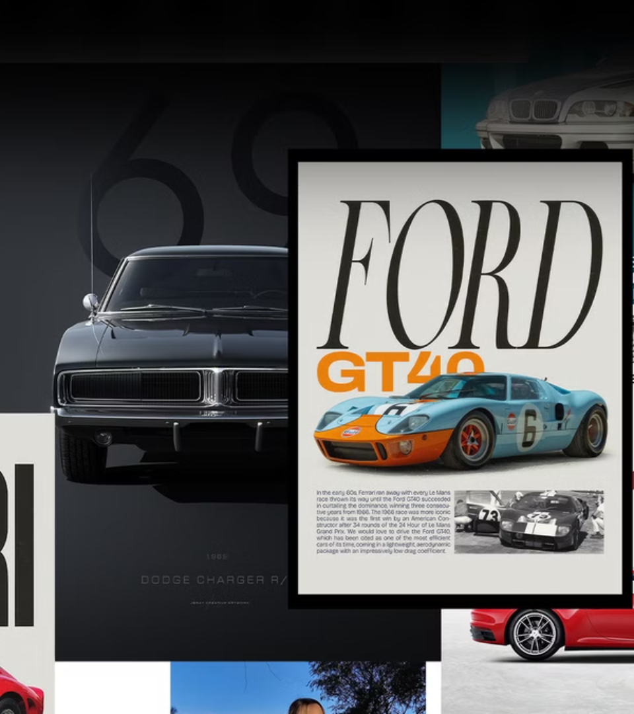
Motivation:
Why Frames?
Rising Demand
Frames have become increasingly popular in home decor, offering a way to personalize and elevate spaces.
Functionality and Aesthetics
Frames not only protect precious memories but also add a touch of elegance to any space.

Slide 4
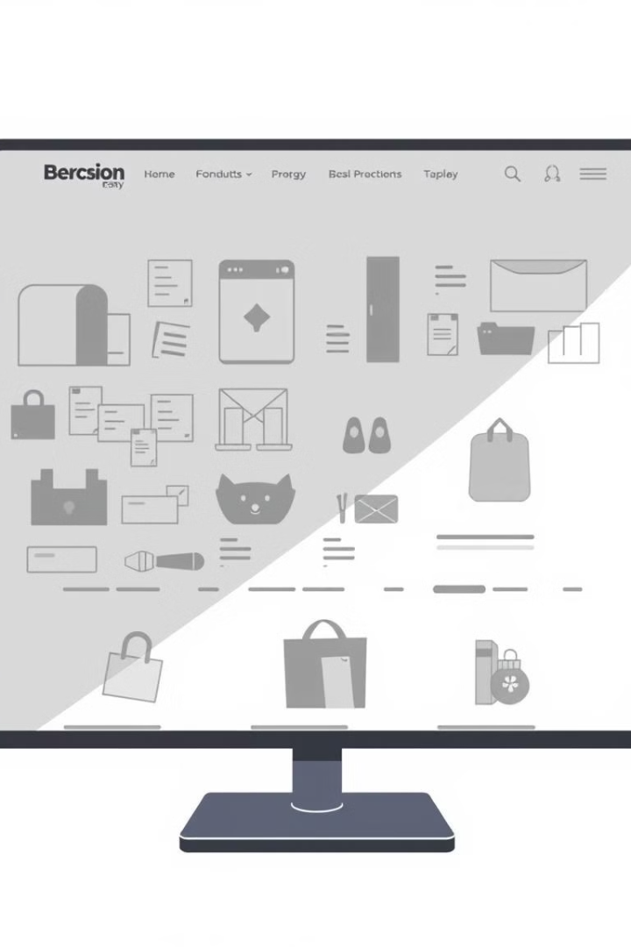
Problem Statement
Lack of Dedicated Platforms
Need for a Focused Site
There is a lack of dedicated e-commerce sites specializing in frames with a focus on user-friendly design and functionality.
There is a need for a platform that combines the aesthetic appeal of frames with an easy-to-use and intuitive shopping experience.

Slide 5




Target Market
Home Decor Enthusiasts
Artists and Photographers
Businesses and Offices
Individuals who enjoy decorating their homes with stylish and personalized accents.
Professionals and hobbyists seeking custom framing solutions for their artwork and photography.
Organizations requiring professional and aesthetically pleasing display solutions for their spaces.

Slide 6

Website Functionality
1
Responsive Design
The website is optimized for all devices, ensuring a smooth and seamless experience for all users.
2
Detailed Product Information
Each product page includes detailed descriptions, specifications, and high-resolution images of the frames.
3
Secure Checkout
Velvetone utilizes secure payment gateways to protect sensitive customer information and ensure safe transactions.

Slide 7



Theme Selection Criteria
Neutral Tones
1
A sophisticated and timeless color palette to complement the frames.
Sleek Typography
2
A modern and easily readable font that enhances the user experience.
Clean Interface
3
A simple and intuitive design that prioritizes usability and aesthetics.

Slide 8
Website Responsiveness
Desktop Optimization
1
The site is designed to be user-friendly and visually appealing on larger screens.
Tablet Adaptation
2
The layout adjusts seamlessly for tablet users, providing an optimized viewing experience.
Mobile Responsiveness
3
The website adapts to smaller screens, ensuring easy navigation and product browsing on mobile devices.

Slide 9

Future Development
Backend Integration
Implementing a robust backend system for managing product inventory, orders, and customer data.
Real-Time Payment
Integrating real-time payment gateways for seamless and secure transactions.
Product Expansion
Adding new product categories and customization options to expand product offerings.

Slide 10

Conclusion
"Velvetone is not just a website; it's a gateway to preserving memories and enhancing spaces with style and convenience."

