Slide 1
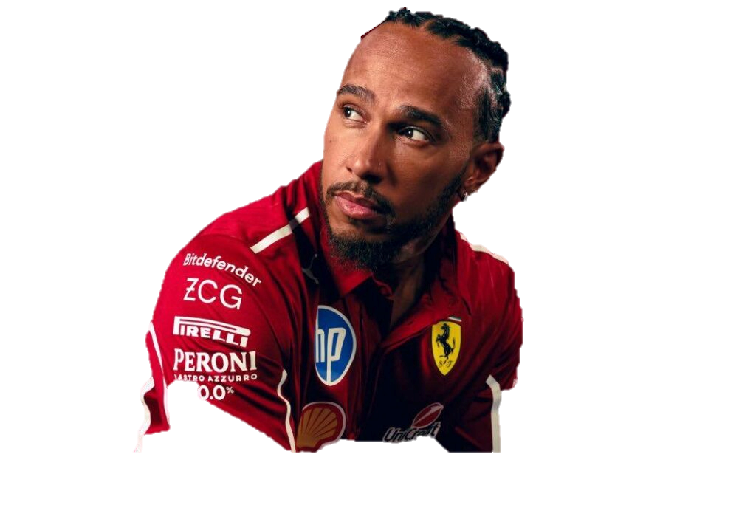
LEWIS HAMILTON

