Slide 1
Shoo: detection layers 1–5
How a page gets its score, and how Guardians feed back into the blocklist
L1–L2 · On the iPhone
L3–L4 · On the server
L5 · Guardian + admin
Notes:
Shoo checks every page in five layers. Layers 1 and 2 run on the iPhone with no network call. Layers 3 and 4 run on our server. Layer 5 is different: it adds no score, it is the Guardian's answer and the admin's decision.

Slide 2
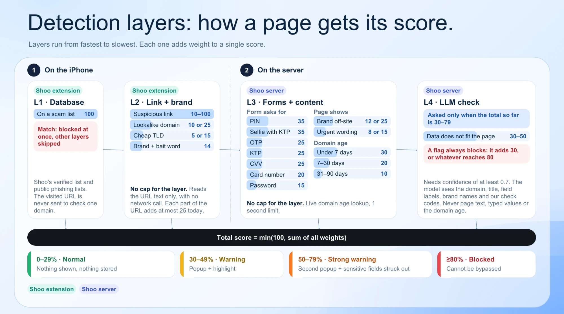
Notes:
Layers run from fastest to slowest and each adds weight to one score, capped at 100. A blocklist match is 100 at once. The LLM is only asked when the total so far is 30 to 79, and a flag from it always blocks.

Slide 3
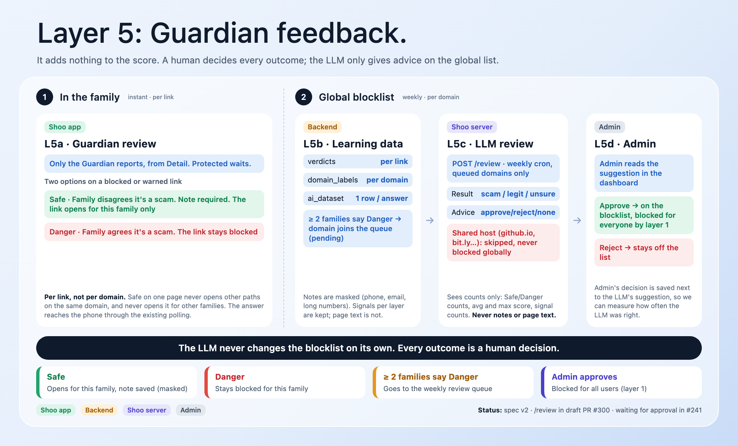
Notes:
Layer 5 adds nothing to the score. In the family it is instant and per link. For the global list it is weekly and per domain: two or more families saying Danger put the domain in the queue, the LLM gives advice, and the admin decides. The LLM never changes the blocklist on its own.

Slide 4
The Guardian has two options
Only the Guardian answers, from Detail in the app. The protected person waits.
Safe
Danger
Family disagrees it’s a scam
Family agrees it’s a scam
The link opens again for this family only
A note is required: why it is safe
Other paths on the same domain stay blocked
Other families are not affected
The link stays blocked
No note needed
Counts toward the global list
2+ families saying Danger send the domain to admin review
Notes:
Two options only. Safe means the family does not agree it is a scam; they must write why, and the link opens for their family only. Danger means they agree; the link stays blocked and their answer counts toward the global blocklist.

Slide 5
verdicts vs ai_dataset
Both hold Guardian answers. One drives the app, the other is what the AI team learns from.
 | public.verdicts | admin.ai_dataset
Purpose | Decide this link for this family | Training and evaluation data
One row is | One answer: one link, one family | One answer plus the scan behind it
Holds | owner_id, url, domain, value (safe / not_safe), notes | url, domain, RDAP age, layer 1–4 signals and scores, is_scam, domain summary, LLM advice, admin decision
Note | Original text | Masked: phone, email, long numbers
Page text | Never stored | Never stored, only each layer’s result
Lifetime | Deleted with the device or family link | Permanent, anonymised when the device is removed
Read by | Extension and app | AI team (read-only role) and admin
Notes:
verdicts is live app data: one row per link per family, and it disappears with the family. ai_dataset is the learning archive: one row per answer joined with that scan's layer results, notes masked, kept permanently but anonymised.

Slide 6
From one answer to the global list
Every answer is stored for learning. Only admin can add a domain to the blocklist.
Every answer · instant
Guardian answers
Safe or Danger, in Detail
→
public.verdicts
Per link, per family. The extension reads it
→
admin.domain_labels
Per domain, copied by the on_verdict trigger
→
admin.ai_dataset
1 row per answer, with that scan’s layer results
Global list · weekly
2+ families say Danger
Domain joins the blocklist queue (pending)
→
POST /review
LLM advice from counts only. Shared hosts skipped
→
Admin decides
Approve or reject in the dashboard
→
Blocked for everyone
On approval, layer 1 blocks it for all users
Status: spec v2. verdicts exists but is still per domain; per link, notes and ai_dataset are not built yet. /review is in draft PR #300, waiting for approval in #241.
Notes:
Top row happens on every answer. Bottom row runs weekly for the global list. The LLM only gives advice; the admin's decision is stored next to it so we can measure how often the LLM was right.

