Slide 1

Fresh Supplies
Less waste. More recovered income. Better decisions.
Board Pitch | Week 11 | Amos Ndungo

Slide 2


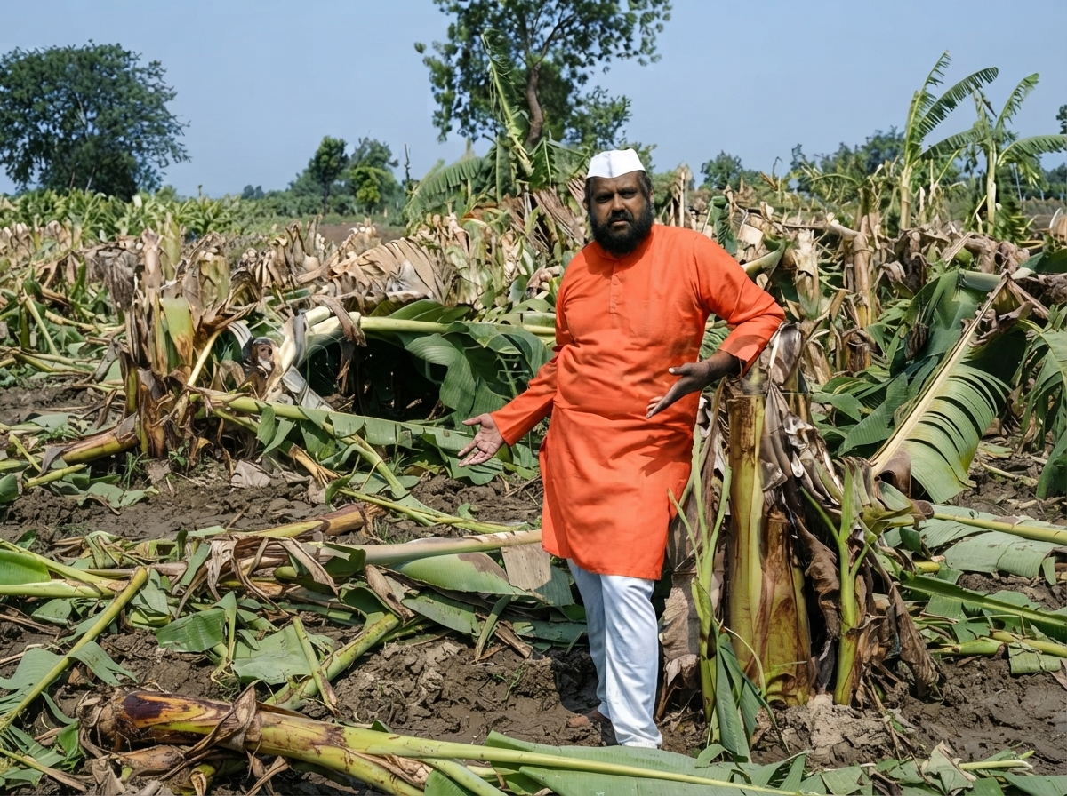
Problem Statement
A quarter of every harvest never reaches a buyer. Produce is routed to the nearest market instead of the best-paying one, and fragile transport corridors compound the loss before it ever reaches a customer.
25%
spoils before sale
KES 5M+
lost value / year

Slide 3

Every season this goes unsolved, it compounds.
WHY THIS MAT TERS NOW
Spoilage isn't a one-time loss. It's a recurring tax on every harvest, every season, compounded by produce routed to the nearest market instead of the one paying the most.
The cost, in one number
KES 5,000,000+
lost to spoilage alone, every single year, on current harvest volumes

Slide 4

Our Solution
We use predictive analytics and market-aware routing to connect fresh produce with the wholesale buyer that pays the most before it spoils.
"
1. Log the harvest
2. Predict the risk
3. Recommend the market
Crop, quantity, and basic storage conditions — phone app or a simple text menu.
The system estimates spoilage risk for that batch, in seconds.
One sentence: which nearby market pays the most before it spoils.

Slide 5


Built for Every Farmer
Works on any phone — smartphone or not.
Mobile App
Text-Message Menu
For farmers and drivers with a smartphone — offline-first, so it works even without a live data connection, syncing automatically once back in range.
For any phone, on any network, with no app install and no data plan required — the same predictions and market recommendation, one text at a time.

Slide 6



How The Prediction Works
Two signals, combined into one answer.
Storage & handling risk
How the batch has been stored and handled since harvest — temperature, time elapsed, and how fragile that crop typically is.
Transit risk
How the trip to a given market — distance, road conditions, expected duration — is likely to affect that same batch.
Combined into: what's it worth, where?
The two risks combine into one spoilage estimate per market, ranked by the money actually retained after loss — not just the closest option.

Slide 7

Business Value
Monthly Subscription: A low, predictable platform-access fee — modeled at KES 300,000/year in the cooperative pilot.
Success Fee: A share of the incremental revenue a customer actually retains, on top of the base subscription.
Shared Value: We only profit meaningfully when our customers save — the incentive is aligned, not extractive.

Slide 8
The math, in full.
FINANCIAL IMPAC T
 | Sold Volume | Avg Price/kg | Revenue
Baseline (today) | 375,000 kg | KES 40.00 | KES 15,000,000
With Fresh Supplies | 412,500 kg | KES 43.20 | KES 17,820,000
Assumptions
500,000 kg annual harvest
KES 40/kg farm-gate value
Annual Financial Benefit = KES 2,820,000 / year
25% current spoilage rate
30% relative spoilage reduction
526%
~1.9 mo
KES 2.52M
8% price lift from better market match
Year-1 ROI
Payback Period
Year-2+ Annual Savings
Conservative, model-based estimates — see Risks (slide 10) for validation plan.

Slide 9



Current Status
This isn't a concept. Most of it is already running.
Backend platform and prediction engine — live
Web dashboard for cooperative and logistics staff — live
Farmer mobile app — in active development
Text-message channel — designed, build starting next
Honest caveat: the prediction model is currently calibrated on realistic, but synthetic, data. It has not yet been field-validated on this cooperative's own harvests — which is exactly what the pilot on slide 12 is for.

Slide 10

Risks & Mitigation
The two risks worth the board's attention.
Unvalidated real-world accuracy
Farmer adoption
Projections come from a calibrated model, not yet tested on this cooperative's actual harvests — year-one results could differ from forecast.
Some farmers have limited smartphone access or connectivity, which could limit reach if the app were the only channel.
Mitigation: Run a 90-day pilot at one collection point first. Measure actual outcomes against the forecast before any cooperative-wide commitment.
Mitigation: The text-message channel (slide 5) requires no smartphone, no app, and no data plan — every farmer can participate on any phone.

Slide 11



Roadmap
Three phases, each gated by proof, not hope.
MONTHS 1 – 3
MONTH 4
MONTHS 5 +
Phase 1 — Pilot
Phase 2 — Evaluate
Phase 3 — Scale
One collection point. Real farmers, real harvests. Measure actual vs. predicted outcomes.
Compare pilot results to this forecast. Re-price the business case with real numbers before scaling.
Cooperative-wide rollout, plus the text-message channel reaching farmers without smartphones.

Slide 12

CTA
Approve a 90-day pilot at one collection point.
Full first-year investment: KES 450,000. Projected payback: under 2 months, even at pilot scale. Full cooperative-wide commitment — and any external partnership or investment to help fund it
— comes only after the pilot proves the numbers on real harvests.
GO — phased. Low cost. Fast proof. Full rollout only after validation.

Slide 13


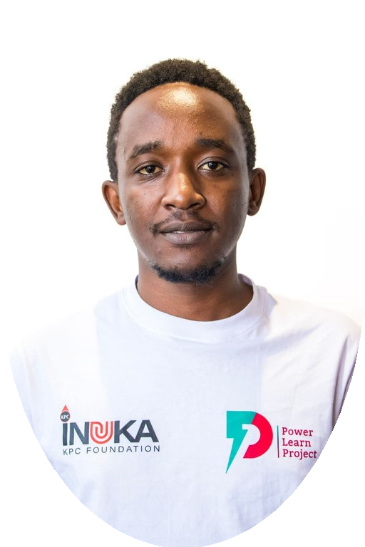
Team Members
AMOS NDUNGO
YVONNE WOCHUNA
KELVIN MORURI
Backend & Infrastructure
Frontend
Machine Learning

Slide 14
Thank you.
Questions and discussion.
Amos Ndungo | Fresh Supplies | Week 11

