Slide 1

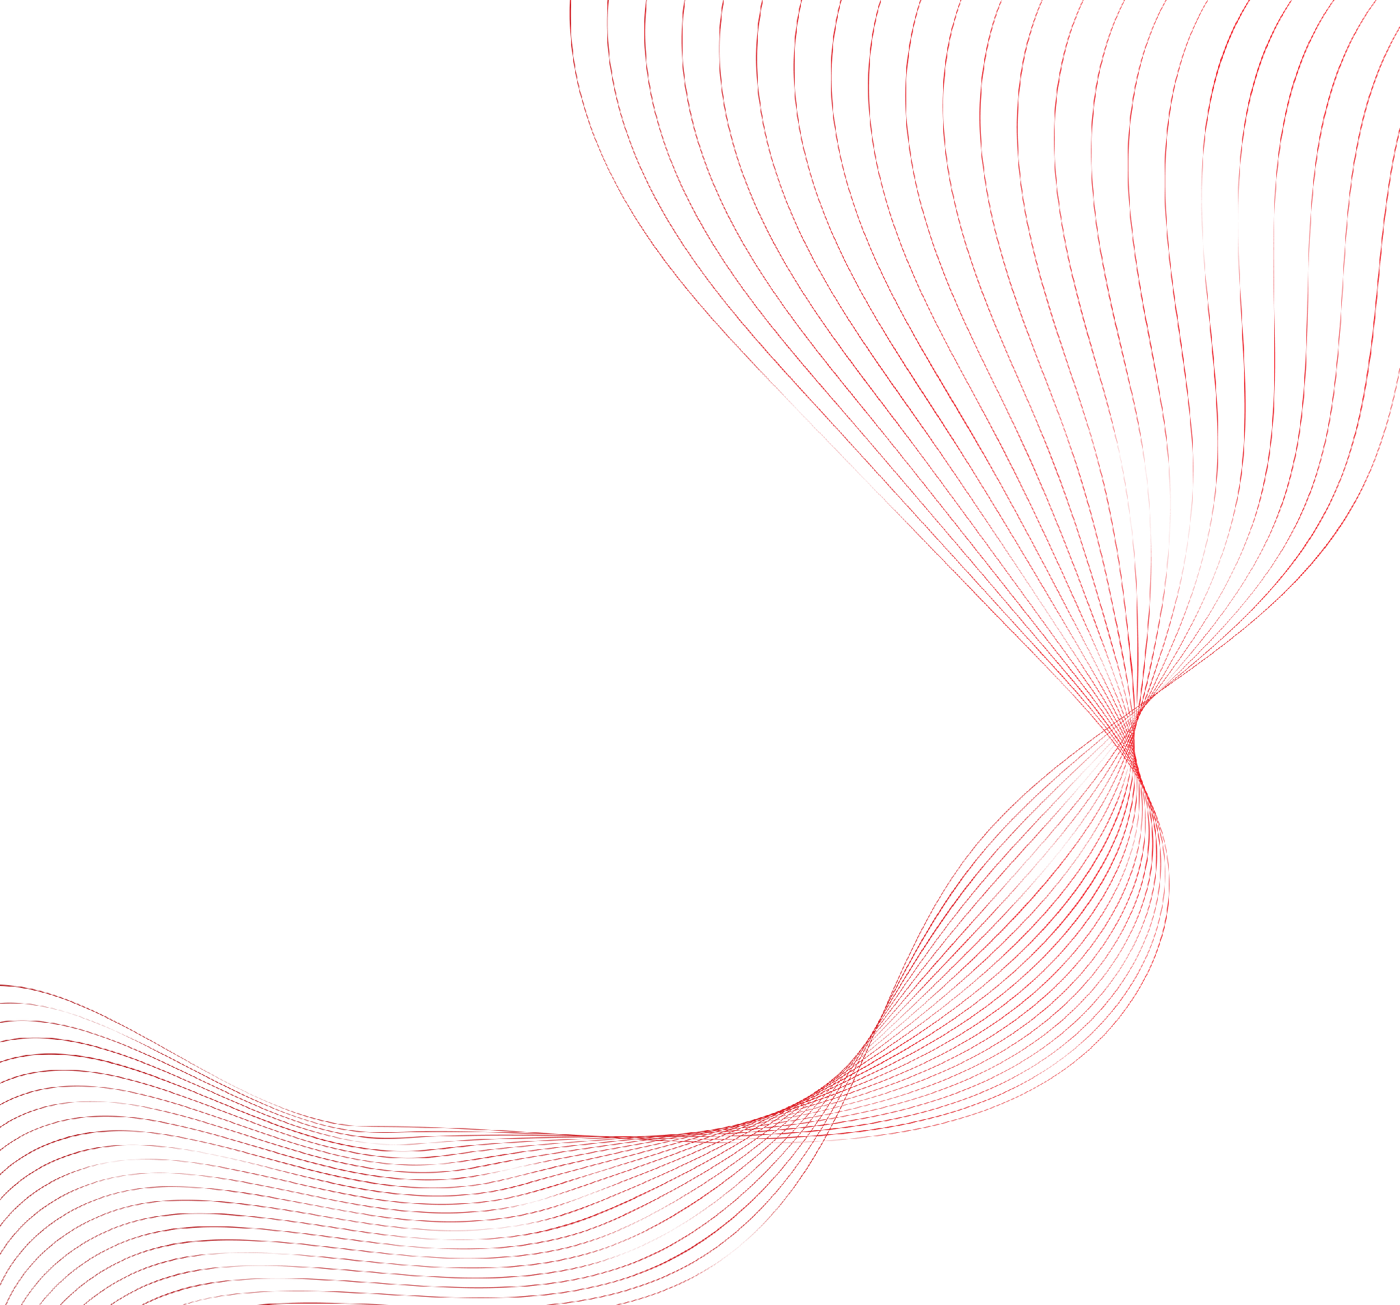


AI's Power Problem
The Grid Wasn't Built For This

Slide 2
899 TWh
AI data centers now draw about 2% of global electricity, a share set to triple by 2028

Slide 3
100+ kW/Rack
One AI rack can draw as much power as an entire row of conventional servers

Slide 4
3 Timescales
From multi-year planning to millisecond stability, AI is testing the grid at every timescale

Slide 5
Power Is the New Bottleneck
Grid ready AI starts with planning for megawatts, not just model size

