Slide 1
Network Intrusion Detection
System & Its Analyzer:
Snort & ACID
60-564: Security and Privacy on the Internet
Instructor: Dr. A. K. Aggarwal
Presented By:
Ahmedur Rahman
Zillur Rahman
Lawangeen Khan
Date: March 27, 2006

Slide 2
Table of Contents
Introduction
Test-bed
Software Components Used
Installation & Configuration
Testing
Acknowledgement
References
Demonstration

Slide 3
Introduction
An Intrusion Detection System (or IDS) generally detects unwanted manipulations to systems.
IDS is required to detect all types of malicious network traffic and computer usage that can't be detected by a conventional firewall.
This includes network attacks against vulnerable services, data driven attacks on applications, host based attacks.
An IDS is composed of several components:
  Sensors: generate security events
  Console: monitor events and alerts and control the sensors
  Engine: records events logged by the sensors in a database and uses a system of rules to generate alerts from security events received.

Slide 4
Test-bed
We have prepared a small network for our project with the followings:
Laptop 1: Software Components:
    Windows XP Home
    WinPCap
    CommView (Packet Generator)
Laptop 2: Software Components:
    Windows XP Professional
    IIS
    PHP
    ADODB
    MySQL
    WinPCap
    Snort
    ACID
    JPGraph
Router: D-link Ethernet Broadband Router

Slide 5
Software Components Used
WinPcap 3.1:
  Industry-standard tool for link-layer network access in Windows environments.
  Allows applications to capture and transmit network packets bypassing the protocol stack.
  It includes kernel-level packet filtering, a network statistics engine and support for remote packet capture.

Slide 6
Software Components Used
Cont.
ADODB 4.72:
  A database abstraction library for PHP and Python.
  Allows developers to write applications in a fairly consistent way regardless of the underlying database storing the information

Slide 7
Software Components Used
Cont.
IIS 5.x:
  A powerful Web server that provides a highly reliable, manageable, and scalable Web application infrastructure for all versions of Windows Server.
  It helps organizations increase Web site and application availability while lowering system administration costs.
PHP 4.3.9:
  A widely-used general-purpose scripting language that is especially suited for Web development and can be embedded into HTML

Slide 8
Software Components Used
Cont.
MySQL 4.1:
  Delivers a very fast, multi-threaded, multi-user, and robust SQL (Structured Query Language) database server.
  Intended for mission-critical, heavy-load production systems as well as for embedding into mass-deployed software. MySQL is a registered trademark of MySQL AB.

Slide 9
Software Components Used
Cont.
Snort 2.4.3:
  Snort is a versatile, lightweight network IDS
  Rules-based detection engine, which are editable and freely available
  Capable of performing real-time traffic analysis, packet logging on IP networks.
  Perform protocol analysis, content searching/matching.
  It can be used to detect a variety of attacks and probes.

Slide 10
Software Components Used
Cont.
ACID 0.9.6b21:
  The Analysis Console for Intrusion Databases (ACID) is a PHP-based analysis engine to search and process a database of security events generated by IDSs, firewalls, and network monitoring tools.
  This console is very useful for viewing Snort alerts in many different ways.
  You can search or view by source, destination, alert type, alerts times, port numbers and or protocols.
  You can create alert groups and email alerts and delete alerts all from this console.

Slide 11
Software Components Used
Cont.
JPGraph 1.20.3:
  JpGraph is a Object-Oriented Graph creating library for PHP 4.3.1. It is completely written in PHP and ready to be used in any PHP scripts.
  The library can be used to create numerous types of graphs either on-line or written to a file.
  ACID will use this JPGraph for creating bar, chart, pie graph to show us the alerts.

Slide 12
Software Components Used
Cont.
CommView 5.1:
  Generate traffic reports in real time.
  Import and export packets in hex and text formats.
  Create your own plug-ins for decoding any protocol.
  View detailed IP connections statistics: IP addresses, ports, sessions, etc.
  Search for strings or hex data in captured packet contents.
  Exchange data with your application over TCP/IP.
  Capture loopback traffic.
  We have used CommView in our project only as traffic generator.

Slide 13
Installation & Configuration
MySQL Server 4.1
  Installation:
    Used windows installation wizard
  Configuration:
    Configure my.ini
    Type: “old_passwords” in my.ini
    Uncomment the “port = 3306” line
    Execute the following command at command prompt:
      mysql> SET PASSWORD FOR
      'some_user'@'some_host' = OLD_PASSWORD('newpwd');
    For our case we used:
      mysql> SET PASSWORD FOR
      root@localhost = OLD_PASSWORD(snort);

Slide 14
Installation & Configuration
Cont.
PHP Version 4.3.9
  Installation:
    Used windows installer wizard
    Following the wizard prompt will install PHP successfully
  Configuration:
    Create a directory named extensions in PHP folder
    In php.ini file uncomment and write:
      Extension_dir = “C:\PHP\extensions
      Uncomment: cgi.force_redirect = 0

Slide 15
Installation & Configuration
Cont.
IIS Configuration:
  Open the Internet Information Services Console
  Expand the Server name
  Expand Web Sites
  Right Click on Default Web Site and Open Properties
  Click on the Home Directory Tab
  Click on Configuration near the bottom
  Under Application mappings click on ADD
  Browse to or type in C:\PHP\php.exe
  Type .php for the Extension
  Check the Script Engine Check box
  Click on OK all the way out of Properties

Slide 16
Installation & Configuration
Cont.
Snort Installation:
  MUST install WinPCap before
    Straight forward windows installation
  Double-click the executable installation file.
  The GNU Public License appears.
    Click the I Agree button.
  In the Installation Options dialog box, click the appropriate boxes to select from among these options:
      I do not plan to log to a database, or I am planning to log to one of the databases listed above. Choose this option if you are not using a database or if you are using MySQL or ODBC databases. Snort has built-in support for these databases, and here, we chose this option.
      I need support for logging to Microsoft SQL Server.
      I need support for logging to Oracle. Only choose this option if you plan to use Oracle database.
  Next steps are simple and straight forward.

Slide 17
Installation & Configuration
Cont.
Configuring snort.conf
  Correct: var RULE_PATH C:\Snort\rules
  Database connection
    Uncomment the appropriate line according to the database
    For our case we uncommented and modified the following line:
      output database: log, mysql, user=root password=snort dbname=snort host=localhost

Slide 18
Installation & Configuration
Cont.
Configuring snort.conf (Continued)
  Find: include classification.config
    Replace with actual path: include C:\Snort\etc\classification.config
  Find: include reference.config
    Replace with actual path: include C:\Snort\etc\reference.config
  Create SNORT database
    Locate create_mysql file in C:\Snort\schemas
    Go to command line browse to mysql’s bin and issue following command:
      MySQL -u Snort -p Snort < C:\Snort\schemas\Create_MySql
      This will create all tables for snort database to be used by ACID

Slide 19
Installation & Configuration
Cont.
Install ADODB
  Download ADODB zip file extract it into C:\Inetpub\wwwroot\adodb
Install JPGraph
  Download JPGraph zip file extract it into C:\Inetpub\wwwroot\jpgraph-1.20.3
Install CommView
  Download zip file and extract it into C:\
  Double click on setup.exe and follow the installation wizard.
Install ACID
  Download acid-0.9.6b21.tar.gz and extract it into C:\Inetpub\wwwroot\acid

Slide 20
Installation & Configuration
Cont.
Configure acid_conf.php
  Give appropriate DBlib path:
    $Dblib_path = “C:\Inetpub\wwwroot\adodb”;
  Give appropriate Chartlib path:
    $Chartlib_path = “C:\Inetpub\wwwroot\jpgraph-1.20.3\src”;
    $chart_file_format = “png”;
  Configure database:
    $Dbtype = “mysql”; $alert_dbname=“snort”;
    $alert_host=“localhost”; $alert_user=“root”;
    $alert_password=“snort”;
    $db_connect_method = 1;

Slide 21
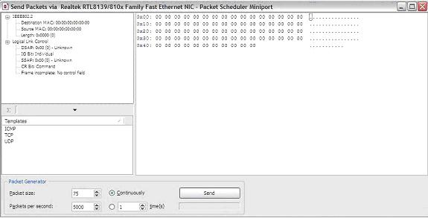
Testing
Step 1: Generate Packet in Laptop 1
  Open CommView
  Go to Tools>Packet Generator. A window like below will open:

Slide 22
Testing
Cont.
- Select the type of packet (TCP/ UDP/ ICMP).
- Write destination MAC, source MAC, dest IP, source IP.
- Place contents of the packets after from Urgent Pointer
- Calculate the total length.
- Click on checksum button. If all checksums show correct then the packet is ready.
- All information will have to be in hex format.

Slide 23
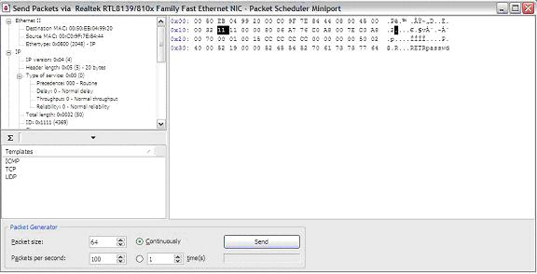
Testing
Cont.
- A sample packet with sid:356 is shown below:

Slide 24
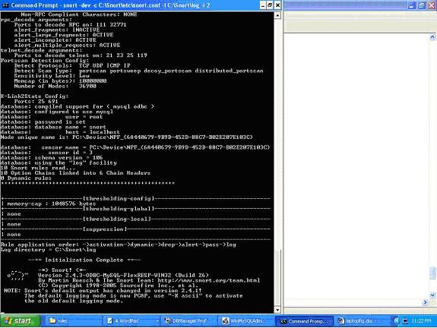
Testing
Cont.
Step 2: Start SNORT:
  Go to command prompt. Go to C:\Snort\bin
  Give the following command:
  C:\Snort\bin>snort –dev –c C:\snort\etc\snort.conf –l C:\snort\log –i 2
  It will be showing as below:

Slide 25
Testing
Cont.
We have used the following options for the above Snort Command to view:
-c <rules> Use Rules File <rules>
-d Dump the Application Layer
-e Display the second layer header info
-i <if> Listen on interface <if>
-l <ld> Log to directory <ld>
Step 3: Send Packet:
  We can choose the packet sending options (like sending rate, how many times/ continuous etc).
  Then press the Send button in CommView.
Step 4: See at Snort:
  Snort will show that it is getting packets continuously. When done press CTR+C
  Snort screen will show that it has generated and logged alerts successfully.

Slide 26
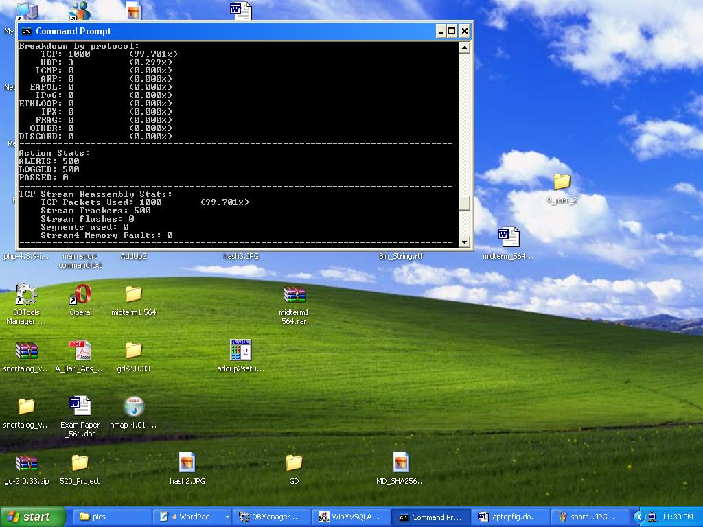
Testing
Cont.

Slide 27
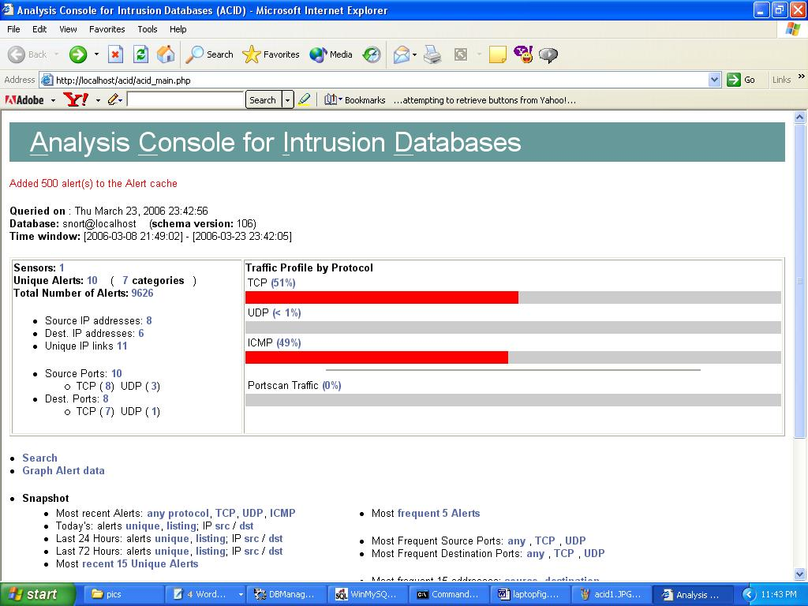
Testing
Cont.
Step 5: ACID viewer:
  Open the browser and type http://localhost/acid/index.html
  It will take to the main page of ACID. There it will show that it has added all the alerts in the cache

Slide 28
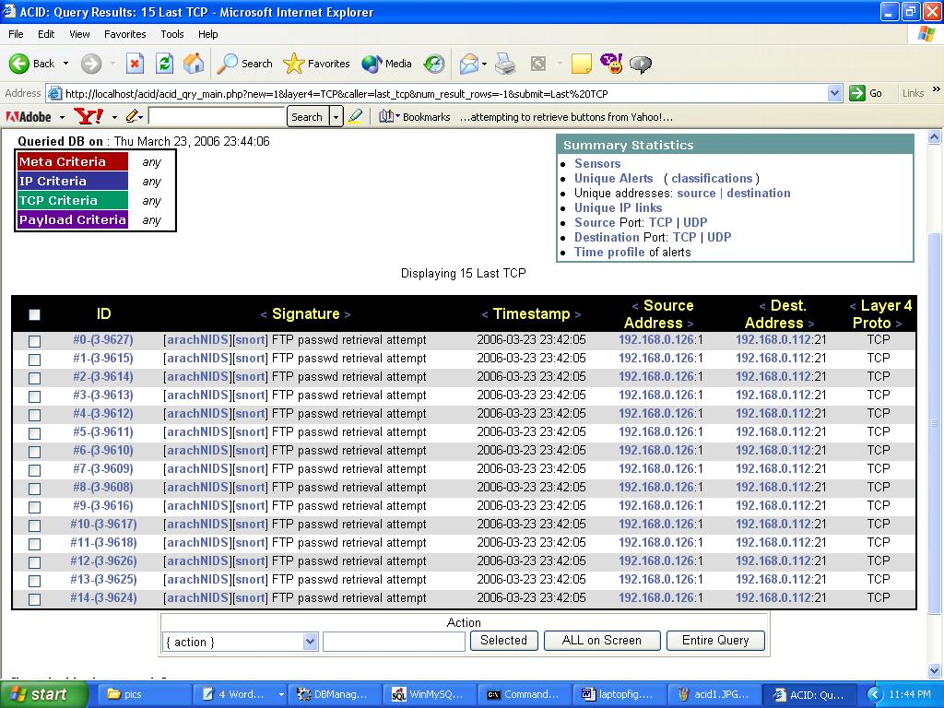
Testing
Cont.
- View snapshot of alerts generated by ACID.

Slide 29
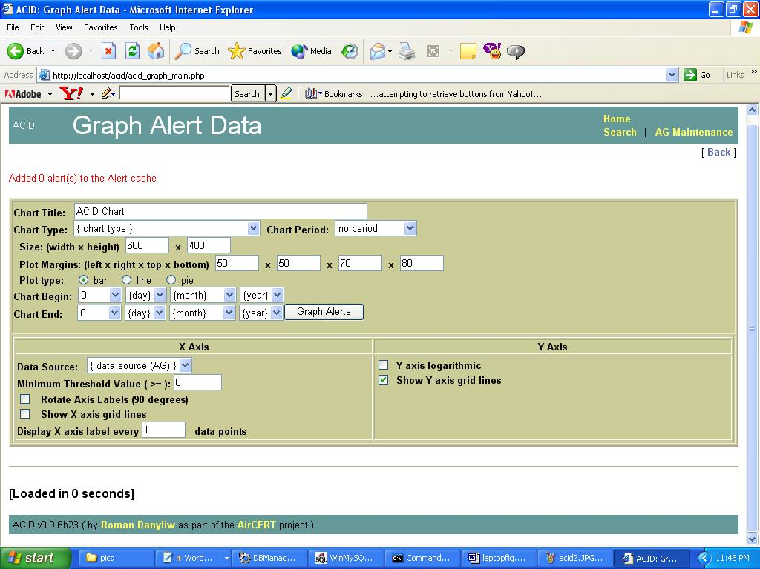
Testing
Cont.
- Click on Graph Alert Data. You can choose your options on how to view the graph. We have three options line, bar, pie.

Slide 30
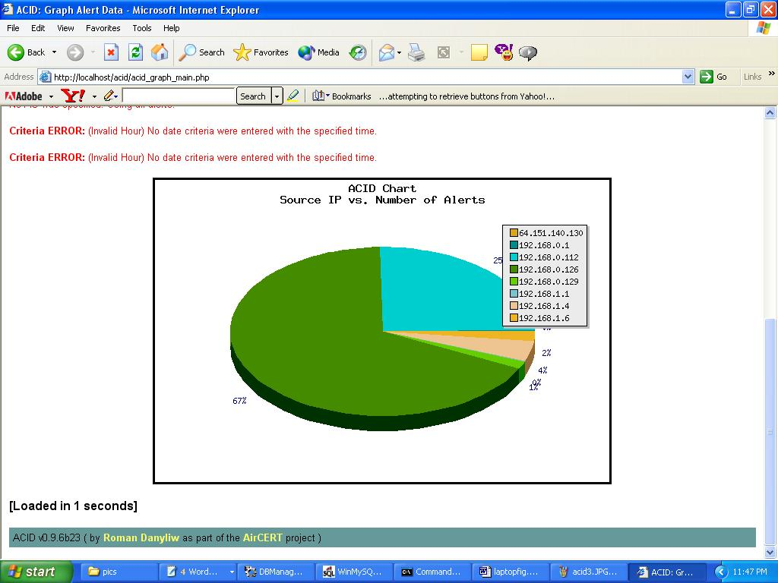
Testing
Cont.

Slide 31
Acknowledgement
We would like to thank all groups for helping to configure different tools in different phases, specially Group#01 (Tahira Farid & Anitha Prahladachar) for their help in generating of packets using Commview.
We would also like to thank Dr. Aggarwal to give us this industry standard real life project to implement.

Slide 32
References
http://www.securitydocs.com/library/1737
http://www.andrew.cmu.edu/user/rdanyliw/snort/acid_config.html
http://www.idevelopment.info/data/MySQL/DBA_tips/Installing/WIN417_4.shtml
http://www.andrew.cmu.edu/user/rdanyliw/snort/snortdb/snortdb_install.html
http://www.iis-resources.com/modules/AMS/article.php?storyid=273
http://en.wikipedia.org/wiki/Intrusion_detection_system

Slide 33


Demonstration
Laptop-1
Laptop-2
Win XP
CommView
Win XP Pro
WinPCap
Snort
IIS
PHP
ADODB
ACID
JPgraph
Router

Slide 34



Questions

