Slide 1
Clustering
Talha Ubaid

Slide 2
What Is Clustering
clusters are loosely defined as groups of data objects that are more similar to other objects in their cluster than they are to data objects in other clusters.
Techniques used to partition data into groups, or clusters
Divide the data into meaningful cluster
Unsupervised Learning

Slide 3
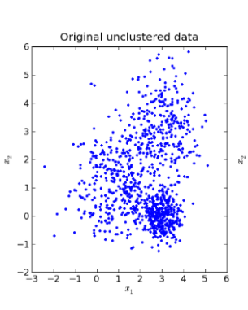
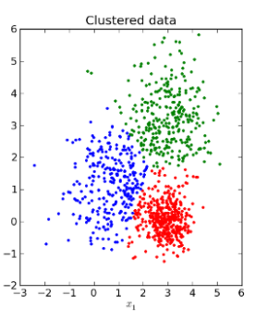
Dataset clustering

Slide 4
categories of clustering
three popular categories of clustering algorithms:
Partitional clustering (k-means)
Hierarchical clustering
Density-based clustering

Slide 5
Applications of Clustering in Real-World Scenarios
Customer Segmentation (liked product)
Document Clustering (email system)
i.e. spam or inbox

Slide 6
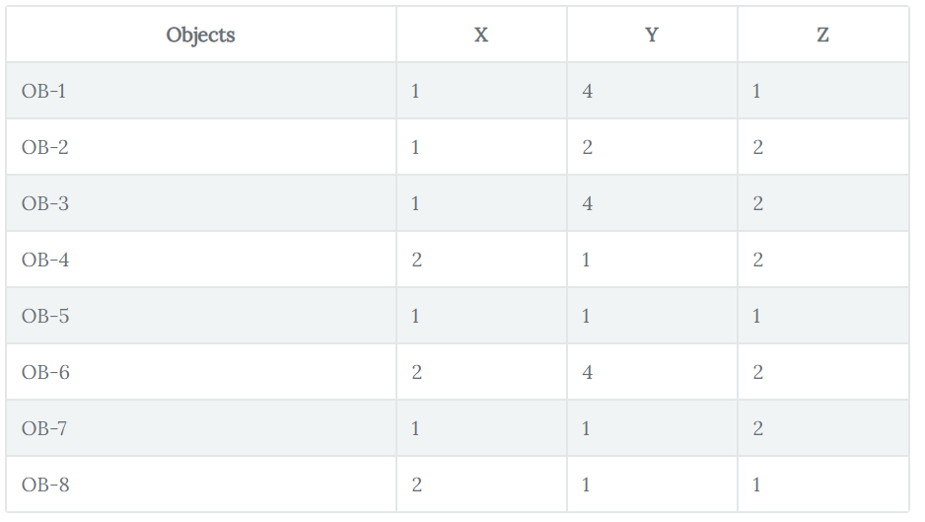
Example

Slide 7
K Means
So, the algorithm works
Taking any two centroids or data points (as you took 2 as K hence the number of centroids also 2) in its account initially.
After choosing the centroids, (say C1 and C2) the data points (coordinates here) are assigned to any of the Clusters (let’s take centroids = clusters for the time being) depending upon the distance between them and the centroids.
Assume that the algorithm chose OB-2 (1,2,2) and OB-6 (2,4,2) as centroids and cluster 1 and cluster 2 as well.
For measuring the distances, you take the following distance measurement function (also termed as similarity measurement function):
d=|x2–x1|+|y2–y1|+|z2–z1|
the calculation of distances (using the above distance measurement function) between the objects and centroids (OB-2 and OB-6)

Slide 8
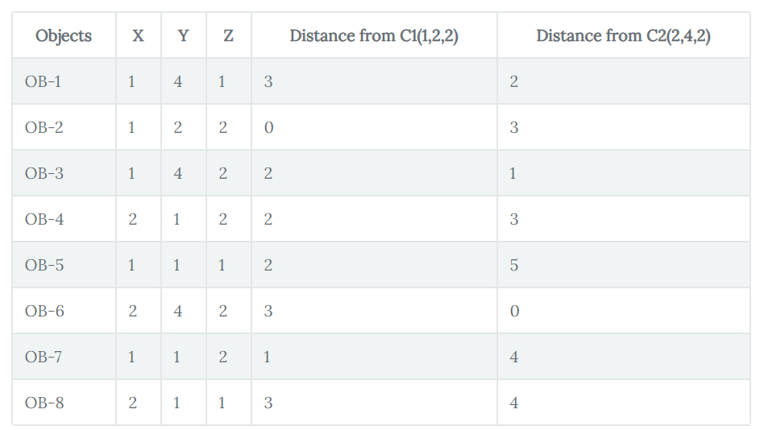
Example (distance from C1 & C2 from all points)

Slide 9
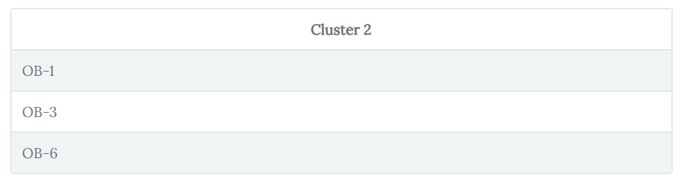
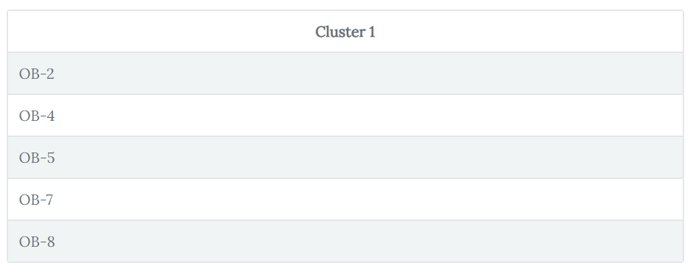
Example
An object which has a shorter distance between a centroid (say C1) than the other centroid (say C2) will fall into the cluster of C1.

Slide 10
solution
Now we have to find again cluster C1 & C2 ( first we choose cluster randomly)
This time we calculate: In C1 we have { OB_2(1,2,2),OB-4(2,1,2),OB-5(1,1,1), OB-7(1,1,2) and OB-8(2,1,1,)}
Cluster 1: ((1+2+1+1+2)/5, (2+1+1+1+1)/5,(2+2+1+2+1)/5) = (1.4,1.2,1.6).
This will be new C1 (1.4,1.2,1.6). Cluster 2: ((1+1+2)/3, (4+4+4)/3, (1+2+2)/3) = (1.33, 4, 1.66)

Slide 11
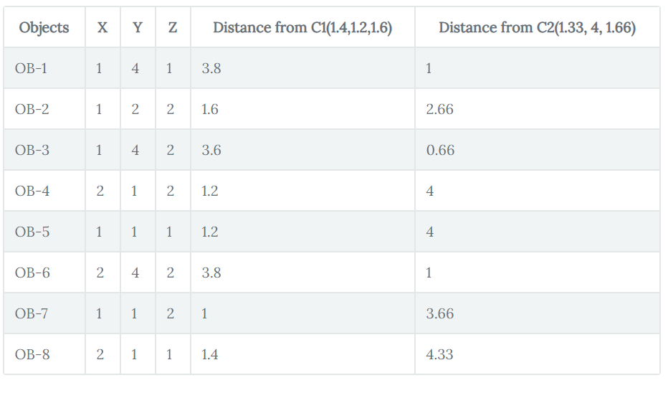
solution
After this, the algorithm again starts finding the distances between the data points and newly derived cluster centroids

Slide 12
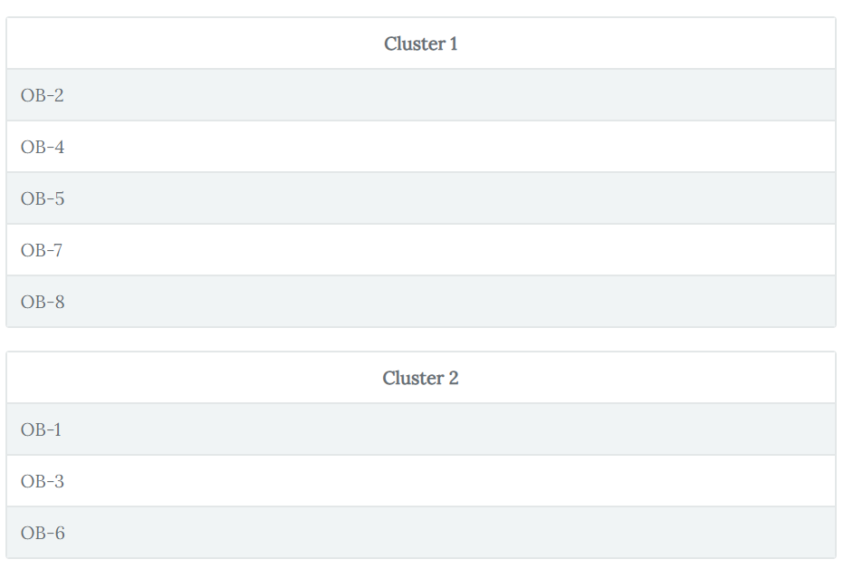
Solution
The new Clusters

Slide 13
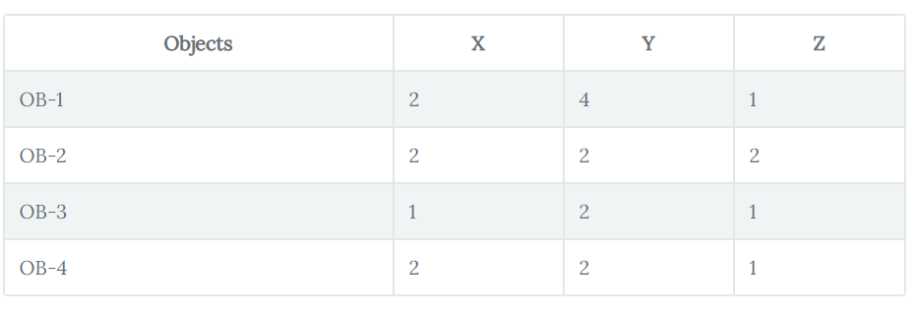
Solution
From previous cluster you can see that it does not changes.
Now Test the new data.( we will choose our last centroid)

Slide 14
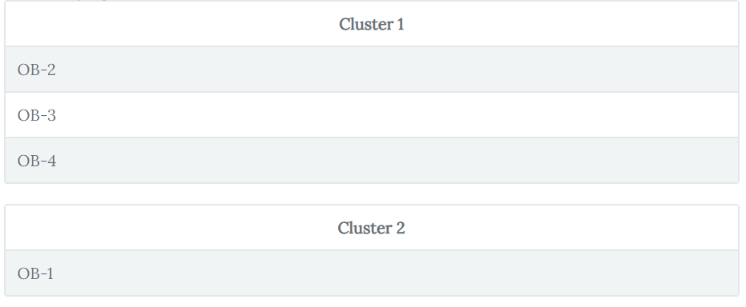
Solution
Now Test the new data.
Results:

