Slide 1
Collocations

Slide 2
A collocation…
is an expression of 2 or more words that correspond to a conventional way of saying things.
broad daylight
Why not? ?bright daylight or ?narrow darkness
Big mistake but not ?large mistake
overlap with the concepts of:
terms, technical terms & terminological phrases
Collocations extracted form technical domains
Ex: hydraulic oil filter, file transfer protocol

Slide 3
Examples of Collocations
strong tea
weapons of mass destruction
to make up
he knocked at the door
I made it all up

Slide 4
Definition of a collocation
(Choueka, 1988)
[A collocation is defined as] “a sequence of two or more consecutive words, that has characteristics of a syntactic and semantic unit, and whose exact and unambiguous meaning or connotation cannot be derived directly from the meaning or connotation of its components."
Criteria for collocation
non-compositionality
non-substitutability
non-modifiability

Slide 5
Non-Compositionality
A phrase is compositional if the meaning can predicted from the meaning of the parts.
Collocations are not fully compositional
there is usually an element of meaning added to the combination
Ex: strong tea, tight lipped
Idioms are the most extreme examples of non-compositionality
Ex: in broad daylight
The whole unit must be considered in NLP tasks, such as Machine Translation

Slide 6
Non-Substitutability
We cannot substitute near-synonyms for the components of a collocation.
Strong is a near-synonym of powerful
strong tea ?powerful tea
yellow is as good a description of the color of white wines
white wine ?yellow wine
Example: in broad daylight
Can never be
* wide daylight

Slide 7
Non-modifiability
Many collocations cannot be freely modified with additional lexical material or through grammatical transformations
weapons of mass destruction --> ?weapons of massive destruction
Example: in broad daylight
Never:
* broad daylights

Slide 8
Linguistic Subclasses of Collocations
Phrases with light verbs:
make, take, do…
Verb particle/phrasal verb constructions
to go down, to check out, make up new stories
Proper nouns
John Smith
CUNY = City University of New York
Terminological expressions
concepts and objects in technical domains
hydraulic oil filter, web crawler

Slide 9
A note on (near-)synonymy
To determine if 2 words are synonyms-- Principle of substitutability:
2 words are synonym if they can be substituted for one another in some?/any? sentence without changing the meaning or acceptability of the sentence
How big/large is this plane?
Would I be flying on a big/large or small plane?
Miss Nelson became a kind of big / ?? large sister to Tom.
I think I made a big / ?? large mistake.

Slide 10
Approaches to finding collocations
Frequency
Mean and Variance
Hypothesis Testing
t-test
χ²-test
Mutual Information

Slide 11
Approaches to finding collocations
--> Frequency
Mean and Variance
Hypothesis Testing
t-test
χ²-test
Mutual Information

Slide 12
Frequency
(Justeson & Katz, 1995)
Hypothesis:
if 2 words occur together very often, they must be interesting candidates for a collocation
Method:
Select the most frequently occurring bigrams (sequence of 2 adjacent words)

Slide 13
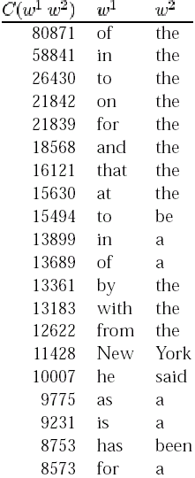
Results
Not very interesting…
Except for “New York”, all bigrams are pairs of function words

Slide 14
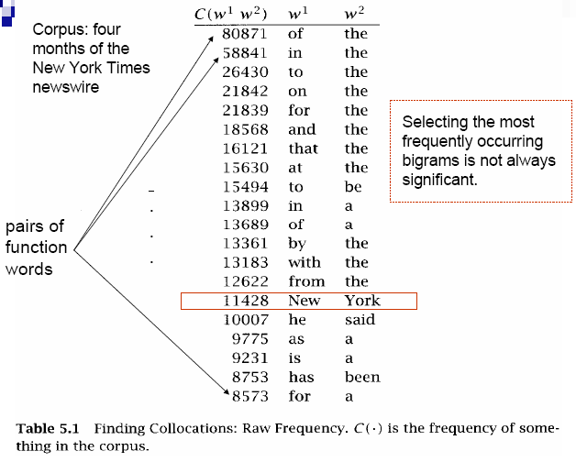

Slide 15
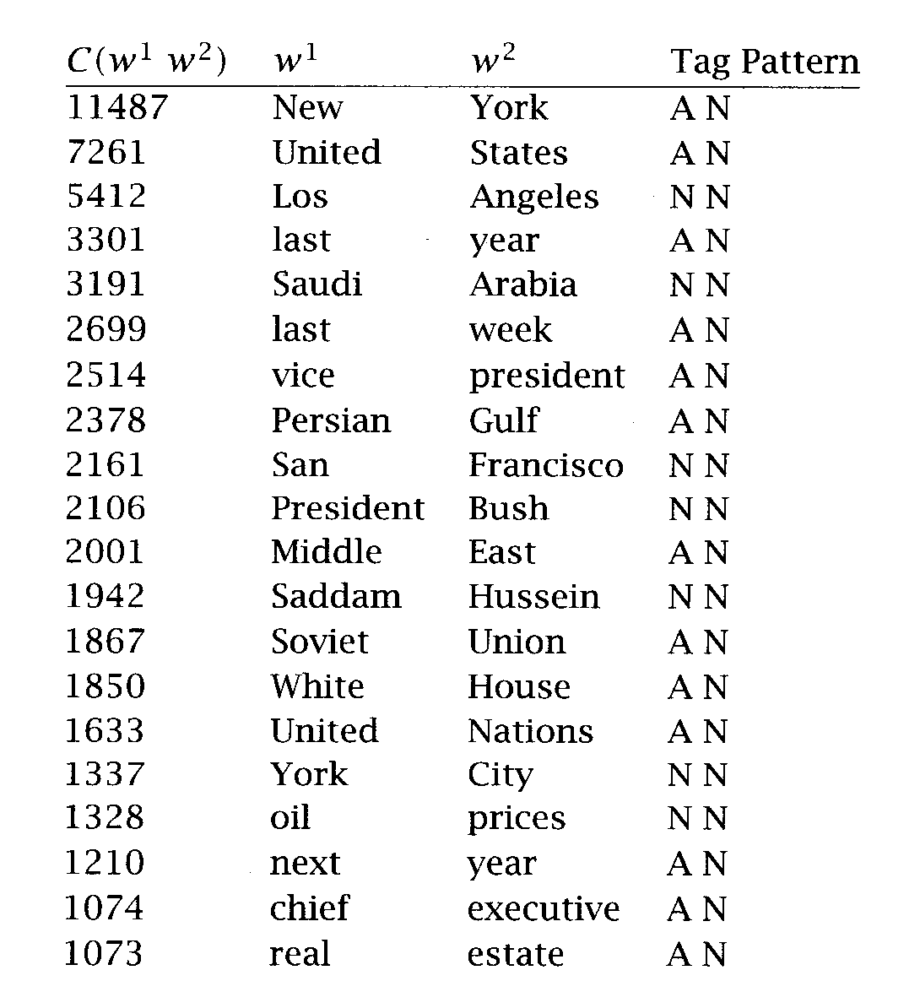
Frequency + POS filter
A:Adjective, P:preposition, N:Noun
So, let’s pass the results through a part-of- speech filter
Simple method that works very well
Most of them are non-compositional phrases
Tag Pattern
Example
A N
linear function
N N
regression coefficient
A A N
Gaussian random variable
A N N
cumulative distribution function
N A N
mean squared error
N N N
class probability function
N P N
degrees of freedom

Slide 16
Frequency: Conclusion
Advantages:
works well for fixed phrases
Simple method & accurate result
Requires small linguistic knowledge
But: many collocations consist of two words in more flexible relationships
she knocked on his door
they knocked at the door
100 women knocked on Donaldson’s door
a man knocked on the metal front door

Slide 17
Approaches to finding collocations
Frequency
--> Mean and Variance
Hypothesis Testing
t-test
χ²-test
Mutual Information

Slide 18
Mean and Variance
(Smadja et al., 1993)
Looks at the distribution of distances between two words in a corpus
looking for pairs of words with low variance
A low variance means that the two words usually occur at about the same distance
A low variance --> good candidate for collocation
Need a Collocational Window to capture collocations of variable distances
knock
door
knock
door

Slide 19
Collocational Window
This is an example of a three word window.
To capture 2-word collocations
this is this an
is an is example
an example an if
example if example a
of a of three
a three a word
three word three window
word window

Slide 20
Mean and Variance (con’t)
The mean is the average offset (signed distance) between two words in a corpus
The variance measures how much the individual offsets deviate from the mean
n is the number of times the two words (two candidates) co-occur
d_{i} is the offset of the i^{th} pair of candidates
is the mean offset of all pairs of candidates
If offsets (d_{i}) are the same in all co-occurrences
--> variance is zero
--> definitely a collocation
If offsets (d_{i}) are randomly distributed
--> variance is high
--> not a collocation

Slide 21
An Example
window size = 11 around knock (5 left, 5 right)
she knocked on his door
they knocked at the door
100 women knocked on Donaldson’s door
a man knocked on the metal front door
Mean d =
Std. deviation s =

Slide 22
Example
word 1 is played, word 2 is ball
he played ball
they played with the ball
many children had played by bouncing the ball up and down
the ball was played twice

Slide 23
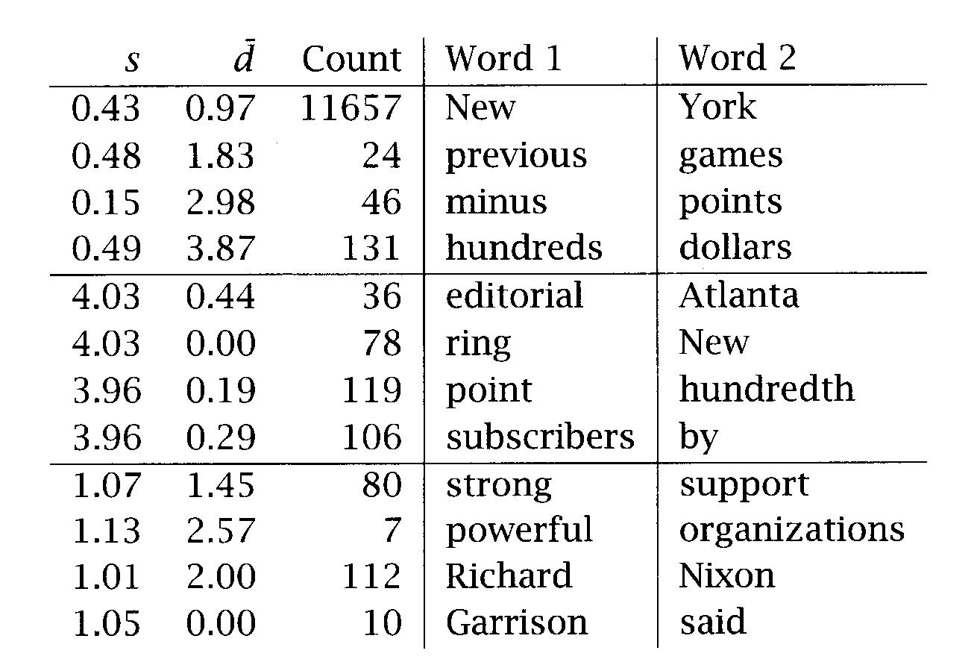
Mean and variance versus Frequency
std. dev. ~0 & mean offset ~1 --> would be found by frequency method
std. dev. ~0 & high mean offset --> very interesting, but would not be found by frequency method
high deviation --> not interesting

Slide 24
Mean & Variance: Conclusion
good for finding collocations that have:
looser relationship between words
intervening material and relative position

Slide 25
Approaches to finding collocations
Frequency
Mean and Variance
--> Hypothesis Testing
t-test
χ²-test
Mutual Information

Slide 26
Hypothesis Testing
If 2 words are frequent… they will frequently occur together…
Frequent bigrams and low variance can be accidental (two words can co-occur by chance)
We want to determine whether the co-occurrence is random or whether it occurs more often than chance
This is a classical problem in statistics called Hypothesis Testing
When two words co-occur, Hypothesis Testing measures how confident we have that this was due to chance or not

Slide 27
Hypothesis Testing (con’t)
We formulate a null hypothesis H₀
H₀ : no real association (just chance…)
H₀ states what should be true if two words do not form a collocation
if 2 words w₁ and w₂ do not form a collocation, then w₁ and w₂ are independently of each other:
We need a statistical test that tells us how probable or improbable it is that a certain combination occurs
Statistical tests:
t test
χ² test

Slide 28
Approaches to finding collocations
Frequency
Mean and Variance
Hypothesis Testing
--> t-test
χ²-test
Mutual Information

Slide 29
Hypothesis Testing: the t-test
(or Student's t-test)
H₀ states that:
We calculate the probability p-value that a collocation would occur if H₀ was true
If p-value is too low, we reject H₀
Typically if under a significant level of p < 0.05, 0.01, or 0.001
Otherwise, retain H₀ as possible

Slide 30
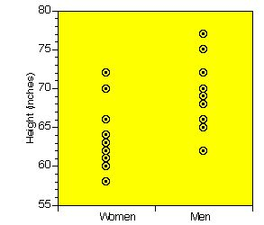
Some intuition
H_{o}: women and men are equally tall, on average
We gather data from 10 men and 10 women
Assume we want to compare the heights of men and women
we cannot measure the height of every adult…
so we take a sample of the population
and make inferences about the whole population
by comparing the sample means and the variation of each mean

Slide 31
Some intuition (con’t)
t-test assigns a probability to describe the likelihood that the null hypothesis is true
high p-value --> Accept Ho
Accept Ho
low p-value --> Reject Ho
Reject Ho
Reject Ho
frequency
frequency
0
value of t
0
value of t
Critical value c (value of t where we decide to reject Ho)
Confidence level a = probability that t-score > critical value c
t distribution (1-tailed)
t distribution (2-tailed)

Slide 32
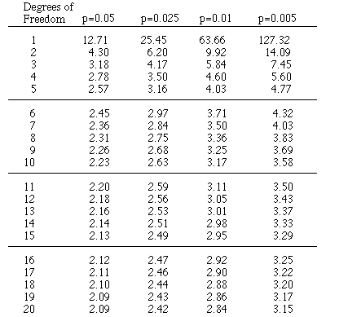
Some intuition (con’t)
Compute t score
Consult the table of critical values with df = 18 (10+10-2)
If t > critical value (value in table), then the 2 samples are significantly different at the probability level that is listed
Assume t=2.7
if there is no difference in height between women and men (H₀ is true) then the probability of finding t=2.7 is between 0.025 & 0.01
… that’s not much…
so we reject the null hypothesis H₀
and conclude that there is a difference in height between men and woman
Probability table based on the t distribution
(2-tailed test)

Slide 33
The t-Test
looks at the mean and variance of a sample of measurements
the null hypothesis is that the sample is drawn from a distribution with mean μ
The test :
looks at the difference between the observed and expected means, scaled by the variance of the data
tells us how likely one is to get a sample of that mean and variance
assuming that the sample is drawn from a normal distribution with mean μ.

Slide 34
The t-Statistic
Difference between the observed mean and the expected mean
is the sample mean
μ is the expected mean of the distribution
s² is the sample variance
N is the sample size
the higher the value of t, the greater the confidence that:
there is a significant difference
it’s not due to chance
the 2 words are not independent

Slide 35
Example
Here’s an example of applying the t test. Our null hypothesis is that the mean height of a population of men is 158cm.
We are given a sample of 200 men with x = 169 and s2 = 2600 and want to know whether this sample is from the general population (the null hypothesis) or whether it is from a different population of smaller men.

Slide 36

Example
This gives us the following t according to the above formula:
We can also find out exactly how large it has to be by looking up the table of the t distribution.

Slide 37
Example
If we look up the value of t that corresponds to a confidence level of α= 0.005, we will find 2.576. Since the t we got is larger than 2.576, we can reject the null hypothesis with 99.5% confidence, our probability of error is less than 0.5%.

Slide 38
t-Test: Example with collocations
In a corpus:
new occurs 15,828 times
companies occurs 4,675 times
new companies occurs 8 times
there are 14,307,668 tokens overall
Is new companies a collocation?
Null hypothesis:
Independence assumption
P(new companies) = P(new) P(companies)

Slide 39
Example (Cont.)
If the null hypothesis is true, then:
if we randomly generate bigrams of words
assign 1 to the outcome new companies
assign 0 to any other outcome
…in effect a Bernoulli trial
then the probability of having new companies is expected to be 3.615 x 10⁻⁷
So the expected mean is μ = 3.615 x 10⁻⁷
The variance s² = p(1-p) ≈ p since for most bigrams p is small
in binomial distribution: s² = np(1-p) … but here, n=1

Slide 40
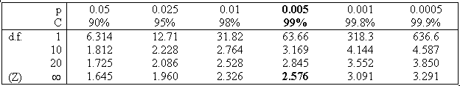
Example (Cont.)
But we counted 8 occurrences of the bigram new companies
So the observed mean is
By applying the t-test, we have:
With a confidence level a=0.005, critical value is 2.576 (t should be at least 2.576)
Since t=1 < 2.576
we cannot reject the H_{o}
so we cannot claim that new and companies form a collocation

Slide 41
t test: Some results
t test applied to 10 bigrams that occur with frequency = 20
Notes:
Frequency-based method could not have seen the difference in these bigrams, because they all have the same frequency
the t test takes into account the frequency of a bigram relative to the frequencies of its component words
If a high proportion of the occurrences of both words occurs in the bigram, then its t is high.
The t test is mostly used to rank collocations
pass the t-test (t > 2.756) so:
we can reject the null hypothesis
so they form collocation
fail the t-test (t < 2.756) so:
we cannot reject the null hypothesis
so they do not form a collocation

Slide 42
Hypothesis testing of differences
Used to see if 2 words (near-synonyms) are used in the same context or not
“strong” vs “powerful”
can be useful in lexicography
we want to test:
if there is a difference in 2 populations
Ex: height of woman / height of man
the null hypothesis is that there is no difference
i.e. the average difference is 0 (μ =0)
is the sample mean of population 1
is the sample mean of population 2
s₁² is the sample variance of population 1
s₂² is the sample variance of population 2
n₁ is the sample size of population 1
n₂ is the sample size of population 2

Slide 43
Hypothesis testing of differences
T values are calculated assuming a Bernoulli distribution: w is the collocate of interest, v₁ and v₂ are the words to compare, and assume that s² ≈ p.

Slide 44
Difference test example
Is there a difference in how we use “powerful” and how we use “strong”?

Slide 45
Approaches to finding collocations
Frequency
Mean and Variance
Hypothesis Testing
t-test
--> χ²-test
Mutual Information

Slide 46
Hypothesis testing: the χ²-test
problem with the t test is that it assumes that probabilities are approximately normally distributed…
the χ²-test does not make this assumption
The essence of the χ²-test is the same as the t-test
Compare observed frequencies and expected frequencies for independence
if the difference is large
then we can reject the null hypothesis of independence

Slide 47
χ²-test
In its simplest form, it is applied to a 2x2 table of observed frequencies
The χ² statistic:
sums the differences between observed frequencies (in the table)
and expected values for independence
scaled by the magnitude of the expected values:

Slide 48
χ²-test- Example
Observed frequencies Obs_{ij}

Slide 49
Pearson’s Chi-Square Test
P(w₁w₂) = P(w₁)p(w₂) = E₁₁/N
=> E₁₁= P(w₁)P(w₂)N
The expected frequencies are computed from the marginal probabilities:
E₁₁= (O₁₁ + O₁₂)/N × (O₁₁ + O₂₁)/N × N
where N is the number of bigrams
 | w₂ | ¬ w₂
w₁ | O₁₁ | O₁₂
¬ w₁ | O₂₁ | O₂₂

Slide 50
χ²-test- Example (con’t)
Expected frequencies
Exp_{ij} =(ith row total)(jth colum total)/total number of observation
If independence
Computed from the marginal probabilities (the totals of the rows and columns converted into proportions)
Ex: expected frequency for cell (1,1) (new companies)
marginal probability of new occurring as the first part of a bigram times marginal probability of companies occurring as the second part of bigram:
If “new” and “companies” occurred completely independent of each other
we would expect 5.17 occurrences of “new companies” on average

Slide 51
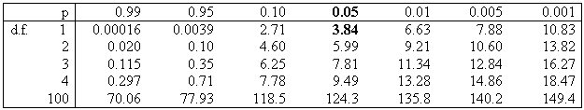
χ²-test- Example (con’t)
But is the difference significant?
df in an nxc table = (n-1)(c-1) = (2-1)(2-1) =1 (degrees of freedom)
The probability level of α=0.05 the critical value is 3.84
Since 1.55 < 3.84:
So we cannot reject H₀ (that new and companies occur independently of each other)
So new companies is not a good candidate for a collocation

Slide 52
χ²-test: Conclusion
Differences between the t statistic and χ² statistic do not seem to be large
But:
the χ² test is appropriate for large probabilities
where t test fails because of the normality assumption
the χ² is not appropriate with sparse data (if numbers in the 2 by 2 tables are small)
χ² test has been applied to a wider range of problems
Machine translation
Corpus similarity

Slide 53
χ²-test for machine translation
(Church & Gale, 1991)
To identify translation word pairs in aligned corpora
Ex:
χ² = 456 400 >> 3.84 (with α= 0.05)
So “vache” and “cow” are not independent… and so are translations of each other
Nb of aligned sentence pairs containing “cow” in English and “vache” in French
Observed frequency | “cow” | ~”cow” | TOTAL
“vache” | 59 | 6 | 65
~”vache” | 8 | 570 934 | 570 942
TOTAL | 67 | 570 940 | 571 007

Slide 54
χ²-test for corpus similarity
(Kilgarriff & Rose, 1998)
Ex:
Compute χ² for the 2 populations (corpus1 and corpus2)
H_{o}: the 2 corpora have the same word distribution
Observed frequency | Corpus 1 | Corpus 2 | Ratio
Word1 | 60 | 9 | 60/9 =6.7
Word2 | 500 | 76 | 6.6
Word3 | 124 | 20 | 6.2
… | … | … | …
Word500 | … | … | …

Slide 55
Collocations across corpora
Ratios of relative frequencies between two or more different corpora
can be used to discover collocations that are characteristic of a corpus when compared to other corpus

Slide 56
Collocations across corpora (con’t)
most useful for the discovery of subject-specific collocations
Compare a general text with a subject-specific text
words and phrases that (on a relative basis) occur most often in the subject-specific text are likely to be part of the vocabulary that is specific to the domain

Slide 57
Approaches to finding collocations
Frequency
Mean and Variance
Hypothesis Testing
t-test
χ²-test
--> Mutual Information

Slide 58
Pointwise Mutual Information
Uses a measure from information-theory
Pointwise mutual information between 2 events x and y (in our case the occurrence of 2 words) is roughly:
a measure of how much one event (word) tells us about the other
or a measure of the independence of 2 events (or 2 words)
If 2 events x and y are independent, then I(x,y) = 0

Slide 59
Example
Assume:
c(Ayatollah) = 42
c(Ruhollah) = 20
c(Ayatollah, Ruhollah) = 20
N = 143 076 668
Then:
So? The occurrence of “Ayatollah” at position i increases by 18.38bits if “Ruhollah” occurs at position i+1
works particularly badly with sparse data

Slide 60
Pointwise Mutual Information (con’t)
With pointwise mutual information:
With t-test (see p.43 of slides)
Same ranking as t-test

Slide 61
Pointwise Mutual Information (con’t)
good measure of independence
values close to 0 --> independence
bad measure of dependence
because score depends on frequency
all things being equal, bigrams of low frequency words will receive a higher score than bigrams of high frequency words
so sometimes we take C(w₁ w₂) I(w₁ , w₂)

Slide 62
Automatic vs manual detection of collocations
Manual detection finds a wider variety of grammatical patterns
Ex: in the BBI combinatory dictionary of English
Quality of collocations is better that computer-generated ones
But… long and requires expertise
strength | power
to build up ~ | to assume ~
to find ~ | emergency ~
to save ~ | discretionary ~
to sap somebody's ~ | fire ~
brute ~ | supernatural ~
tensile ~ | to turn off the ~
the ~ to [do X] | the ~ to [do X]

Slide 63
Why study collocations?
In NLG
The output should be natural
Strong tea ?Powerful tea
In lexicography
Identify collocations to list them in a dictionary
To distinguish the usage of synonyms or near-synonyms
In corpus linguistics and psycholinguists
Ex: To study social attitudes towards different types of substances
strong cigarettes/tea/coffee

