Slide 1
Introduction to NLP
What is Natural Language Processing?

Slide 2
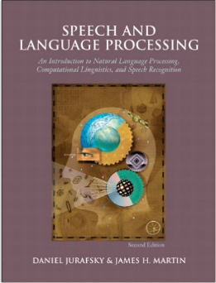
Text Books
Daniel Jurafsky and James H. Martin. 2008. Speech and Language Processing: An Introduction to Natural Language Processing, Computational Linguistics and Speech Recognition. Prentice Hall 2nd/3rd Edition
http://www.cs.colorado.edu/~martin/slp.html
Great Overview of the Field, explanations of
techniques, algorithms, etc.

Slide 3

Text Books
Christopher D. Manning and Hinrich Schütze. 1999. Foundations of Statistical Natural Language Processing. MIT Press
Natural Language Processing with Python
By Steven Bird, Ewan Klein, and Edward Loper
http://www.nltk.org/book
Downloadable open source programs to try out various

Slide 4
More Stuff to Read/Download, etc.
Look at projects at Stanford:
http://web.stanford.edu/class/cs224n/
Other useful links
http://aclweb.org/
http://www.cs.vassar.edu/sigann/

Slide 5
Programming?
Historically popular language for NLP courses:
Prolog (clean, hard to learn)
Perl (quick, but obfuscated syntax, messy to read)
Why Python is better-suited:
easy to learn, clean syntax, powerful features
becoming increasingly popular in CompLinguistics!
Extensive tutorials, CompLing support, toolkits, data, etc.

Slide 6
Goals of the Course
Introduce you to Natural Language Processing problems and solutions.
Ultimate focus on handling ambiguity by probabilistic integration of evidence.
Give you some hands-on practice with data and a handful of methods.

Slide 7
NLP/Computational Linguistics
Natural Language Processing (NLP) is both a modern computational technology and a method of investigating and evaluating claims about human language itself.
Some prefer the term Computational Linguistics in order to capture this latter function, but NLP is a term that links back into the history of Artificial Intelligence (AI), the general study of cognitive function by computational processes, normally with an emphasis on the role of knowledge representations, that is to say the need for representations of our knowledge of the world in order to understand human language with computers.

Slide 8
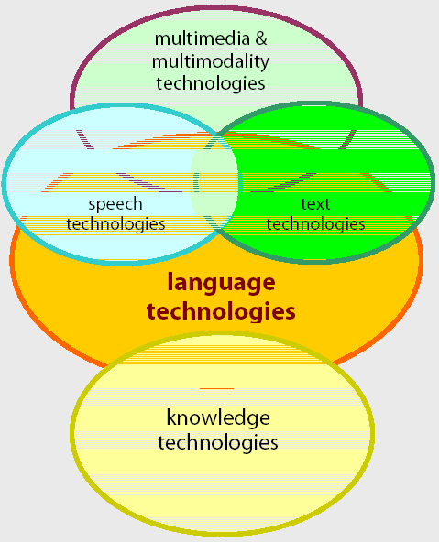
Scope
Language technologies are information technologies that are specialized for dealing with the most complex information medium in our world: human language (Human Language Technology).

Slide 9
Information Extraction
Event: Curriculum mtg
Date: Jan-16-2012
Start: 10:00am
End: 11:30am
Where: Gates 159
Subject: curriculum meeting
Date: January 15, 2012
To: Dan Jurafsky
Hi Dan, we’ve now scheduled the curriculum meeting.
It will be in Gates 159 tomorrow from 10:00-11:30.
-Chris
Create new Calendar entry

Slide 10
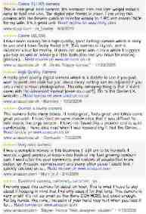

Information Extraction & Sentiment Analysis
Attributes:
zoom
affordability
size and weight
flash
ease of use
Size and weight
✓
nice and compact to carry!
since the camera is small and light, I won't need to carry around those heavy, bulky professional cameras either!
the camera feels flimsy, is plastic and very light in weight you have to be very delicate in the handling of this camera
✓
✗

Slide 11
Question Answering: IBM’s Watson
Won Jeopardy on February 16, 2011!
WILLIAM WILKINSON’S
“AN ACCOUNT OF THE PRINCIPALITIES OF WALLACHIA AND MOLDOVIA”
INSPIRED THIS AUTHOR’S
MOST FAMOUS NOVEL
Bram Stoker

Slide 12
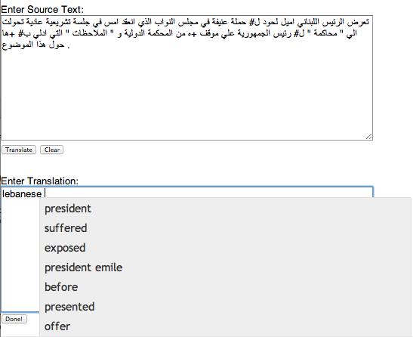
Machine Translation
Helping human translators
Fully automatic
Enter Source Text:
这 不过 是 一 个 时间 的 问题 .
Translation from Stanford’s Phrasal:
This is only a matter of time.

Slide 13


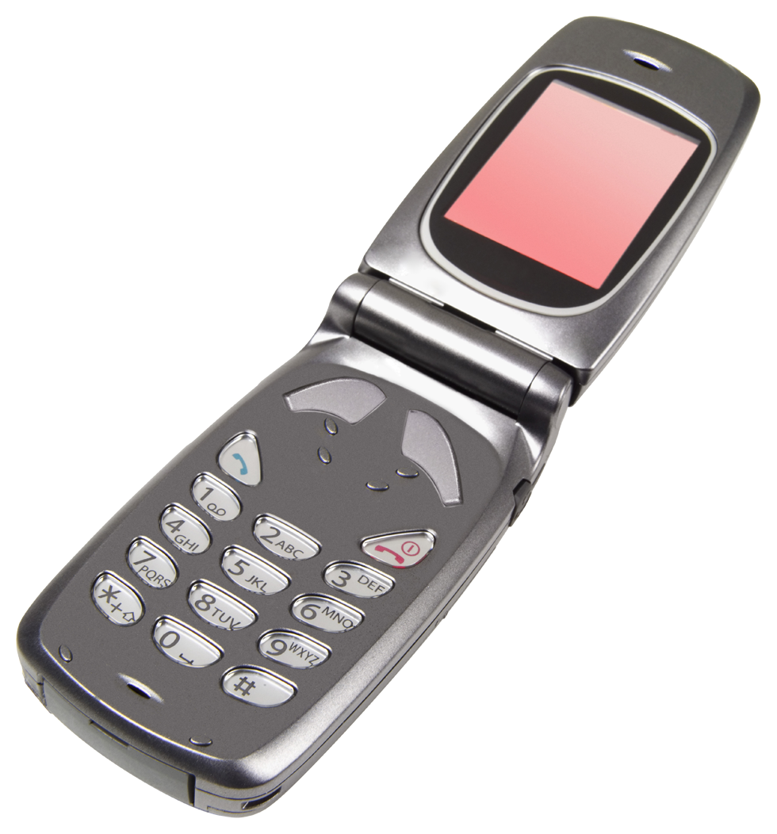

Language Technology
making good progress
Sentiment analysis
still really hard
mostly solved
Best roast chicken in San Francisco!
Question answering (QA)
The waiter ignored us for 20 minutes.
Spam detection
Coreference resolution
Q. How effective is ibuprofen in reducing fever in patients with acute febrile illness?
✓
Let’s go to Agra!
Paraphrase
✗
Carter told Mubarak he shouldn’t run again.
Buy V1AGRA …
Word sense disambiguation (WSD)
XYZ acquired ABC yesterday
Part-of-speech (POS) tagging
I need new batteries for my mouse.
ABC has been taken over by XYZ
ADJ ADJ NOUN VERB ADV
Summarization
Colorless green ideas sleep furiously.
Parsing
The Dow Jones is up
Economy is good
I can see Alcatraz from the window!
The S&P500 jumped
Named entity recognition (NER)
Machine translation (MT)
Housing prices rose
PERSON ORG LOC
第13届上海国际电影节开幕…
Dialog
Where is Citizen Kane playing in SF?
Einstein met with UN officials in Princeton
The 13th Shanghai International Film Festival…
Information extraction (IE)
Castro Theatre at 7:30. Do you want a ticket?
You’re invited to our dinner party, Friday May 27 at 8:30
Party May 27 add

Slide 14
Applications
Spoken Language
dictation (IBM ViaVoice, Dragon Naturally Speaking)
Telephone-based customer support (phone mazes)

Slide 15
Applications
Machine translation
Methods are not at all based on how humans translate
Works better for “controlled languages” – technical manuals
(Microsoft, Catterpiller, etc.)
ex: Systran: http://www.systransoft.com/ , Google:
http://www.google.com/language_tools?hl=en

Slide 16
Applications
Information Extraction
Dealtime, Google Products, Monster.com (job search)
Some open source tools:
http://cs.nyu.edu/courses/spring10/G22.2590-001/index.html
http://alias-i.com/lingpipe/

Slide 17
Applications
Question Answering
ask.com, Wolfram Alpha, MIT start: http://start.csail.mit.edu/
Summarization: http://newsblaster.cs.columbia.edu/
Summarization, Spelling/Grammar Checking, etc.

Slide 18
Ambiguity makes NLP hard:
100% REAL
Red Tape Holds Up New Bridges
Hospitals Are Sued by 7 Foot Doctors
Juvenile Court to Try Shooting Defendant
Local High School Dropouts Cut in Half

Slide 19
Why else is natural language understanding difficult?
non-standard English
segmentation issues
idioms
Great job @justinbieber! Were SOO PROUD of what youve accomplished! U taught us 2 #neversaynever & you yourself should never give up either♥
dark horse
get cold feet
lose face
throw in the towel
the New York-New Haven Railroad
the New York-New Haven Railroad
neologisms
world knowledge
tricky entity names
unfriend
Retweet
bromance
Mary and Sue are sisters.
Mary and Sue are mothers.
Where is A Bug’s Life playing …
Let It Be was recorded …
… a mutation on the for gene …

Slide 20
Making progress on this problem…
The task is difficult! What tools do we need?
Knowledge about language
Knowledge about the world
A way to combine knowledge sources
How we generally do this:
probabilistic models built from language data
P(“maison” → “house”) high
P(“L’avocat général” → “the general avocado”) low
Luckily, rough text features can often do half the job.

Slide 21
Lexical Resources
Read machine readable text, dictionaries, thesauri and tools for processing them
Brown Corpus (1960-70): widely known, million words corpus, American English, pay to use it, include press reportage, fiction, scientific text, legal text, and many others.
Lancaster Oslo Bergen (LOB) corpus is British English replication of Brown Corpus.
Susanne Corpus : 130,000 words, freely available, subset of Brown Corpus, contain information on syntactic structure of sentence,
Penn Treebank: text from Wall Street Journal, widely used, not free
Canadian Hansards: proceeding of Canadian parliament, bilingual corpus, not freely available, such parallel text corpus is important for statistical machine translation and other cross lingual NLP work.

