Slide 1

GOOGLE STOCK PRICE PREDICTION USING MACHINE LEARNING
Under the guidance of
Dr. B.K. Sharma
Submitted by:-
Umashankar ray MCA/40028/22
Abinash Thakur MCA/40058/22

Slide 2
INTRODUCTION
This project aims to predict Google stock prices through a data-driven approach, crucial for investors and financial analysts. Leveraging historical stock price data, various machine learning algorithms such as Linear Regression, ARIMA, and LSTM are employed for forecasting. Data preprocessing steps, including handling missing values and feature selection, enhance model accuracy. Exploratory Data Analysis (EDA) uncovers trends and patterns in the data, informing the modeling process. Model evaluation metrics such as Mean Absolute Error (MAE) and Root Mean Squared Error (RMSE) assess predictive performance. Results are compared against actual historical prices, facilitating insights into model robustness and limitations. Challenges like data quality and model complexity are discussed, alongside suggestions for future research. The project underscores the importance of accurate stock price prediction in investment decision-making.
Data-Driven Approach
Machine Learning Algorithms
Data Preprocessing
Exploratory Data Analysis (EDA)
Model Evaluation Metrics

Slide 3
NumPy & Python
NumPy is python package which provide scientific and higher-level mathematical abstractions wrapped in python. It is the core library for scientific computing, that contains a provide tools for integrating C, strong n-dimensional array object, C++ etc. It is also useful in random number capability, linear algebra etc.
NumPy’s array type augments the Python language with an efficient data structure used for numerical work, e.g., manipulating matrices. NumPy additionally provides basic numerical routines, like tools for locating Eigenvectors.
Pandas is an open-source library that is built on top of NumPy library. It is a Python package that offers various data structures and operations for manipulating numerical data and time series. It is mainly popular for importing and analyzing data much easier. Pandas is fast and it has high-performance & productivity for users.
Creating Objects
Viewing Data
Selection
Manipulating Data
Grouping Data
Merging, Joining and Concatenating
Working with Date and Time
Working With Text Data
Working with CSV and Excel files

Slide 4
Scikit-Learn & Tensorflow
Scikit-learn could be a free machine learning library for Python. It features numerous classification, clustering and regression algorithms like random forests, k-neighbours, support vector machine, and it furthermore supports Python scientific and numerical libraries like SciPy and NumPy.
In Python Scikit-learn is specifically written, with the core algorithms written in Python to get the performance. Support vector machines are enforced by a Python wrapper around LIBSVM.i.e., linear support vector machines and logistic regression by a similar wrapper around LIBLINEAR.
In the Tensor Flow has an open-source software library for numerical computation using data flow graphs. Inside the graph nodes represent mathematical formulae, the edges of graph represent the multidimensional knowledge arrays (tensors) communicated between them. The versatile architecture permits to deploy the computation to at least one or many GPUs or CPUs in a desktop, mobile device, servers with a single API. TensorFlow was firstly developing by engineers and researchers acting on the Google Brain Team at intervals Google's Machine Intelligence analysis organization for the needs of conducting deep neural networks research and machine learning, but the system is generally enough to be appropriate in a wide range of alternate domains as well.
Google Brain's second-generation system is TensorFlow. Whereas the reference implementation runs on single devices, TensorFlow can run on multiple GPUs and CPUs. TensorFlow is offered on Windows, macOS, 64-bit Linux and mobile computing platforms together with iOS and Android.

Slide 5
KERAS
Keras is a high-level neural networks API, it is written in Python and also capable of running on top of the Theano, CNTK, or. TensorFlow. It was developed with attention on enabling quick experimentation. having the ability to travel from plan to result with the smallest amount doable delay is key to doing great research. Keras permits for straightforward and quick prototyping (through user-friendliness, modularity, and extensibility). Supports each recurrent networks and convolutional networks, also as combinations of the 2. Runs seamlessly on GPU and CPU. The library contains numerous implementations of generally used neural network building blocks like optimizers, activation functions, layers, objectives and a number of tools to create operating with text and image data easier. The code is hosted on GitHub, and community support forums embody the GitHub issues page, a Gitter channel and a Slack channel.

Slide 6
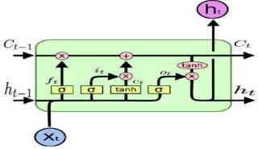
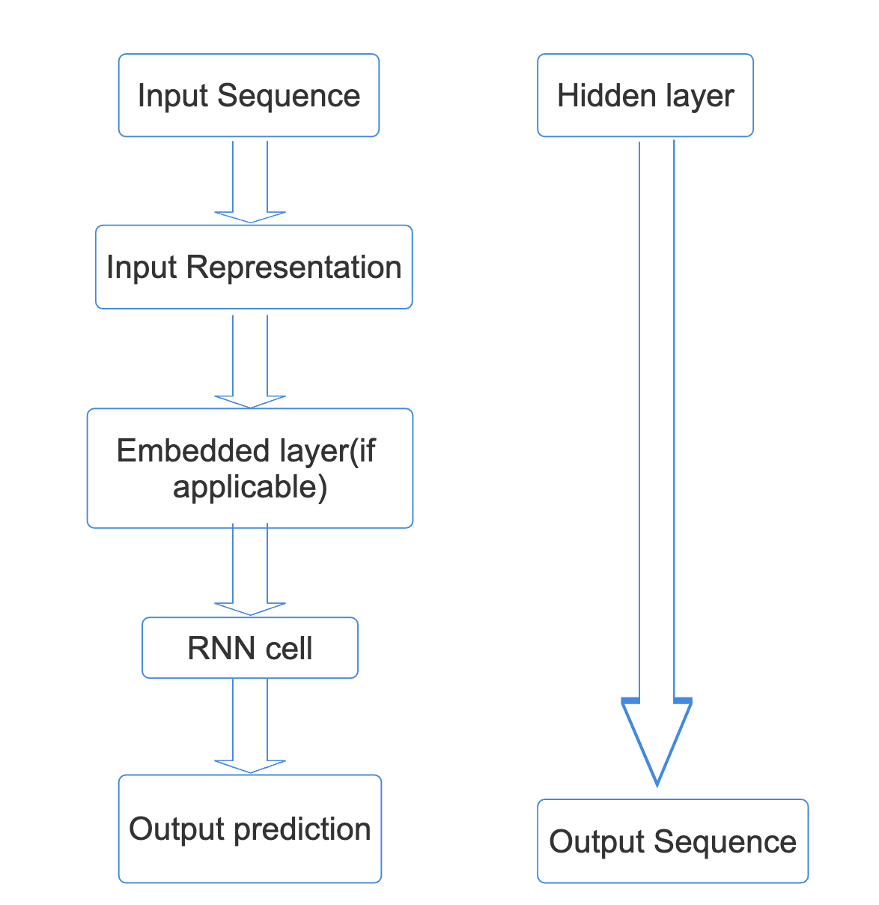
Working of LSTM & RNN model
LSTM
RNN

Slide 7
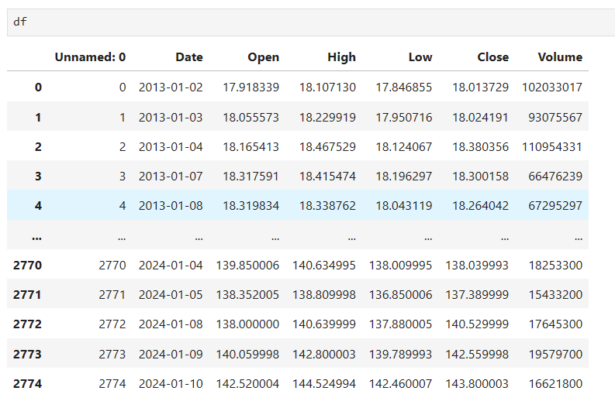
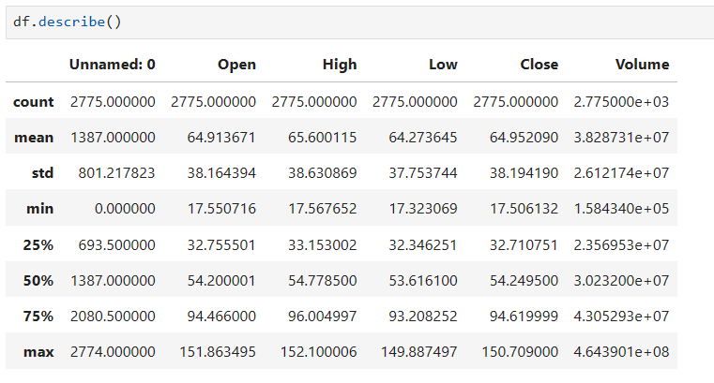
STEPS IN IMPLEMENTATION & RESULT Reading Datasets Data Preprocessing
After Dataset reading, I have performed preprocessing operation on the dataset. Here I apply Min-Max Scaler to preprocess the dataset. In preprocessing operation removes the noise into the data and convert data into 0 to 1 form.
After performing data analysis, I have read the dataset. It shows the dataset information table starting from the tail. There are 4274 data are available in each companies’ dataset.

Slide 8
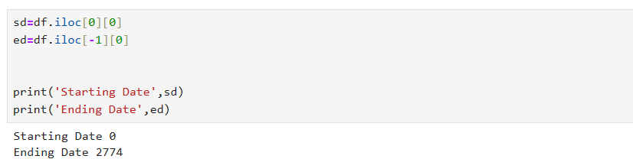
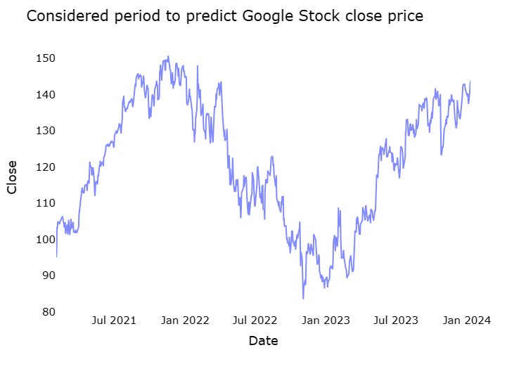
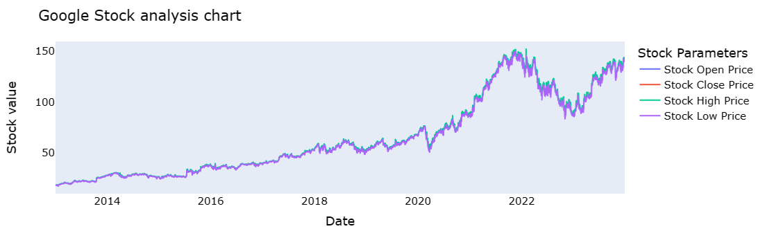
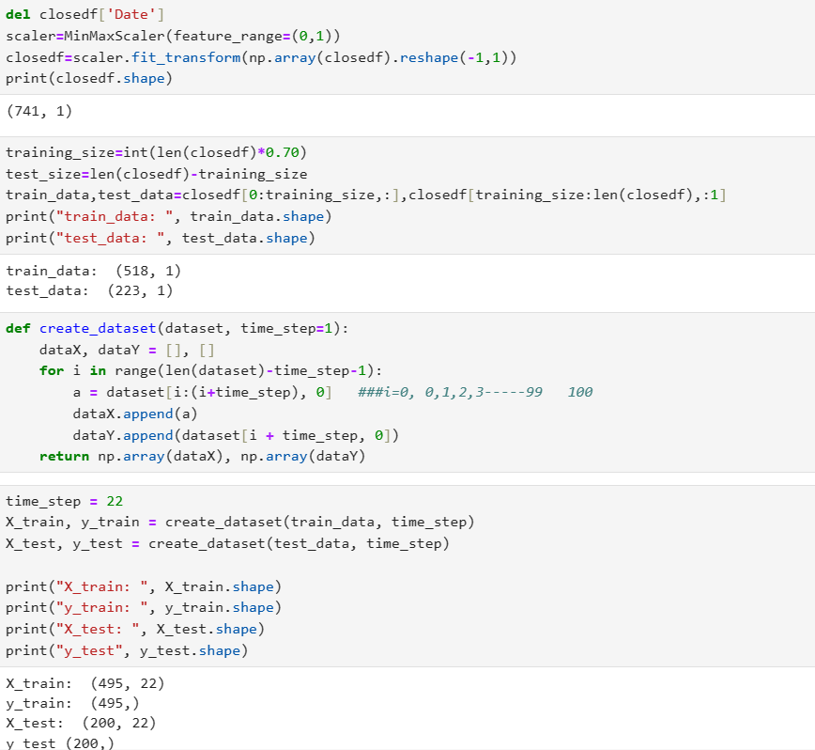
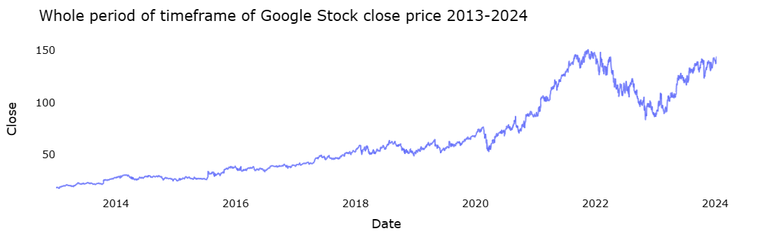
EDA & Building LSTM Train & Test Split
EDA(Exploratory Data Analysis) involves reading, writing & shaping of data. It involves figuring of chart graph using LSTM with RNN.
Here 2d Testing and Training data sets are splitted into
3d training and testing set with time step.

Slide 9
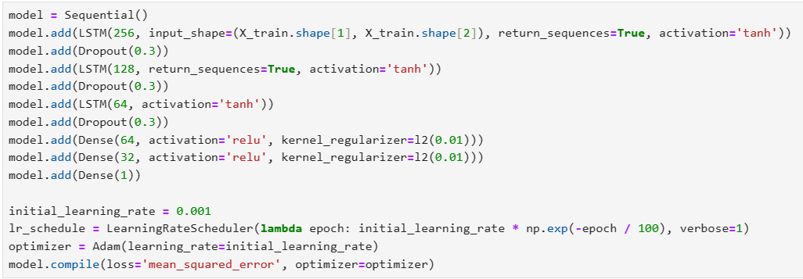
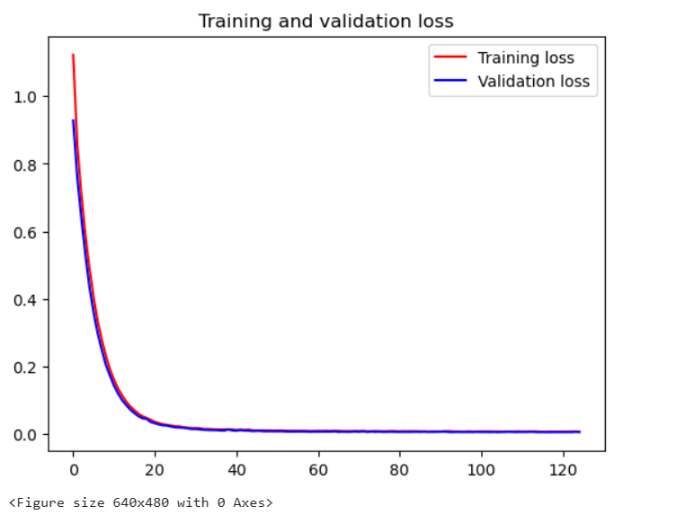
Model fitting of LSTM,RNN & hybrid approach of LSTM+RNN & Training & Validation Loss & Apply Training

Slide 10
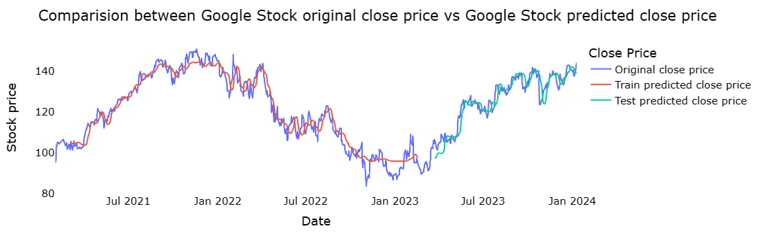
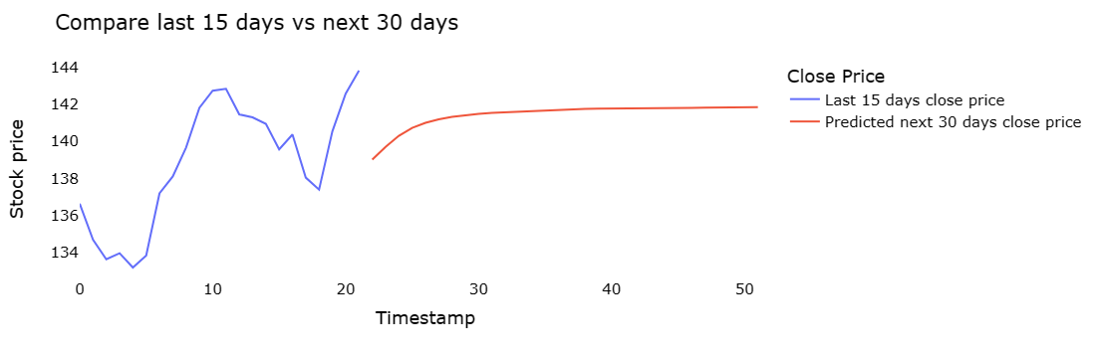
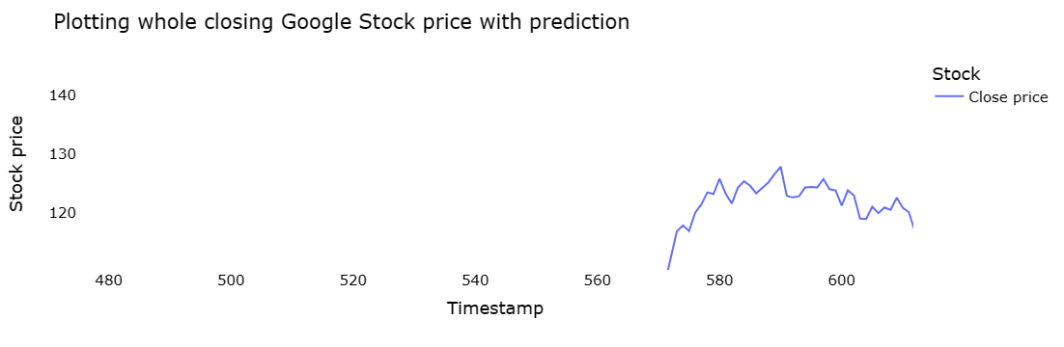
Predicted Graph

Slide 11
Conclusion and Future work
In report, we will compare a machine learning models like LSTM model, the RNN model and also the hybrid approach of LSTM + RNN model. We have a tendency to train the model using the data of google company to predict the stock future value. This shows the proposed method is capable to distinctive around interrelation with the data. Also, it is evident from the results that, Hybrid approach of LSTM+RNN model is capable to identify the changes in trends. For the projected method the Hybrid approach of LSTM+RNN is known as the best model. It uses the information given at a specific instant for prediction. Even if the other two models LSTM and RNN are utilized in a lot of other time-dependent data analysis, it is not outperforming over the Hybrid approach of LSTM+RNN architecture in this case. This is often because of quick changes occur in stock market. The changes in the stock market are not always be in a regular pattern or not always follow the continuous cycle. Based on the companies and sectors, the existence of the trends and the period of their existence will differ. The analysis of this type of cycles and trends can offer a more profit to the investors. In future work, we add more stock market data and compare more model to improve accuracy of predicted stock price.
In the future, for better accuracy model can be trained with more varied and detailed data. Also, other algorithms along with proposed can be used to create a new hybrid model.

Slide 12
Refrences

