Slide 1
Code basics resume project challenge
Challenge : Provide Insights to the Marketing Team in Food & Beverage Industry
Company name : Codex
Domain : F & B Function: Marketing
Presenter : Uma Sharma

Slide 2
Plan of action
About Codex
Problem Statement
Insights from data
Recommendations

Slide 3
About Codex Problem Statement
Codex is German beverage company that is aiming to make its mark in the Indian market. A few month ago they have launched their energy drink in 10 cities in India.
As a Marketing data analyst, I need to convert the survey results to actionable insights which can be used by the marketing team to take necessary actions that drive the growth of company.

Slide 4
Sections
Demographics
Consumer Preferences
Competition Analysis
Marketing Channel and Awareness
Brand Penetration
Purchase Behaviour
Product Development
Recommendations

Slide 5
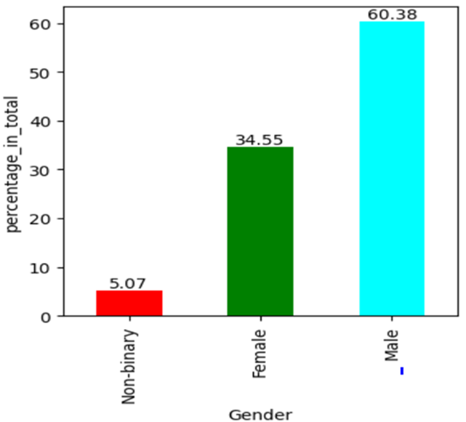
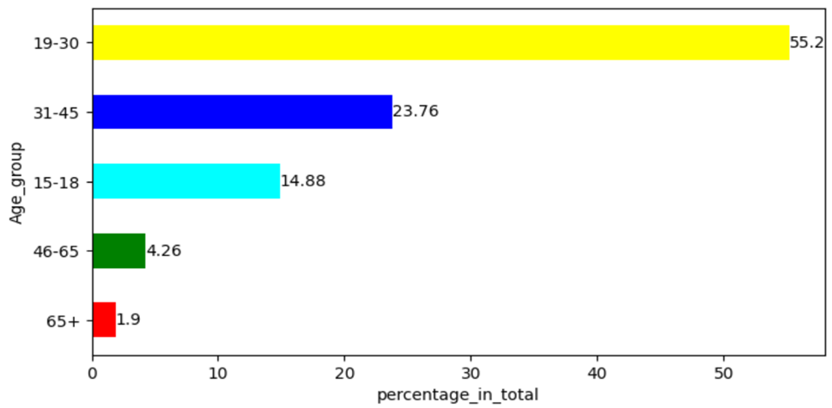
DEMOGRAPHICS INSIGHTS
1. Who PREFERS ENERGY DRINKS MORE?
2. Which age group prefers energy drinks more?

Slide 6
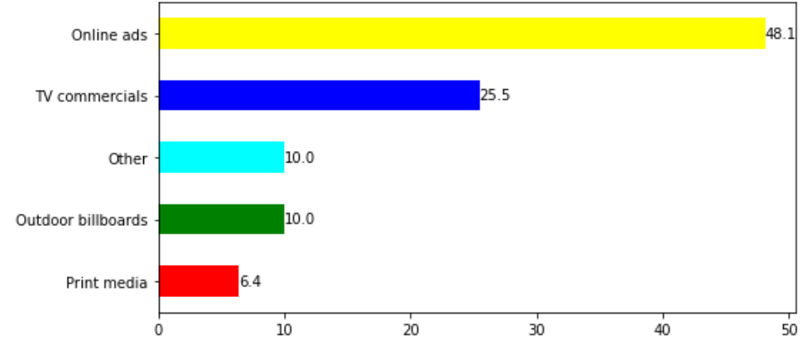
DEMOGRAPHICS INSIGHTS
3. Which type of marketing reaches the most Youth (15-30)?
Online ads seems most powerful marketing strategy with 48.1% .Tv commercials with around 26% cannot be ignored.

Slide 7
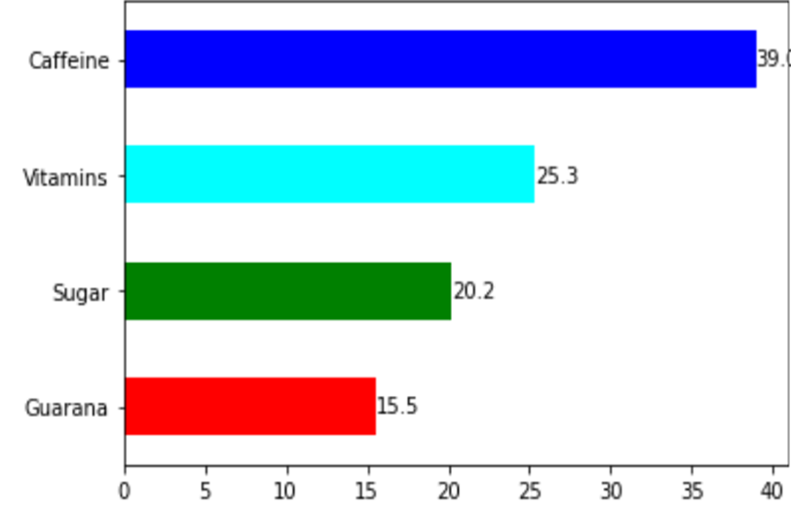
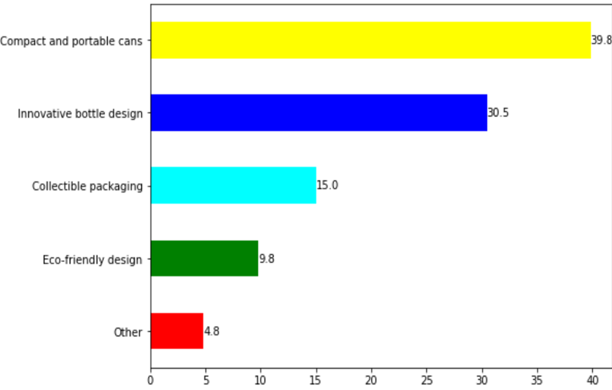
Consumers Preferences
2. What packaging preferences do respondents have for energy drinks?
1 . What are the preferred ingredients of energy drinks among respondents?

Slide 8
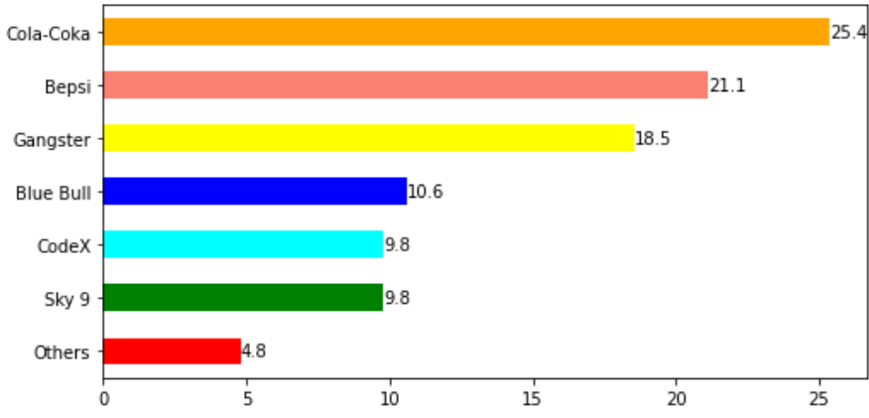
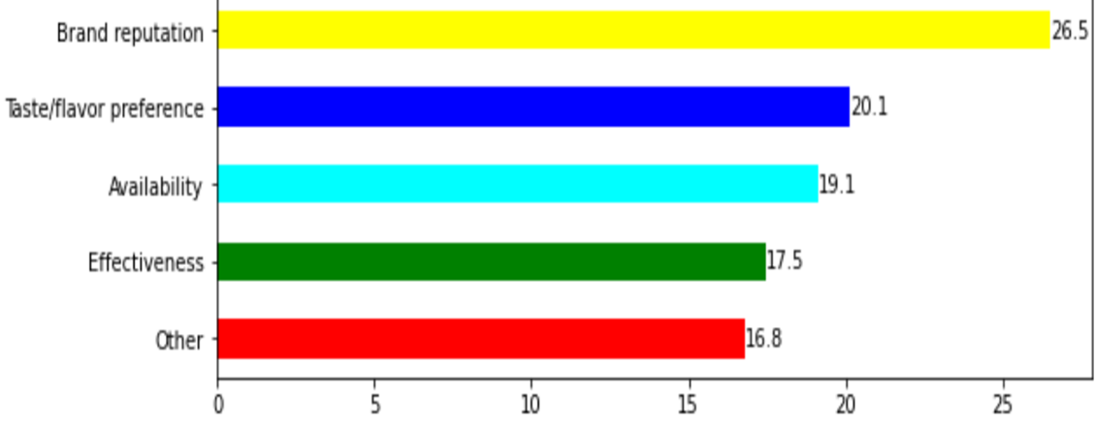
Competition Analysis
1.Who are the current market leaders?
2.What are the primary reasons consumers prefer those brands over ours?

Slide 9

Competition Analysis
2. What are the primary reasons consumers prefer those brands over ours?
Brand reputation>Taste/flavour preference>Availability>Effectiveness
first place brand reputation is on the first place with 27 % of people, the reasons are 1-Brands save decision making time
2-Brands provids safety
3-Brand adds value
4-Strong Brands give consumers a reason to share their experience and so on .
so it becomes very important to establish brand.

Slide 10
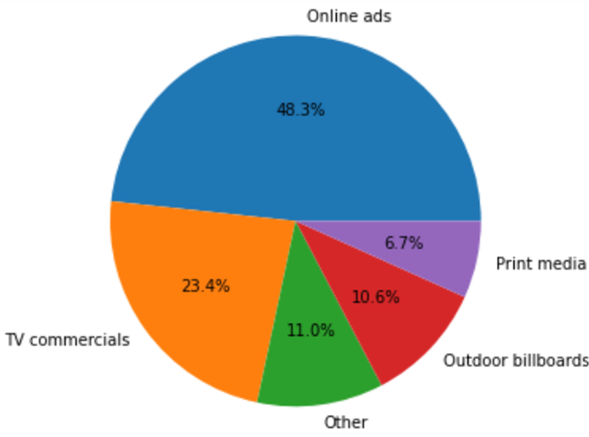
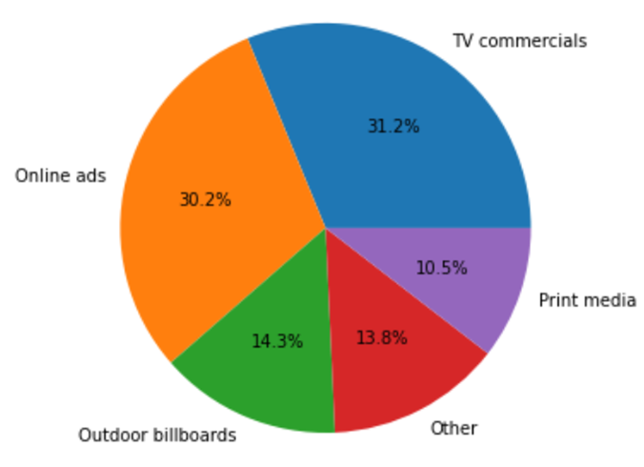
Marketing Channels and Brand Awareness: 1.Which marketing channel can be used to reach more customers?
19-30 age group can be targeted through online ads having 48% because they use social media.
other age groups except 19-30 are seeing ads almost equally through ‘TV commercials’ and ‘Online ads’.so we can’t take ‘TV commercials’ lightly.

Slide 11
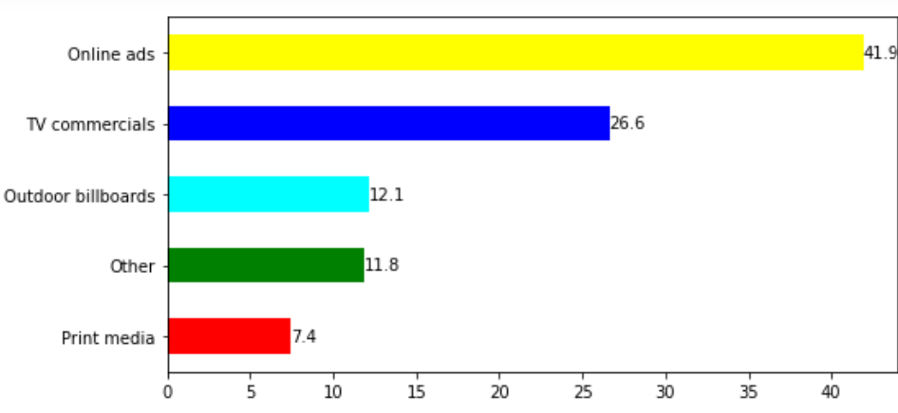
Marketing Channels and Brand Awareness 2. How effective are different marketing strategies and channels in reaching our customers?

Slide 12
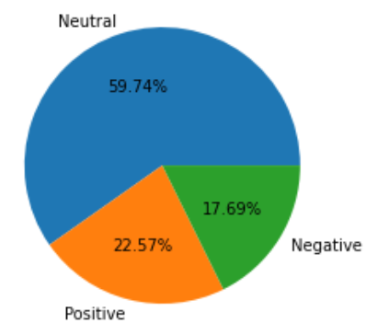
Brand Penetration 1. What do people think about our brand? (overall rating)
around 82% customers are having no hate about the brand but in future we can work on it as 60% people are finding it neutral jbki brand name must be so unique and impressive

Slide 13
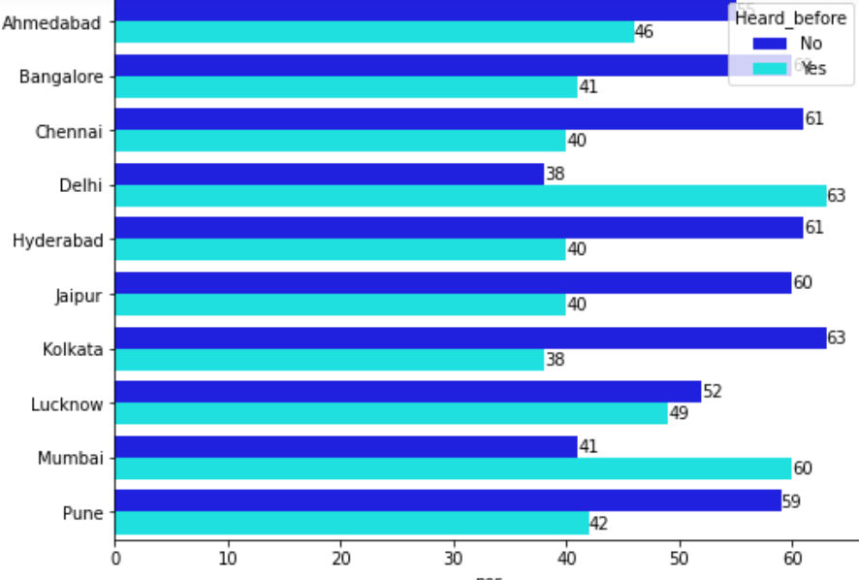
Brand Penetration 2. Which cities do we need to focus more on?
Delhi is performing best ,63% already heard
Kolkata is doing not well as 63% never heard about codex

Slide 14
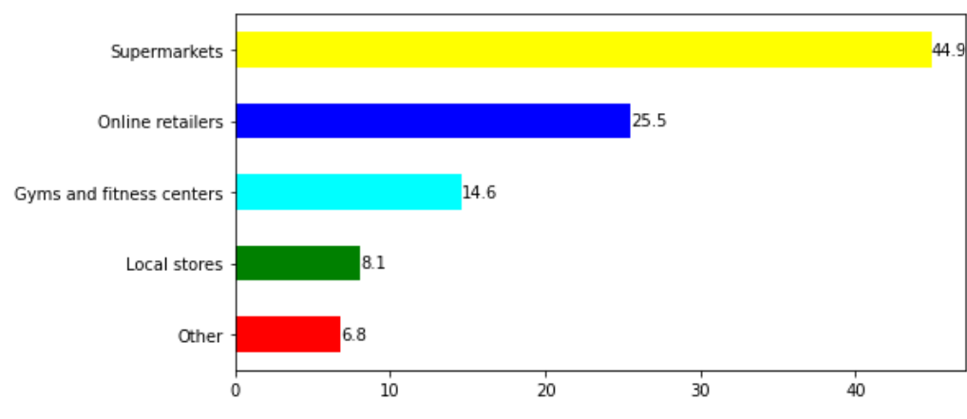
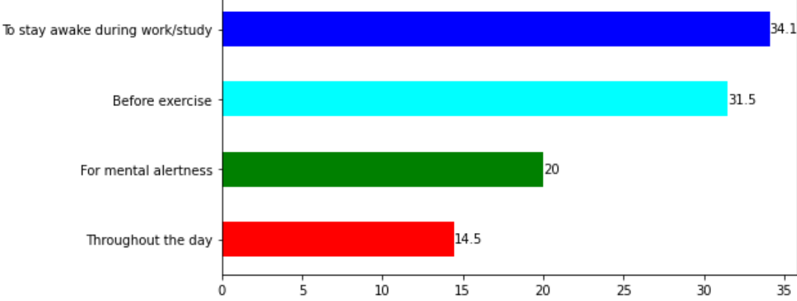
Purchase BEHAVIOUR
2. What are the typical consumption situations for energy drinks among respondents?
1. Where do respondents prefer to purchase energy drinks?

Slide 15
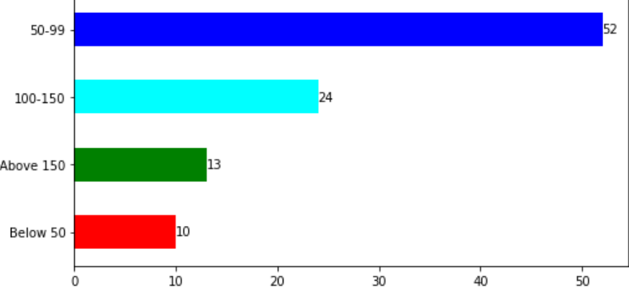
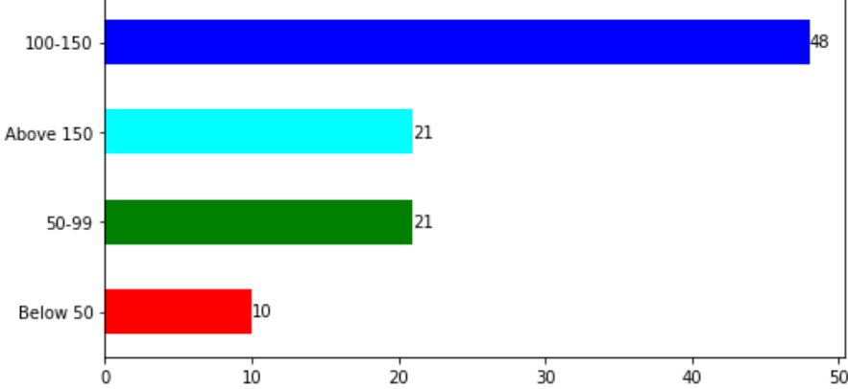
Purchase behaviour 3. What factors influence respondents' purchase decisions, such as price range and limited edition packaging?
52% Consumers under 30 are preferring energy drink in price range of 50-99.
69% Consumers above 30 are preferring energy drink for 100 Rs+.

Slide 16
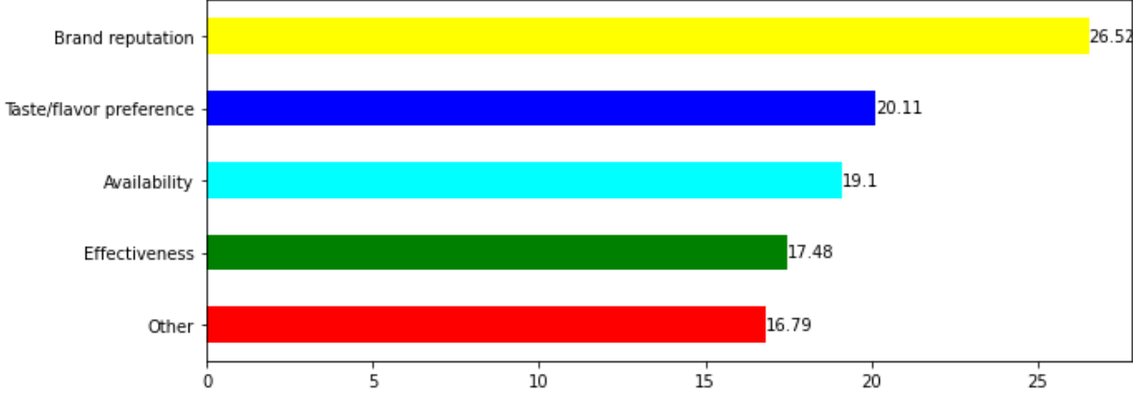
Product Development 1. Which area of business should we focus more on our product development? (Branding/taste/availability)?
We should focus on Brand reputation and then Availability because 75% consumers are giving 3+ rating about taste so Taste/flavor can take place after these two.

Slide 17
Recommendations
What immediate improvements can we bring to the product?
As people are having more Interest in organic energy drink ,we must use more natural ingredients in production and also reduce sugar content as per the customers demand.
We must focus on creative cans from packaging preference.
Taste/Flavor is also very importance factor of choosing any specific brand currently so we should launch codex with better taste and more flavor varieties.

Slide 18
Recommendations
What should be the ideal price of our product?
We can have two price buckets one is 50-99 and other is 100-130 .
Because out of target customers around 52% of consumers are preferring 50-99 price range.
For price range 100-130 ,we can give more flavour choices and extra volume (like some % extra energy drink in volume).

Slide 19
Recommendations
What kind of marketing campaigns, offers, and discounts we can run?
Build Partnership with developing brand and tie up with colleges, corporate offices, gyms (as 34% for study & focus and 31.5% before exercise).
Referral Program.
Organize workshops and campaigns for product awareness at desired public places.
Student and family based discounts (like 20% on second bucket price i.e. 100-130 for students and for family Buy 3 get 1 free)

Slide 20
Recommendations
Who can be a brand ambassador, and why?
Firstly Choose persons who belongs to gym/fitness domain(as 31% takes before exercise) and look up to those students who prepares for exams and also active on social media through blogs and other activities (34% takes before study and work).
Second most important thing which is considerable is that ,An Ideal brand ambassador must have a good engagement rate means are their followers really engaged with them.
We must look for multiple mid-scale influencers as they have more engagement .
Choose those who enjoy their workouts on social media having positive image also they must have personal interest rooted in what our brand does so that they will be able to effectively represent our brand to public.

Slide 21
Recommendations
Who should be our target audience, and why?
As out of total males are having fist place with 60% so they can be our target audience.
From frequent audience 70% belongs to age group 15-30 so they can be considered as our target audience.

Slide 22
Thank you

