Slide 1

Chapter 1 Getting Organized

Slide 2
Chapter 1: Getting Organized
1.1 – Software Engineering
1.2 – Object Orientation
1.3 – Classes, Objects, and Applications
1.4 – Organizing Classes
1.5 – Data Structures
1.6 – Basic Structuring Mechanisms
1.7 – Comparing Algorithms: Big-O Analysis

Slide 3
1.1 Software Engineering
The field devoted to the specification, design, production, and maintenance of non-trivial software products.
Includes supporting activities such as
cost estimation
documentation
team organization
use of tools

Slide 4
Software Life Cycle Activities
Problem analysis
Requirements
elicitation
specification
Design
high-level
low-level
Testing
Verification
Delivery
Operation
Maintenance

Slide 5
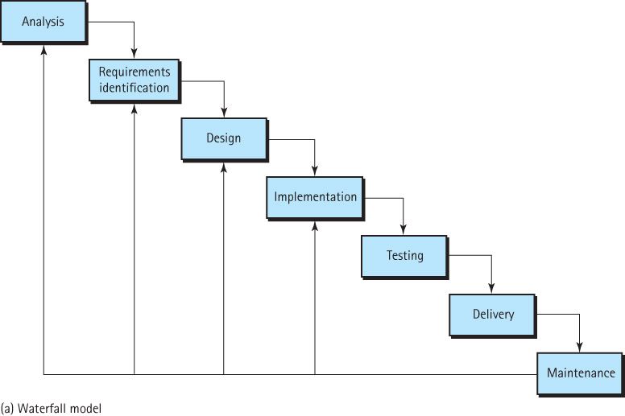
Waterfall Life-Cycle Model

Slide 6
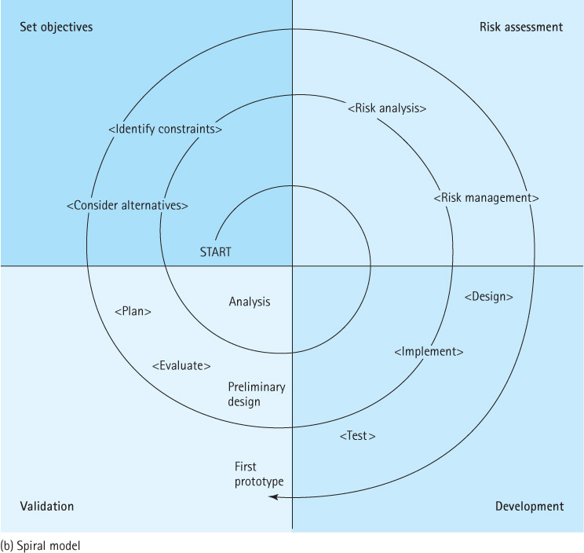
Spiral Life-Cycle Model

Slide 7
Agile Methods
Customer involvement across life cycle
Incremental development and delivery
Embrace change
Customer satisfaction is primary goal
Pair Programming
and more

Slide 8
Some Goals of Quality Software (no matter what approach you use)
It works.
It can be modified without excessive time and effort.
It is reusable.
It is completed on time and within budget.

Slide 9
1.2 Object Orientation
Objects represent
information: we say the objects have attributes
behavior: we say the objects have responsibilities
Objects can represent “real-world” entities such as bank accounts
Objects are self-contained and therefore easy to implement, modify, and test for correctness
Object-oriented classes, when designed properly, are very easy to reuse

Slide 10
1.3 Classes, Objects, and Applications
An object is an instantiation of a class
Alternately, a class defines the structure of its objects.
A class definition includes variables (data) and methods (actions) that determine the behavior of an object.
Example: the Date class (next slide)

Slide 11
public class Date
{
protected int year;
protected int month;
protected int day;
public static final
int MINYEAR = 1583;
// Constructor
public Date(int newMonth,
int newDay,
int newYear)
{
month = newMonth;
day = newDay;
year = newYear;
}
// Observers
public int getYear()
{
return year;
}
public int getMonth()
{
return month;
}
public int getDay()
{
return day;
}
public int lilian()
{
// Returns the Lilian Day Number
// of this date.
// Algorithm goes here.
}
public String toString()
// Returns this date as a String.
{
return(month + "/" + day
+ "/" + year);
}
}

Slide 12
Java Access Control Modifiers
 | Within the Class | Within Subclasses in the Same Package | Within Subclasses in Other Packages | Everywhere
public | X | X | X | X
protected | X | X | X
package | X | X
private | X

Slide 13
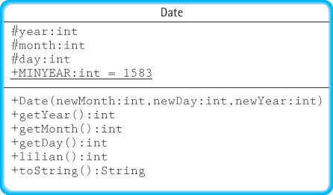
Class Diagram for Date Class

Slide 14
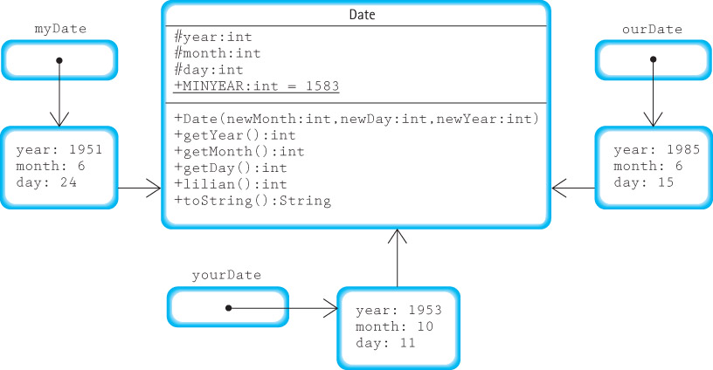
Objects
Date myDate = new Date(6, 24, 1951);
Date yourDate = new Date(10, 11, 1953);
Date ourDate = new Date(6, 15, 1985);

Slide 15
Applications
An object-oriented application is a set of objects working together, by sending each other messages, to solve a problem.
In object-oriented programming a key step is identifying classes that can be used to help solve a problem.
An example – using our Date class to solve the problem of calculating the number of days between two dates (next 3 slides)

Slide 16
DaysBetween Design
display instructions
prompt for and read in info about the first date
create the date1 object
prompt for and read in info about the second date
create the date2 object
if dates entered are too early
print an error message
else
use the date.lilian method to obtain the
Lilian Day Numbers
compute and print the number of days
between the dates

Slide 17
//----------------------------------------------------------------------
// DaysBetween.java by Dale/Joyce/Weems Chapter 1
//
// Asks the user to enter two "modern" dates and then reports
// the number of days between the two dates.
//----------------------------------------------------------------------
import java.util.Scanner;
public class DaysBetween
{
public static void main(String[] args)
{
Scanner conIn = new Scanner(System.in);
int day, month, year;
System.out.println("Enter two 'modern' dates: month day year");
System.out.println("For example January 12, 1954 would be: 1 12 1954");
System.out.println();
System.out.println("Modern dates occur after " + Date.MINYEAR + ".");
System.out.println();
System.out.println("Enter the first date:");
month = conIn.nextInt();
day = conIn.nextInt();
year = conIn.nextInt();
Date date1 = new Date(month, day, year);

Slide 18
System.out.println("Enter the second date:");
month = conIn.nextInt();
day = conIn.nextInt();
year = conIn.nextInt();
Date date2 = new Date(month, day, year);
if ((date1.getYear() <= Date.MINYEAR) ||
(date2.getYear() <= Date.MINYEAR))
System.out.println("You entered a 'pre-modern' date.");
else
{
System.out.println("The number of days between");
System.out.print(date1);
System.out.print(" and ");
System.out.print(date2);
System.out.print(" is ");
System.out.println(Math.abs(date1.lilian() - date2.lilian()));
}
}
}

Slide 19
1.4 Organizing Classes
During object-oriented development hundreds of classes can be generated or reused to help build a system.
The task of keeping track of these classes would be impossible without organizational structure.
Two of the most important ways of organizing Java classes are
inheritance: classes are organized in an “is-a” hierarchy
packages: let us group related classes together into a single named unit

Slide 20
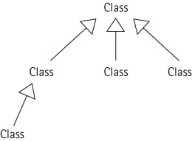
Inheritance
Allows programmers to create a new class that is a specialization of an existing class.
We say that the new class is a subclass of the existing class, which in turn is the superclass of the new class.

Slide 21
Example of Inheritance
public class IncDate extends Date
{
public IncDate(int newMonth, int newDay, int newYear)
{
super(newMonth, newDay, newYear);
}
public void increment()
// Increments this IncDate to represent the next day.
// For example if this = 6/30/2005 then this becomes 7/1/2005.
{
// increment algorithm goes here
}
}

Slide 22
Declaring and Using Date and IncDate Objects
Date myDate = new Date(6, 24, 1951);
IncDate aDate = new IncDate(1, 11, 2001);
System.out.println("mydate day is: " + myDate.getDay());
System.out.println("aDate day is: " + aDate.getDay());
aDate.increment();
System.out.println("the day after is: " + aDate.getDay());
See Extended Class Diagram next slide.

Slide 23
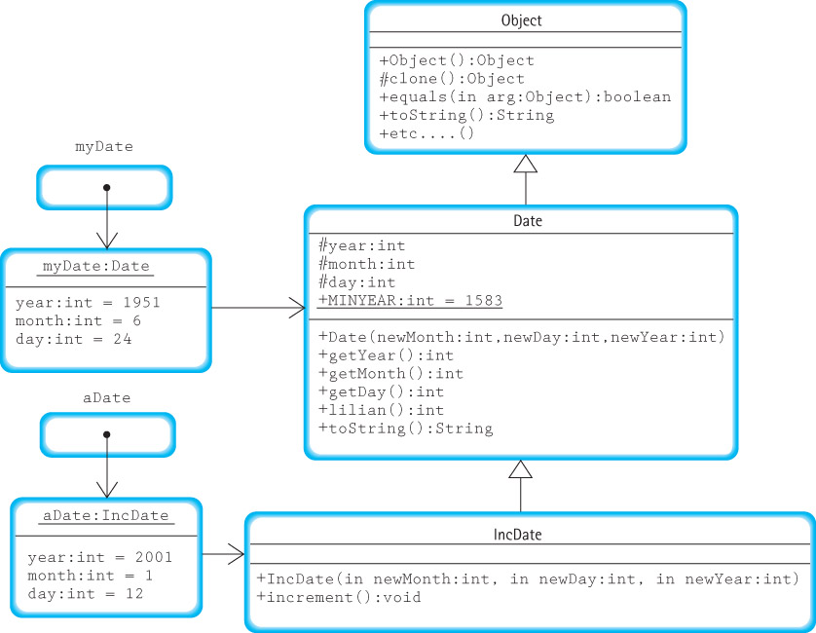

Slide 24
Packages
Java lets us group related classes together into a unit called a package. Packages provide several advantages. They
let us organize our files.
can be compiled separately and imported into our programs.
make it easier for programs to use common class files.
help us avoid naming conflicts (two classes can have the same name if they are in different packages).

Slide 25
Using Packages
A Java compilation unit can consist of a file with
the keyword package followed by an identifier indicating the name of the package:
package someName;
import declarations, to make the contents of other packages available:
import java.util.Scanner;
one or more declarations of classes; exactly one of these classes must be public
The classes defined in the file are members of the package.
The imported classes are not members of the package.
The name of the file containing the compilation unit must match the name of the public class within the unit.

Slide 26
Using Packages
Each Java compilation unit is stored in its own file.
The Java system identifies the file using a combination of the package name and the name of the public class in the compilation unit.
Java restricts us to having a single public class in a file so that it can use file names to locate all public classes.
Thus, a package with multiple public classes must be implemented with multiple compilation units, each in a separate file.

Slide 27
Using Packages
In order to access the contents of a package from within a program, you must import it into your program:
import packagename.*;
import packagename.Classname;
The Java package rules are defined to work seamlessly with hierarchical file systems:
import ch03.stacks.*;

Slide 28
1.5 Data Structures
The way you view and structure the data that your programs manipulate greatly influences your success.
A language's set of primitive types (Java's are byte, char, short, int, long, float, double, and boolean) are not sufficient, by themselves, for dealing with data that have many parts and complex interrelationships among those parts.
Data structures provide this ability.

Slide 29


Implementation Dependent Structures
Array
Linked List

Slide 30
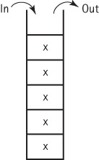


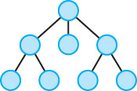
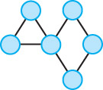
Implementation Independent Structures
Stack
Queue
Sorted List
Tree
Graph

Slide 31
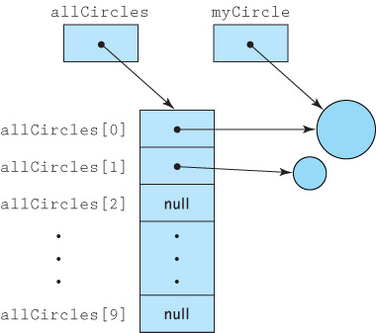
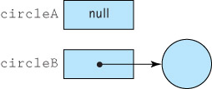
1.6 Basic Structuring Mechanisms
There are two basic structuring mechanisms provided in Java (and many other high level languages)
Arrays
References

Slide 32
References
Are memory addresses
Sometimes referred to as links, addresses, or pointers
Java uses the reserved word null to indicate an “absence of reference”
A variable of a reference (non-primitive) type holds the address of the memory location that holds the value of the variable, rather than the value itself.
This has several ramifications …

Slide 33
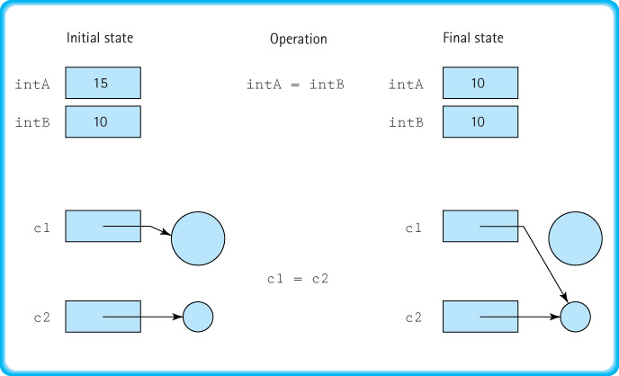
Assignment Statements

Slide 34
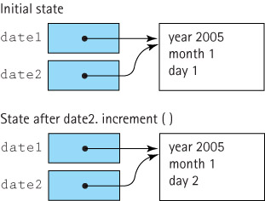
Be aware of aliases

Slide 35
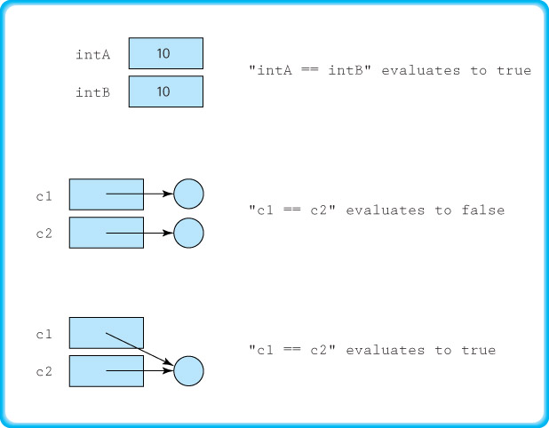
Comparison Statements

Slide 36
Garbage Management
Garbage The set of currently unreachable objects
Garbage collection The process of finding all unreachable objects and deallocating their storage space
Deallocate To return the storage space for an object to the pool of free memory so that it can be reallocated to new objects
Dynamic memory management The allocation and deallocation of storage space as needed while an application is executing

Slide 37
Arrays
We assume students are already familiar with arrays. The subsection on pages 37 to 41 reviews some of the subtle aspects of using arrays in Java:
they are handled “by reference”
they must be instantiated
initialization lists are supported
you can use arrays of objects
you can use multi-dimensional arrays

Slide 38
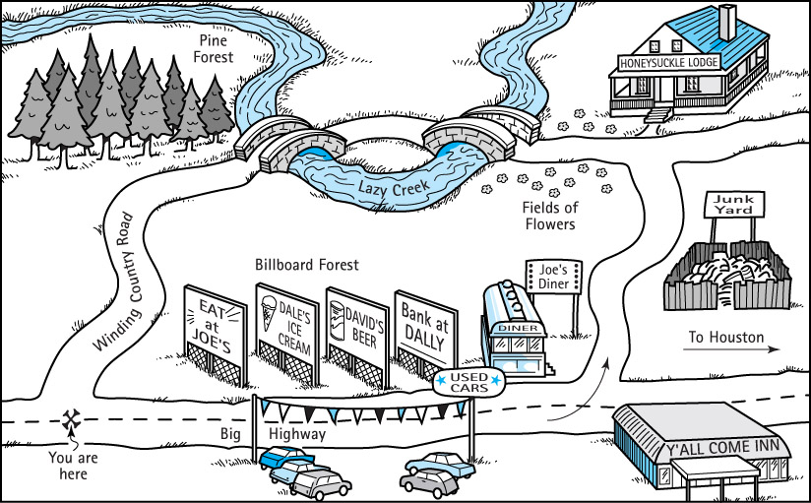
1.7 Comparing Algorithms: Big-O Analysis
There can be more than one algorithm to solve a problem.

Slide 39
Counting Operations
To measure the complexity of an algorithm we attempt to count the number of basic operations required to complete the algorithm
To make our count generally usable we express it as a function of the size of the problem.

Slide 40
Counting Operations Example
problem: return true if sum of numbers in array is > 0, false otherwise
Set sum to zero
while more integers
Set sum to
sum + next int
if sum > 0
Return true
else
Return false
if N = size of array the number of operations required is N + 3
But
too dependent on programming language and counting approach
difficult if problem/algorithm is more complicated

Slide 41
Isolate a fundamental operation
Rather than count all operations, select a fundamental operation, an operation that is performed “the most”, and count it.
For example, if the problem is to sort the elements of an array, count the number of times one element is compared to another element, i.e., only count comparison operations when comparing sorting algorithms.

Slide 42
A further simplification: Big-O Notation
We measure the complexity of an algorithm as the number of times a fundamental operation is performed, represented as a function of the size of the problem.
For example, an algorithm performed on an N element array may require 2N² + 4N + 3 comparisons.
Big-O notation expresses computing time (complexity) as the term in the function that increases most rapidly relative to the size of a problem.
In our example, rather than saying the complexity is 2N² + 4N + 3 we say it is O(N²).
This works just as well for most purposes and simplifies the analysis and use of the complexity measure.

Slide 43
Common Orders of Magnitude
O(1) is called bounded time. The amount of work is not dependent on the size of the problem.
O(log₂N) is called logarithmic time. Algorithms that successively cut the amount of data to be processed in half at each step typically fall into this category.
O(N) is called linear time. Adding together the elements of an array is O(N).
O(N log₂N) is called N log N time. Good sorting algorithms, such as Quicksort, Heapsort, and Mergesort presented in Chapter 10, have N log N complexity.
O(N²) is called quadratic time. Some simple sorting algorithms are O(N²) algorithms.
O(2^{N}) is called exponential time. These algorithms are extremely costly.

Slide 44
Comparison of Growth Rates
N | log₂N | Nlog₂N | N² | N³ | 2^{N}
1 | 0 | 1 | 1 | 1 | 2
2 | 1 | 2 | 4 | 8 | 4
4 | 2 | 8 | 16 | 64 | 16
16 | 4 | 64 | 256 | 4,096 | 65,536
64 | 6 | 384 | 4,096 | 262,144 | requires 20 digits
128 | 7 | 896 | 16,384 | 2,097,152 | requires 39 digits
256 | 8 | 2,048 | 65,536 | 16,777,216 | requires 78 digits

Slide 45
Three Complexity Cases
Best case complexity Related to the minimum number of steps required by an algorithm, given an ideal set of input values in terms of efficiency
Average case complexity Related to the average number of steps required by an algorithm, calculated across all possible sets of input values
Worst case complexity Related to the maximum number of steps required by an algorithm, given the worst possible set of input values in terms of efficiency
To simplify analysis yet still provide a useful approach, we usually use worst case complexity

Slide 46
Ways to simplify analysis of algorithms
Consider worst case only
but average case can also be important
Count a fundamental operation
careful; make sure it is the most used operation within the algorithm
Use Big-O complexity
especially when interested in “large” problems

Slide 47
Sum of Consecutive Integers
Algorithm Sum1
sum = 0;
for (count = 1;
count <= n;
count++)
sum = sum + count;
Sum1 is O(N)
Algorithm Sum2
sum = ((n + 1) * n) / 2;
Sum2 is O(1)

Slide 48
Finding a Number in a Phone Book
Algorithm Lookup1
Check first name
While (unsuccessful)
Check the next name
Lookup1 is O(N)
Algorithm Lookup2
Search area = entire book
Check middle name in search area
While (unsuccessful)
If middle name > target name
Search area = first half of search area
Else
Search area = second half of
search area
Check middle name in search area
Lookup2 is O(log₂N)

