Slide 1
Programming Methodology
Lecture 02 – Source Control and Scala

Slide 2
Objectives
To understand source control
To learn and apply git basics
To learn about Java Collections
To understand the use of Scala
To understand Java vs Scala
To learn the basics of Scala
To learn about the REPL

Slide 3
From last time…
You will be graded on a number of aspects including functional (did it pass tests), your own tests, code style, following instructions, git activity, comments and documentation, and any other criteria designated by the assignment documentations
Grades will be on a letter scale: A-F
This course does not give 0’s on assignments. Why?
Because: 100+0/2 = 50 (an F), 100+50/2 = 75 (a C)
But: A+F/2 != F, so it makes sense for A+F/2 = C (in my book!)

Slide 4
VirtualBox/Vagrant
Why use a virtual machine?
How is it configured?
How do we boot up?
How do we connect?

Slide 5
Basic Command Line
Why do we use the command line?
What are some simple commands?

Slide 6
Compiling Java Programs
IDE is not necessary!
We will use javac to compile Java programs
Need a good structure for our source code
src/main/java, bin
Other things to consider?
packages, classpath

Slide 7
Creating a Project Directory
Very simple from the command line:
$ mkdir –p myproj/src/main/java
$ mkdir myproj/bin
$ cd myproj
$ touch README.md

Slide 8
Quick Git Introduction
Let us go to the command line for this!

Slide 9
Example: Compiling Java
How to compile Java’s hello world
$ javac –d bin src/main/java/Hello.java
This will generate class files into the bin directory.
What is a class file?

Slide 10
Example: Running Java
How to run Java’s hello world
$ java –cp bin Hello
This designates that the “classpath” will be the bin directory and the class to run is Hello.

Slide 11
Example: Compiling Packages
What if we have our code in a package?
$ javac –d bin src/main/java/cs220/Hello.java
This will generate class files into the bin directory.
What is different about the bin directory now? Is there anything wrong?

Slide 12
Example: Running Packaged Java
How to run Java’s hello world
$ java –cp bin cs220.Hello
This designates that the “classpath” will be the bin directory and the class to run is cs220.Hello.

Slide 13
Java and Data Structures
Java has a vast library that comes with many useful data structures.
You can find these in java.util
It helps to understand these data structures a little so that we can compare them to what Scala and other languages provide.

Slide 14
Java’s Data Structures
List
ArrayList, LinkedList, Stack, Vector, …
Map
HashMap, Hashtable, TreeMap, …
Set
HashSet, TreeSet, …
Queue
LinkedList, PriorityQueue, …

Slide 15
ArrayList<T>
How is an array list implemented?
What does the <T> mean?
Here is how you create one: List<String> xs = new ArrayList<String>();
What is interesting about the line above?

Slide 16
Elements in a List
How do you search a list to determine if an element exists?

Slide 17
Elements in a List
How do you search a list to determine if an element exists? xs.contains(“Hello”)
What does this return?

Slide 18
Lists of Other Things
Imagine this class: class Student { private String sid, fname, lname; }
And creating a new list: List<Person> xs = new ArrayList<Person>();

Slide 19
Elements in a List of other things
Assume we have a Person p, then what does this mean? xs.contains(p)
What does this return?
Is this ok for lists?

Slide 20
What about sets?
Here is a set in Java Set<Person> s = new HashSet<Person>();
Then, what does s.contains() mean?

Slide 21
Object Equality
Very important to understand!
Java’s data structures depend on it!
A set contains 1 and only 1 element as defined by what it means to be “equal” to other elements in the set.
So, how do we make this work right?

Slide 22
Overriding equals
We need to define what it means for objects to be “equal” to each other. How might we define this for the Student class? Let us look at an example… Is this all we need?

Slide 23
Object hashCode
Very important to understand!
Java’s data structures depend on it!
A set contains 1 and only 1 element as defined by what it means to be “equal” to other elements in the set.
So, how do we make this work right?

Slide 24
Overriding hashCode
We need to define what it means for objects to be “unique”. How might we define this for the Student class? Let us look at an example… Is this all we need?

Slide 25
What if we use TreeSet?
Here is a tree set in Java Set<Person> s = new TreeSet<Person>();
Are we still required to implement equals and hashCode?
No, instead we must implement Comparable<T>!

Slide 26
Maps
Maps are an extremely useful data structure
Often referred to as a Hashtable or Dictionary
Java provides multiple implementations
Offer O(1) (constant time) insertion and lookup Map<String, Integer> m = new HashMap<String,Integer>(); m.put(“banana”, 24); m.put(“pear”, 43); m.get(“banana”) == 24; // evaluates to true

Slide 27
What do we override?
If we use a HashMap<F,T>
We must override equals and hashCode
If we use a TreeMap<F,T>
We must implement Comparable<T>
And override compareTo
How do we know?
Read the documentation of the class in the Java API carefully to understand how to use the data structure properly!

Slide 28
Activity
Take 5 minutes to write a class called Student that can be used correctly with both a HashMap and a TreeMap.
In addition, given a Person P with fname = “Jane”, lname = “Doe”, and sid = “1234”, the following should produce the proper output: System.out.println(P); // evaluates to: Jane Doe (1234)

Slide 29
i-clicker
How many methods does your Person class contain?
1
2
3
4
5

Slide 30
Take Away Point
In Java, always override the equals and hashCode methods!
In Java, always implement Comparable<T>
And implement the compareTo method!
If you do not do this your classes will not be safe to use with the java.util Collections!

Slide 31

Switch Gears
Ok, enough about Java for the moment…

Slide 32
Scala
A Language that Grows on You Scala is a blend of two important programming paradigms: functional and object-oriented. Scala is useful both in the small (scripting) as well as in the large to build robust and reusable frameworks and libraries. Scala compiles to the JVM and can easily interoperate with Java and its API making it a good next language to learn and transition to.

Slide 33
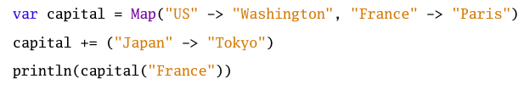
Concise

Slide 34

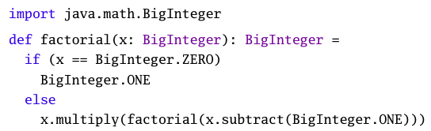
Growing New Types
As compared to Java’s

Slide 35
Scala – Is Scalable
Object-Oriented
Provides classes, interfaces (traits), inheritance, …
Goes further than Java, everything is an Object
Functional
Functions are first-class values
Lisp, Scheme, SML, Erlang, Haskell, OCaml, F#
Emphasizes immutability, functions map input values to output values providing referential transparency

Slide 36
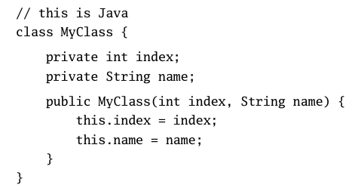
Scala – Why?
Simpler, more concise code. Take a look:
Java

Slide 37
Scala – Why?
Simpler, more concise code. Take a look:
Java
Scala

Slide 38
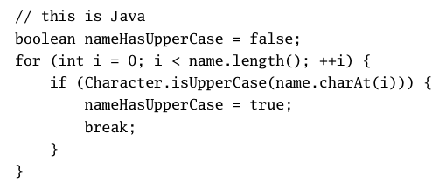
Scala – Why?
High level. Take a look:
Java

Slide 39
Scala – Why?
High level. Take a look:
Java
Scala

Slide 40

Scala – Type Inference
Scala provides more type inference then Java which leads to more concise code:

Slide 41
Scala – First Steps
The Read-Eval-Print Loop!
Will become your best friend!
A wonderful way to experiment and learn!
$ scala
Welcome to Scala version 2.11.5 (Java HotSpot(TM) 64-Bit Server VM, Java 1.8.0_25).
Type in expressions to have them evaluated.
Type :help for more information.
scala>

Slide 42
Scala – Simple Evaluation
scala> 3+4
res0: Int = 7
scala> res0 * 3
res1: Int = 21
scala> println("Hello, World")
Hello, World

