Slide 1
Programming Methodology
Lecture 04 – Programming Principles and Scala

Slide 2
Objectives
To understand Scala basics
To learn and apply Scala control structures
To understand and apply Scala functions
To understand, learn, and use Scala data structures
To learn Scala companion objects
To learn how to use scala, scalac, and fsc

Slide 3
Scala – Simple Evaluation
scala> 3+4
res0: Int = 7
scala> res0 * 3
res1: Int = 21
scala> println("Hello, World")
Hello, World

Slide 4
Scala – Simple Variables
scala> val msg = "Hello, World"
msg: String = Hello, World
scala> val msg2: java.lang.String = "Hello, World Again"
msg2: String = Hello, World Again
scala> val msg3: String = "Hello, World Once Again!"
msg3: String = Hello, World Once Again!
scala> println(msg)
Hello, World

Slide 5
Scala – val versus var
scala> msg = "Bye World"
<console>:8: error: reassignment to val
msg = "Bye World"
^
scala> var greeting = "Hello There"
greeting: String = Hello There
scala> greeting = "Nice to meet you"
greeting: String = Nice to meet you

Slide 6
Scala – Functions
scala> def max(x: Int, y: Int): Int = {
| if (x > y) x
| else y
| }
max: (x: Int, y: Int)Int
scala> max(4,5)
res3: Int = 5
What is peculiar about this function?
How is it different from Java?

Slide 7
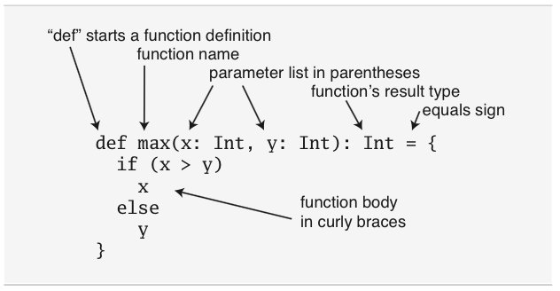
Scala – Function Parts

Slide 8
Scala – Short Functions
scala> def max2(x: Int, y: Int) = if (x > y) x else y
max2: (x: Int, y: Int)Int
scala> max2(4,5)
res4: Int = 5
Where did the curly braces go?

Slide 9
Scala – Unit
scala> def greet() = println("Hello, my friend")
greet: ()Unit
scala> greet()
Hello, my friend
All functions in Scala return a value!

Slide 10
Scala – Scripts
hello.scala:
val hello = "Hello World...From a Script!"
println(args(0) + ", " + hello)
Command Line:
$ scala hello.scala Tim
Tim, Hello World...From a Script!
Scala can easily be used in the small!

Slide 11
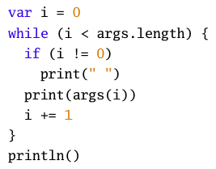
Scala – While/If
Very similar to Java’s while loop and if conditional.
Remember, though that if/else in scala returns a value!

Slide 12

Scala – for/foreach
This is called an anonymous function or lambda from the lambda calculus. More on these later…
You can simplify this to…
args.foreach(println)
You can also use for:
The technical name for this is
a “for comprehension”. These are included in other languages such as Python! More on these at a later point…
However: you do not have for loops like in Java!

Slide 13
Scala Data Structures
Arrays (01-array.scala)
Lists (02-list.scala)
Tuples (03-tuple.scala)
Sets (04-set.scala)
Maps (05-map.scala)

