Slide 1
Programming Methodology
Lecture 05 – classes, objects, tools, and patterns

Slide 2
Objectives
To learn how to use scala, scalac, and fsc
To learn how to recognize “functional”
To learn about classes and objects in Scala
To learn a little “design pattern” in Java
What is a design pattern?
The Singleton pattern in Java
The Factory Method in Java
How does Scala handle this?
To learn how to create Scala applications
To learn about basic types and operations in Scala

Slide 3
Project Assignment 01
How hard was Project Assignment 01?
piece of cake!
moderately easy
reasonable
hard
very hard

Slide 4
Project Assignment 01
How much time on Project Assignment 01?
1-2 hours
2-4 hours
4-6 hours
6-8 hours
8+ hours

Slide 5
Project Assignment 01
Do you understand Java packages?
completely
mostly
a little
not at all

Slide 6
Recognizing Functional
Scala is:
object-oriented
functional
Important to become acquainted with this.
Let us look at some script examples:
Recognize Functional (scala-script/06-functional.scala)
Formatting Lines (scala-script/07-fmt-lines.scala)

Slide 7
Classes and Objects
Scala has classes!
including fields and methods
Scala has objects!
Instantiated from classes
Similar to Java, but Different!

Slide 8


Class Declaration/Instantiation

Slide 9
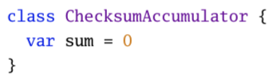
Class Fields

Slide 10

Class Fields

Slide 11
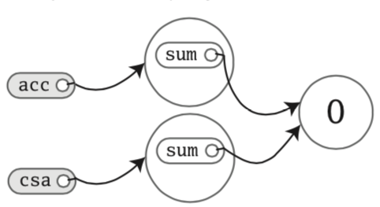
Class Fields

Slide 12
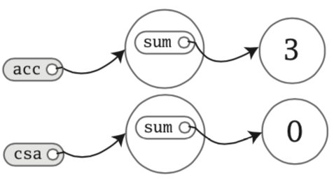

Class Fields

Slide 13

Class Fields

Slide 14
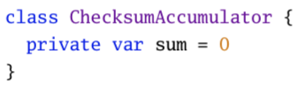
Privacy

Slide 15

Privacy
The way you make members public in Scala is to simply specify nothing. In Java,
you would be required to use the public keyword.

Slide 16
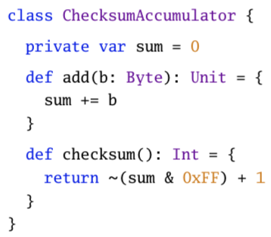
Methods

Slide 17
Methods
An important note to make here is that all function/method parameters in Scala are vals not vars.
This means you can’t do this:
def add(b: Byte): Unit = {
b = 1
sum += b
}

Slide 18
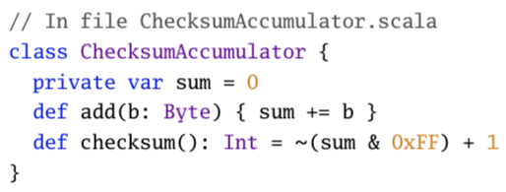
Conciseness
Because these methods are short you would typically put them on a single line!

Slide 19

Method Notes

Slide 20

Method Notes

Slide 21
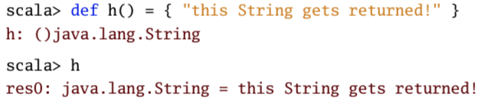
Method Notes

Slide 22
Compiling Scala
We saw Scala in the small
Use scripts
How do we compile Scala to class files?
scalac
scala
fsc
Example: scala-compiling

Slide 23
What is a “Design Pattern”?
In software engineering, a design pattern is a general reusable solution to a commonly occurring problem within a given context in software design.
Recognizing the problem
Recognizing the solution
Different languages offer different solutions
Programming languages are tools
Designed for different purposes
Design patterns often occur when a language does not provide support to solve a typical problem!

Slide 24
Singletons
In class-based programming, the singleton pattern is implemented by creating a class with a method that creates a new instance of the class if one does not exist. If an instance already exists, it simply returns the a reference to that object. To make sure that the object can’t be instantiated in any other way, the constructor is made private.
How do we typically create objects in Java?
Yes, we use the new operator
What if we wanted to ensure that only one instance of a class exists?
Why would we want to do this?
Let us look at an example:
Example: java-singleton

