Slide 1
Programming Methodology
Lecture 06 –patterns and types

Slide 2
Objectives
To learn a little “design pattern” in Java
What is a design pattern?
The Singleton pattern in Java
The Factory Method in Java
How does Scala handle this?
To learn how to create Scala applications
To learn about basic types

Slide 3
What is a “Design Pattern”?
In software engineering, a design pattern is a general reusable solution to a commonly occurring problem within a given context in software design.
Recognizing the problem
Recognizing the solution
Different languages offer different solutions
Programming languages are tools
Designed for different purposes
Design patterns often occur when a language does not provide support to solve a typical problem!

Slide 4
Singletons
In class-based programming, the singleton pattern is implemented by creating a class with a method that creates a new instance of the class if one does not exist. If an instance already exists, it simply returns the a reference to that object. To make sure that the object can’t be instantiated in any other way, the constructor is made private.
How do we typically create objects in Java?
Yes, we use the new operator
What if we wanted to ensure that only one instance of a class exists?
Why would we want to do this?
Let us look at an example:
Example: java-singleton

Slide 5
Singleton in Scala?
Singleton in Scala?
Scala provides language support to handle this!
Scala has class definitions
You define them with class
Scala has object definitions
These act as a single object
You define them with object
Let us look at an example:
Example: scala-singleton
This example also shows you how to create Scala applications!

Slide 6
Scala Companion Objects
Scala objects can be associated with a class
They provide additional support to a class of the same name.
They are typically defined in the same file as the class.
Let us look at an example:
Example: scala-checksum-app

Slide 7
Factory Method
In class-based programming, the factory method pattern is a creational pattern which uses factory methods to deal with the problem of creating objects without specifying the exact class of object that will be created.
How do we typically create objects in Java?
Yes, we use the new operator
We already saw this in the homework!
src/main/java/cs220/util/Util.java
Let us look at another example
Example: java-singleton-factory-method

Slide 8
Factory Method in Scala?
Factory method in Scala?
Scala provides language support to handle this!
Scala has class definitions
You define them with class
Scala has object definitions
These act as a single object
You define them with object
Scala has traits
These are similar to Java interfaces, but provide much more!
Example: scala-singleton-factory-method

Slide 9
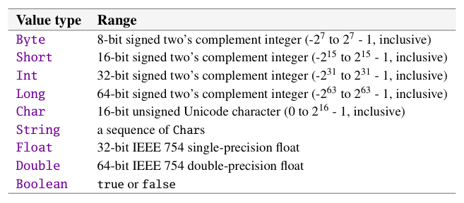
Scala: Basic Types

Slide 10
Scala: Literals
We have seen most of these already!
Int: 2, -3, 0xdeadbeef, …
Float/Double: 1.234, 1.23e1, …
Char: ‘A’, ‘b’, ‘\n’, ‘\101’, ‘\u0041’, …
String: “hello”, “””multiline string”””
Boolean: true, false

Slide 11
Scala: Symbols
This one we haven’t seen!
Symbol: ‘Apple
A symbol has a type:
Symbol
Symbols are interned
The same symbol it refers to the same object
This demonstrates the flyweight pattern
We will see this later in the course!

