Slide 1
CMPSCI 220 Programming Methodology
12: Design Patterns Part 1
(Observer and Decorator)
Based on Head First Design Patterns

Slide 2
Objectives
Observer Pattern
Learn how objects can "observe" other objects.
Apply the observer pattern in Scala.
Decorator Pattern
Learn how objects can gain new responsibilities at runtime.
Apply the decorator pattern in Scala.

Slide 3
i-clicker Question!
Why should you favor composition over inheritance?
It is in fashion
It leads to a more flexible class design
It allows you to create classes automatically
It lets you defer implementation to super classes
I am not sure

Slide 4

Observer: Weather Monitoring Application
Humidity Sensor Service
Weather Station
Temperature Sensor Service
pulls data...
displays...
Current Conditions
Temp: 72 F
Humidity: 60
Pressure:
Pressure Sensor Service
WeatherData
Object
Display Device
Weather-O-Rama Provides
What we Implement
Our job, if we choose to accept it, is to create an app that uses the WeatherData object to update three displays for current conditions, weather stats, and a forecast.

Slide 5
Weather Monitoring App: First Try...
WeatherData
getTemperature()
getHumidity()
getPressure()
measurementsChanged()
// Other Methods
/* This method gets called whenever the
* weather measurements have been updated
*/
def measurementsChanged() {
// Your code goes here.
}
The developers of the WeatherData object left us a clue about what we need to add...

Slide 6
Weather Monitoring App: First Try...
WeatherData
getTemperature()
getHumidity()
getPressure()
measurementsChanged()
// Other Methods
/* This method gets called whenever the
* weather measurements have been updated
*/
def measurementsChanged() {
val t = getTemperature
val h = getHumidity
val p = getPressure
conditionDisplay.update(t, h, p)
statsDisplay.update(t, h, p)
forcastDisplay.update(t, h, p)
}
The developers of the WeatherData object left us a clue about what we need to add...

Slide 7
Weather Monitoring App: First Try...
WeatherData
getTemperature()
getHumidity()
getPressure()
measurementsChanged()
// Other Methods
/* This method gets called whenever the
* weather measurements have been updated
*/
def measurementsChanged() {
val t = getTemperature
val h = getHumidity
val p = getPressure
conditionDisplay.update(t, h, p)
statsDisplay.update(t, h, p)
forcastDisplay.update(t, h, p)
}
The developers of the WeatherData object left us a clue about what we need to add...
What is wrong with this implementation?

Slide 8
Weather Monitoring App: First Try...
WeatherData
getTemperature()
getHumidity()
getPressure()
measurementsChanged()
// Other Methods
/* This method gets called whenever the
* weather measurements have been updated
*/
def measurementsChanged() {
val t = getTemperature
val h = getHumidity
val p = getPressure
conditionDisplay.update(t, h, p)
statsDisplay.update(t, h, p)
forcastDisplay.update(t, h, p)
}
The developers of the WeatherData object left us a clue about what we need to add...
We have hardcoded the display elements! Yuck!

Slide 9
Observer Pattern Defined
A newspaper publisher goes into business and begins publishing newspapers.
You subscribe to a particular publisher, and every time there's a new edition it gets delivered to you - as long as you remain a subscriber.
You unsubscribe when you don't want the newspaper anymore, and they stop being delivered.
While the publisher remains in business, people, hotels, airlines, and other businesses constantly subscribe and unsubscribe to the newspaper.

Slide 10
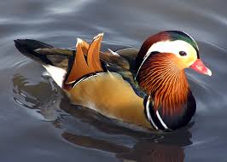
Publisher + Subscriber = Observer Pattern
When data in the Subject changes the observers are notified of the change.
Dog Object
Subject Object
Cat Object
This object isn't an observer so it does not get notified when the Subject's data changes.
Mouse Object
Observer Objects
Duck Object

Slide 11
Subscribing...
A duck object comes along and tells the Subject object that it wants to become an observer...
Register/Subscribe me! QUACK!
Subject Object
Duck Object

Slide 12
Subscribing...
A duck object comes along and tells the Subject object that it wants to become an observer...
You are subscribed!
Subject Object
Duck Object

Slide 13
Publisher + Subscriber = Observer Pattern
When data in the Subject changes the observers are notified of the change.
Dog Object
Subject Object
Cat Object
Mouse Object
Observer Objects
The Duck Object is now subscribed and will receive updates from the Subject object where there is a change in its data!
Duck Object

Slide 14
Publisher + Subscriber = Observer Pattern
When data in the Subject changes the observers are notified of the change.
Dog Object
Unregister/Unsubscribe me! SQUEEK!
Subject Object
Cat Object
Mouse Object
Observer Objects
Duck Object

Slide 15
Publisher + Subscriber = Observer Pattern
When data in the Subject changes the observers are notified of the change.
Dog Object
Subject Object
Cat Object
Observer Objects
The Mouse Object is now Unsubscribed!
Duck Object
Mouse Object

Slide 16
Publisher + Subscriber = Observer Pattern
When data in the Subject changes the observers are notified of the change.
45
Dog Object
Subject Object
Cat Object
When the Subject Object has a new data value it must notify each of its subscribers...
Observer Objects
Duck Object

Slide 17
Publisher + Subscriber = Observer Pattern
When data in the Subject changes the observers are notified of the change.
45
45
45
Dog Object
Subject Object
Cat Object
When the Subject Object has a new data value it must notify each of its subscribers...
45
Observer Objects
Duck Object

Slide 18
The Observer Pattern Defined
The Observer Pattern defines a one-to-many dependency between objects so that when one object changes state, all of its dependents are notified and updated automatically.

Slide 19
Observer Class Diagram
observers
<Subject>
<Observer>
registerObserver()
removeObserver()
notifyObservers()
update()
When two objects are loosely coupled, they can interact, but have very little knowledge of each other.
The observer pattern provides an object design where subjects and observers are loosely coupled.
subject
ConcreteSubject
ConcreteObserver
registerObserver() = { … }
removeObserver() = { … }
notifyObservers() = { … }
// Other possible methods...
getState()
setState()
update() = { … }
// Other possible methods...

Slide 20
Designing the Weather Station: Try Sketching it Out!
Before moving on, try sketching out the classes/traits you'll need to implement the Weather Station, including the WeatherData class and its display elements. Make sure your diagram shows how all the pieces fit together and also how another developer might implement her own display element.
You can do this with the people around you…
We will collect a paper from each of you at the end of class.

Slide 21
This Might Help: Observer Class Diagram
observers
<Subject>
<Observer>
registerObserver()
removeObserver()
notifyObservers()
update()
When two objects are loosely coupled, they can interact, but have very little knowledge of each other.
The observer pattern provides an object design where subjects and observers are loosely coupled.
subject
ConcreteSubject
ConcreteObserver
registerObserver() = { … }
removeObserver() = { … }
notifyObservers() = { … }
// Other possible methods...
getState()
setState()
update() = { … }
// Other possible methods...

Slide 22
Designing the Weather Station
<Subject>
<Observer>
<DisplayElement>
registerObserver()
removeObserver()
notifyObservers()
update()
display()
CurrentConditionDisplay
ConcreteSubject
update()
display()
registerObserver()
removeObserver()
notifyObservers()
getTemperature()
getHumidity()
getPressure()
measurementsChanged()
StatisticsDisplay
update()
display()
ForecastDisplay
ThirdPartyDisplay
An additional 3rd party display can be easily added!
update()
display()
update()
display()

Slide 23
Implementing the Weather Application
src/main/scala/cs220/Observer.scala

Slide 24
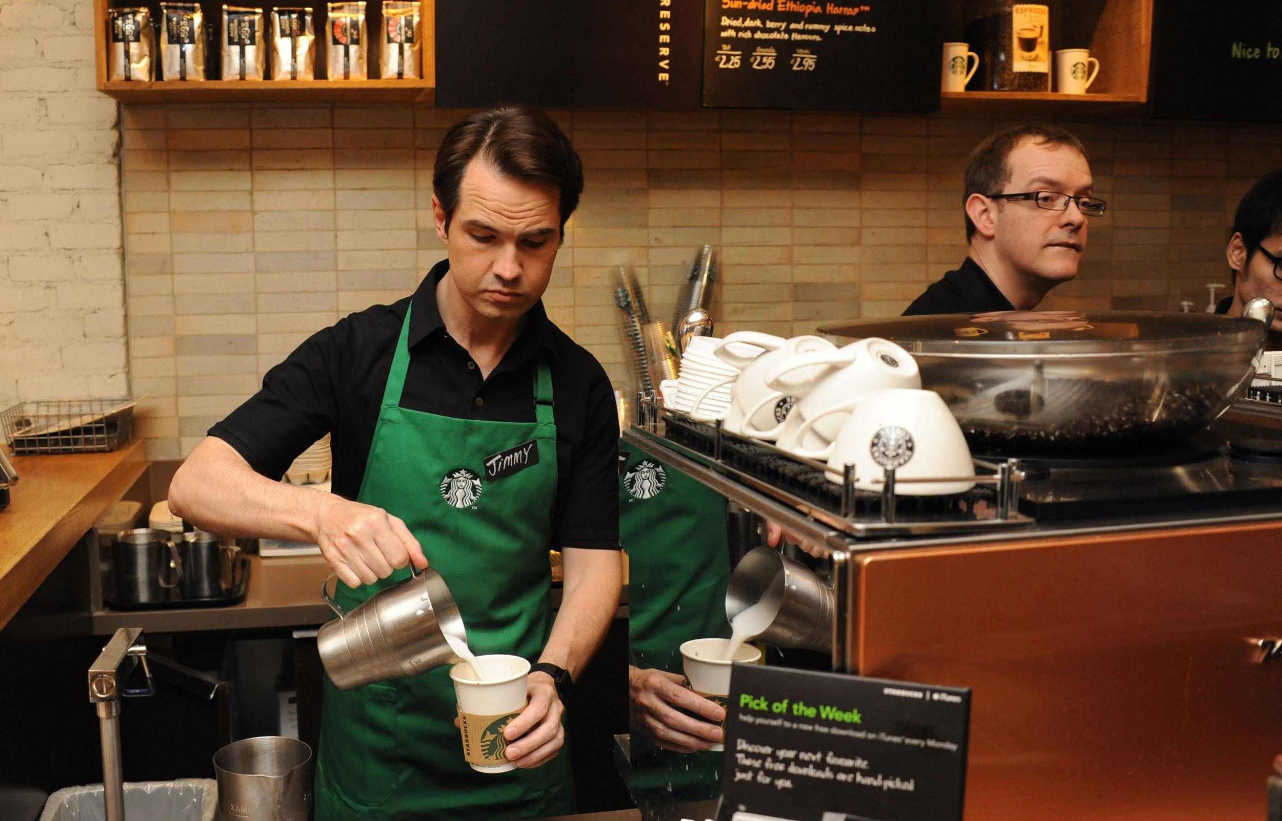
Welcome to Starbuzz Coffee!
This is Milton Waddams. He didn't take CMPSCI 220 at UMass Amherst. He thinks he is awesome, but he is not. He is the mastermind behind the poorly designed ordering system at Starbuzz. He can't code himself out of a paper bag. He really likes staplers.
This is Peter Gibbons (aka Jimmy). He is a sad man because he is upset with the developer of Starbuzz's ordering system. Every time there is a new beverage it takes forever for the beverage to become available in their system. Not to mention the system is sooo slow!

Slide 25


Starbuzz Ordering System Design
Beverage
description
getDescription()
cost()
// Other useful methods
"Oh Yeah! This is a good design!"
Milton, you SUCK!
HouseBlend
DarkRoast
Decaf
Espresso
cost()
cost()
cost()
cost()
In addition to your coffee, you can also ask for several condiments like steamed milk, soy, and mocha, and have it all topped off with whipped milk. Starbuzz charges a bit for each of these, so they really need to get them build into their ordering system.
How might this be done in this design?

Slide 26
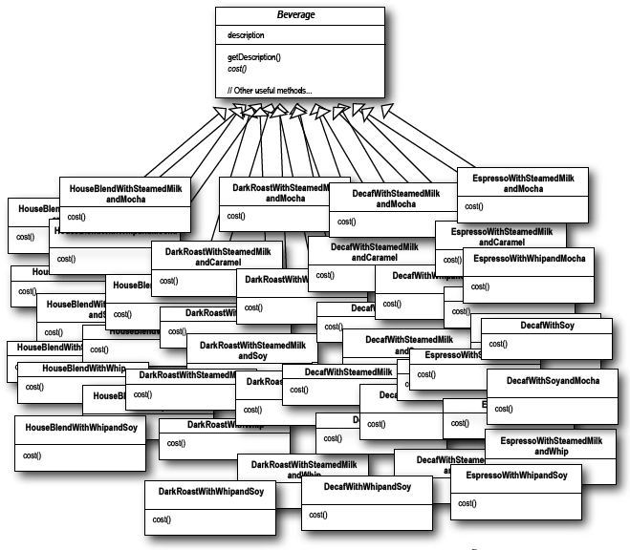
Class Explosion!!!
"So, what is your point..."

Slide 27

Class Explosion!!!
"You are FIRED! And leave the stapler!"
How can we fix this?

Slide 28
Starbuzz Ordering System Design Take 2
The superclass cost() will calculate the costs for all of the condiments, while the overridden cost() in the subclasses will extend that functionality to include costs for the specific beverage type.
Each cost() method needs to compute the cost of the beverage and then add in the condiments by calling the superclass implementation of cost().
Beverage
description
milk, soy, mocha, whip
getDescription()
cost()
hasMilk()
setMilk()
hasSoy()
hasMocha()
setMocha()
hasWhip()
setWhip()
// And other useful methods...
HouseBlend
DarkRoast
Decaf
Espresso
cost()
cost()
cost()
cost()

Slide 29
Your Turn!
Write the cost() methods for the two classes below (pseudo-Scala is okay)
class Beverage {
def cost: Double = {
}
}
class DarkRoast extends Beverage {
val description = "Most Excellent Dark Roast"
def cost: Double = {
}
}

Slide 30
What Might Impact This Design?
Price changes for condiments will force us to alter existing code.
New condiments will force us to add new methods and alter the cost method of the superclass.
We may have new beverages. For some of these beverages (iced tea?), the condiments may not be appropriate, yet the Tea subclass will still inherit methods like hasWhip().
What if a customer wants a double mocha or espresso?

Slide 31
The Open-Closed Principle
Design Principle: Classes should be open for extension, but closed for modification.
How does this relate to our existing ordering system design?
Our goal is to allow classes to be easily extended to incorporate new behavior without modifying existing code.
What do we get if we accomplish this?
Designs that are resilient to change and flexible enough to take on new functionality to meet changing requirements.

Slide 32
Meet The Decorator Pattern
Take a DarkRoast object.
Decorate it with a Mocha object.
Decorate it with a Whip object.
Call the cost() method and rely on delegation to add on the condiment costs.

Slide 33
The Decorator Pattern Defined
The Decorator Pattern attaches additional responsibilities to an object dynamically. Decorators provide a flexible alternative to subclassing for extending functionality.

Slide 34
Decorator Class Diagram
Each decorator HAS-A component, which means that the decorator has an instance variable that holds a reference to a component.
Decorators implement the same trait or abstract class as the component they are going to decorate.
<Component>
methodA()
methodB()
// Other useful methods
Decorator
methodA()
methodB()
// Other useful methods
ConcreteComponent
methodA()
methodB()
// Other useful methods
ConcreteDecoratorA
ConcreteDecoratorB
val wrappedObj: Component
methodA()
methodB()
newBehavior()
// Other useful methods
val wrappedObj: Component
val newState
methodA()
methodB()
newBehavior()
// Other useful methods

Slide 35
Starbuzz's New Design
<Beverage>
CondimentDecorator
getDescription()
cost()
// Other useful methods
getDescription()
HouseBlend
DarkRoast
Espresso
Decaf
cost()
cost()
cost()
cost()
Milk
Mocha
Soy
Whip
beverage
cost()
getDescription()
beverage
cost()
getDescription()
beverage
cost()
getDescription()
beverage
cost()
getDescription()

