Slide 1
CMPSCI 220 Programming Methodology
13: Design Patterns Part 2
(Command)
Based on Head First Design Patterns

Slide 2
Objectives
Command Pattern
Learn how objects can encapsulate invocation.
Apply the command pattern in Scala.
Learn how to evolve the command pattern to support undo.

Slide 3

Free Hardware!
Home Automation or Bust!
You have been hired to implement an API for programming a remote for home automation. The goal is to make it as easy and as flexible as possible to allow the remote to be easily reprogrammed.
Are you up for the challenge?

Slide 4
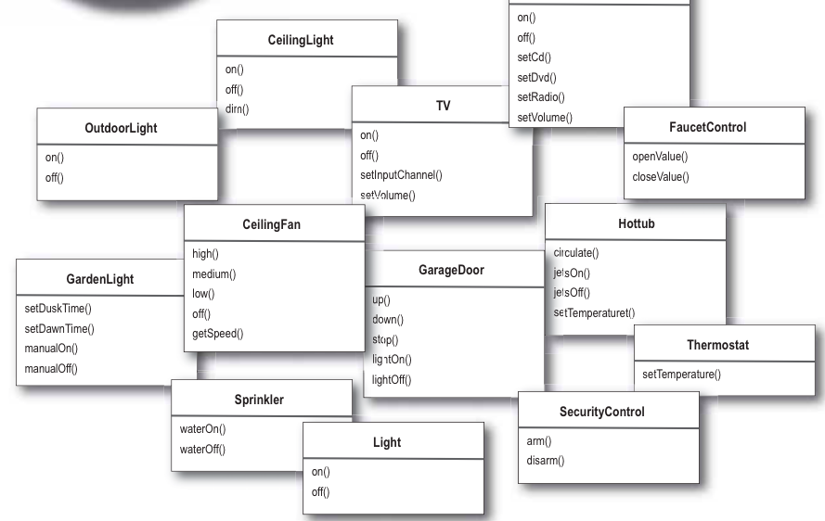
The Vendor Classes
This should give you a
good idea of what we
need to control from the
remote!

Slide 5
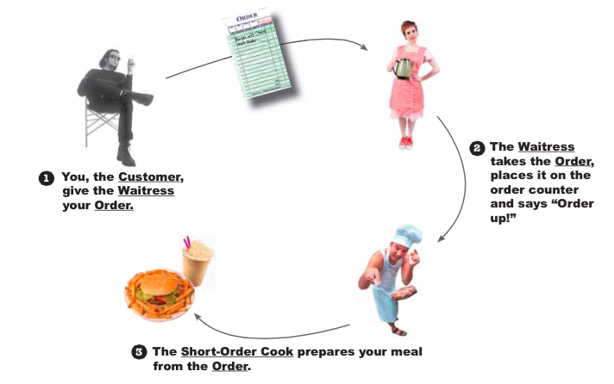
A Brief Introduction to the Command Pattern

Slide 6
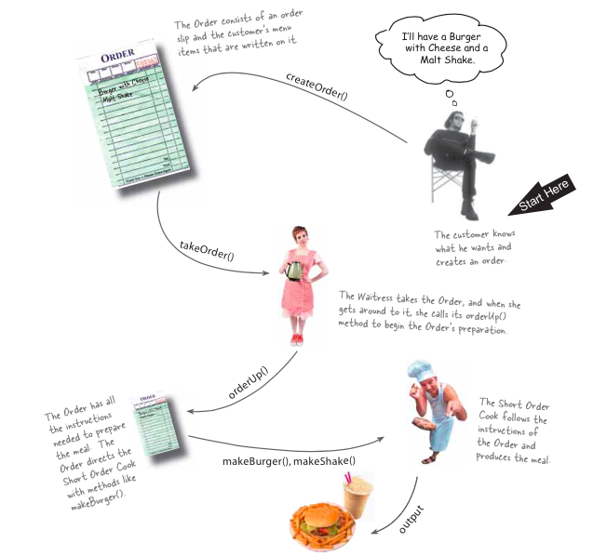
Let us look at this a little closer…

Slide 7
Let us look at this a little closer…
The customer knows what he wants and creates an order.

Slide 8
Let us look at this a little closer…
The order consists of an order slip and the customer’s menu items that are written on it.

Slide 9
Let us look at this a little closer…
The waitress takes the order, and when she gets around to it, she calls its orderUp() method to being the Order’s preparation.

Slide 10
Let us look at this a little closer…
The Order has all the instructions need to prepare the meal. The Order directs the Short Order Cook with methods like makeBurger()

Slide 11
Let us look at this a little closer…
The Short Order cook follows the instructions of the Order and produces the meal.

Slide 12
Let us look at this a little closer…
Finally, we have the meal as output.

Slide 13
From Diner to Command Pattern
create Command object
Client
The client is responsible for creating the command object. The command object consists of a set of actions on a receiver.

Slide 14
From Diner to Command Pattern
execute
create Command object
Create Command Object
Command
Client
The actions and the Receiver are bound together in the Command object

Slide 15
From Diner to Command Pattern
execute
create Command object
Create Command Object
Command
Client
The Command object provides one method, execute(), that encapsulates the actions and can be called to invoke the actions on the Receiver.

Slide 16
From Diner to Command Pattern
execute
create Command object
Create Command Object
Command
Client
setCommand()
setCommand
The client calls setCommand() on an Invoker object and passes it the command object, where it gets stored until it is needed.
Invoker

Slide 17
From Diner to Command Pattern
execute
create Command object
Create Command Object
Command
Client
setCommand()
setCommand
At some point in the future the Invoker calls the command object’s execute() method…
Invoker

Slide 18
From Diner to Command Pattern
execute
create Command object
Create Command Object
Command
Client
setCommand()
setCommand
action1()
action2()
Invoker
Receiver
At some point in the future the Invoker calls the command object’s execute() method…

Slide 19
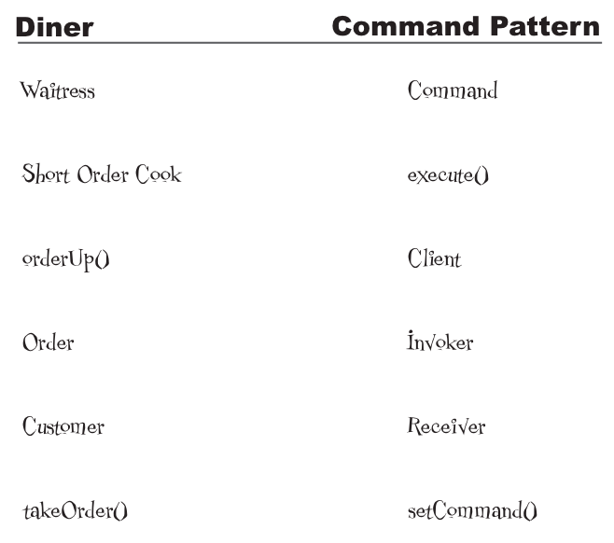
What Does What?

Slide 20
What Does What?

Slide 21
What Does What?

Slide 22
What Does What?

Slide 23
What Does What?

Slide 24
What Does What?

Slide 25
What Does What?

Slide 26
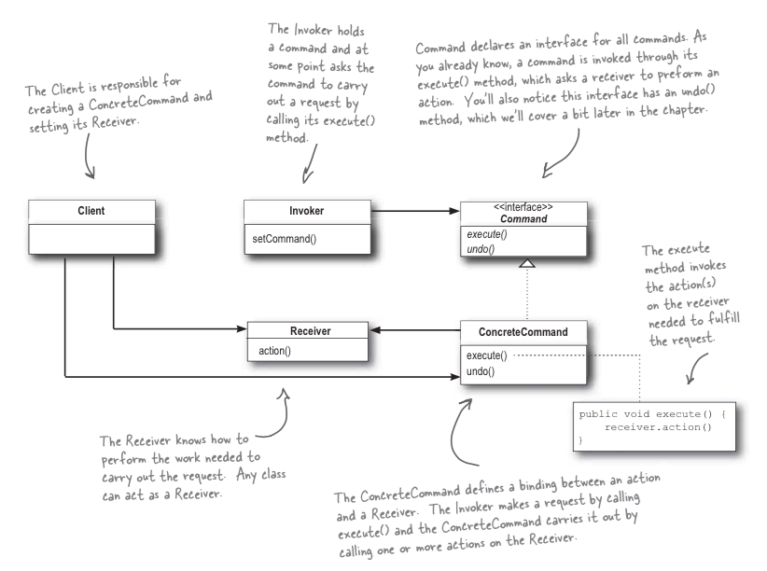
Command Pattern Class Diagram

Slide 27
Command Pattern Defined
The Command Pattern encapsulates a request as an object, thereby letting you parameterize other objects with different requests, queue or log requests, and support undoable operations.

Slide 28
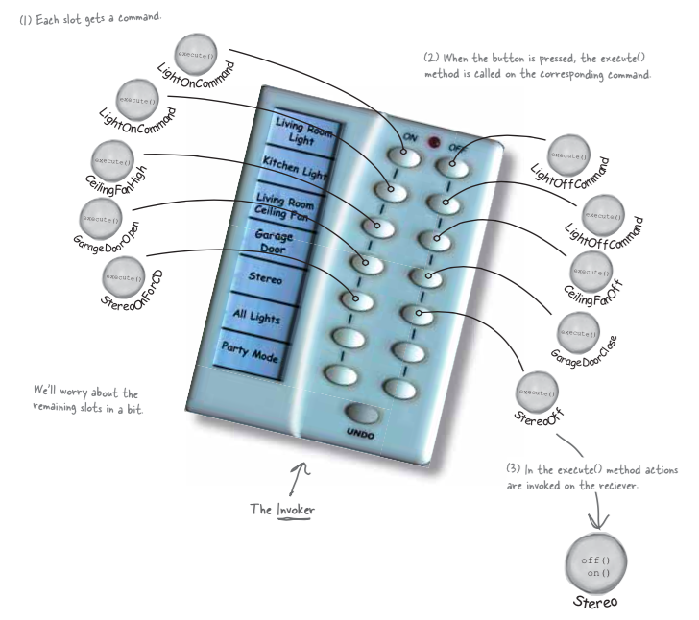
Assigning Commands to Slots…

Slide 29
Example
command example…

