Slide 1
CMPSCI 220 Programming Methodology
Traits and Packages
Based on Head First Design Patterns

Slide 2
Objectives
Traits
Learn how traits work
Learn the difference between thin and rich interfaces
Learn about stackable modifications and linearization
Learn why multiple inheritance is bad
Packages and Imports
Learn about putting code into packages
Learn about concise access to related code
Learn about access modifiers

Slide 3
Traits are Interfaces
trait Philosophical {
def philosophize(): Unit
}

Slide 4
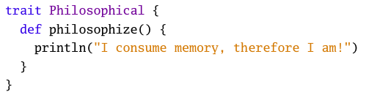
Traits are like Classes

Slide 5

Traits can be “Mixed In”

Slide 6
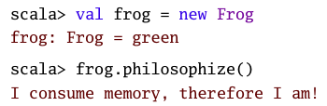
Traits can be “Mixed In” and Used

Slide 7
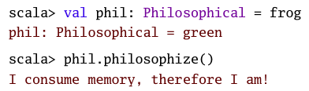
Traits can be “Mixed In” and Used

Slide 8
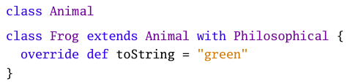
Traits can be used with Classes

Slide 9
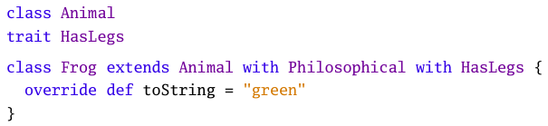
Traits can be used with Classes/Traits

Slide 10
Thin Interfaces
A “thin” interface is one that provides fewer methods requiring less to implement.
This is good from the Java perspective as interfaces can’t provide implementation.

Slide 11
Rich Interfaces
A “rich” interface provides many methods requiring more to (possibly) implement.
This is bad from the Java perspective as interfaces can’t provide implementation.
For Scala, however, traits can provide implementation that can be used in terms of the class extending it.

Slide 12
Example
src/main/scala/cs220/graphics/Shapes.scala

Slide 13
Traits: Stackable Modifications
Imagine we want to implement a Queue library. This is simple enough – we all know how queues are implemented.
What if…
We wanted to be able to create similar (but different) variants that allow for queues with slightly different behaviors?

Slide 14
Queue Library: Java
What if we wanted to implement integer queue variants that can have one or more of the following behaviors:
doubling: doubles the element on put
increment: increments the element on put
filtering: filters out negative integers on put
How might you do this in a language such as Java?

Slide 15
Queue Library: Scala
What if we wanted to implement integer queue variants that can have one or more of the following behaviors:
doubling: doubles the element on put
increment: increments the element on put
filtering: filters out negative integers on put
How might you do this in a language such as Scala?

Slide 16
Example
src/main/cs220/queue/Queue.scala

Slide 17
Multiple Inheritance?
Traits are a way to inherit from multiple class-like constructs, but they differ from other languages that provide multiple inheritance.
The interpretation of super is different In Scala, super depends on a linearization process which allows traits to be “stacked”
In other languages super is chosen for only one of the multiple classes that are inherited.

Slide 18
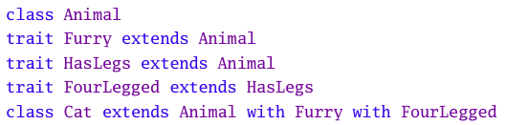
Animals

Slide 19
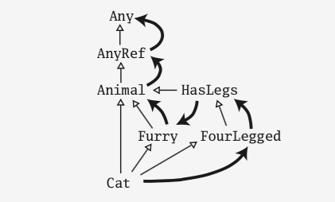
Animals Linearization

Slide 20
To trait, or not to trait?
If the behavior will not be reused make it a concrete class.
If it might be reused in multiple, unrelated classes make it a trait
If it is distributed as a compiled library make it an abstract class
If efficiency is crucial make it a class
Like any other programing language construct it takes practice and experience to know when it should be used or not.
When building libraries it is important to know which language construct to use to benefit clients and to simplify the use of the library.

Slide 21
SimUDuck
Think back to the problem we had with creating ducks that could Quack, Fly, etc. How might you use stackable traits to achieve a better design for your employer?

