Slide 1
Programming Methodology
Control Abstraction

Slide 2
Objectives
Functions and Closures (Review)
Local Functions
Anonymous Functions
First-Class Functions
Function Literal Short Cuts
Partial Application
Closures
Reducing Code Duplication
Simplify Libraries: Functional Composition
Simplify Client Code: Control Abstraction
Writing New Control Structures
Currying
By-name Parameters

Slide 3
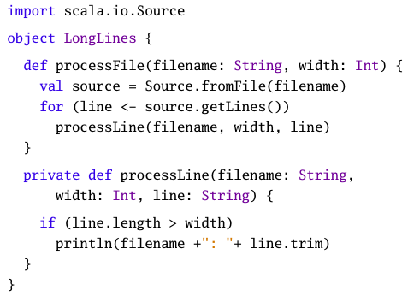
Methods
Defn: A function that is defined as a member of some class/object.

Slide 4
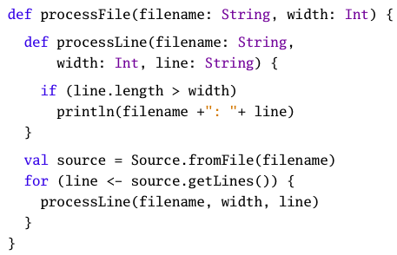
Local Functions
Defn: A function that is defined inside other functions.

Slide 5

Anonymous Functions
Defn: A function definition that is not bound to an identifier.
Parameters on the left.
Body on the right.

Slide 6

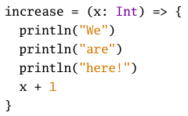
Anonymous Functions
Defn: A function definition that is not bound to an identifier.
Also knows as a function literal or lambda abstraction.

Slide 7
First-Class Functions
Defn: Functions that are treated as values.
Functions that can be assigned to variables.
Functions that are arguments to other functions.
Functions that are return values.
Functions that can be stored in data structures.
someNumbers.map(increase)

Slide 8
Function Literal Short Cuts
There are a number of different short cuts in writing function literals in Scala.
Elide parameter type
someNumbers.filter((x) => x > 0)

Slide 9
Function Literal Short Cuts
There are a number of different short cuts in writing function literals in Scala.
Elide parameter type
Elide parameter parens
someNumbers.filter((x) => x > 0)
someNumbers.filter(x => x > 0)

Slide 10
Function Literal Short Cuts
There are a number of different short cuts in writing function literals in Scala.
Elide parameter type
Elide parameter parens
Elide parameter name type is inferred
someNumbers.filter((x) => x > 0)
someNumbers.filter(x => x > 0)
someNumbers.filter(_ > 0)

Slide 11
Function Literal Short Cuts
There are a number of different short cuts in writing function literals in Scala.
Elide parameter type
Elide parameter parens
Elide parameter name type is inferred
someNumbers.filter((x) => x > 0)
someNumbers.filter(x => x > 0)
someNumbers.filter(_ > 0)
val f = _ + _

Slide 12
Function Literal Short Cuts
There are a number of different short cuts in writing function literals in Scala.
Elide parameter type
Elide parameter parens
Elide parameter name type is inferred
someNumbers.filter((x) => x > 0)
someNumbers.filter(x => x > 0)
someNumbers.filter(_ > 0)
val f = _ + _
val f = (_: Int) + (_: Int)

Slide 13

Partial Application
Defn: Partial application is the process of fixing a number of arguments to a function to produce a new function with the same of fewer parameters.
Which is the same as…

Slide 14

Partial Application
Defn: Partial application is the process of fixing a number of arguments to a function to produce a new function with the same of fewer parameters.
This example makes it more clear:

Slide 15
Closure
Defn: A function literal that “captures” the bindings of its “free” variables from an outer scope.
def makeIncreaser(more: Int) =
(x: Int) => x + more
scala> val a = makeIncreaser(2)
scala> a(2)
4
scala> val b = makeIncreaser(3)
scala> b(5)
8

Slide 16
Repeated Parameters
Addition Scala Details
Scala allows you to indicate that the last parameter to a function may be repeated.
This is known as a variadic function – a function in which its arity is indefinite
def echo(args: String*) =
for (arg <- args) println(arg)
scala> echo()
scala> echo(“hello”, “world”)
hello
world

Slide 17
Repeated Parameters
Addition Scala Details
Scala allows you to indicate that the last parameter to a function may be repeated.
This is known as a variadic function – a function in which its arity is indefinite
def echo(args: String*) =
for (arg <- args) println(arg)
scala> echo()
scala> echo(“hello”, “world”)
hello
world
val arr = Array(“hello”, “world”)
scala> echo(arr)

Slide 18
Repeated Parameters
Addition Scala Details
Scala allows you to indicate that the last parameter to a function may be repeated.
This is known as a variadic function – a function in which its arity is indefinite
def echo(args: String*) =
for (arg <- args) println(arg)
scala> echo()
scala> echo(“hello”, “world”)
hello
world
val arr = Array(“hello”, “world”)
scala> echo(arr)
scala> echo(arr: _*)

Slide 19
Named Arguments
Addition Scala Details
Scala allows you to name the parameters so you can invoke a function with its parameters in any order.
def speed(dist: Float, time: Float) =
distance / time
scala> speed(100, 10)
10.0
scala> speed(time = 10, dist = 100)
10.0
scala> speed(dist = 100, time = 10)

Slide 20
Default Parameter Values
Addition Scala Details
Scala allows you to provide default parameters.
The argument for such a parameter can optionally be omitted from a function call.
def printTime(out: PrintStream =
Console.out) =
out.println(“time = “ +
System.currentTimeMillis())
scala> printTime()

Slide 21
Default Parameter Values
Addition Scala Details
Scala allows you to provide default parameters.
The argument for such a parameter can optionally be omitted from a function call.
def printTime(out: PrintStream =
Console.out) =
out.println(“time = “ +
System.currentTimeMillis())
scala> printTime()
def printTime2(
out: PrintStream = Console.out,
divisor: Int = 1) =
out.println(“time = “ +
System.currentTimeMillis()/divisor)
scala> printTime2
scala> printTime2(divisor = 1000)

Slide 22
Reducing Code Duplication
All functions are separated into common parts, which are the same in every invocation of the function, and non-common parts, which may vary from one function invocation to the next.
Common parts exist in the body of the code.
Non-common parts are supplied by parameters.
Sometimes, these non-common parts could in fact be algorithms themselves – higher-order functions (functions that take functions as parameters) give you opportunities to reduce code duplication.

Slide 23
File Matching
Imagine you are writing a file browser and you want to provide an API that allows users to search for files matching some criterion:
Search for files with names ending with a particular string.
Search for files with names containing a string.
Search for files with names matching a regular expression.

