Slide 1
CS 326 Lab 1
2/10/23
Credit to William, Ishan, Sridhama, Isi, and Stanley

Slide 2
For Windows you can install Git from from it’s website For MacOS you first installed a package manager (e.g., Homebrew) via the curl command (which just downloads files via the terminal) and then you used the package manager to install Git
A package manager is just a program that installs and manages other programs. It’s like the app store, except it doesn’t have a GUI
For Linux you used the built-in package manager called Aptitude (abbreviated apt) to install Git
Install Git

Slide 3
Install git
Windows
Go to git-scm.com/download/win
Download and run the Windows installer
MacOS
Go to brew.sh
Copy & Paste the command into your terminal
Type brew install git into your terminal
Linux (Debian/Ubuntu)
Type sudo apt install git into your terminal

Slide 4
VS Code
Windows, MacOS, and Linux:
Go to code.VisualStudio.com and download & install

Slide 5
One extra step if you’re on Windows…
To use Linux commands on Windows, the easiest solution is to use Git Bash, a terminal emulator that comes with Git:
Press CTRL + , to bring up the settings menu in VS Code and then search “terminal.integrated.defaultProfile.windows”
Change your default terminal to Git Bash

Slide 6
All together now!
From within VS Code type CTRL + ~ to open the terminal
In the terminal, type git --version and make sure something appears
Your development environment is now set up!

Slide 7
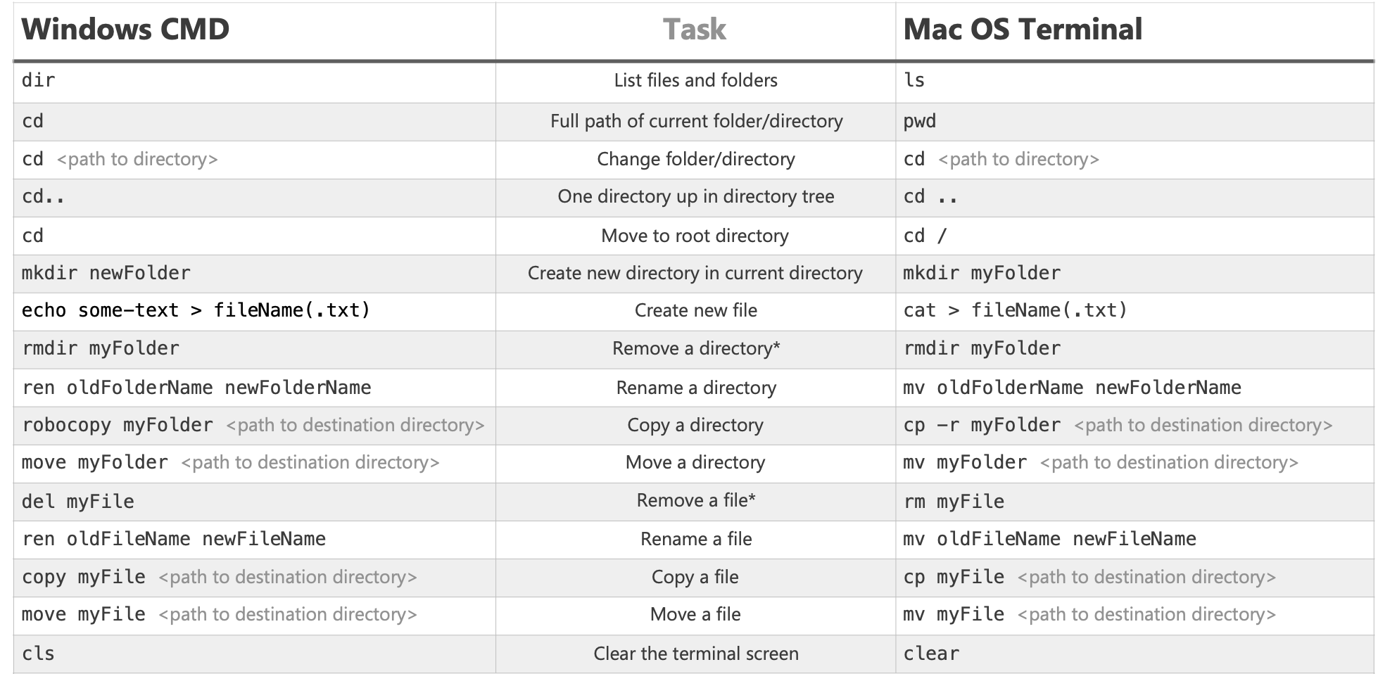
Some basic terminal command
Source: https://enexdi.sciencesconf.org/data/pages/windows_vs_mac_commands_1.pdf

Slide 8
Getting set up on GitHub
What is Github?
Github is a provider of Internet hosting for software development and version control using Git
Register an account at GitHub.com!
In your VS Code terminal, type “ssh-keygen -t ed25519 -C <email>“ where <email> is the email you used to register your GitHub account (e.g., ibernoff@umass.edu)
Press enter to keep the default filename, noting the file location ($USERPROFILE$\.ssh\id_ed25519.pub) on Windows and (~/.ssh/id_ed25519.pub) on MacOS and Windows.
Optionally enter a password, keeping in mind you’ll have to enter that password every time you commit changes to a GitHub repository
Once your terminal outputs a randomart image, open id_ed25519.pub and copy the SSH key.
Go to GitHub.com/settings/keys, click “New SSH key,” and paste the SSH key.
Accept the GitHub Classroom assignment at classroom.github.com/a/N8XX_gQC, make sure your account is linked with this Classroom after you accept it, and wait until you can access the repositoriy
Back in your VS Code terminal, type git clone git@github.com:umass-cs-326-s23/lab-1-git-github-<username>.git, where <username> is your GitHub username to get started

Slide 9
Git Workflow
To edit an existing repository using Git, we use the following commands:
git clone
Creates a copy of the repository in a new directory, that “points” to the original repository
git add
Adds a local change made in the current working directory, to the staging area
git commit
Takes everything in the staging area and makes a snapshot of the current state of your repository
git push
Upload (“push”) local repository content to a remote repository(in our case the original repository we cloned from)

Slide 10
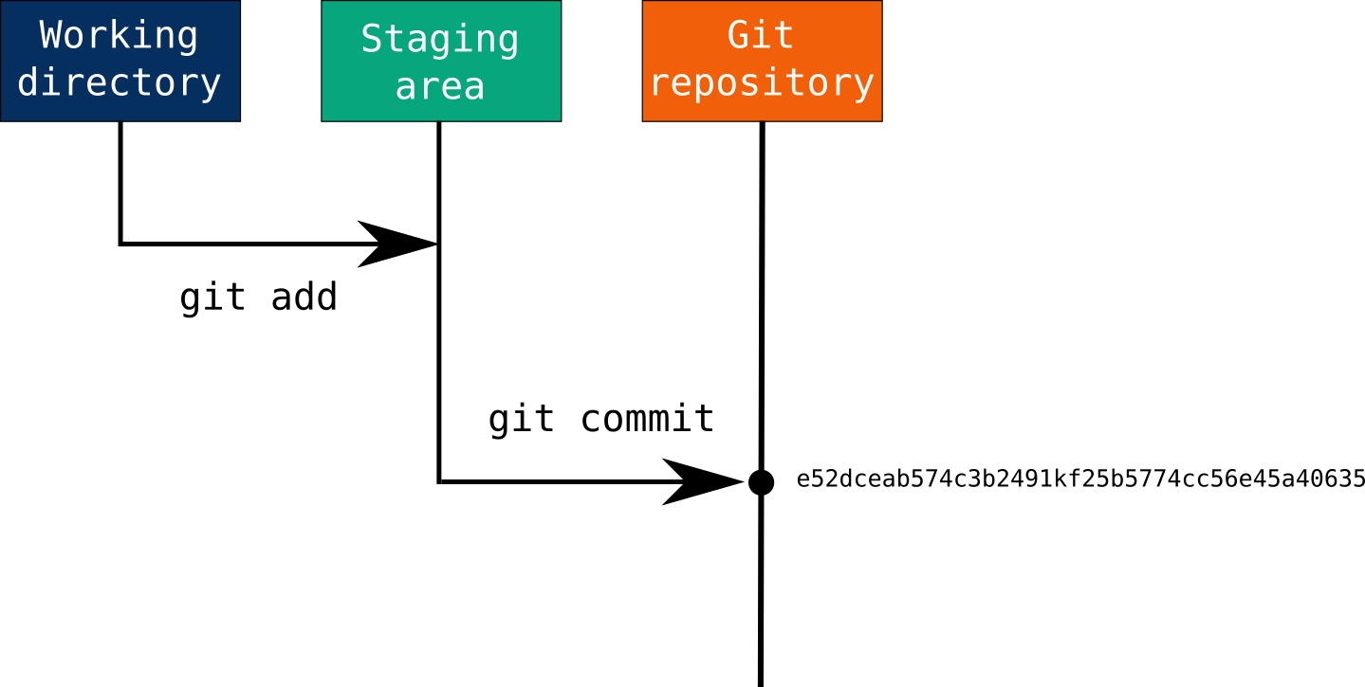
https://www.earthdatascience.org/images/earth-analytics/git-version-control/

