Slide 1
CS 326 Lab 1
1/27/2022
Credit to William, Ishan and Sridhama

Slide 2
For windows you can use the default command prompt https://git-scm.com/download/win
For MacOS you first installed a package manager (homebrew) via the `curl` command (which just downloads files via the terminal) and then you used the package manager to install git
A package manager is just a program that installs and manages other programs. It’s like the app store, except it doesn’t have a GUI
For linux you used the built in package manager called “aptitude” (abbreviated `apt`) to install git
Install git

Slide 3
Install git
Windows
Go to https://git-scm.com/download/win
Download and run the Windows installer
MacOS
Go to https://brew.sh
Copy & Paste the command into your terminal
Type `brew install git` into your terminal
Linux (Ubuntu)
Type `sudo apt install git` into your terminal

Slide 4
VS Code
Windows & MacOS:
Go to https://code.visualstudio.com and download & install
Linux (Ubuntu)
Use the snap package if your OS supports it (just google vscode snap package)
Else, follow the same instructions as Windows & MacOS

Slide 5
One extra step if you’re on windows and decide to use terminal emulator
We want to make vscode use the fancy new terminal we just installed
Type `ctrl + ,` to bring up the settings menu in vscode, and then click the little button in the top right to get the JSON version of settings
Paste the following into the settings: (you can find it here https://dev.to/andrewriveradev/how-to-setup-cmder-in-vscode-in-2021-3nkc) to copy & paste

Slide 6
All together now!
From within vscode type `ctrl + ~` (this is the shortcut for opening the terminal)
Type `git --version` and make sure something appears
Your development environment is now set up!

Slide 7
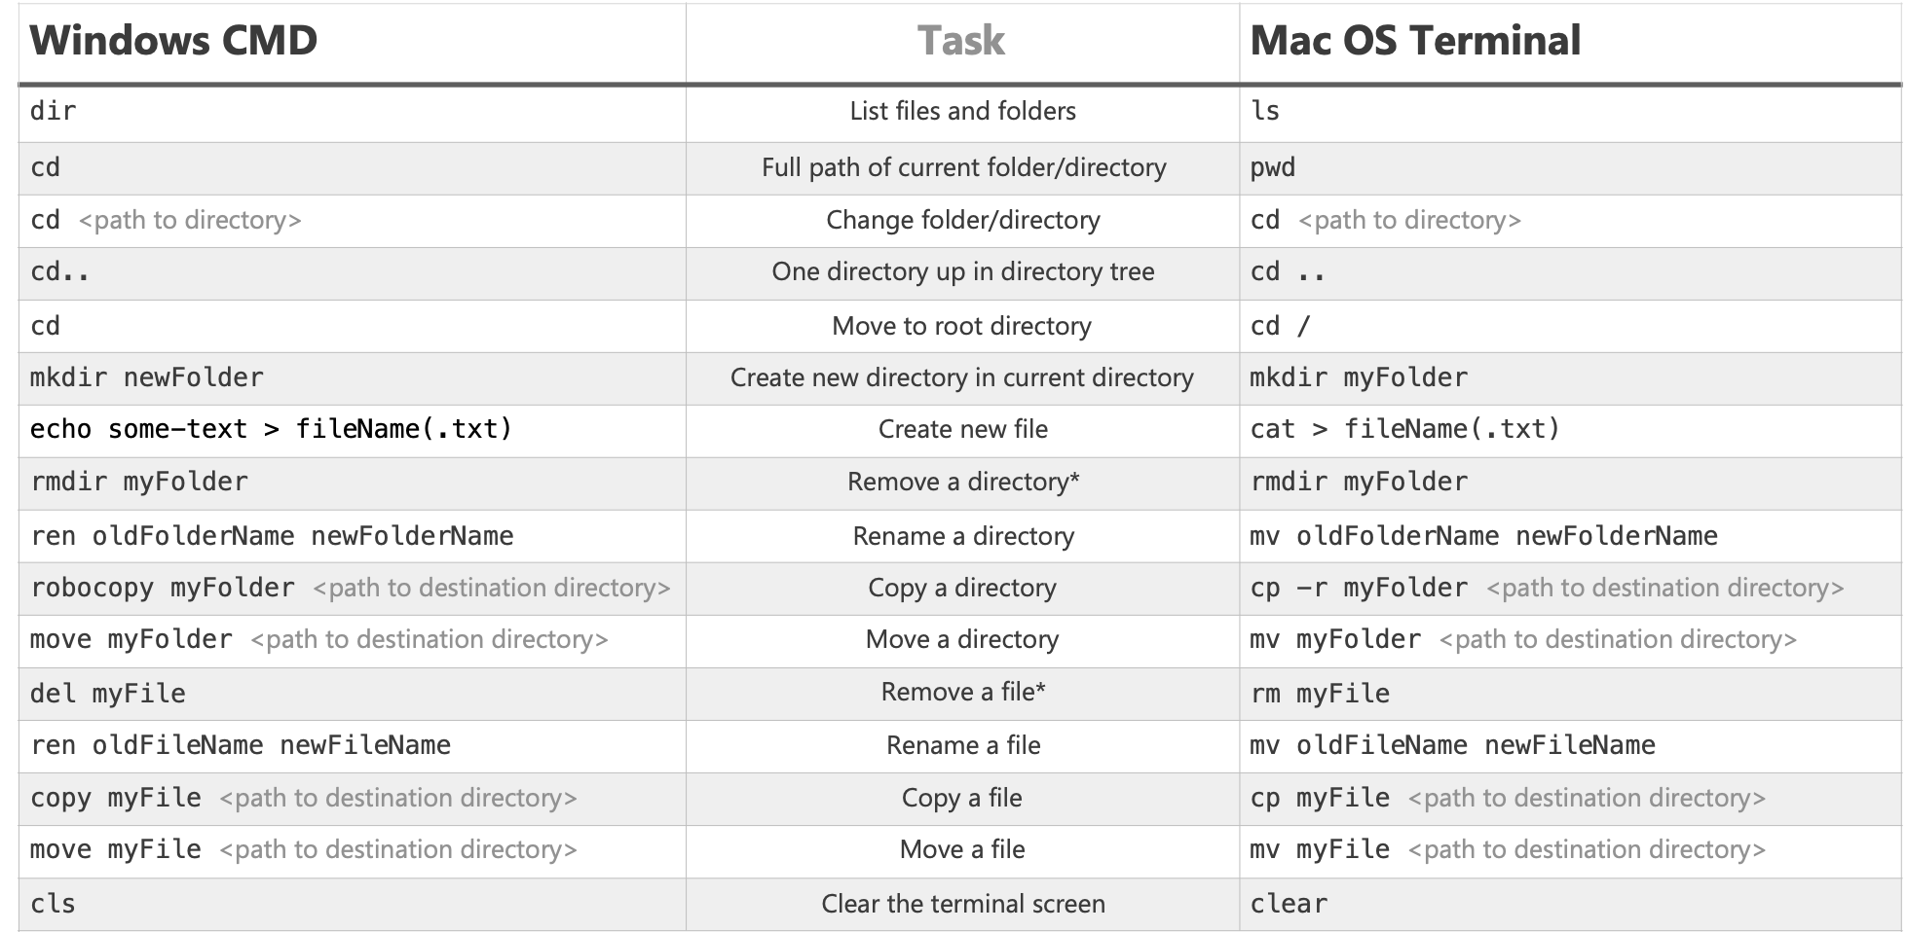
Some basic terminal command
Source: https://enexdi.sciencesconf.org/data/pages/windows_vs_mac_commands_1.pdf

Slide 8
Github
What is Github?
Github is a provider of Internet hosting for software development and version control using Git
Register for Github account!
Github global config set up
https://git-scm.com/book/en/v2/Customizing-Git-Git-Configuration
Configuring name and email will be sufficient
For authentication problem with personal access token as error: https://docs.github.com/en/authentication/keeping-your-account-and-data-secure/creating-a-personal-access-token
Accept the assignment from Github classroom! Make sure to check if your account is linked with this classroom after you accept it.
https://classroom.github.com/a/-yXcXh-p

Slide 9
Starter assignment
https://classroom.github.com/a/-yXcXh-p
Going through the README in the repo can give you an idea of the concepts in git such as repo, clone, commit, and push.
Common git commands that you will be using for every assignment/project on git:
git clone //make some changes after clone
git add (git status -s to see the changes you have made)
git commit
git push

Slide 10
Lab attendance
Please fill out this google form by the end of the day:
https://forms.gle/otGEHY2ZVqmBJwm97

