Slide 1
Lecture 12
Midterm Exam Review

Slide 2
Midterm
Covers lecture 1-9, labs 1-5, HW 1-5
TONIGHT, 7-9pm in 0221 ISB
Don’t need to bring anything except a pencil

Slide 3
Next week
Lab 6 on Monday about hypothesis testing
Lecture Tuesday on Confidence Intervals (Ch 13)
HW 6 assigned Tuesday (due after break)

Slide 4
Histograms

Slide 5
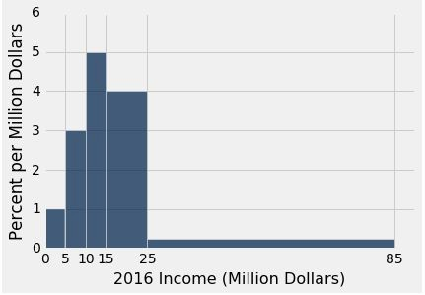
Using the Density Scale
Which bin has more people: [10, 15) or [15, 25)?
What percent of incomes are in the [25,85) bin?
If you draw one bar over [10,25), how tall will it be?
Find (or give bounds for) the median income.

Slide 6
Answers
(a) [15, 25)
(b) 15%
4.33 percent per million dollars
At least 15 and less than 25

Slide 7
Probability

Slide 8
Exercise 1
I pick one of the 12 months at random. Independently, you pick one of the 12 months at random.
What is the chance that we both pick the same month?
(i) (1/12) * (1/12)
(ii) (1/12) + (1/12)
(iii) 1/12
(iii) = (12/12) * (1/12)

Slide 9
Exercise 2
Marbles: G, G, G, G, R, R, R, B, B, Y. Draw 4 at random.
P(no G) = ?
P(all G) = ?

Slide 10
Exercise 2
Marbles: G, G, G, G, R, R, R, B, B, Y. Draw 4 at random.
P(no G) = ?
If with replacement:
(6/10)*(6/10)*(6/10)*(6/10)
If without replacement:
(6/10)*(5/9)*(4/8)*(3/7)
P(all G) = ?
If with replacement:
(4/10)*(4/10)*(4/10)*(4/10)
If without replacement:
(4/10)*(3/9)*(2/8)*(1/7)

Slide 11
Exercise 3
Marbles: G, G, G, G, R, R, R, B, B, Y. Draw 4 times at random with replacement.
1 - (6/10)*(6/10)*(6/10)*(6/10) is the chance of: at least one G
(4/10)**4 + (3/10)**4 + (2/10)**4 + (1/10)**4 is the chance of: all four are the same color

Slide 12
Some python commands to think about
Try to write a correct expression using the following:
max/min/sum
take
where
sample

Slide 13
Q&A

