Slide 1
Lecture 6
Functions

Slide 2
Announcements

Slide 3
Overlaid Graphs
For visually comparing two populations
(Demo)

Slide 4
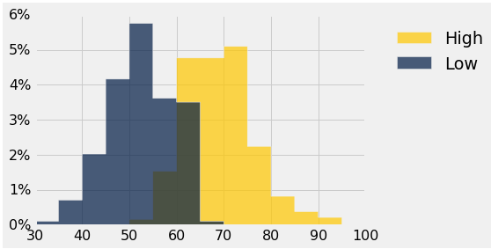
Discussion Question
This histogram describes a year of daily temperatures
Try to answer these questions:
What proportion of days had a high temp in the range 60-69?
What proportion had a low of 45 or more?
How many days had a difference of more than 20 degrees between their high & low temperatures?

Slide 5
Defining Functions

Slide 6
Def Statements
User-defined functions give names to blocks of code
Name
Argument names (parameters)
def spread(values):
return max(values) - min(values)
Return expression
Body
(Demo)

Slide 7
Discussion Question
What does this function do? What kind of input does it take? What output will it give? What's a reasonable name?
def f(s):
return np.round(s / sum(s) * 100, 2)
(Demo)

Slide 8
Apply

Slide 9
Apply
The apply method creates an array by calling a function on every element in input column(s)
First argument: Function to apply
Other arguments: The input column(s)
table_name.apply(function_name, 'column_label')
(Demo)

Slide 10
Example: Prediction

Slide 11
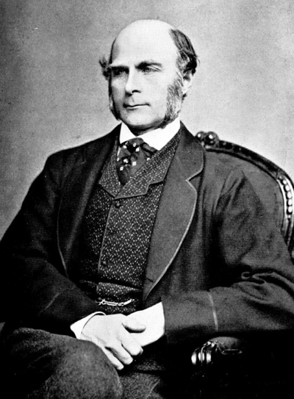
Sir Francis Galton
1822 - 1911 (knighted in 1909)
A pioneer in making predictions
Particular interest in heredity
Charles Darwin's half-cousin
(Demo)

Slide 12
Apply
The apply method creates an array by calling a function on every element in one or more input columns
First argument: Function to apply
Other arguments: The input column(s)
table_name.apply(one_arg_function, 'column_label')
table_name.apply(two_arg_function,
'column_label_for_first_arg',
'column_label_for_second_arg')
apply called with only a function applies it to each row
(Demo)

Slide 13
Grouping Rows

Slide 14
Group
The group method aggregates all rows with the same value for a column into a single row in the result
First argument: Which column to group by
Second argument: (Optional) How to combine values
len — number of grouped values (default)
sum — total of all grouped values
list — list of all grouped values
(Demo)

Slide 15
Grouping By Two Columns
The group method can also aggregate all rows that share the combination of values in multiple columns
First argument: A list of which columns to group by
Second argument: (Optional) How to combine values
(Demo)

Slide 16
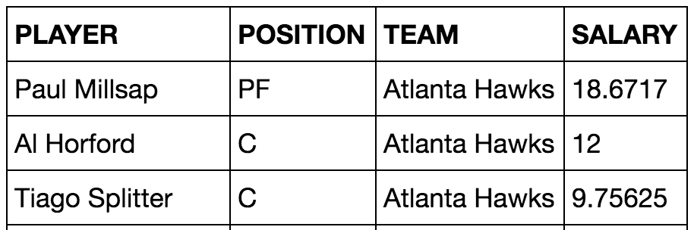
Challenge Question
Which NBA teams spent the most on their starters in 2016?
Each team has one starter per position
Assume the starter for a team & position is the player with the highest salary on that team in that position

Slide 17
Pivot Tables

Slide 18
Pivot
Cross-classifies according to two categorical variables
Produces a grid of counts or aggregated values
Two required arguments:
First: variable that forms column labels of grid
Second: variable that forms row labels of grid
Two optional arguments (include both or neither)
values=’column_label_to_aggregate’
collect=function_with_which_to_aggregate
(Demo)

