Slide 1
Lecture 11
Error Probabilities and A/B testing

Slide 2
Announcements

Slide 3
Testing a Hypothesis
Step 1: Select Two Hypotheses
A test chooses between two views of how data were generated: Null hypothesis proposes that data were generated at random; Alternative hypothesis proposes some effect other than chance
Step 2: Choose a Test Statistic
A value that can be computed from the data
Step 3: Compute What The Null Hypothesis Predicts
Compute the distribution of the test statistic: what the test statistic might be if the null hypothesis were true.
Step 4: Compare the Prediction to the Observed Data

Slide 4
Conclusions From a Test
Can't reject the null hypothesis (inconclusive, don't know)
Hypothesis test
Reject the null hypothesis (favor the alternative)

Slide 5
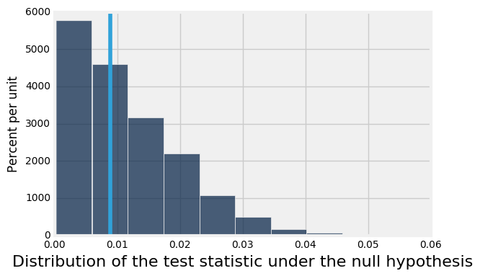
Quantifying Conclusions
P(the test statistic would be equal to or more extreme than the observed test statistic under the null hypothesis)
Evaluating Mendel's pea flower hypothesis
This area is the P-value (approximately)

Slide 6
Statistical Significance

Slide 7
Conventions of Consistency
“Inconsistent”: The test statistic is in the tail of the null distribution.
“In the tail,” first convention:
The area in the upper (or lower) tail is less than 5%.
The result is “statistically significant.”
“In the tail,” second convention:
The area in the upper (or lower) tail is less than 1%.
The result is “highly statistically significant.”

Slide 8
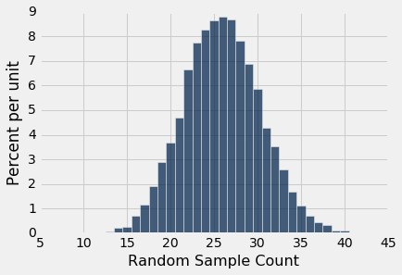
Tail Areas
Lower 5% Tail
Upper 5% Tail

Slide 9
Tail Areas
Lower 1% Tail
Upper 1% Tail

Slide 10
Conventions About Inconsistency
Which tail do you look at?
The tail that corresponds to values of the statistic that favor the alternative.
This is why you generally don’t want a statistic where both tails indicate support for the alternative hypothesis.

Slide 11
Definition of the P-value
Formal name: observed significance level
The P-value is the chance,
under the null hypothesis,
that the test statistic
is equal to the value that was observed in the data
or is even further in the direction of the alternative.

Slide 12

Tail Areas
The probability associated with this area is the (approximate)
P-value for the observed statistic

Slide 13
Error probability of a test

Slide 14
Can the Conclusion be Wrong?
Yes.
 | Null is true | Alternative is true
Test rejects the null | ❌ | ✅
Test doesn’t reject the null | ✅ | ?

Slide 15
An Error Probability
The cutoff for the P-value is an error probability.
If:
your cutoff is 5%
and the null hypothesis happens to be true
(but you don’t know that)
then there is about a 5% chance that your test will reject the null hypothesis anyway.

Slide 16
Tail Areas
Upper 5% Tail

Slide 17
Setting a Cutoff
Let's draw a cutoff point for where we'll reject the null.
Won't reject the null
Will reject the null
Evaluating Mendel's pea flower hypothesis
This area is the probability of wrongly rejecting the null

Slide 18
How Much Risk To Accept?
First convention:
Accept a 5% risk of wrongly rejecting the null.
The result is “statistically significant.”
Second convention:
Accept a 1% risk of wrongly rejecting the null.
The result is “highly statistically significant.”

Slide 19
Origin of the conventions

Slide 20
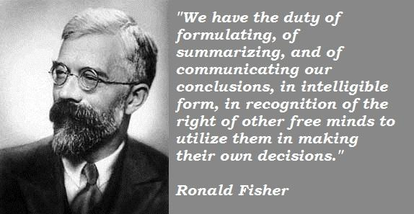
Sir Ronald Fisher, 1890-1962

Slide 21
Sir Ronald Fisher, 1925
“It is convenient to take this point [5%] as a limit in judging whether a deviation is to be considered significant or not.”
–– Statistical Methods for Research Workers

Slide 22
Sir Ronald Fisher, 1926
“If one in twenty does not seem high enough odds, we may, if we prefer it, draw the line at one in fifty (the 2 percent point), or one in a hundred (the 1 percent point). Personally, the author prefers to set a low standard of significance at the 5 percent point …”

Slide 23
A/B testing

Slide 24
Comparing Two Samples
Compare values of sampled individuals in Group A with values of sampled individuals in Group B.
Question: Do the two sets of values come from the same underlying distribution?
Answering this question by performing a statistical test is called A/B testing.
(Demo)

Slide 25
The Groups and the Question
Random sample of mothers of newborns. Compare:
(A) Birth weights of babies born to mothers who smoked during pregnancy
(B) Birth weights of babies born to mothers who did not smoke during pregnancy
Question: Could the differences be due to chance alone?

Slide 26
Hypotheses
Null:
In the population, the distributions of the birth weights of the babies in the two groups are the same. (They are different in the sample just due to chance.)
Alternative:
In the population, the babies of the mothers who smoked weighed less, on average, than the babies of the non-smokers.

Slide 27
Test Statistic
Group A: smokers
Group B: non-smokers
Statistic: Difference between average weights Group B average - Group A average
Large values of this statistic favor the alternative

Slide 28
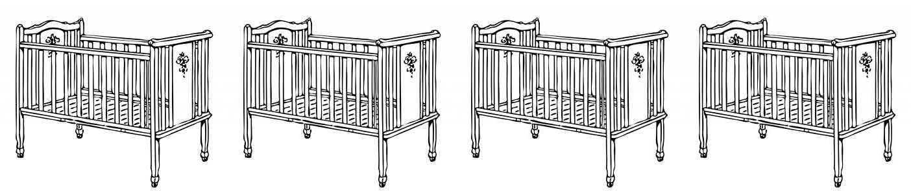
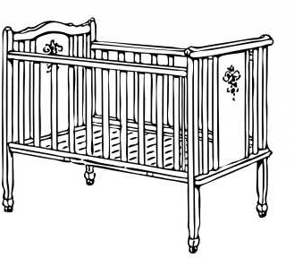
Simulating Under the Null
...
Non-smoker
120 oz
Non-smoker
113 oz
Smoker
128 oz
Non-smoker
136 oz
Smoker
108 oz

Slide 29
Simulating Under the Null
...
Smoker
120 oz
Non-smoker
113 oz
Non-smoker
128 oz
Smoker
136 oz
Non-smoker
108 oz

Slide 30
Simulating Under the Null
If the null is true, all rearrangements of the birth weights among the two groups are equally likely
Plan:
Shuffle all the birth weights
Assign some to “Group A” and the rest to “Group B”, maintaining the two sample sizes
Find the difference between the averages of the two shuffled groups
Repeat
(Demo)

