Slide 1
Lecture 10
Hypothesis Testing

Slide 2
Announcements

Slide 3
Science
Hypothesis: The sun always rises in the east.
Prediction: If you observe a bunch of sunrises, all of them will be in the east.
Test: Go watch some sunsets.

Slide 4
Science
Hypothesis: All swans are white.
Prediction: If you observe a bunch of swans, all of them will be white.
Test: Go find swans.

Slide 5
Where it gets hairy
Hypothesis: Most swans are white.
Prediction: ???
Test: ???

Slide 6
Dealing with randomness
Hypothesis: At least 99% of swans are white.
Prediction: ???
Test: ???

Slide 7
Dealing with randomness
Hypothesis: At least 99% of swans are white.
Prediction: If you observe a random sample of 100 swans, at least 99 will be white.
Test: ???

Slide 8
Dealing with randomness
Hypothesis: At least 99% of swans are white.
Prediction: If you observe a random sample of 100 swans, more likely than not, at least 99 will be white.
Test: ???

Slide 9
Dealing with randomness
Hypothesis: At least 99% of swans are white.
Prediction: If you observe a random sample of 100 swans, almost certainly, at least 90 will be white.
Test: ???

Slide 10
Dealing with randomness
Hypothesis: At least 99% of swans are white.
Prediction: If you observe a random sample of 100 swans, almost certainly, at least 90 will be white.
Test: Randomly sample 100 swans. Observe their color.

Slide 11
Interpreting the result of a test
Test: Randomly sample 100 swans. Observe their color.
If at least 90 are white: hypothesis could be true.
If fewer than 80 are white: either the hypothesis is false, or a ginormous coincidence just happened.

Slide 12
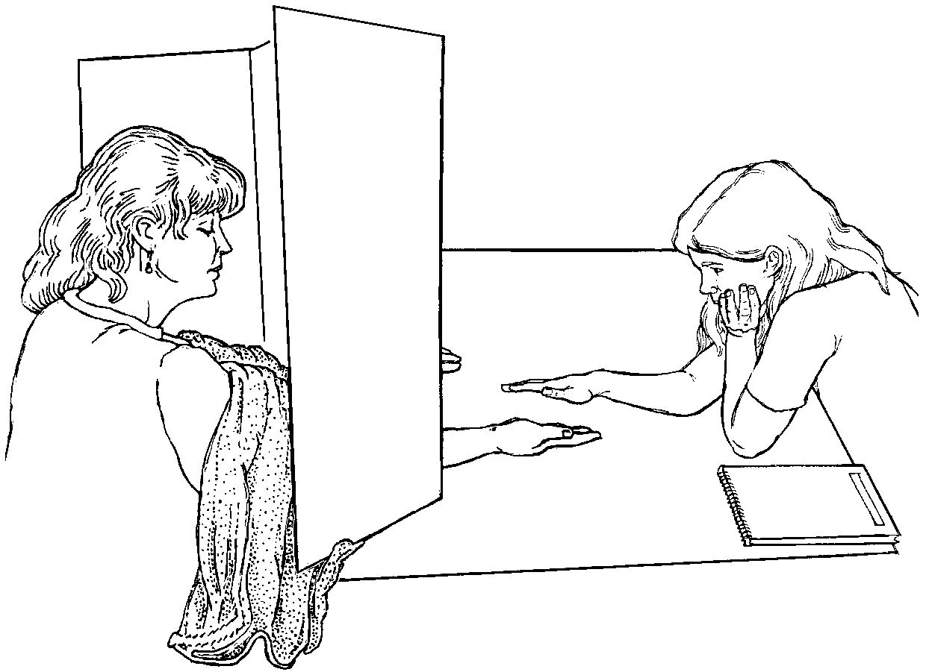
Emily Rosa and the healing touch
Emily Rosa's 4th grade science fair project:
Touch healers say they detect and use the healing energy field (HEF) to cure patients. Can they detect HEF?

Slide 13
Science
Hypothesis: Healers cannot detect HEF better than random guessing.
Prediction: If you test healers 150 times, almost certainly, they'll be right at most 60% of the time.
Test: Go find healers and test them.

Slide 14
Jury Panels

Slide 15
Jury Panels
Eligible jurors in a County
List of eligible residents
Jury panel
Jury
"All persons selected for jury service shall be selected at random, from a source or sources inclusive of a representative cross section of the population of the area served by the court."
(Demo)

Slide 16
Distances

Slide 17
Computing Distance
Every distance has a computational recipe
Total Variation Distance (TVD):
For each category, compute the difference in proportions between two distributions
Take the absolute value of each difference
Sum & divide by 2
Chi Squared (χ² Optional):
For each category, compute the difference in proportions between two distributions
Square each difference and divide by the first proportion
Sum & multiply by sample size
(Demo)

Slide 18
Empirical Distributions

Slide 19
Distribution of a Statistic
Statistic: A quantity computed for a particular sample
Distribution: The chance of each outcome of sampling
Sampling distribution: Chance of each value of a statistic (computed from all possible samples)
Also known as the probability distribution of the statistic
Empirical distribution: Observations of a statistic (computed from some samples drawn at random)
(Demo)

Slide 20
Hypothesis Testing

Slide 21
Testing a Hypothesis
Step 1: Select Two Hypotheses
A test chooses between two views of how data were generated: Null hypothesis proposes that data were generated at random; Alternative hypothesis proposes some effect other than chance
Step 2: Choose a Test Statistic
A value that can be computed from the data
Step 3: Compute What The Null Hypothesis Predicts
Compute the distribution of the test statistic: what the test statistic might be if the null hypothesis were true.
Step 4: Compare the Prediction to the Observed Data

Slide 22
Hypothesis Testing Logic
Define 2 mutually exclusive descriptions: either this or that.
One of them can be evaluated using probability (the null hypothesis)
You can "reject the null," so then you “accept” the alternative.
Otherwise: you're still not sure, but null looks plausible.

Slide 23
Step 1: Select Two Hypotheses

Slide 24
Example: The Two Hypotheses
Gregor Mendel (1822-1884) was an Austrian monk and founder of the modern field of genetics. Among many experiments, he tested the hypothesis that pea plants will bear purple or white flowers at random, in the ratio 3:1.
Mendel’s model describes the world. If the distribution of the observed plants is different from the distribution in the model, it's just chance variation.
Mendel’s model doesn't.
Null
Alternative
(Demo)

Slide 25
Example: Smoking and Babies
Researchers are interested in whether there is an association between smoking mothers and the health of their babies. For each birth, they record the baby's birth weight and whether the mother smokes or not.
Birth weights aren't affected by maternal smoking. The birthweight distribution for babies of smokers is same as that of babies of non-smokers.
They are affected.
Null
Alternative

Slide 26
Example: Smoking and Babies
Researchers are interested in whether there is an association between smoking mothers and the health of their babies. For each birth, they record the baby's birth weight and whether the mother smokes or not.
Birth weights aren't affected by maternal smoking. The birthweight distribution for babies of smokers is same as that of babies of non-smokers.
They are lower. Birthweight of babies of smokers are lower than birthweights of babies of non-smokers.

Slide 27
Step 2: Choose a Test Statistic

Slide 28
Choosing a Test Statistic
Test statistic: The statistic that you have chosen to calculate, to help you decide between the two hypotheses
Goal: If the null hypothesis is false, then you expect that measuring the test statistic will allow you to reject the null

Slide 29
Choosing a Test Statistic
If the alternative hypothesis is true, will test statistic be larger than prediction, smaller, or could be either way?
For Mendel's pea flower experiment, which of the following would be reasonable test statistics? (Choose all that are OK.)
The proportion of plants with purple flowers.
The proportion of plants with white flowers.
abs(p - 0.75), where p is the proportion of plants with purple flowers.
The number of different colors in the plants flowers.
The total variation distance between the distribution in the observed data, vs the model distribution (0.75, 0.25)

Slide 30
Choosing a Test Statistic
If the alternative hypothesis is true, will test statistic be larger than prediction, smaller, or could be either way?
For the baby birth weights experiment, which of the following would be reasonable test statistics? (Choose all that are OK.)
The average birth weight of all the babies.
The proportion of babies whose mother smoked.
The average birth weight of babies of smokers, minus the average birth weight of babies of non-smokers.
The absolute value of the previous difference.

Slide 31
Absolute Values & Alternatives
Choose a test statistic where alternative hypothesis suggests which direction statistic will go.
Alternative: Smoking causes poor health.
Test statistic: Average birth weight for smokers, minus average for non-smokers.
Alternative: Smoking has some relation to health.
Test statistic: Absolute value of that difference.

Slide 32
Step 3: Compute the Distribution of the Test Statistic under the Null Hypothesis

Slide 33
Step 4: Compare the Prediction to the Observed Data

Slide 34
Conclusion of a Test
Resolve choice between null and alternative hypotheses
Compare observed test statistic to its empirical distribution under the null hypothesis
If the observed value is consistent with the distribution, then the test does not reject the null hypothesis
Whether a value is consistent with a distribution:
A visualization may be sufficient
Convention: The observed significance level (P-value)

Slide 35
Definition of P-value
The P-value is the chance,
under the null hypothesis,
that the test statistic
is equal to the value that was observed in the data or is even further in the direction of the alternative.

Slide 36
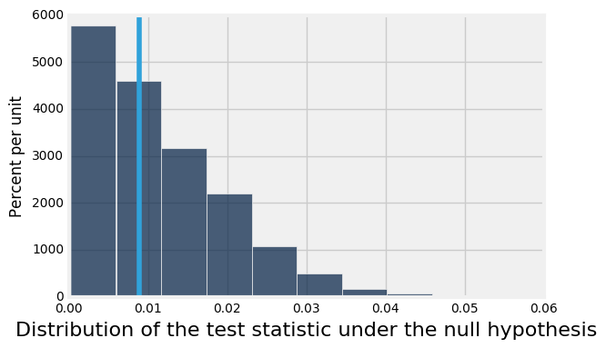
Quantifying Conclusions
P(the test statistic would be equal to or more extreme than the observed test statistic under the null hypothesis)
Evaluating Mendel's pea flower hypothesis
This area is the P-value (approximately)

Slide 37
Conventions of Consistency
“Inconsistent”: The test statistic is in the tail of the null distribution.
“In the tail,” first convention:
The area in the tail is less than 5%.
The result is “statistically significant.”
“In the tail,” second convention:
The area in the tail is less than 1%.
The result is “highly statistically significant.”

